Slide 1
Pharmacy Benefit Managers
A Policy Overview
Joe Hanel
Communications Director
House Health & Insurance Committee
February 12, 2020

Slide 2
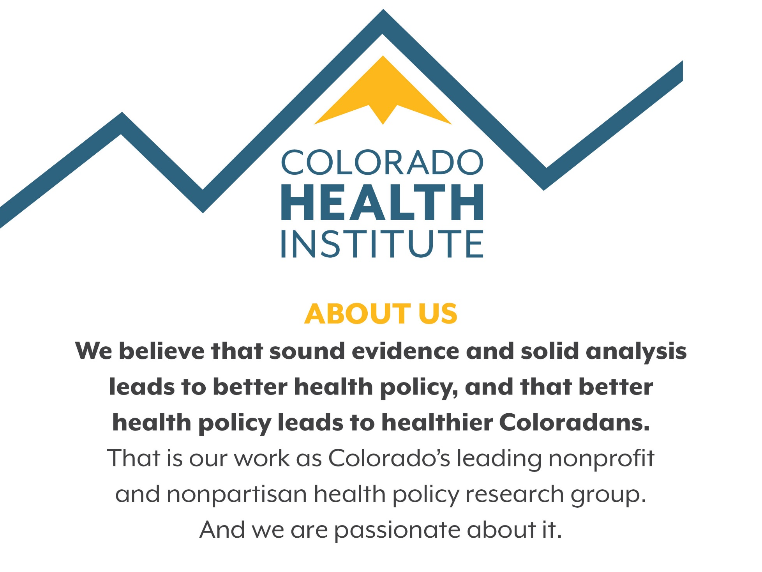

Slide 3
Today’s Takeaways
‘Fixing’ Pharmacy Benefit Managers (PBMs) will not fix drug prices
PBMs’ incentives can work against consumers
Other states are imposing more transparency and regulation on PBMs

Slide 4
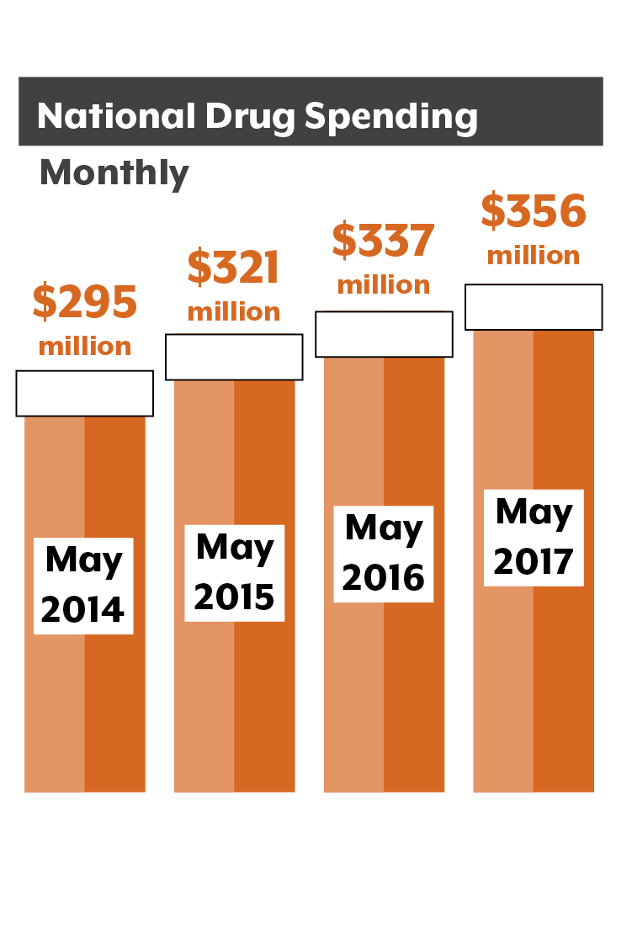
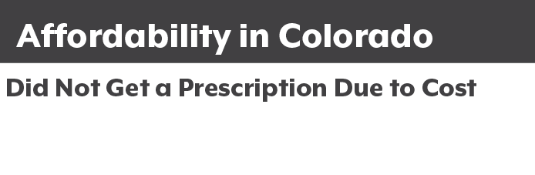
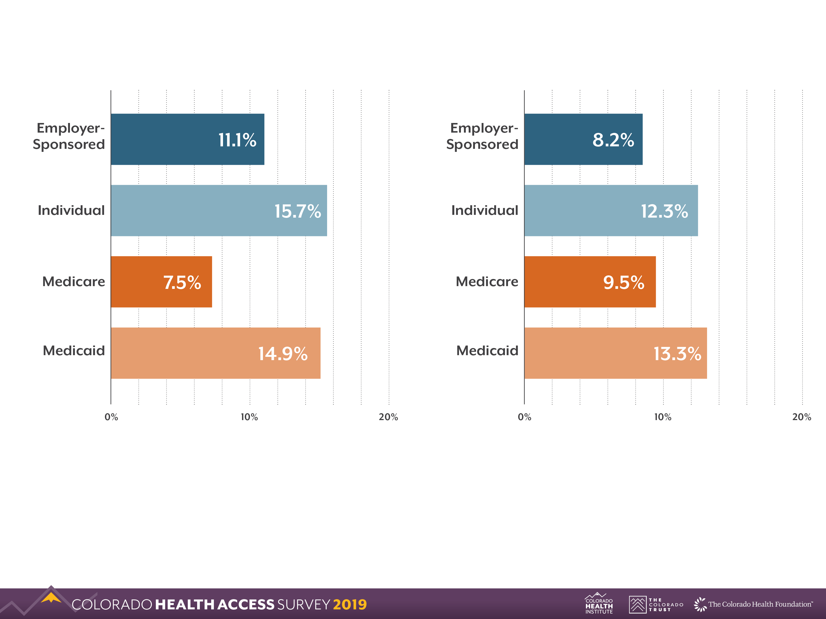
Rx Drugs: Lay of the Land
Source: 2019 Colorado Health Access Survey
Source: Altarum Health Sector Economic Indicators
Notes:
Level setting
11% of Coloradans in 2019 said they did not fill a prescription because it was too expensive. It affects people with all insurance types.
Prescription drugs account for about a tenth of all U.S. health care spending. But it’s the fastest-growing large category of spending — growing faster than doctor’s care or hospital costs.
Estimates for annual spending on prescription drugs vary from $323 billion to $480 billion. (2016, Health Affairs). That’s roughly the GDP of Colorado ($372B in 2018, St. Louis Fed)

Slide 5
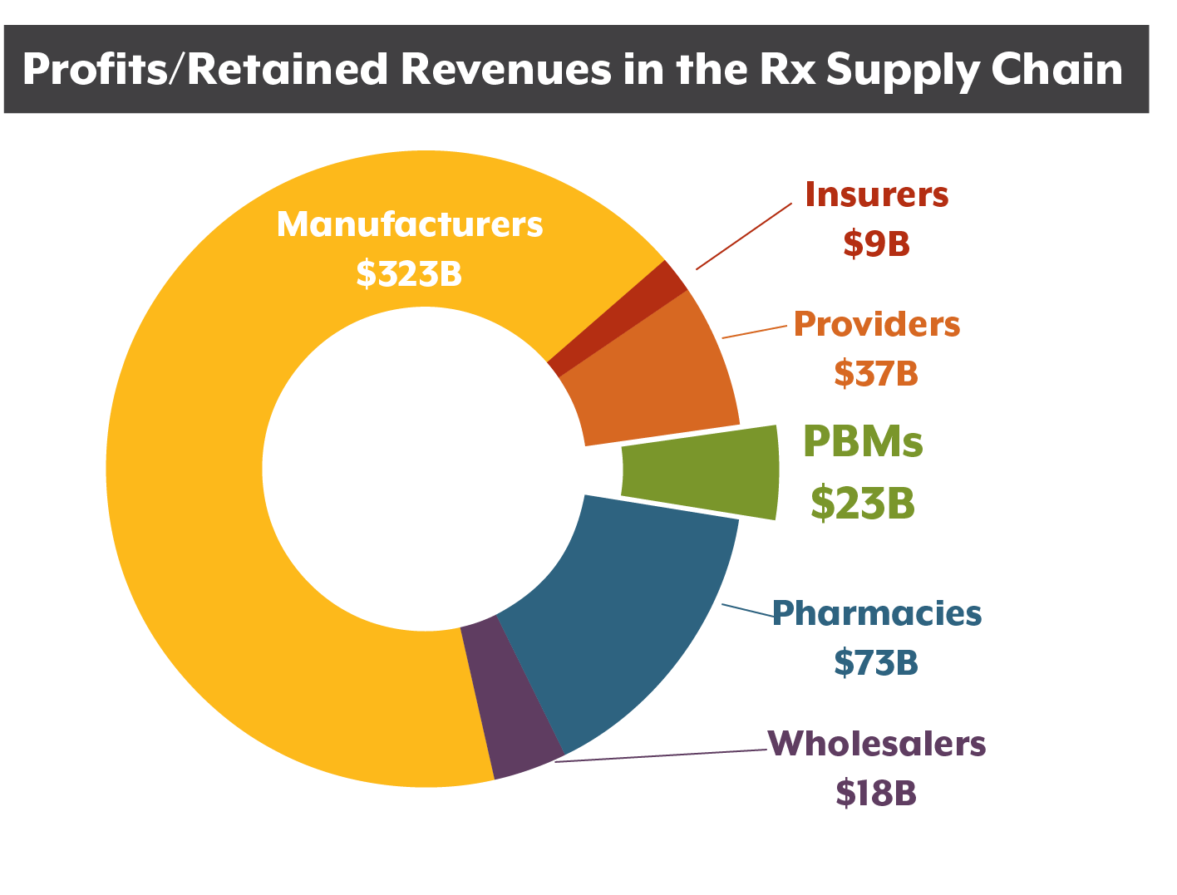
PBMs: The Bottom Line
Source: “Spending On Prescription Drugs In The US: Where Does All The Money Go?” Health Affairs Blog. 2018.
Notes:
Pharmacy benefit mangers are just a part of this spending on prescription drugs.
Who is making money?
Drug manufacturers make most of the profits.
PBMs account for less than 5% of profits in the Rx supply chain. But that’s still an estimated $23 billion a year.
Source: Health Affairs Blog: Spending On Prescription Drugs In The US: Where Does All The Money Go? July 31, 2018

Slide 6
Definitions: PBM Revenues
Fees:
Rebates:
Spread:
Clawbacks:
Paid by insurers to PBMs for services
Paid by drug manufacturers to PBMs
Difference between the price a PBM pays a pharmacy and what it charges insurers
Pharmacy pays PBM when the copay exceeds the price of the drug
Notes:
Each of these definitions is also a revenue stream for PBMs.
Rebates are the source of much contention regarding PBMs. Drug manufacturers pay rebates to PBMs in exchange for putting their drug on the PBM’s formulary.
PBMs do share their rebates with insurance companies, but it’s not always clear how much savings gets passed along. A recent study by Pew Charitable Trusts found that PBMs pass along 91% of the rebates they get to insurers.

Slide 7
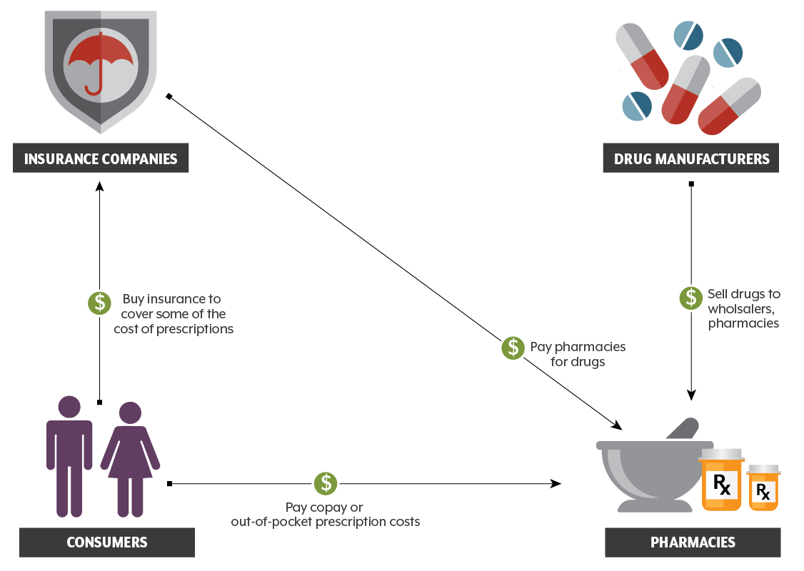
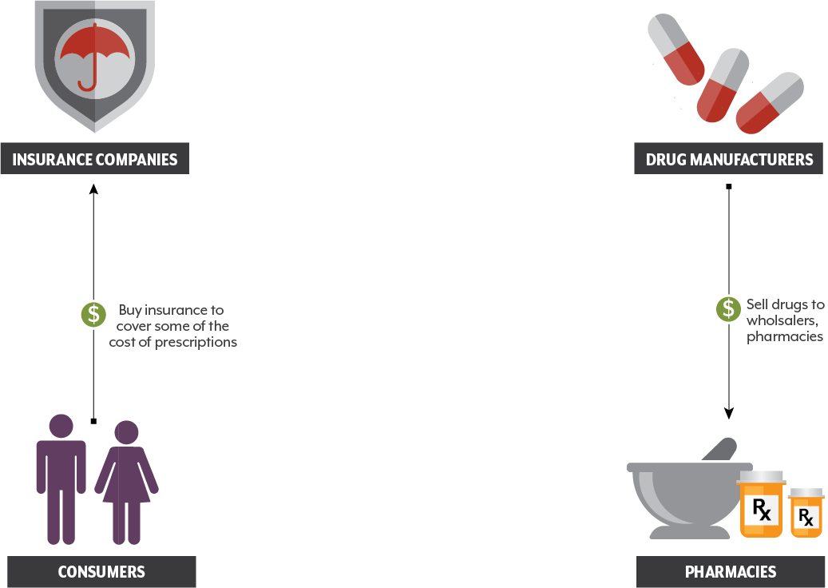
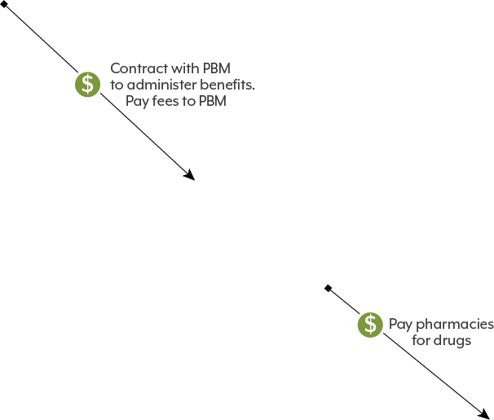
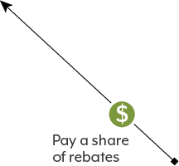
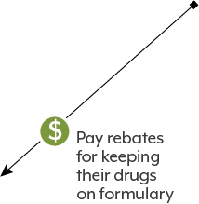

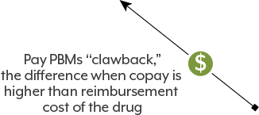

PBMs: The Basics
Notes:
[NOTE: This slide uses animations and is best viewed in the Slide Show mode.]
Let’s walk through PBMs place in the prescription drug economy step-by-step.
We start with the demand side: consumers and their insurance companies.
[CLICK] On the supply side, we have drug manufacturers, pharmacies, and wholesalers (not pictured here). Before PBMs, insurance companies would pay pharmacies for the price of drugs, and patients would pay a copay to pharmacies.
[CLICK] When PBMs got into the drug purchasing market in the 1990s, they started paying pharmacies, and insurers now pay FEES to the PBM, and they reimburse the PBM for the price of drugs. The difference between what insurers pay PBMs and what PBMs pay the pharmacy is the SPREAD
[CLICK] Drug manufacturers pay REBATES to PBMs, [CLICK] and the PBMs usually share most of the rebates with insurers.
[CLICK] PBMs also get money from pharmacies when consumers pay a copay that is higher than the prices of the drug. This is the CLAWBACK

Slide 8
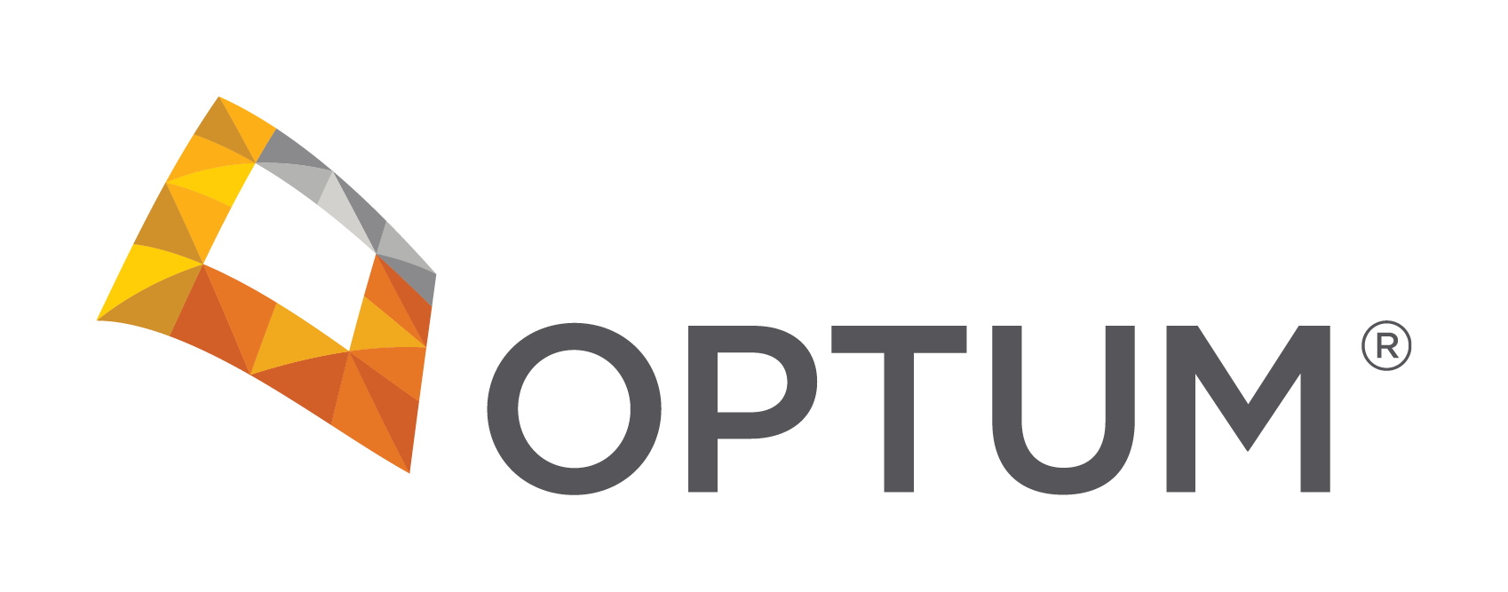
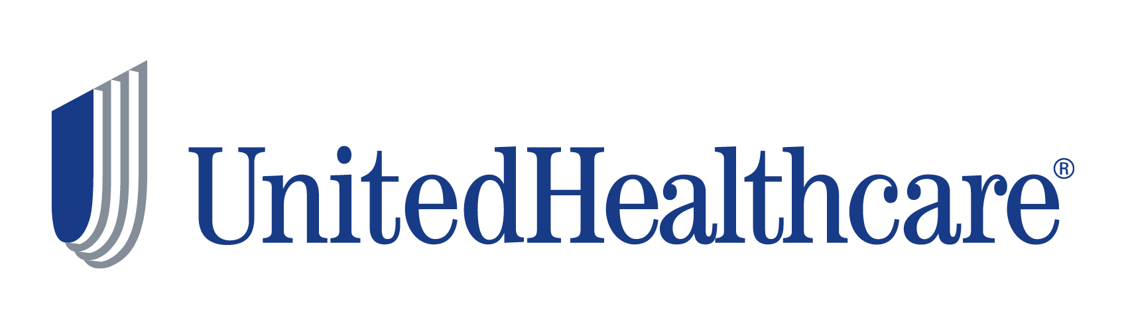
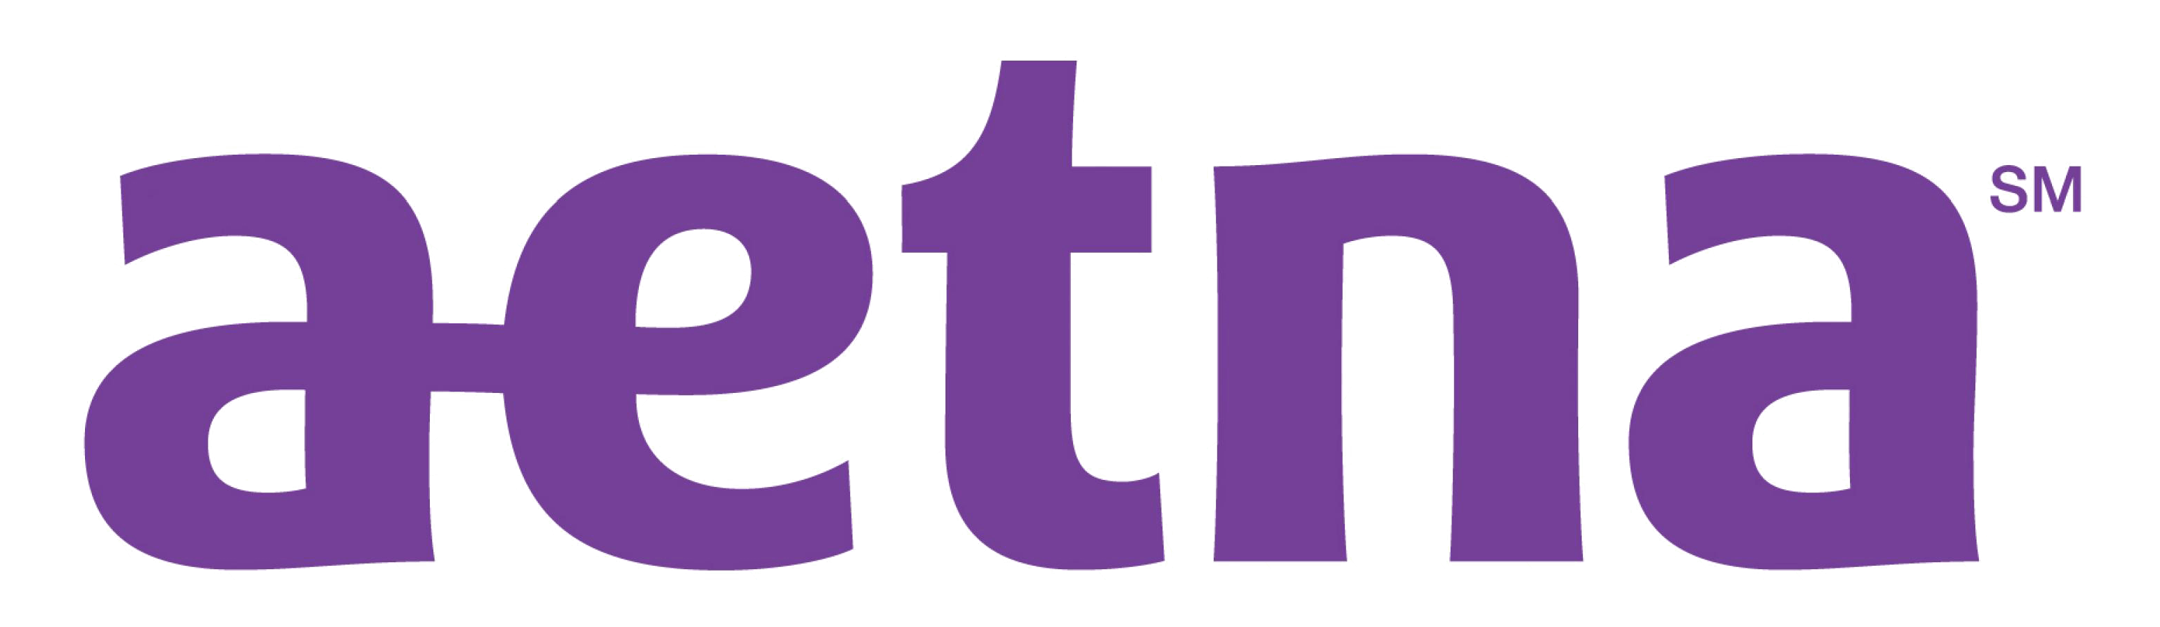

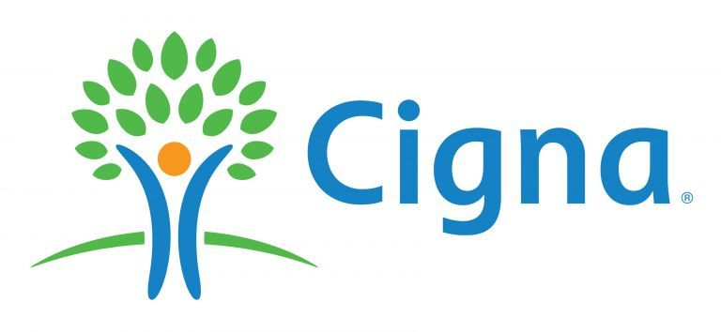

PBMs: The Players
Notes:
Three quarters of the PBM market is dominated by three companies: Optum, CVS Caremark, and Express Scripts.
Economists would call this an oligopoly. There are so few players that it’s not a truly competitive market.
The Big 3 are deeply enmeshed with the insurance industry. UnitedHealthcare owns Optum.
In recent years,
CVS Caremark bought Aetna.
Cigna bought Express Scripts.
What is harder to know: the relationship inside these companies and the advantages insurers get from the PBMs the own (or are owned by).

Slide 9
What the PBMs Say
PBMs’ size and market power allow them to secure better prices than insurers and consumers could
$654 billion in savings over the next decade – up to 30%
PBMs save patients an average of $941 per year
Notes:
PBMs’ size and market power secure better prices than insurers and consumers could
PBMs are projected to save employers, unions, government programs, and consumers $654 billion – up to 30 percent –on drug benefit costs over the next decade. Source: PBMs: Generating Savings for Plan Sponsors & Consumers
PBMs save patients an average of $941 per year. Source: The Return on Investment (ROI) on PBM Services.
Both reports by Visante, a pharma consulting firm

Slide 10

Let’s Talk About Incentives
Notes:
So the question is, are PBMs the good guy or the bad guy? That’s not a helpful way to look at it.
PBMs respond to incentives, just like everyone else.
[CLICK] Like this goat. When you want the goat to follow you into the barn, you can chase it and wrestle it. But if you give her the incentive of a carrot, she will follow you. But if someone else comes along with a basket of yummy apples, she will drop the carrot and chase those apples.
PBMs get carrots from some entities and apples from others, and this system doesn’t always work to the advantage of the people with the carrots.

Slide 11
Critiques of PBMs
PBMs are incentivized to chase big rebates, not low prices
PBMs operate in an opaque manner, and we can’t verify what they keep in rebates, spreads, and clawbacks
PBMs are ripe for disruption from Silicon Valley

Slide 12
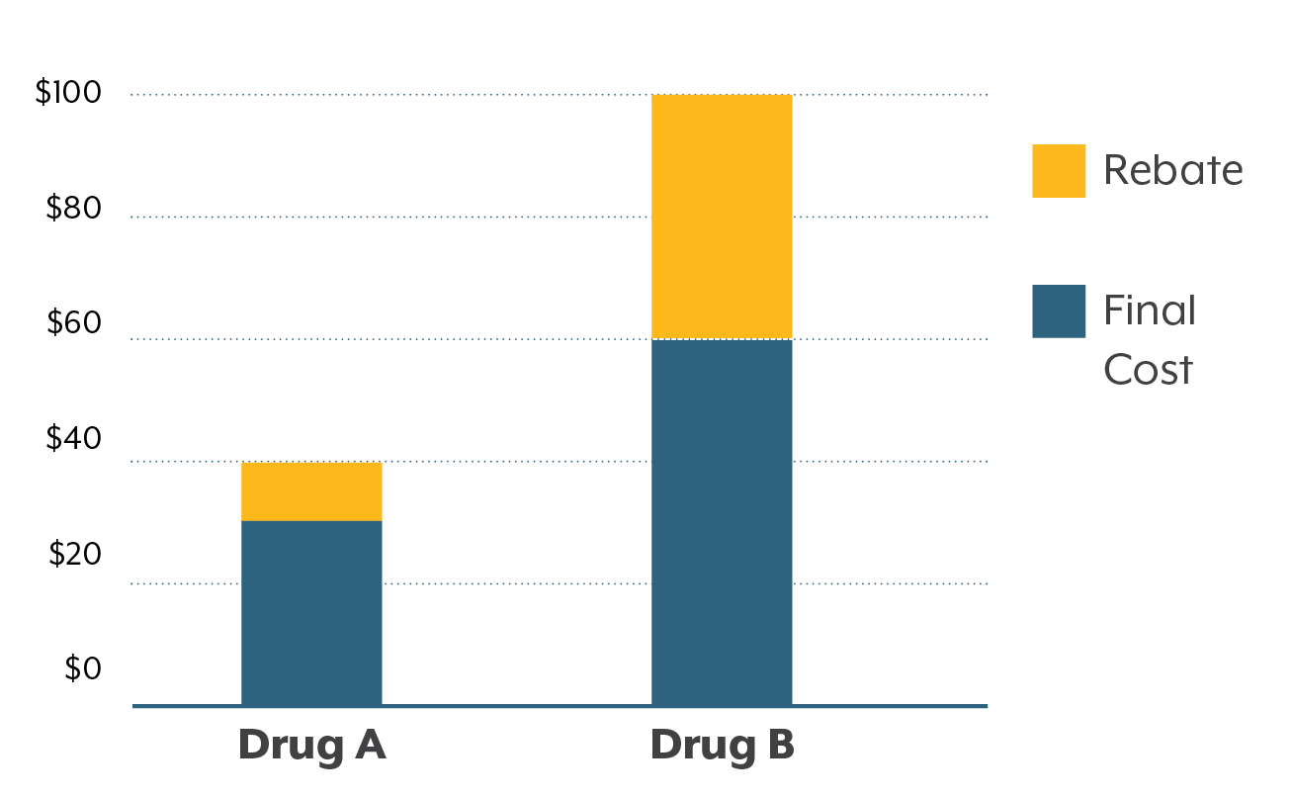
Critiques of PBMs: Rebates
Hypothetical Drug Purchasing Choice
Notes:
Consider this hypothetical example. If Drug A costs $40, and the PBM secures a $10 rebate, then the final cost to the insurance company will be a little more than $30 (accounting for the share of the rebate PBMs keep).
Drug B costs $100, but it has a $40 rebate. So the final cost to the insurance company is more than $60.
The PBM might choose Drug B, because its share of the rebate will be larger. The PBMs incentive is to pursue the high rebate, while the insurers’ incentive is to hold down final costs.

Slide 13
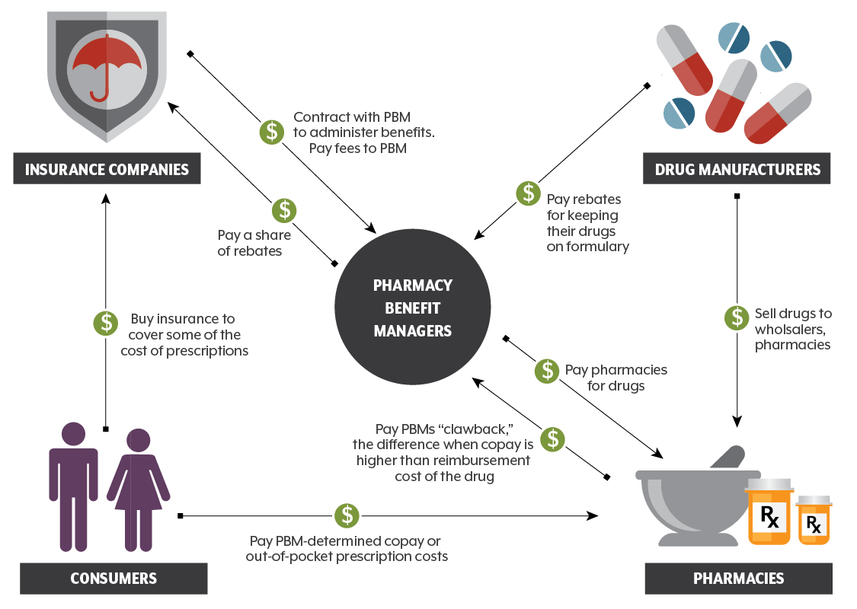
Critiques of PBMs: Transparency
Notes:
Insurers and policy researchers say it’s hard to know what’s going on financially with PBMs.
[CLICK] First, we can’t track the rebates they get and the degree to which they pass them along to insurers.
[CLICK] Second, PBMs can charge insurers more for a drug than the PBM pays pharmacies. This is called the spread. It’s basically a middleman markup.
[CLICK] Third, consumer copays are sometimes higher than the PBM’s cost of a drug, so the PBM gets to keep the difference. This is called the clawback.
It creates a situation where a consumer would be better off not using insurance.
Colorado’s legislature addressed this in 2018 by passing a “gag clause” law that says PBMs can no longer forbid pharmacists from telling consumers that they could get a better deal by not using their insurance.

Slide 14
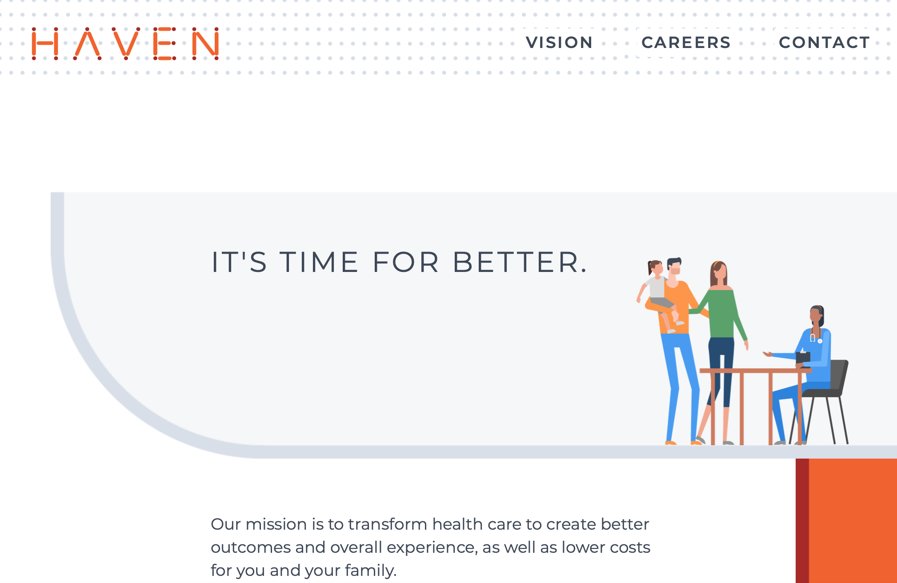
Critiques of PBMs: Disruption?
Notes:
This is the homepage of Haven, a health care company set up by Amazon, Berkshire Hathaway, and JPMorgan. They’re new, and it’s hard to know what they are up to. But there was a lot of buzz a couple years ago that Amazon was ready to disrupt the health industry, just like they did to retail.
But we know that tech firms have disrupted all sorts of industries and business models — often businesses that had set themselves up as intermediaries between suppliers and consumers.
For example, you don’t see a lot of travel agents these days. People used to go to a travel agent to buy airline tickets. But now you have Travelocity, Expedia, etc., or you can buy directly from the airline. There are plusses and minuses to this approach. Consumers can shop around for a deal on their own. But it’s not always easy and they don’t have the same power as the airlines. It’s common to find a good ticket price and then see it change right before your eyes. That’s because the airline is constantly trying to maximize the price it can get for each seat. It has loads of data and research and the technology to help it out. Consumers don’t have these advantages.
A consumer-driven disruption of prescription drug purchasing could have the same effect. The source of PBMs’ power comes from their size, which allows them to demand rebates for including a drug on their formularies. Removing these big middlemen might end up shifting power to drug manufacturers.

Slide 15
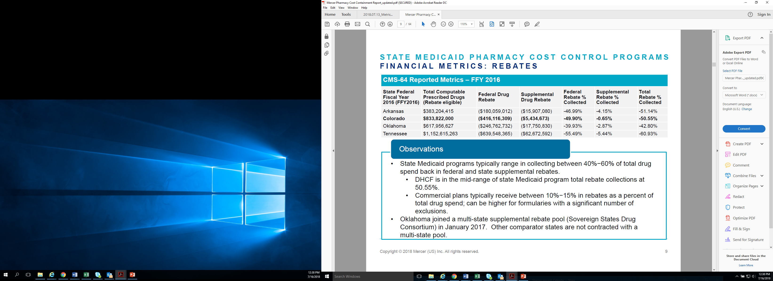
Rebates in Medicaid
Medicaid Prescription Drug Rebate Program
Federal law
50%
average savings
Much better than Medicare!
Notes:
An aside: Rebates are also an important part of drug purchasing in Medicaid, but it works differently than PBMs.
State Medicaid programs do use PBMs, but most of their rebates from from the Medicaid Prescription Drug Rebate Program.
The program was created in 1990 by federal law.
Under the program, a manufacturer who wants its drug covered under Medicaid has to rebate a portion of the Medicaid payment for the drug to the states, who in turn share the rebates with the federal government.
In exchange, Medicaid programs cover nearly all of the manufacturer’s FDA-approved drugs, and the drugs are eligible for federal matching funds.
The ACA expanded MPDR rebates.
The statute ensures that Medicaid gets the lowest price in most cases. Rebates based on average manufacturer price plus an adjustment for inflation, so if a drug’s price rises faster than average inflation, the manufacturer has to refund the difference to Medicaid.
States also negotiate for additional rebates from manufacturers in exchange for putting their drugs on the Preferred Drug List.
Many states also use PBMs.
In 2017, Medicaid spent $64 billion on drugs and received nearly $35 billion in rebates. Colorado Medicaid gets about 50% of its costs rebated
In comparison to other programs, like Medicare Part D, rebates in Medicaid are a much larger share of drug spending.
MDRP is a federal statute, so policy changes must happen at the federal level.
Separately, the federal 340B program offers discounted drugs to certain safety net providers that serve vulnerable or underserved populations, including Medicaid beneficiaries
More info: https://www.kff.org/medicaid/issue-brief/understanding-the-medicaid-prescription-drug-rebate-program/

Slide 16
Colorado Legislation
HB18-1284 (Reps. Buckner, Wilson): Ban on ‘gag clauses’
HB20-1198 (Rep. Buckner): Transparency, restrictions on business practices
HB20-1078 (Reps. Jaquez Lewis, Mullica): Claims reimbursement for pharmacies
Notes:
Colorado has had several bills in recent years targeting the high cost of prescription drugs, and some of these bills would affect PBMs.
We highlight three here.
First was the 2018 law that banned ‘gag clauses,’ which we already discussed.
This year, there are two bills to highlight as of Feb. 12, 2020.

Slide 17
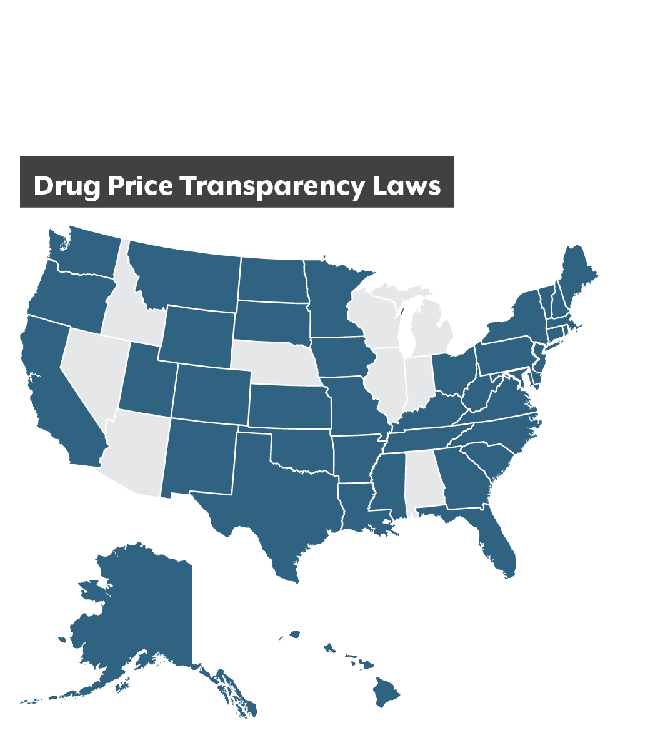
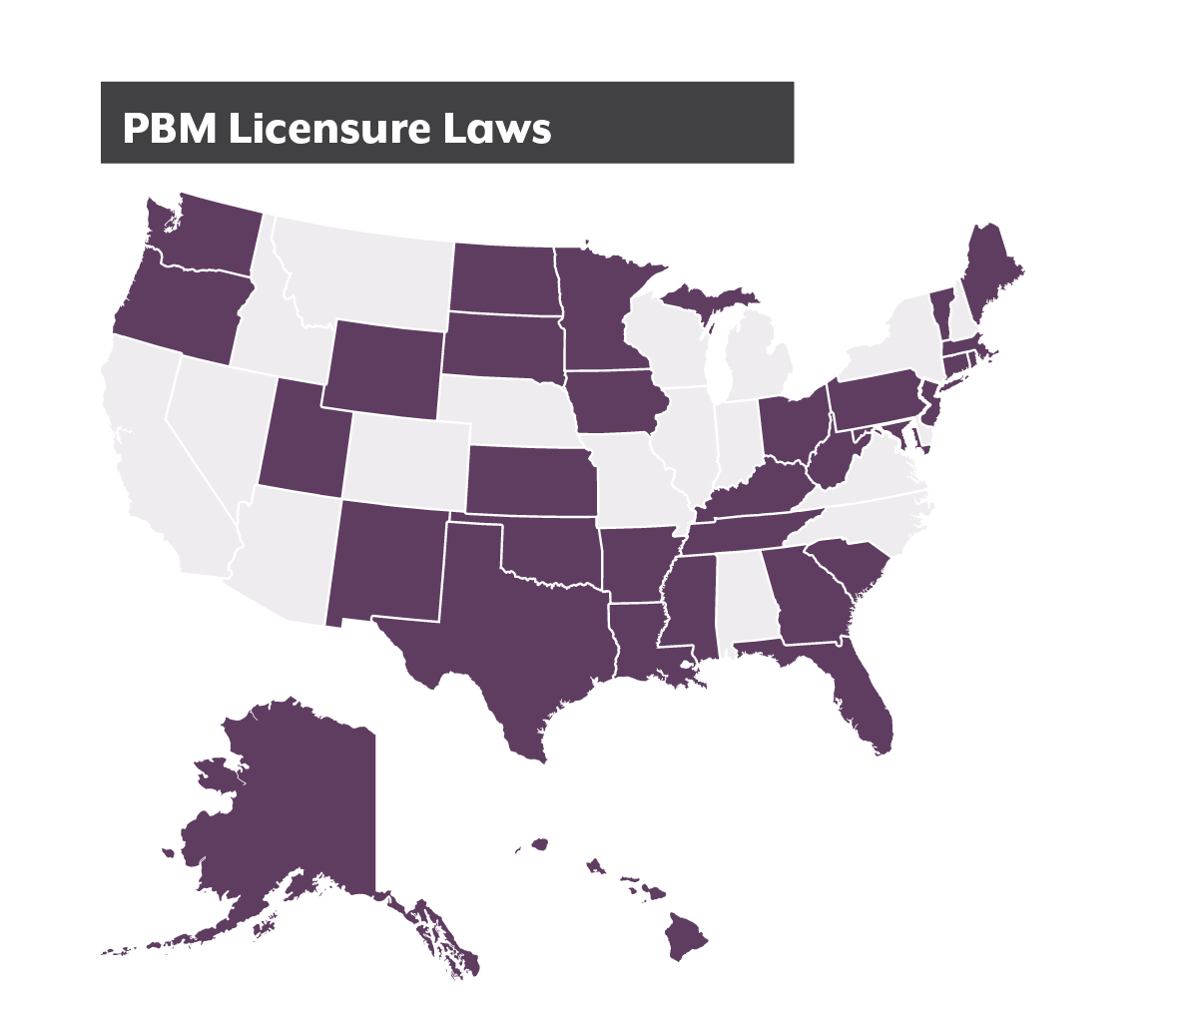


Policy Options
Transparency:
Most states have some sort of law
Licensure:
Give DOI an oversight role
Fiduciary duty:
Require PBMs to act in best interest of customers
Sources: National Community Pharmacists Association, National Academy for State Health Policy
Notes:
[NOTE: This slide uses animation. View in Slide Show mode to see a second map.]
**We have not researched any of these ideas from other states in depth, but if any legislator would like us to, we’d be happy to do it. Just ask.**
Most other states are also passing legislation on PBMs.
Broadly, this legislation is in three categories:
Transparency
Licensing
Fiduciary Duty/Oversight by Insurers
Transparency: Most states have some sort of law requiring transparency into drug pricing. But there’s a wide gamut. A transparency law specifically for PBMs might require them to disclose their rebates and other financial incentives, or even require those incentives be passed through to consumers.
Licensure: Many states require PBMs to register with their insurance commission, which gives the state the power of regulatory oversight.
Fiduciary Duty: This option would require PBMs to act in a fiduciary duty to their customers, which means they always have to act in a customer’s best interest. One twist on this: In Maine, the legislature recently told insurance companies that they have to exercise oversight over the PBMs they contract with. Since insurers are regulated by the state, this method gives the state an avenue into PBM regulation.
31 states now require licensing
Travelocity. No-haggle pricing. Downsides. Market power
Transparency
Market disruption? Amazon-style
PBM licensure
27 states require PBMs to obtain licensure from their states’ departments of insurance prior to operating. In 2019, Minnesota, South Carolina, West Virginia, and Utah enacted laws to require PBM licensure.
States also passed stronger transparency reporting requirements for PBMs. New York passed and Minnesota enacted measures requiring transparency reporting to both health plans and relevant state agencies. Notably, under the New York bill, a health plan will have access to all financial and utilization information of a PBM in relation to pharmacy benefit management services provided to the plan.
The Minnesota law goes beyond other states’ transparency bills by requiring PBMs to submit de-identified claims level information to their plan sponsors. Under this law, PBMs must report any spread collected on a claim, along with the amount paid to the pharmacy for each prescription. The law also requires PBMs give information to plan sponsors that differentiates between payments made to pharmacies owned or controlled by the PBMs and those not affiliated with the PBM.
Health Plan Oversight
States are also increasingly focused on requiring health plans to take more responsibility for monitoring the PBMs they contract with. For example, under Maine’s new law, if a health insurance carrier uses a PBM to manage its prescription drug benefits, the carrier is responsible for monitoring all activities performed by the contracted PBM. By tasking carriers with PBM monitoring responsibilities, Maine is leveraging its Bureau of Insurance to enforce these provisions of the law. The law also stipulates that PBMs have a fiduciary duty to their insurance carriers
NCSL: 2019:
137 laws enacted on pharma supply chain. Almost a third of enacted laws in 27 states related to PBMs. Measures varied from requiring certain cost and rebate information be reported to the state, to allowing pharmacists to disclose alternative cost information to patients at the pharmacy counter, to anti-steering prohibitions—where patients are ‘steered’ to an affiliated pharmacy. Still other state actions imposed licensing and registration requirements for PBMs.
Joining the ranks of Ohio and West Virginia, Louisiana enacted a PBM law that bans spread pricing
Around the country: ttps://www.ncsl.org/blog/2020/01/27/prescription-drug-policy-trends-in-2019-will-hindsight-be-2020.aspx

Slide 18
Today’s Takeaways
‘Fixing’ PBMs will not fix drug prices
PBMs’ incentives can work against consumers
Other states are imposing more transparency and regulation on PBMs

Slide 19
Sources
Seeley, Elizabeth and Kesselheim, Aaron S. (2019). Pharmacy Benefit Managers: Practices, Controversies, and What Lies Ahead. Commonwealth Fund. Online at: https://www.commonwealthfund.org/publications/issue-briefs/2019/mar/pharmacy-benefit-managers-practices-controversies-what-lies-ahead
Yu, Nancy, Atteberry, Preston, and Bach, Peter. (2018). “Spending On Prescription Drugs In The US: Where Does All The Money Go?” Health Affairs Blog. Online at: https://www.healthaffairs.org/do/10.1377/hblog20180726.670593/full/
Carrier, Michael. (2018). “A Six-Step Solution To The PBM Problem.” Health Affairs Blog. Online at: https://www.healthaffairs.org/do/10.1377/hblog20180823.383881/full/
Colorado Health Institute. (2018). Understanding Pharmacy Benefit Managers. Online at: https://www.coloradohealthinstitute.org/research/understanding-pharmacy-benefit-managers
Sood, Neeraj, et.al. (2017). The Flow of Money Through the Pharmaceutical Distribution System. University of Southern California. Online at: https://healthpolicy.usc.edu/wp-content/uploads/2017/06/USC_Flow-of-MoneyWhitePaper_Final_Spreads.pdf
Becker, Collen. (2019). “Prescription Drug Policy Trends in 2019: Will Hindsight be 2020?” NCSL Blog. Online at: https://www.ncsl.org/blog/2020/01/27/prescription-drug-policy-trends-in-2019-will-hindsight-be-2020.aspx

Slide 20

Joe Hanel
hanelj@coloradohealthinstitute.org

