Slide 1
HIH opener

Slide 5
Welcome Back!

Slide 6
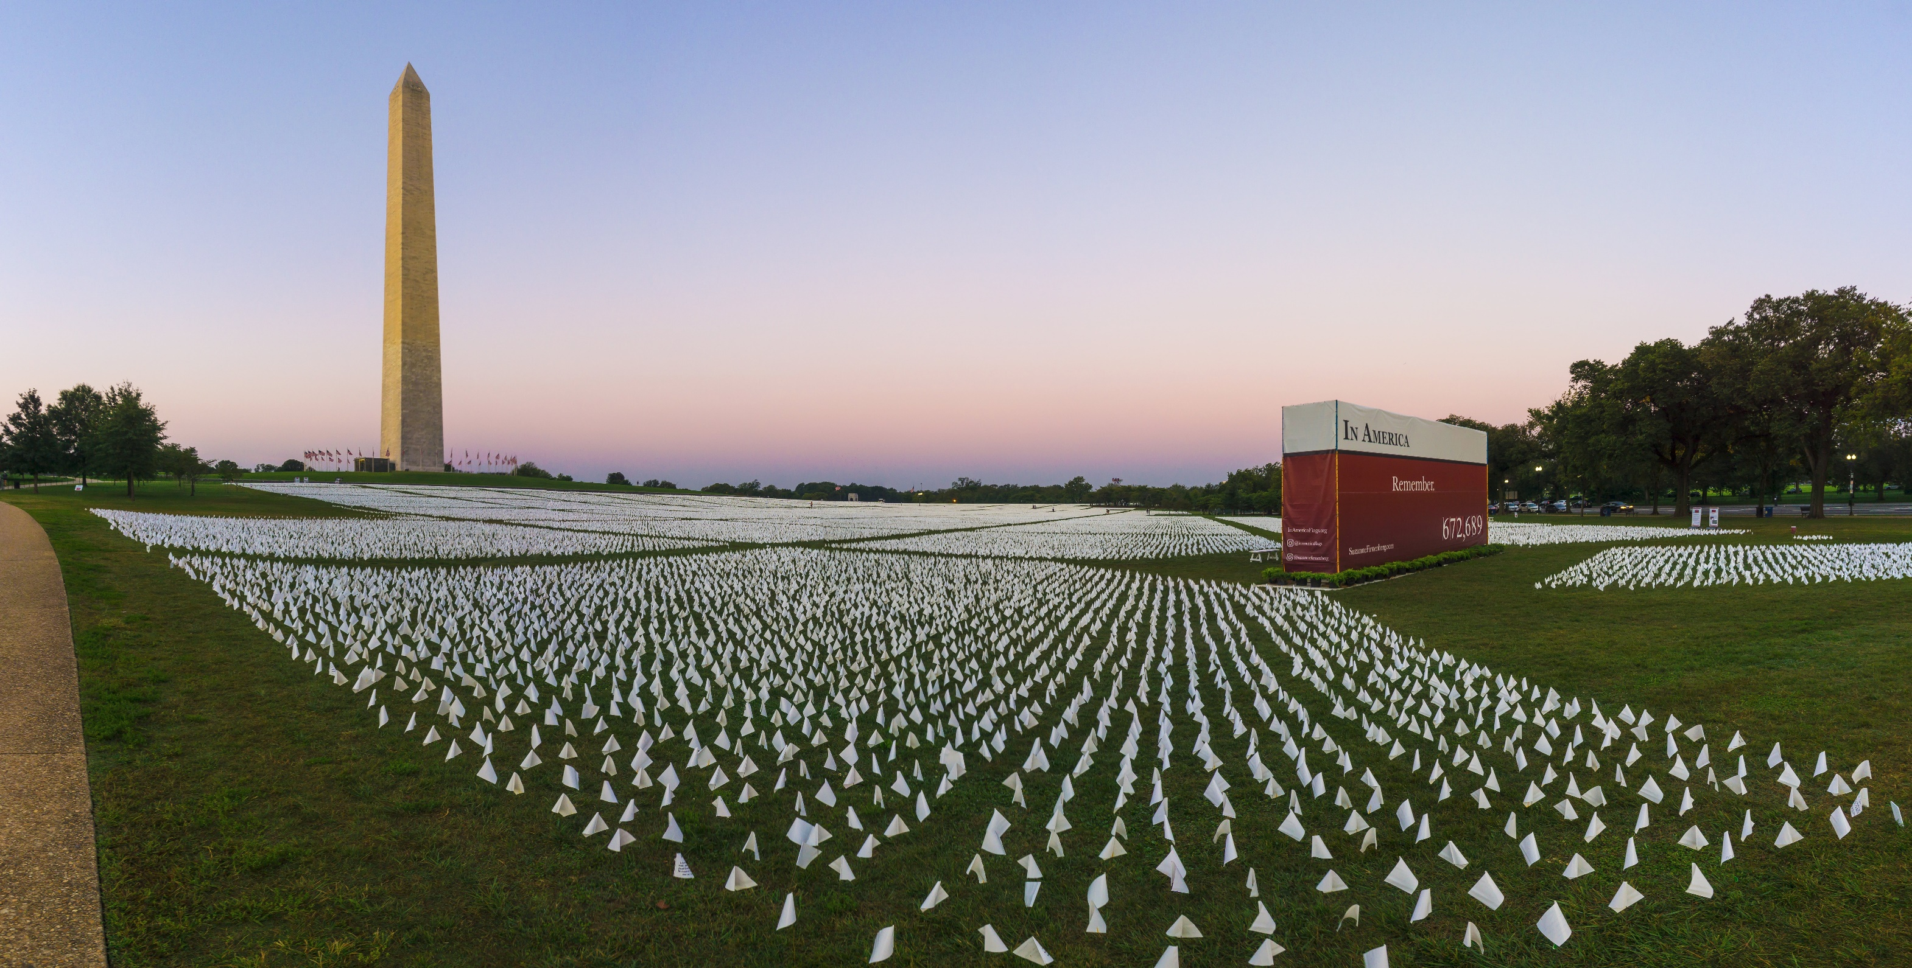

Slide 9
Barack Obama

Slide 10
State Obligation
Resources
Motivated Partners

Slide 12
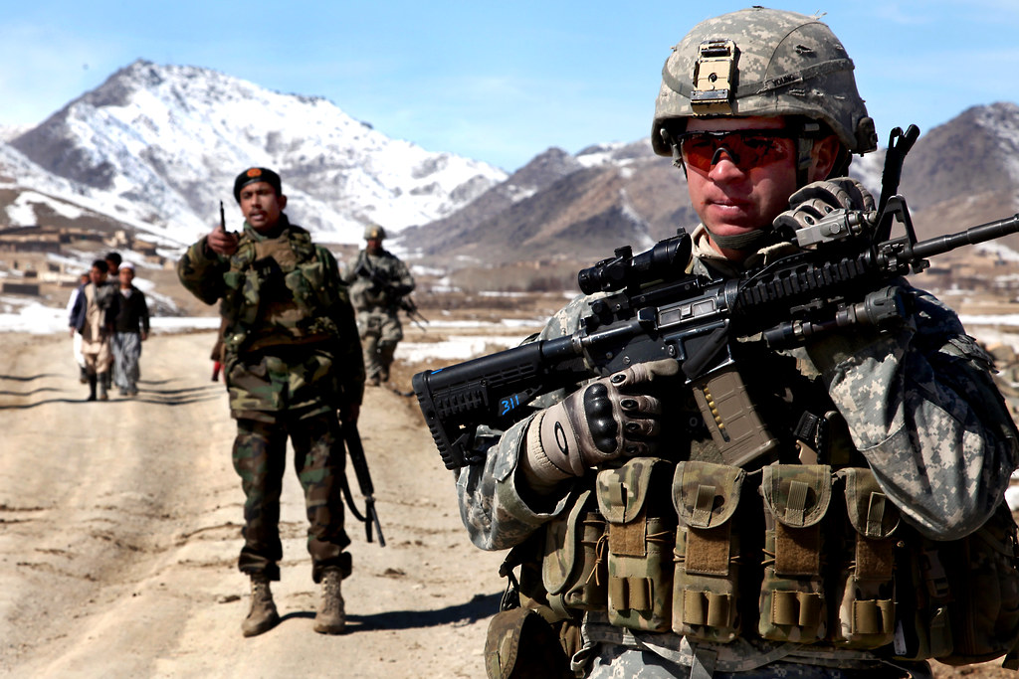
U.S. Army https://www.flickr.com/photos/soldiersmediacenter/4378533001

Slide 13
https://commons.wikimedia.org/wiki/File:Google-apps-training-logo.png
https://commons.wikimedia.org/wiki/File:Mobile_phone_timeline.png

Slide 15
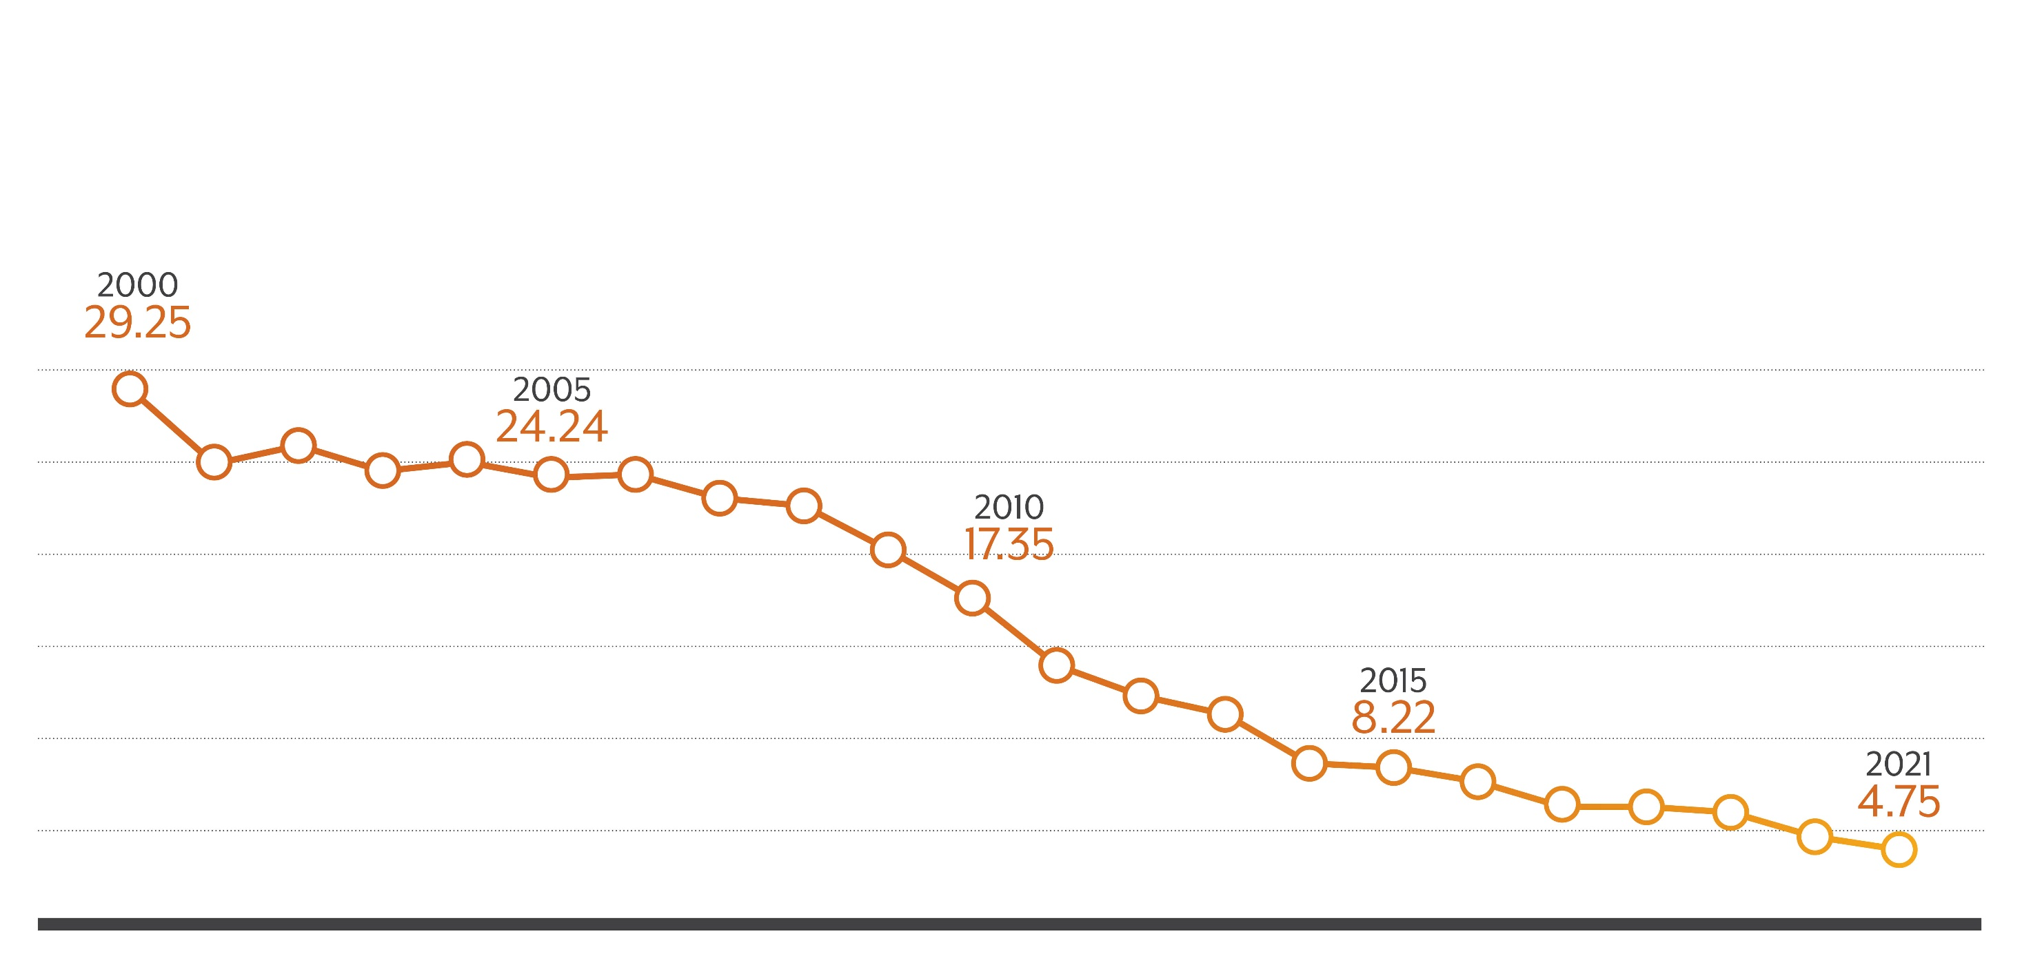
Teen Pregnancy
Crude Birth Rate by Year, 2000-2021, Ages 15-17
Source: CDPHE

Slide 16
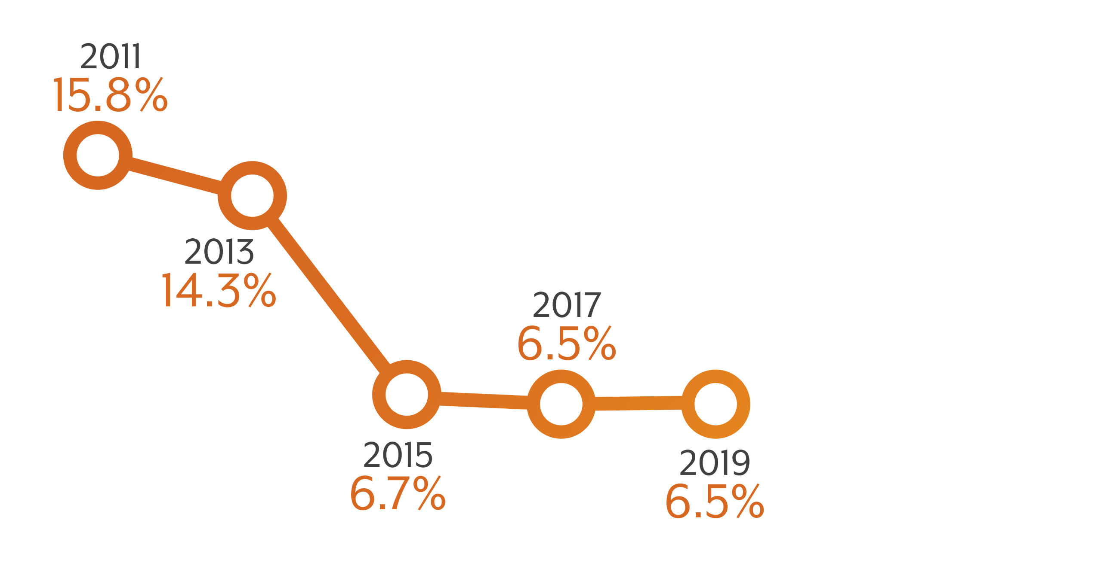
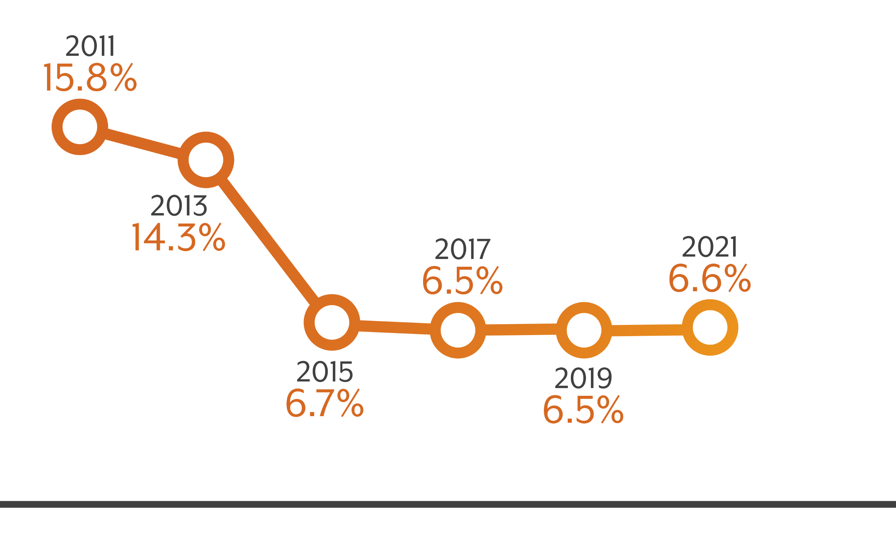
Colorado Uninsured Rate 2011-2021

Slide 17
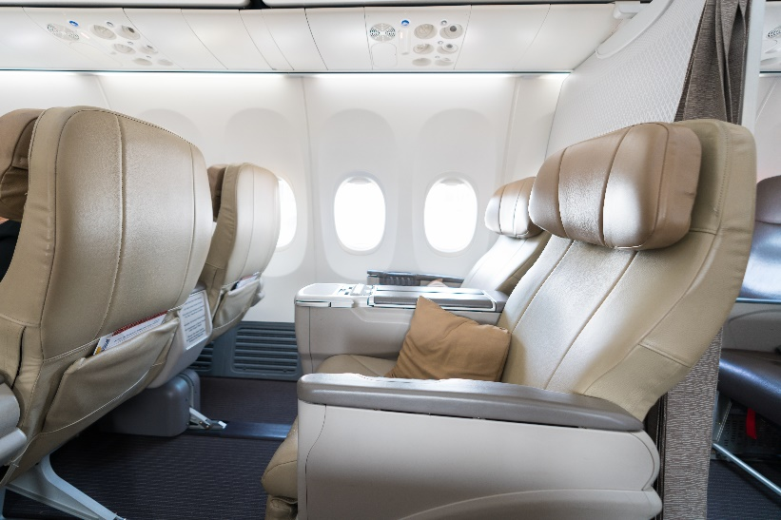
Smoking

Slide 18
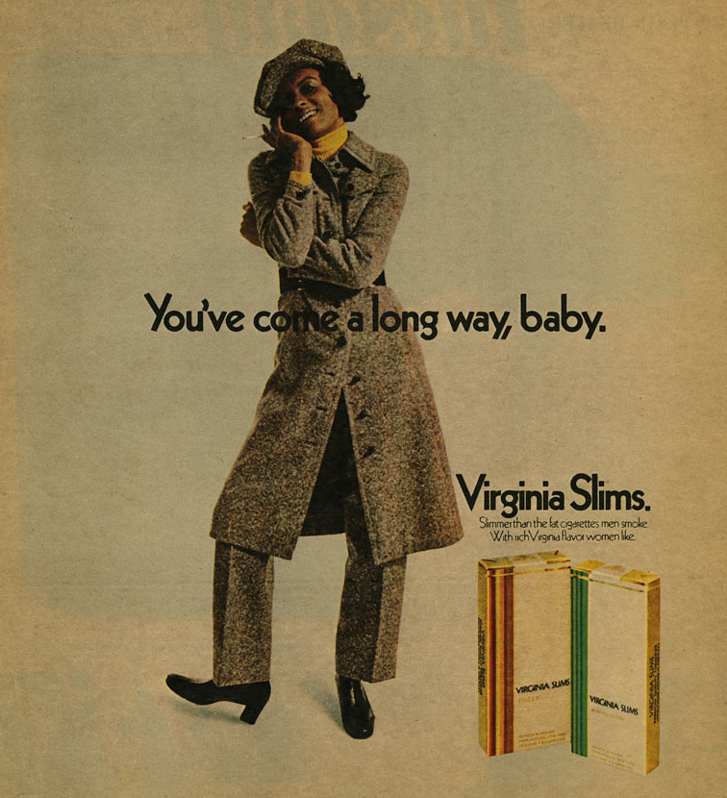
You’ve come a long way, baby.
National Museum of American History Smithsonian Institution https://www.flickr.com/photos/8113246@N02/39900005401

Slide 19
Teen Births
State Obligation Absence of action at a national level
Resources $27 million private investment
Motivated Partners Public and private family planning service providers, schools, community organizations, philanthropy, young people

Slide 20
Uninsured Rate
State Obligation Lack of federal action in 1990s, managed care backlash
Resources Hospital provider fee, leveraging federal funds
Motivated Partners Hospitals, providers, government agencies, advocates, philanthropy, academia

Slide 21
Smoking
State Obligation Tobacco litigation and settlement, indoor smoking ban
Resources Master Settlement Agreement and Amendment 35 (tobacco tax)
Motivated Partners Public health, clinicians, policy-makers, advocates

Slide 24
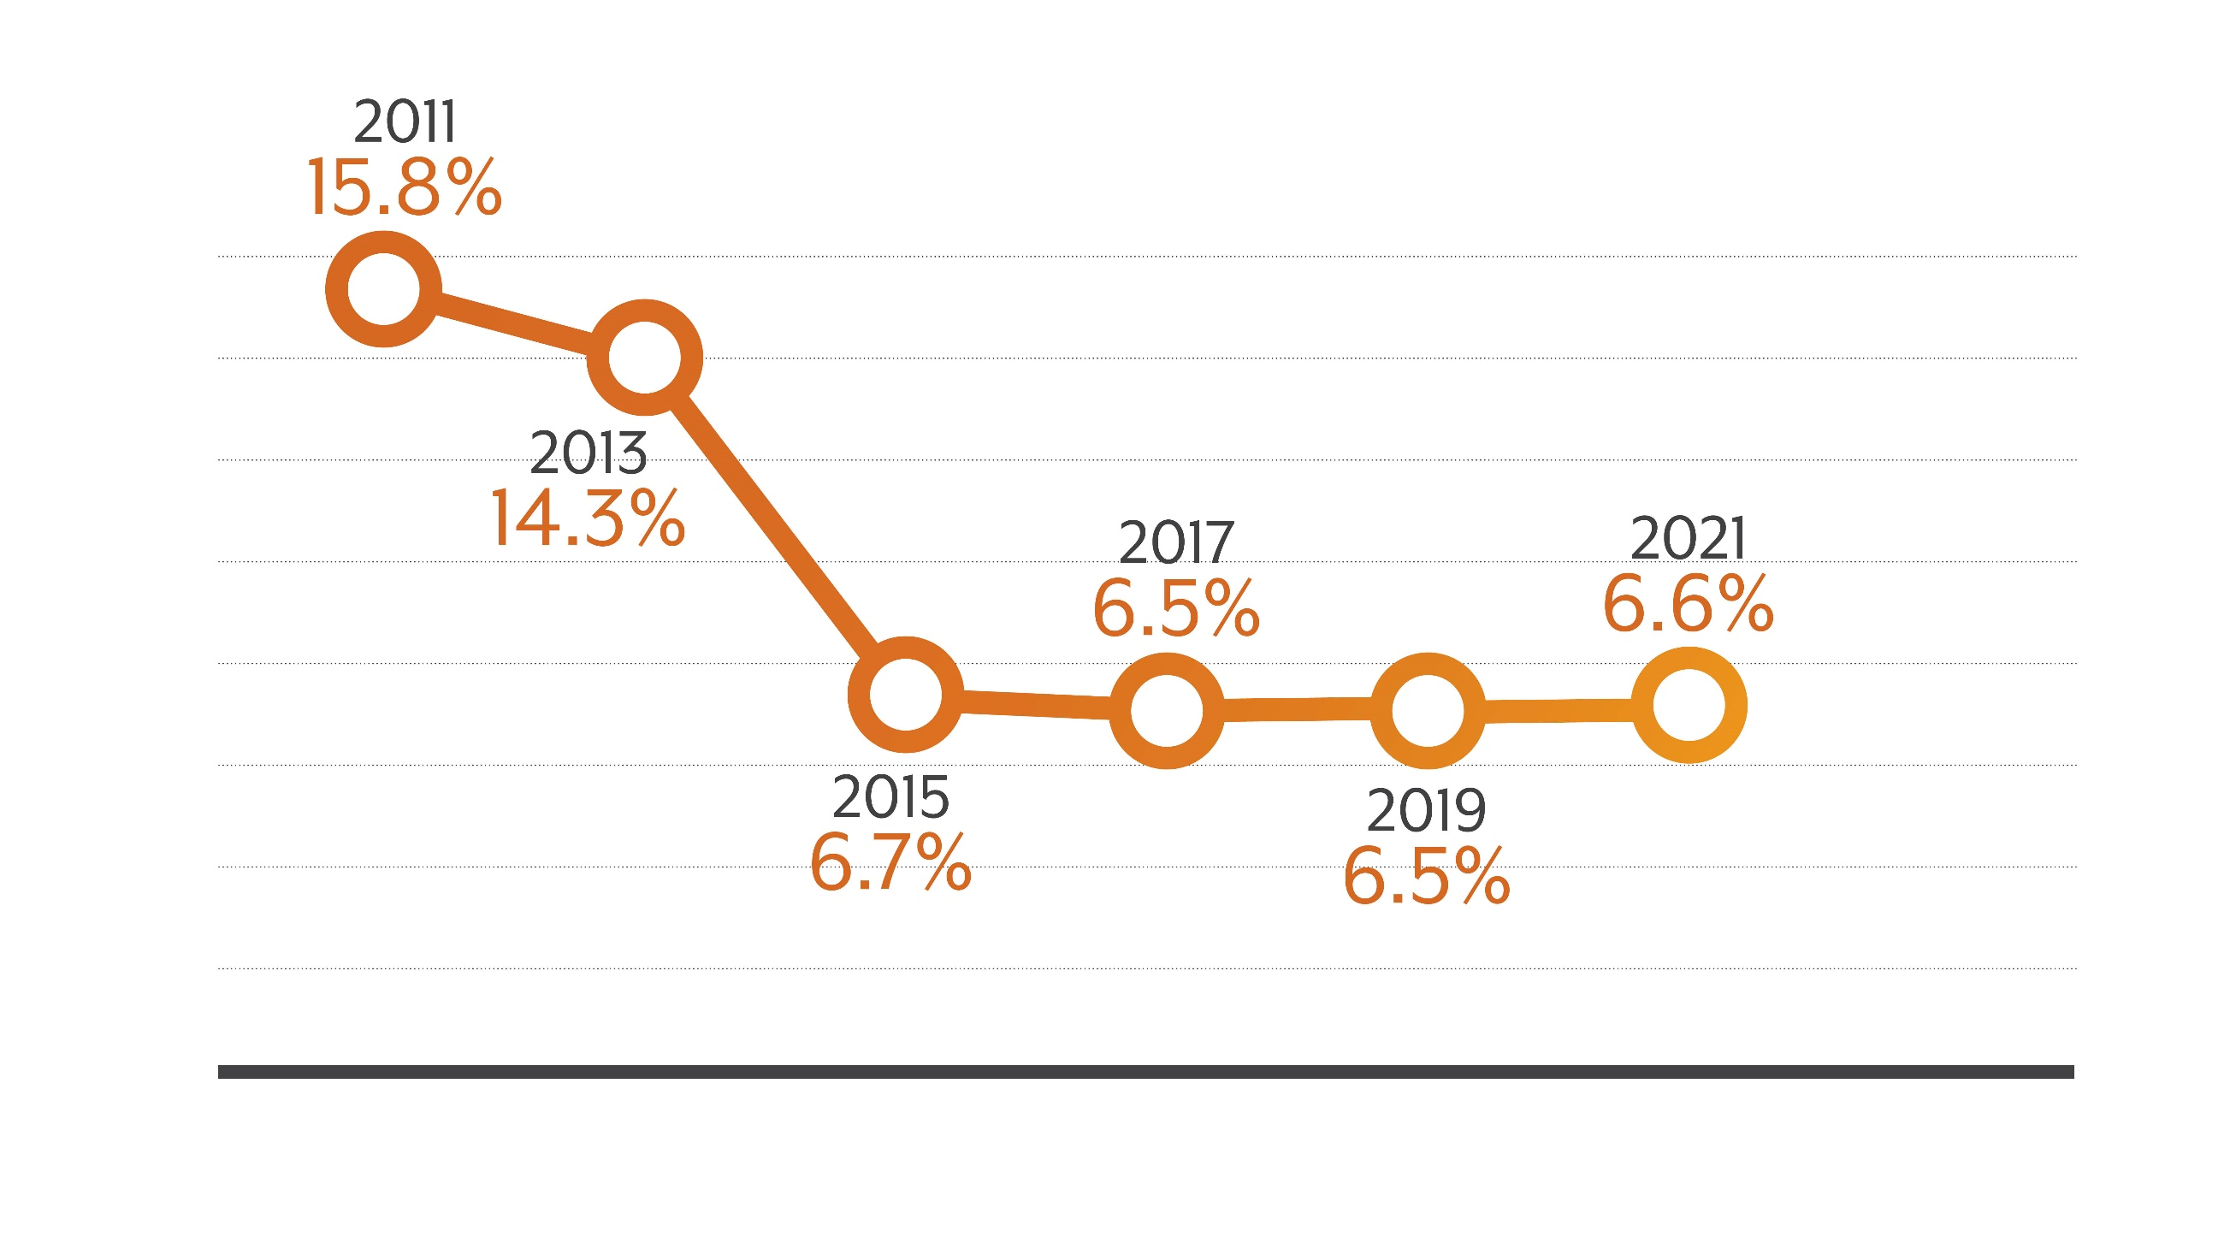
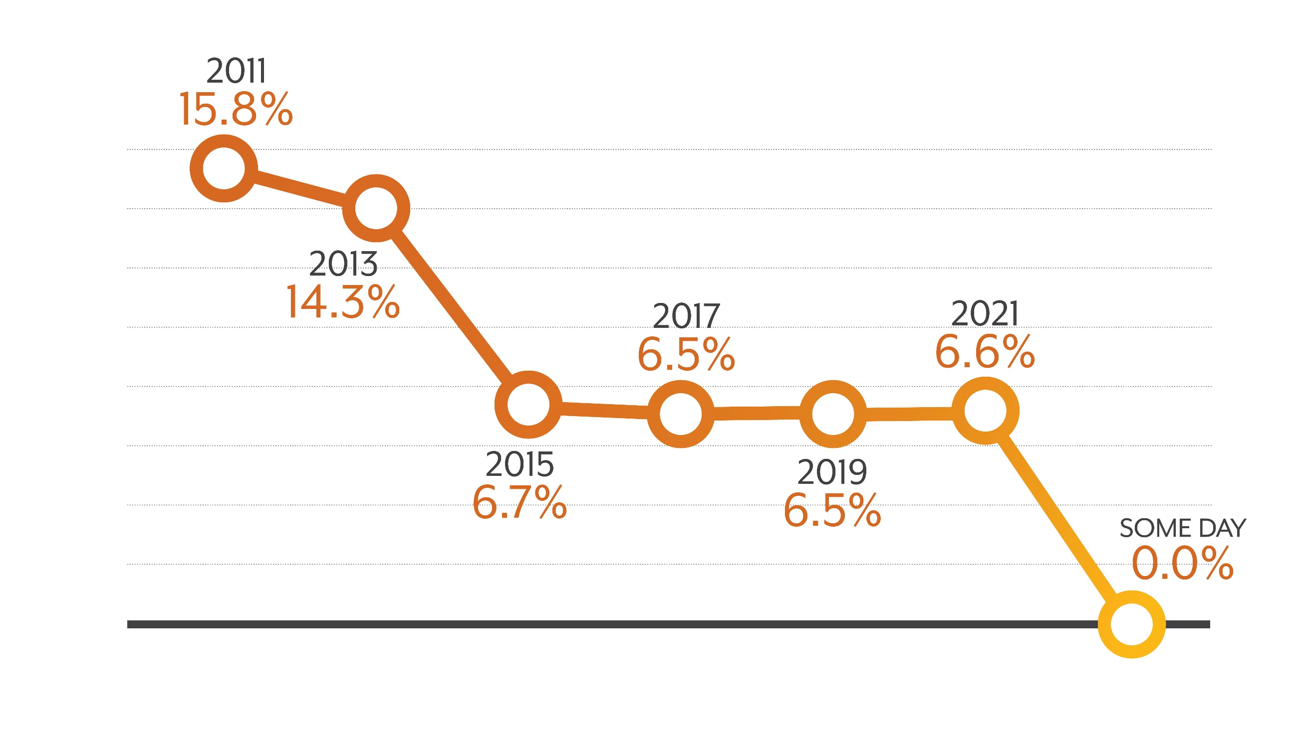
Colorado Uninsured Rate

Slide 25
State Obligation
Resources
Motivated Partners

Slide 30
9-10 a.m.
Climate change image (maybe an allusion to the presentation?)
Still working on this slide

Slide 31
10:35-11:35 a.m.
Integrated systems image (maybe an allusion to the presentation?)
Still working on this slide

Slide 32
1-2 p.m.
BH image (maybe an allusion to the presentation?)
Still working on this slide

Slide 33
