Slide 1


Slide 2

Notes:
We used to talk a lot about integration in Colorado.
State Innovation Model – investing $65 million for integrating the delivery of behavioral health and primary care services.
SIM ended in July of this year.

Slide 3
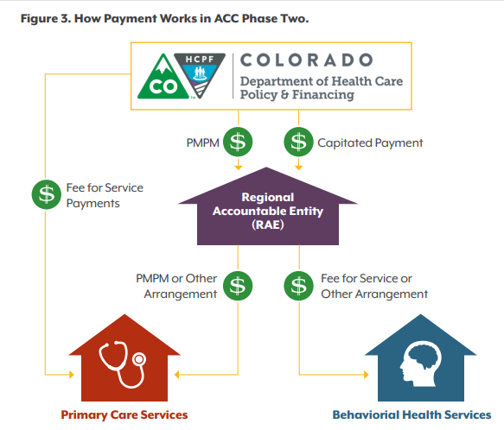
Notes:
We saw a pivot at the Department of Health Care Policy and Financing with the Accountable Care Collaborative 2.0 – further integrating funding and payment for behavioral health and primary care. Missing, however, are services like dental care. Although visits to a dental provider became a key performance indicator to which providers are held accountable, payment remains siloed for most providers.

Slide 4

What’s Happening
With Integration?
Notes:
A scan of 2019 legislation found just one bill that focused on integrating different types of care (Senate Bill 228, creating a maternal child health pilot program at CDPHE to link substance use disorder treatment and medication assisted treatment with OB/GYN care. Seems quiet on the policy front when it comes to integration.
What happened? Let’s talk about it.

Slide 5
When you think about integration, which
of the following options is top of mind?
  Primary care and behavioral health
  Primary care and some other type of care
  Multidisciplinary care teams
  Telehealth-enabled care
  None of the above
Talk about why with the person next to you.

Slide 6

Think about the professional ‘hats’ you wear. Are you talking about integration
in any of those roles?
  If you are, what is the
  current conversation like?
  If not, why not?
  What’s changed in the
  past few years?

Slide 7
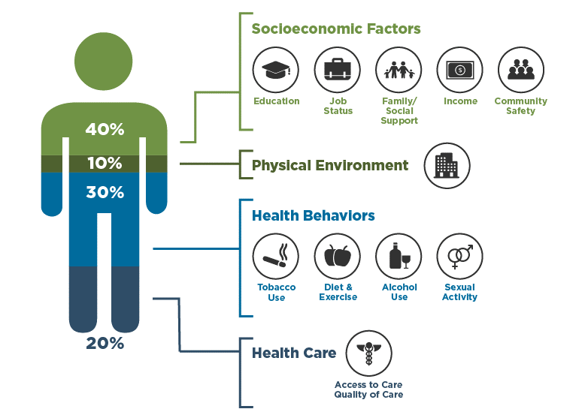
What Goes Into Your Health
Source: Institute for Clinical Systems Improvement, Going Beyond Clinical Walls: Solving Complex Problems (October 2014). Adapted from the Bridgespan Group

Slide 8
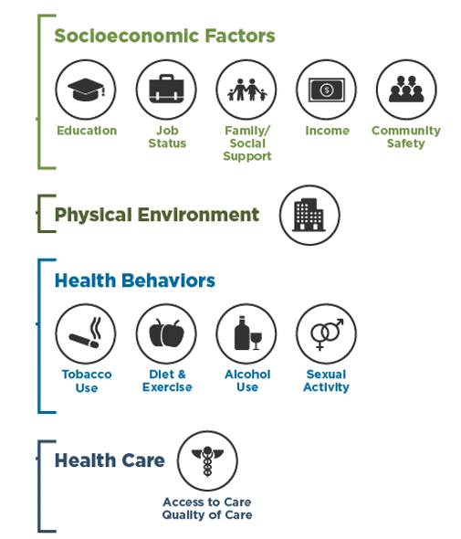
Given what we know about what impacts health, what services need to be integrated?

Slide 9

Today’s Panelists
Michael Niyompong,
Vice President of Strategic Community Partnerships, Mental Health Center of Denver
Neha Patel,
Director of Care Delivery Transformation, Anthem
Linda Reiner,
Executive Vice President,
Caring for Colorado Foundation

