Slide 3
Three Takeaways
1 + 1 = Economic Security Supports Good Health
4 x 2 = Colorado Takes on Two Generation Approaches
35 x ? = ROI Is A Tough Sell

Slide 5
1 + 1 = Economic Security Supports Good Health

Slide 6
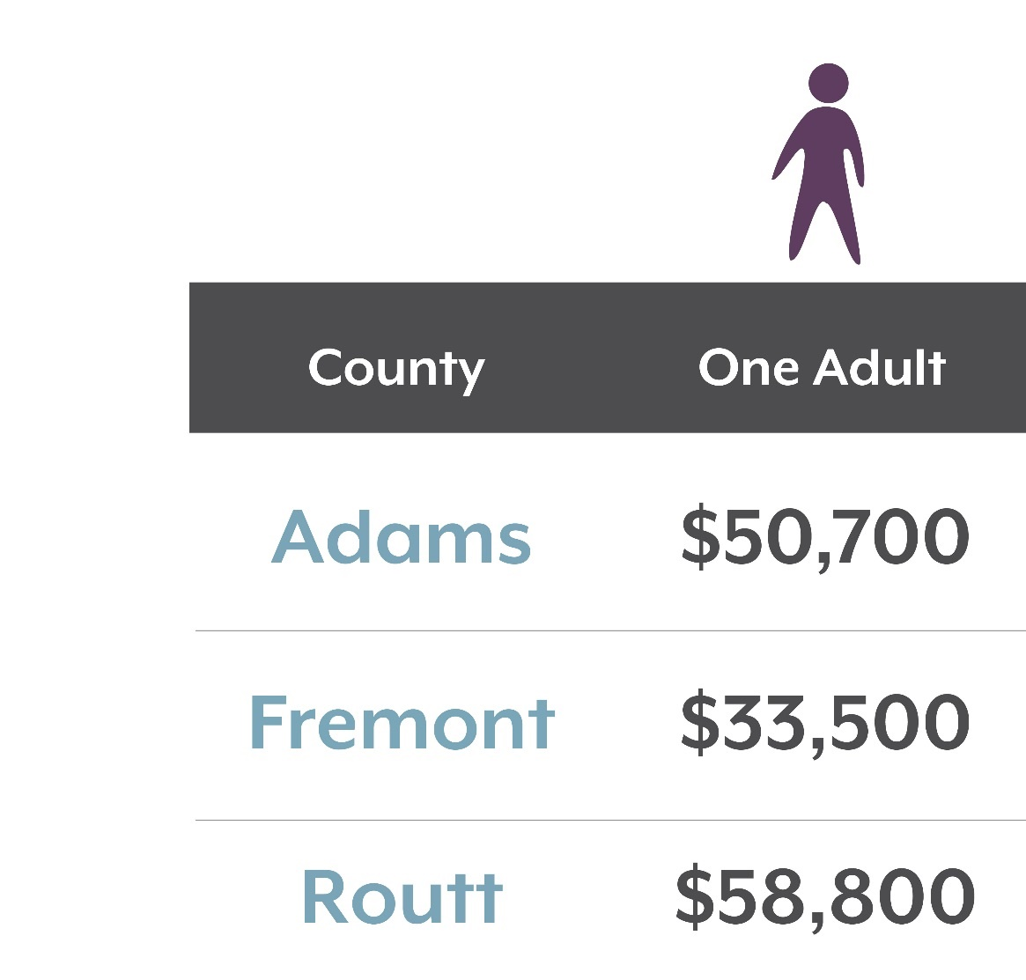

Slide 7
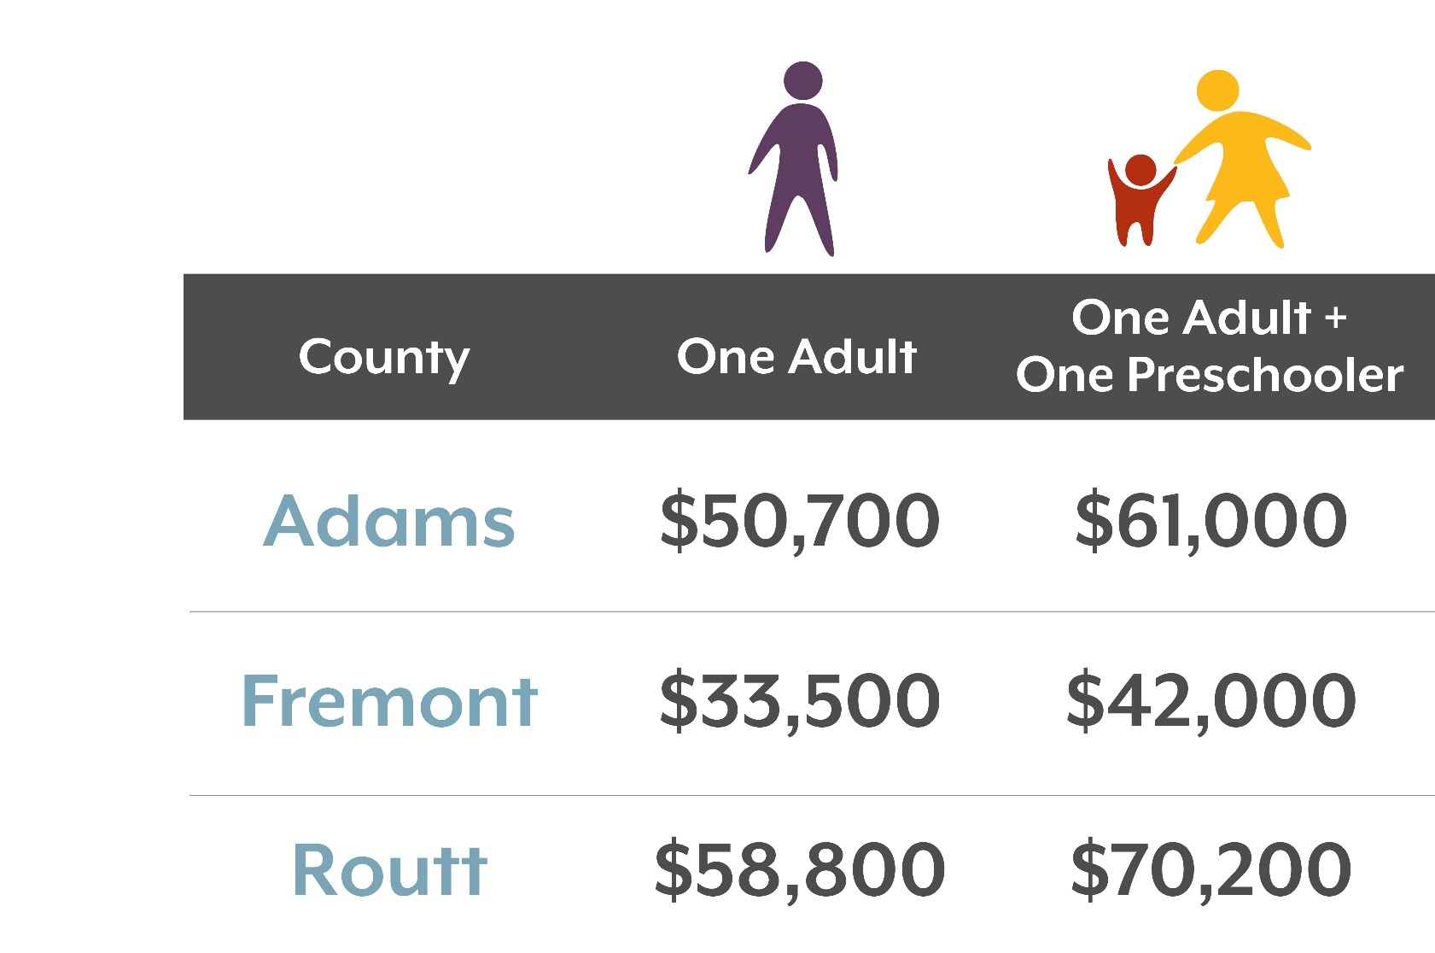

Slide 8
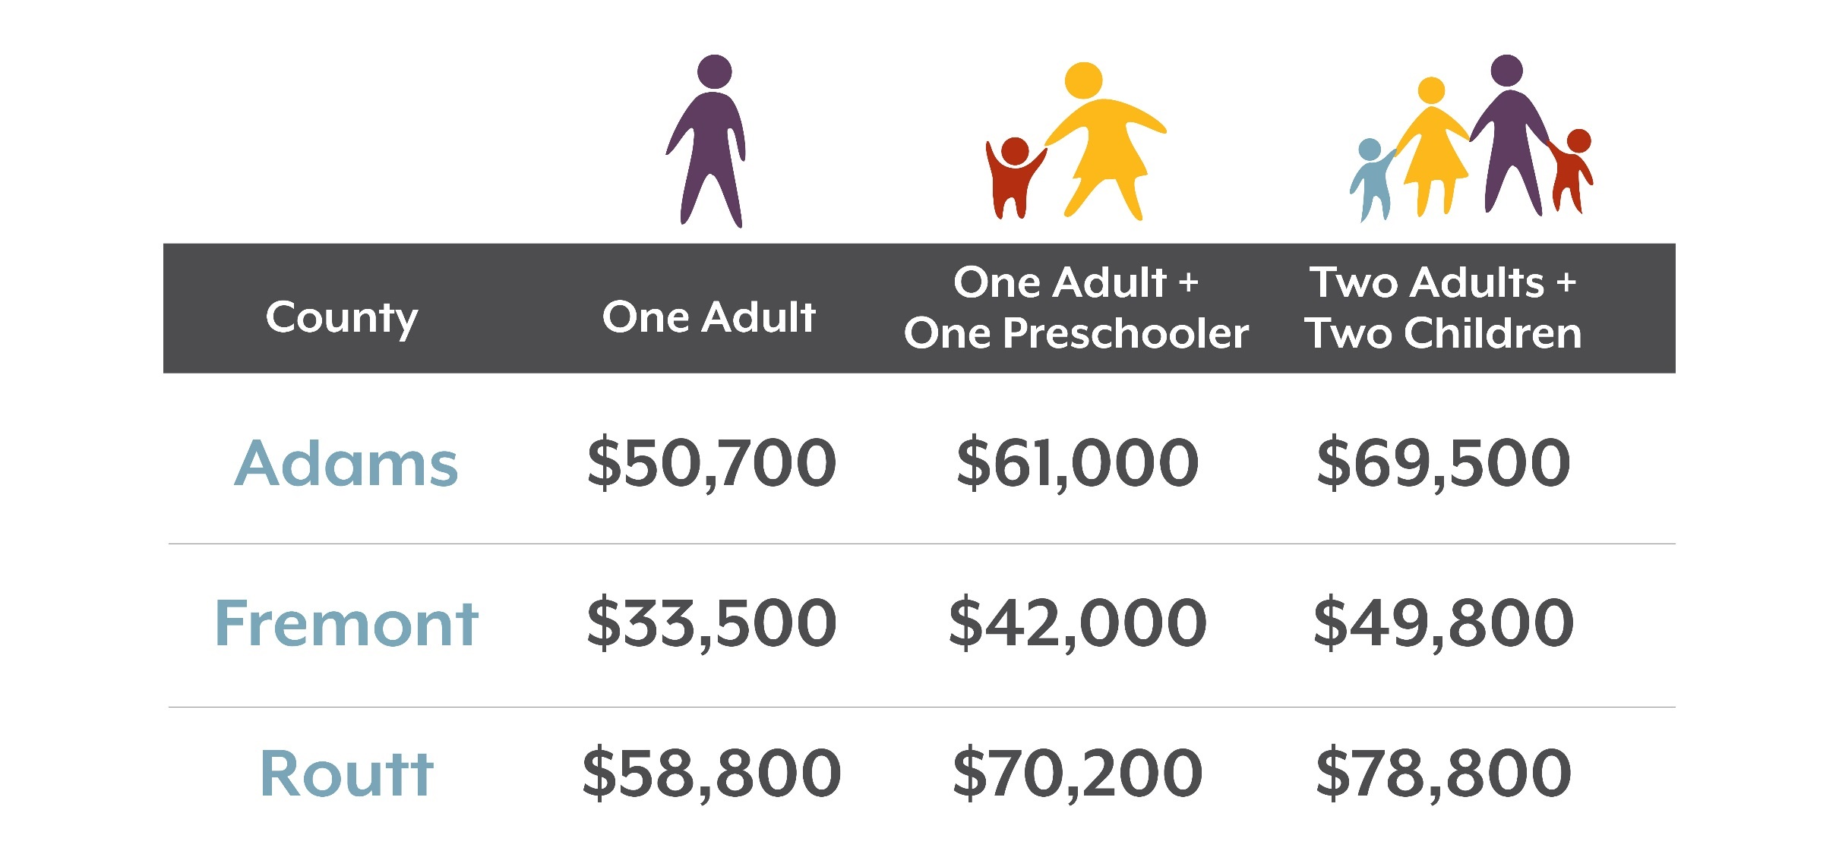

Slide 9
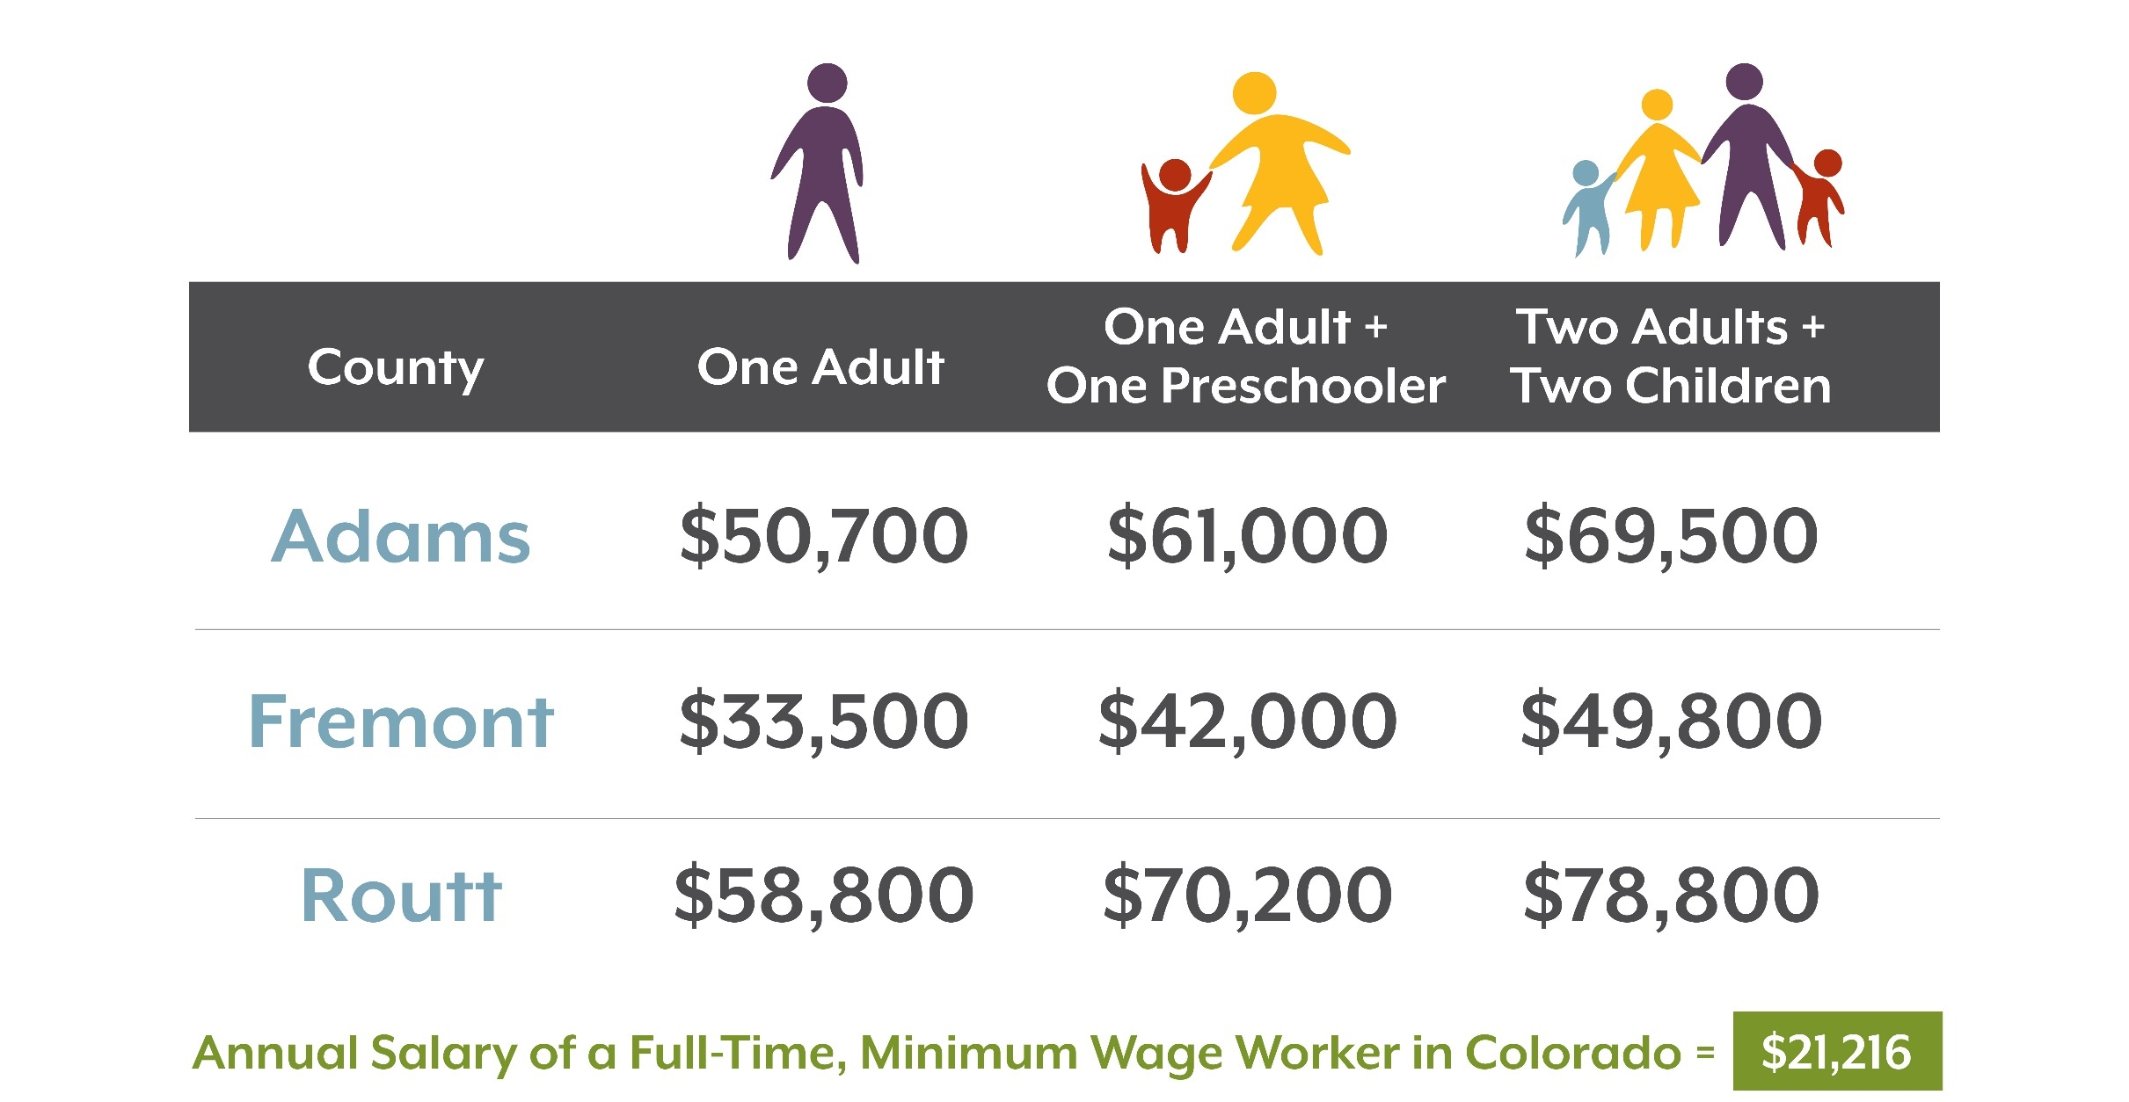

Slide 11
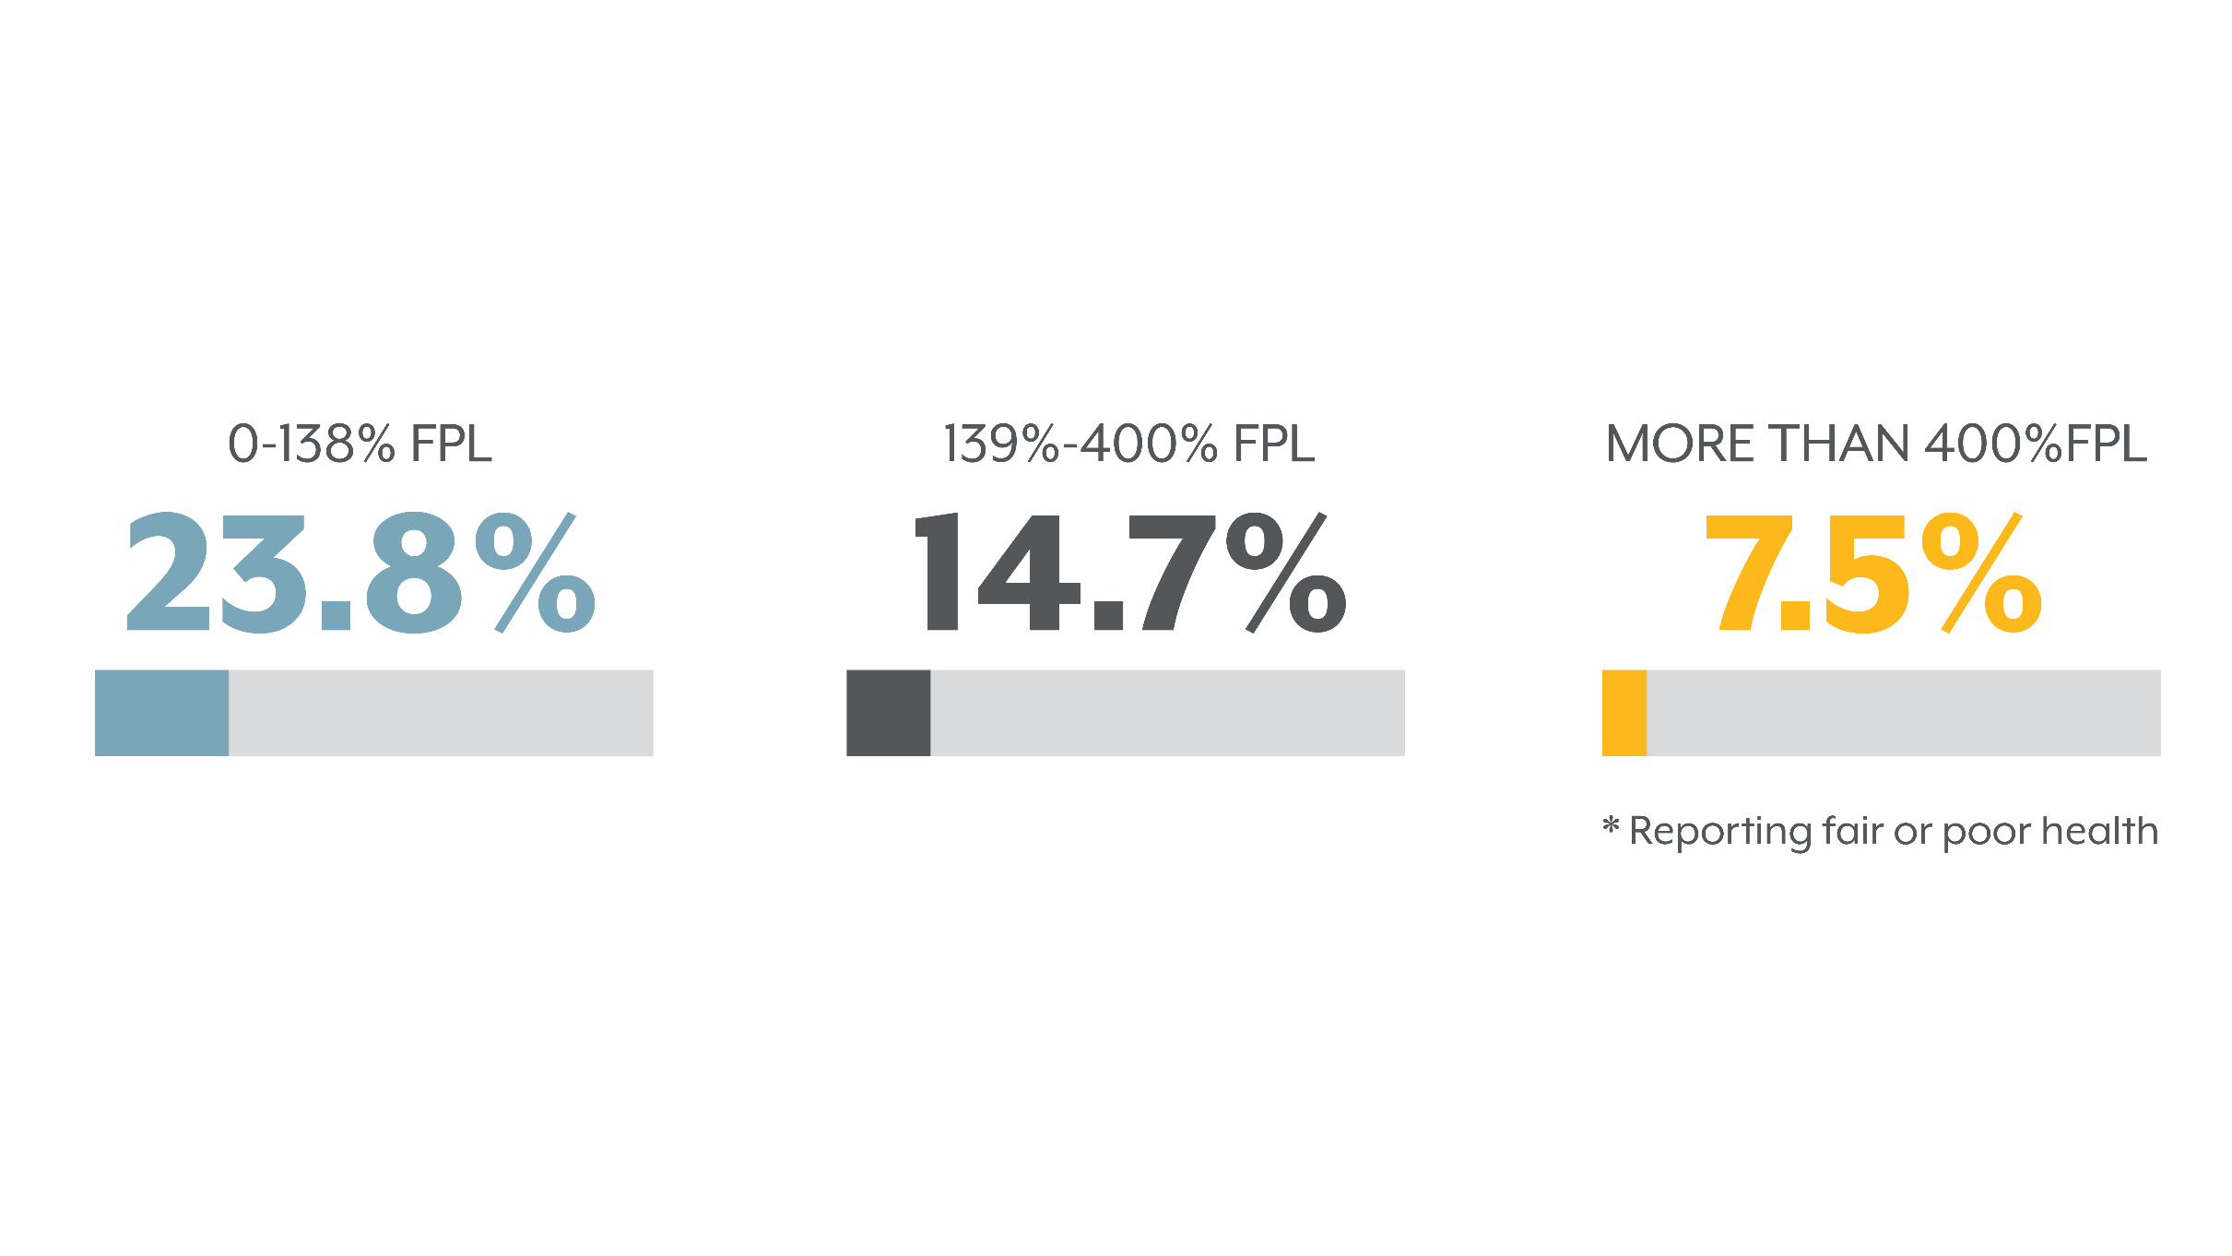
Lower Incomes, Worse Health, 2017

Slide 12
Average Annual Income for Colorado Households

Slide 13
Two Generation Policies and Programs Impact All Families
#HIHC18

Slide 14
Creating a Foundation of Opportunity and Mobility

Slide 15
#HIHC18

Slide 16
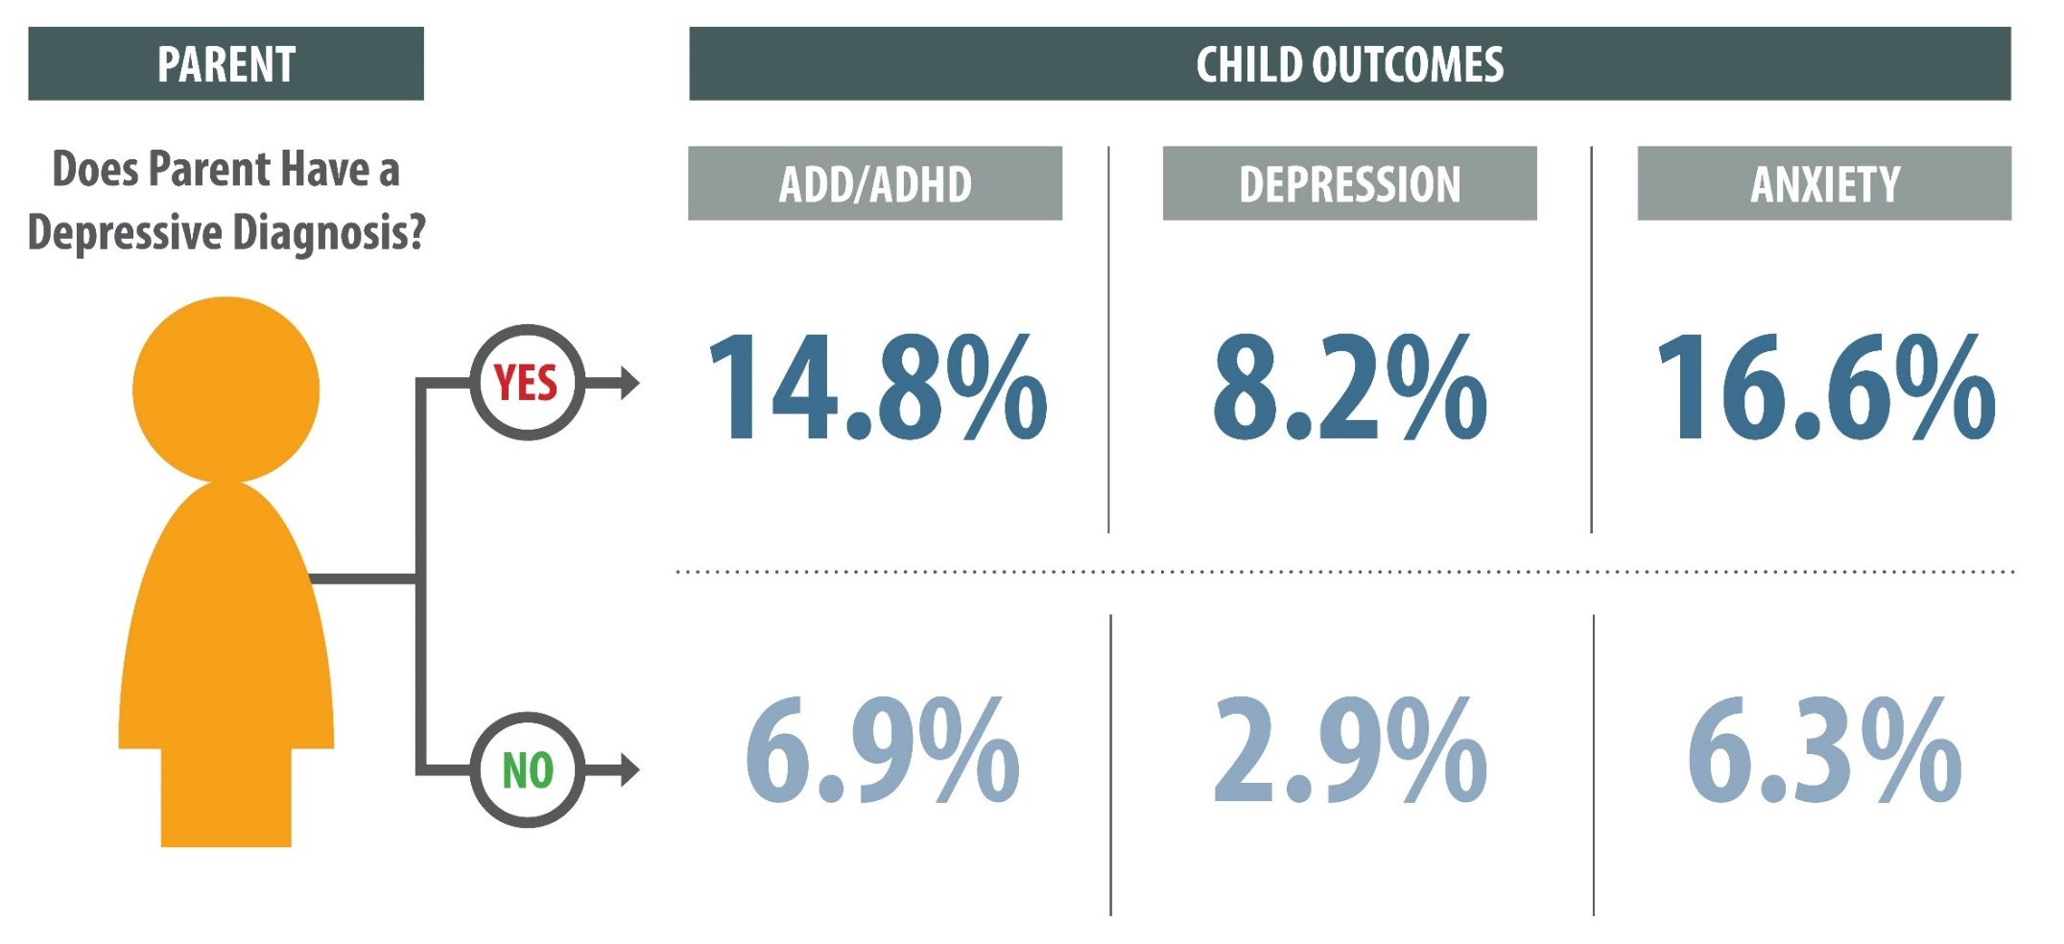
Parent Well-Being Influences Child

Slide 17
4 x 2 = Colorado Takes on Two Generation Approaches

Slide 18
10
A. 10 x 2
B. 10 x .5

Slide 19
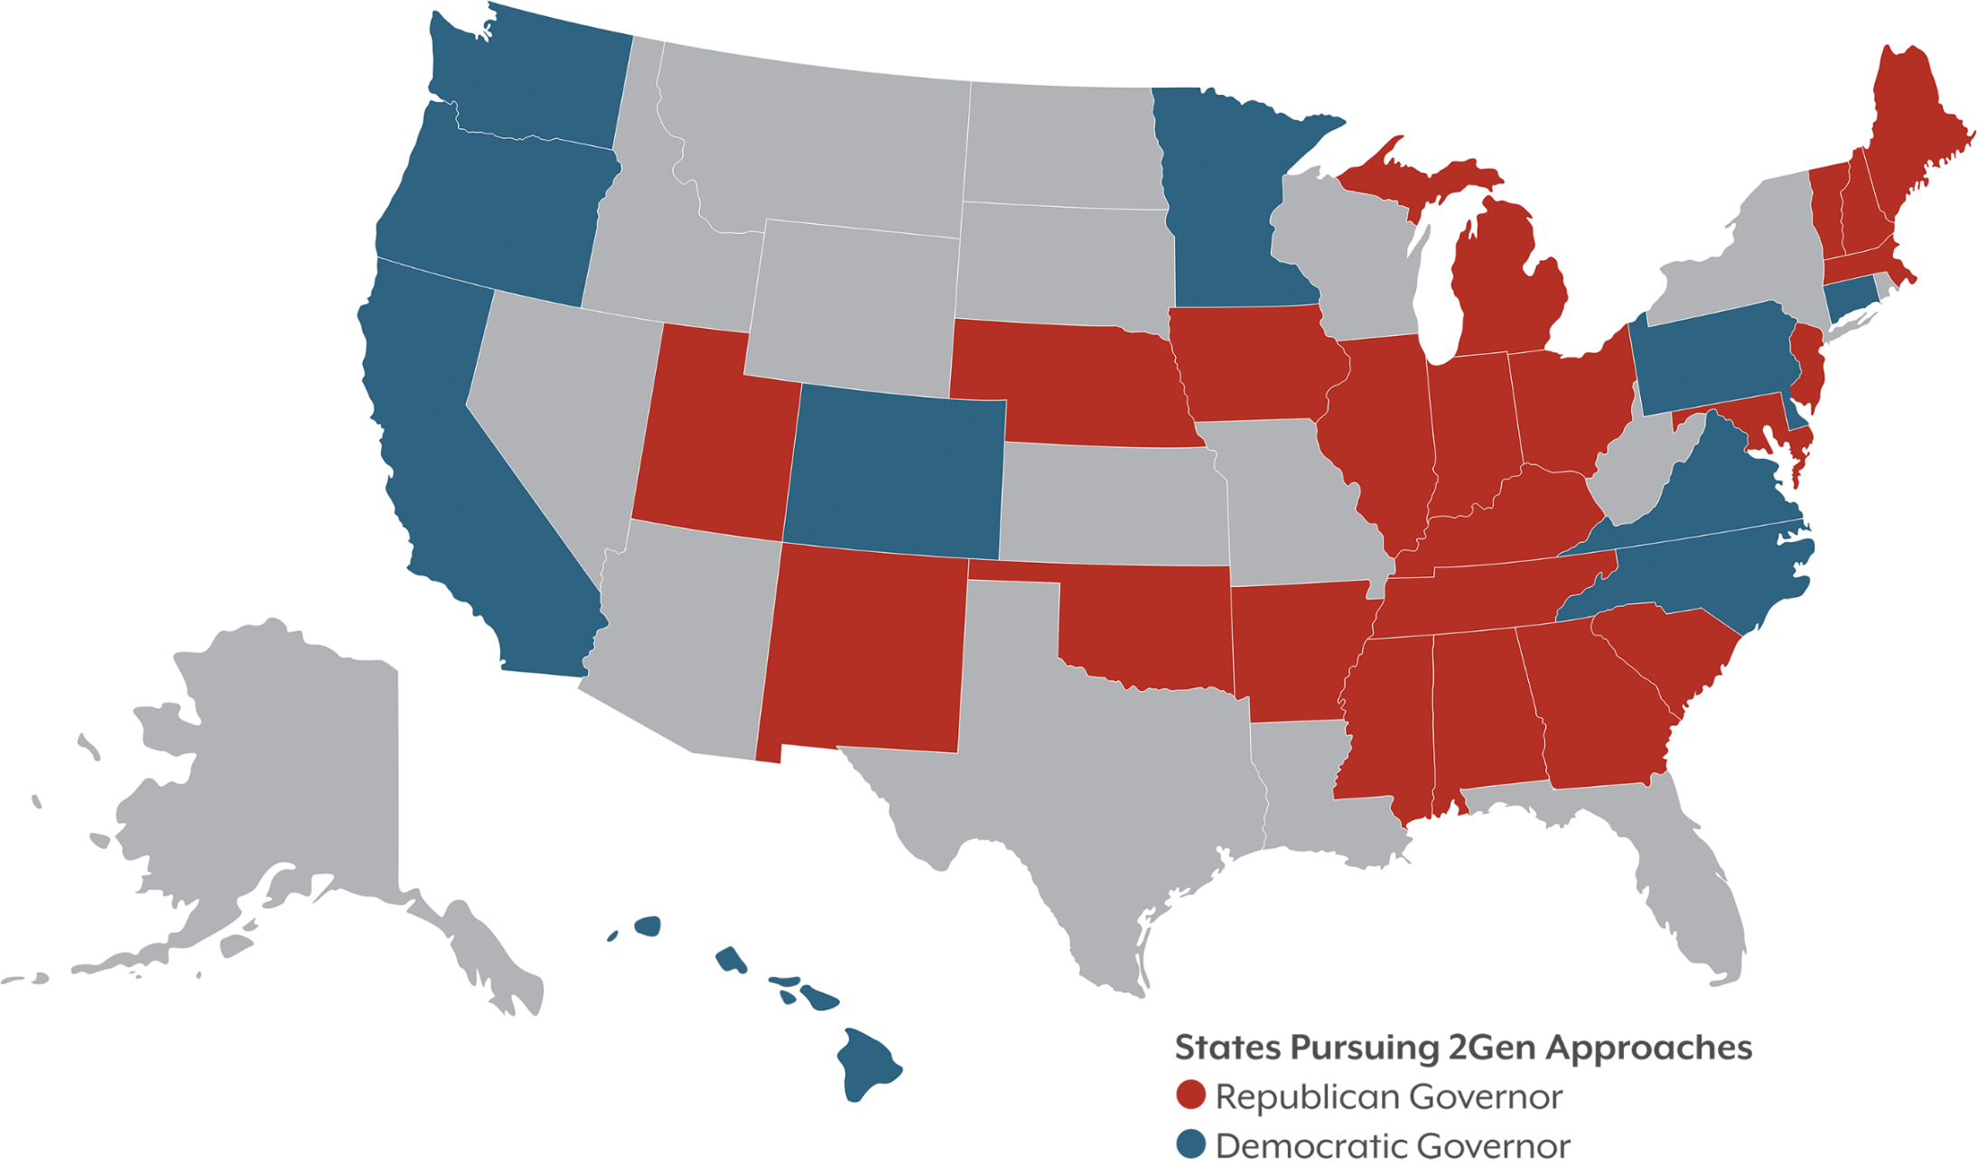

Slide 20
Photo of the Colorado & US flags on a flag poll … Brian do you have that?

Slide 22
The Colorado Opportunity Project is a life cycle model with life stages and benchmarks of success for each life stage.

Slide 25
Pregnancy-Related Depression Screening

Slide 27
Research Questions
Risk: Which areas of the state show the greatest need for ECMH services?
Reach: Where are ECMH services currently provided, and where are there gaps?
Resources: What are the sources and levels of funding for ECMH in Colorado?
#HIHC18

Slide 28
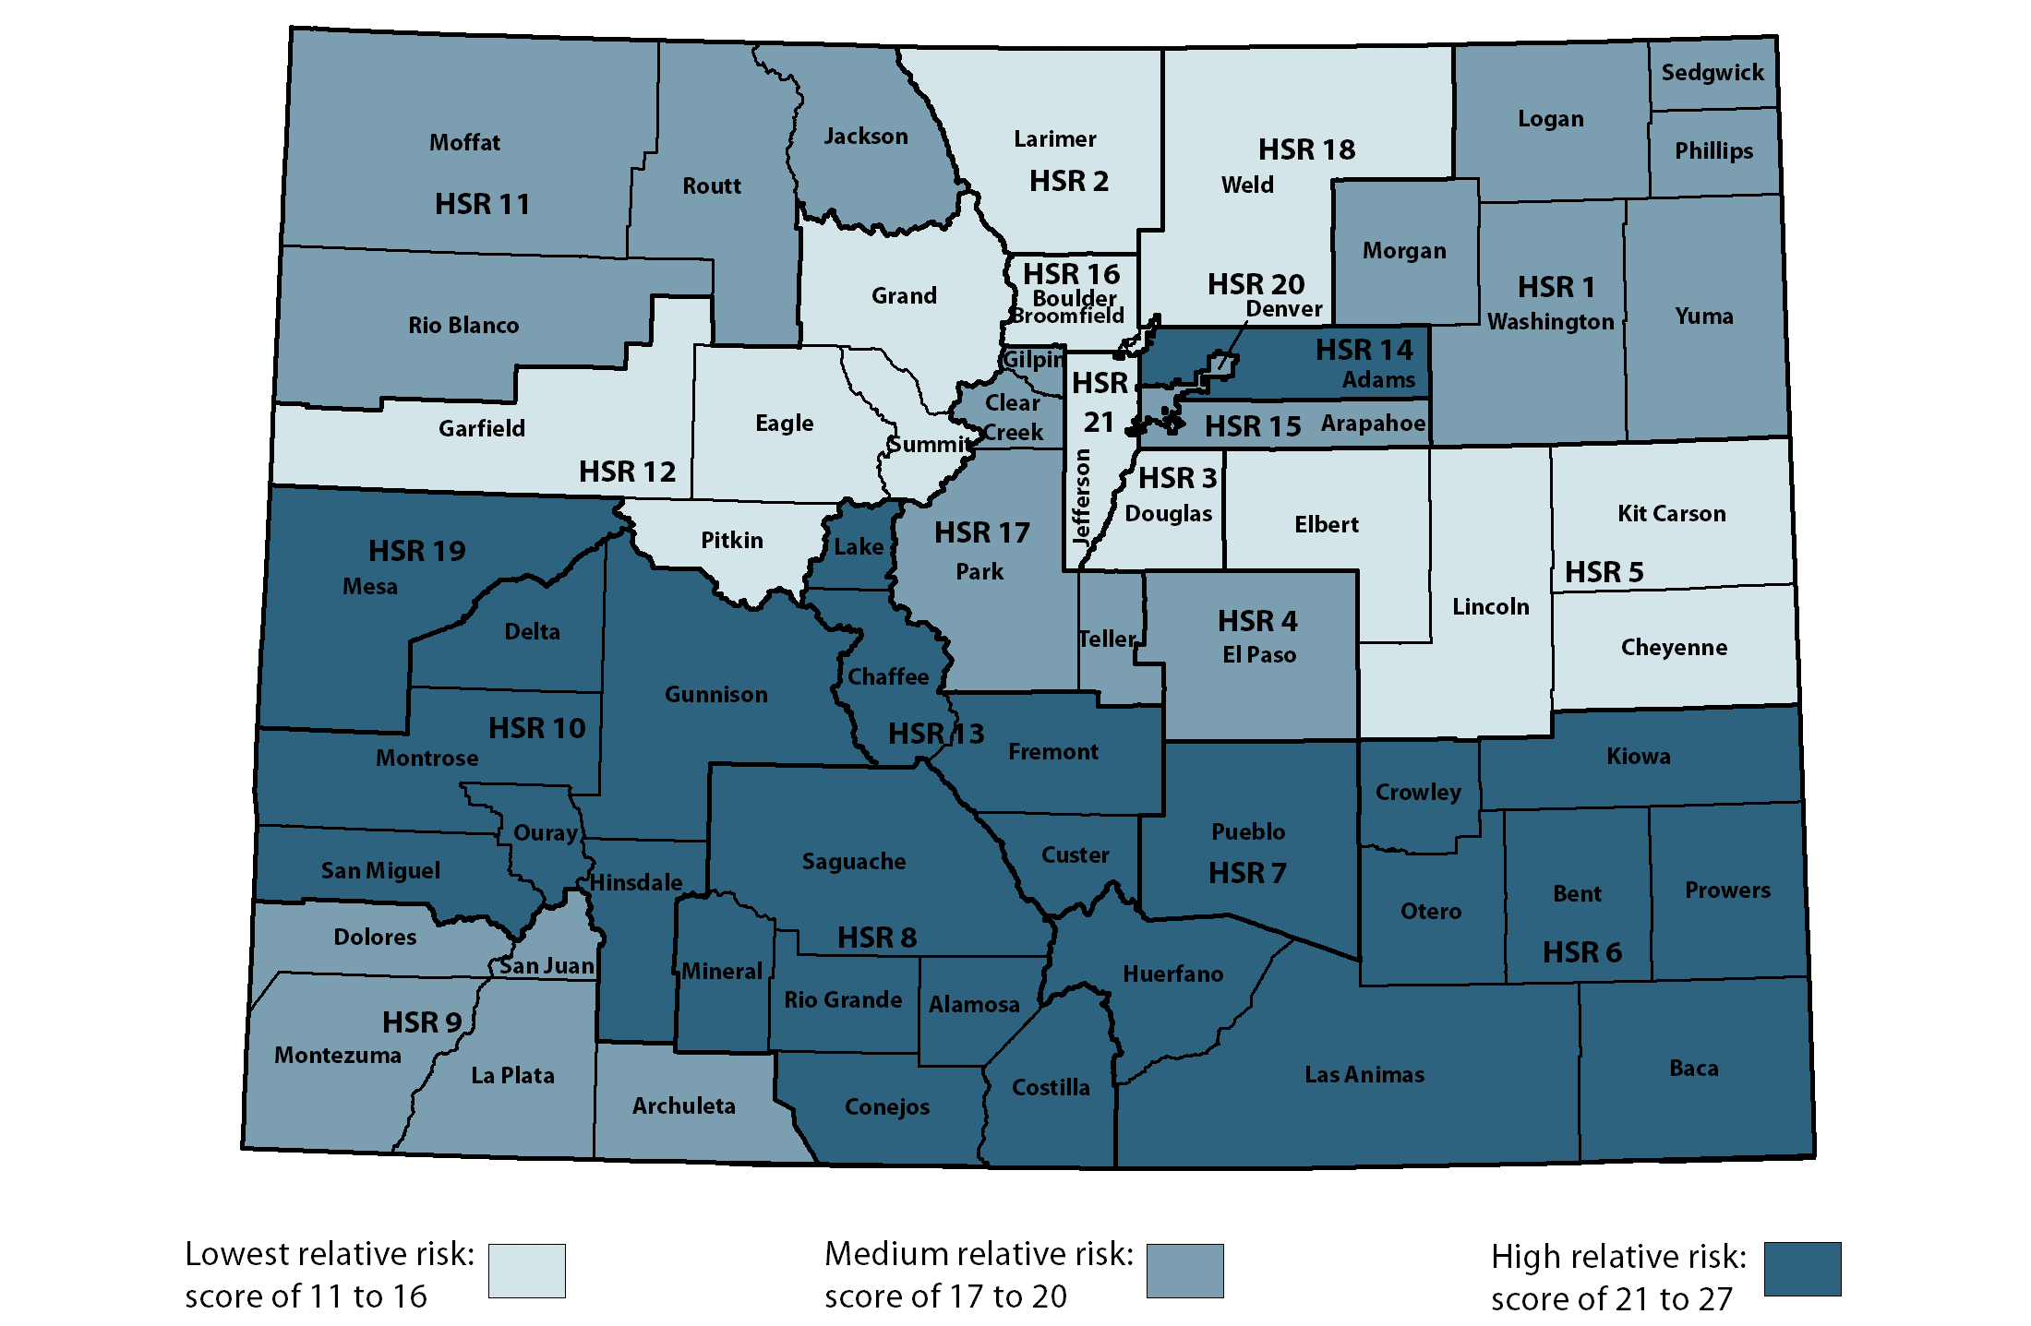
Southern Counties and Adams At the Highest Risk

Slide 29
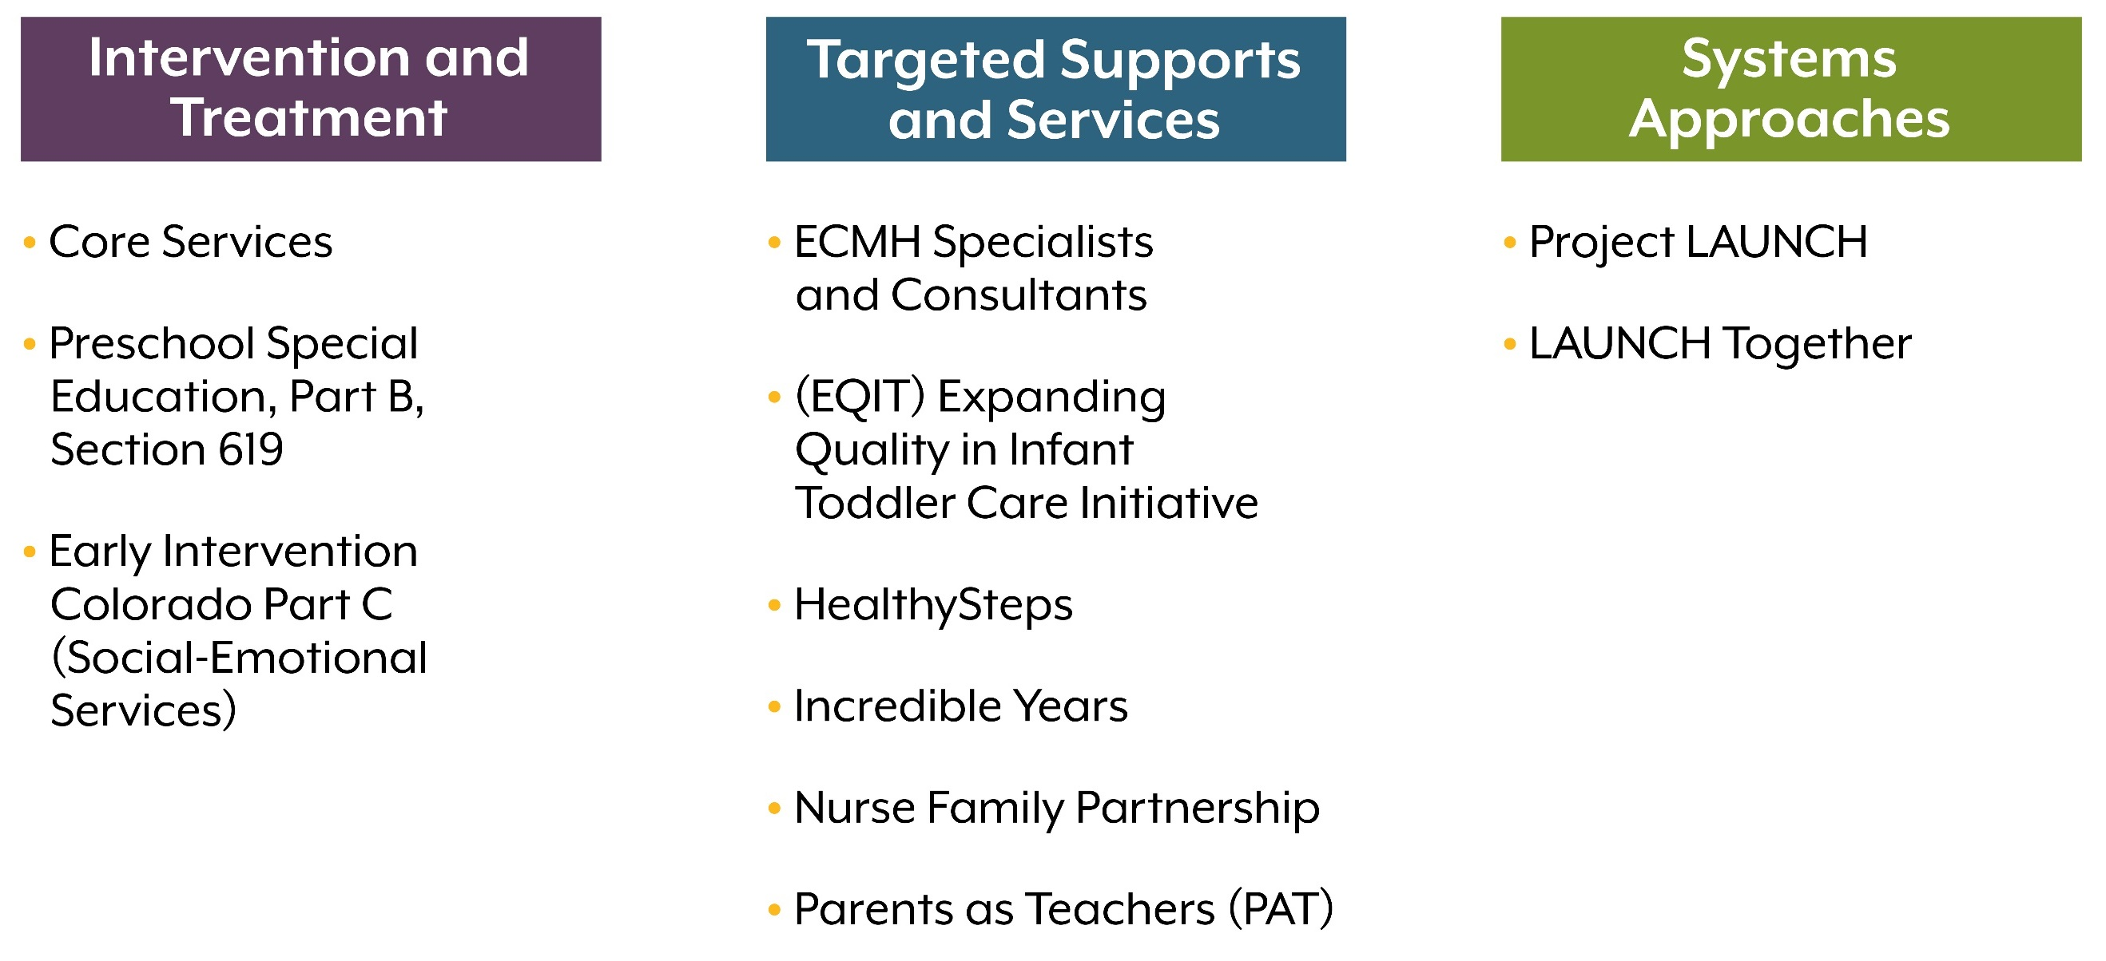
What’s Included

Slide 30
Risk and Reach Are Often Mismatched

Slide 31
Per Capita Investment Varies Widely

Slide 32
Public Investment Plays a Major Role
Total: $62,360,348

Slide 33
35 x ? = ROI is a Tough Sell

Slide 34
Hard to Make The Money Work
Who saves is not who pays.
Reimbursement low, if at all.
No way to bill.
#HIHC18

Slide 35
For a Moment: History – Not Math – Lessons
Colorado 2Gen
Colorado Opportunity Project
SCL Maternal Mental Health Continuum
Early Childhood Mental Health

Slide 36
Hearing From You
What are your lessons?
How do we build political will?

Slide 37
Three Takeaways
1 + 1 = Economic Security Supports Good Health
4 x 2 = Colorado Takes on Two Generation Approaches
35 x ? = ROI Is A Tough Sell

