Slide 1
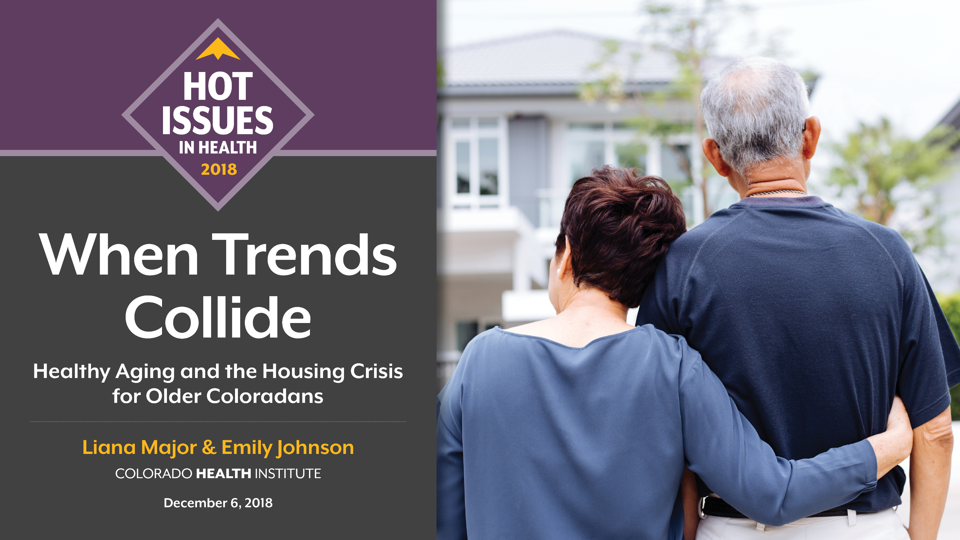

Slide 2
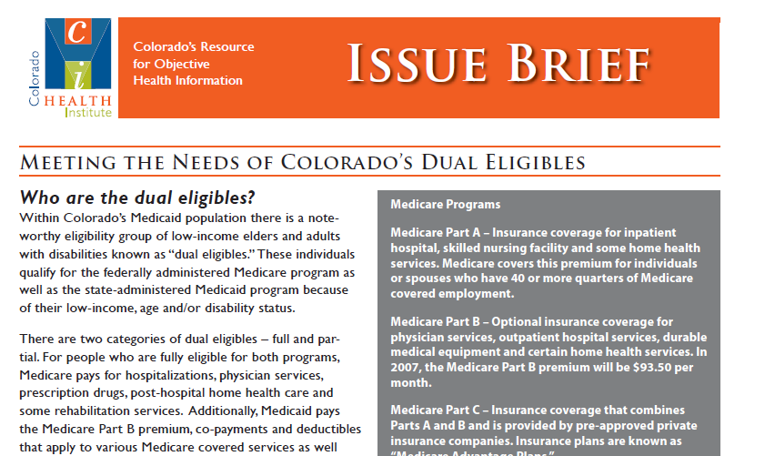
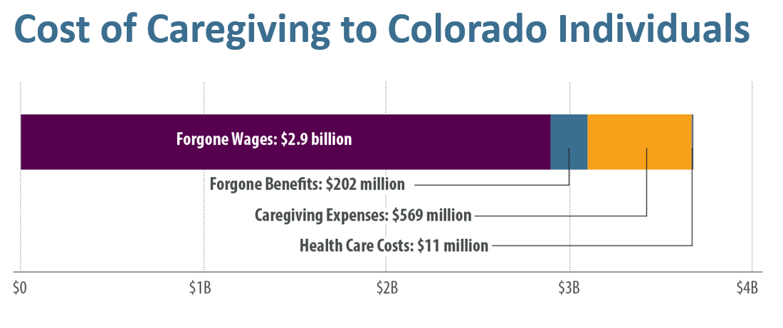



Slide 3
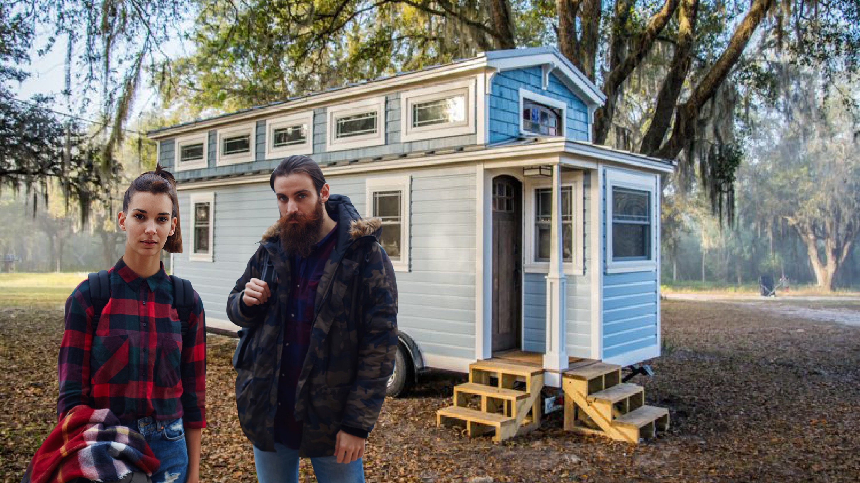
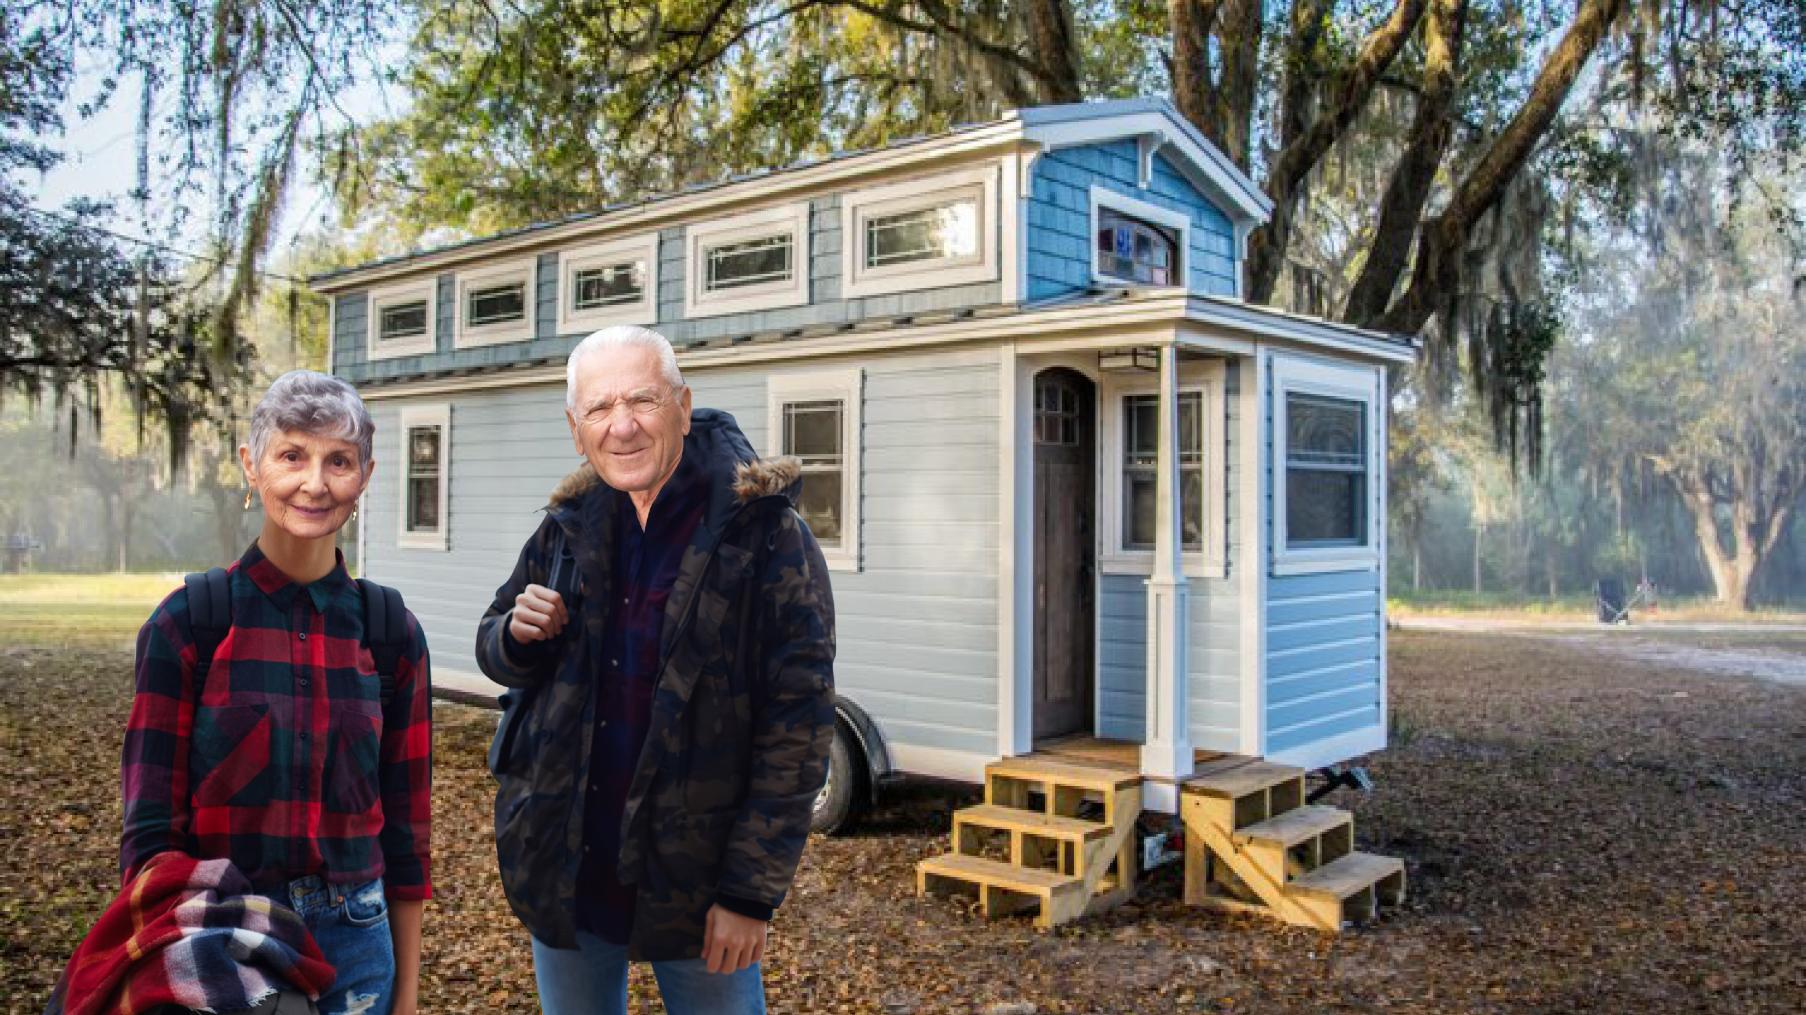
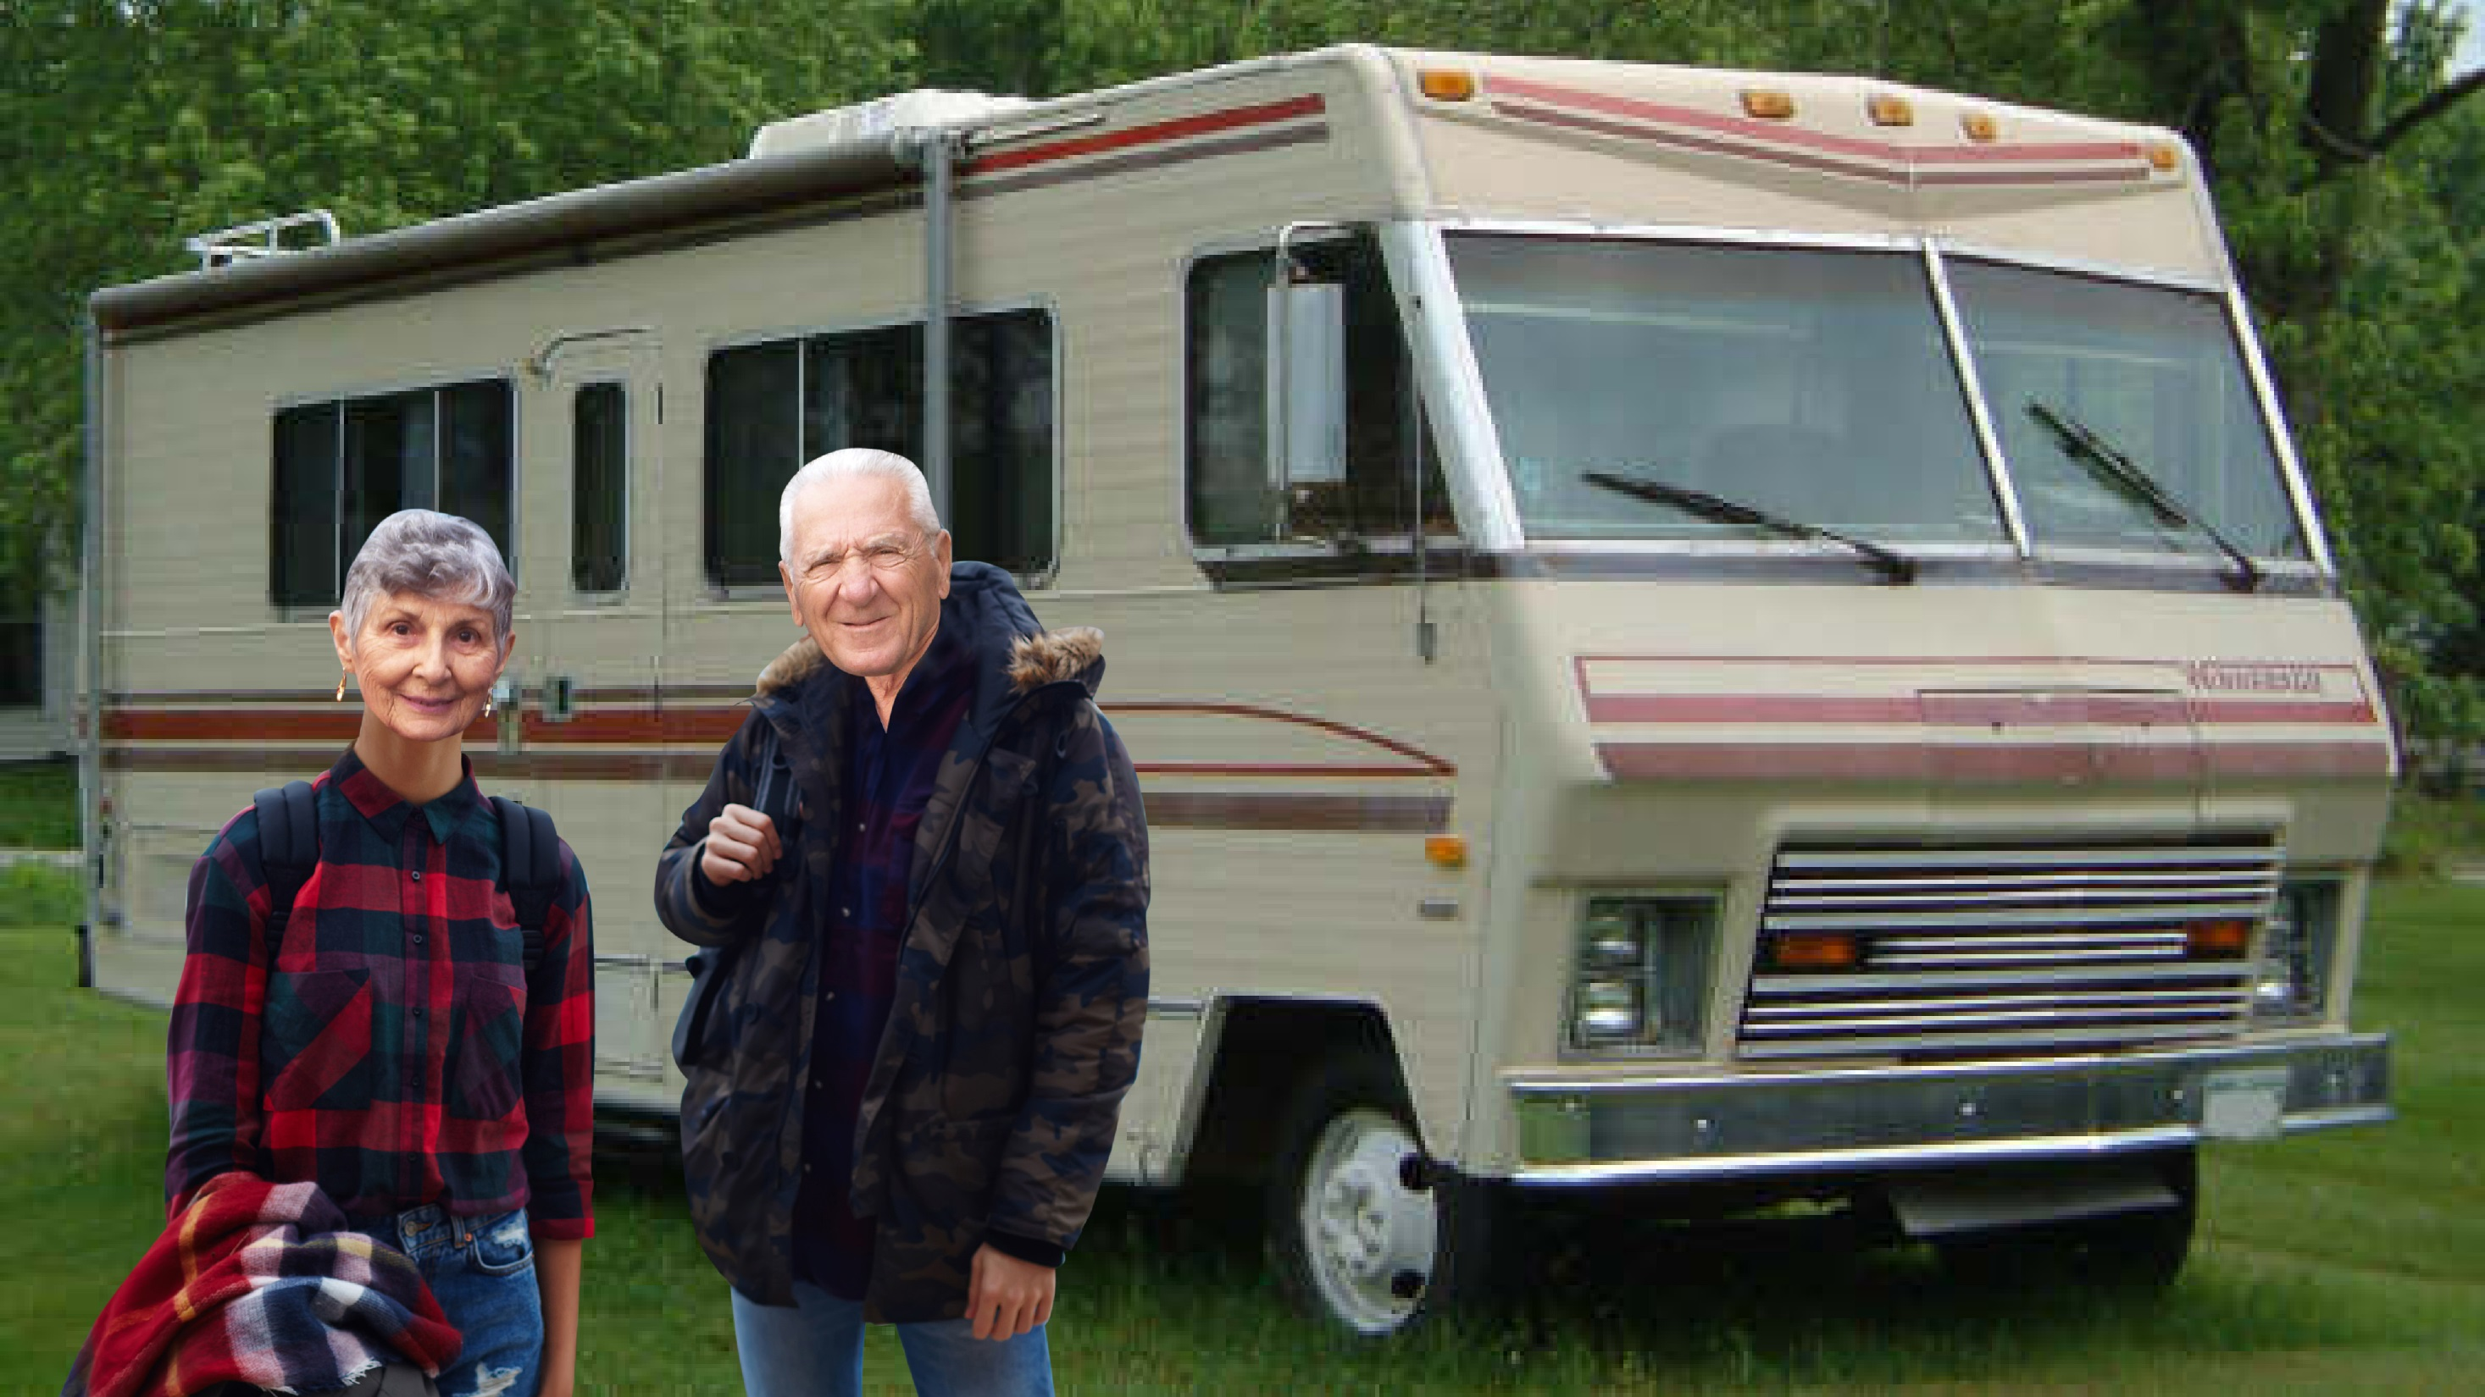

#HIHC18

Slide 4
Three Takeaways
Older adults face both visible and invisible housing challenges.
Communities are innovating, but scalability is tough.
Legislation and policy can support communities and expand innovations.

Slide 5
Colorado’s Older Adult Population is Growing
Source: State Demography Office

Slide 6
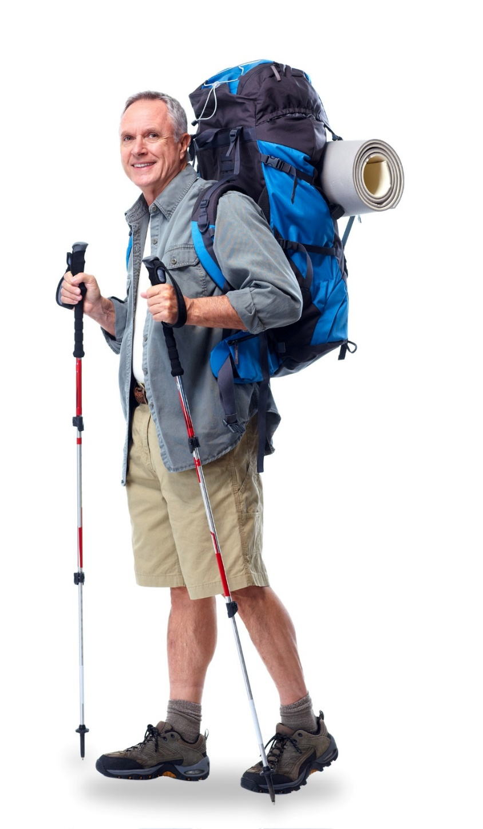
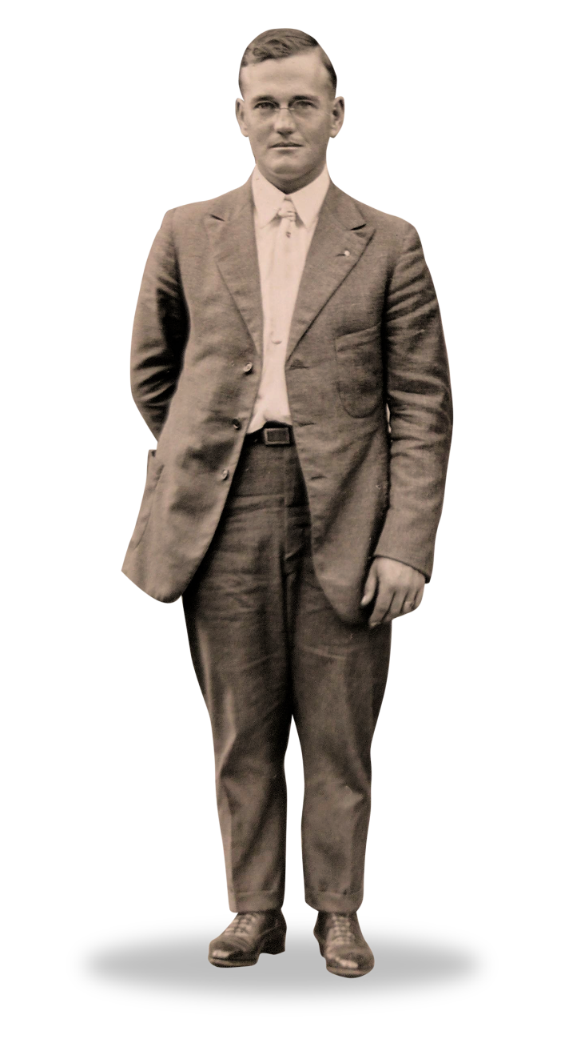
And This Is Good News for Us All
U.S. Life Expectancy
100 Years Ago
U.S. Life Expectancy Today
39
79
Source: UN Population Division

Slide 7

Older Adults Face Both Visible
and Invisible Housing Challenges

Slide 8

The Case for Affordable, Adequate Housing
48,000 more
older adults
are housing cost
burdened in 2017
than in 2010

Slide 9
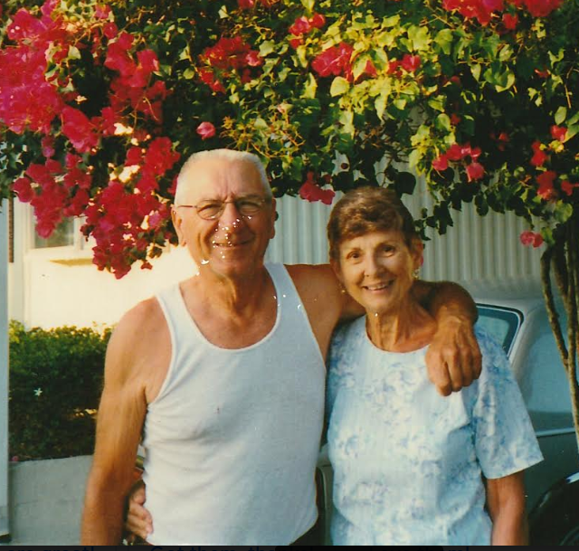
Who are Your People?

Slide 10


Housing Impacts Everyone,
But Is a Special Concern for Older Adults
87 percent
want to age at home
2 in 3
older adults will develop a disability and need care
Source: Georgetown University / AARP

Slide 11
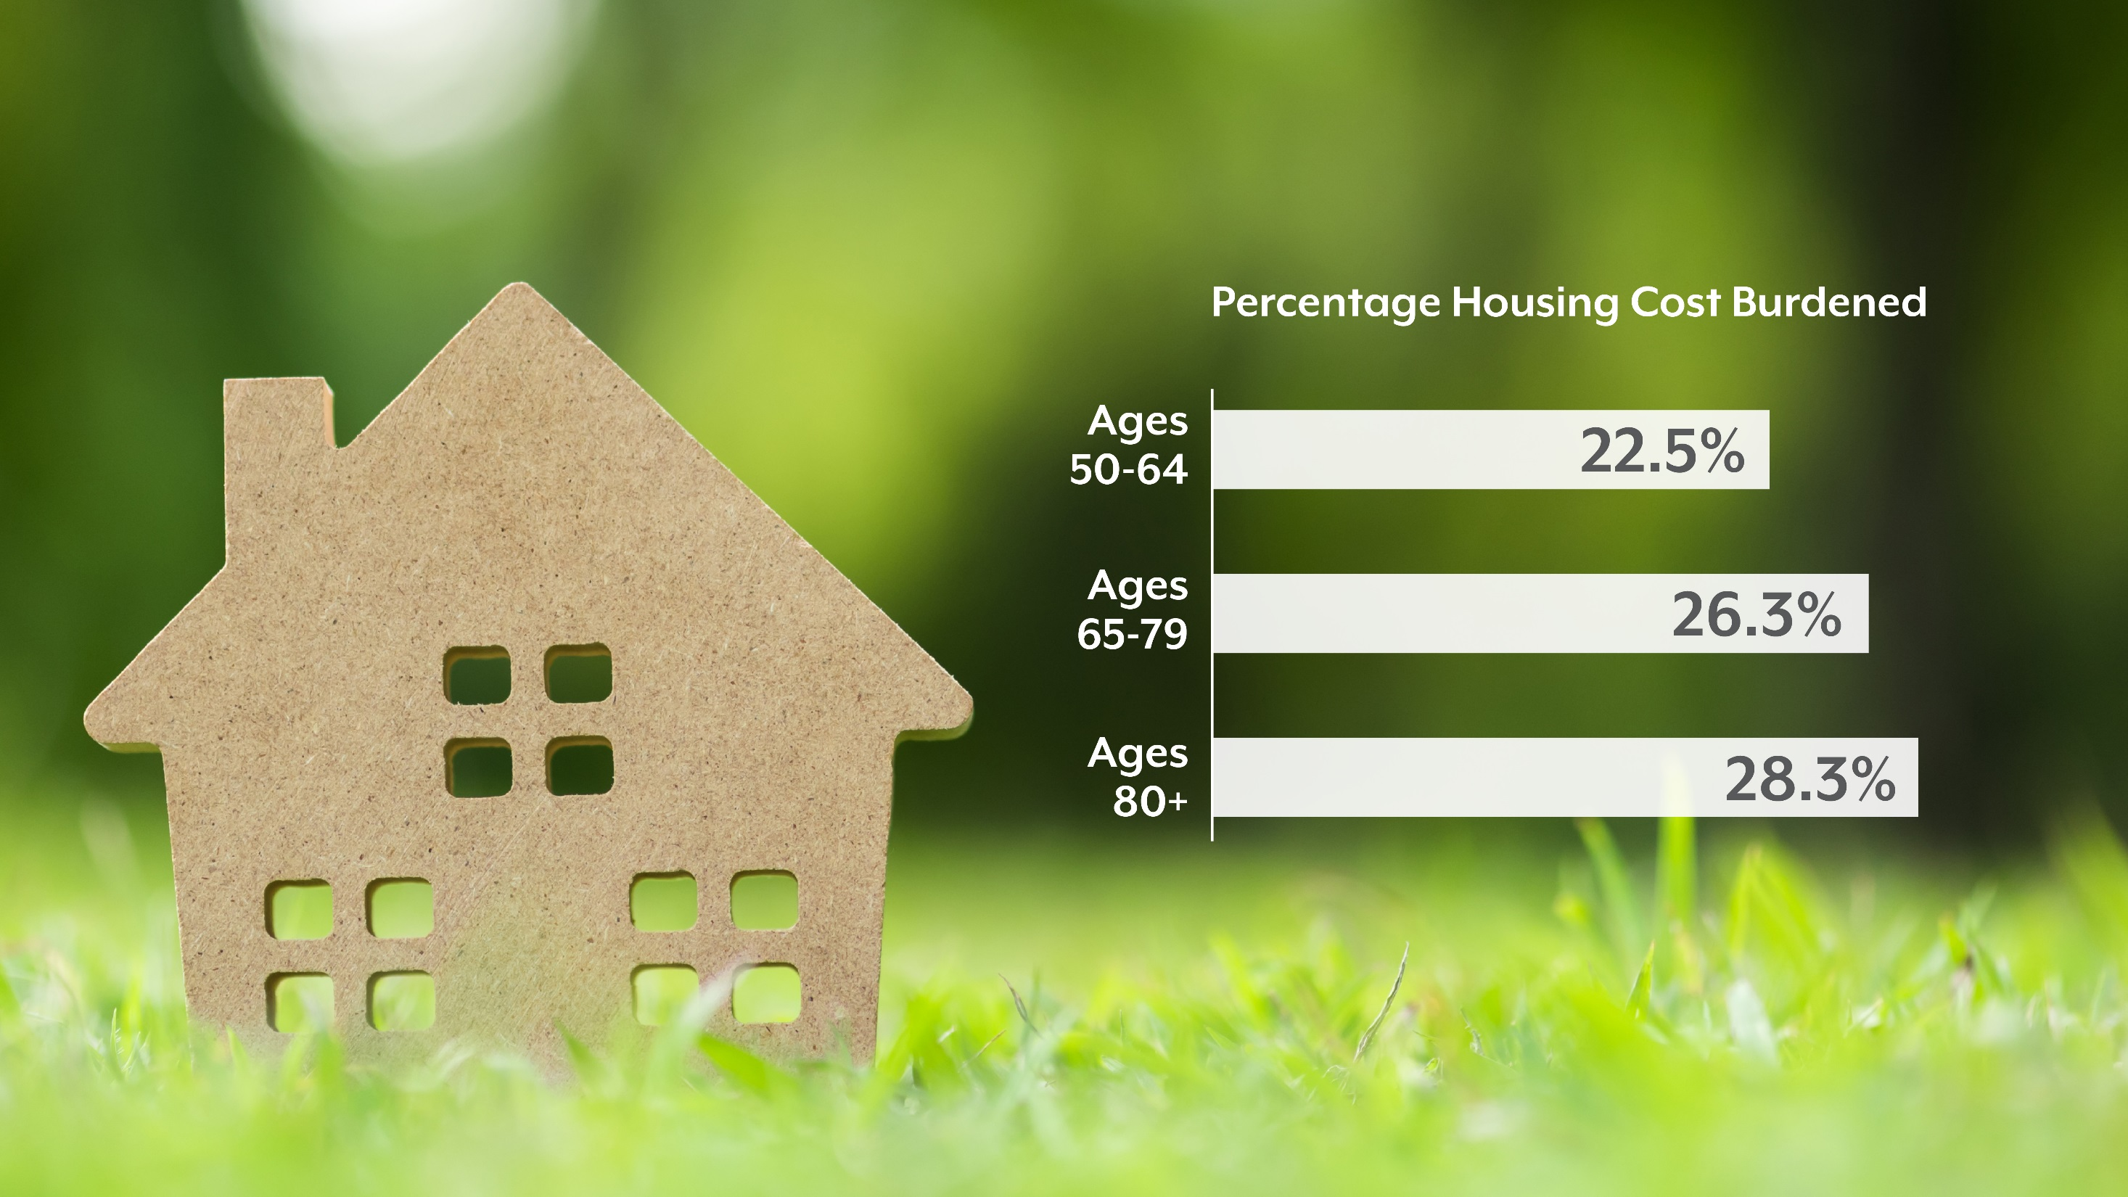
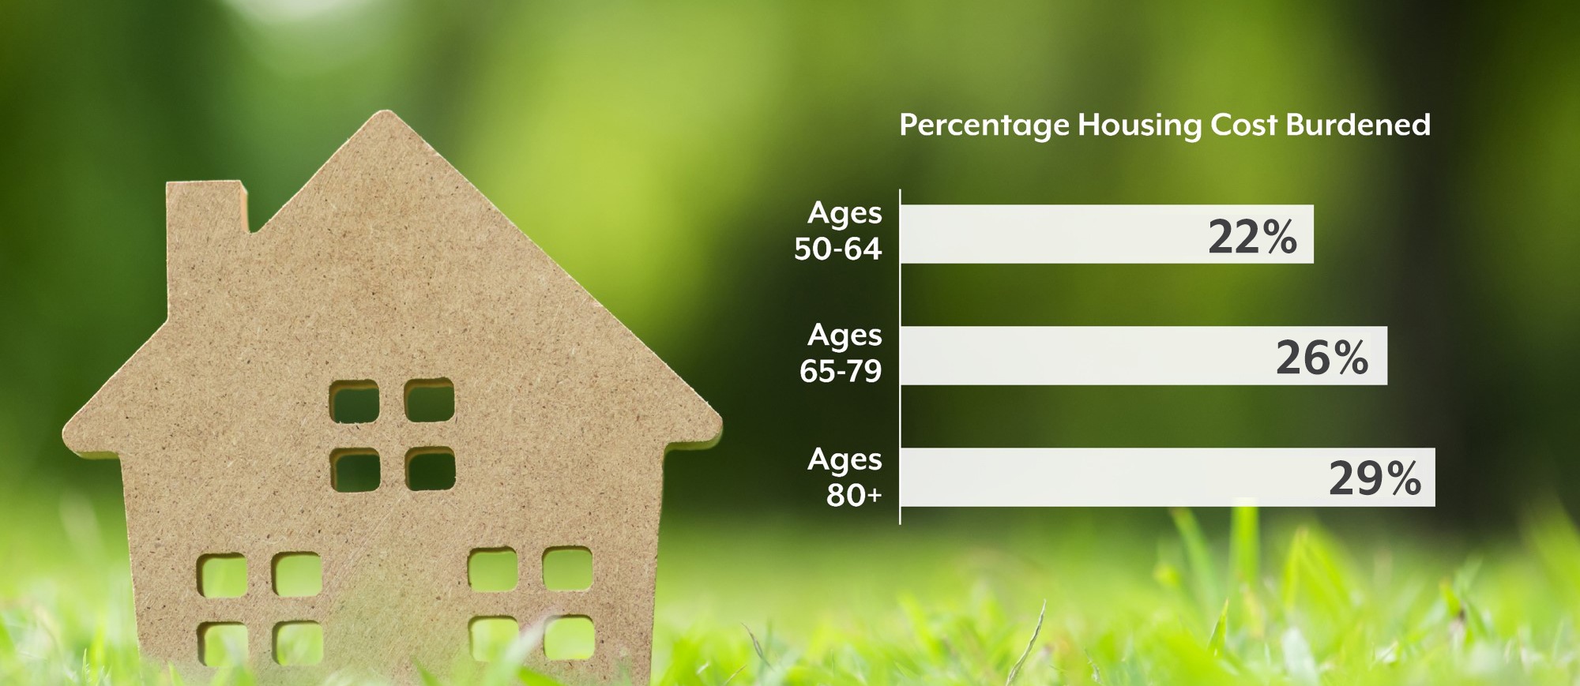
More Than One in Four Older Coloradans are Housing Cost Burdened
Source: American Community Survey, 2017

Slide 12


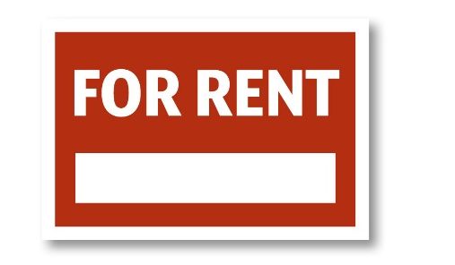
What It Takes: Monthly Housing Costs
Median monthly income = $2,162
Affordable = $649 per month
… $347
in the red
Median monthly rent = $996
Source: American Community Survey

Slide 13
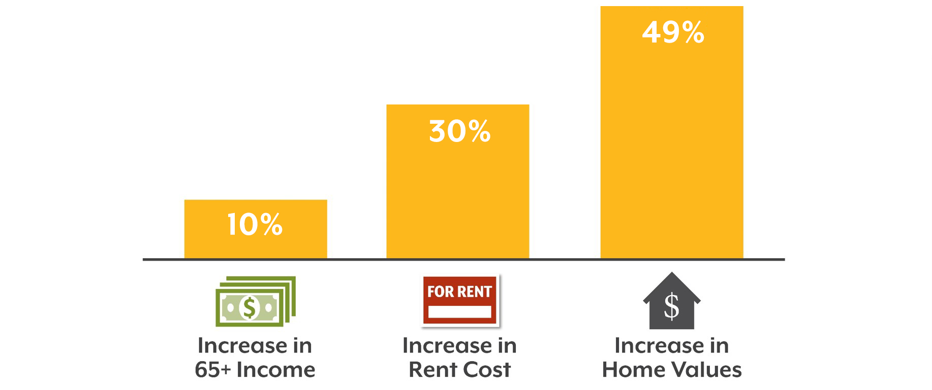
The Affordability Gap for Older Adults is Growing 2010-2017
Source: American Community Survey / Zillow

Slide 14

Half of Older Adult Renters Are Cost Burdened
Source: American Community Survey

Slide 15
As Are One in Five Homeowners
Source: American Community Survey

Slide 16
Housing in Colorado
The Inequitable State of Housing
Source: American Community Survey

Slide 17


Housing Costs Can Crowd Out Health
Healthy Baseline
Low-income cost-burdened older adults spend…
53%
Less on Food
70%
Less on Medical Care
Source: Joint Center for Housing Studies, Harvard University

Slide 18

Housing + Aging
A Workforce As Housing Burdened As Their Patients

Slide 19


Housing in Colorado
Summarizing the Impact
The Visible
The Invisible?
Rent
Utilities
Property taxes
Repairs
Insurance
Displacement and doubling up
Physical and mental health impacts
Food access
The workforce
Transportation
Access to medical appointments and community ties

Slide 20


Slide 21
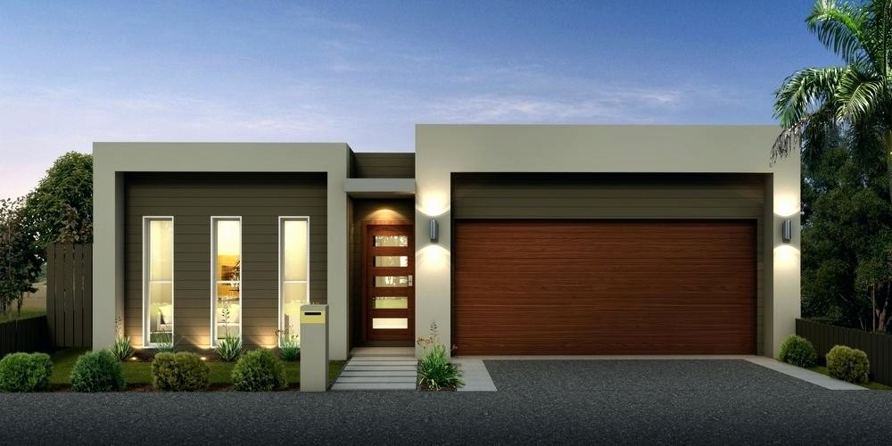

Slide 22
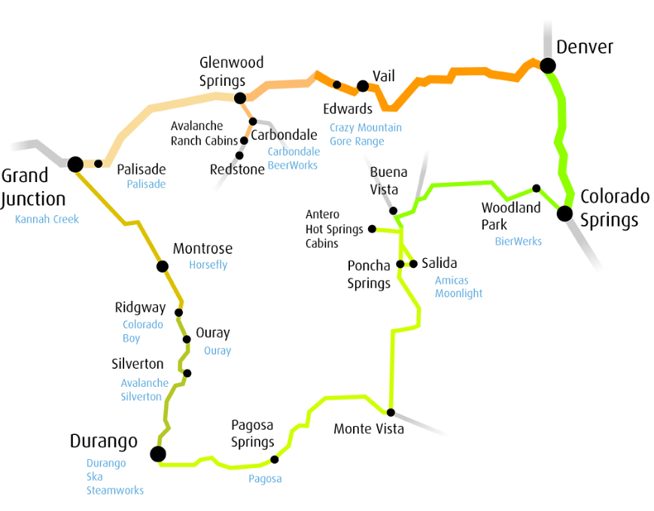


Slide 23
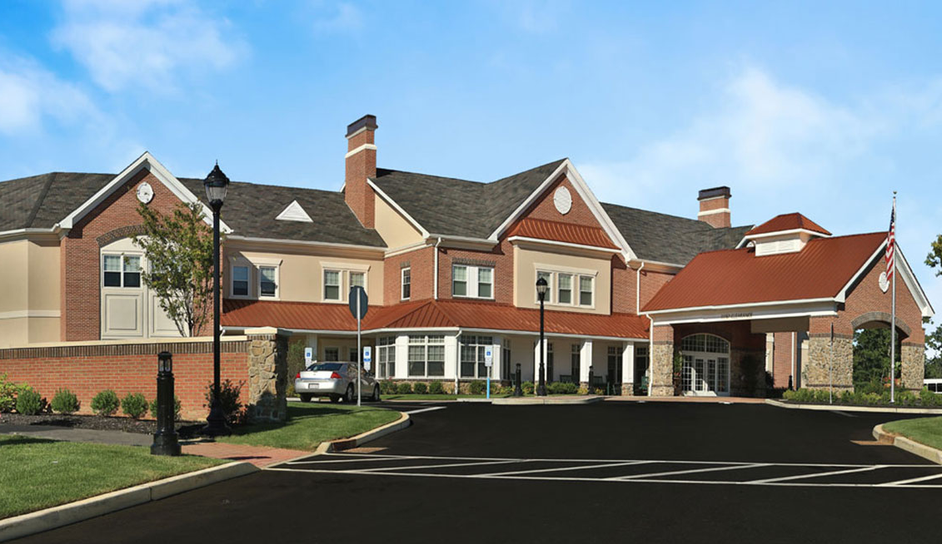
Average Household Income of Older Coloradans is $24,929
Assisted Living Costs 1.9x as Much
Source: American Community Survey / Genworth Cost of Care Study

Slide 24


Slide 25


Slide 26
Communities are Innovating,
but Scalability is Tough

Slide 27





Rolling Up Our Sleeves
Community Innovations
Notes:
And there’s no shortage of examples in Colorado, where we’re seeing some really interesting things happen.
You’ve got AARP’s livable communities initiative --- which isn’t specific to Colorado, but has a large presence here. Livable communities is an initiative where AARP actually engages public officials, stakeholders, and volunteers at local levels to support these folks enacting positive changes for older adults in their communities.
Colorado has a strategic action planning group on aging, called “SAPGA.” Do we have any SAPGA members in the audience? Great, so chat with those folks if you want to learn more, but the 30,000-foot view is that SAPGA was established by the general assembly in 2015 and is tasked with producing a comprehensive strategic action plan for aging, covering areas ranging from workforce to housing to health to economic well-being, etc.
We also have Area Agencies on Aging around the state like DRCOG or Northwest Colorado Alpine Area Agency on Aging. These groups coordinate services for older adults and connect them with available resources.
We have a new initiative, Lifelong Colorado. Lifelong Colorado launched in September with the goal of making Colorado the “age-friendliest” state and making individual communities within our state more age-friendly. To this aim, they’ll be supporting and coordinating with these and other efforts across the state, promoting livable communities and idea-sharing.
And then here at CHI, you have work we’re doing with the NextFifty Initiative. If you don’t know NextFifty, I recommend that you check them out and the projects they fund, but they’re an independent non-profit organization that funds initiatives to improve community services for older Coloradans and their caregivers. We are five months into a two-year grant with them to look at housing (and later, workforce) issues and how these relate to older adults in Colorado. The project involves a lot of analysis and reporting, but the real heart of it is working with communities across the state to hear more about what challenges they face in this arena or what they’ve been doing to address them.

Slide 28
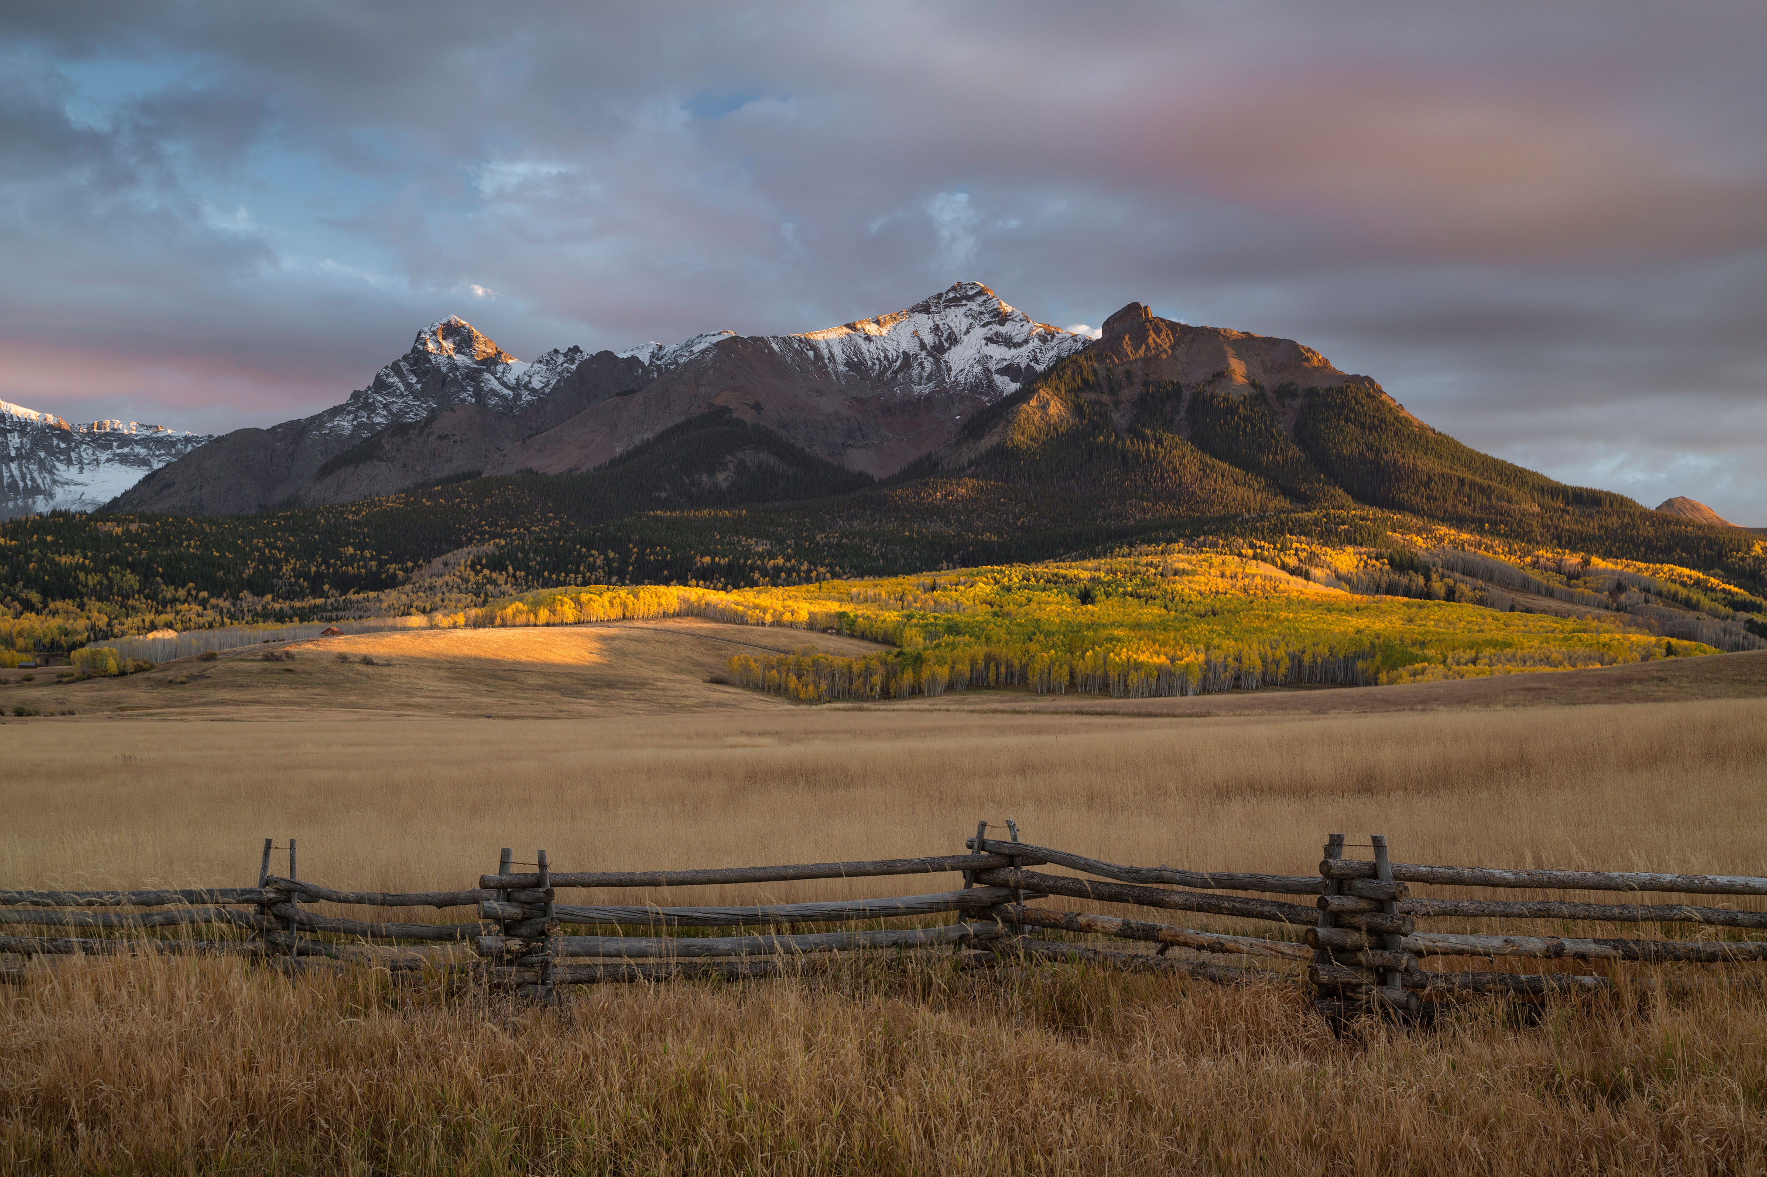
Rolling Up Our Sleeves
Highlights from Around the State
Rolling Up Our Sleeves
Highlights from Around the State
Notes:
And we wanted to spotlight what’s happening in a couple local areas we’re working with as part of this project.
We’ve specifically selected a couple areas where some cool and innovative solutions are afoot, happening now or in recent years.

Slide 29
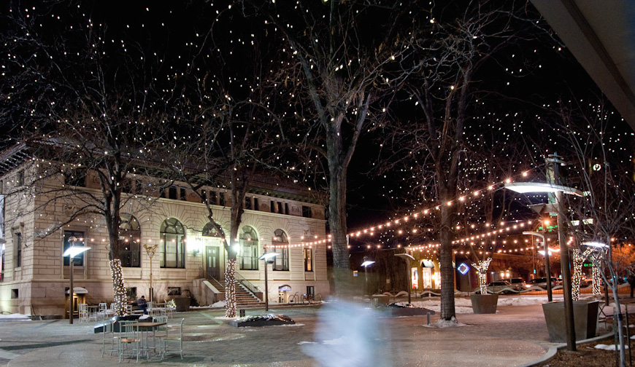
Rolling Up Our Sleeves
Larimer County
Notes:
Starting with Larimer County, where we’re working with their Partnership for Age-Friendly Communities

Slide 30


Rolling Up Our Sleeves
Larimer County
2008
2018
2028
11%
16%
19%
24%
of older adults are housing-burdened
Source: Colorado Demography Office; American Community Survey
Notes:
First, we want to share a bit of info on what Larimer County looks like today.
Do we have anyone from Larimer county in the room?
Do you want to guess what these three numbers are?
Yeah, so this is the percentage of Larimer County’s population that is age 65 or older – today, ten years ago, and ten years from now. In 2008, one in five residents were over 65, and ten years from now one in ten will be. This is all about on par with what we’re seeing in the rest of the state.
And also like many parts of Colorado, Larimer County is facing some challenges when it comes to affordable housing. About one in four older adults here are cost-burdened by housing.

Slide 31

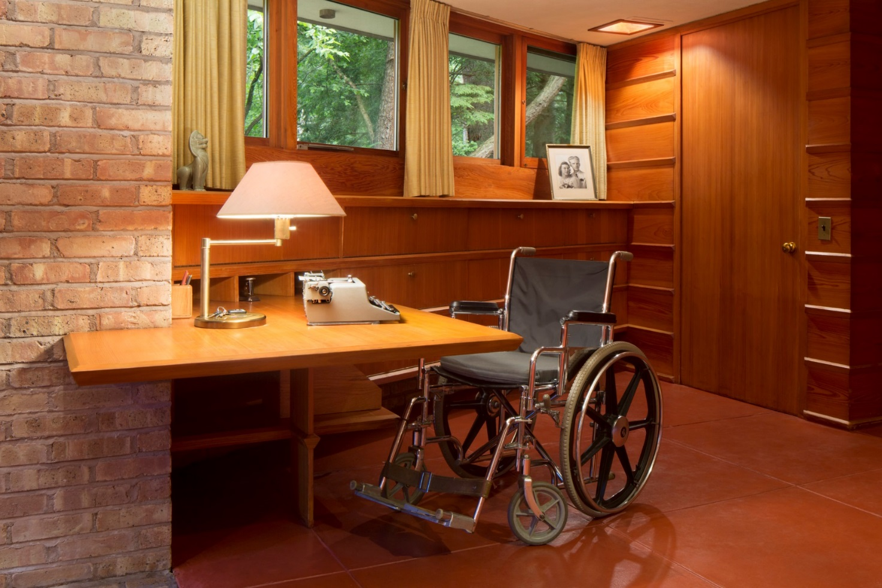
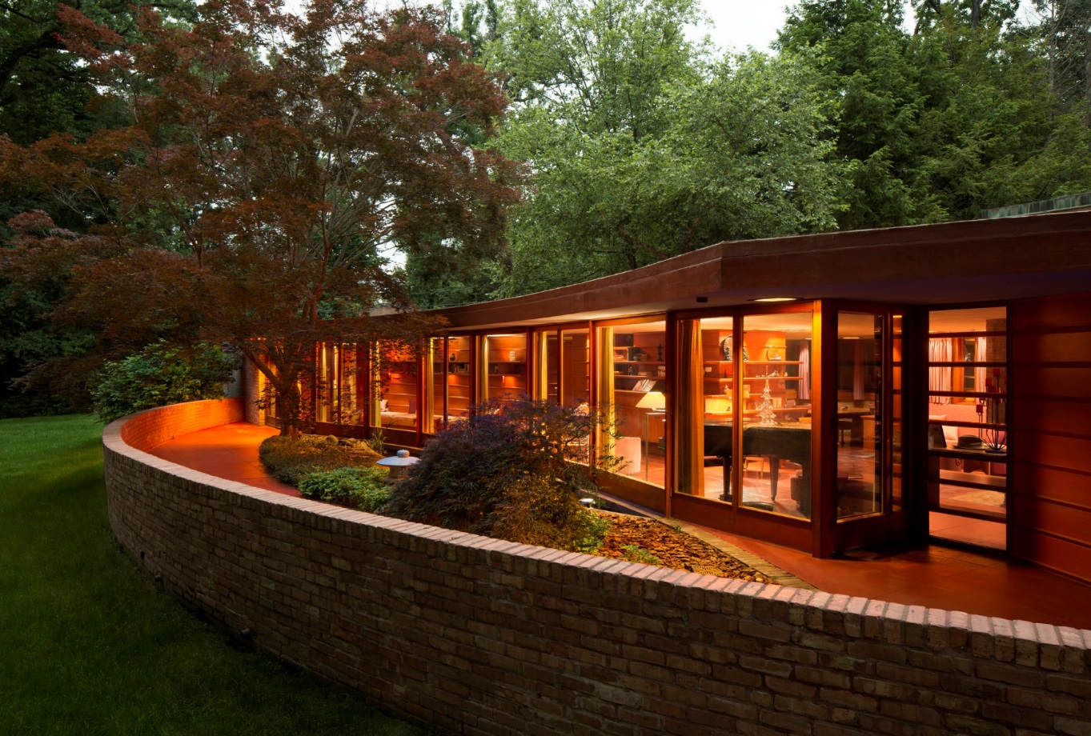
Rolling Up Our Sleeves
Universal Design
Notes:
And one solution Larimer County and the Partnership for Age-Friendly Communities has been looking at a lot is this idea of universal design.
Universal design is a way of designing housing that makes it usable by everyone, regardless of live stage or health status or disability. This can include things like no-step entry, which makes for better accessibility for a parent pushing a stroller or a person with disabilities or really someone of any age that may have trouble getting into a home with a stepped entry. It can include things like light switches or storage at a reachable level.
Since 2016, the Partnership for Age-Friendly Communities has been working with the Institute for Built Environment at CSU to research universal design, among other components of lifelong homes, and are looking at piloting a certification program for homes next year.
The idea is that the certification would change the market by bringing awareness to this issue, educating consumers, and helping the sellers of these types of homes to differentiate their products. These types of certifications like LEED have been successful at really changing markets in the past, so the hope is that a universal design certification would enjoy a similar success.

Slide 32
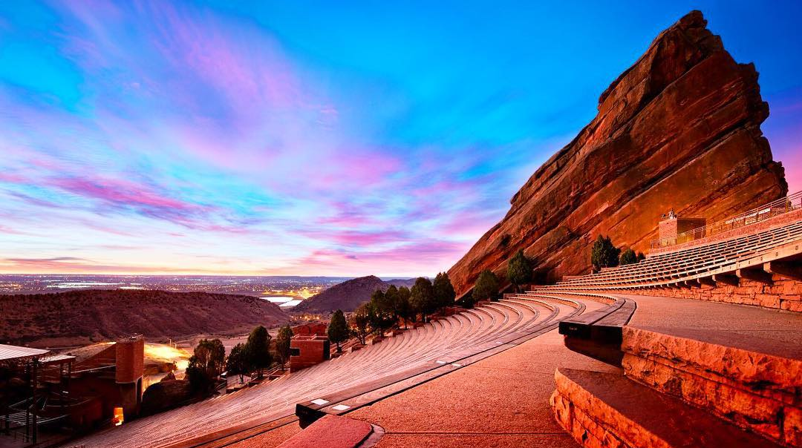
Rolling Up Our Sleeves
Jefferson County
Notes:
Pivoting now from Larimer, let’s take a look at Jefferson County as another example.
Here, we’re partnering with folks from the Aging Well Project here. If you aren’t familiar with Aging Well, they’re a strategic planning group with representation from a huge diversity of industries and professions including civic engagement, food security, and…you guessed it…housing.

Slide 33
Rolling Up Our Sleeves
Jefferson County
2008
2018
2028
12%
17%
23%
28%
of older adults are housing-burdened
Source: Colorado Demography Office; American Community Survey
Notes:
So again, we want to start with a profile of Jefferson County.
As is true with Larimer, about one in ten residents were over age 65 in 2008, and today it’s about 17 percent.
But this a county where the older adult population is actually growing a little more quickly than we see in the state overall, and by 2028 it’s expected that almost one in four residents will be 65 or older.
At the same time, Jefferson County is facing a large housing burden for older adults, with about 28 percent reporting that housing costs take up more than 30 percent of their income.

Slide 34
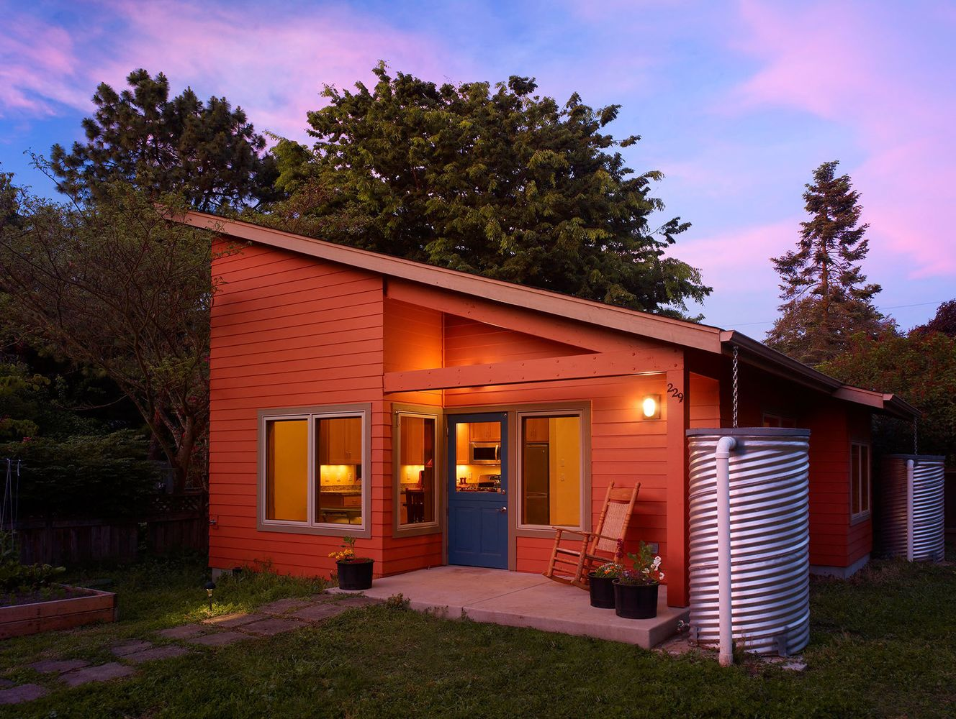
Rolling Up Our Sleeves
Jefferson County
Rolling Up Our Sleeves
Accessory Dwelling Units
What they’ve done about it
  Info to come based on our data gathering / KIIs
Notes:
And one solution they’ve been engaged in for a few years is promoting increased access to accessory dwelling units, or ADUs.
Whether or not you know, you’re probably familiar with ADUs. They’re sometimes called in-law suites or carriage houses. These are smaller homes or suites that exist on a lot with another house.
And ADUs can help older adults in a few ways:
If older adults have property but less income, or are “house rich and cash poor,” having two dwellings on their property and renting out one can be an additional source of income for them.
It can allow older adults to live independently but still in close proximity to family or other caretakers.
And they can just increase the number of affordable rental options for a community
ADUs have always been allowed in Jefferson County, but Aging Well helped make them easier to build and more broadly accessible. They researched best practices in other states and elsewhere in Colorado, and worked with the county zoning office to get these practices in the Jefferson County rules. For example, there used to be a rule that only family members could inhabit the ADU, but they changed that to expand access…so now, you could have someone not related to you living there to help with caretaking, for example. And it also just increases the options.
So these are some great ways communities are finding innovative solutions to these colliding trends of aging and housing in their areas.
But there’s also this question of scalability. If something works really well in Larimer or Jefferson county, should it be adopted by Hinsdale or Saguache? Is it scalable, and what barriers remain in place? A lot of what we’re doing with NextFifty is trying to help with this cross-pollination of ideas, but just knowing what other parts of the state have done isn’t always enough. There are some barriers that need a different tact.

Slide 35
Legislation and Policy Can Support Communities and Expand Innovations
Notes:
So this is where we want to turn our attention to the roles of legislation and policy. Both what’s happening and what maybe isn’t.

Slide 36
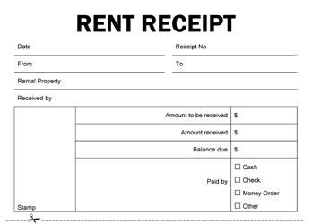

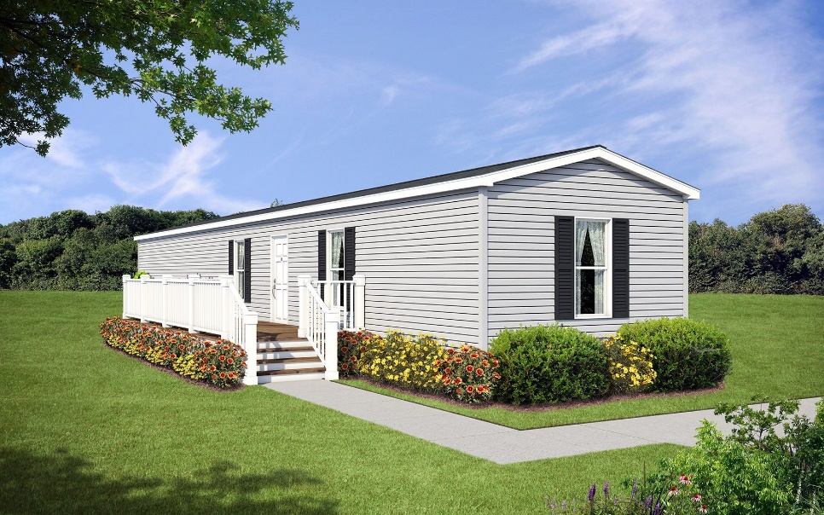
Pushing for Policy
Legislation is Lagging in Colorado
SB18-010
More rental protections
HB18-1315
Fewer rental protections
43rd
Source: RentCafe
Notes:
So quick quiz. Of the 50 states and DC, where do you think Colorado ranks in terms of rental protections?
In fact, Colorado’s not doing a lot. We rank 43rd. We don’t have any statutes around things like requiring notice from a landlord before entering your home. Landlords are allowed to wait up to 60 days to return a security deposit when there aren’t any deductions, versus two weeks in a lot of other states.
There are lots of theories as to why this is. It could be our libertarian bent as a state. But also, we’ve traditionally just not been as hyper-focused on renting as other states have. In Colorado, about a third of us rent. Then you look at places California or DC or New York, it’s closer to half. Areas of high wealth concentration there, like New York City, it’s more in the 80 percent range. But still, a third of people rent, and it can be a really great option for adjusting your home status.
And there does seem to be some response to this. 2018 was a big housing bill year. Sixteen bills were introduced, but only two passed, both with bipartisan support.
Two that did pass were Senate bill 10 and House bill 1315.
SB18-010 passed and required landlords to provide tenants with a copy of their rental agreement and a receipt when they pay their monthly rent in cash. That way, they can’t make a claim that they didn’t pay if they try to evict them. That seems basic, but the same bill failed the year before.
HB18-1315 exempts manufactured homes (mobile homes) from state sales and use tax. There’s an increasing view that these homes are a solution to the affordability crisis because they’re smaller and cost less, so there should be attempts to keep them accessible rather than encouraging their conversion to more profitable development
SOURCES:
https://www.rentcafe.com/blog/renting/states-best-worst-laws-renters/
-best: Vermont
-worst: Arkansas

Slide 37


Pushing for Policy
Bills Making a Comeback
HB18-1432
HB18-1397
Notes:
And then there are some bills that didn’t pass last year, but we expect to see returning in the new legislative session.
You can expect to see some bills that failed last year returning this year.
Among them are HB 1432, which would prohibit landlords from discriminating based on a renter’s source of income, including the use of housing vouchers, which are federal funds administered locally to help low-income folks afford housing. There’s been some discrimination based on use of these vouchers in the past, and this law would prohibit that. A similar rule has already been passed by the city of Denver, and this would extend the protection state-wide.
And house bill 1397, which would increase protections for renters whose homes become inhabitable. It adds things to the definition of “uninhabitable” such as mold, and makes it easier for tenets to do things like give official notice of these problems.

Slide 38


Pushing for Policy
New Legislation
Senior Homestead Property Tax Exemption
Evictions
Notes:
And then we expect to see some brand-new arrivals. The recent election means a new governor, and a lot of new legislators…so probably some new bills.
One thing we’ve heard talked about a lot lately are possible changes to something called the homestead property tax exemption. If you’re not familiar with the property tax exemption, it basically means that if I’m an older adult who owns my home and I’ve lived there for at least ten years, half of my property taxes for the first $200,000 in my home value are forgiven.
The green bars here represent the cost to the state of this tax exemption over seven years. As we have more older adults and as home values rise, the cost of this program is growing too. There’s concern over these rising costs and a lot of folks, including governor-elect Polis, have proposed making some changes to how this is set up.
One change frequently talked about is making this program means-tested, which means it would vary based on how much money you have. Right now, Bill Gates and my aunt Kay get the same exemption. Means-testing would adjust for the fact that my aunt’s overall income is just shy of Bill Gates’s.
There also seems to be a lot of concern over renters’ rights and evictions in the state. Our senator Michael Bennet has talked about a national bill that would track evictions in a database to help us better understand and prevent them. I wouldn’t be surprised if we saw some legislation around increase protections to renters like giving them more leverage in due process before an eviction or just an expansion of resources for these tenets.
So these are the things I think we might expect under the gold dome this session.

Slide 39





Pushing for Policy
Legislation Isn’t the Only Option
Notes:
But it’s also important to remember that not everything that happens in Colorado happens on capitol hill. There are other ways for policy to change.
For example, there are administrative policies or regulations that can address our changing population and housing challenges.
Here in Colorado, we already have a Medicaid waiver that helps support home repairs for older adults.
Alex Azar, HHS secretary, has said he’s open to Medicaid and Medicare being used to support housing for members.
Or we could see a new housing regulation, like prioritizing vouchers for older adults. This is done in several parts of the state – like in Denver, one-third of waivers are set aside for older adults and people with disabilities.
We have a lot of policy passed by ballot initiatives in our state. The way our property tax is set up today was decided by ballot, and a change could be too.
There are non-profits like Sunshine Home Share Colorado, which helps older adults age in place by matching them with potential renters. These renters may agree to provide some service, say, meal preparation a few times a week, in exchange for a discount on rent
And creative for-profit groups like Silvernest, which matches older adults with roommates, sort of Golden Girls-style. This can keep people connected and also make living in your community more affordable for folks.
And some really cool opportunities for public-private partnerships. A perhaps not super well-known feature of the 2017 tax bill was the creation of these things called “opportunity zone” funds, which provide tax incentive for investors to invest in lower-income areas. Real estate investments for more affordable or accessible housing is one way these could be utilized.

Slide 40
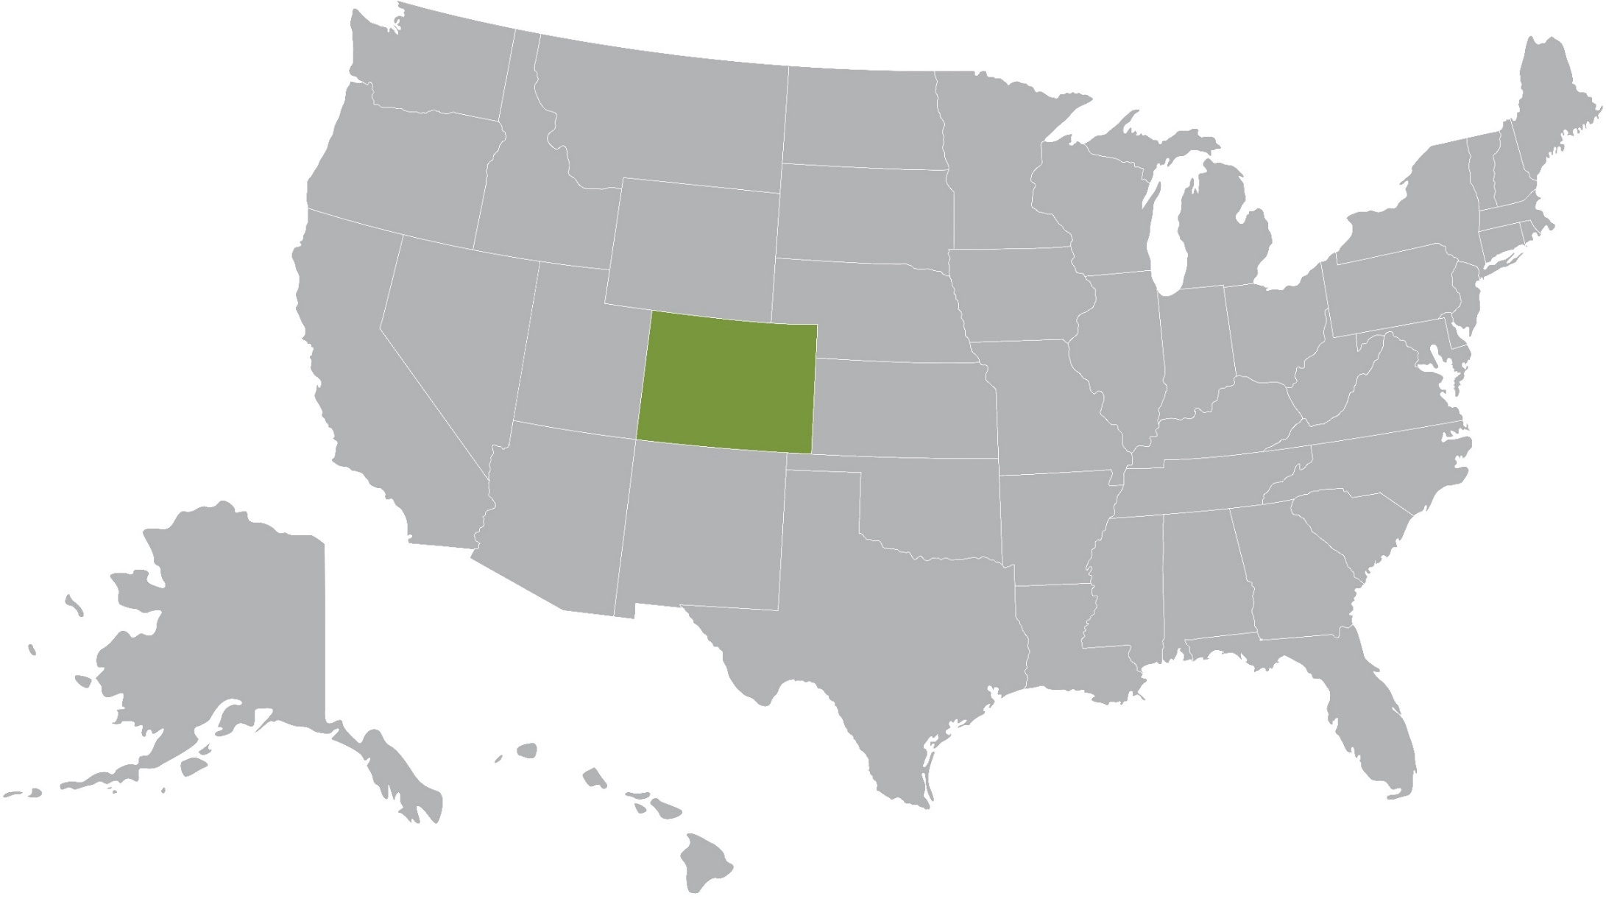
Pushing for Policy
Lessons From Other States
Notes:
And let’s not forget that we aren’t the only state working our way through these two trends. It’s also helpful to look at what other states have done to ease the pressure on housing + aging that could work in Colorado.
Star 1:
In Sarasota, Florida, there’s been a lot of support in the form of training planners and neighborhood leaders around creating “livable community tenets,” which are basically a dedication to make public surroundings that are safe, secure, and supportive. The idea is to help people age in place and promote engagement in community life.
Star 2:
Cleveland is launching a home repair coordination effort, where the city’s department of aging would hook homeowners up with coordinators to help them ID home repairs they need to be able to safely age in place.
Star 3:
In Montgomery County, MD, we are seeing an old friend, accessory dwelling units, pop up. They’re promoting these with a swifter adu approval process
Star 4:
A local aging group in Oregon is developing a lifelong housing certification program that will certify certain homes based on a number of age-friendly features and universal design standards so people can more easily find homes that will enable this.
Star 5:
Then Tennessee, the Medicaid department is using payment reform. They’re getting capitated payments for Medicaid enrollees at a nursing facility level of care—paid regardless of whether they continue to stay in nursing facilities or move to community-based settings. This is to encourage home-based settings of care and innovative ways to think about providing that.
SOURCES:
Sarasota: https://www.aarp.org/content/dam/aarp/livable-communities/documents-2017/Age-Friendly-Sarasota-Action-Plan-2017-2020.pdf
Cleveland: https://www.aarp.org/content/dam/aarp/livable-communities/documents-2017/AgeFriendlyClevelandActionPlan-2017-2019.pdf
Maryland: https://www.montgomerycountymd.gov/HHS-Program/Resources/Files/A&D%20Docs/CEAccomplishmentsSeniors.pdf
Oregon: https://www.aarp.org/livable-communities/housing/info-2015/how-to-encourage-more-lifelong-housing.html

Slide 41
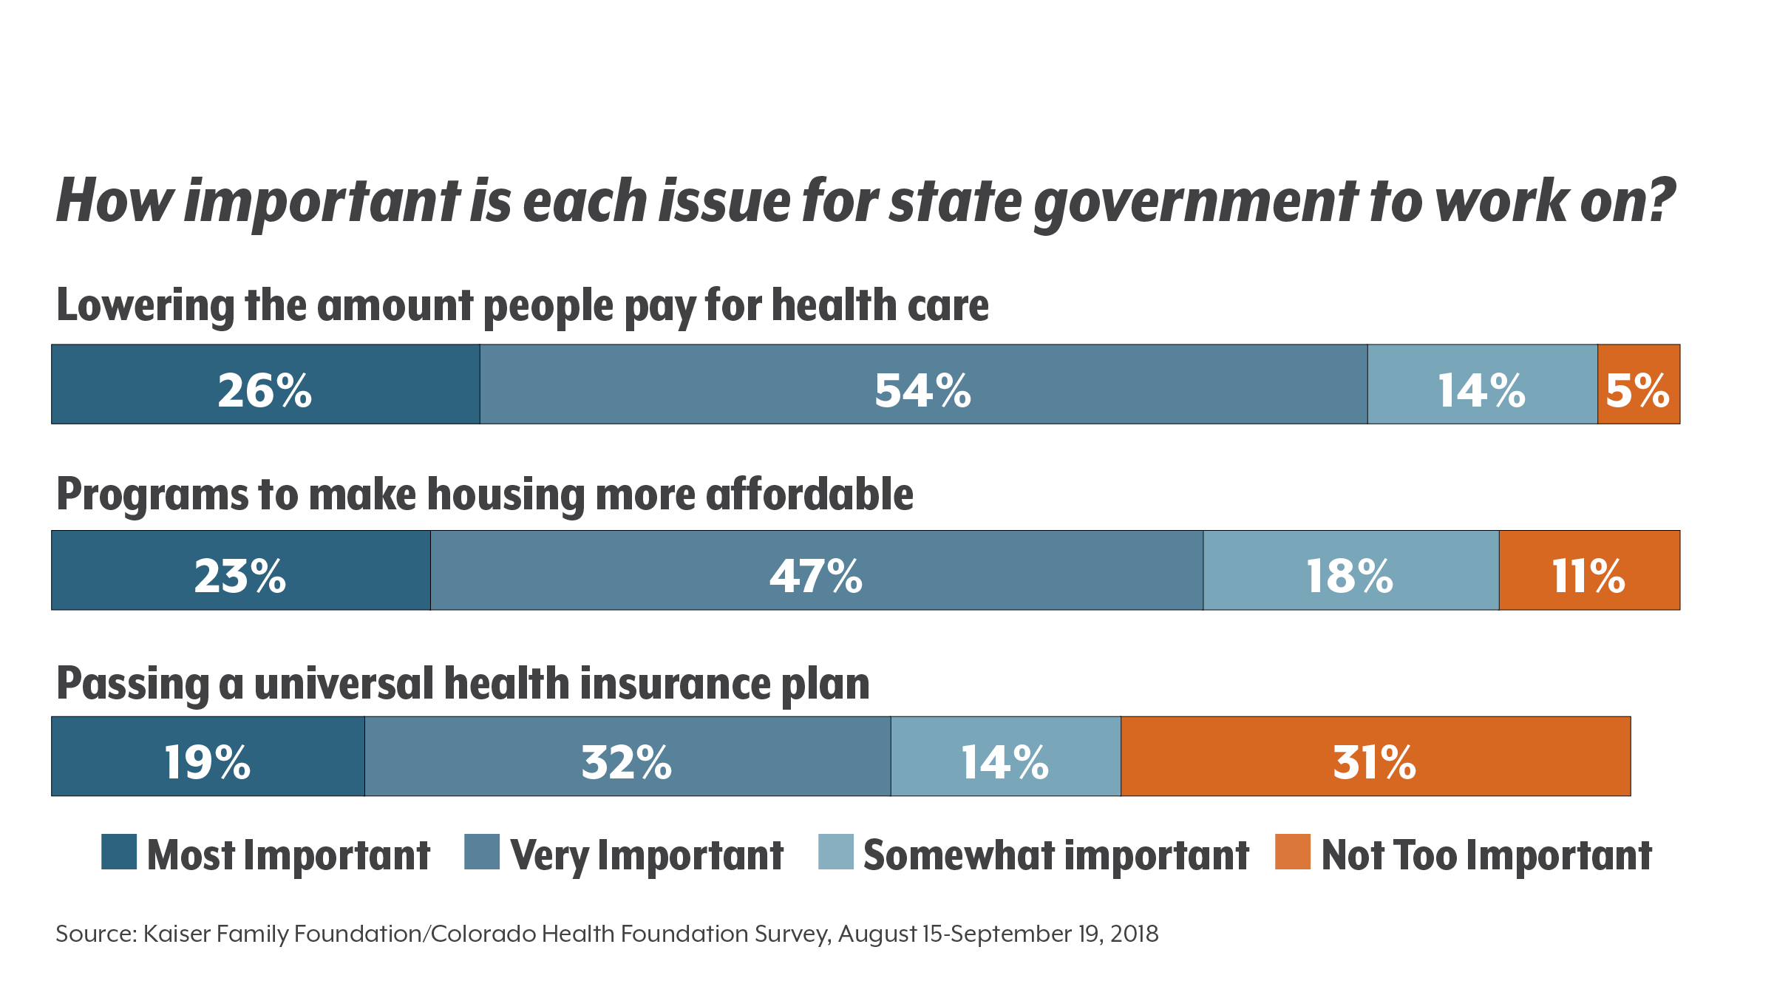
Source: Kaiser Family Foundation / Colorado Health Foundation Survey, August 15-September 19, 2018
Notes:
And it seems Colorado might be primed to address some of these ideas. Those who saw Edmond Toy and Joe Hanel’s presentation this morning may recognize this slide.
What it shows on that second bar, if you add up the blue lines, is that 89 percent of voters in Colorado say that affordable housing is at least somewhat important in terms of what they want the state government to work on.
This puts it as the #2 concern for voters, behind only making health care more affordable. So this poll shows a stronger case for the state government to tackle both health and housing.
Colorado, though, has typically been very hands-off when it comes to housing. So a big question we face in this new session is, is it time for this to end? Do we need to start looking for new solutions, not just for older adults, but for people of all ages?

Slide 42

Notes:
So how will we answer that? Well, we don’t know. There’s a huge diversity of potential solutions, coming from communities and policy.
One paradigm the federal government often uses is this movement from pilots in small communities, to demonstration projects in a larger context, and then finally scaling an idea by making it an actual policy.
I think you could say with a lot of our ideas, we’re in the pilot stage now. Pilots are really key, but we’re hoping that our work with Next Fifty will help move some of these ideas into a demonstration space. And a few steps down, I think we’re seeing that movement from some more local policies like Denver’s voucher discrimination policy going statewide.
And so how this will all pan out, we don’t know, but we know we’re moving in a good direction. “Stay tuned” is such an unsatisfying way to end a presentation, but it’s really all we can say now – stay tuned, and I know we at CHI will be.

Slide 43
Three Takeaways
Older adults face both visible and less visible housing challenges.
Communities are innovating, but scalability is tough.
Legislation and policy can support communities and expand innovations.
Notes:
So we don’t know what the future holds, but here are again three things we do know and we again want to make sure everyone takes way today.
The first is that older adults face both visible and less visible housing challenges. This is true of Coloradans of all ages, but there are some special considerations when it comes to thinking about housing as we age.
The second is that we’re seeing a lot of really interesting things happening in communities across the state.
And finally, there’s also this really key role for legislation and policy.
And we want to start now to plan smart for these colliding aging and housing trends.

Slide 44


A Note of Thanks
Notes:
And so on that note, we want to close with a note of thanks to NextFifty, who again is funding the work that we are doing at CHI along with the five great local communities across that state that are committed to making a difference in housing options for older adults. It’s because of their investment that we are here today.

Slide 45

TK
TK
TK@colordaohealthinstitute.org
TK@coloradohealthinstitute.org
TK
TK
Notes:
So we have X minutes left for questions, but also for comments – we’d love to hear any thoughts you all have to share on the things we talked about today and ways of addressing this issue that you think might be helpful. So thanks again, and who has our first question?

