Slide 1


Fragmented Systems of Care
#HIHC22
Can We Ever Escape?
Ashlie Brown and Nicole Weber
Colorado Health Institute

Slide 2
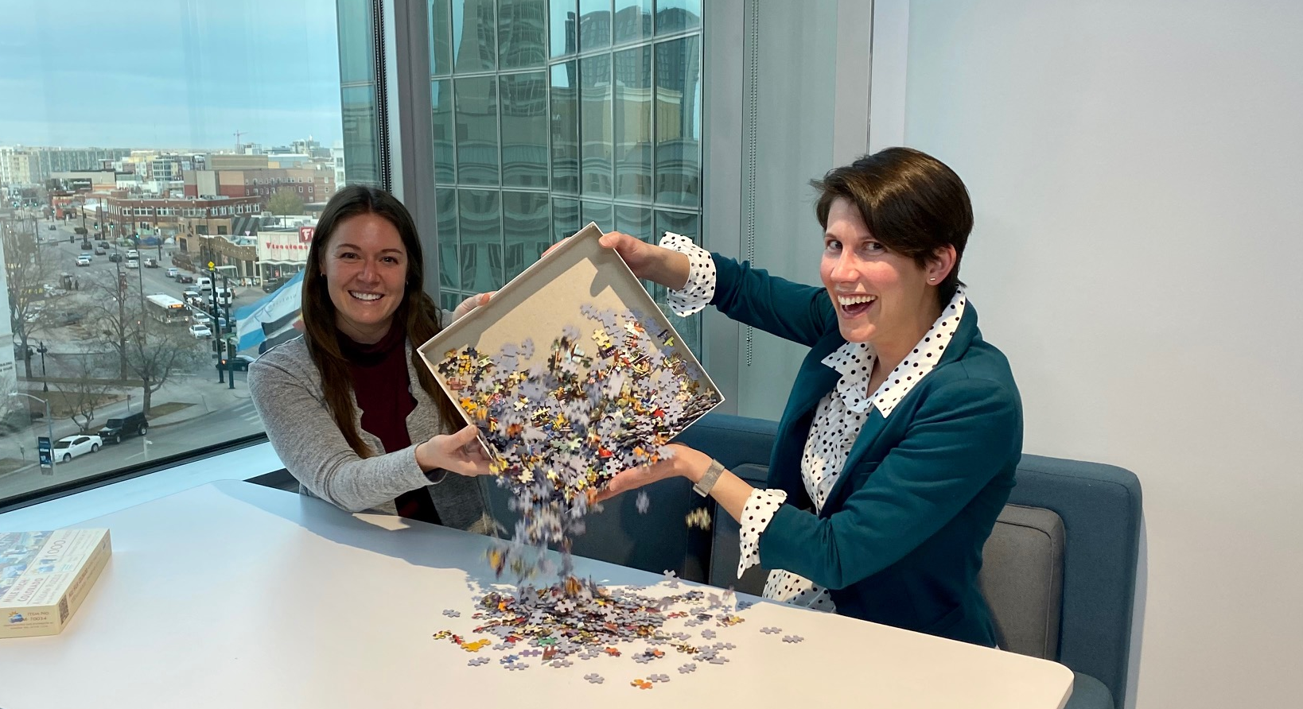

Ashlie Brown
Nicole Weber

Slide 3







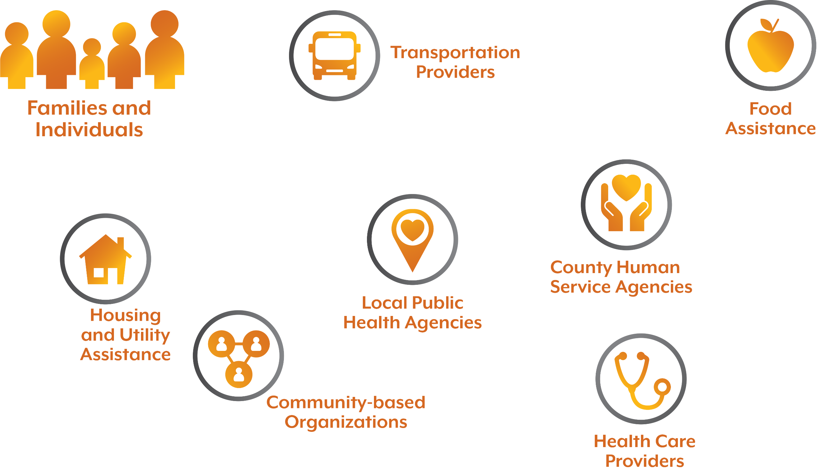

Slide 4
Imagine a world…

Slide 5
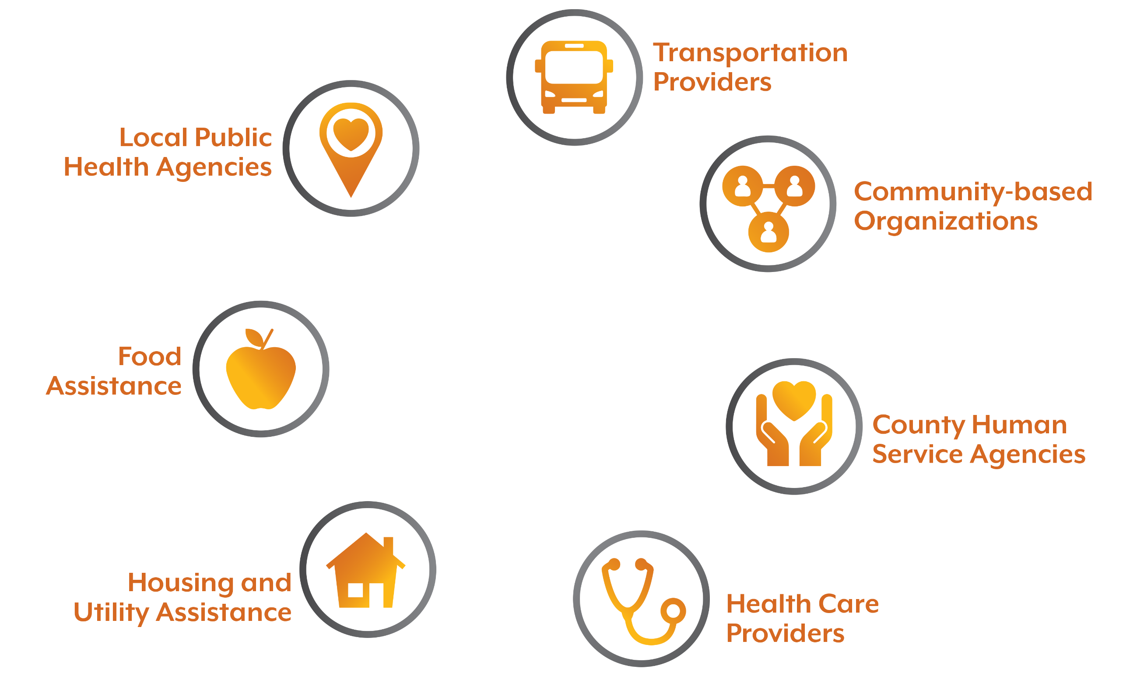
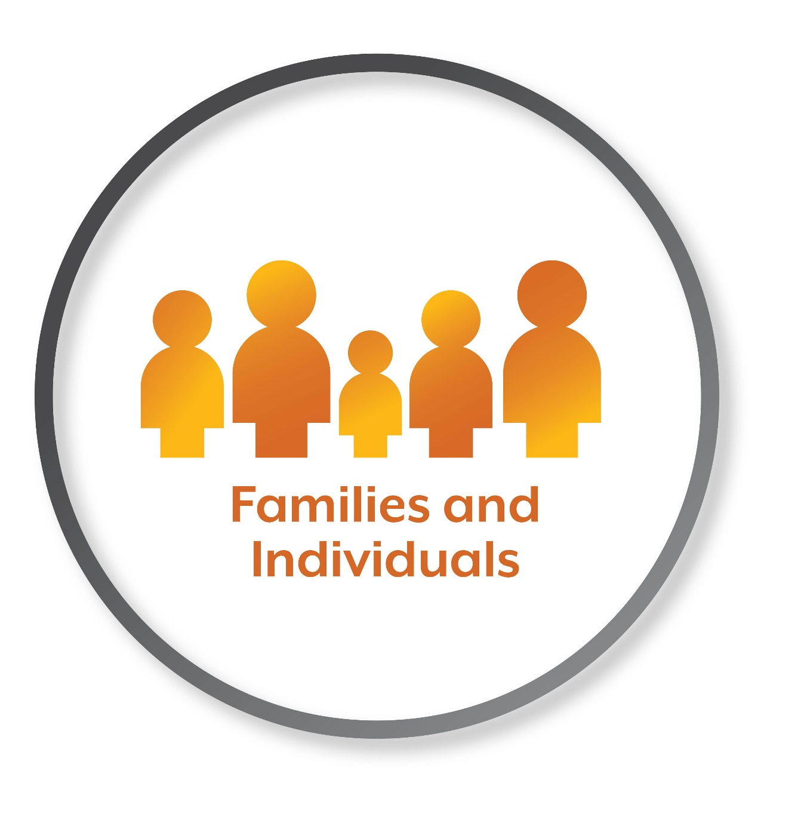


Slide 6

Problems Come and Go
Problem-Solving is Forever

Slide 7




How to Solve Problems
Implement
Decisions
Build Relationships
Achieve
Consensus

Slide 8



Slide 9


About the Metro Denver Partnership for Health
Vision
Improved health in metro Denver through regional collaboration
Mission
We build partnerships between our agencies and across sectors to increase capacity for achieving our vision

Slide 10


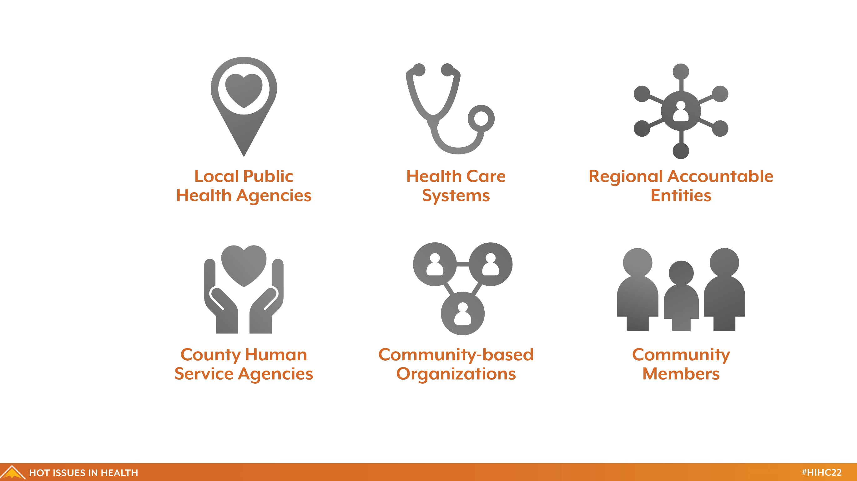
Metro Denver Partnership for Health
Step 1: Build Relationships

Slide 11


A Precious Child
Adams County Health Department
Adelante Community Development
African Chamber
African Youth Advocates
Amigos de Mexico
Arapahoe County Public Health
Aurora Community Connection
Aurora Health Alliance
Aurora Mental Health Center
Benefits in Action
Blazing Cloud Consulting, LLC
Boulder County Department of Housing and Human Services
Boulder County Public Health
Broomfield County Public Health and Environment
Broomfield FISH Food Bank and Family Resource Center
Caring and Sharing Community Resources and Transformation Center
Center for African American Health
Centura Health
Chamba LLC
Cherishing Life Youth Transformation Services
Children’s Hospital Colorado
City of Aurora Office of Immigrant and Refugees
Colectiva
Colorado Access
Colorado Association of Local Public Health Officials
Colorado Black Health Collaborative
Colorado Changemakers Collective
Colorado Coalition for the Homeless
Colorado Community Health Alliance
Colorado Community Managed Care Network
Colorado Department of Public Health & Environment
Community Members
Contexture/CORHIO
Council of Churches
CREA Results
Denver Department of Public Health and Environment
Denver Health and Hospital Authority
Denver Human Services
Denver Regional Council of Governments (DRCOG)
Douglas County Co-Responder Program
Douglas County Health Department
Edgewater Collective
El Centro Amistad
El Comite
El Grupo Vida
Equal Language
Family Resource Center Association
Family Voices Colorado
First Hmong Baptist Church
HealthONE
Healthy Jeffco Alliance
Inner City Health Center
iNOW
Intercambio
Interfaith Alliance of Colorado
Intermountain Healthcare (previously SCL Health)
Jefferson Center
Jefferson County Public Health
Kaiser Permanente Colorado
Latina Safehouse
Mile High Health Alliance
Mile High United Way (211)
Mountain Resource Center
National Jewish Health
Peak to Peak Housing and Human Services Alliance
Office of eHealth Innovation
One Colorado
Out Boulder
Project Worthmore
Public Health Institute at Denver Health
Rocky Mountain Welcome Center
Red Rocks Triad Early Council
Second Chance Center
Sisters of Color United for Education
Spring Institute
St. Benedict Health & Healing Ministry
The Refuge
Tri-County Health Department
UCHealth
Vuela for Health
WellPower (previously Mental Health Center of Denver)

Slide 12






Metro Denver Partnership for Health
Step 2: Achieve Consensus
12

Slide 13





Metro Denver Partnership for Health
Step 3: Implement Decisions
Understand community needs using feedback from stakeholders
Evaluate program using outcomes important to community
Support Ambassador activities through individual meetings, trainings, and communities
of practice
Work with Ambassadors
to develop strategies and implement activities

Slide 14

Integrated Systems of Care
Colorado’s leaders know how to make efficient and effective decisions together.
Colorado makes smart investments to ensure accessibility and capacity of services.
People can connect to the care and services they need.

Slide 15
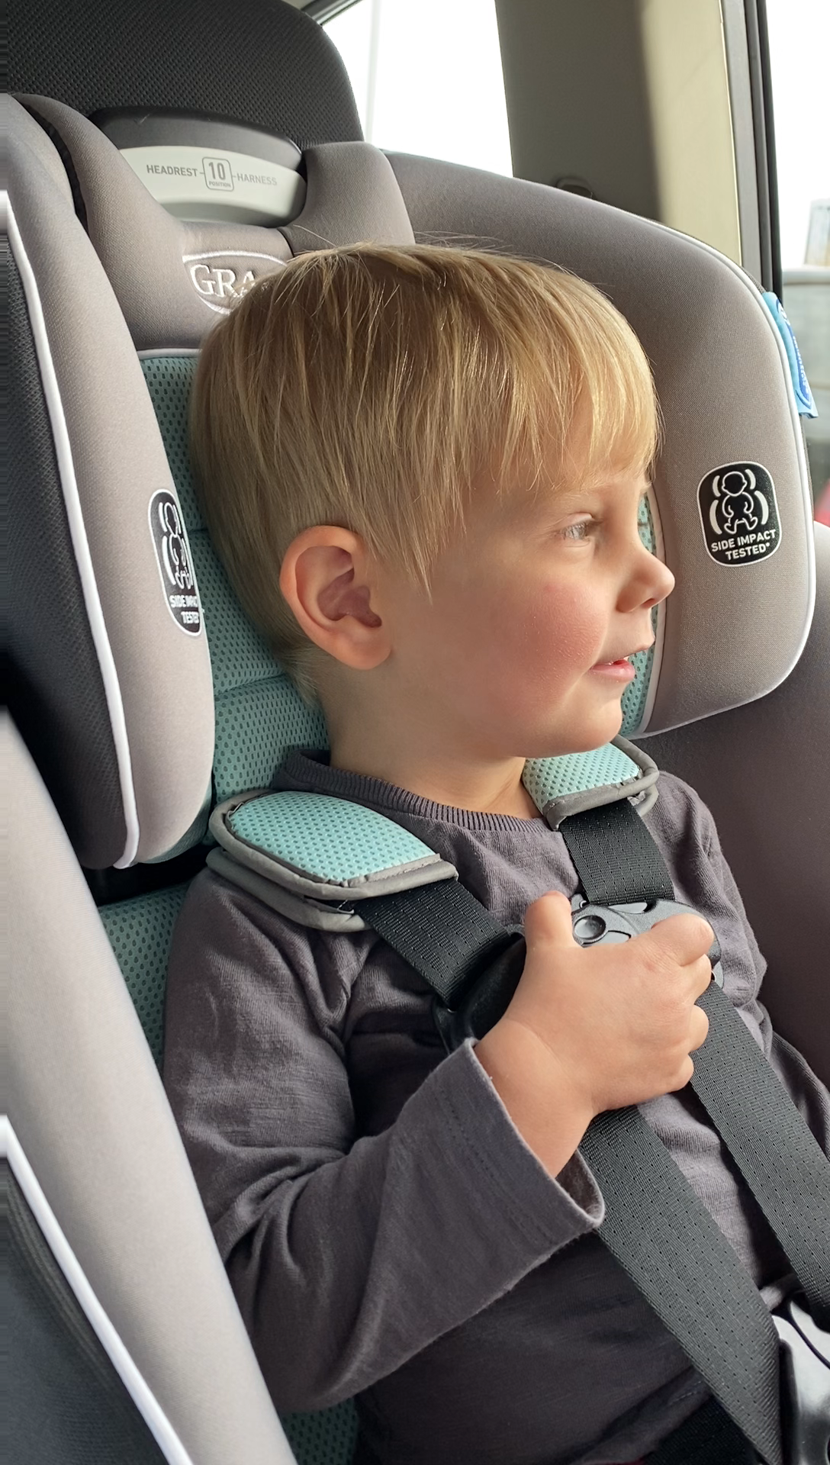



How Long Have You
Been on This Journey?
0 years
1 year
2 years
3 years
4 years
5+ years

Slide 16

Work Together to Solve
Three Puzzles to …
… and go to lunch!

Slide 17
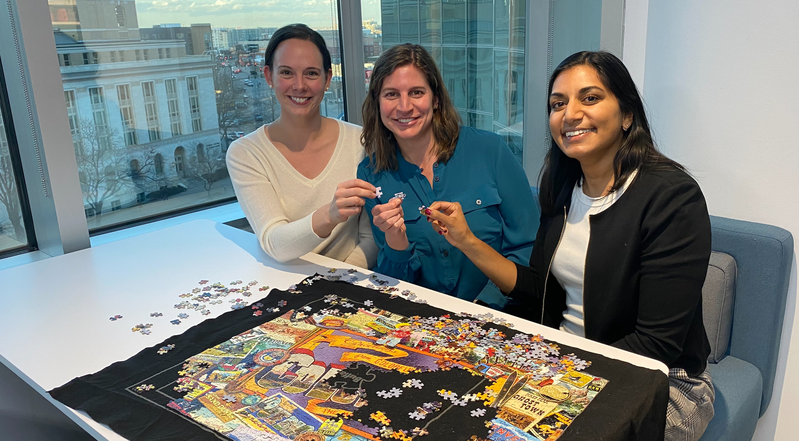

Kirsti Klaverkamp
Social-Health Information Exchange
Care Coordination
Suman Mathur
Early Childhood Comprehensive Systems
Accountable Care Collaborative
Nina Bastian
Health Information Technology
Payment Reform

Slide 18

Puzzle #1: Build Relationships
Your Task:
Find a partner (or two!) you don’t know
Add up your combined years of experience
working to integrate systems of care
Get to know each other
5 minutes
Your Goal:
A combined total of 5+ years of experience in each group
Virtual Attendees:
Stay tuned!
You will be put in a group with other Zoom attendees.

Slide 19
05:00
Puzzle #1: Build Relationships
Partner up for a combined 5 years of experience
Partners with 1-5 years
Share what you are working on
Partners with 0 years
Ask your top question

Slide 20
Report Out

Slide 21
Puzzle #2: Achieve Consensus
Your Task:
Team up with another group
Discuss: If you could wave a magic wand, what is one thing each of you would change about our current systems of care?
10 minutes
Your Goal:
Identify one common theme across the answers in your group
Virtual Attendees:
Stay tuned!
You will be put in a group with other Zoom attendees.

Slide 22
10:00
Puzzle #2: Achieve Consensus
Merge with another group to identify a common goal
Discuss:
If you could wave a magic wand, what is one thing each of you would change about our current systems of care?
What is one common theme across the answers in your group?

Slide 23
Report Out

Slide 24
Puzzle #3: Implement Decisions
Your Task:
Stay in your group!
Discuss: What is one thing that each of you can do
in the next two weeks to achieve your common goal?
Exchange contact information
10 min
Your Goal:
Follow up with each other in two weeks
Virtual Attendees:
Stay tuned!
You will be put in a group with other Zoom attendees.

Slide 25
10:00
Puzzle #3: Implement Decisions
Identify tangible next steps and follow up with each other
Discuss:
What is one thing that each of you can do in the next two weeks to advance your common goal?
Exchange contact information and follow up in 2023!

Slide 26
Report Out

Slide 27


CONGRATULATIONS!
Build Relationships
Achieve Consensus
Implement Decisions

Slide 29


Ashlie Brown browna@coloradohealthinstitute.org Nicole Weber webern@coloradohealthinstitute.org

