Slide 1
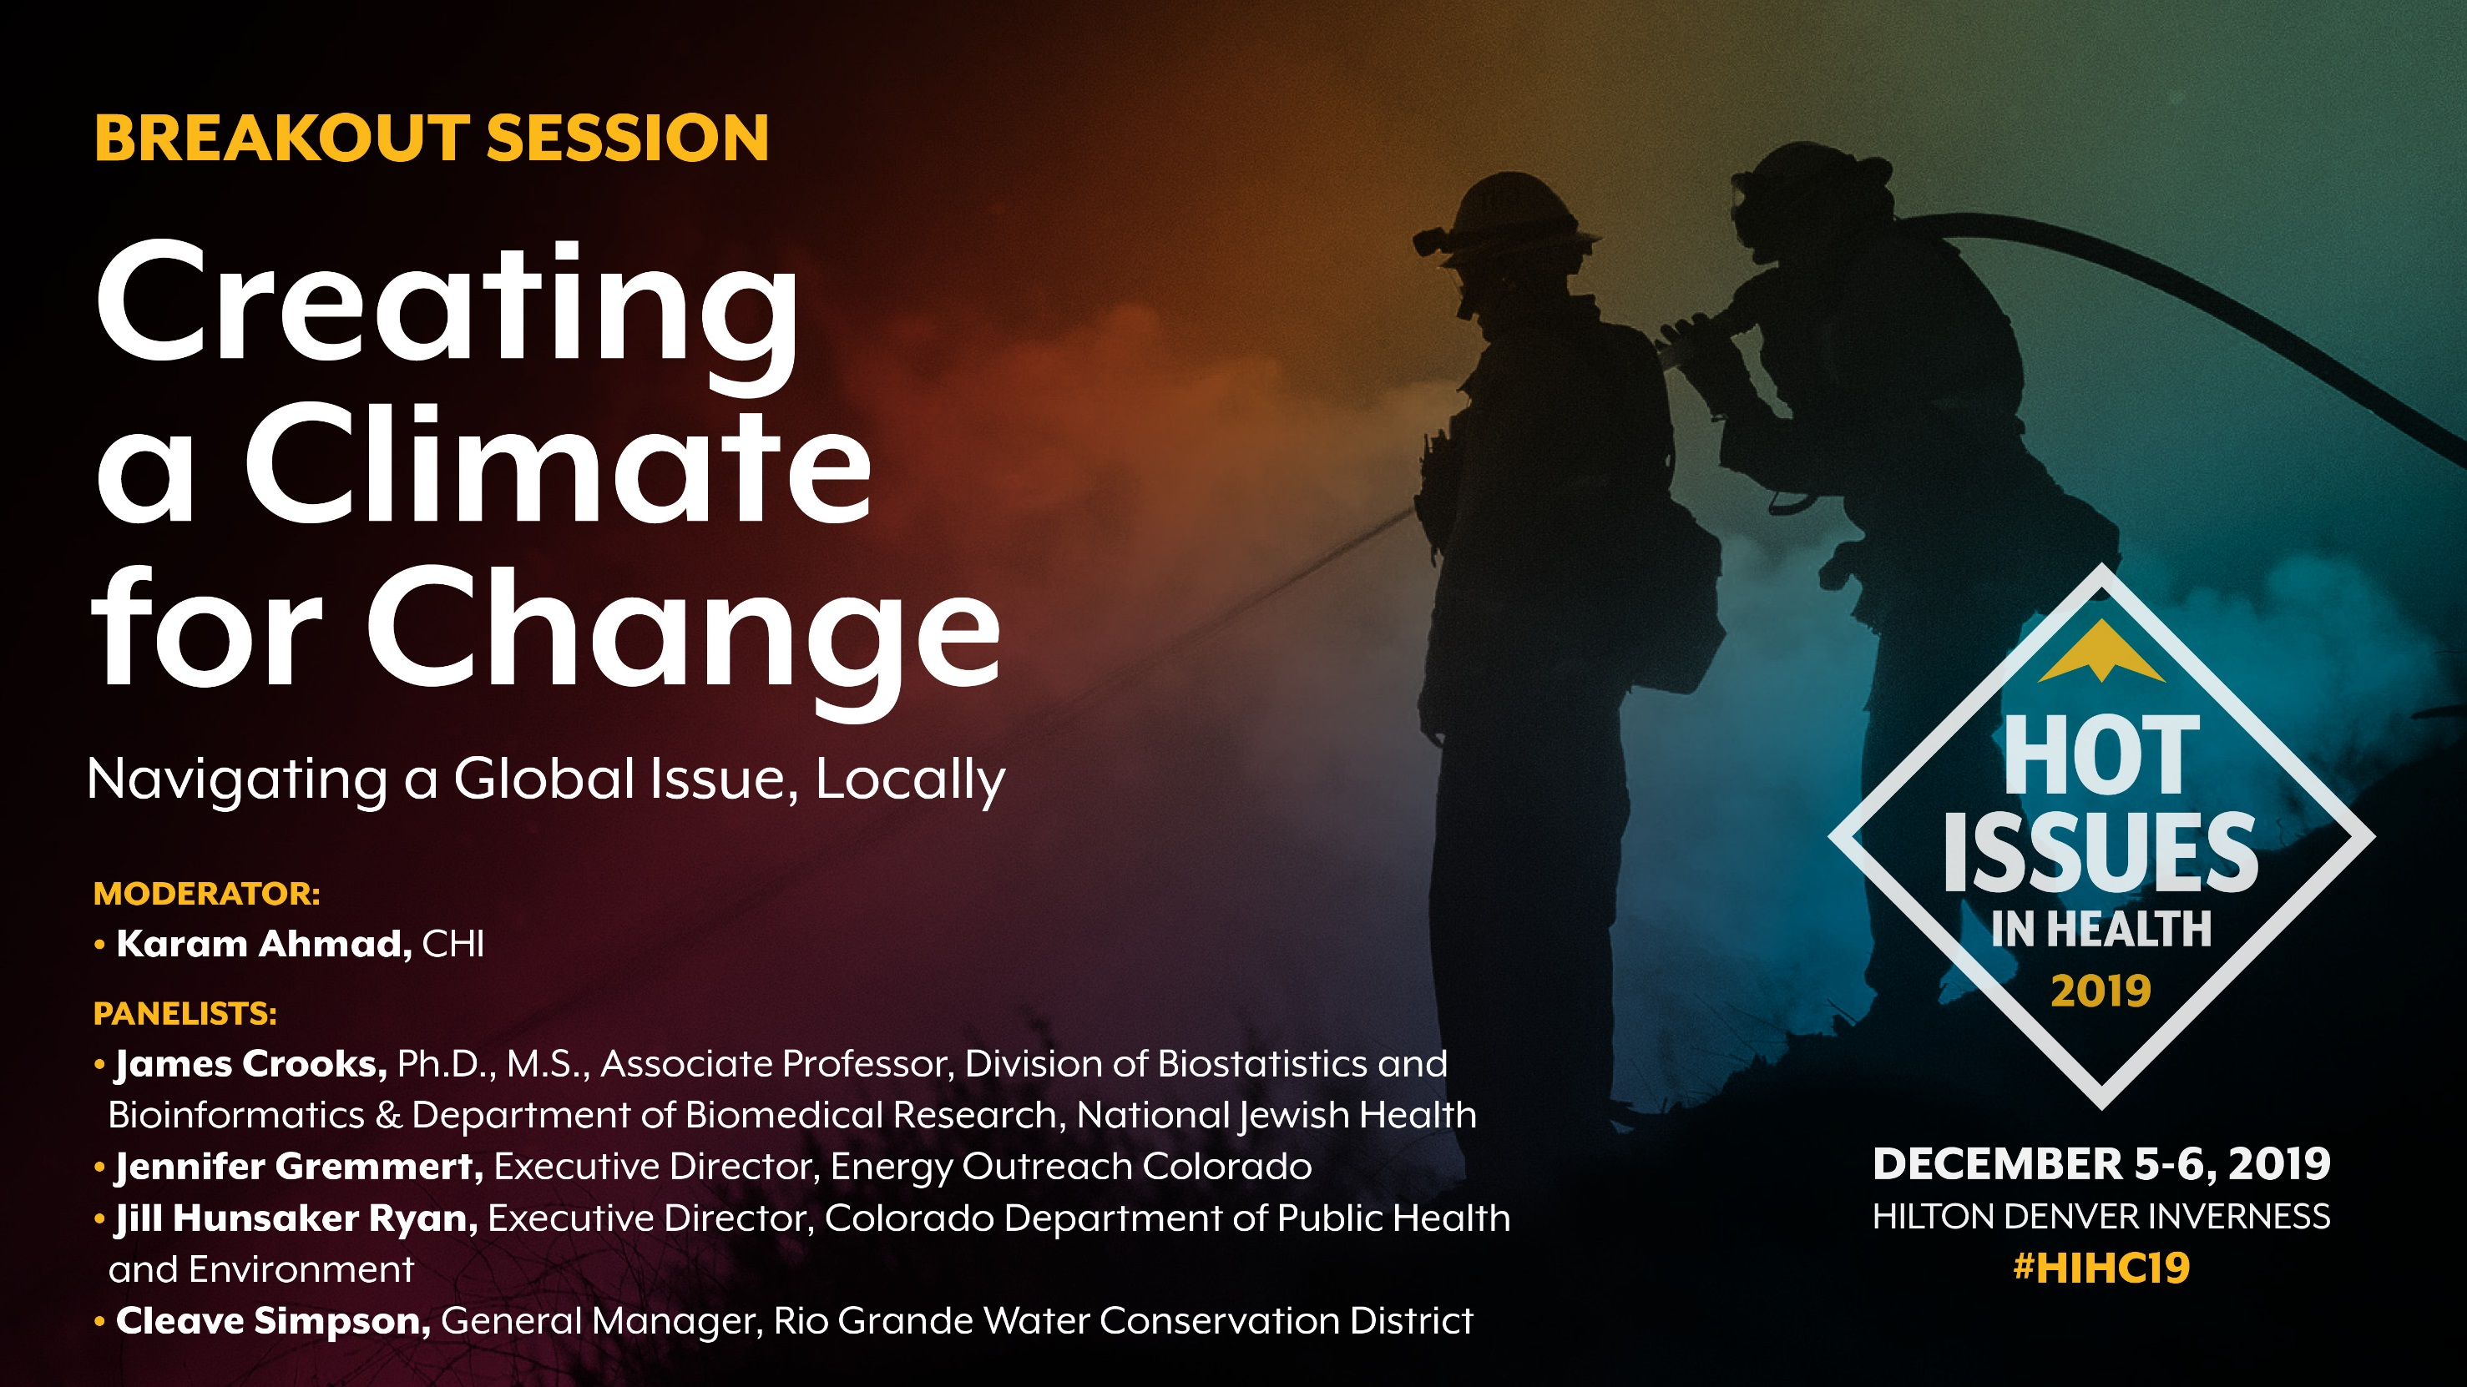
Creating a Climate for Change: Navigating a Global Issue, Locally
Notes:
In 2017 CHI put out a paper that outlined the connection between climate change and health here in Colorado, looking at extreme heat, wildfires and poor air and their connection to Colorado health
This last earth day we released a climate change and health index that looked at localizing those connections with data. Identifying sensitive populations, extreme exposures and what government action or inaction looks like by county.
We’re talking about climate change at a health policy conference because climate change is affecting the health of Coloradans now, and we need to talk about how we’re going to navigate this global issue with local solutions.

Slide 2
Three Takeaways
Coloradans feel the impact
of climate change every day.
Colorado is at the vanguard of
climate change policy.
Focusing on values, not numbers, can help create real climate change.

Slide 3

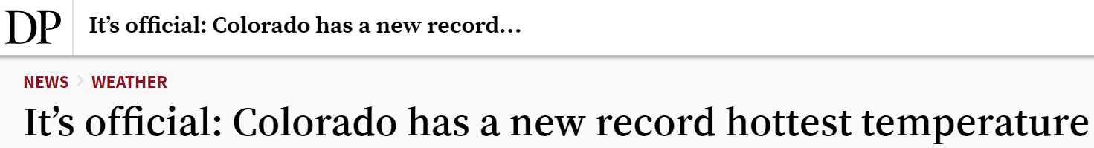
Colorado is a Hot Place to Live Right Now
Temperatures have increased by 2°F in the past 30 years.
Denver is ranked #3 in the urban island heat effect.
Fort Collins is the 9th fastest warming city in the United States.
Notes:
Extreme heat can cause stroke, heat exhaustion, CV problems, putting sensitive populations at risk (like older adults, the housing insecure, those without energy/AC)

Slide 4
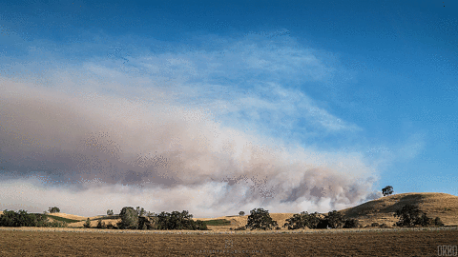
Wildfires Becoming More Severe, Complex
2018 was Colorado’s second worst wildfire season on record.
The complexity, severity, and number of fires are predicted to get worse.
Nearly 3 million Coloradans live in wildland-urban interfaces.
Notes:
In 2018 wildfires more than doubled in number from 2017.
This time last year we saw the Paradise, California fire.. And see a similar story in 2019 in LA. Thankfullly, because of increased snowpack and a delay in warm weather, our wildfire season has been tame in 2019.
2017- 30 fires reported
2018- 61 fires reported
2019- 11 fires, three are current
Complexity, severity, frequency of wildfires are expected to increase and get worse, according to the state’s wildfire preparedness plan.
WUI – areas at risk of wildfires.
Wildfires can cause burns, respiratory issues, impacts breathing, can exacerbate CVD, mental health, and even cause death. Those with chronic conditions like COPD/CVD are especially at risk when there are wildfires.

Slide 5
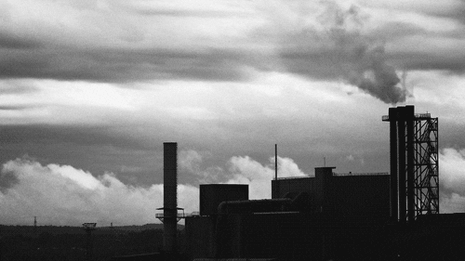
Poor Air Quality Persists in 2019
Denver and Northern Colorado fail ozone standards, again.
The Metro Denver area is ranked 12th worst in country for ozone pollution.
The Metro Denver area is among the worst in the country for particle pollution.
Notes:
Rising temperatures and wildfires lead to poor air quality.
Rising temperatures and more emissions (from traffic and industry) increase the presence of pollutants. Warmer temps “cook” pollutants, creating ground ozone. Wildfires in Colorado and surrounding states increase particulate matter in the air.
Ozone and particulate matter can aggravate asthma and contribute to early deaths from respiratory disease and affect those with cardiovascular disease. We’ll hear more on this from Jim.

Slide 6
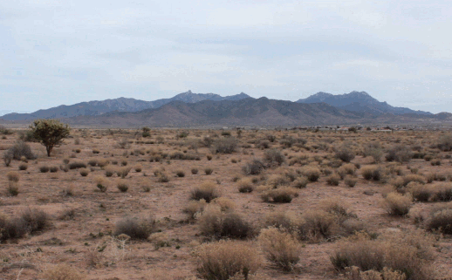
Drought: When Hope Dries Up
Colorado was drought-free earlier in 2019; now 23 percent of state population is living in drought.
1,144,000 Coloradans currently live in severe drought areas.
Drought is a major stress for Colorado’s farmers and ranchers.
Notes:
Drought has especially been an issue in Colorado in the last 20 years. Severe droughts have occurred in recent years. Projected warming in Colorado will increase these droughts. This fluctuates and threatens local agriculture and water. (23 percent of state population is living in drought)
It’s a stress you have no control over. Drought causes economic losses to businesses that rely on water which can drive stress, anxiety and depression in those communities.

Slide 7


Colorado Adopts Historic Legislation to Address Climate Change
12
Climate Change Related Bills Passed in 2019
House Bill 1261
Senate Bill 181
Notes:
Colorado has recently made some bold moves. Colorado is a vanguard in climate change policy.
In 2019 alone, the Colorado legislature passed a dozen climate-related bills — from pollution reductions, to oil and gas regulation, to wildfire prevention.
I want to highlight two hallmark bills. HB 1261 “Climate Action Plan to Reduce Pollution” and SB 181 “Protect Public Welfare Oil and Gas Operations”
Many of these bills were controversial. I am not here to debate the merits of the bill, but they are both the first of their kind.
HB19-1261, the first of its kind in the US, makes Colorado the first state to put into statute both strong short-term and long-term goals for cutting climate pollution while requiring the state to develop and implement regulations to achieve these critical reductions in a timely manner.
It declares that : Climate change adversely affects Colorado's economy, air quality and public health, ecosystems, natural resources, and quality of life;
Under the law, Colorado will cut climate pollution by At least 90 percent by 2050 (relative to 2005 pollution levels):
- most notably - At least 50 percent by 2030 – That’s in ten years.
The bill also directs the Air Quality Control Commission at the CDPHE to identify disproportionately impacted communities (income, health status, race, where they live, etc.)
Senate Bill 181 is also the first of its kind nationally.
It directs the COGCC to regulate the development and production of oil and gas in a manner that “PROTECTS public health and safety.”
It also provides local government with increased authority to regulate oil and gas development in their jurisdictions. That means regulation can vary in different areas of the state.
Both laws are currently in the rule writing stages.

Slide 8

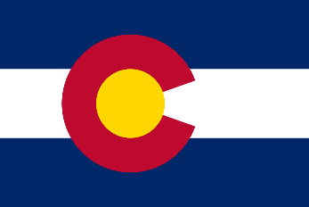



A Paradigm Shift
From Paris to Pueblo
It’s a Global Issue Creating Local Risk
Notes:
Colorado is leading the US on mitigation (Mitigation is reducing our impact on climate change) but we need a paradigm shift to start focusing our attention on adapting (Adaptation is adapting to the changes in the environment.)
Click slide (France flag) : This is a global issue that’s creating local risks. Local risks we have to be prepared for. Local risks that affect our health.
Click (India flag): If other states and top emitting countries (like China and iIdia) don’t mitigate, PAUSE. we have to adapt.
We need to start shifting our thinking towards what levers we can pull to make Colorado the healthiest, safest place it can be.

Slide 9


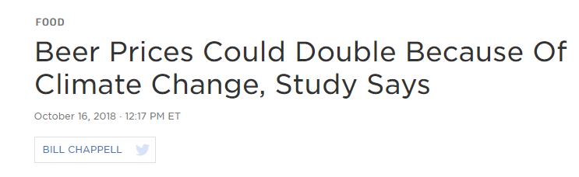
What do we value?
Family
Farming
Skiing
Outdoors
Our Health
Notes:
Let’s Focus on what we value, not the numbers / (pause). Numbers don’t always change minds – values do.
Seven in 10 Coloradans believe climate change is happening, but only four in 10 believe it will harm them personally.
So what do you value? Family, job, hobbies….
The literature says the best way to get people to believe, care, and act on climate change is to connect it to their health.
The closer we can bring this global issue to home, the more prepared and resilient we can be moving forward. So I challenge you to draw those connections to your life and what you value most in your life.
Transition:
And if skiing, your dog, or your kids aren’t enough to get Coloradans to care and respond to climate change, the price of beer doubling will.
And if beer doesn’t, maybe these four amazing panelists can.

Slide 10
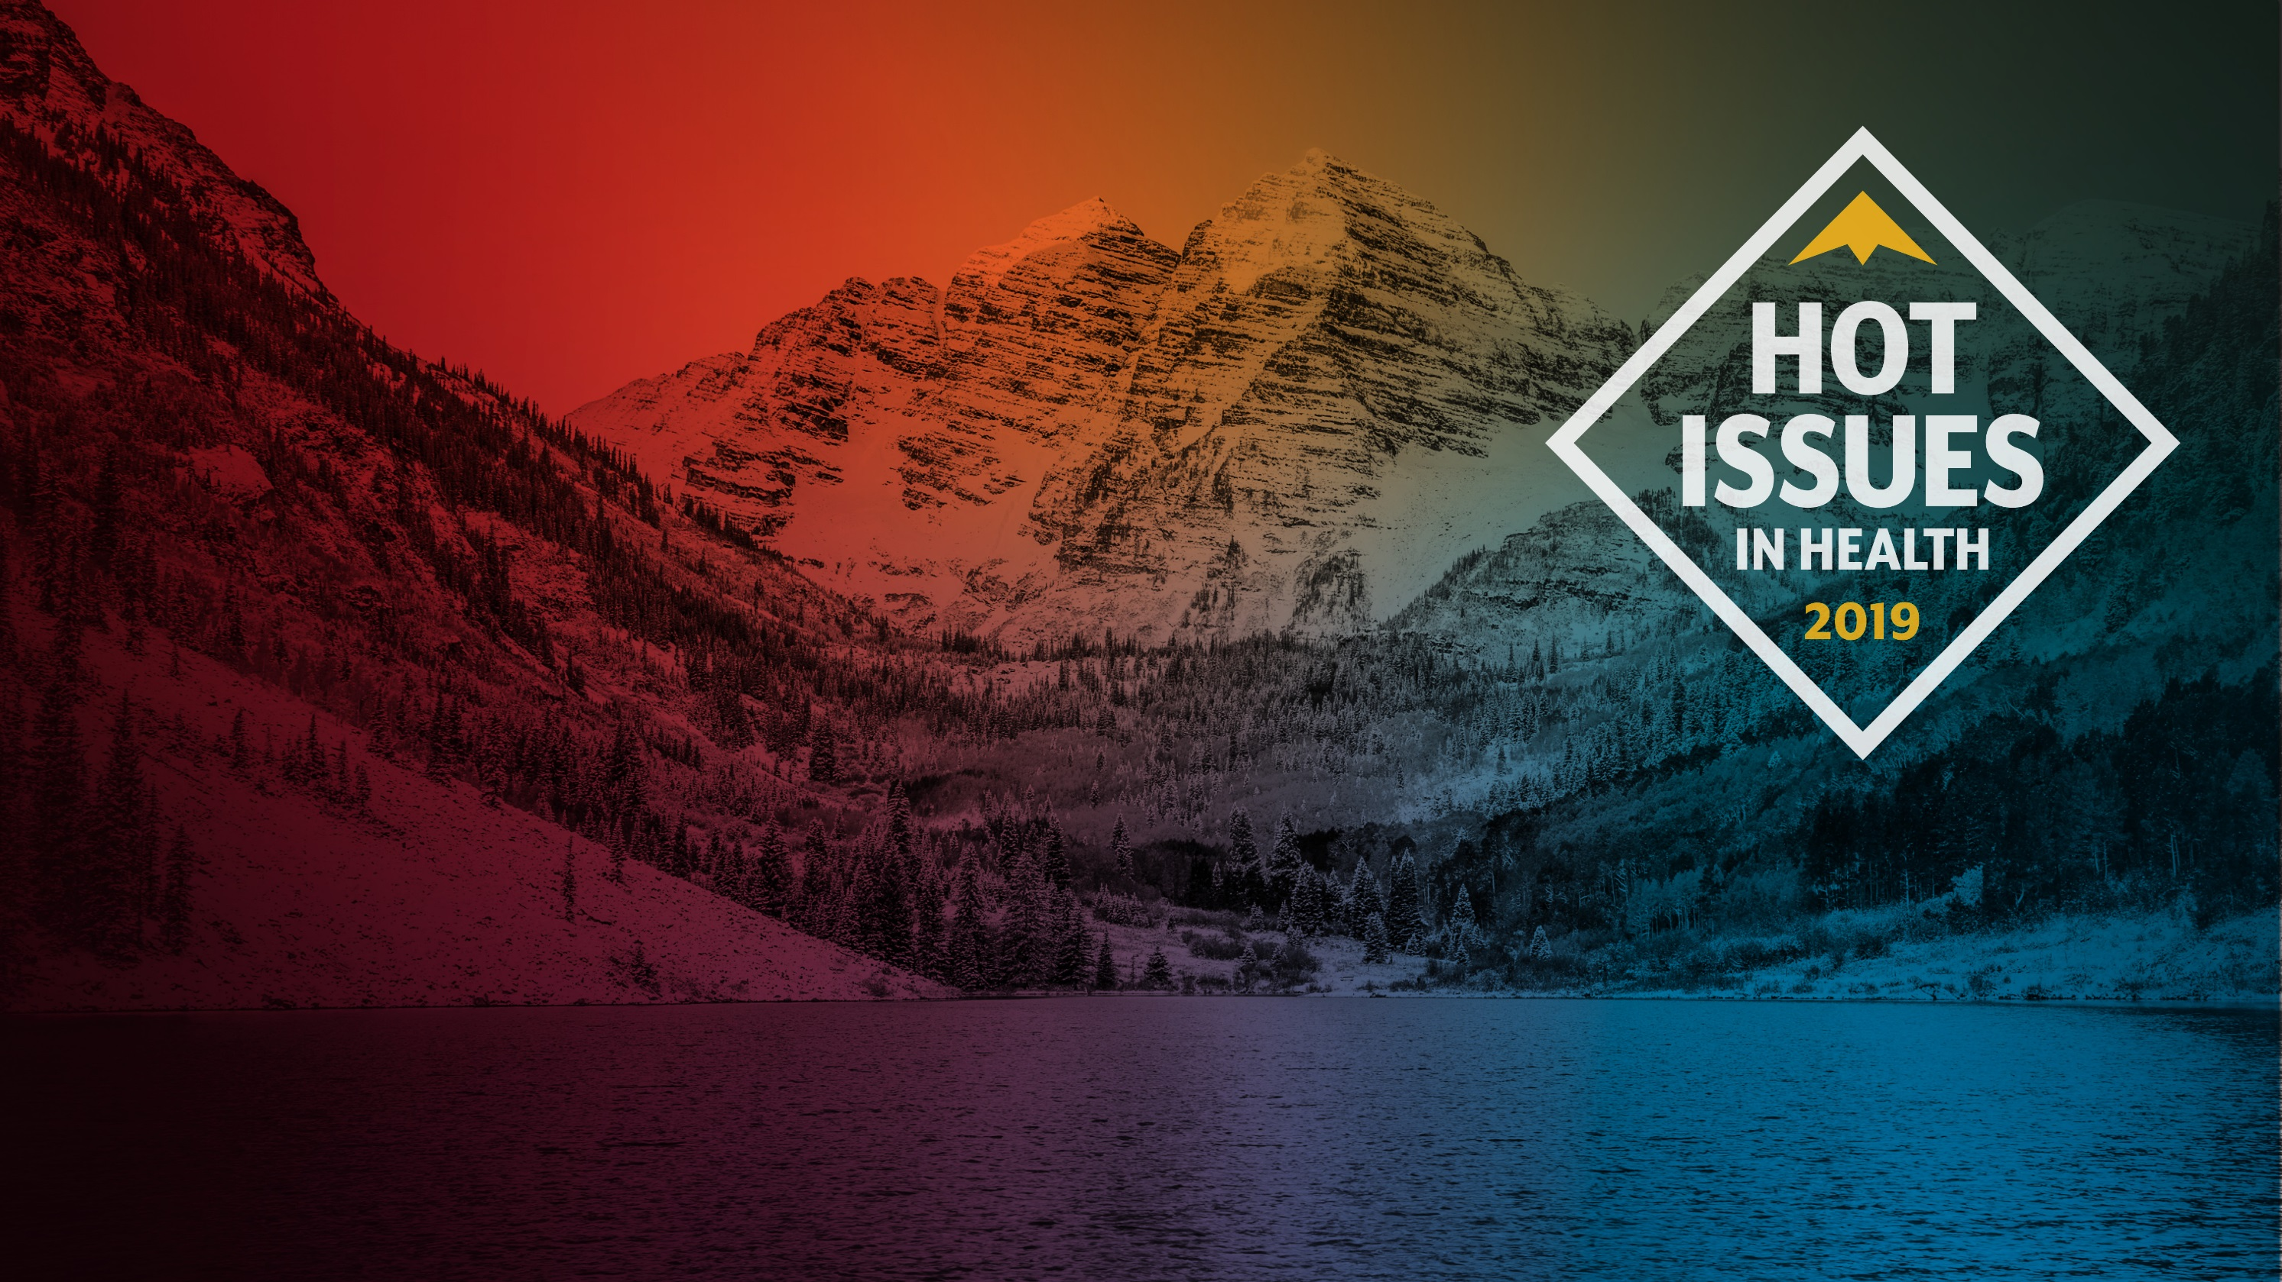
Panelists
Jennifer Gremmert,
Executive Director,
Energy Outreach Colorado
Cleave Simpson,
General Manager of Rio Grande
Water Conservation District
Jim Crooks,
Ph.D., M.S., Associate Professor,
Division of Biostatistics and Bioinformatics & Department of Biomedical Research, National Jewish Health
Jill Hunsaker Ryan,
Executive Director, Colorado Department of Public Health and Environment
Notes:
Jennifer Gremmert – executive director of Energy Outreach Colorado or EOC. Energy Outreach Colorado is a statewide nonprofit that provides energy bill payment assistance year-round through 100 partner organizations. They believe everyone deserves affordable access to the vital resources that power their homes. EOC is the only non-profit organization in Colorado that raises funds to help low-income Coloradans afford home energy and remain warm and safe in their homes.
Cleave Simpson is the General Manager of the Rio Grande Water Conservation District in Alamosa. The RGWCD was created to protect, enhance and develop water resources in the Rio Grande River basin inside the state of Colorado. Cleave is native of the San Luis Valley and is also a rancher and farmer who works closely with the community.
Dr. Jim Crooks is an associate professor and Boettcher investigator in the division of biostats and bioinformatics and dept of biomedical research at National Jewish Health, the nation’s leading respiratory hospital. He also is a clinical assistant profession in the department of epidemiology at the Colorado School of Public Health. He leads a research group studying the health impacts of climate change and air pollution and previously worked at the US Environmental Protection Agency as a Health Scientist.
Jill Hunsaker Ryan is the executive director of the Colorado Department of Public Health and Environment with more than two decades of experience in public health. She was a two-term Eagle County commissioner where she focused efforts on health care and climate action and served as the president of the Colorado Communities for Climate Action. She also previously directed the Office of Health Disparities, now called the Office of Health Equity.

