Slide 1
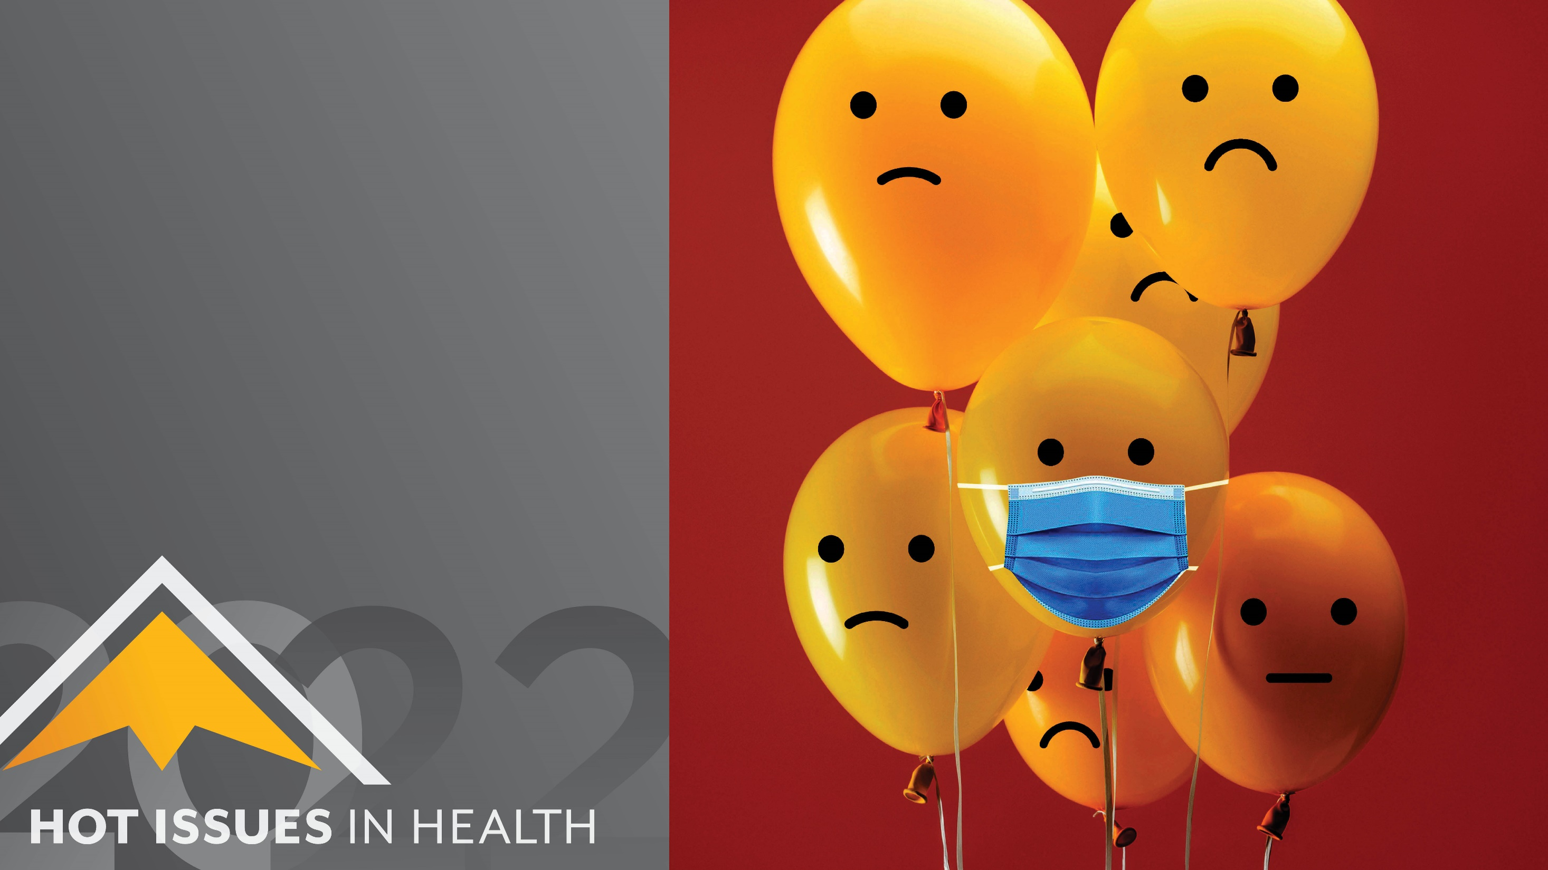
It’s Not Just COVID
A Social Justice Lens on the Mental Health Crisis
Suman Mathur
Colorado Health Institute
#HIHC22

Slide 2
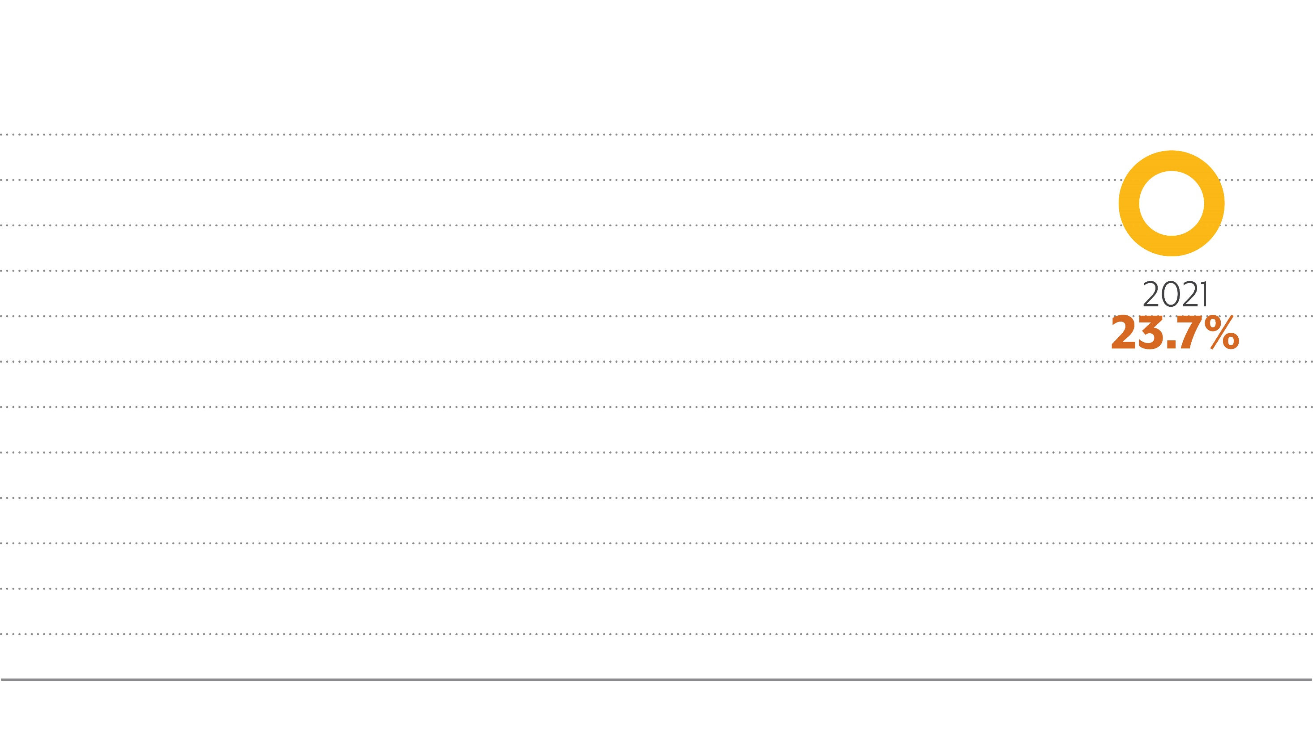
Percentage Reporting Eight or More Poor Mental Health Days in the Past Month, 2013-2021

Slide 3
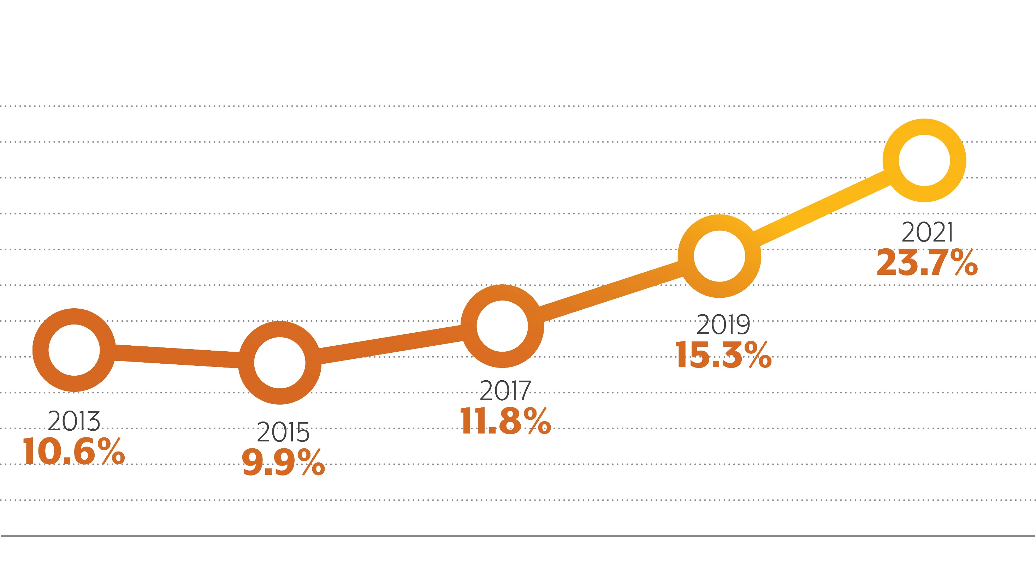
Percentage Reporting Eight or More Poor Mental Health Days in the Past Month, 2013-2021

Slide 6
Who Experiences Poor Mental Health?

Slide 7
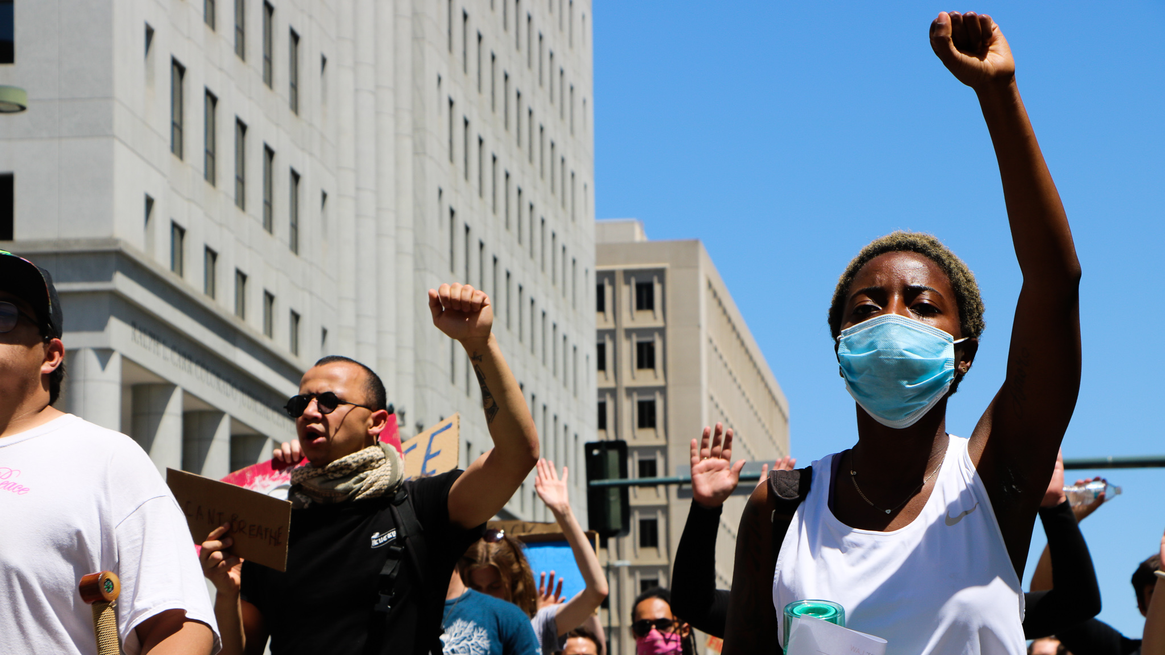

Slide 8
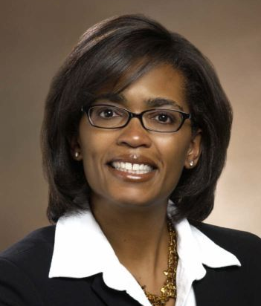
Dr. Morgan Medlock
Dr. Lesley Brooks

