Slide 1
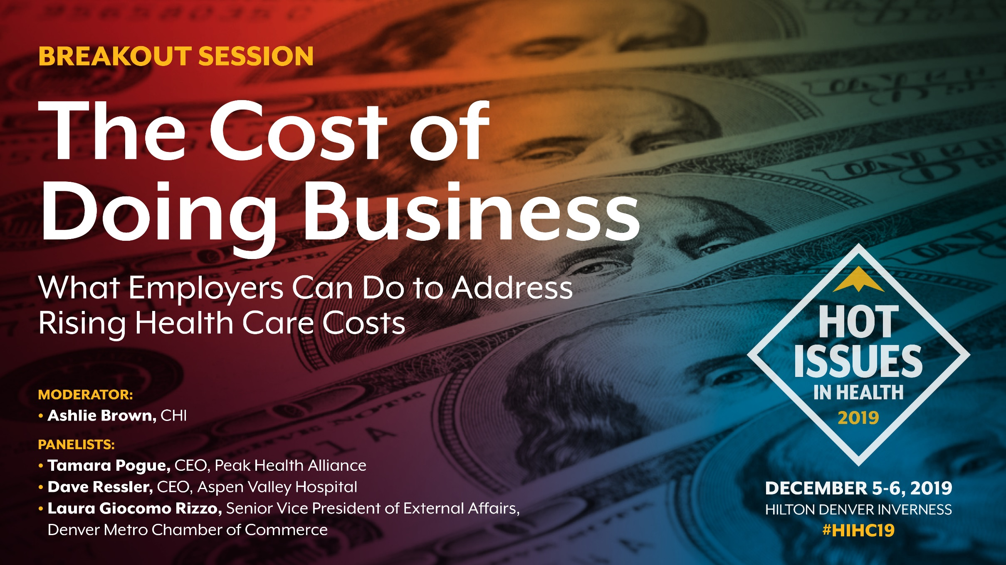
The Cost of Doing Business
What employers can do to address rising health care costs
Notes:
Why are employers important in the conversation and what are some of the challenges they face to getting more involved?

Slide 2
Three Takeaways
Employers foot the bill for most Coloradans (and it’s a big one)
Relationship status: It’s Complicated
Many employers, many strategies
Notes:
As we dive into this conversation about what employers can do to address rising health care costs, I want you to keep three things in mind:
- First, employers pay a large share of health care costs. Most Coloradans still get insurance through their employer. Collectively, this adds up to a big bill… and a big opportunity for change.
- While many of us get insurance through our employer, this relationship is complicated. And it’s getting more complicated.
- Finally, while there is a big opportunity collectively, there are many different types of employers, and that’s going to require a variety of strategies.

Slide 3
Colorado’s Employers Pick Up More of the Cost of Health Insurance
Employer contribution
Employee contribution
$13,351
$4,963
Average Out of Pocket
$797
Deductible
$4,011
Average Premium Cost for Family Coverage in Colorado (2018): $18,314
Source: Medical Expenditure Panel Survey 2018
Notes:
We start with a car because that’s how much health insurance costs for the average family in Colorado, and just like our parents, our employers are helping us out. A lot.
Source: MEPS
Premium cost with employer/employee split: https://www.kff.org/other/state-indicator/family-coverage/?currentTimeframe=0&sortModel=%7B%22colId%22:%22Location%22,%22sort%22:%22asc%22%7D
Deductible: https://meps.ahrq.gov/data_stats/summ_tables/insr/state/series_2/2018/tiif3.pdf

Slide 4
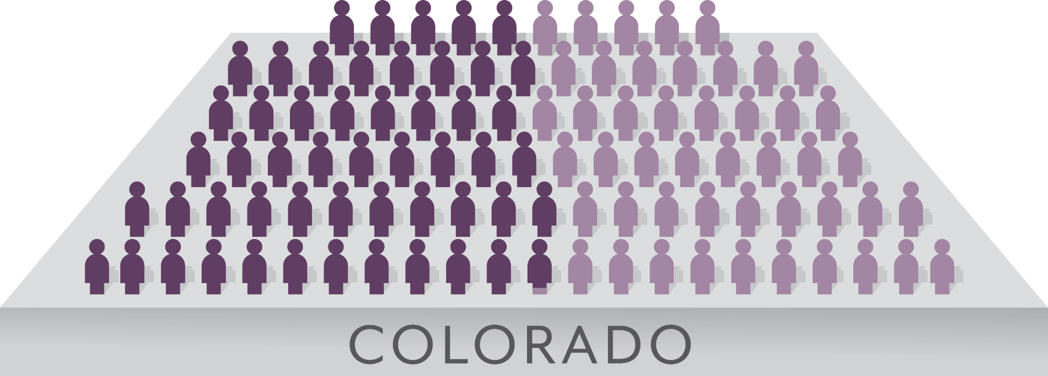
Most Coloradans Still Get Insurance Through Their Employer …
52.7%
of Coloradans had employer-sponsored insurance in 2019
Source: Colorado Health Access Survey 2019

Slide 5
… But It’s Not the Same Employer as Last Year
~580,000
Number of Coloradans who either lose, gain, or change their ESI coverage every year
4.2
Average number of years an employee remains with their employer (nationally)
Source: Colorado Health Access Survey 2019, U.S. Bureau of Labor Statistics

Slide 6
Times Are Changing
In 2019, More Than Half Are in Favor of a National Health Plan
Percentage who favor a national health plan in which all Americans would get their insurance from a single government plan:
Source: Kaiser Family Foundation Polling Data
Notes:
Sources:
First four bars from slide 3 at this source: https://www.kff.org/slideshow/public-opinion-on-single-payer-national-health-plans-and-expanding-access-to-medicare-coverage/
Last bar calculated from KFF 2019 polling values from here: https://www.kff.org/interactive/tracking-public-opinion-on-national-health-plan/

Slide 7
Spectrum of Solutions: Our Focus
More Government
Less Government
Single Payer
Reinsurance
Employer- Sponsored Insurance
Consumer-Driven Health Care
Medicaid/Medicare
Catastrophic Plans
Marketplace
Public Option
High Risk Pools

Slide 8
Employers Are a Mosaic, Not a Monolith
Retailers
Health Care Companies
Large Corporations
Professional Services
Mid-sized Firms
Local entrepreneurs
County Governments
State Government
Hospitality
Small Businesses

Slide 9
Different Employers Take Different Approaches to Risk
More Control, More Risk
Self-Funded
Partially Self-Funded (Level Funded)
Fully-Insured
Less Control, Less Risk
Notes:
Self-Funded employers can customize their health plan rather than simply buying an off the shelf product from an insurer. Self-Funded employers are not subject to state-level regulation (regulated by ERISA), but are on the hook for all health expenses their employees incur.
Fully-Insured employers have less flexibility, but are only responsible for paying the predetermined amount in premium contributions since the insurer is responsible for paying the claims.
A hybrid approach sometimes called Level Funding has emerged in the past few years. Level Funding allows employers to pay a regular monthly fee based on expected claim costs, with the potential to recoup funds if actual claims are lower than expected.
Stop loss insurance (AKA excess loss insurance), which kicks in once health expenses reach a certain threshold, can limit the financial exposure of self-funded employers, allowing smaller employers to self-fund or level-fund their health plans (source: DOI 2017 Health Insurance Cost Report).
https://www.kff.org/report-section/2018-employer-health-benefits-survey-section-10-plan-funding/
https://www.onedigital.com/blog/is-partially-self-funding-plan-in-your-future/

Slide 10
Many Employers, Many Strategies
Today’s Panel:
Tamara Pogue CEO, Peak Health Alliance
Marguerite Tuthill Director, Value-based Operations, Community Care Alliance
Laura Giocomo Rizzo Senior Vice President of External Affairs, Denver Metro Chamber of Commerce

