Slide 1
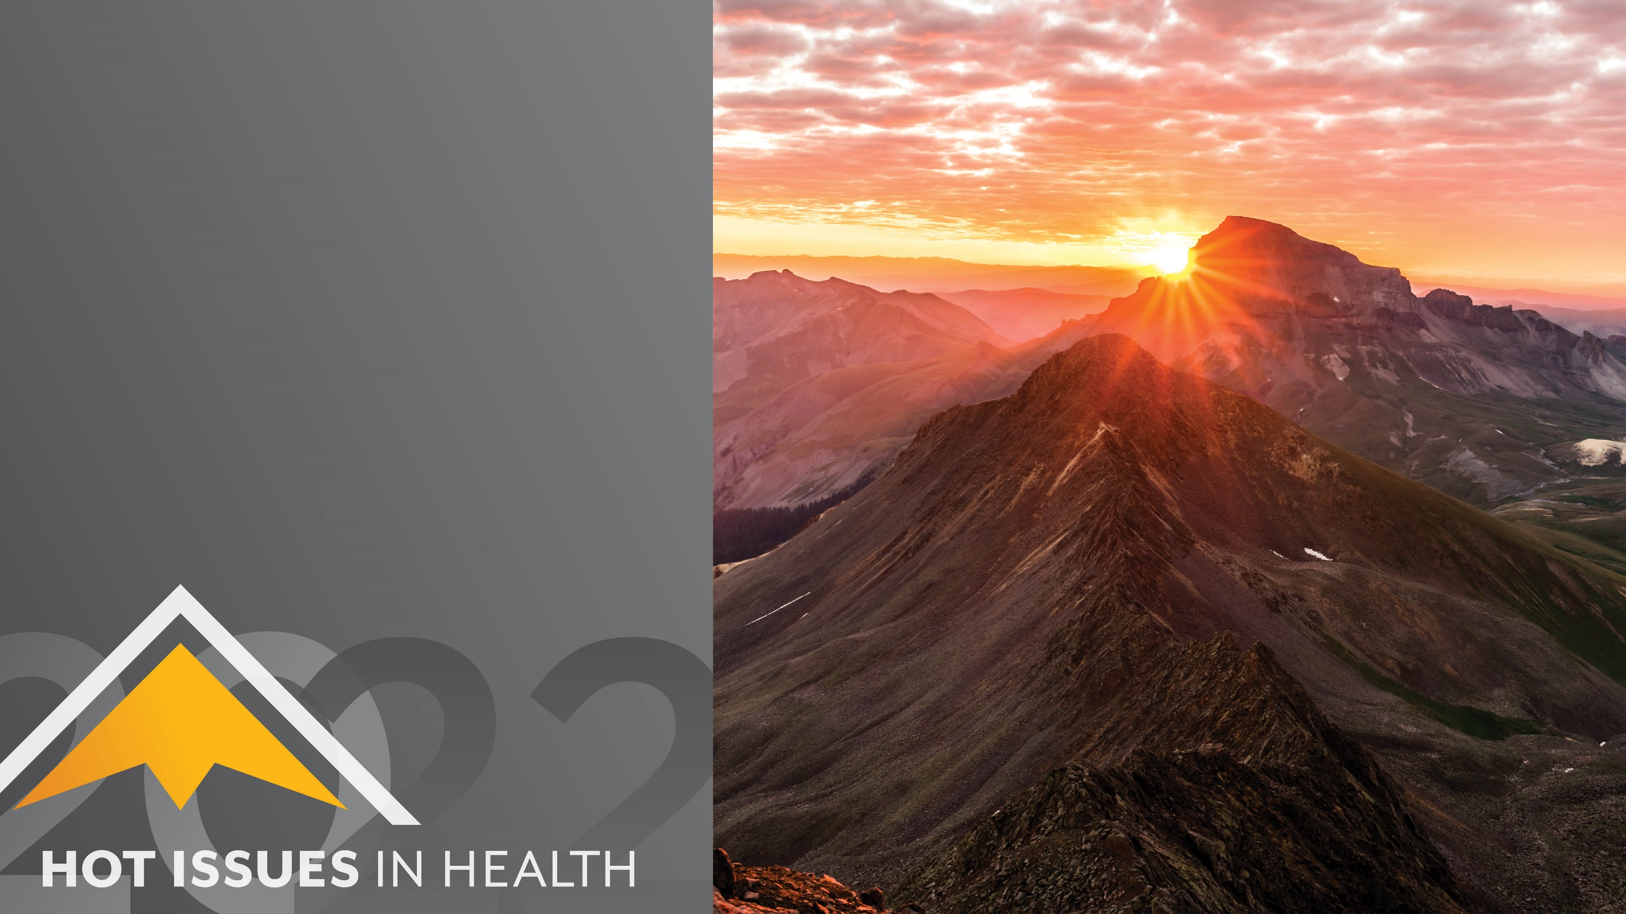
Let’s Acclimate, Colorado
The Leadership Needed to Protect Community Health from Climate Change
Karam Ahmad
Colorado Health Institute
#HIHC22

Slide 2

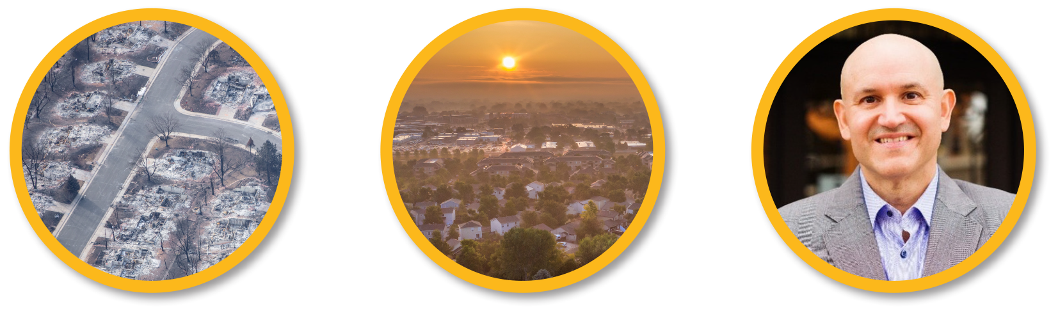
Overview for Today

Slide 3
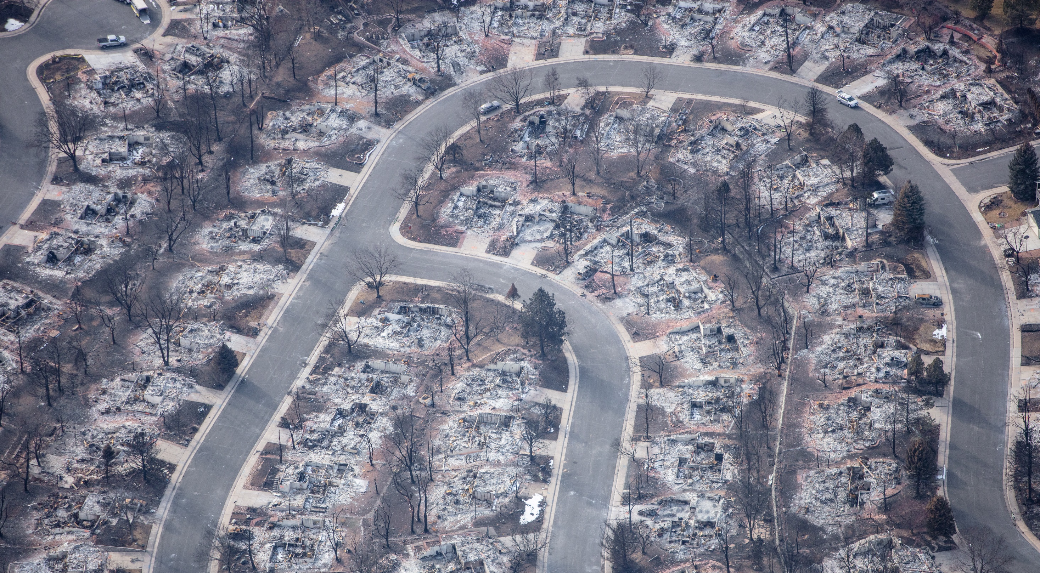


Slide 4
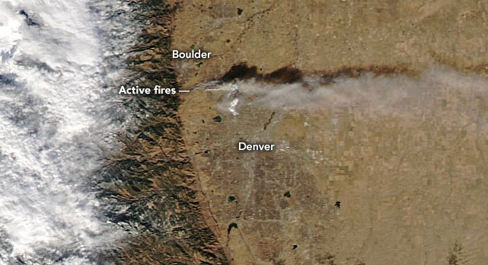


Slide 5


What do you value most that climate change threatens?

Slide 6
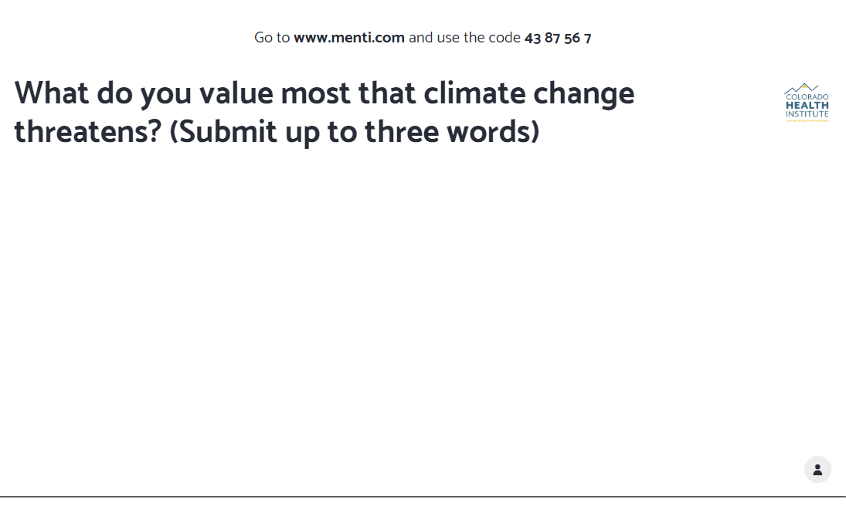

Slide 7





Climate Change is a Threat Multiplier

Slide 8
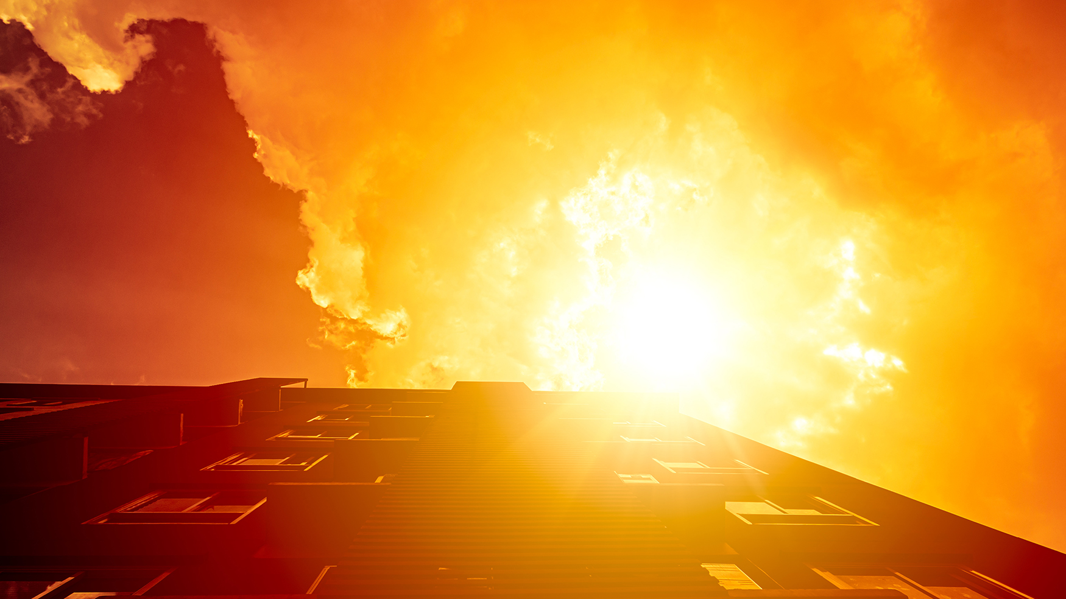
Extreme Heat
Temperatures have increased by about 2°F in the past 30 years.
Fort Collins is the 9th fastest warming city in the United States.
Nearly one out of five days in the last three years was over 90°F in Denver.
Lamar recorded the state’s hottest temperature: 115°F

Slide 9
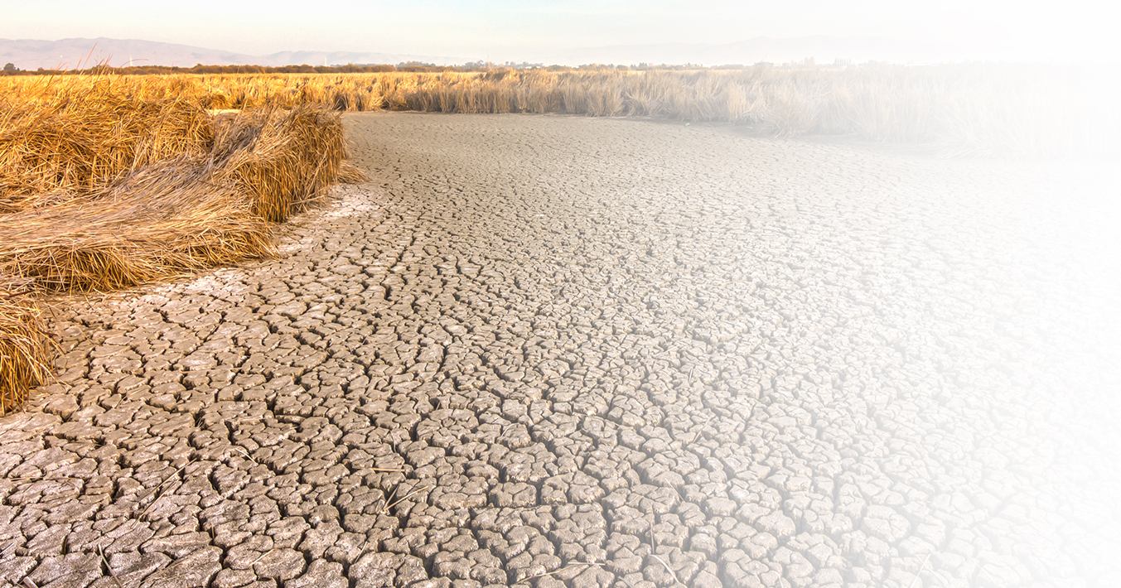
Drought
More than 3.5 million Coloradans live in drought-stricken areas.
Sustained drought makes wildfires
more common.
Drought is a
major stressor for Colorado’s farmers, agricultural workers, and their families.

Slide 10
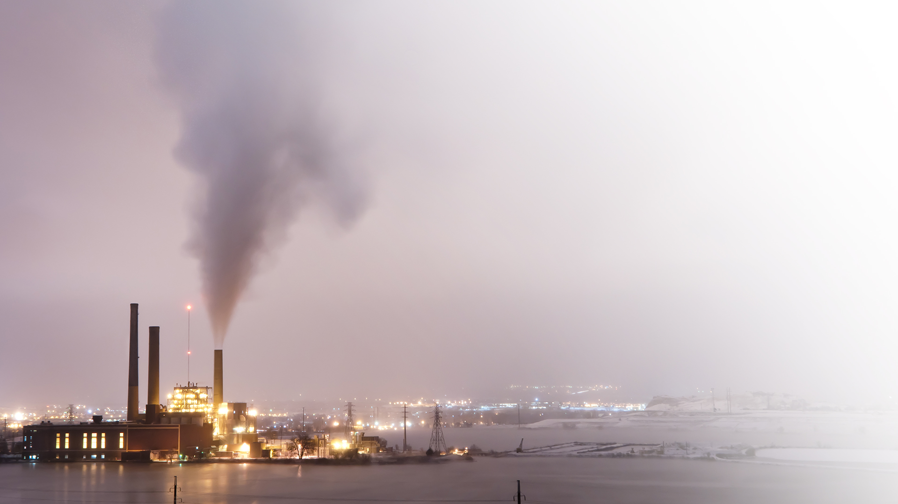
Poor Air
Denver and northern Colorado fail ozone standards, again.
The metro Denver area is among the worst regions in the country for particle pollution and ozone.

Slide 11
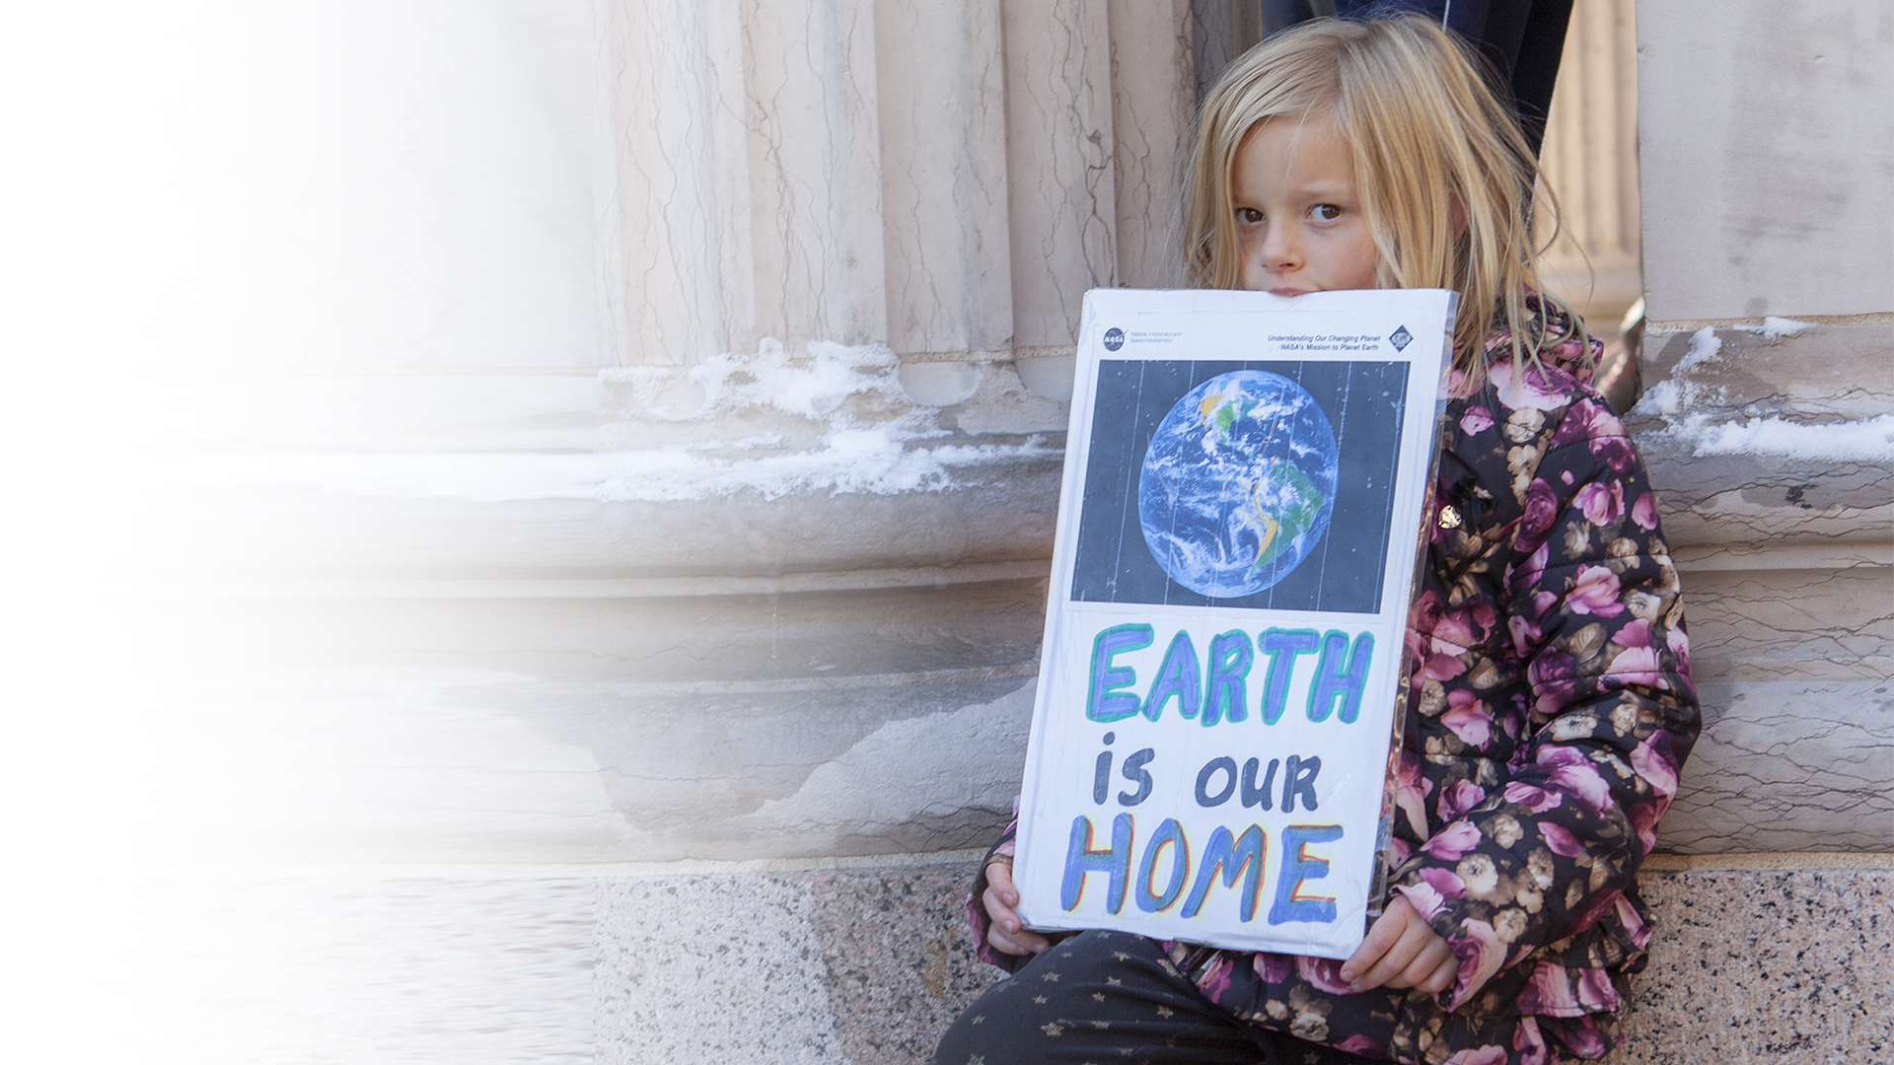
Disproportionately Impacted Communities
People earning low incomes
Indigenous and
communities of color
Children
Older adults
People with chronic illnesses
Outdoor workers
(Example: agricultural)
People experiencing homelessness

Slide 12

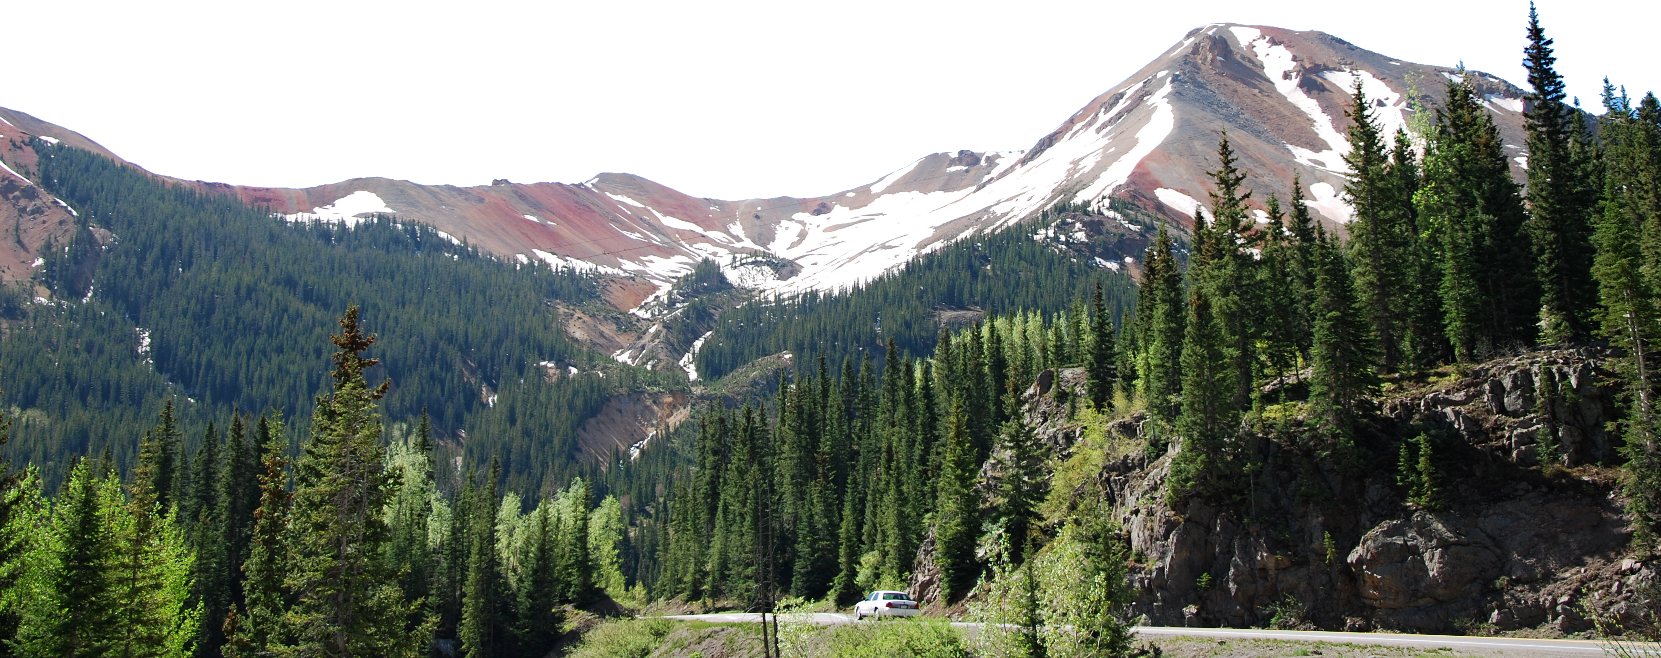


Slide 13
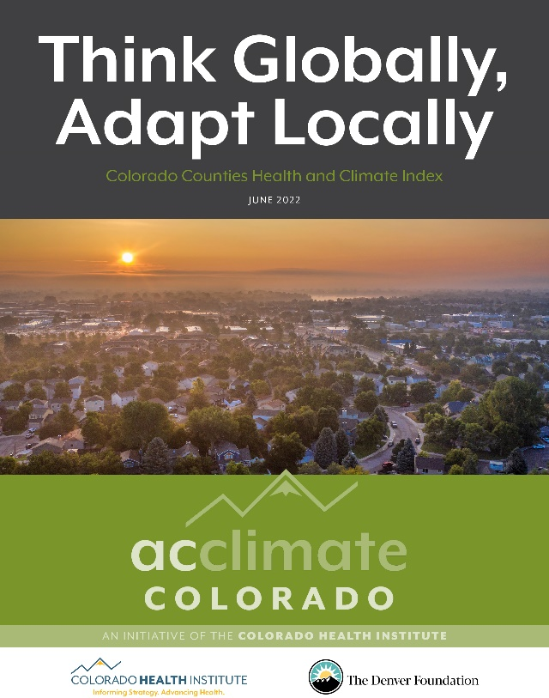
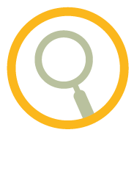
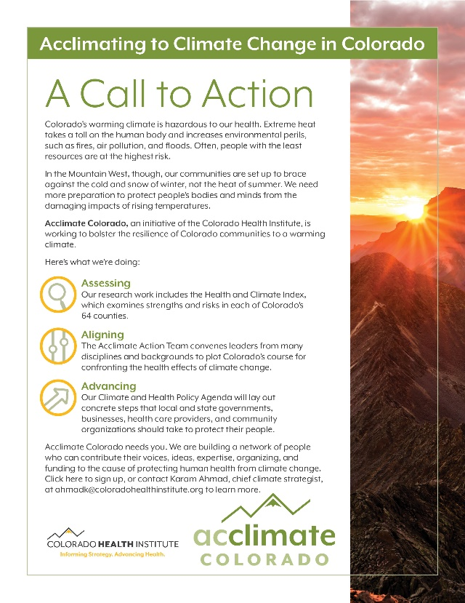
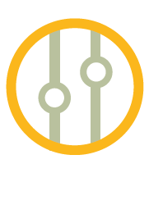

Let’s Acclimate, Colorado
Assessing
Aligning
Advancing

Slide 14



Slide 15

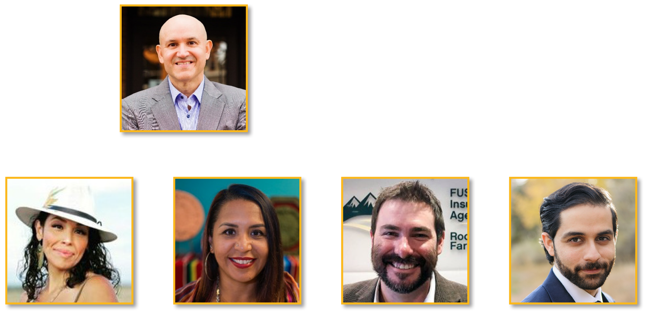
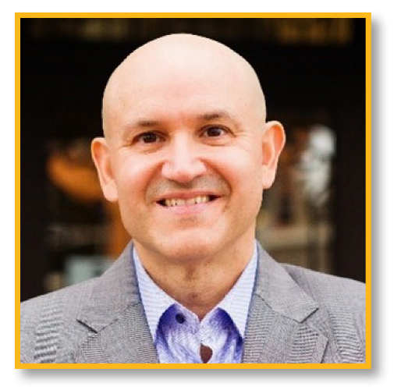

Renée
Millard-Chacon
Co-Founder,
Womxn from
the Mountain
Javier Alberto Soto
CEO,
The Denver Foundation
Olga Gonzalez Executive Director, Cultivando
Karam Ahmad
Senior Policy Analyst,
Colorado
Health Institute
Dan Waldvogle Director of
External Affairs, Rocky Mountain Farmers Union

Slide 16

Q:
What community leadership and action is necessary to protect the well-being and health of our communities?

