Slide 1
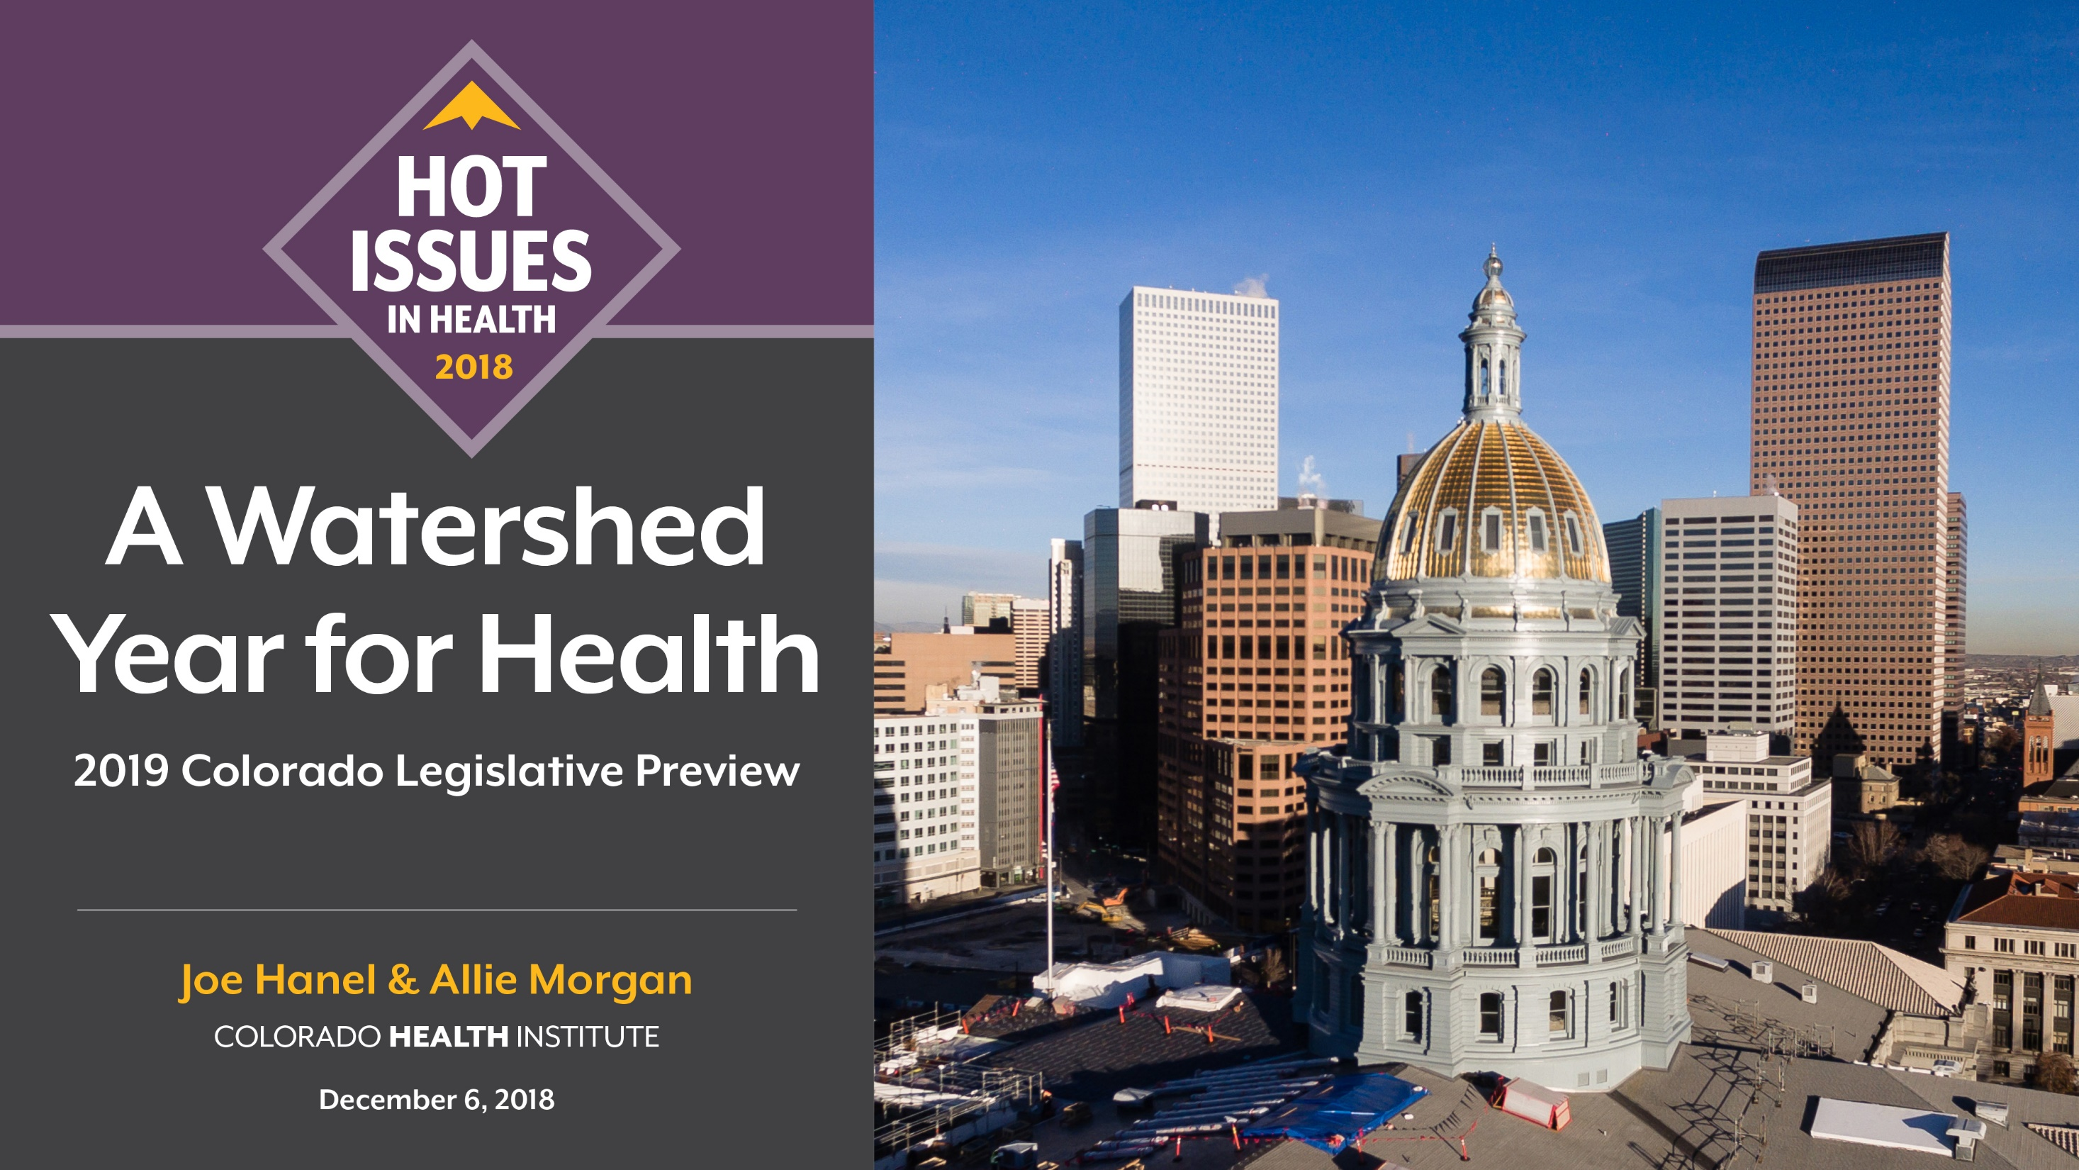

Slide 2



Slide 3
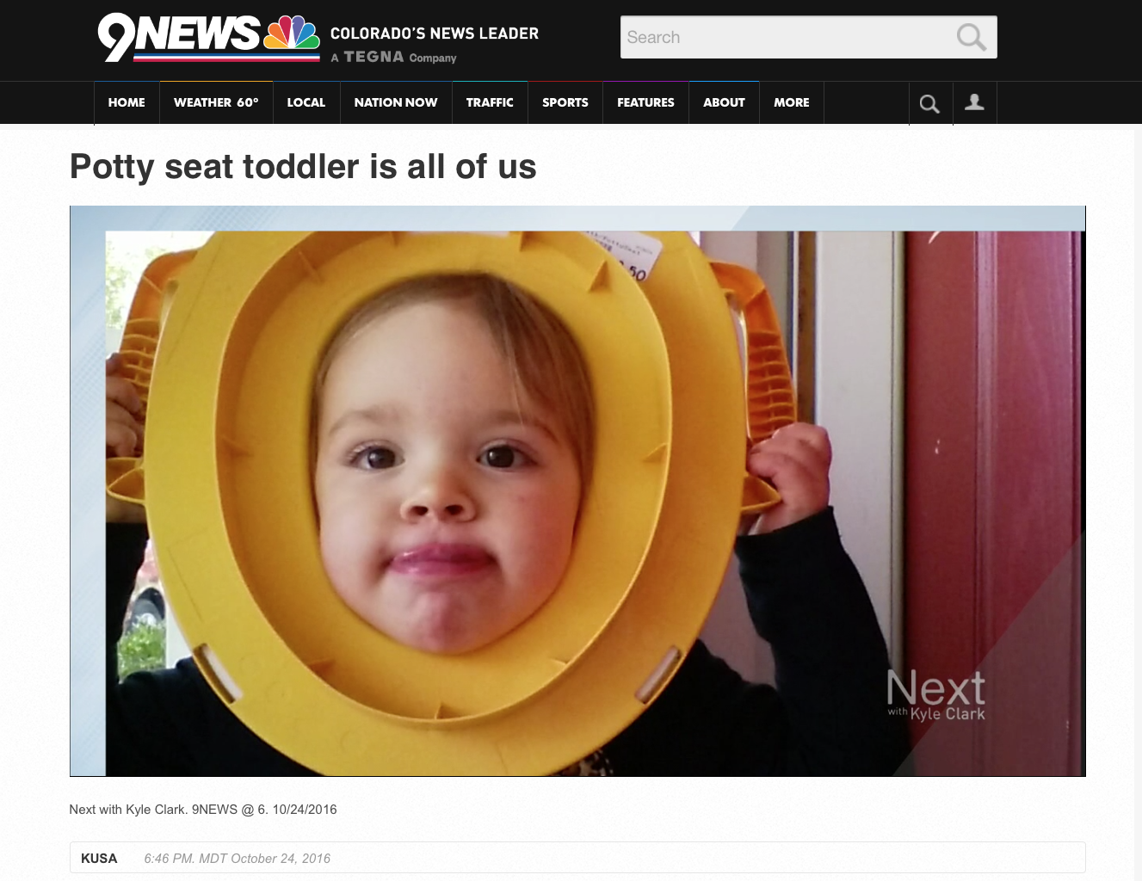
2016

Slide 4

2018

Slide 5

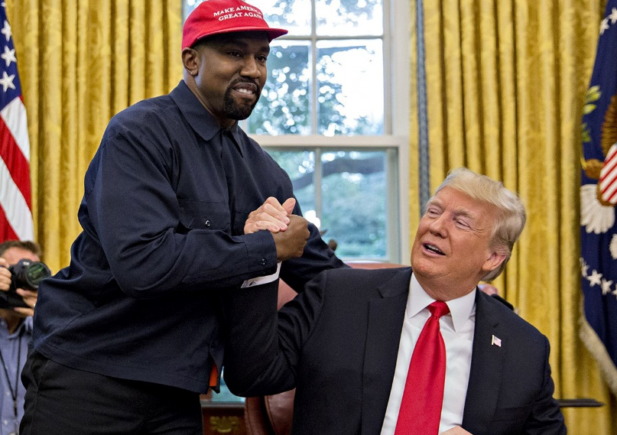


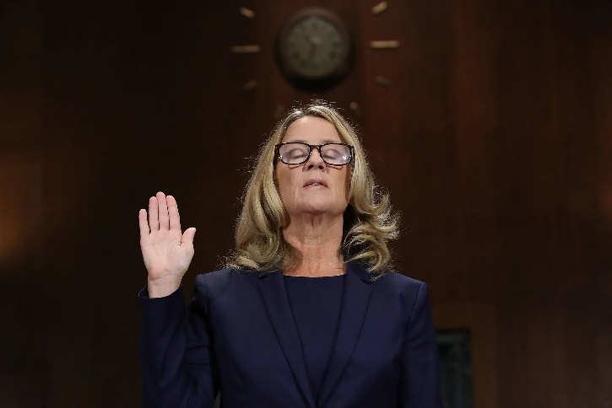


A Tumultuous Year in America

Slide 6
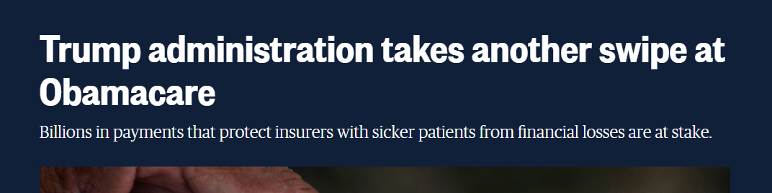
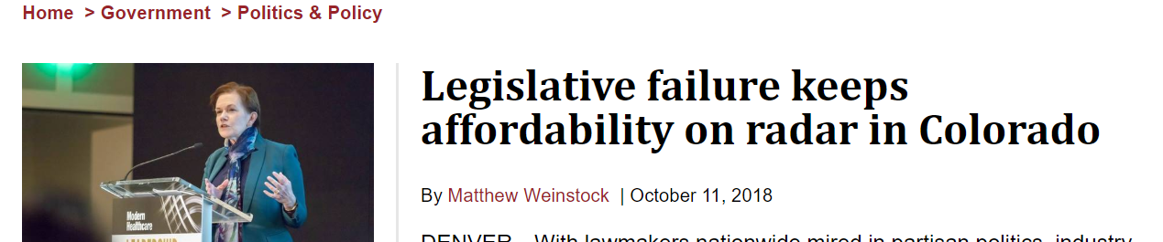
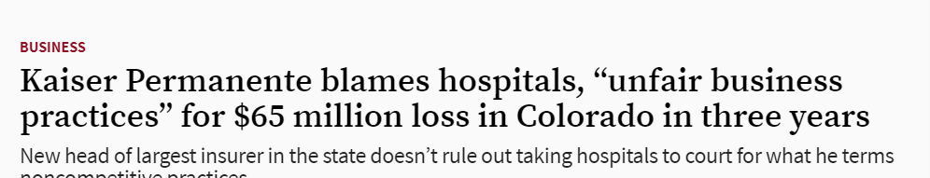
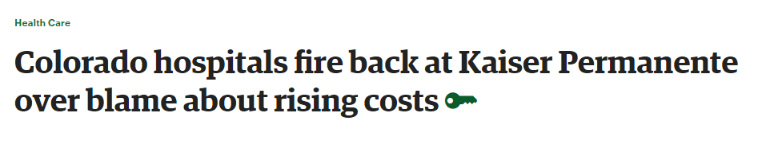
A Tumultuous Year in Health Care

Slide 7
Three Takeaways
1.
2.
3.
Progressive Democrats will run state government in 2019.
The state budget will constrain ambitious policy agendas.
Expect to see many familiar bill topics backed by Democrats.

Slide 8

Progressive Democrats Will Run
State Government in 2019

Slide 9
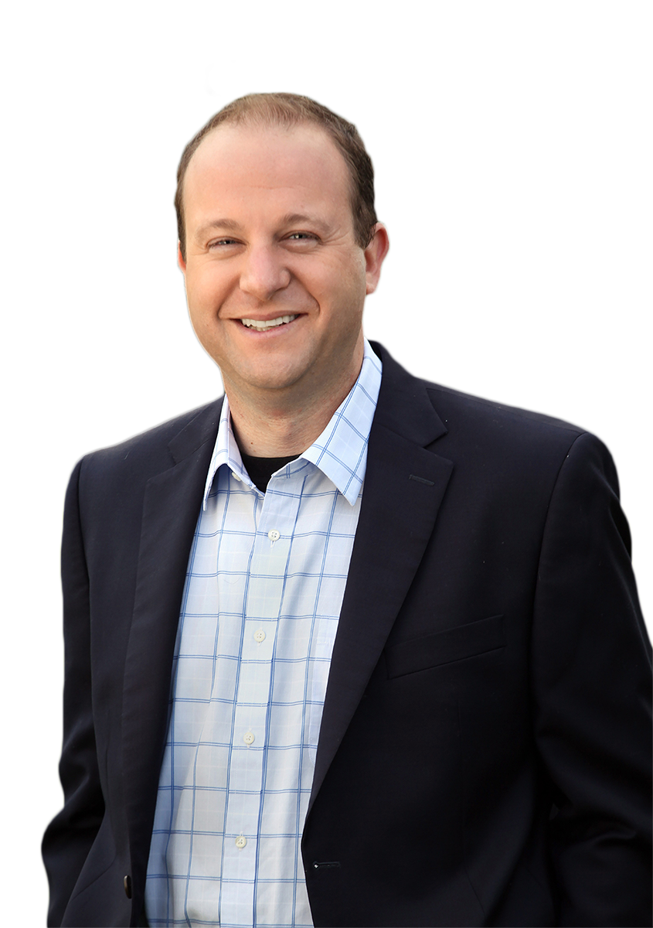


Your New Governor Is…

Slide 10
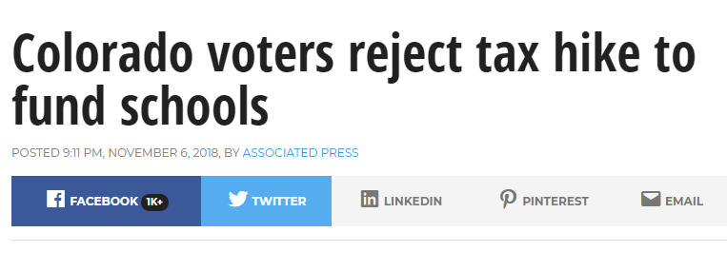
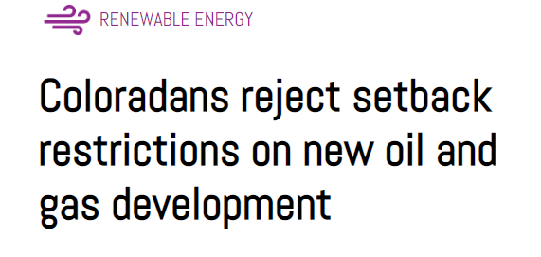
Voters Rejected Statewide Tax Hikes
Amendment 73, Propositions 109 and 110: Funding measures for schools and roads
Proposition 112: Setbacks for oil and gas

Slide 11

…But Backed Local Taxes
Nearly a dozen initiatives for county mental health and substance use funding
  Caring 4 Denver passed: $45 million annually
  Failed in Pueblo
  Passed in Adams, Arapahoe, Boulder, Douglas, Jefferson, Larimer, Pitkin, San Miguel, and Summit counties

Slide 12
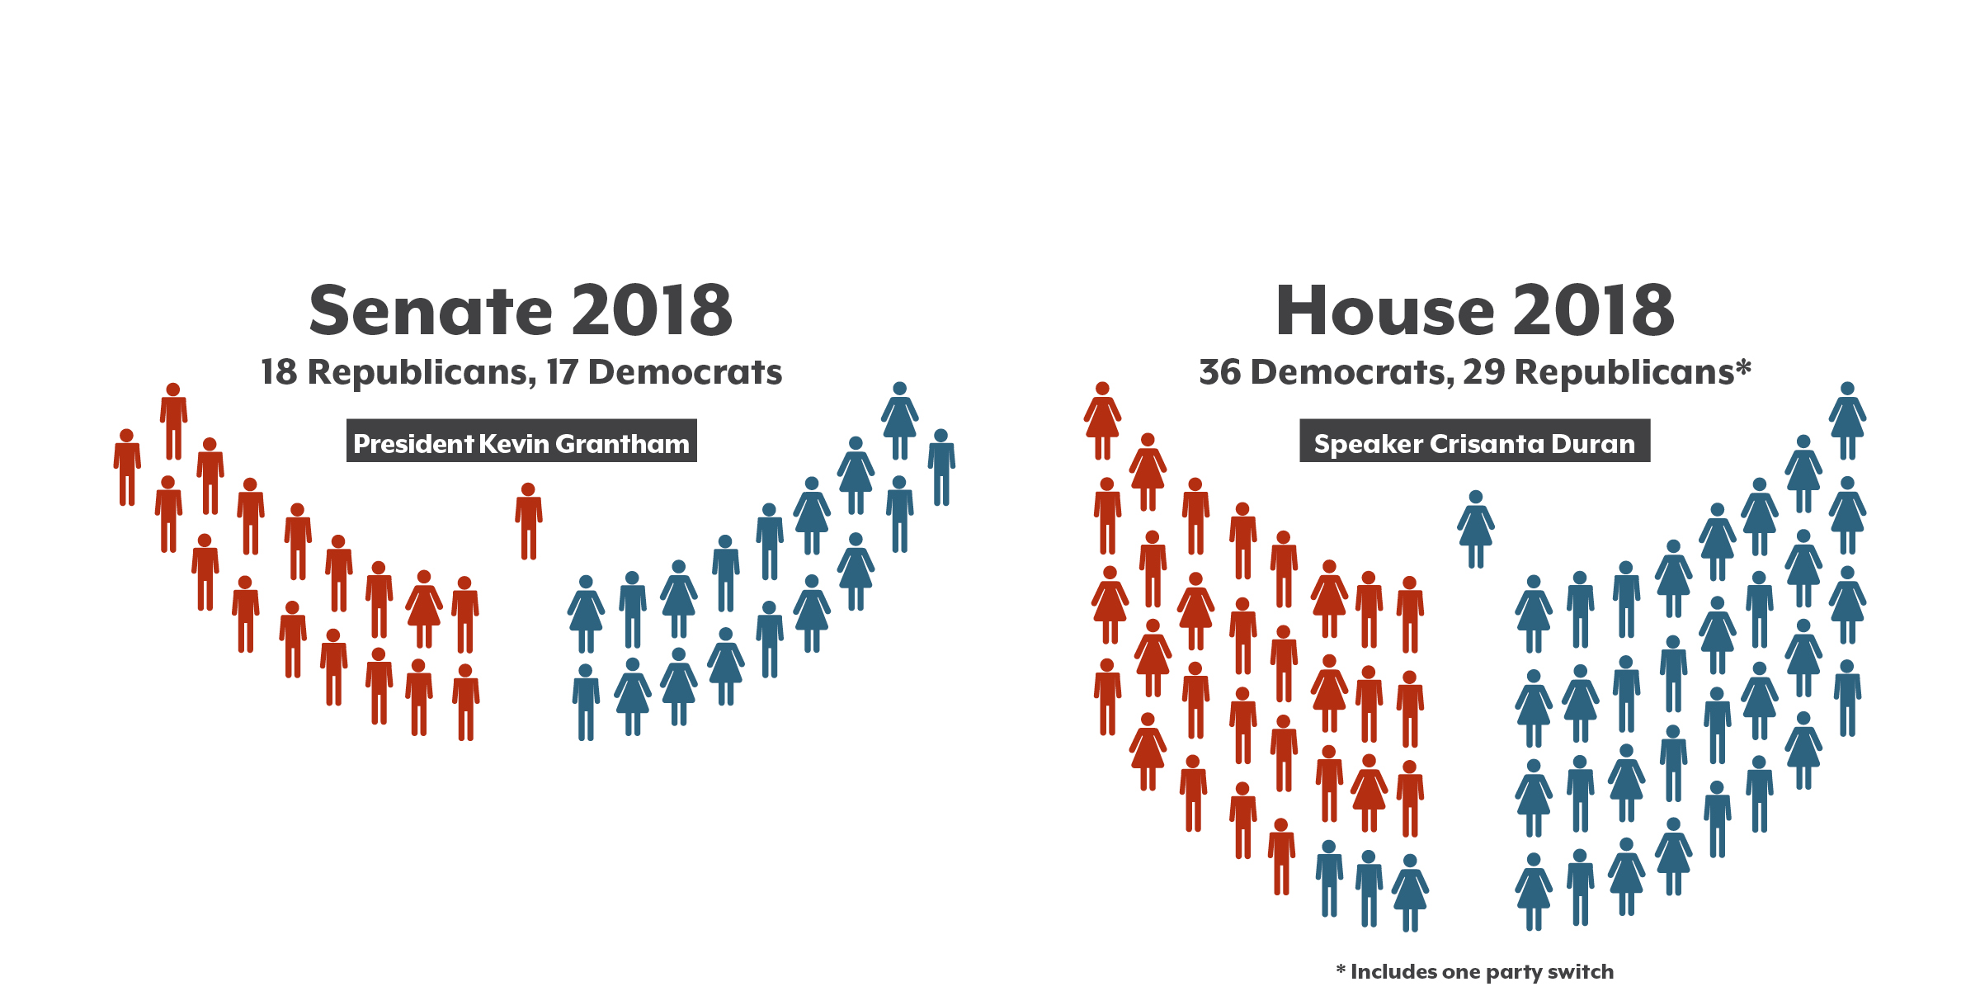

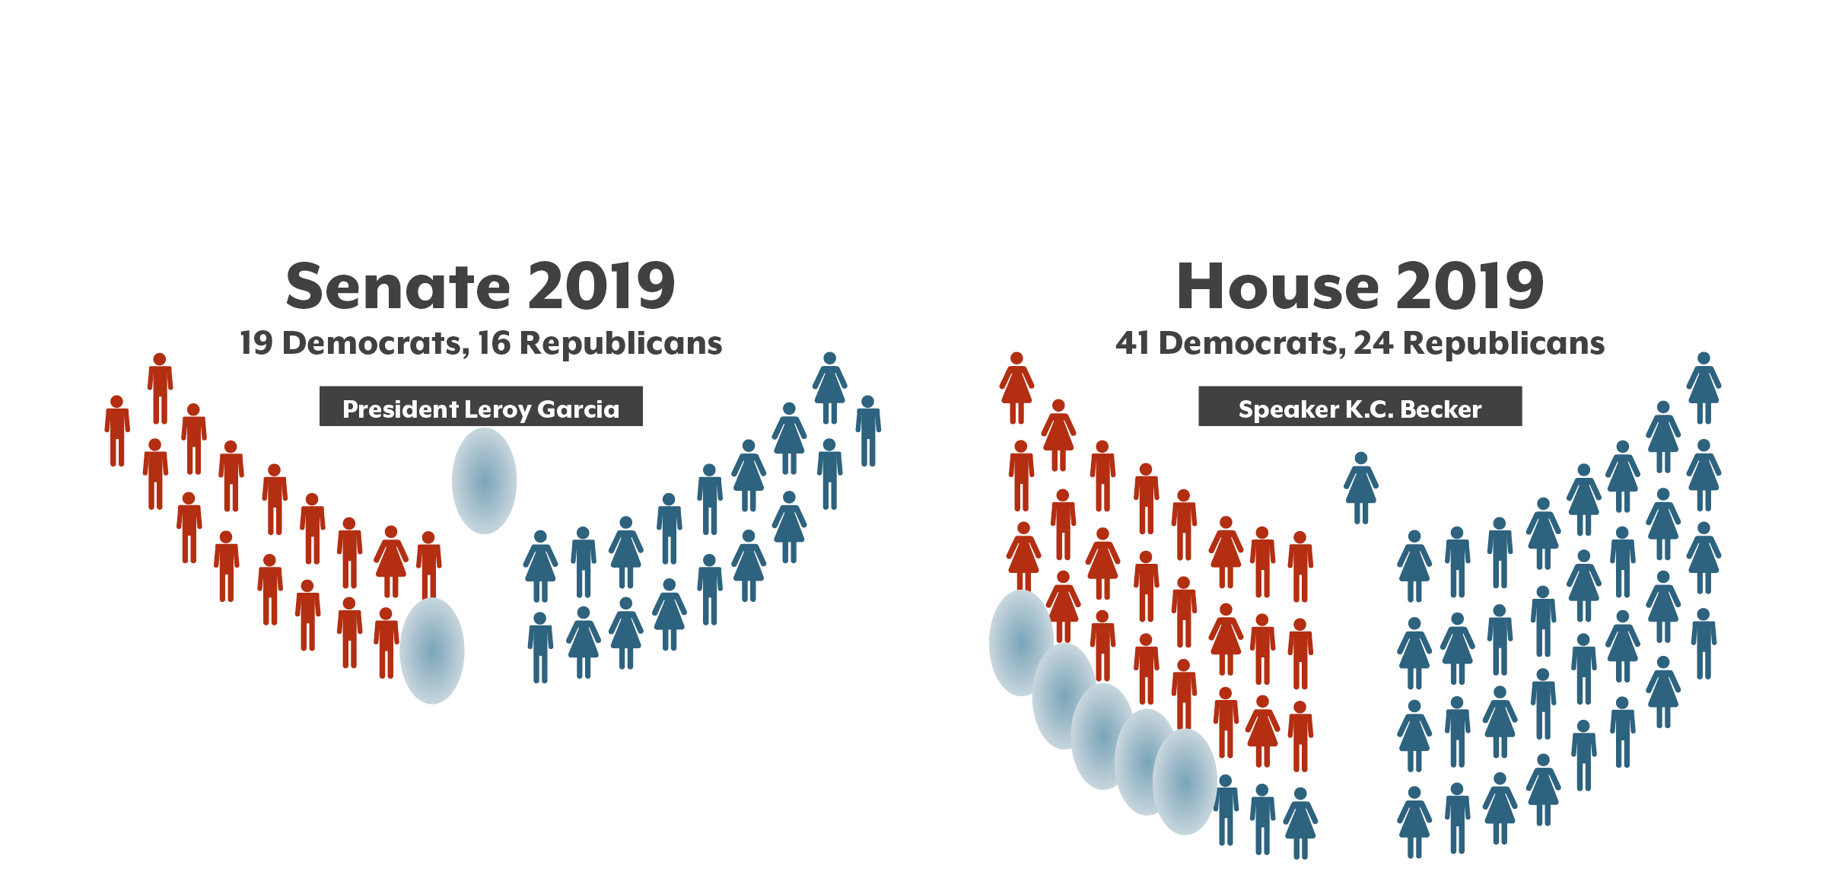
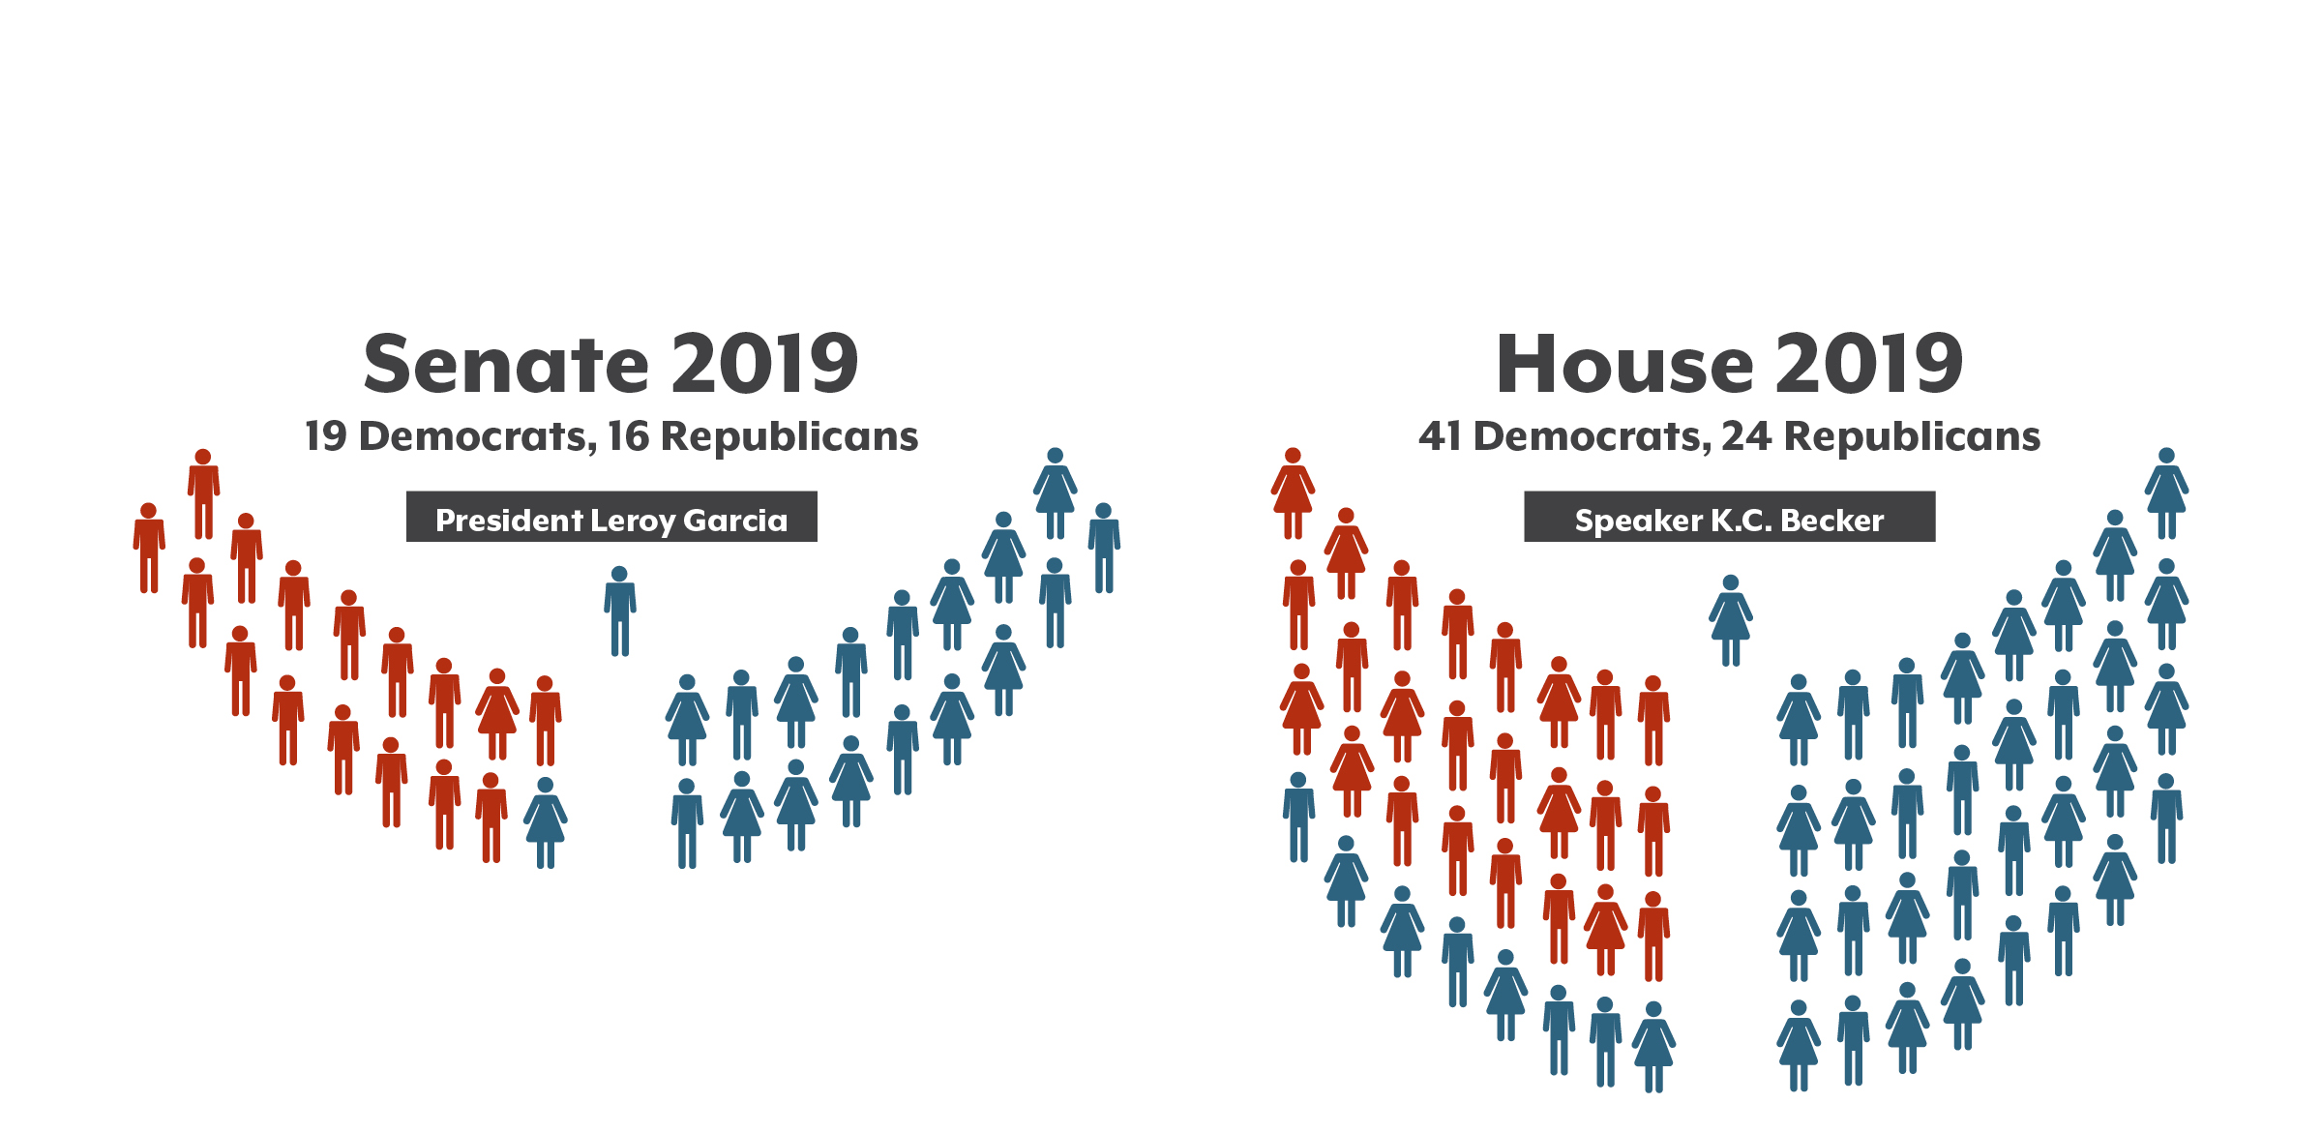
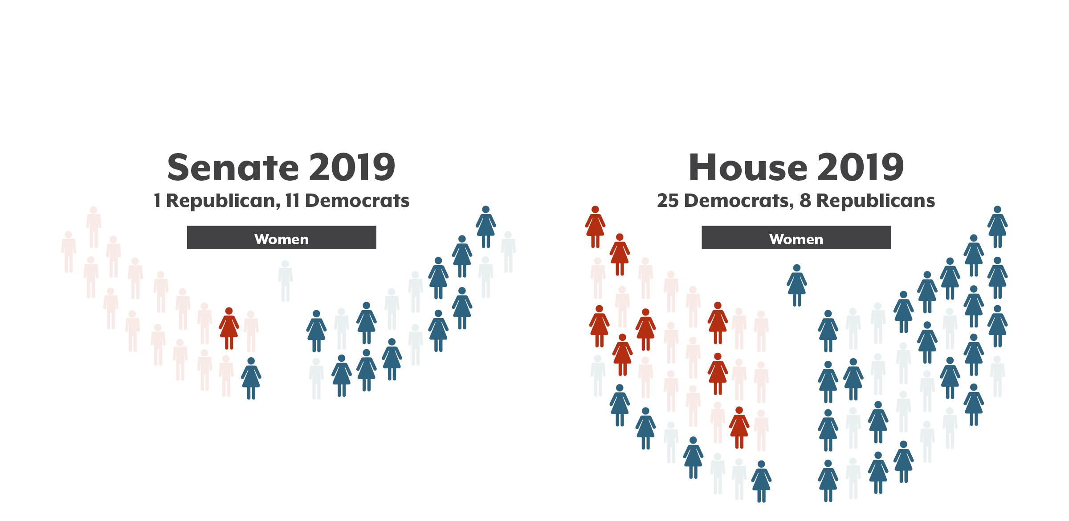

State Legislature

Slide 13
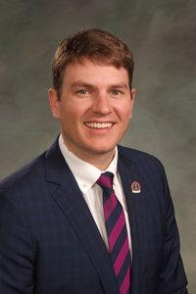
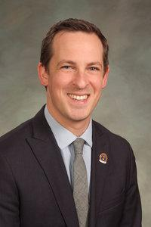
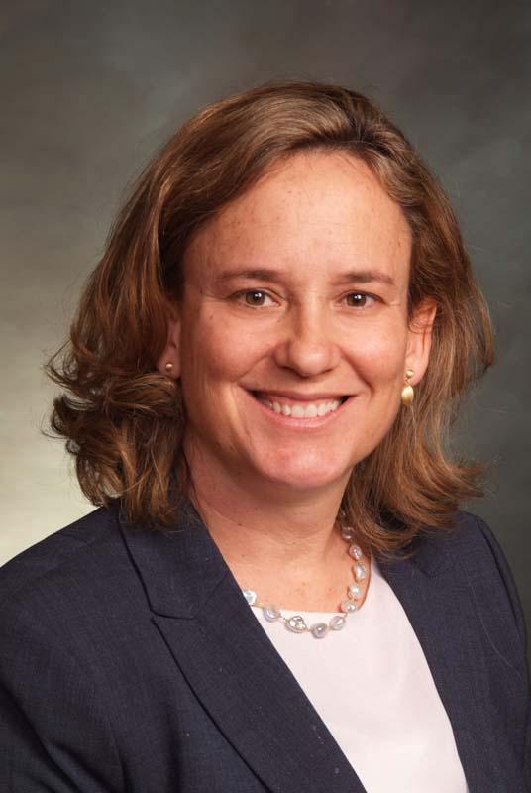
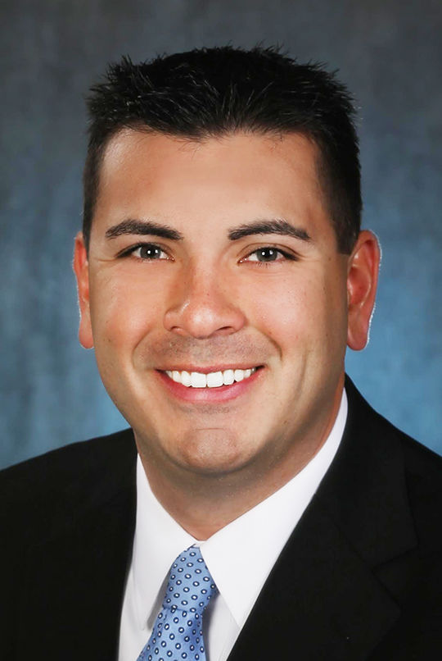
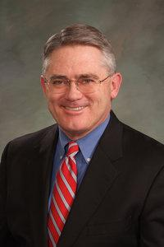
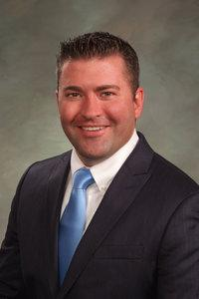
Spotlight on New Leadership
Alec Garnett
Majority Leader
Stephen Fenberg
Majority Leader
KC Becker
Speaker of the House
Leroy Garcia
Senate President
Patrick Neville
Minority Leader
Chris Holbert
Minority Leader

Slide 14
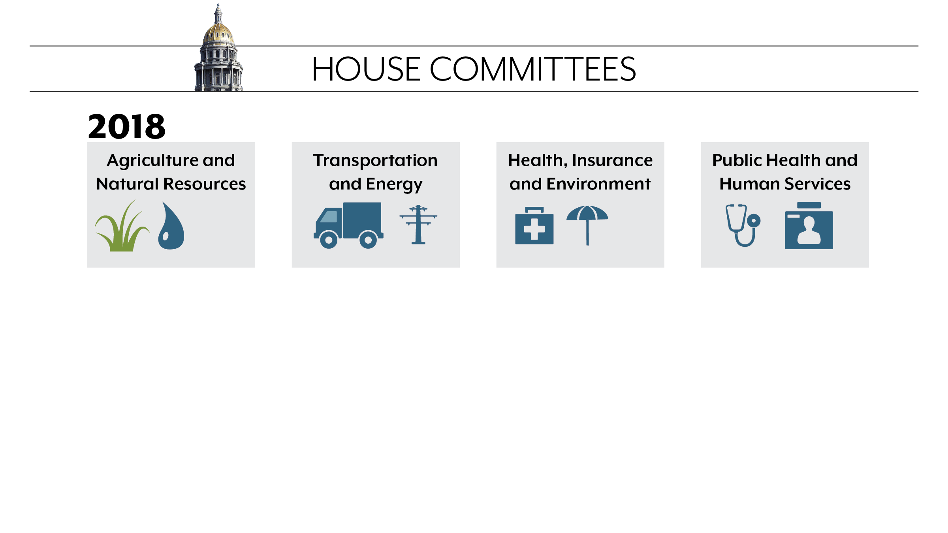
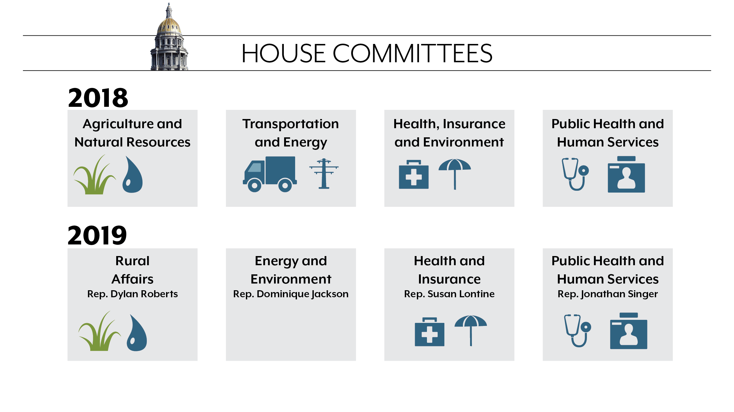





Slide 15



Terrific Turnout
62.7% of voting eligible population
76% of active voters
45% of young voters

Slide 16

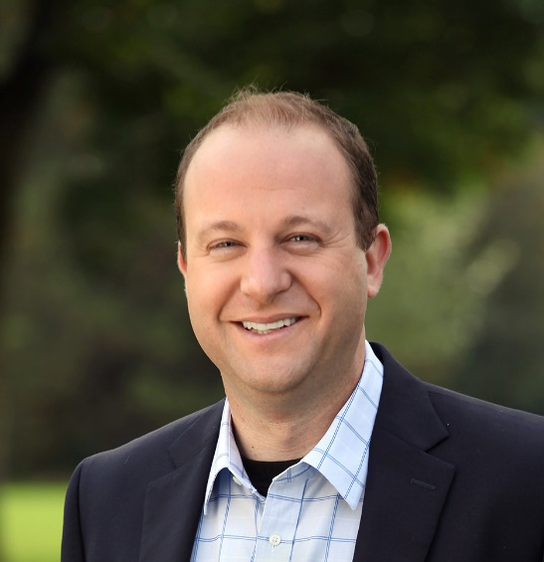
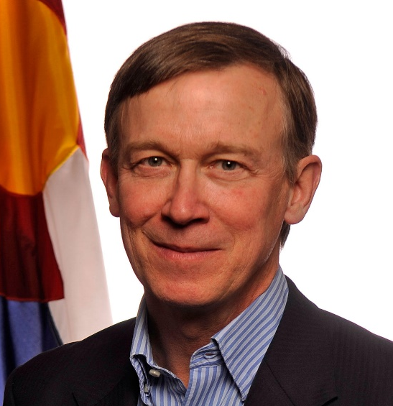
Red, Purple, Blue, or … Periwinkle?
Bluetiful
Indigo
Periwinkle
Purple Mountains’ Majesty
Fuchsia

Slide 17
Budget Will Constrain Ambitious Agendas

Slide 18


Slide 19






Slide 20

Polis: Not Another Hickenlooper

Slide 21




100-Day Health Care Road Map
Strengthen DOI’s consumer watchdog role
Modify insurance rating regions
Establish a reinsurance program
End prescription drug price gouging
End the doctor and provider shortage
Expand access to mental health treatment

Slide 22

The Royal “We”
Lieutenant Governor-elect Dianne Primavera

Slide 23












Cabinet Filled by December 26
Priorities for HCPF director:
Lower health care costs
Strive towards universal coverage
Continue to integrate mental, behavioral and physical health
Improving the delivery of care and treatment for people with disabilities

Slide 24
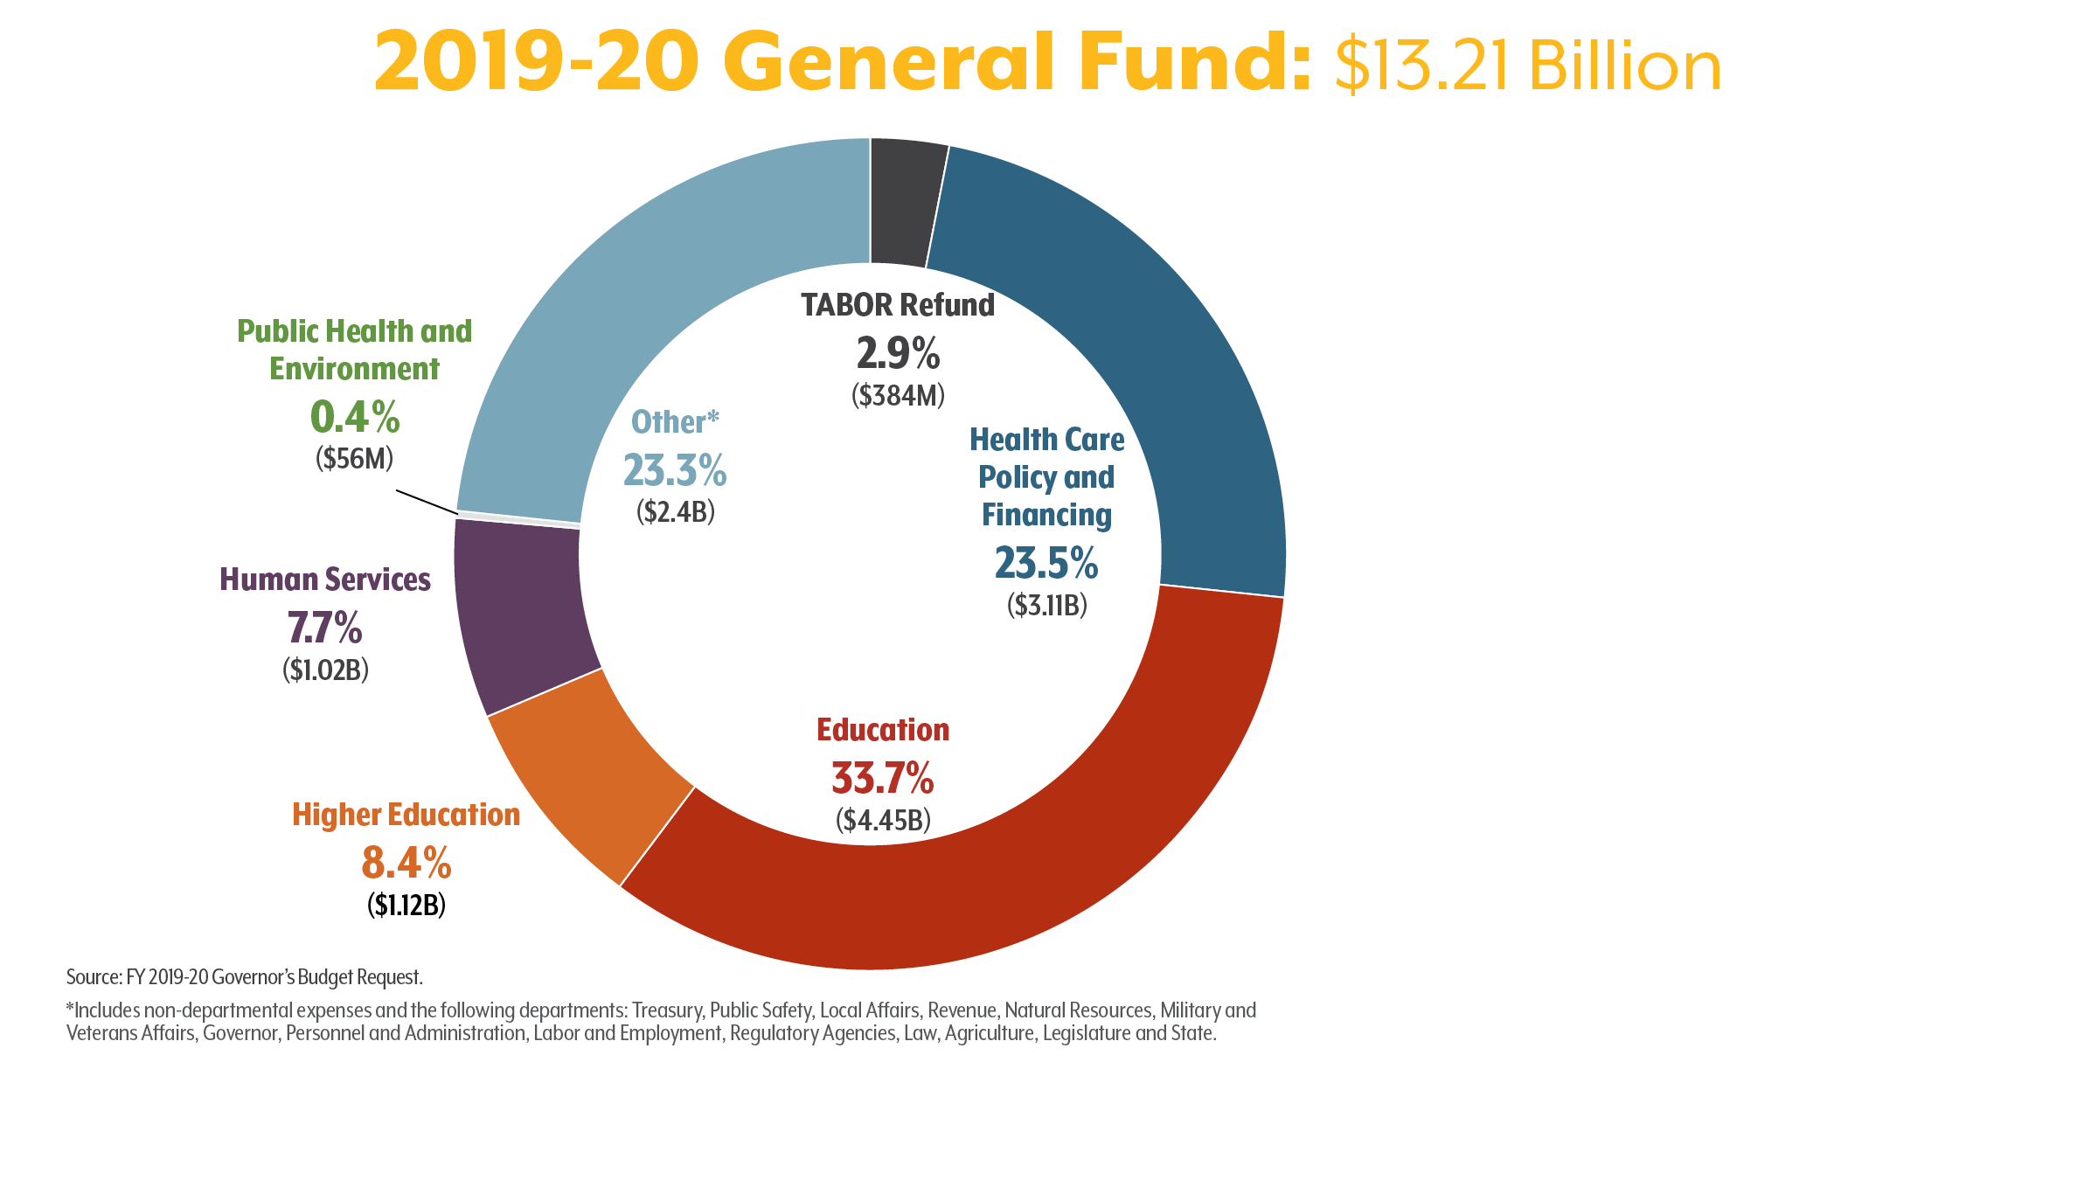
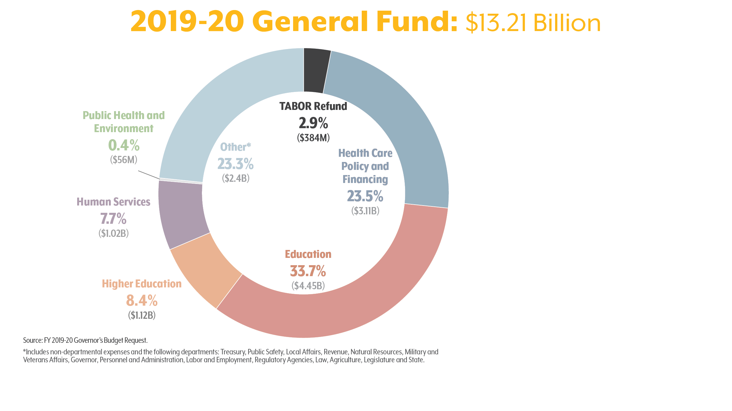
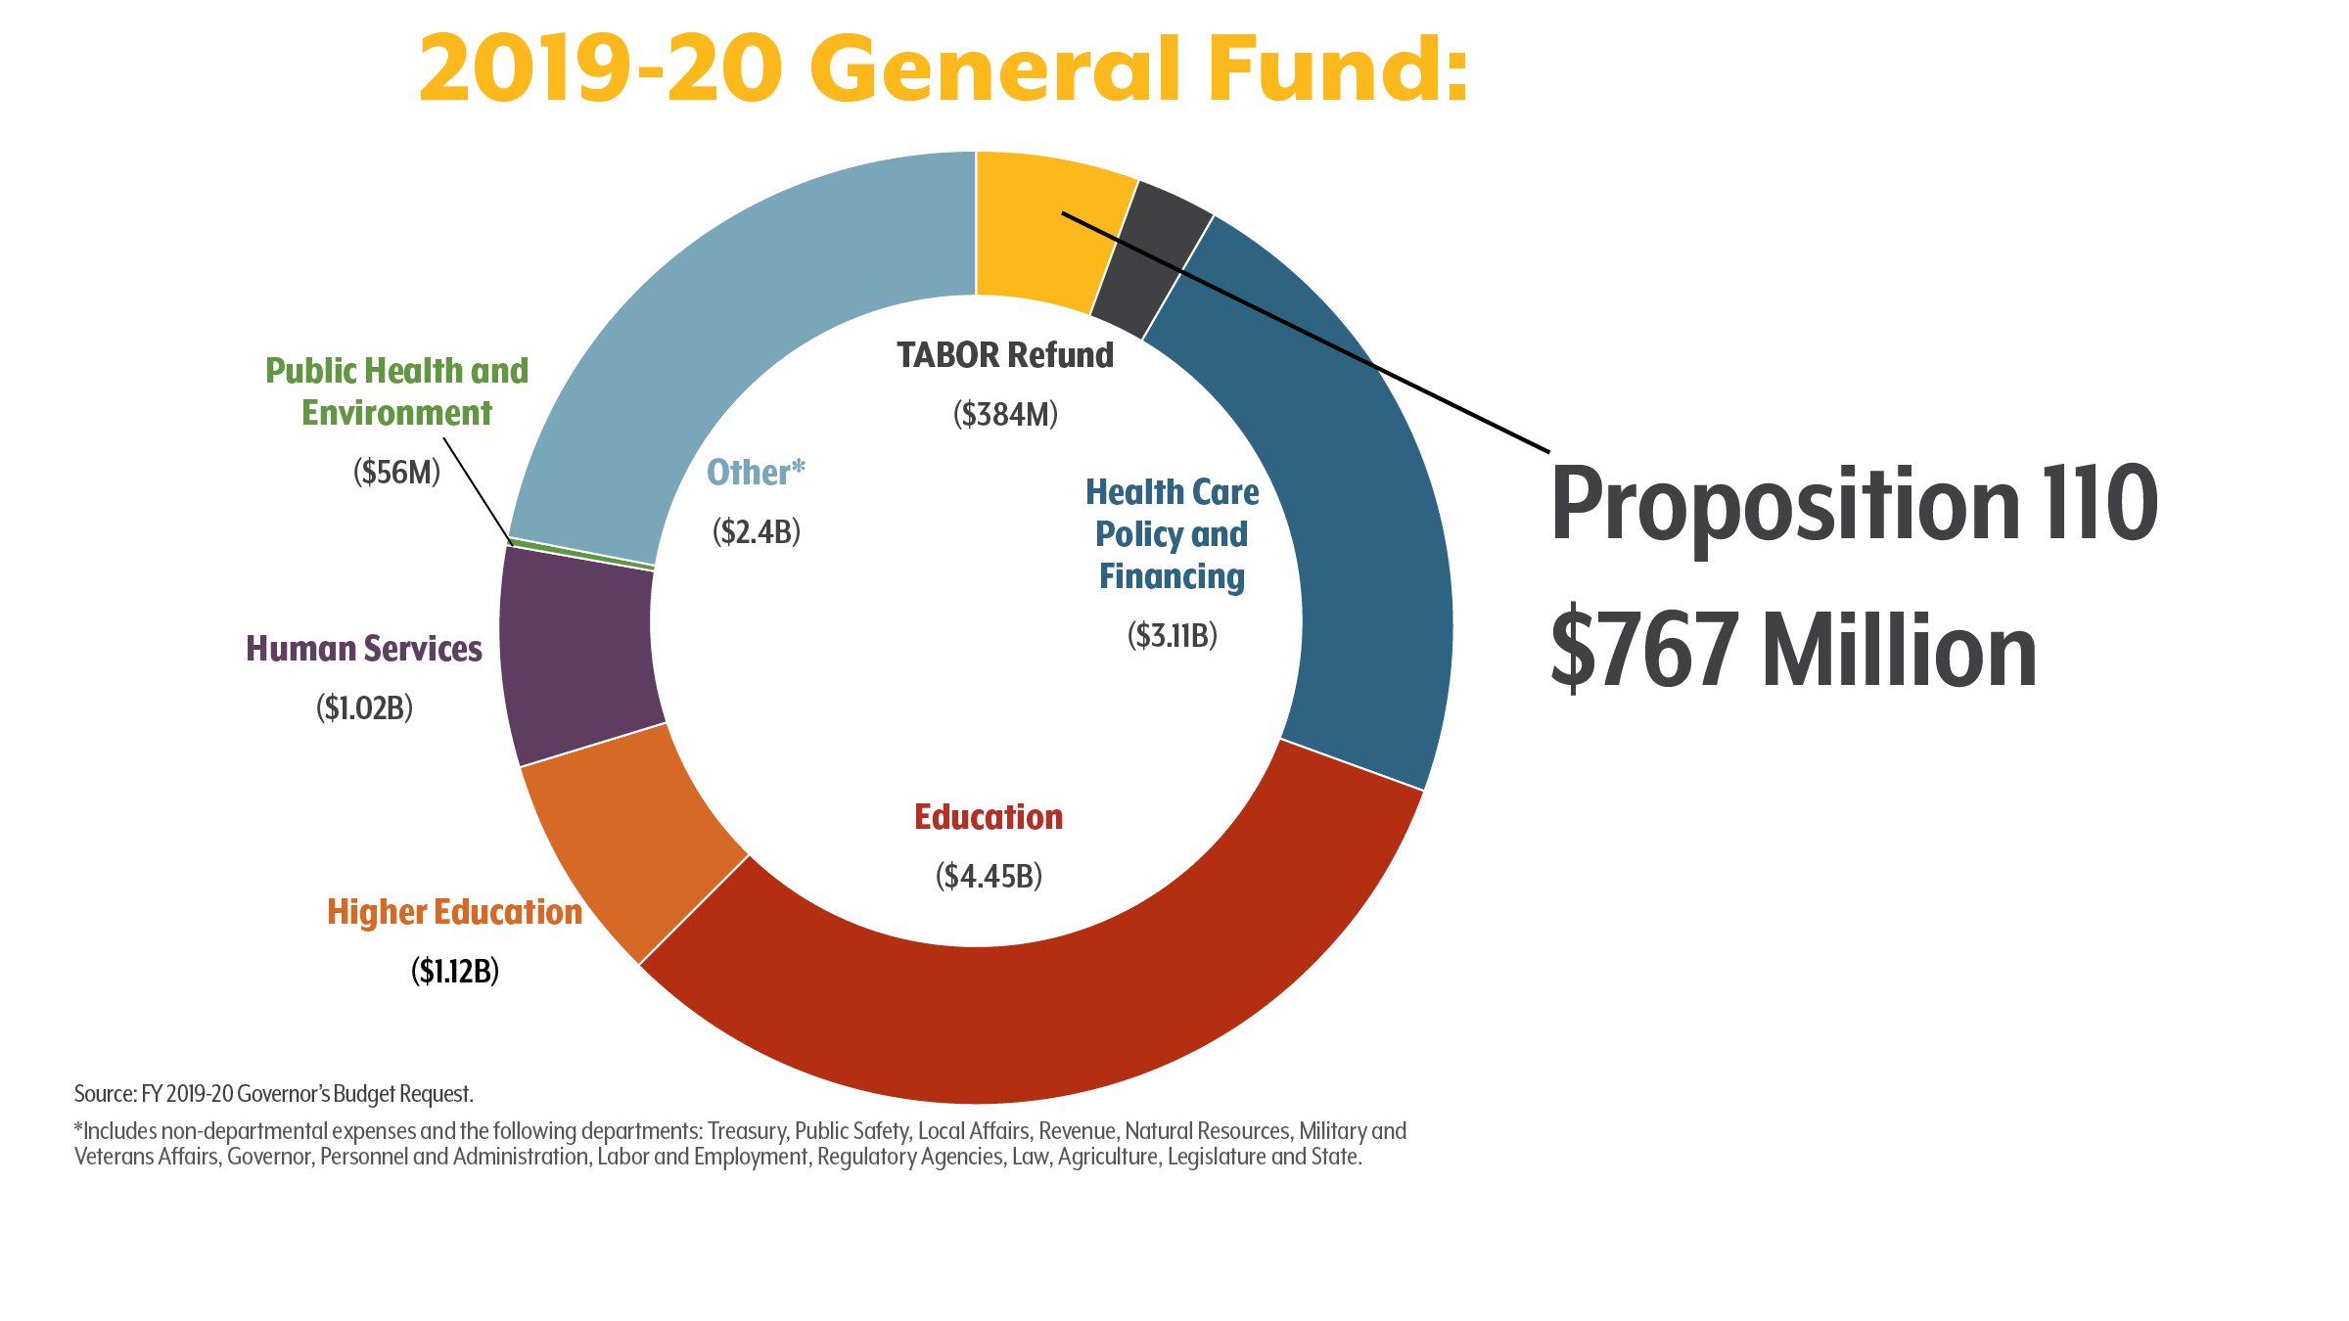
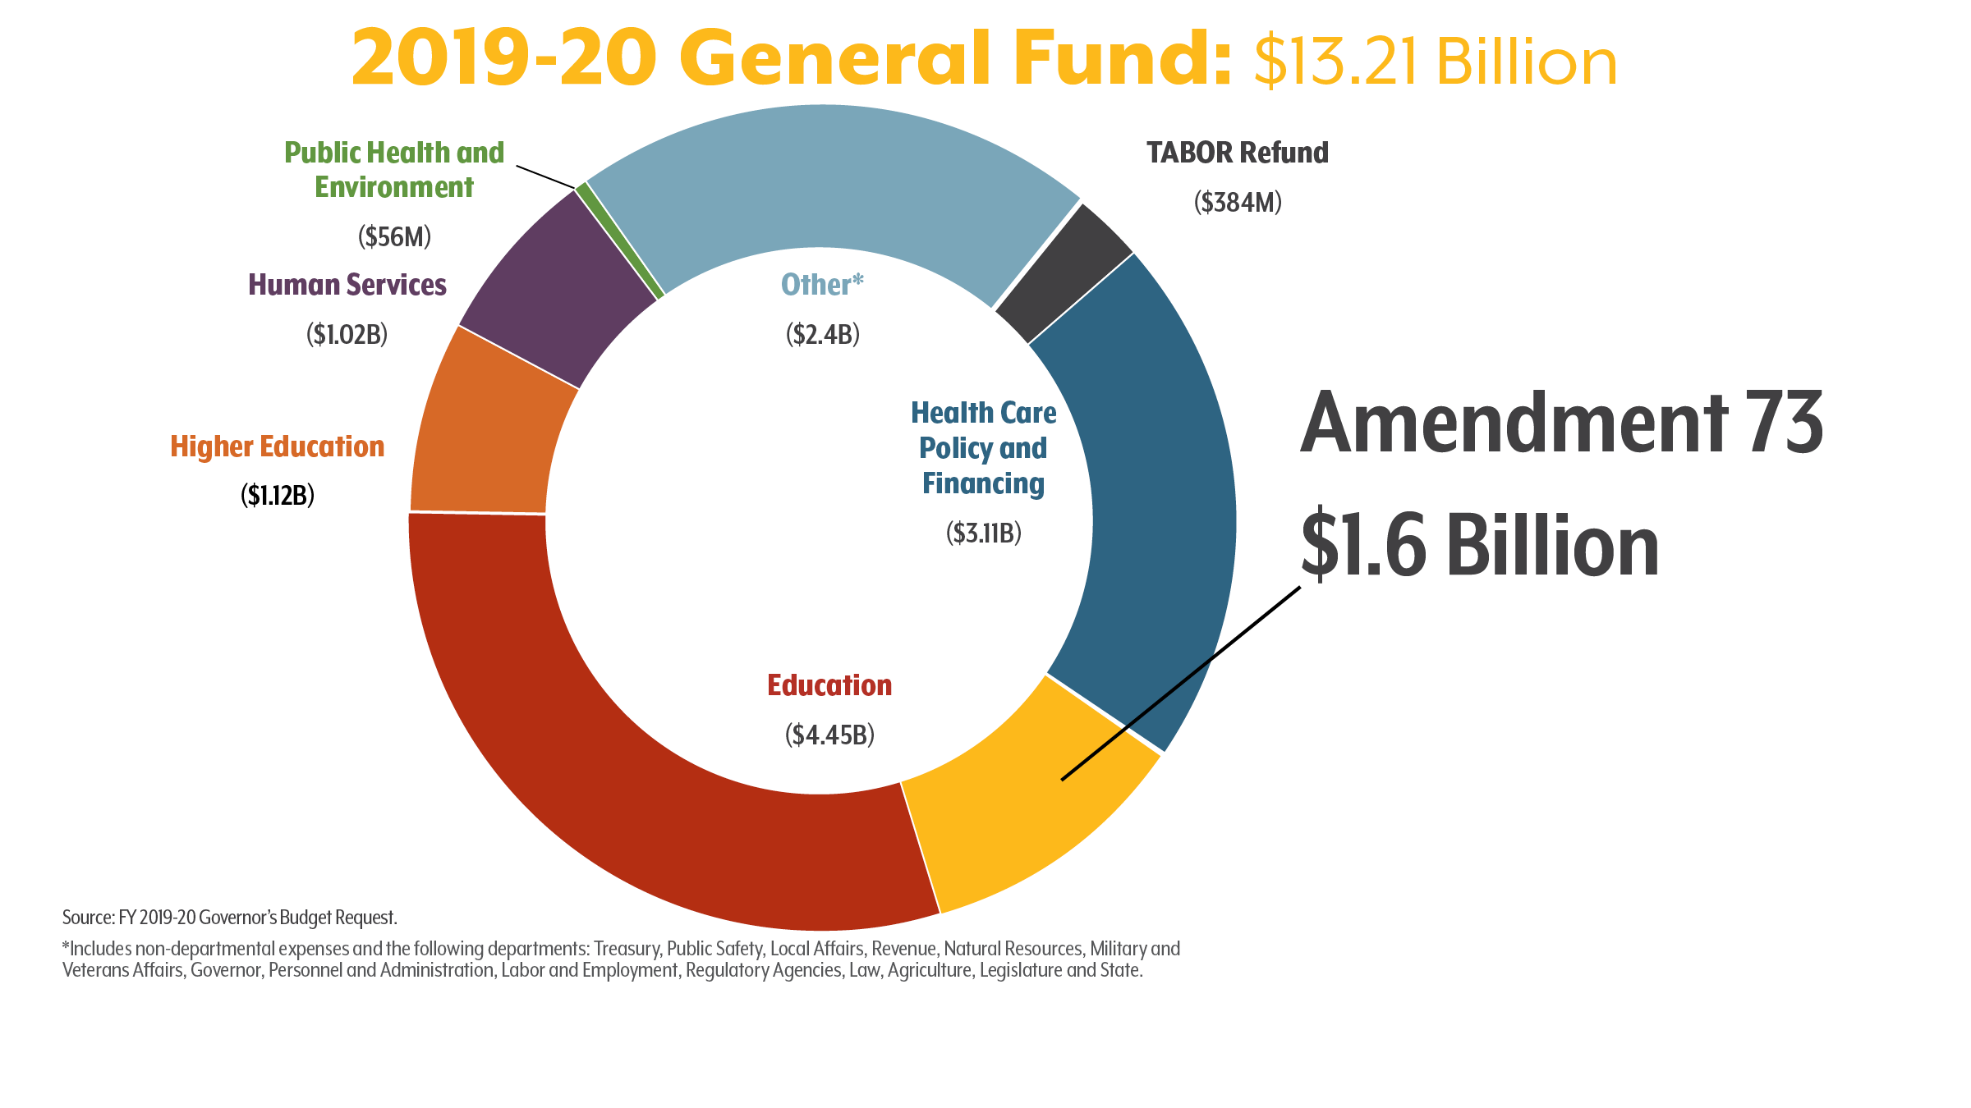
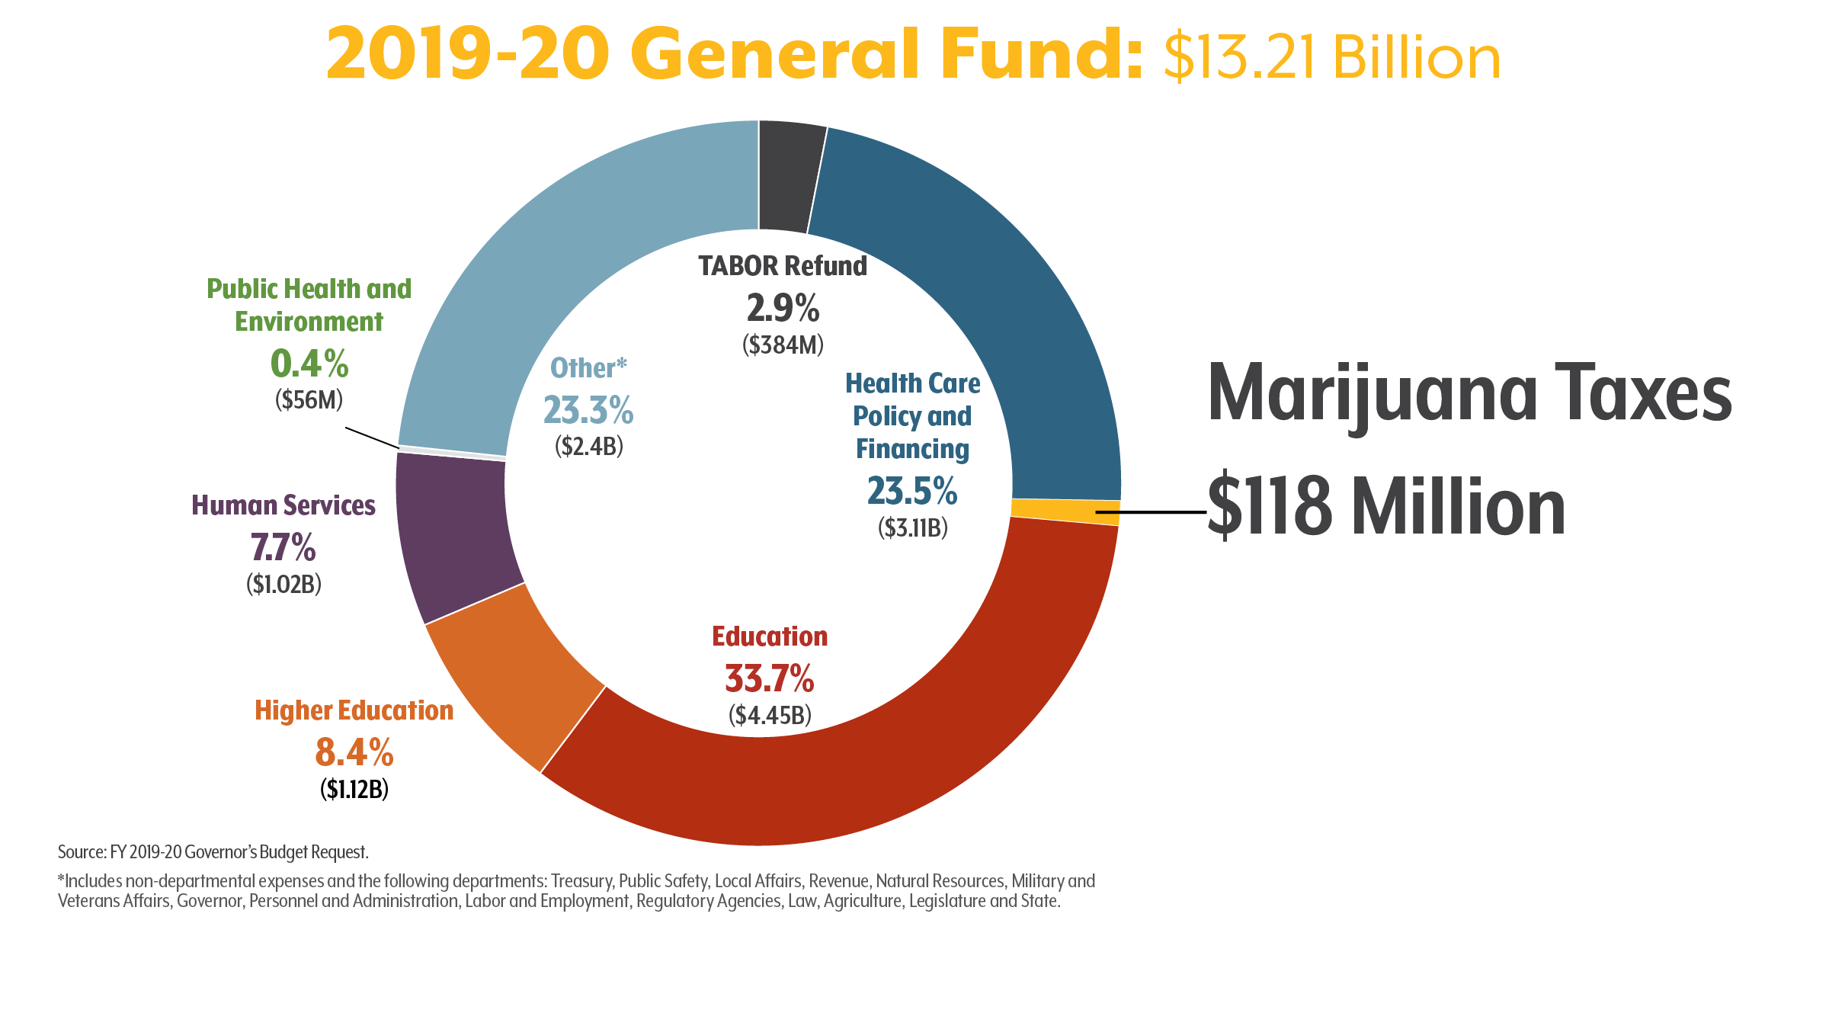

Slide 25
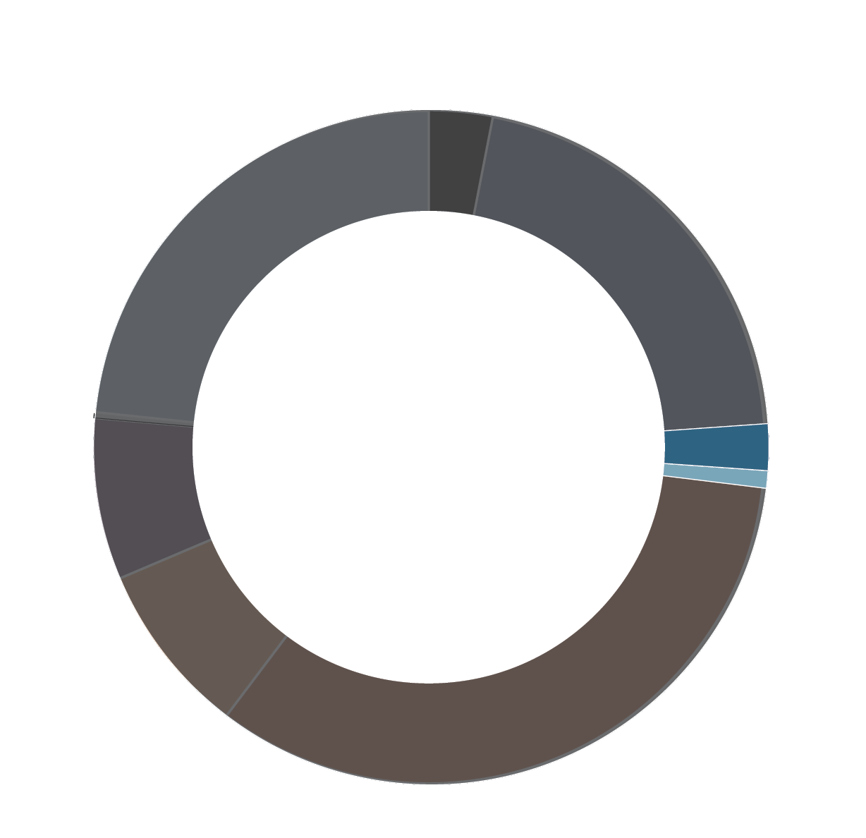
Promises,
Meet Budget
Full-day Kindergarten: $300 million
Reinsurance: $135 million
Full-Day Preschool: $50 kajillion
Also…
Passenger Rail
Rural Broadband

Slide 26
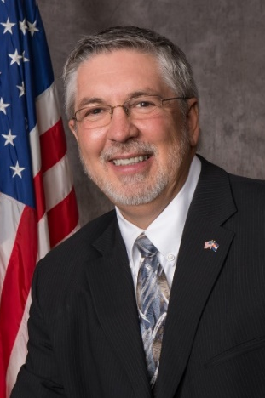
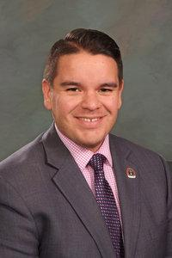
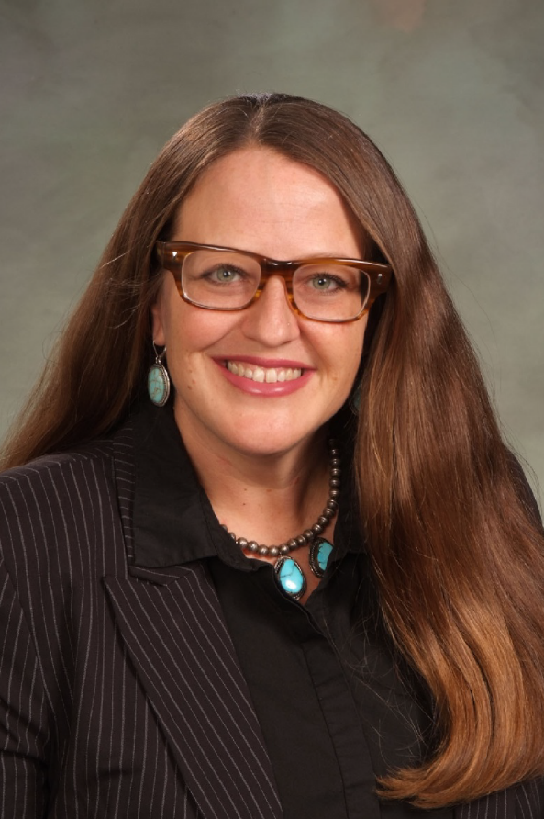
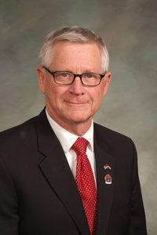
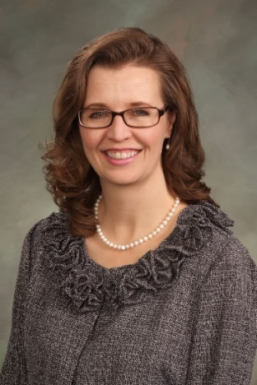
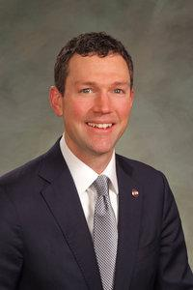
Fresh Look for the Joint Budget Committee
Sen. Dennis Hisey
Republican
Rep. Bob Rankin
Republican
Sen. Dominick Moreno
Chair
Rep. Daneya Esgar
Vice-Chair
Sen. Rachel Zenzinger
Democrat
Rep. Chris Hansen
Democrat

Slide 27
Expect Many Familiar Bill Topics

Slide 28

The Floodgates Are Open
Health Care and Insurance Costs
Transparency
Behavioral Health

Slide 29

Swimming Upstream?
Questions to ask yourself:
How much does it cost?
Is it focused on saving money or improving care?
Does it involve a fight with major industry sectors?

Slide 30
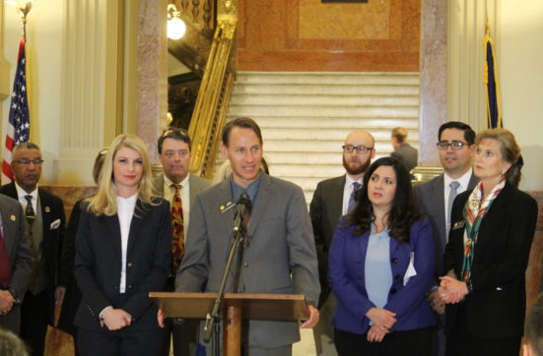
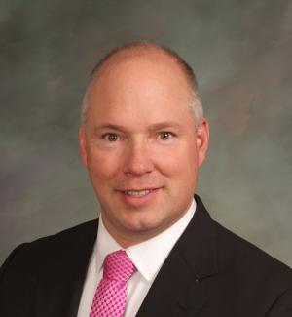
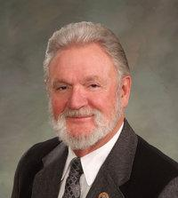
Bills to Watch: Substance Use
Opioid Study Committee:
  Bill B: Recovery Services
  Bill E: Criminal Justice
Voted down in Legislative Council Committee:
  Bill A: Treatment
  Bill C: Harm Reduction
  Bill D: Prevention

Slide 31

Bills to Watch: Mental Health
More mental health services for youth
  In schools
  Without parental consent
Mental health parity: enforce and augment laws

Slide 32

Bills to Watch: Health Costs
Transparency and Accountability
Hospital financials
Pharmaceutical prices
Consumer billing protections

Slide 33

Bills to Watch: Health Costs
Insurance Costs
Public option (Medicaid buy-in)
Reinsurance
Targeted subsidy increases

Slide 34





Bills to Watch: Grab Bag
Housing vouchers, navigators, and support services
Strengthening Maternal Mortality Review Committee
Doing more to prevent infant mortality
Creating statewide advance directive registry
Sunset reviews and malpractice damage caps

Slide 35
Hearing from You
What do YOU think is the most important issue for legislators to address during the 2019 session?
Email a word or phrase to
HIHC@coloradohealthinstitute.org
or tweet using #HIHC18

Slide 36
Three Takeaways
1.
2.
3.
Progressive Democrats will run state government in 2019.
The state budget will constrain ambitious policy agendas.
Expect to see many familiar bill topics backed by Democrats.

Slide 37


