Slide 1
The Colorado Health Institute’s Annual Legislative Forecast
Health Care Trends to Expect in the
2014 Session
December 11, 2013

Slide 2

Today’s Discussion
An overview of Colorado’s political climate heading into 2014.
What we know about the governor’s budget and its potential impact on health care.
Health care legislation and
trends that we expect to see.

Slide 3
Three Takeaways
Recalls and 2014 elections will change the political calculus.
Health care legislation in 2014 is likely to be characterized by small changes.
Health topics will fall into a few buckets:
  Health Reform Clean-up
  Outcomes of Task Forces
  The Grab Bag

Slide 4
Post-Election State of Affairs
With the federal political field stable
going into 2014, we turn to state activity.
The balance of state power is the same,
but the calculus has changed:
  Governor (D) Senate (D) House (D)
  New Senate majority 18-17
Some leadership shifts.
Run-up to the 2014 state elections.

Slide 5

2014: A Year of Watershed Health Care Legislation?
No.
Mostly “reflection” on health care legislation.
Education may be the issue to take center stage.

Slide 6
The Governor’s Budget Proposal and Health Care

Slide 7
The Governor’s Budget Proposal FY14-15
State Context
State’s financial position continues to improve.
Exceeded the
pre-Great Recession
peak employment level.
Funding being restored to many programs and state reserves rebuilt.
The Governor and K-12 education saw the defeat of Amendment 66 by voters.
Federal Context
National economy remains sluggish.
Federal budget uncertainty.
Ongoing implementation of the ACA.

Slide 8
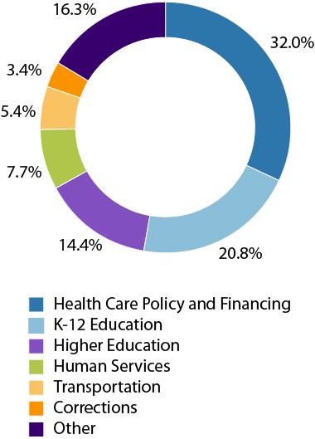
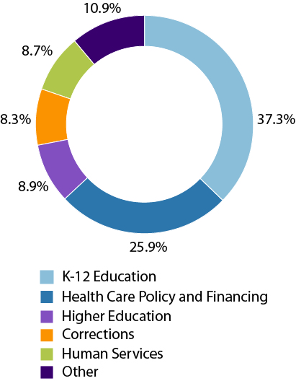
Governor’s Proposed Budget: The Big Picture
Highlights:
A bit of breathing room compared to last year.
Increases in spending for most departments.
Focus on programs for persons with developmental disabilities.
FY 2014-15 Total Funds
FY 2014-15 General Fund

Slide 9
Department of Health Care Policy and Financing:
FY 2014-15 Proposal
Highlights:
Includes funds to support Medicaid caseload expansion.
Increases Medicaid provider rates by 1.5 percent.
New resources for programs that serve people with developmental disabilities.
New project: the Primary Care Specialty Collaborative
FY 13-14
Enacted:
$6.5 Billion
Proposed FY 14-15 Budget:
$7.5 Billion
Total
Increase:
15.5 percent

Slide 10
Department of Human Services:
FY 2014-15 Proposal
FY 13-14 Enacted:
$2.2 Billion
Proposed FY 14-15 Budget:
$1.8 Billion
Total Increase:
-17.7 percent
Highlights:
1.5 percent community provider rate increase.
Funding to enhance the quality of early childhood programs.
Investment in the Colorado Mental Health Institutes.

Slide 11
Department of Public Health and Environment:
FY 2014-15 Proposal
FY 13-14 Enacted:
$524 Million
Proposed FY 14-15 Budget:
$554 Million
Total Increase:
5.7 percent
Highlights:
$7.1 million from the Medical Marijuana Cash Fund to grant research on the health effects of marijuana on various diseases and disorders.
$12 million to support community improvements in wastewater and drinking water infrastructure.

Slide 12
Colorado’s General Assembly in 2014

Slide 13
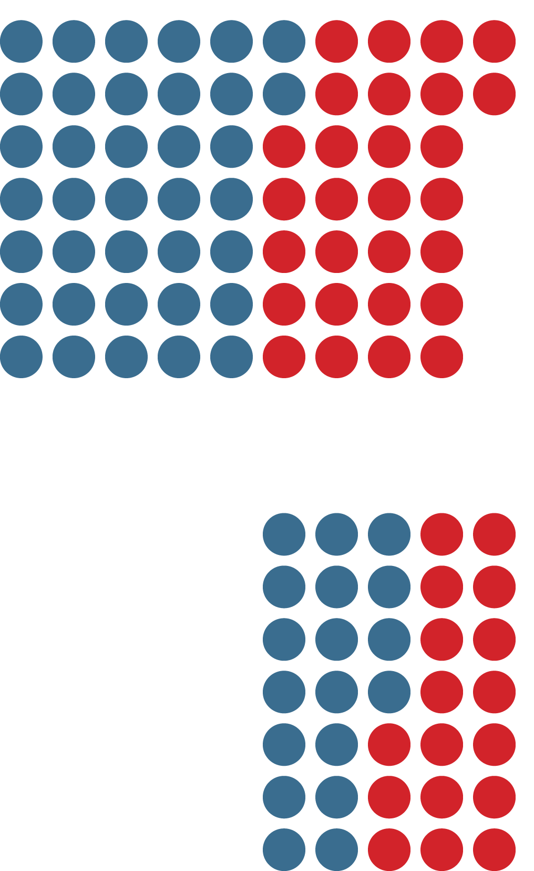
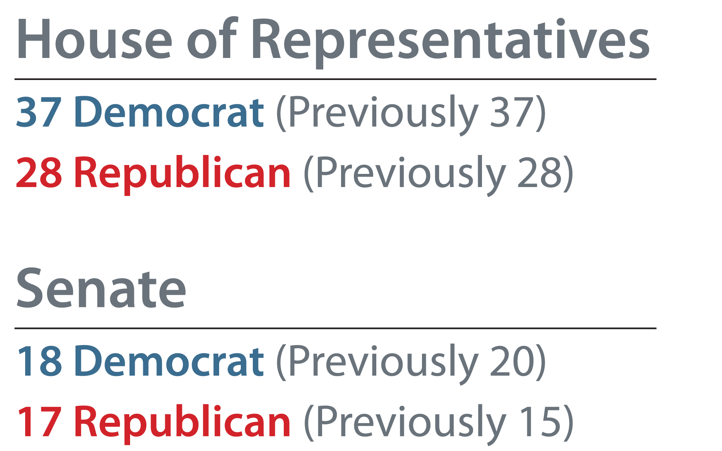
Colorado’s 2014 General Assembly

Slide 14
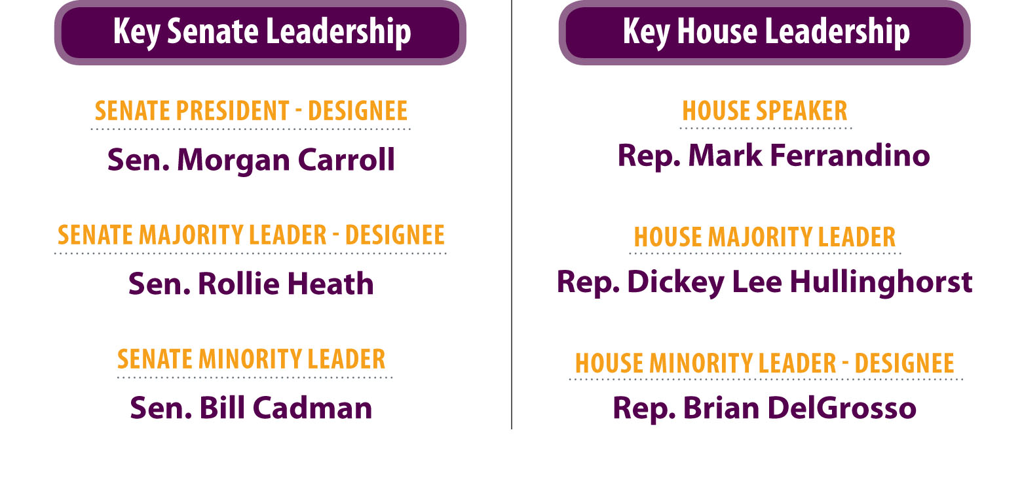
Who’s Leading the Charge?

Slide 15
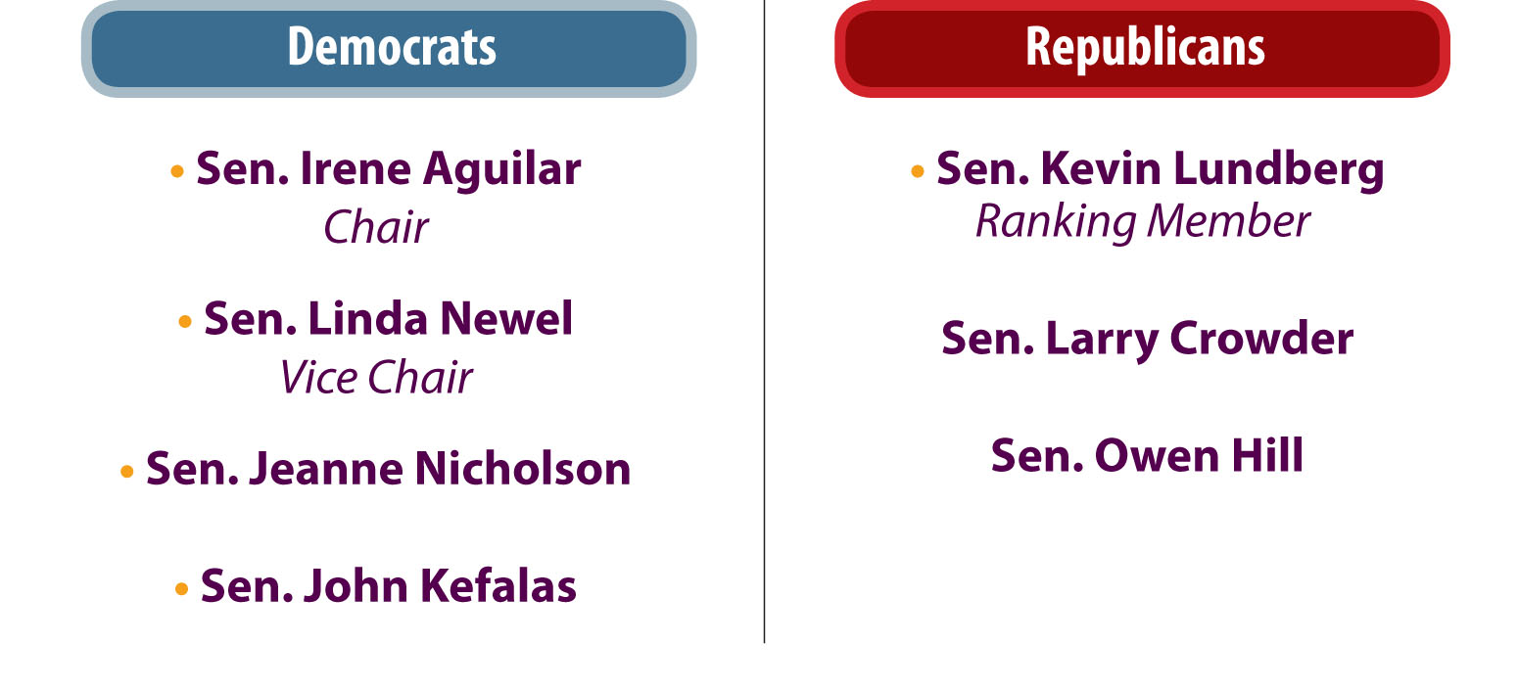
2014 Senate Health and Human Services Committee

Slide 16
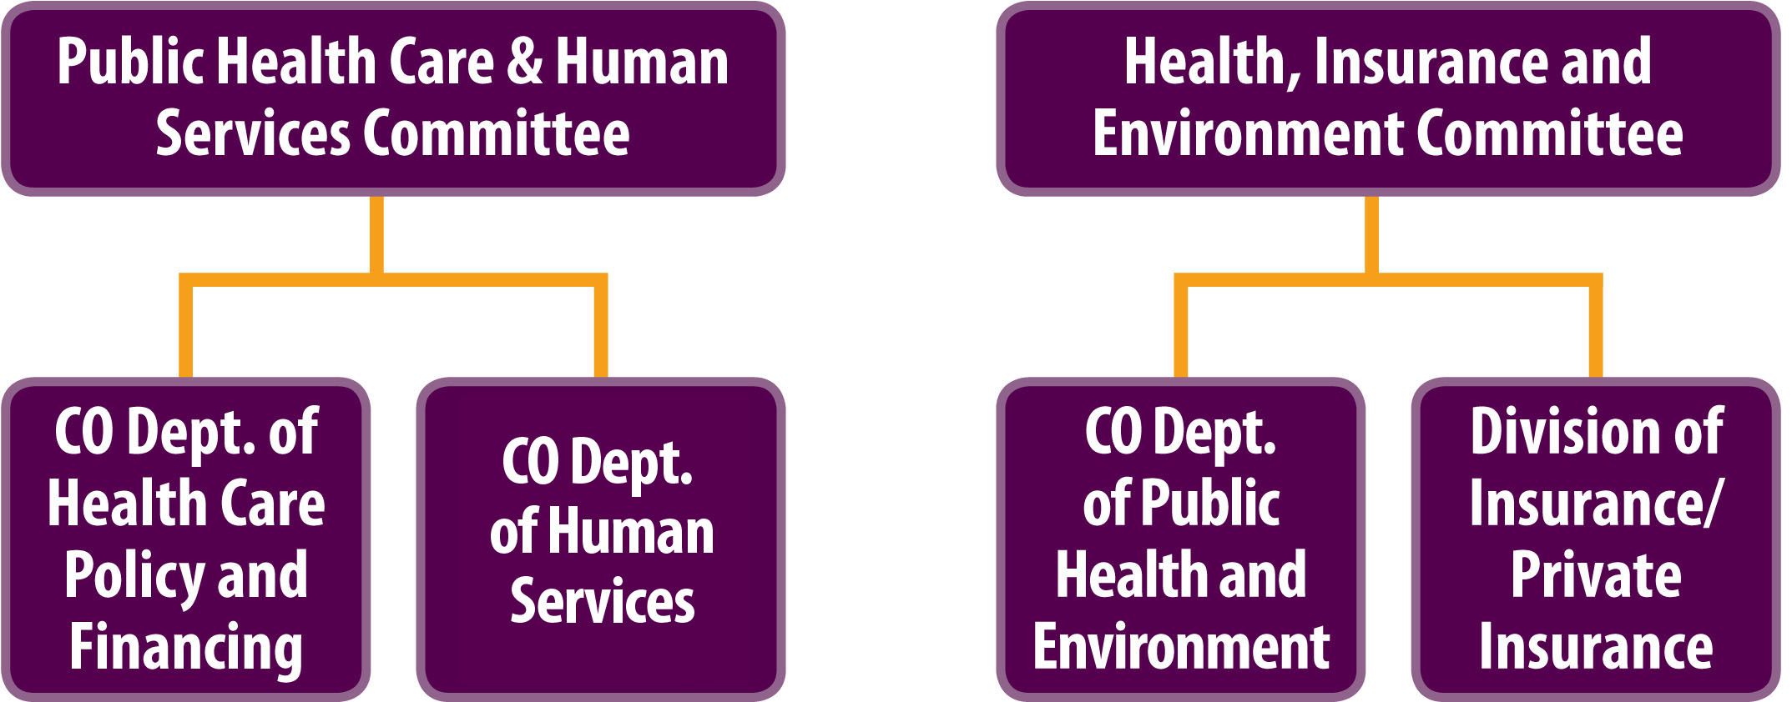
House Health Committees

Slide 17
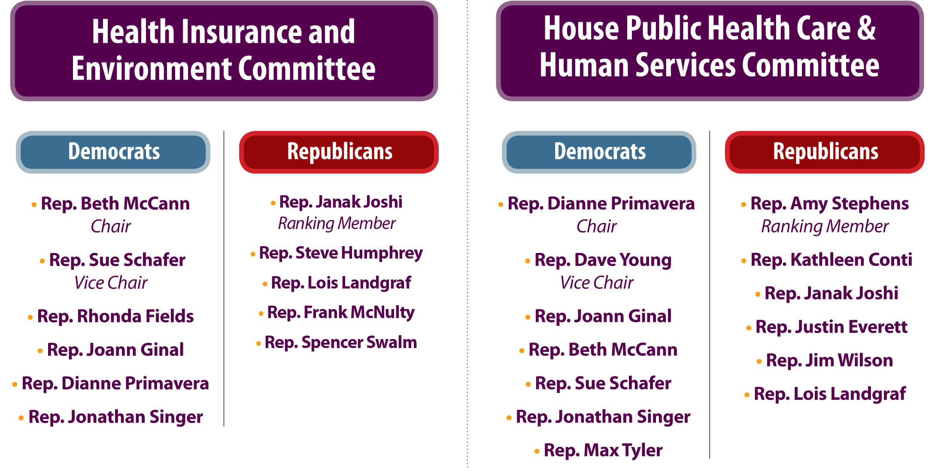
House Health Committees: Membership

Slide 18
Key Health Care Legislation Anticipated
in 2014

Slide 19
Three Major Legislative Themes
Health Reform Clean-up
Outcomes of Task Forces
and Committees
The Grab Bag

Slide 20

Theme One:
Health Reform Clean-up
Insurance Offerings – Consistency inside and outside of the marketplace.
Simplifying Medicaid Eligibility Categories – Major reduction and consistency with federal standard.

Slide 21
Theme Two:
Outcomes of Task Forces and Committees
Civil Commitments – Behavioral Health Advanced Directives
Sunset reviews
***************************************
Childhood vaccines
Social Determinants of Health

Slide 22
Theme Three:
The Grab Bag
Free-standing Emergency Rooms
Suicide Prevention
Breast and Cervical Cancer Program extension
Technical change for Nursing Facility rates
Adjusting Advance Practice Nurse training requirements
***************************************
Obesity Prevention Caucus

Slide 23
General Assembly: 2014 Key Dates
Deadline to introduce Senate Bills
Deadline to Introduce House Bills
Convene
Passage of SBs in Senate and HBs in House
Introduction of long bill in House
Legislative Timeline
Jan 8
Jan 24
Jan 29
Feb 26
March 24
Final passage of Senate-originating bills in House
Final passage of House-originating bills in Senate
Final passage of long bill in House
Appropriation Committee Complete
Adjourn
Mar 28
Mar 31
April 7
April 11
May 7

Slide 24
Three Takeaways
Recalls and 2014 elections will change the political calculus.
Health care legislation in 2014 is likely to be characterized by small changes.
Health topics will fall into a few buckets:
  Health Reform Clean-up
  Outcomes of Task Forces
  The Grab Bag

Slide 25




