Slide 1
2013 Key Findings
November 2013

Slide 2

A CHAS Primer

Slide 3

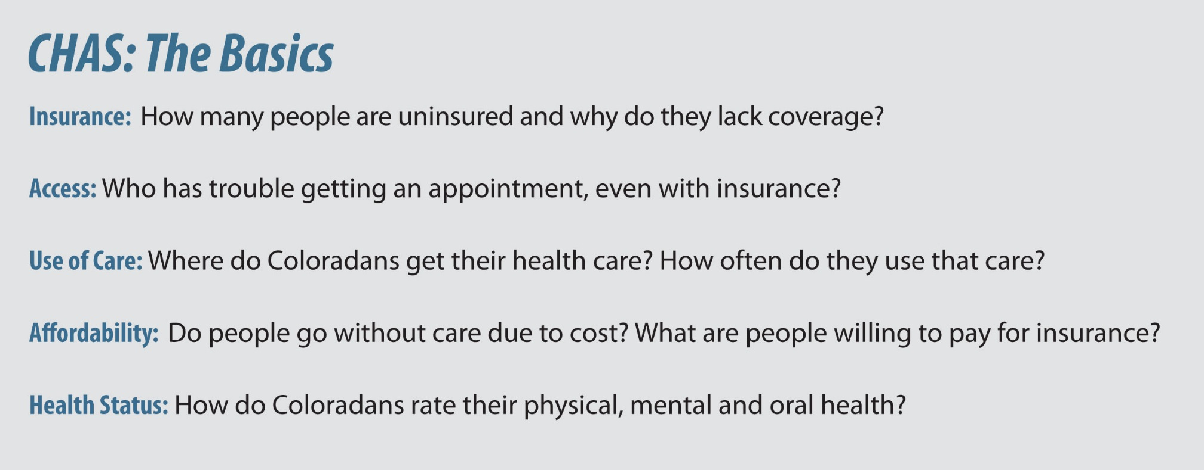
CHAS: The Questions It Answers

Slide 4
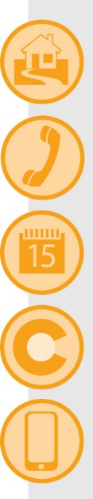
CHAS: How It’s Fielded
Who: 10,224 randomly selected households
What: Twenty-minute telephone survey
When: Between April 15 and July 27, 2013
Where: Statewide, divided among 21 Health Statistics Regions
Why: To gather information that can inform policy-making and help measure health reform efforts

Slide 5

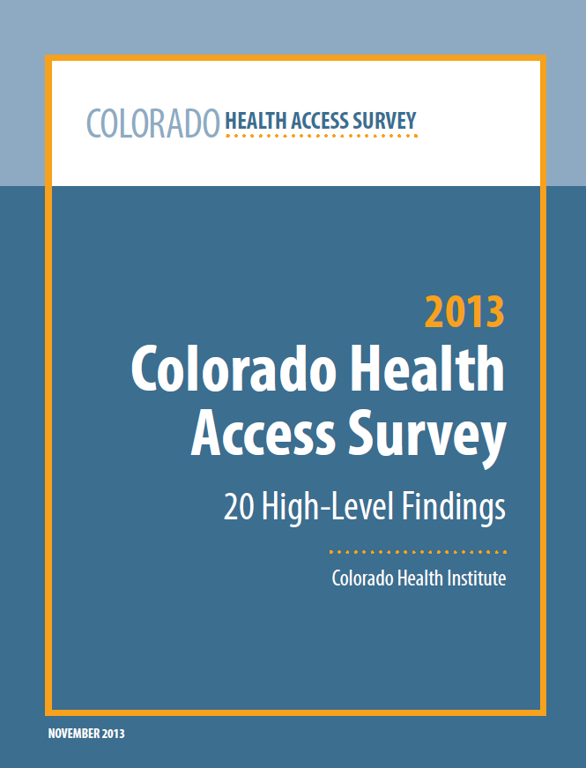
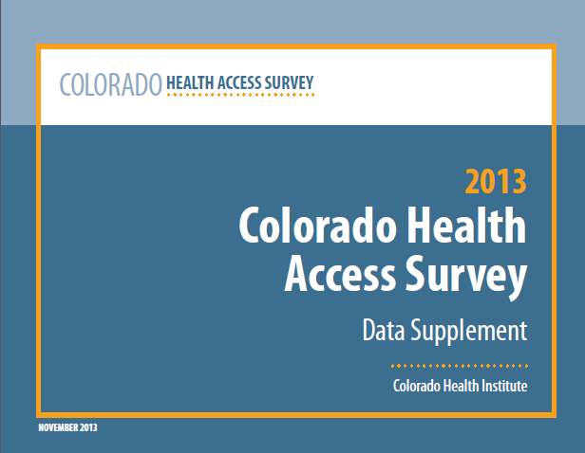
CHAS: What’s New For 2013
Sets a baseline for health reform
Trends three years of data
Adds questions
Makes data
more accessible

Slide 6
Coverage and the Uninsured
Notes:
Now let’s get to the data.

Slide 7
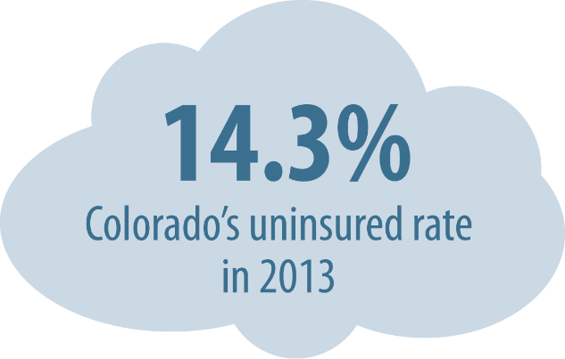

2013 Uninsured Rate

Slide 8
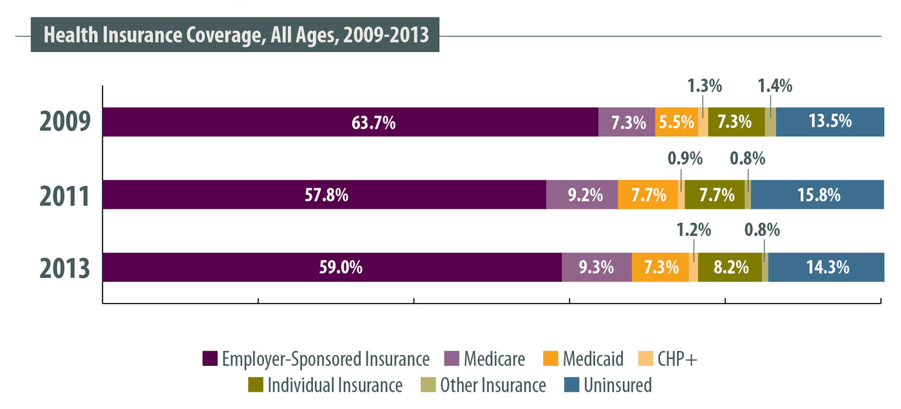
2013 Health Insurance Coverage Rates

Slide 9
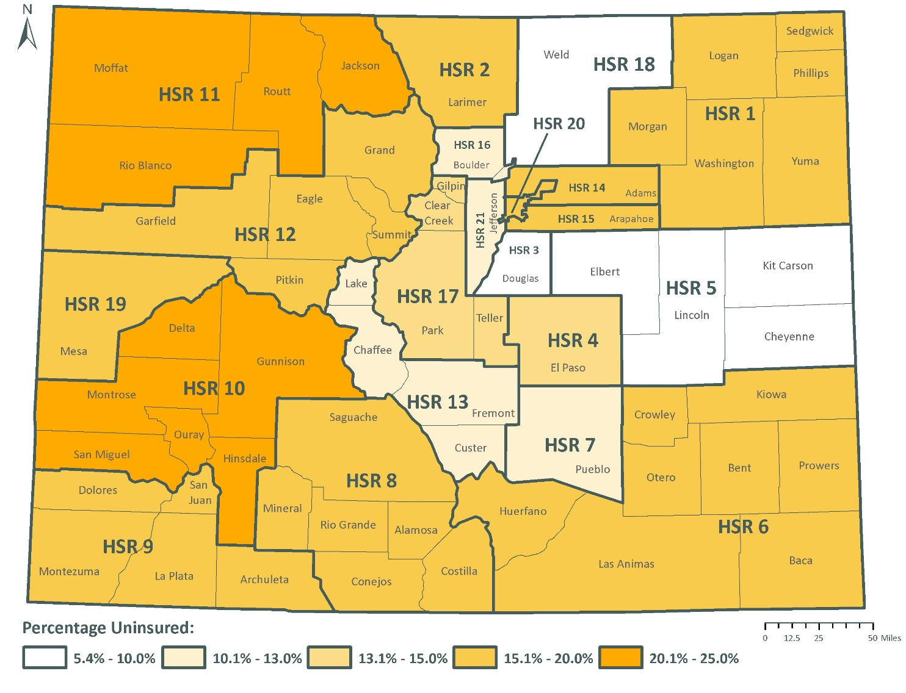
Uninsured Rates by Region

Slide 10
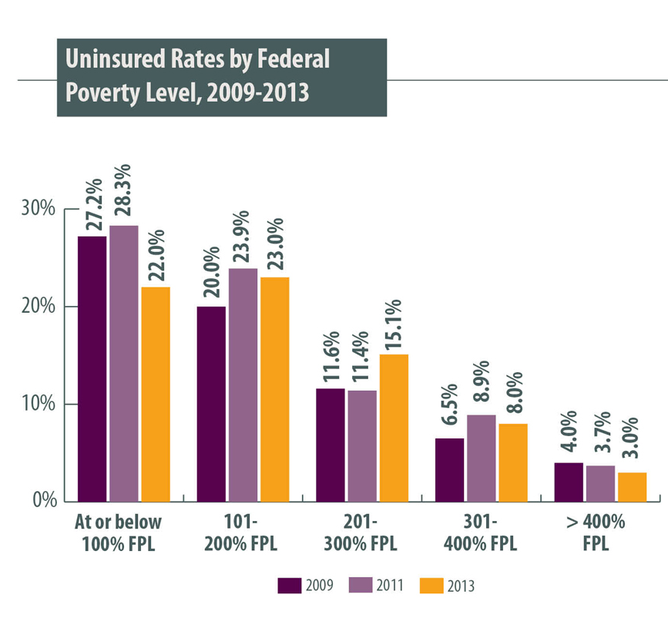
Uninsured Rates by Income
Lower-income Coloradans most likely to be uninsured
Uninsurance rates dropped for most income levels
One income bracket saw uninsured rates rise: 201-300% FPL

Slide 11
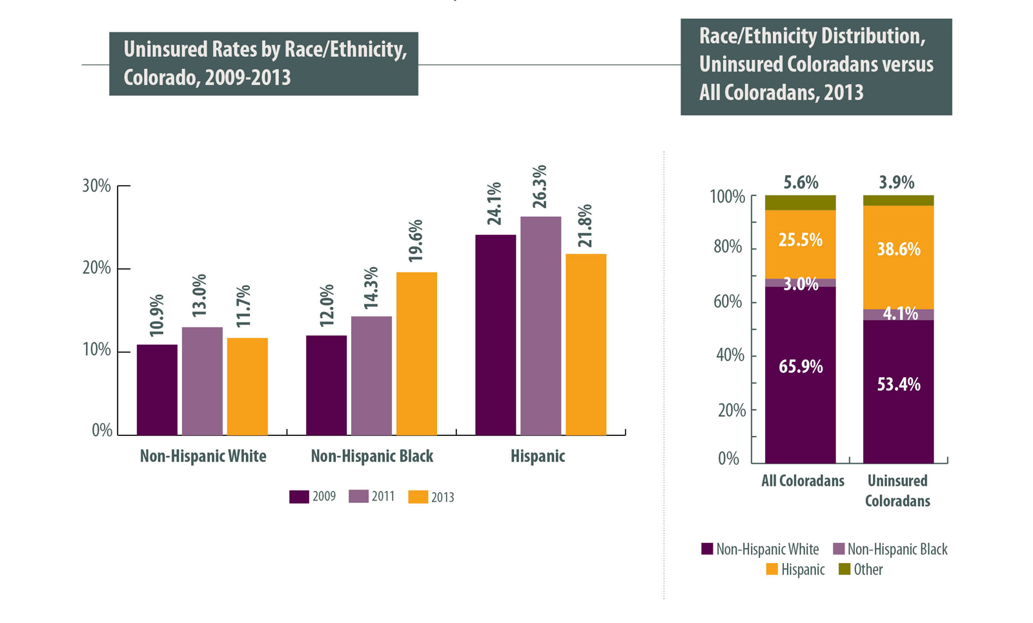
Uninsured Rates By Race/Ethnicity

Slide 12
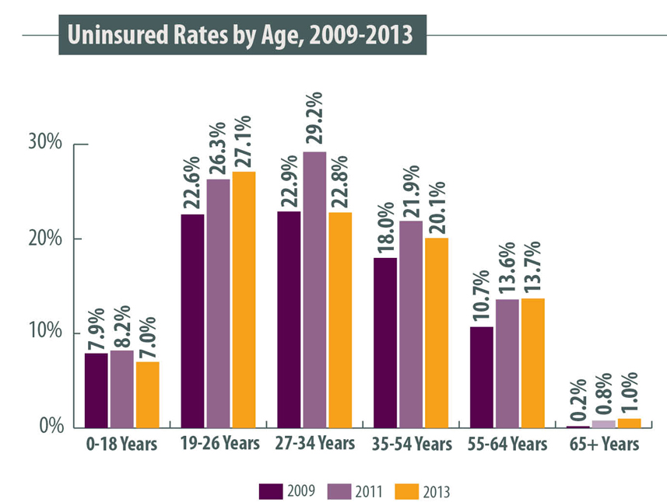
Uninsured Rates by Age

Slide 13
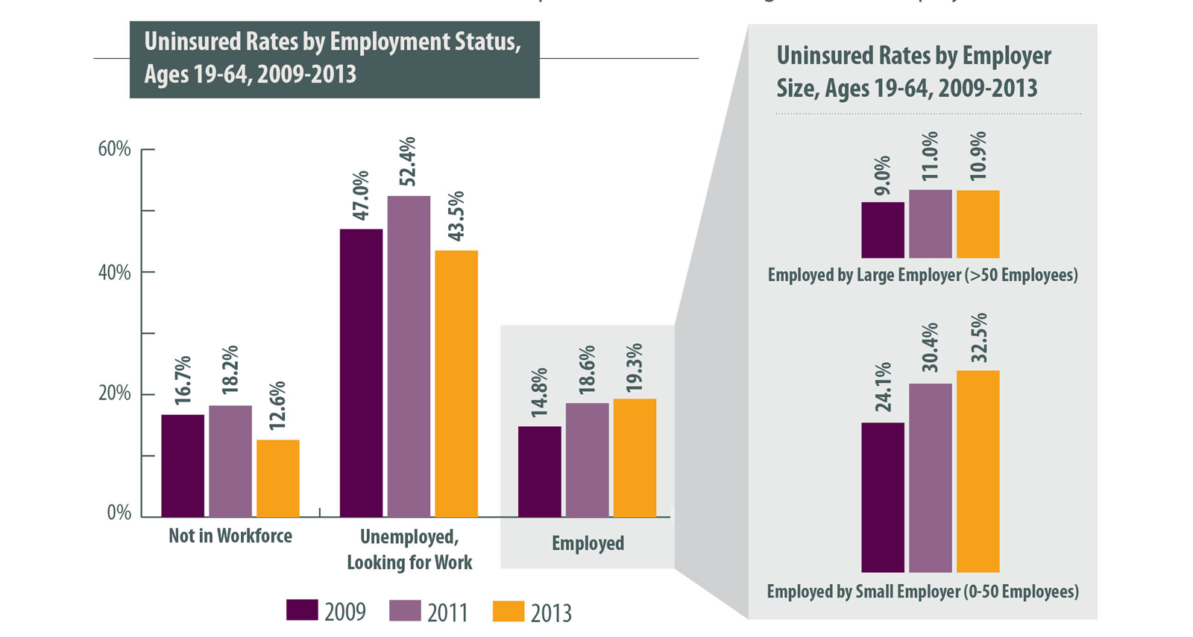
Uninsured Rates by Employment (#13)

Slide 14
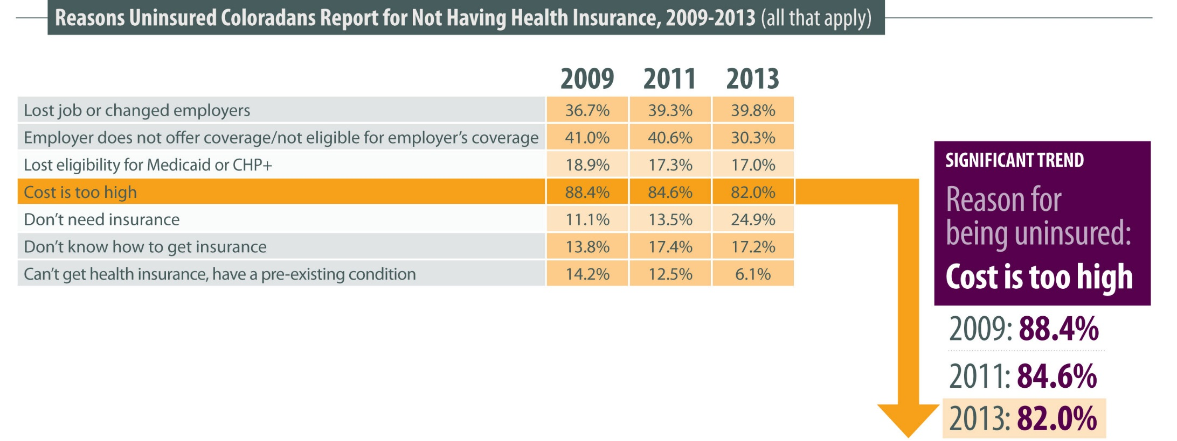
Reasons for Being Uninsured

Slide 15

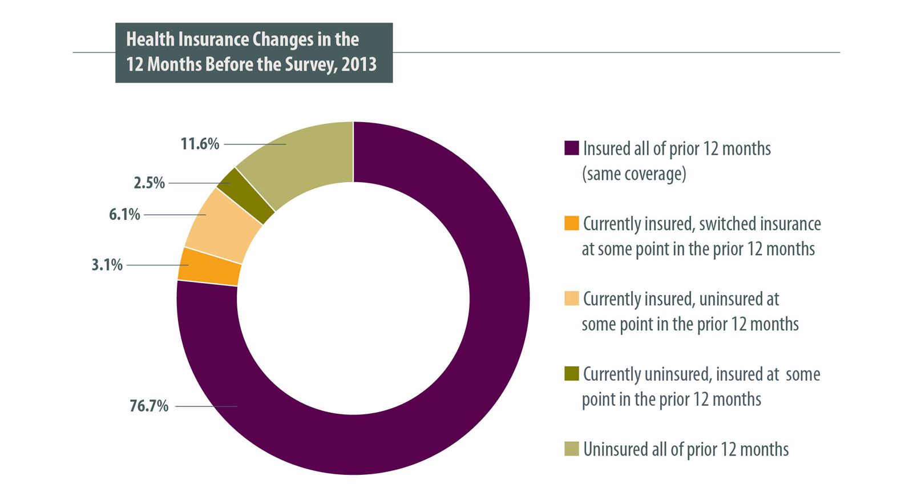
Churn

Slide 16

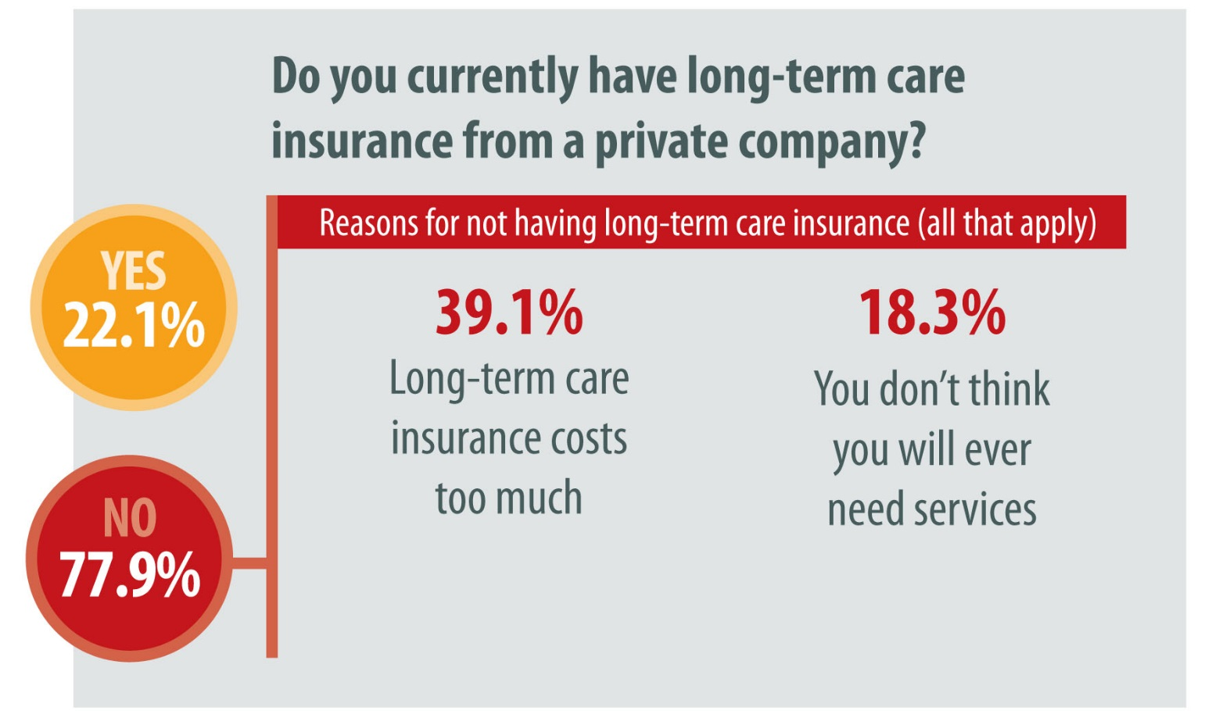
Long-Term Care Insurance
One of five Coloradans ages 50+ have long-term care insurance

Slide 17
Affordability

Slide 18
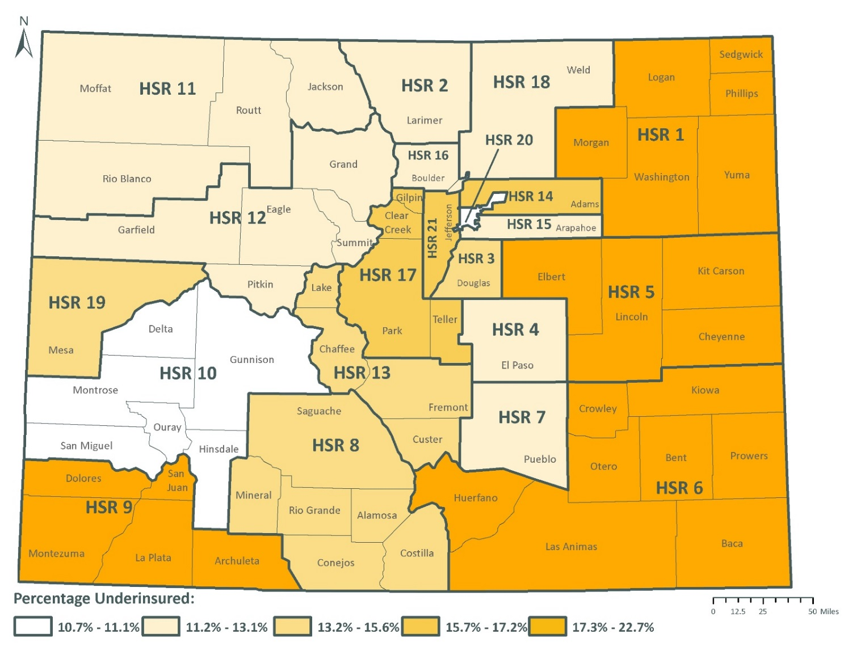
Underinsurance

Slide 19
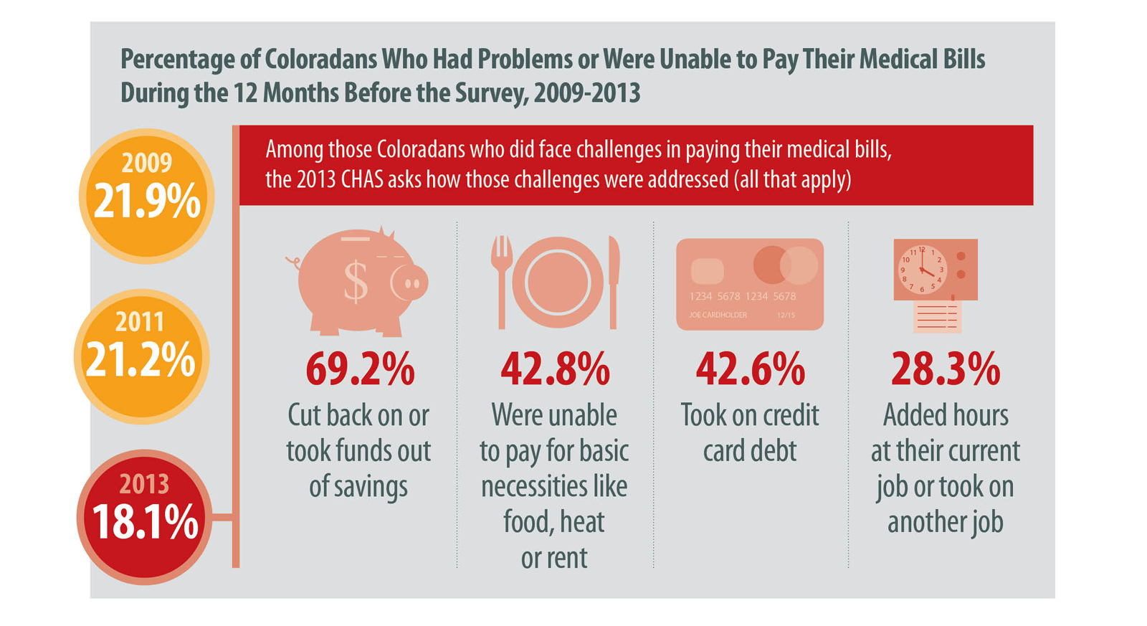
Problems Paying Medical Bills

Slide 20
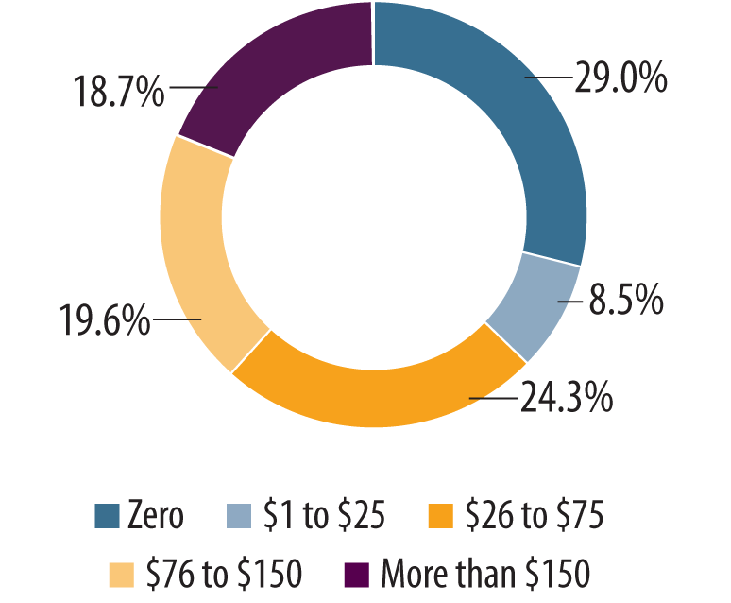
Measuring Affordability
Monthly Amount the Uninsured are Willing to Pay for Insurance

Slide 21
Access and Use
of Health Care

Slide 22
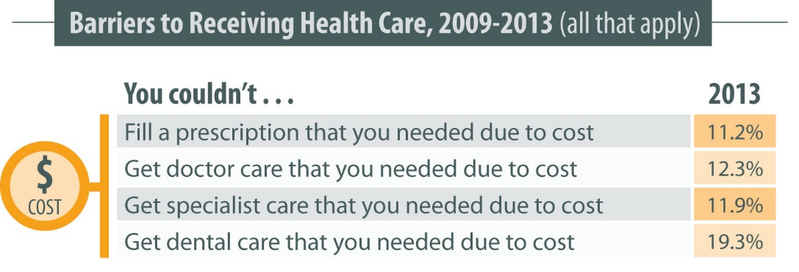
Barriers to Care

Slide 23
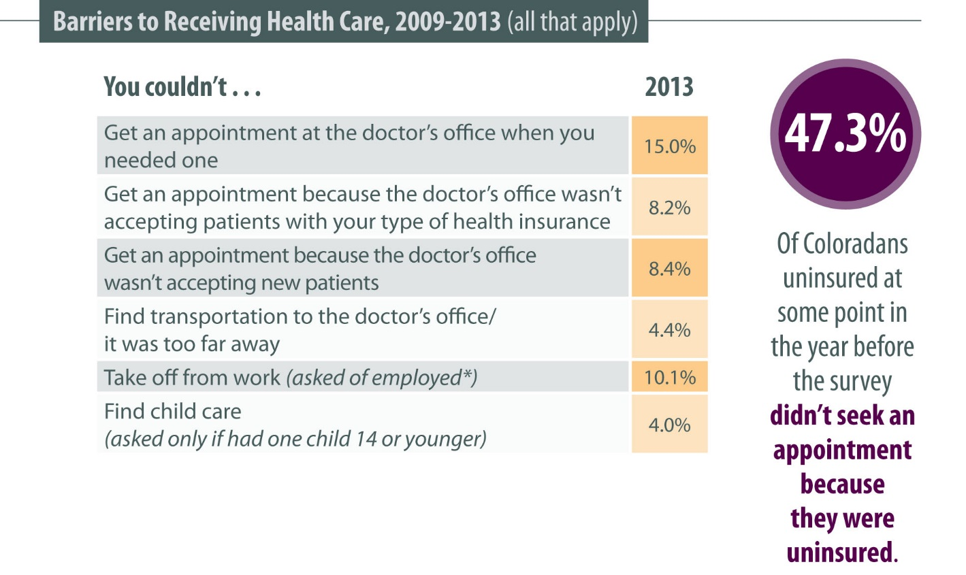
Barriers to Care
*Asked of employed adults or children with employed parents

Slide 24
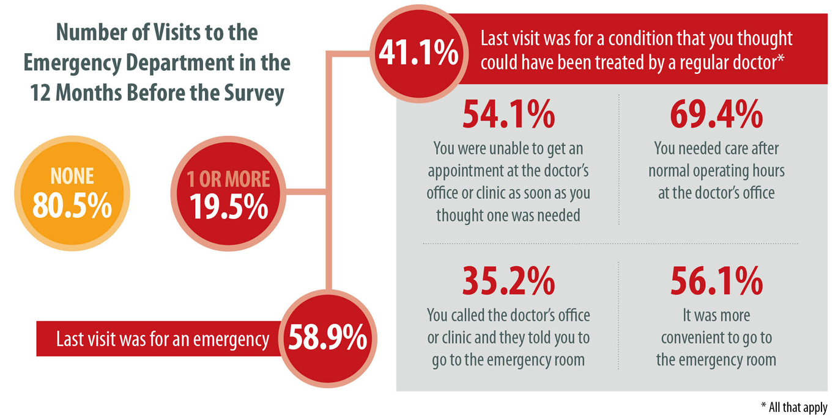
Emergency Department Use

Slide 25
Physical, Oral and Mental Health

Slide 26
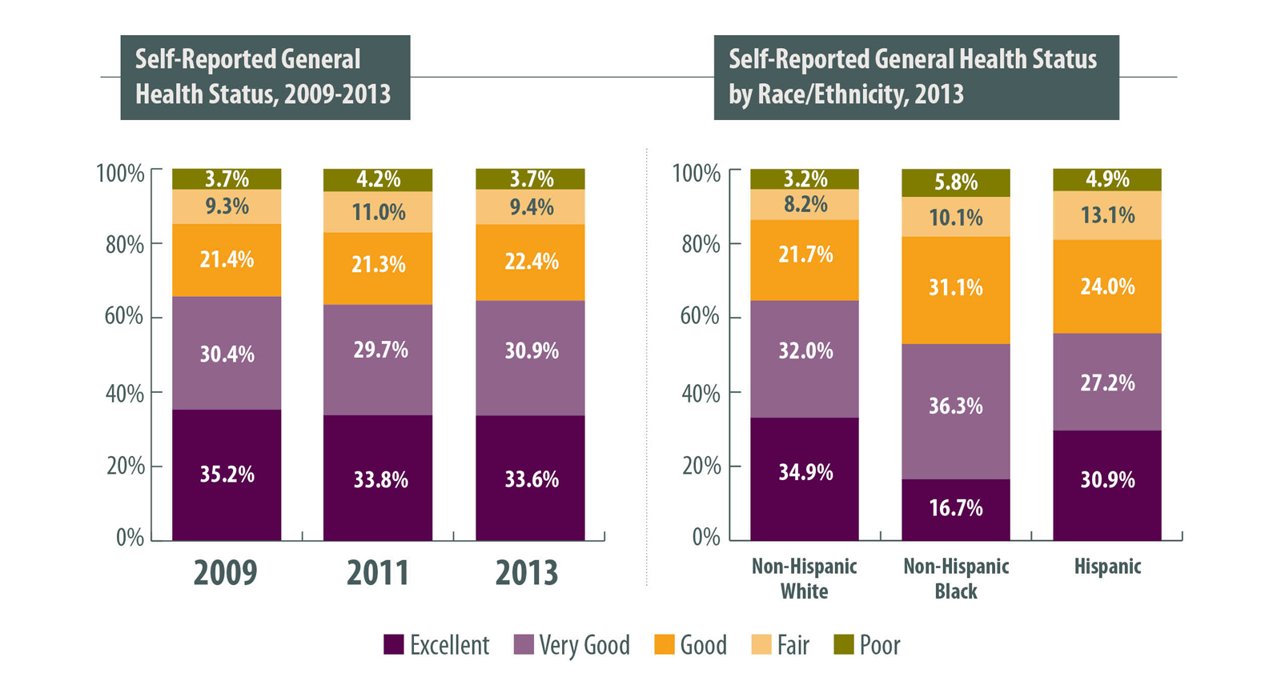
General Health
Disparities apparent in health outcomes

Slide 27
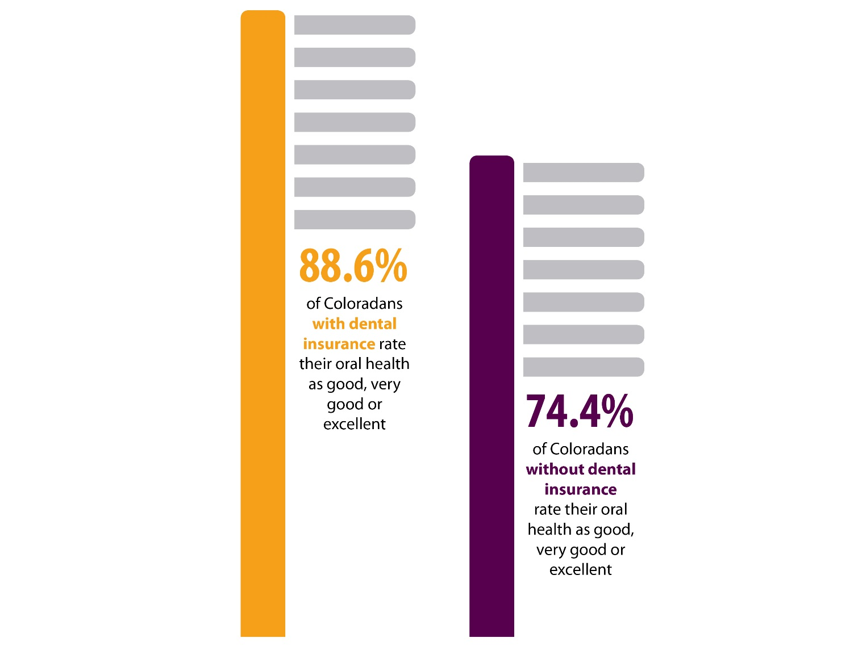
Oral Health

Slide 28
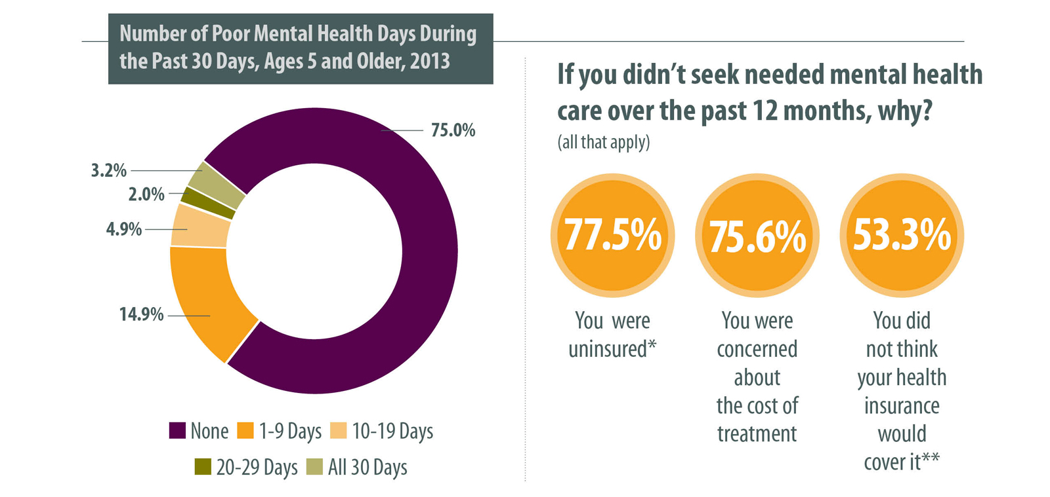
Mental Health
*Ask if uninsured at some point in the past 12 months
**Ask if insured at some point in the past 12 months

Slide 29
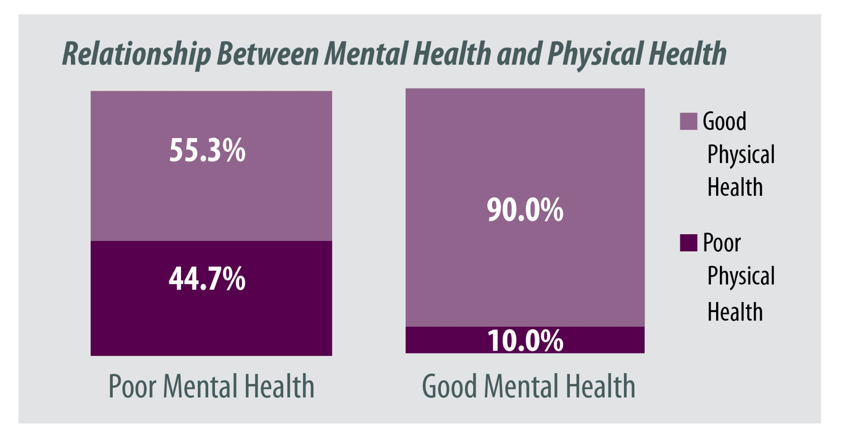
Drawing Connections

Slide 30
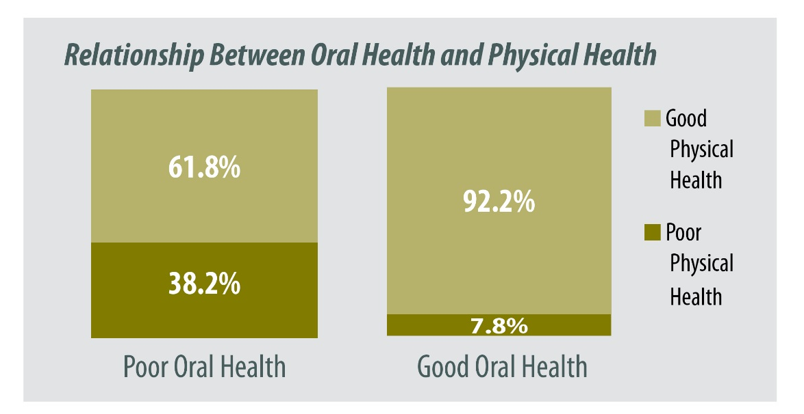
Drawing Connections

Slide 31
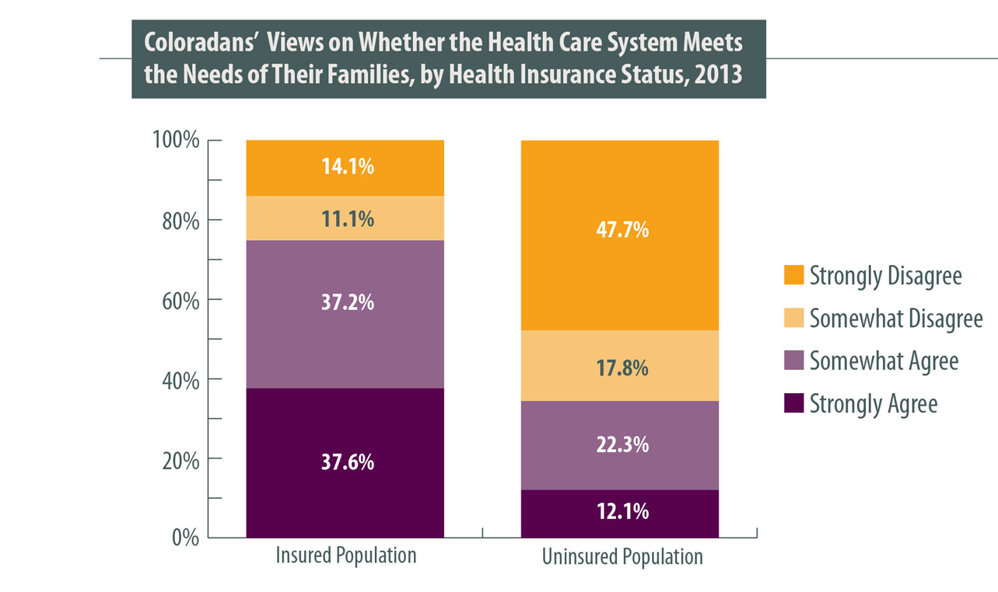
Views of the Health Care System

Slide 32


I Want More Data!

Slide 33


Q&A

