Slide 1
Reining in Growth in Health Spending

Slide 2
Webinar basics
How do I ask questions during the webinar?
Recorded webinar and PowerPoint slides will be available after the webinar.
Special thanks to our funders:

Slide 3
Your presenters
Amy Downs
Senior Director for
Policy and Analysis
Sara Schmitt
Director

Slide 4
Our Vision
CHI is a trusted and leading source of credible health information for Colorado leaders. Our insight is used to:
Inform policy
Contribute to effective implementation
Support state efforts to improve health
Access
Quality
Value
Prevention

Slide 5
Three Take-Aways
Colorado’s health care costs are increasing steadily but not uniformly, much like the rest of the U.S.
Colorado is testing several models and methods for reining in health spending.
Building the evidence base for reforming health spending takes time, patience and realistic expectations.

Slide 6
Trends and Why They Matter

Slide 7
Why Are You Most Concerned About Rising Health Spending?
Limits public funds for non-health programs
Reduces employer ability to invest in job growth and wages
Prevents low income individuals from accessing care
Cost of care is not impacting the outcome of care
Not concerned about increases in health spending

Slide 8
Health Care: A Growing Share of the GDP

Slide 9
Employers and Employees Bear the Burden
SOURCE: Medical Expenditure Panel Survey

Slide 10
Family Premiums: Employees Face Largest Increase

Slide 11
Health Insurance Premiums Compared to Other Economic Indicators

Slide 12
Drivers of Health Care Spending

Slide 13
Health Care Expenditures: A Simple Equation
Unit Price * Quantity of Units = Expenditures

Slide 14
Health Care Cost Drivers
System pays for volume
Insurance drives utilization
Wealthier countries afford more services
Aging population increases disease prevalence
Inefficiencies abound
SOURCE: Health Care Costs: Key Information on Health Care Costs and their Impact, Kaiser Family Foundation, 2009

Slide 15
“Hot Spotters”

Slide 16
The Skewing of Health Expenditures

Slide 17
Hot Spotting: The Elderly
Annual Cost Per Capita

Slide 18
What Are We Doing To Address Costs?

Slide 19
Which Strategy is Most Effective in Controlling Health Spending?
A. Bundled Payments
B. Care Coordination
C. Gain-Sharing/Shared Savings
D. Global Payments
E. No idea, that’s why I’m on the webinar

Slide 20
Continuum of Evidence: From Research to Program Implementation

Slide 21
Models for Reining in Health Spending
Care Coordination
Gain-Sharing/Shared Savings
Bundled Payments
Global Payments

Slide 22
Care Coordination: Medical Homes
Multidisciplinary Care Team
Coordinated care across providers and specialties
Patient
Emphasis on prevention primary care education

Slide 23
Colorado Medical Home Efforts
Medical Home
Medical Home Initiative for Children
Safety Net Medical Home Initiative Demonstration
Comprehensive Primary Care Initiative
Multi-Payer, Multi-State Patient Centered Medical Home Initiative

Slide 24
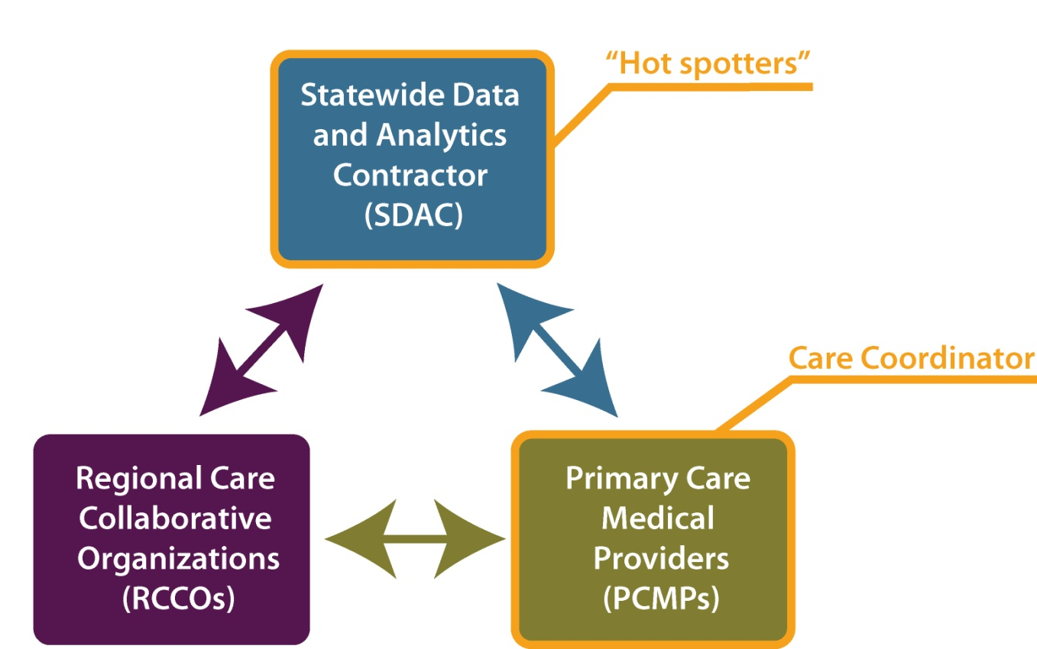
Medicaid Accountable Care Collaborative

Slide 25
Care Coordination: Impact on Controlling Costs
Preliminary estimates on cost savings show some decreases in utilization but data are limited
Colorado programs still being evaluated, early returns and national results encouraging
Complex, lengthy, resource-intensive process for practices to become medical homes

Slide 26
Models for Reining in Health Spending
Care Coordination
Gain-Sharing/Shared Savings
Bundled Payments
Global Payments

Slide 27
Gain-Sharing/Shared Savings

Slide 28
Colorado Efforts
Accountable Care Organizations
Provider networks that are responsible for controlling costs through rewards and penalties
Pioneer ACO Model
Commercial Payers
Medicaid

Slide 29
Models for Reining in Health Spending
Care Coordination
Gain-Sharing/Shared Savings
Bundled Payments
Global Payments

Slide 30
Bundled Payments
Bundled payment is fixed amount to providers for specific episode of care.
RAND – of payment reform ideas modeled, bundled payments hold greatest promise
Heart bypass Medicare bundling demonstration
10% decline in bypass surgery costs

Slide 31
PROMETHEUS Pilot Program in Colorado
Pilot implemented by Health Care Incentives Improvement Institute and Colorado Business Group on Health
Testing bundled payments concept in San Luis Valley, Boulder/Longmont, Colorado Springs
Providers financially encouraged to reduce potentially avoidable complications (PACs)

Slide 32
Models for Reining in Health Spending
Care Coordination
Gain-Sharing/Shared Savings
Bundled Payments
Global Payments

Slide 33
Global Payment
What is Global Payment?
Single, risk-adjusted payment to a responsible provider for patient’s care over fixed period of time
Colorado efforts
Program of All-Inclusive Care for the Elderly (PACE)
HB 1281 Medicaid Payment Reform Pilot

Slide 34
Continuum of Evidence: From Research to Program Implementation

Slide 35
Which Strategy is Most Effective in Controlling Health Spending?
A. Bundled Payments
B. Care Coordination
C. Gain-Sharing/Shared Savings
D. Global Payments
E. Even after the webinar I’m still not sure

Slide 36
Three Take-Aways
Colorado’s health care costs are increasing steadily but not uniformly, much like the rest of the U.S.
Colorado is testing several models and methods for reining in health spending.
Building the evidence base for reforming health spending takes time, patience and realistic expectations.

Slide 37
Inner City Health Center, Denver
Amy Downs 720.382.7091 downsa@coloradohealthinstitute.org
Sara Schmitt 720.382.7081 schmitts@coloradohealthinstitute.org

Slide 38
Upcoming Webinars
July 11 – The Supreme Court and Health Reform: Implications for Colorado
August 1 – Addressing the Boomer Challenge: Long-term Services and Supports
All webinars are at noon. Register here: bit.ly/KFIP0P

