Slide 1


Slide 2





Webinar basics
How do I ask questions during the webinar?
Recorded webinar and PowerPoint slides will be available after the webinar.
Special thanks to our funders:

Slide 3

Your presenter
Jeff Bontrager
Director of Research on Coverage and Access
Colorado Health Institute

Slide 4
Delivering
Health Care – and Savings?
Cost Containment
Through Accountable Care
March 23, 2012
2012 Webinar Series

Slide 5
Today's Discussion
The principles of accountable care
Colorado’s flavor of accountable care:
the Medicaid Accountable Care Collaborative (ACC)
Care coordination
Bonus: Medicare Pioneer Accountable Care Organization (ACO)

Slide 6

Poll #1
How familiar are you with the concepts of accountable care?
Very familiar
Somewhat familiar
Not very familiar
Accountable what?

Slide 7
Three take-away points
Accountable care and care coordination is aimed at improving health while reducing costs
Colorado is at the forefront of trying new models
The Medicaid Accountable Care Collaborative (ACC) represents an incremental approach to health system reform

Slide 8
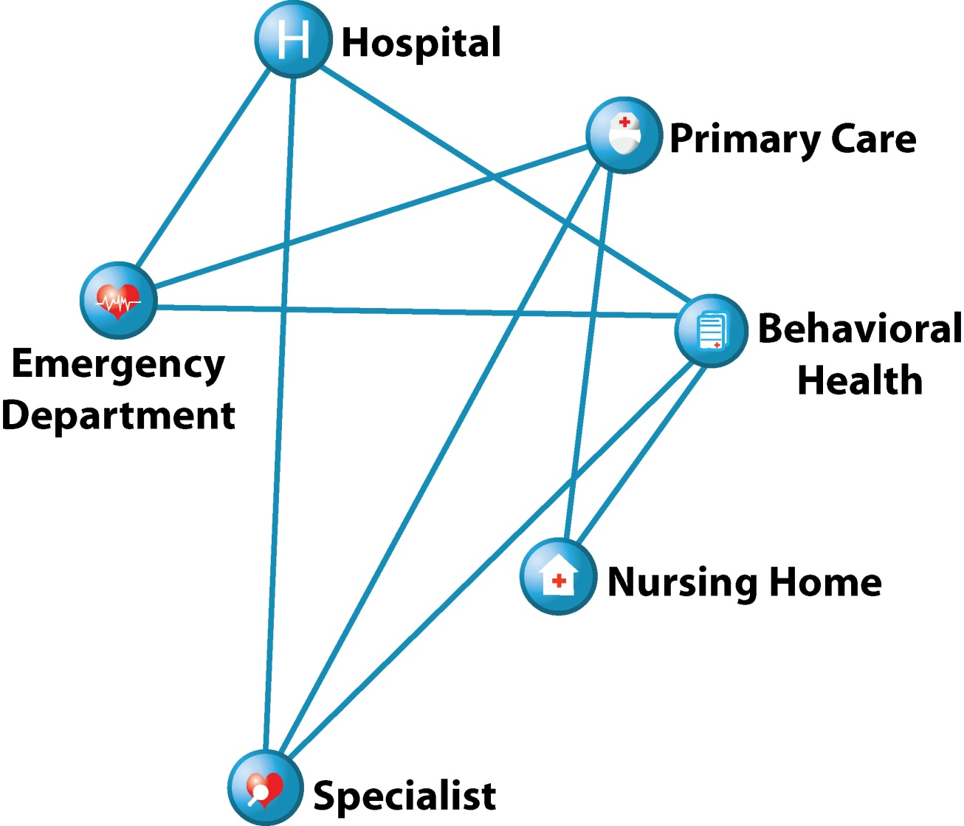
The Current Delivery System is Fragmented
  Primary care providers may be unaware their patient has been to the hospital.
  Patients may be subjected to
  unnecessary,
  repetitive tests.
  A Dartmouth Institute study suggests 30 percent of care is unnecessary.¹
¹ The Dartmouth Institute, “Reflections on Geographic Variations in U.S. Health Care”, 2010.

Slide 9
What is
Accountable Care?

Slide 10
Principles of Accountable Care
Provider leadership
Emphasis on primary care
Active and proactive care coordination
Electronic Health Records for care coordination and disease management
Community-based collaboration
Payment reform
{
Patient Centered Medical Home

Slide 11
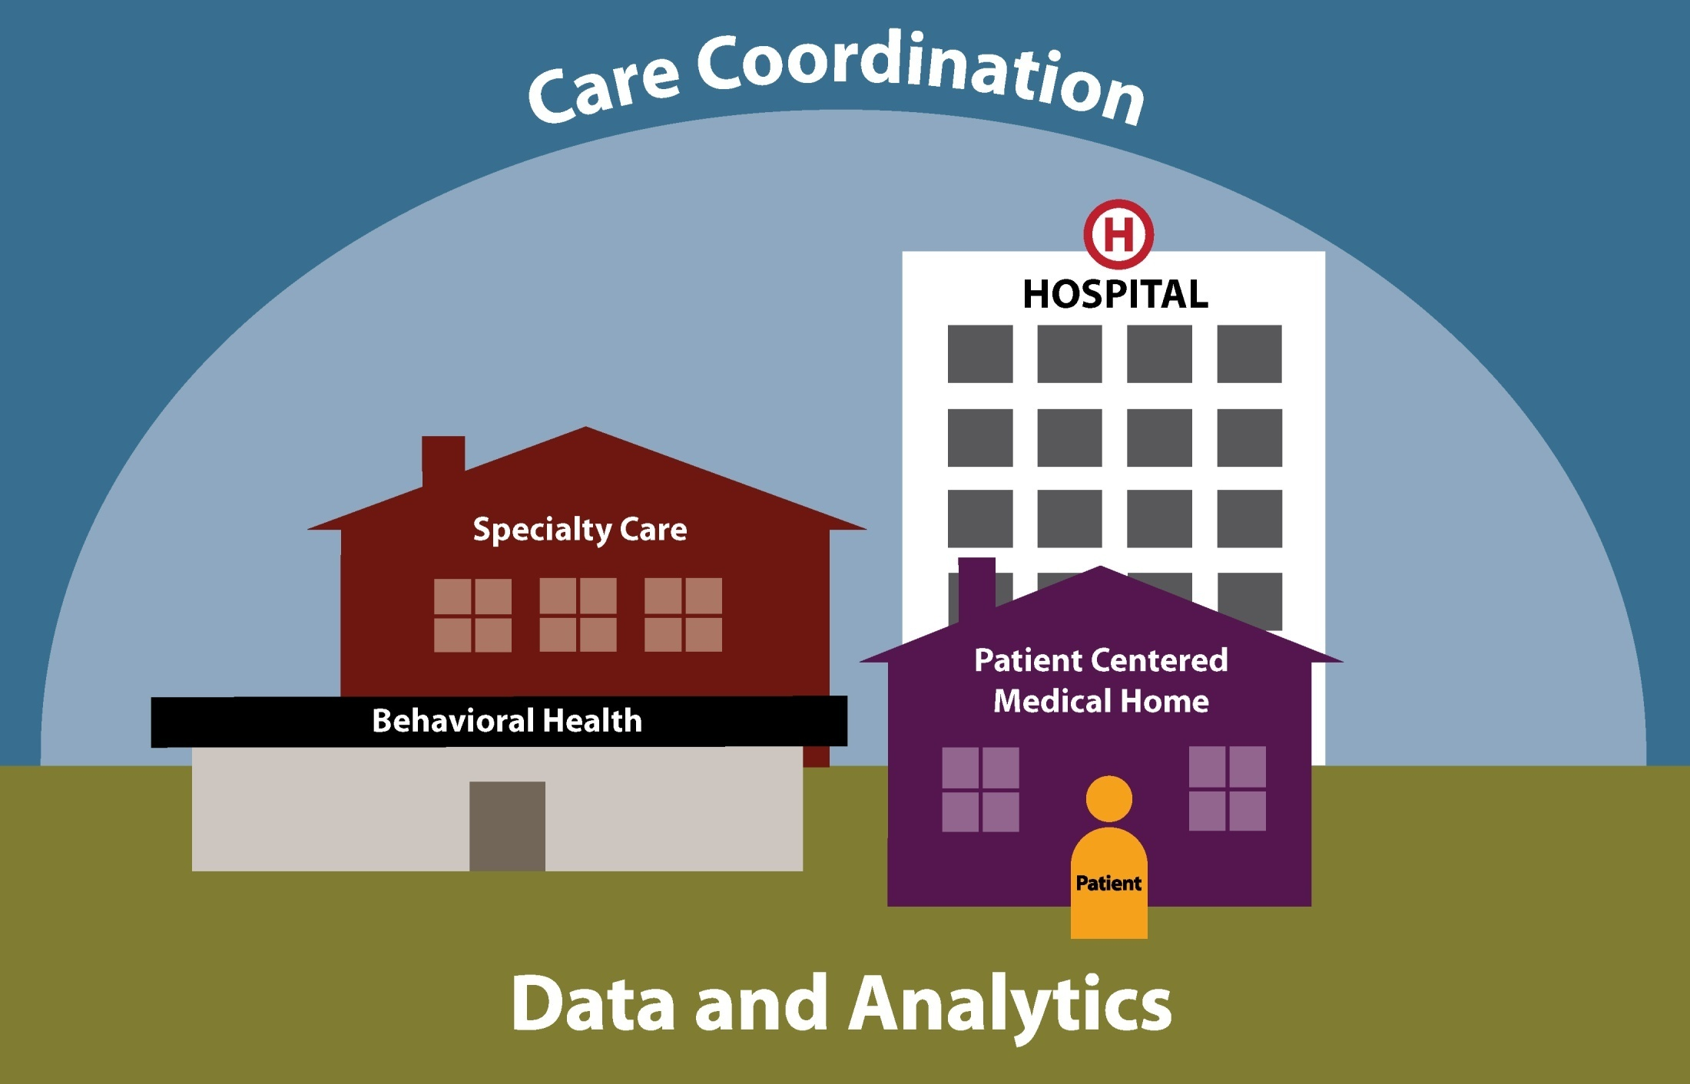
How Accountable Care Works

Slide 12

Care Coordination Example
A pregnant woman with mental health needs visited the emergency room
28 times over
6 months.

Slide 13
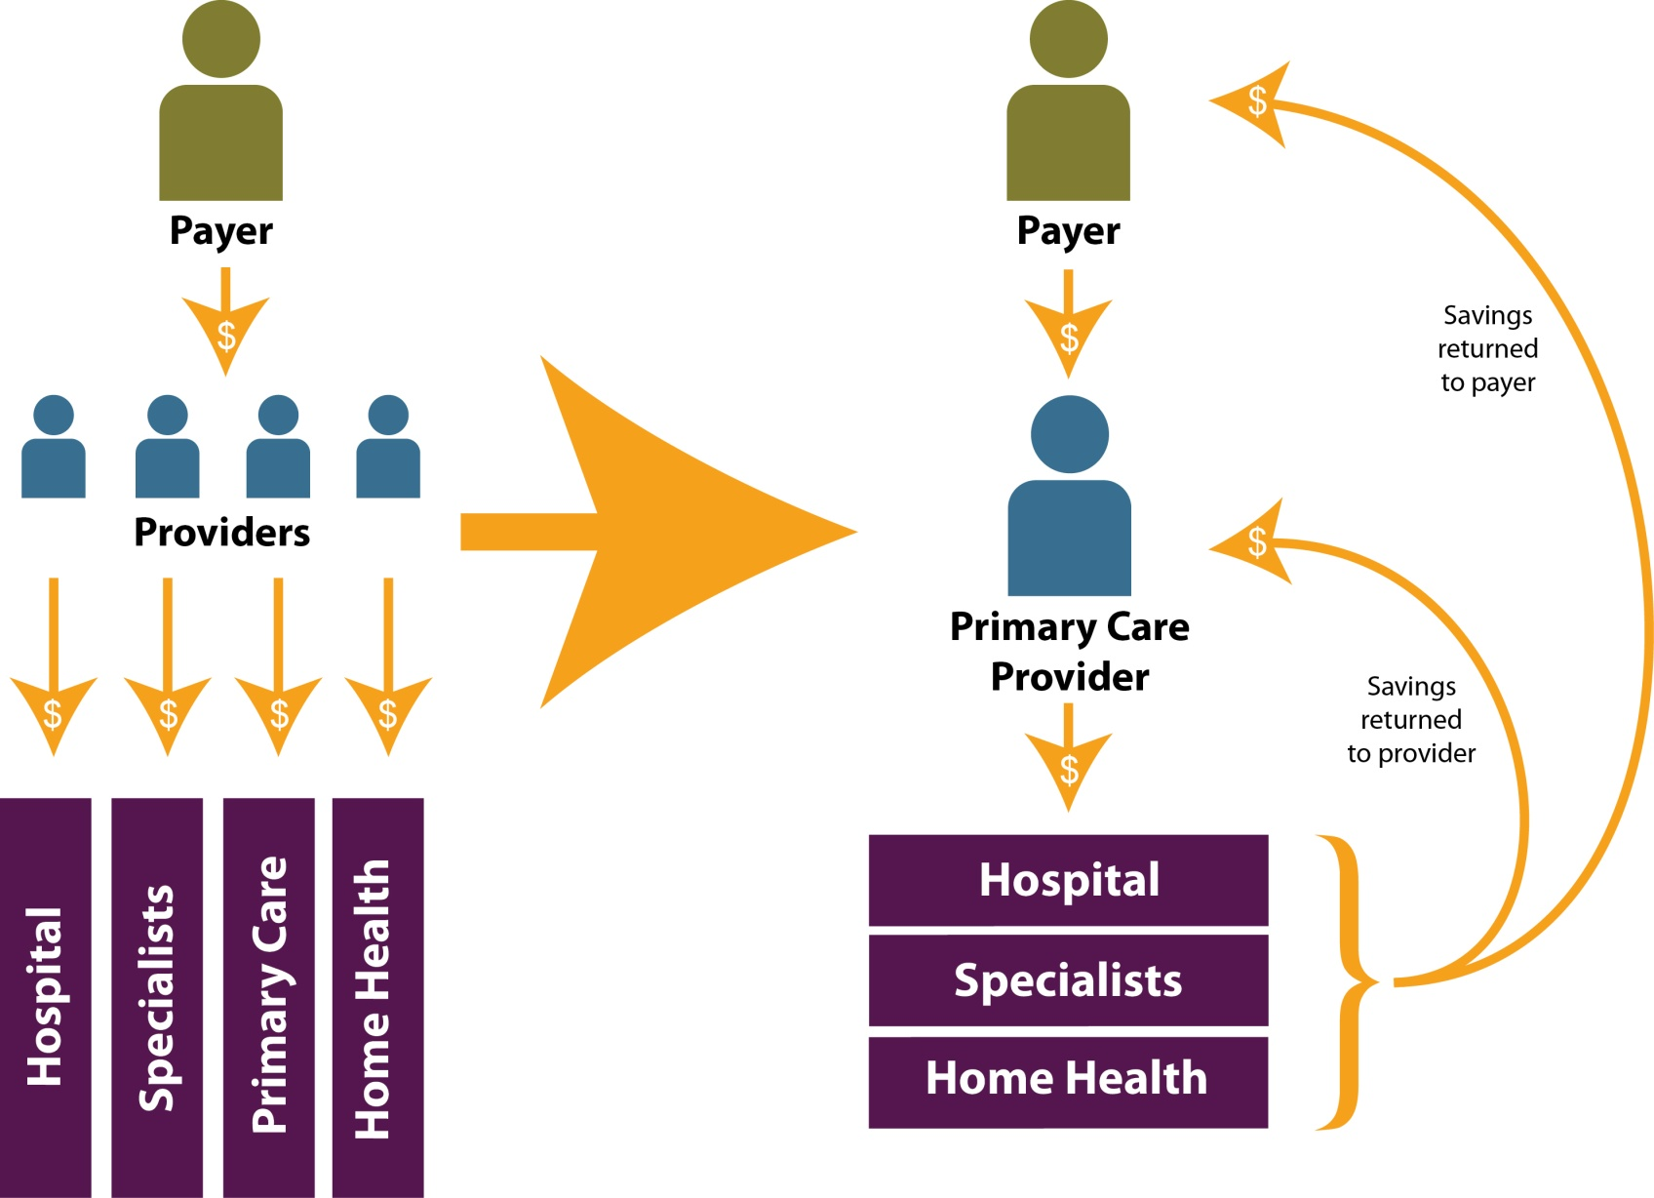
Payment Reform under Accountable Care

Slide 14
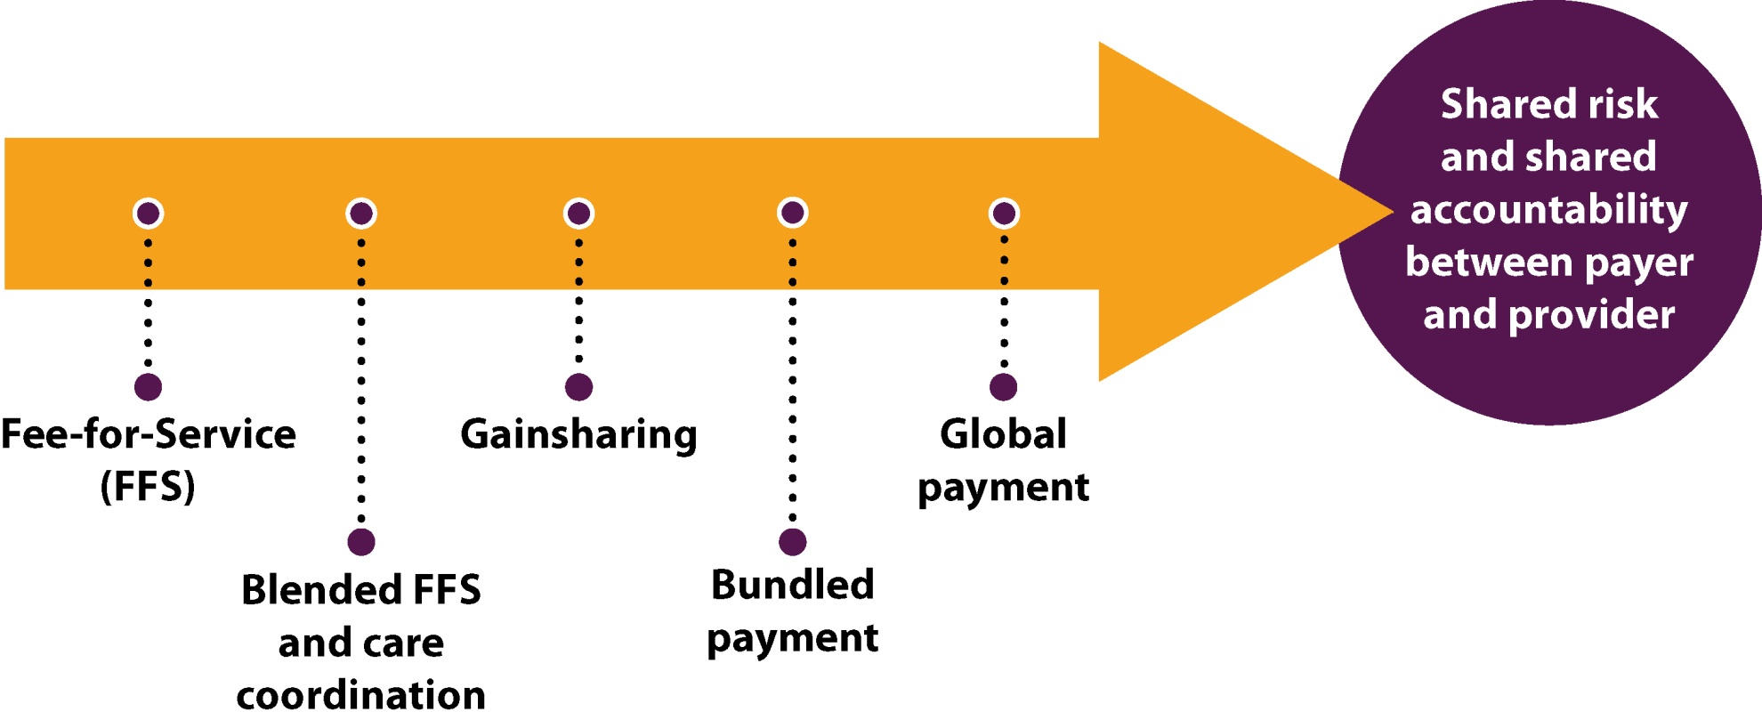
Continued Payment Reform

Slide 15
The Medicaid Accountable Care Collaborative

Slide 16
Poll #2
Colorado’s Medicaid ACC is loosely modeled after another state’s program. Which state is it?
Arizona
North Carolina
Rhode Island

Slide 17
Medicaid Community Care of North Carolina
Three decades of experience
Began in 1980s in a single county, expanded to regional networks covering the state
Wide engagement of primary care physicians (92%)
$1.5 B in savings attributable 2007-2009
Source: Community Care of North Carolina. http://www.communitycarenc.com/our-results/

Slide 18
Colorado’s Accountable Care Collaborative (ACC)
A Colorado-grown Medicaid cost containment strategy
One of a handful of states at the forefront
Began development in 2009, implemented
in spring of 2011
ACC aligns with principles of accountable care
Seven regional ACOs

Slide 19
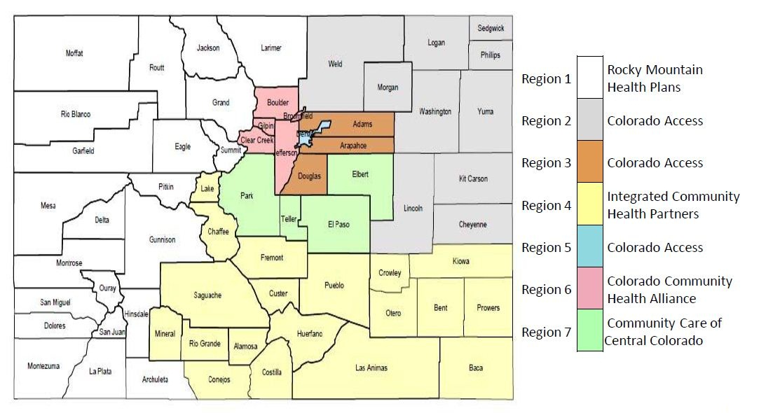
The ACC’s Seven Regional Care Coordination Organizations (RCCOs)

Slide 20
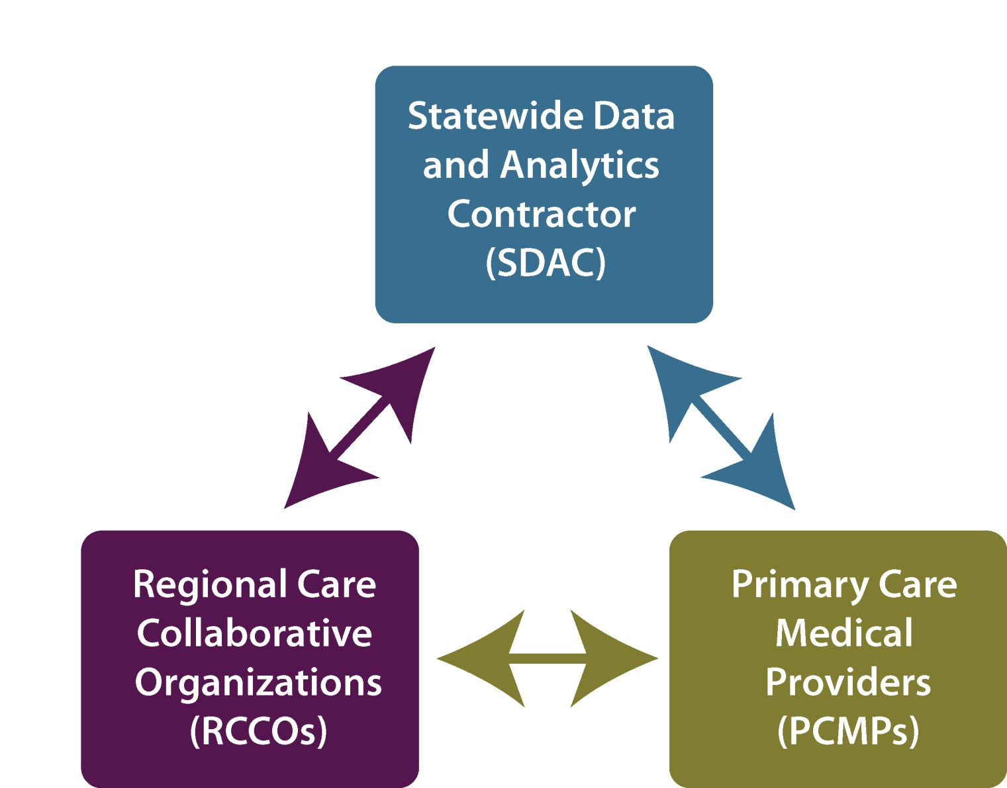

Colorado’s ACC Model

Slide 21
Poll #3
How many Coloradans have enrolled in the Medicaid ACC (HCPF figures as of April 2012)?
198,248
125,193
89,496

Slide 22
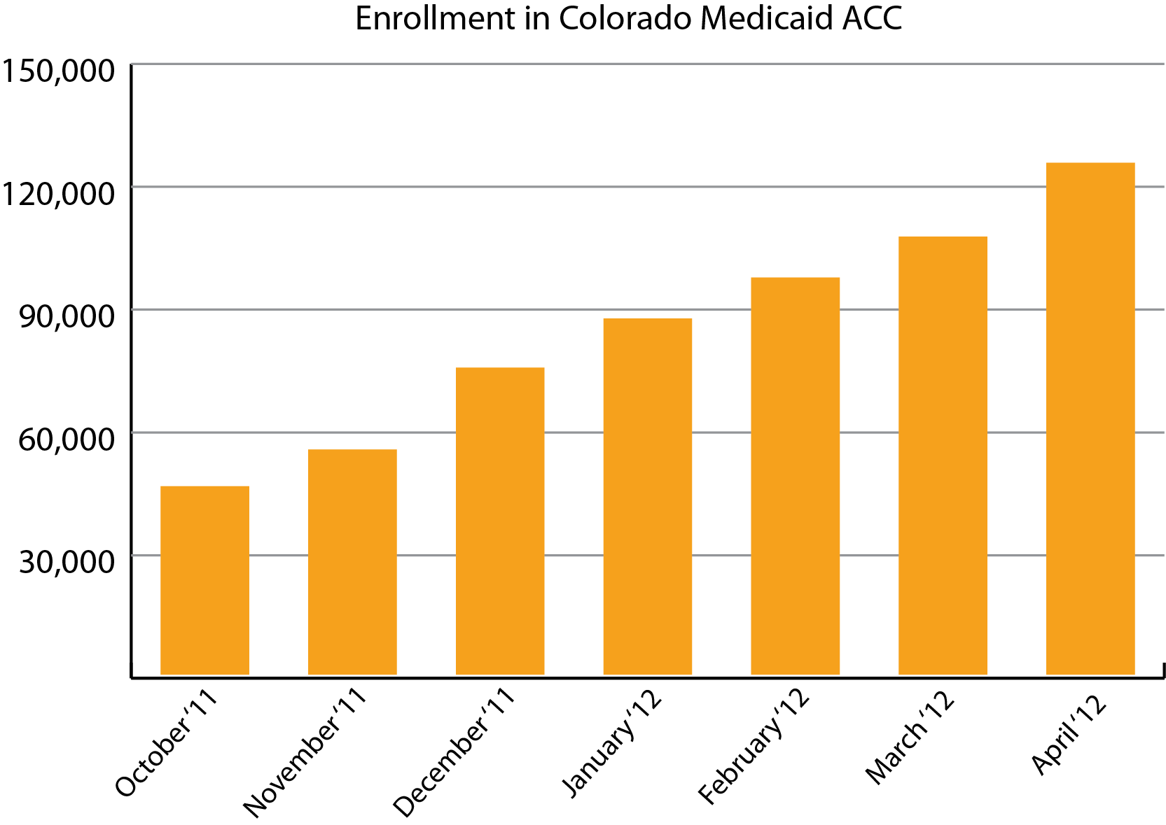
ACC Enrollment
Source: Colorado Department of Health Care Policy and Financing

Slide 23
Accountable Care: Challenges and Opportunities
Culture change
Initial investment
Attribution process
  Preserving choice of provider
  Maintaining pre-existing relationships
Real-time health information

Slide 24
Poll #4
Which bill created a Medicaid Payment Reform Pilot Program?
HB12-1044
HB12-1280
HB12-1281
HB12-1354
Spruce beetle kill wood products tax exemption
- Video lottery terminals for college scholarships
- Dog breeder provide solid flooring for dogs
- Medicaid payment reform pilot program

Slide 25
Future Directions for Payment Reform: HB12-1281

Slide 26

Poll #5
In the remaining time on this webinar, would you prefer to:
Hear about the Medicare Pioneer ACO?
Have additional time for questions?

Slide 27
Medicare Pioneer ACO

Slide 28

Medicare Pioneer Accountable Care Organization (ACO)
Physician Health Partners (Denver)
Provides care coordination and business process improvement services for physician practices
Established in 1996, a collaborative of 260 providers, serves 450,000 patients in metro area
One of 32 Medicare Pioneer ACOs in the U.S.
Will serve up to 28,000 Medicare patients

Slide 29
Medicare ACO Implementation
Year 1
Year 2
Year 3
2012
ACO shares 60% of savings or loss above benchmark
2013
ACO shares 70%
of savings or loss above benchmark
2014
Eligible to move
to a population-based payment
Must report
(not meet) 33 quality measures
Payment tied to meeting 25 of 33 quality measures
Must engage
ACO with non-Medicare payers

Slide 30

Salud Family Health Centers, Commerce City
Jeff Bontrager 720.382.7075 bontragerj@coloradohealthinstitute.org

Slide 31
Upcoming Webinars
June 6 – Legislative Session in Review: Innovations in Health Care
June 20 – Reining in Growth in Health Spending
July 11 – The Supreme Court and Health Reform: Implications for Colorado
August 1 – Addressing the Boomer Challenge: Long-term Services and Supports
All webinars are at noon. Register here: http://bit.ly/KFIP0P

