Slide 1
Health Coverage
In Colorado
The Top Five Questions Your Constituents Are Asking About The Affordable Care Act
January 29, 2014
Legislative Lunch & Learn

Slide 2
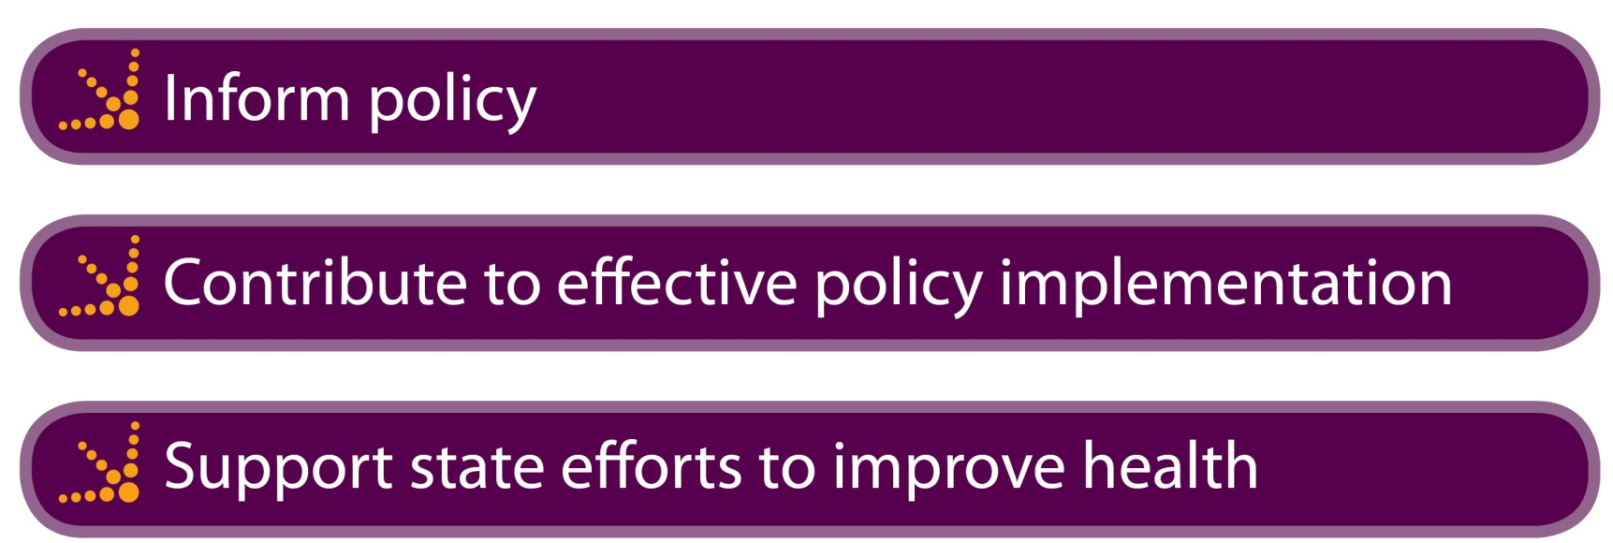
The Colorado Health Institute: An Introduction
We are non-partisan.
We do not take positions on bills.
Our insight is used to:

Slide 3

Thanks to Our Sponsor

Slide 4
Five Questions Your Constituents are Asking
Is the ACA just a public entitlement program?
Is it affordable for me and my family?
How will employers be affected?
How is the ACA being paid for?
Will we have enough doctors and other health care providers?

Slide 5
Three Takeaways
Medicaid is outpacing private insurance in marketplace enrollment, but private enrollment is picking up.
The jury is out on how employers will respond.
What to watch: Whether Colorado will have enough health care providers, and whether they are in the right places.

Slide 6

Setting the Stage: The Affordable Care Act (ACA)
Rocky rollout of federal
HealthCare.gov.
Enrollment has increased.
Unintended consequences?
  Cancellation of plans in
  individual market.
  Contraception debate.
  Healthier people not enrolling as expected?
New feature: transparency

Slide 7
1. Is the ACA Just a Public Entitlement Program?

Slide 8
Two Major Components . . . And A Lot More
Focus on the big two:
  Health insurance marketplaces (exchanges)
  Medicaid
A lot in this law beyond insurance:
  Insurance market reforms
  Individual mandate
  Employer incentives
  Health care workforce
  Safety net and public health

Slide 9

Colorado’s Health Insurance Marketplace
Online marketplace.
Subsidies for people 138-400 percent of federal poverty level (FPL).
Open enrollment closes March 31.

Slide 10
Enrollment in Public and Private Insurance
Medicaid
Connect for Health Colorado
150,641: Colorado Health Institute projected new Medicaid enrollees 2014
136,300: Connect for Health Colorado medium projection 2013-14
101,730 enrolled as of 1/15/14
63,407 enrolled as of 1/15/14
67.5%
46.5%
Sources: Connect for Health Colorado enrollment projections; and Medicaid and individual marketplace enrollment figures as of January 15, 2014. Medicaid projection based on Colorado Health Institute analysis of individuals 0-64 years of age.

Slide 11
Why is Medicaid Enrollment Greater?
Medicaid | Connect for Health Colorado
Established program. | New program.
Infrastructure for enrollment already exists. | Built from the ground up.
No premiums. | Enrollees must pay premiums.
First step in applying for coverage. | Have to be deemed ineligible for Medicaid before applying for subsidies.

Slide 12
2. Is it Affordable for Me and My Family?

Slide 13
Shopping in Summit County
Monthly premium ranges for a single 38-year-old non-smoker, silver plan, Connect for Health Colorado marketplace:
  Pitkin County: $471 - $650
  Summit County: $450 - $620
  Montezuma County: $340 - $582
  Otero County: $295 - $432
  Denver County: $239 - $448
Source: Connect for Health Colorado, January 2014, using community ZIP codes.

Slide 14
The Reality: A Disconnect
How much per month are Colorado’s uninsured willing to pay for coverage?
  ▪ $0 - 29 percent
  ▪ $1 to $25 - 9 percent
  ▪ $26 to $75 - 24 percent
Average monthly price paid for single insurance premiums on Connect for Health Colorado: $376
Average advance premium tax credit awarded through the marketplace: $248
Sources: 2013 CHAS, Connect for Health Colorado 12/31/13

Slide 15
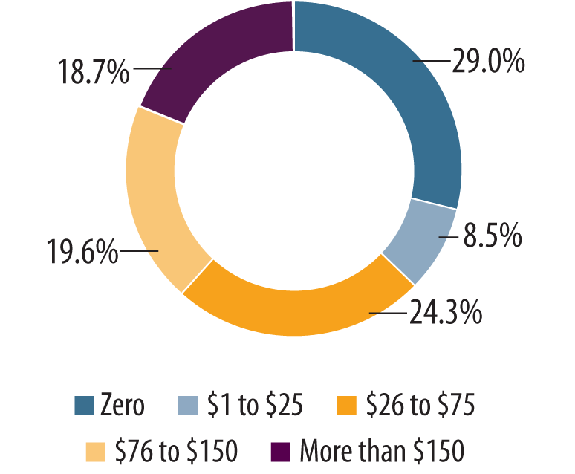
The Reality: A Disconnect
How Much Uninsured Coloradans are Willing To Pay for Insurance
How Much Insurance Costs on the Marketplace
Average monthly price paid for single insurance premiums through the marketplace: $376
Average advance premium tax credit awarded through the marketplace: $248
  56 percent have received advance premium tax credits
Sources: 2013 Colorado Health Access Survey, Connect for Health Colorado 12/31/13, 02/17/14
Notes:
$128, which is more than 62 percent of all Coloradans are willing to pay

Slide 16
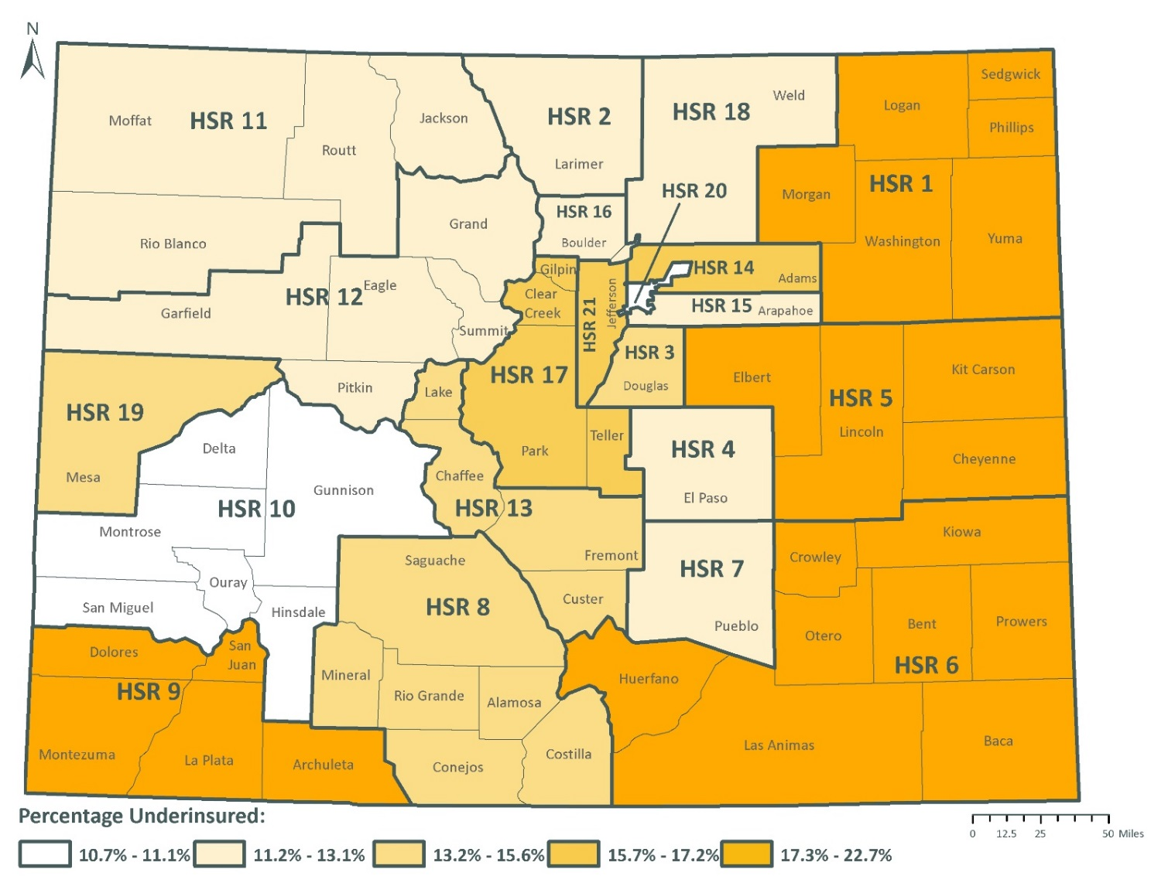
Underinsurance

Slide 17
3. How Will Employers Be Affected By the ACA?

Slide 18
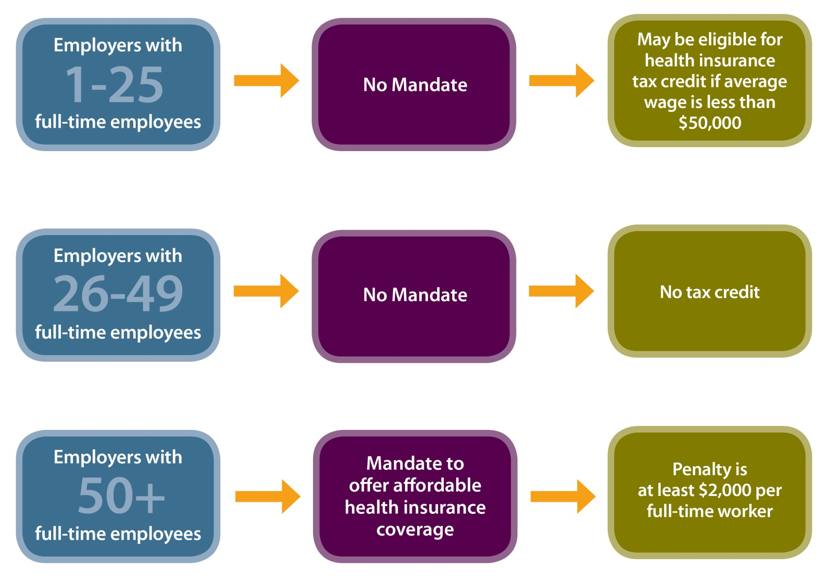
Employer Mandates and Health Reform

Slide 19

Colorado Small Businesses and the Exchange
Many opting for early renewal of existing plans.
Many small businesses do not qualify for tax incentive.
Approximately 100 small businesses have enrolled in the Small Business Health Options Program (SHOP) through Connect for Health Colorado.

Slide 20
Large Employers and the 30-Hour Requirement
Percentage of employers who said they will have to
change their workforce strategy to avoid penalties
SOURCE: “Health reform poses biggest challenges to companies with the most part-time and low-paid employees” Mercer LLC, August 8, 2012

Slide 21
4. How is the U.S. Paying for the ACA?

Slide 22
The Plan to Pay for the ACA
Changes to Medicare
  Reduced provider, Medicare Advantage payments
  Increased premiums for higher-income beneficiaries
Taxes and Fees
  High premium (Cadillac) insurance plans
  Medical devices, indoor tanning salons
  Medicare hospital payroll tax
Employer and individual mandate penalties

Slide 23
How Is Colorado Paying
For Medicaid Expansion?
160,000 additional adults eligible =
$280 million in savings over 10 years
Enhanced federal match
Hospital Provider Fee
Accountable Care Collaborative
Medicaid reform
Savings from CHP+

Slide 24
5. Will We Have Enough Providers?

Slide 25

Does Colorado Have Enough
Health Care Providers?
It depends on where you live.
  Wide variation across the state in workforce capacity both in physical health and dental workforce capacity
It depends on your insurance.
  Challenges with Medicaid capacity both in physical health and dental workforce capacity

Slide 26

A Sneak Peak: Colorado’s Health Care Workforce
A new Colorado Health Institute study compares the primary care workforce
by region – critical information to train, recruit and retain Colorado’s health care providers of the future.

Slide 27
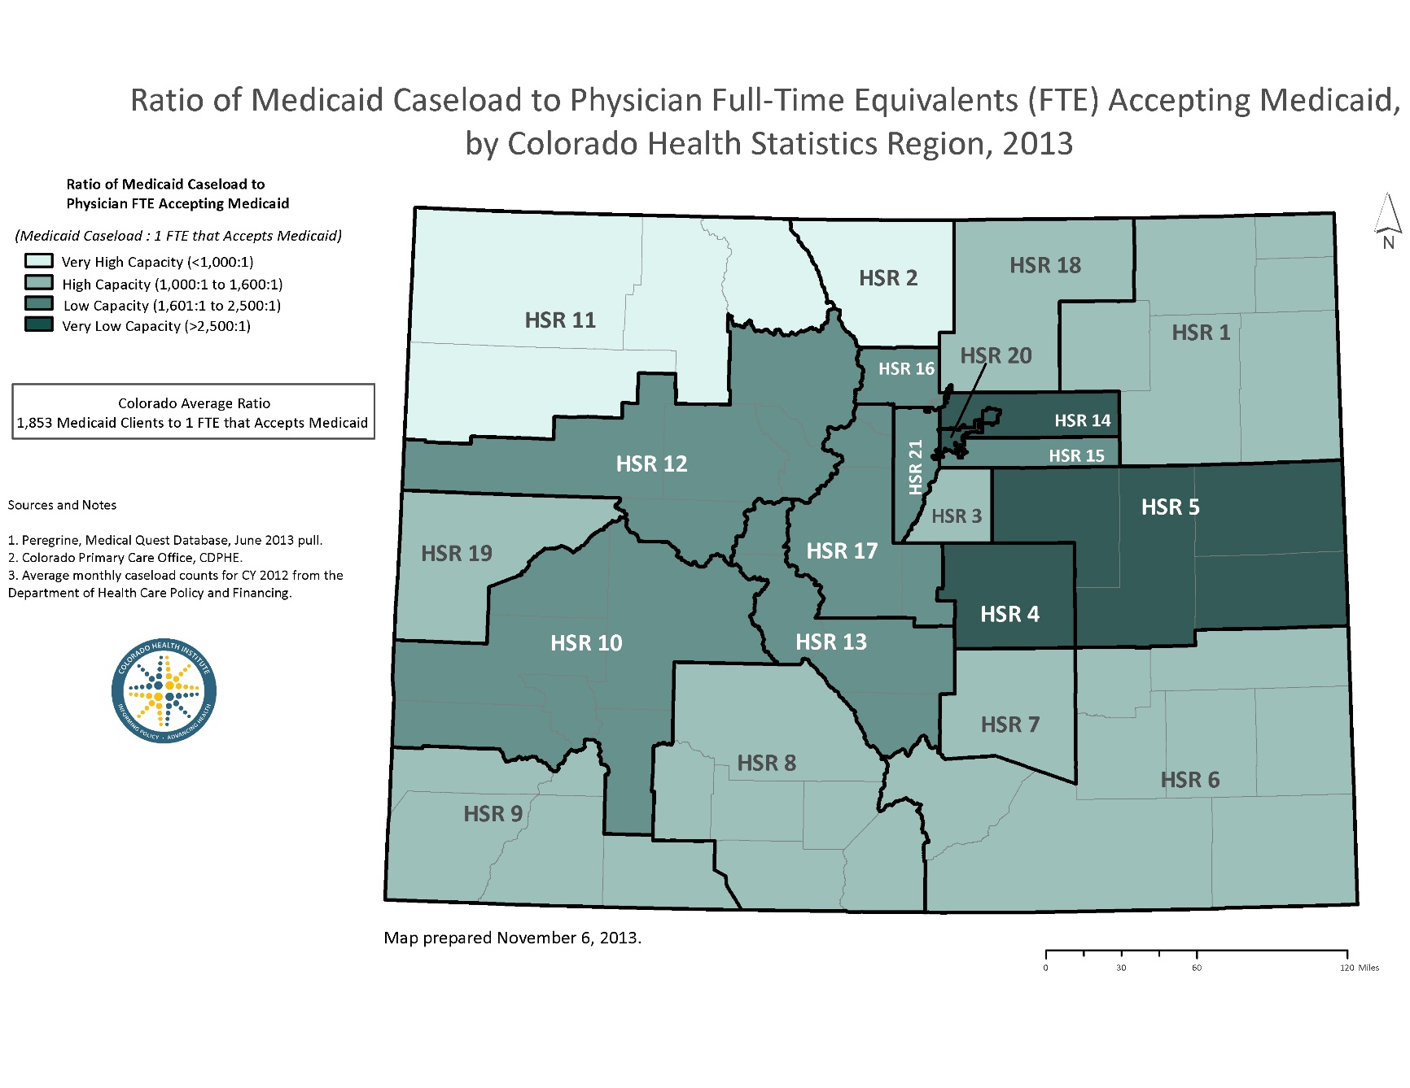
Medicaid Access to Care: Regional Differences

Slide 28
Save the Date: Future Lunch and Learns
February 11th (4pm)
“Special Briefing on Colorado’s Primary Care Workforce”
February 26th (12pm – 1pm)*
  “Bending the Health Cost Curve” Market-Based Solutions”
  *Lunch Provided!

Slide 29
Three Takeaways
Medicaid is outpacing private insurance in marketplace enrollment, but private enrollment is picking up.
The jury is out on how employers will respond.
What to watch: Whether Colorado will have enough health care providers, and whether they are in the right places.

