Slide 1
Scope of Practice:
Colorado and the Current Debate

Slide 2
Today’s Discussion
Primary Care: A booming market
The National Conversation
State of the Debate in Colorado
APN & PA Survey Findings
Planning now for new solutions
Training
Regulatory
Financial
Cultural

Slide 3
Primary Care: A booming market

Slide 4



On the Horizon: Primary Care Need
In Colorado 500k more “newly insured”
How much care will they seek?
Where will they seek care?
214,000
153,000
175,000

Slide 5
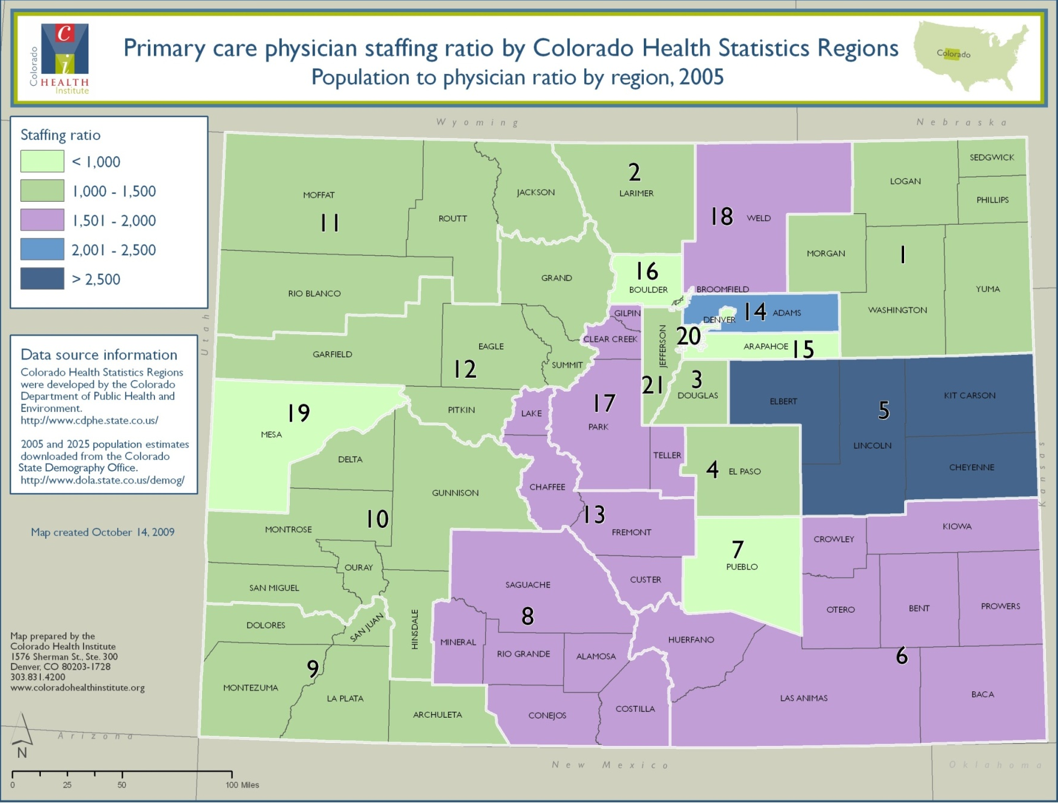
Gaps in Primary Care

Slide 6
Who Can Practice Primary Care?
Medicine
Physicians
Physician assistants (PAs)
Nursing
Nurse Practitioners (NPs)
Clinical Nurse Midwives (CNMs)

Slide 7
Scope of Practice
Training & complexity of care
LPNs
RNs
MAs
CNAs
Specialist MDs
PAs
APNs
GeneralistMDs
Sub-specialist MDs
Cost-effective care & providers, access

Slide 8
Progression of the Debate
Training
Curriculum
Certification
Regulatory
Licensing
Statutes
Financial
Insurance empanelment
Reimbursement
Billing
Cultural

Slide 9
The National Conversation

Slide 10






The Importance of Frame of Reference
Nursing Perspective
Physician Perspective
IOM Perspective
Growing literature: plenty for everyone

Slide 11
National-level reform
Federal role
Mid-to-long range change
State role
Immediate term change

Slide 12

The Promise of Medical Homes
Reduced costs
Improved care quality
Reduced medical errors
Higher patient satisfaction
Fewer health disparities

Slide 13

The Promise Deferred
Not today or tomorrow
Require transformation
Workforce as members of “care teams”
Technology is not “plug and play”
Health care neighborhoods
Payment reform

Slide 14
Accountable Care Organizations
A model for reforming health care delivery and payment
Integrated care delivery
Payments linked to cost-reducing quality benchmarks
Performance measurement
Notes:
A model for reforming health care
delivery and payment
Integrated care delivery
Focus on primary care, prevention, chronic disease mgt.
Payments linked to cost-reducing quality benchmarks
(shared risk/reward)
Performance measurement
Medicare
Shared Savings Program (FFS)
Pioneer (capitated)
Transitions
Commercial Insurance Pilots
Colorado RCCOs
Everyone knows what one looks like, but no one has actually seen one…

Slide 15
Scope of Practice: Market Dynamics
Cost/Value
Reimbursement
Efficiency
Access & Choice
Educational capacity
Mal-distribution
Medical homes
Delivery models
Payment reform

Slide 16
State of The Debate in Colorado

Slide 17
Our Primary Care Workforce
NOTES: Estimates do not include non-primary care practitioners.
*Colorado providers include practicing/working providers only.
SOURCES: GAO, Peregrine, DORA, Colorado Office of Demography, CHI)

Slide 18
State Role: Leverage Points
Practice Acts (legislative decisions)
Medicaid payment structure
Insurance regulation

Slide 19
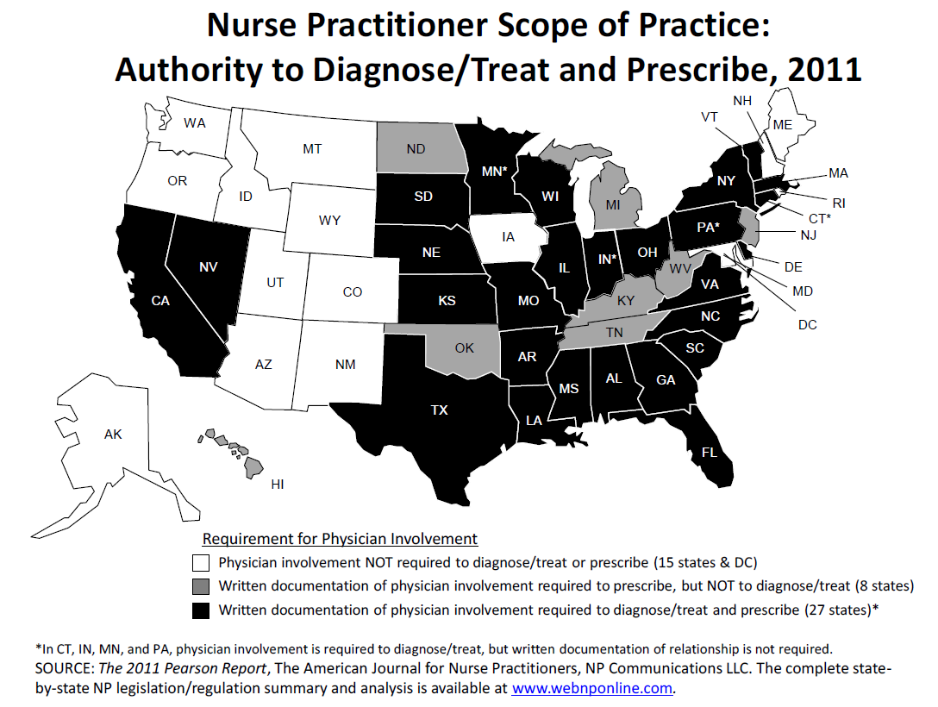
CO

Slide 20
Scope of Practice: APNs
Pre-2008
2008
2009
2010
2011
Education program OR certification
Graduate degree required
National certification required
Prescriptive authority for APNs
APN physician collaborative agreement dropped
Medicaid reimbursement for all APNs
APN insurance empanelment?

Slide 21
APN & PA Workforce Surveys

Slide 22
Colorado NPs
NOTE: The total of all specialties sums to more than 100% because each respondent could select more than one specialty.
SOURCE: 2010 Colorado Advanced Practice Nurse Workforce Survey, Colorado Health Institute, Q14, Q15, Q24

Slide 23
NPs: Many recent graduates

Slide 24
NPs: A homogenous profession
NOTE: The total of all specialties sums to more than 100% because each respondent could select more than one specialty.
SOURCE: 2010 Colorado Advanced Practice Nurse Workforce Survey, Colorado Health Institute, Q14, Q15, Q24

Slide 25
NPs: Age and career cycle

Slide 26
NPs: Policy opinions

Slide 27
Colorado PAs
43% of PAs
57% of PAs
*PAs were classified as primary care if they practiced family/general medicine, general internal medicine, general pediatrics or prevention/wellness at least 50% of their practice time during a typical work week.
SOURCE: CHI: 2011 Physician Assistant Workforce Survey, Q24, Q17, Q1.

Slide 28
PAs: Increasingly educated
SOURCE: CHI: 2011 Physician Assistant Workforce Survey, Q24, Q2, Q13

Slide 29
PAs: Policy opinions
SOURCE: CHI: 2011 Physician Assistant Workforce Survey, Q8

Slide 30
What the surveys tell us:
Important primary care providers
Meeting higher education standards
Some of the same issues as physicians
NP issues: Reimbursement, institutional policies, physician convenings
PA issues: Reimbursement and Medicare scope

Slide 31
Planning now for new solutions

Slide 32
The late stages of the debate
Training
Regulatory
Financial
Interdisciplinary education
Monitor mentor/preceptor availability
Reimbursement, billing
Payment reform/health exchange policy
Nurse-led health centers
DORA Data Bill
Insurance empanelment

Slide 33
Are the Changes Enough?
Calls for Disruptive Innovation
Clinician-led teams, practices
Telehealth
Leveraging new practitioners: Community health workers/patient navigators/care managers?
Training
Regulatory
Financial
Innovation

Slide 34
Options Moving Forward
Aligning financial structures & institutional policies
Paying for value
Building consensus: NPATCH
Support for loan forgiveness
Evaluate Community health worker models

