Slide 1
Oral Health in Colorado
Data and Opportunities for the Safety Net
Safety Net Advisory
Committee (SNAC) Lab
November 2, 2017

Slide 2
Objectives
Leverage our collective focus on vulnerable populations.
Provide a forum for opportunities and lessons learned.
Share the latest strategies for using data to measure effectiveness.
Synthesize input from the group and develop a shared body of knowledge.
2

Slide 3
What We Will Cover (1/2)
New Oral Health Coverage, Access and Outcomes Data
Sara Schmitt, Director of Community Health Policy, Colorado Health Institute
Katya Mauritson, DMD, MPH Candidate, Colorado Dental Director, Colorado Department of Public Health and Environment
Renee Calanan, PhD, Chronic Disease Epidemiologist, Colorado Department of Public Health and Environment
3

Slide 4
What We Will Cover (2/2)
Expert Panel: Ongoing Efforts in Oral Health
Jennifer Goodrum, Director of Government Relations, Colorado Dental Association
Linda Reiner, Vice President, Caring for Colorado
Gina Schmidt, RDH, School Oral Health Program, Denver Public Schools and Denver Health
Facilitated Discussion
4

Slide 5
Good Oral Health More Likely Among Those with Good Physical Health
88.7 percent
Of Coloradans in good physical health report good oral health.
52.4 percent
Of Coloradans in poor physical health report good oral health.
5

Slide 6
Coverage Matters
6

Slide 7
Colorado Health Access Survey, 2009-2017
7

Slide 8
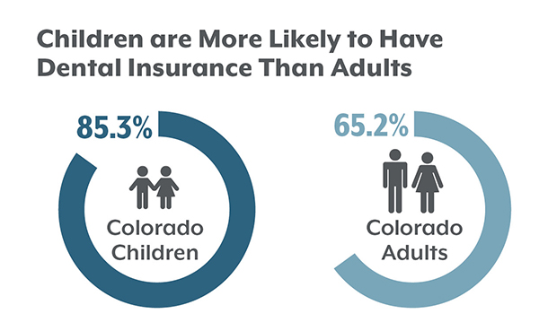
Colorado Health Access Survey, 2017
8

Slide 9
Two of Three Low-Income Coloradans Have Dental Insurance
Colorado Health Access Survey, 2013-2017, Coloradans with Dental Insurance by Income
9

Slide 10
Colorado Health Access Survey, 2009-2017
10

Slide 11
Lower Percentage of Medicaid Enrollees Getting Dental Care
Visited a Dentist or Dental Hygienist in the Past 12 Months, by Medical Insurance Type, Colorado Health Access Survey, 2013-2017
11

Slide 13
Adults
13

Slide 14
Decrease in Younger Adults Getting Dental Care
Visited a Dentist or Dental Hygienist in the Past 12 Months, by Age, Colorado, 2013-2017
14

Slide 16
Spotlight on Children’s Oral Health
16

Slide 17
More Children Over Age 1 Getting Dental Care
Visited a Dentist or Dental Hygienist in the Past 12 Months, by Age, Colorado Health Access Survey, 2013-2015
17

Slide 19
Colorado’s Oral Health Basic Screening Survey
Highlights of the 2016-2017 Results
Renee Calanan, PhD
Epidemiologist
Katya Mauritson, DMD, MPH(c) Dental Director
Colorado Department of Public Health and Environment

Slide 20
Methods

Slide 21
School-Level Sampling
Selected a sample of 59 elementary schools in Colorado
All K and 3rd grade students at the school
Ensured selection of schools from each of 21 Health Statistics Regions
Ensured selection of schools across the range of % eligibility for free/reduced price meal program
If a school declined to participate, a replacement school was selected. In total, 104 schools were recruited.
40 schools participated
8 schools used active consent
Student response rate: 58.9% (K) and 49.5% (3rd)
32 schools used passive consent
Student response rate: 78.6% (K) and 79.2% (3rd)

Slide 22
Data Collection & Analysis
Dental hygienists conducted in-mouth exams to screen for caries experience (i.e., fillings or untreated decay), untreated decay, treatment urgency, and dental sealants.
Dental hygienists and school nurses also measured height and weight and collected data on sex, race and ethnicity, and child age from school rosters.
Data were weighted to be representative of the general population of K and 3rd grade students in Colorado.

Slide 23
Results: Prevalence & Trends

Slide 24
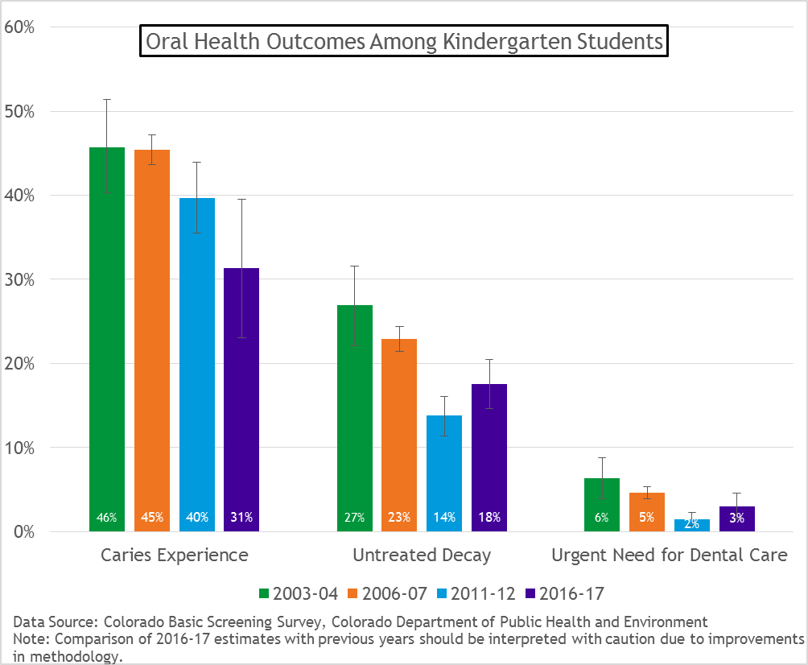

Slide 25
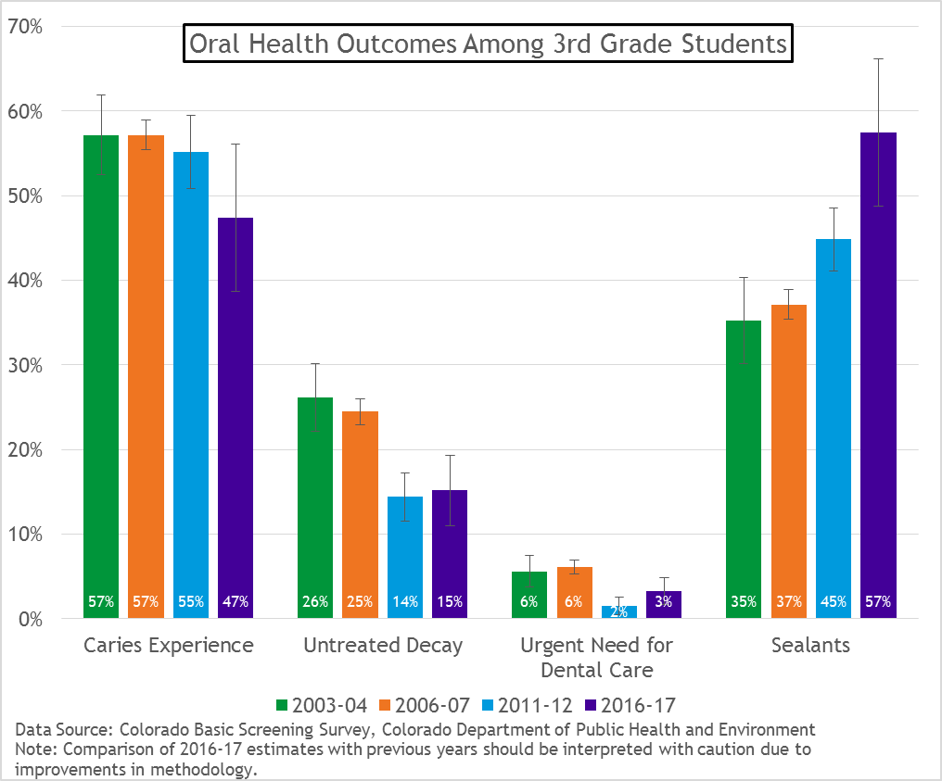

Slide 26
Results: Disparities The Colorado Department of Public Health and Environment acknowledges that generations-long social, economic and environmental inequities result in adverse health outcomes. They affect communities differently and have a greater influence on health outcomes than either individual choices or one’s ability to access health care. Reducing health disparities through policies, practices and organizational systems can help improve opportunities for all Coloradans.

Slide 27
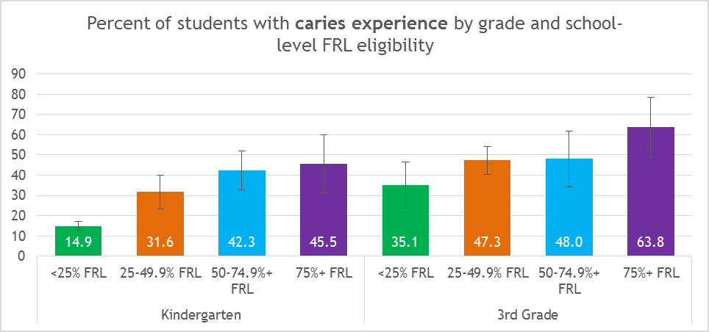
Data Source: Colorado Basic Screening Survey, Colorado Department of Public Health and Environment

Slide 28
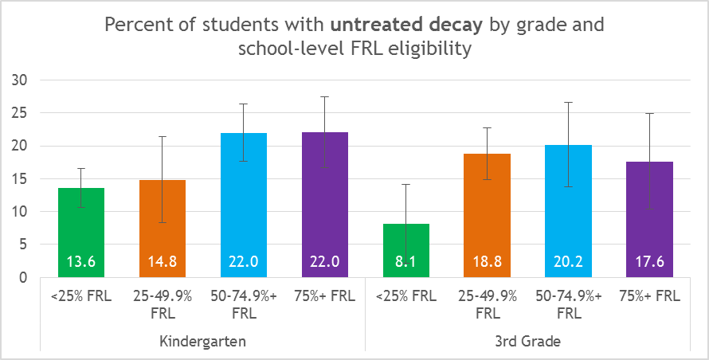
Data Source: Colorado Basic Screening Survey, Colorado Department of Public Health and Environment

Slide 29
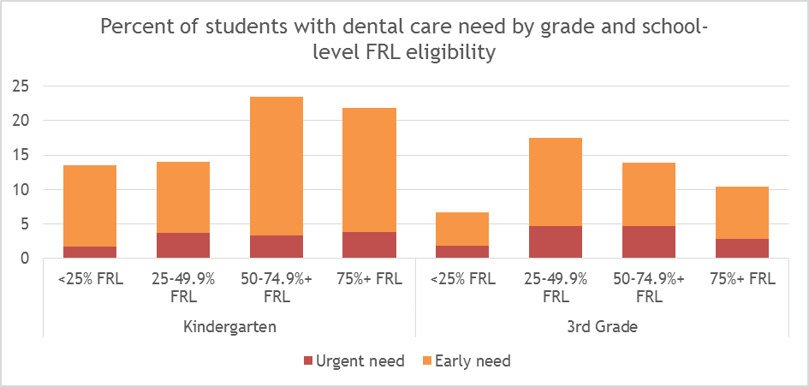
Data Source: Colorado Basic Screening Survey, Colorado Department of Public Health and Environment

Slide 30
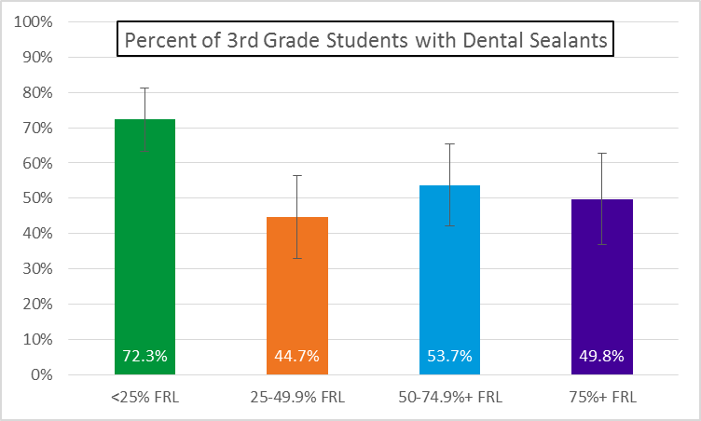
Data Source: Colorado Basic Screening Survey, Colorado Department of Public Health and Environment

Slide 31
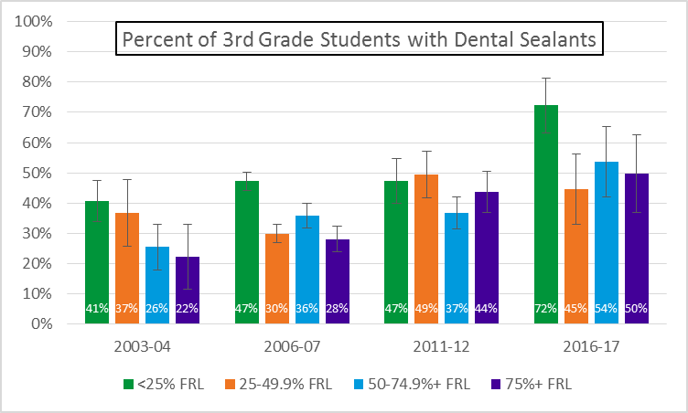

Slide 32
Conclusions
Since 2003-2004, the prevalence of caries experience and untreated decay decreased among kindergarten students.
Since 2003-2004, the prevalence of untreated decay decreased and the prevalence of dental sealants increased among 3rd grade students.
Disparities exist in oral health outcomes among students at schools with higher FRL eligibility.
Since 2003-2004, dental sealant prevalence has increased among students at schools with 50% FRL eligibility or greater.

Slide 33
Notes:
OHU: CWF (top 10…), SBSP, CF3
BSS changes are population level: one small cavity is counted the same as 10 large
Real improvements
Over decade of investments
Why does it matter?

Slide 34
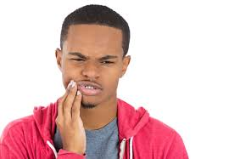
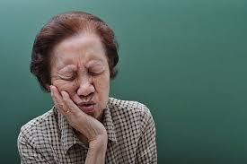
Why Oral Health Matters
Notes:
Individual costs: school readiness, economic achievement, lifespan health and wealth
Kids with toothaches: 4 x more likely low GPA; 6x more likely to miss school https://www.ncbi.nlm.nih.gov/pmc/articles/PMC3482021/
Parents missed 2.5 days of work
More than 25,000 kids miss at least one day of school due to tooth pain in last 12 months
Societal costs: lost school hours, productivity, paying more for downstream, inability to thrive
Everyone pays...for CWF few $ per person, 4 FV/by age 3, sealants, or a lot more
BSS
BSS lack of response trend, cost, future? SMSK

Slide 35
Notes:
Future of surveillance?
SMSK; EDR like IHS with supplemental screenings?
School districts with universal screening: San Fran, DPS (tied with other: MH, BMI, etc.)

Slide 36
Why Oral Health Matters

Slide 37
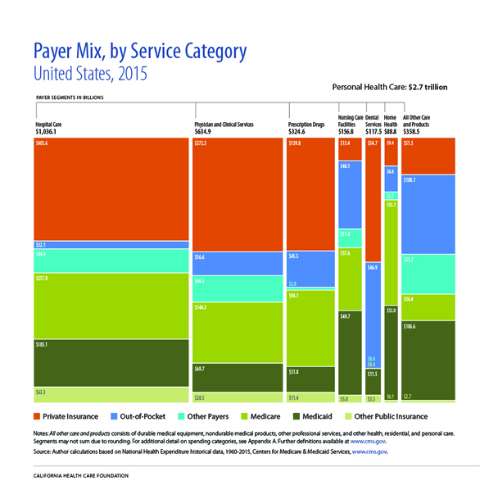
Why Oral Health Matters

Slide 38
Why Oral Health Matters
Jeffcoat MK, Jeffcoat RL, Gladkowski PA, Bramson JB, Blum JJ. Impact of Periodontal Therapy on General Health: Evidence from Insurance Data for Five Systemic Conditions, Am J Prev Med 2014;47(2):166-174.

Slide 39
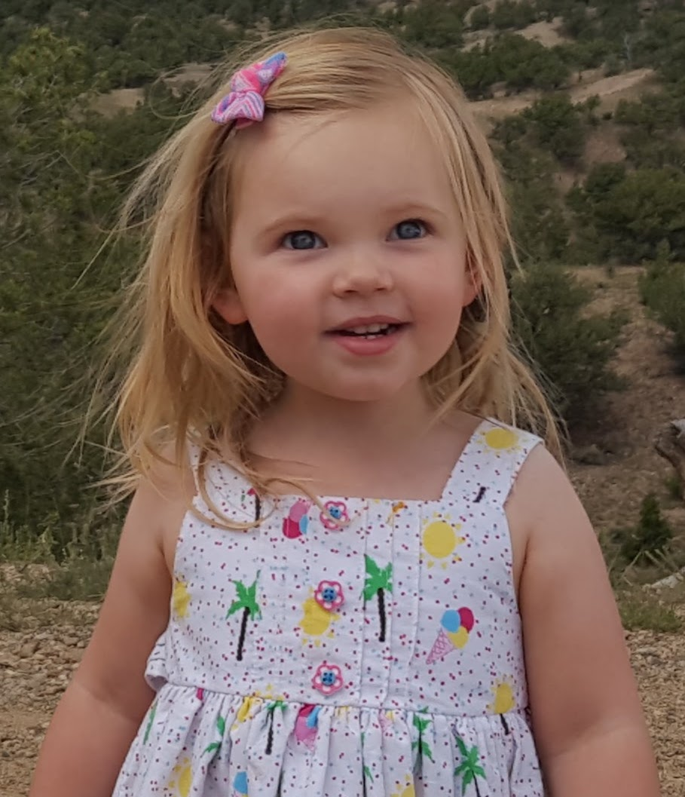
Why Oral Health Matters
Notes:
Racial inequities because of compounded structural inequities
Disparities…
economic: by lower income communities
Geographic: lack of access esp to prevention:
ities

Slide 40
Notes:
VISION: Visual Information System for Identifying Opportunities and Need
Kindergarten readiness
Hope to have next BSS updated with similar

Slide 41
Notes:
Pueblo, SLV, Denver

Slide 42
Data Source: Colorado Basic Screening Survey, Colorado Department of Public Health and Environment
Notes:
School readiness again; how to make early interventions and SBSP thrive?

Slide 43
7.7-fold decrease in untreated decay when ≥ 4 FVA by age 3
(adjusted for behaviors)
35% to 7%*
3.5-fold decrease in any decay when ≥ 4 FVA by age 3
(adjusted for behaviors)
46% to 30%*

Slide 44
Next steps….
BSS Report release
Children’s Dental Health Month
Next five year oral health plan: supporting gains
Resources?
What would you find useful?
Notes:
Other analyses, call to action
Fact sheets
Updating CDPHE’s VISION
SWOT analysis of data:
Positive trends, who is missing, EB interventions, funding
“Thrivability” of prevention programs
Targeted resources for care

Slide 45
Questions?
renee.calanan@state.co.us
katya.mauritson@state.co.us

Slide 46
Expert Panel: Ongoing Efforts in Oral Health
Panelists
Jennifer Goodrum, Director of Government Relations, Colorado Dental Association
Linda Reiner, Vice President, Caring for Colorado
Gina Schmidt, RDH, School Oral Health Program, Denver Public Schools and Denver Health
Facilitated Discussion
46

Slide 47
Discussion Questions
What other policy changes are necessary to improve oral health outcomes and access to care ?
How can researchers, philanthropists and advocates work to improve oral health outcomes and access to care?
Other questions and comments?

