Slide 1
Colorado’s
Primary Care
Workforce
A Study of
Regional Disparities
February 11, 2014
Legislative Briefing

Slide 2
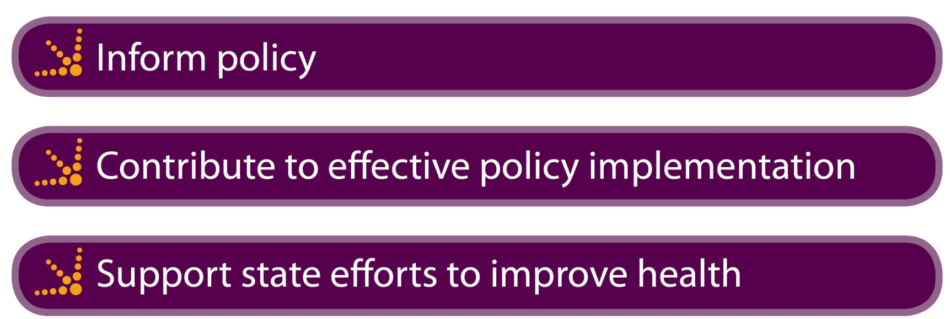
The Colorado Health Institute: An Introduction
We are non-partisan.
We do not take positions on bills.
Our insight is used to:

Slide 3
Three Takeaways
The study finds disparities in the availability
of primary care across Colorado.
Five “hot spot” regions face significant challenges in primary care and Medicaid workforce capacity.
Potential solutions revolve around training, retention, new models of care and technology.

Slide 4
Some Background

Slide 5
Why We Conducted This Study
We responded to requests for baseline information on Colorado’s primary care capacity.
  Two primary care workforce projections in the past five years indicated the potential need for increased capacity.
  No study had assessed current primary care capacity, especially across regions.

Slide 6
The Questions We Asked
Is Colorado’s primary care capacity adequate to provide care to all Coloradans, regardless of insurance?
Does primary care capacity differ on a regional basis?
Do Coloradans covered by Medicaid have access to primary care physicians?

Slide 7
The Colorado Health Institute Analysis
Calculates full-time equivalents for the primary care workforce, statewide and regionally.
Introduces benchmark panel size to compare capacity across regions – and time.
Analyzes Medicaid capacity, today and after expansion.

Slide 8
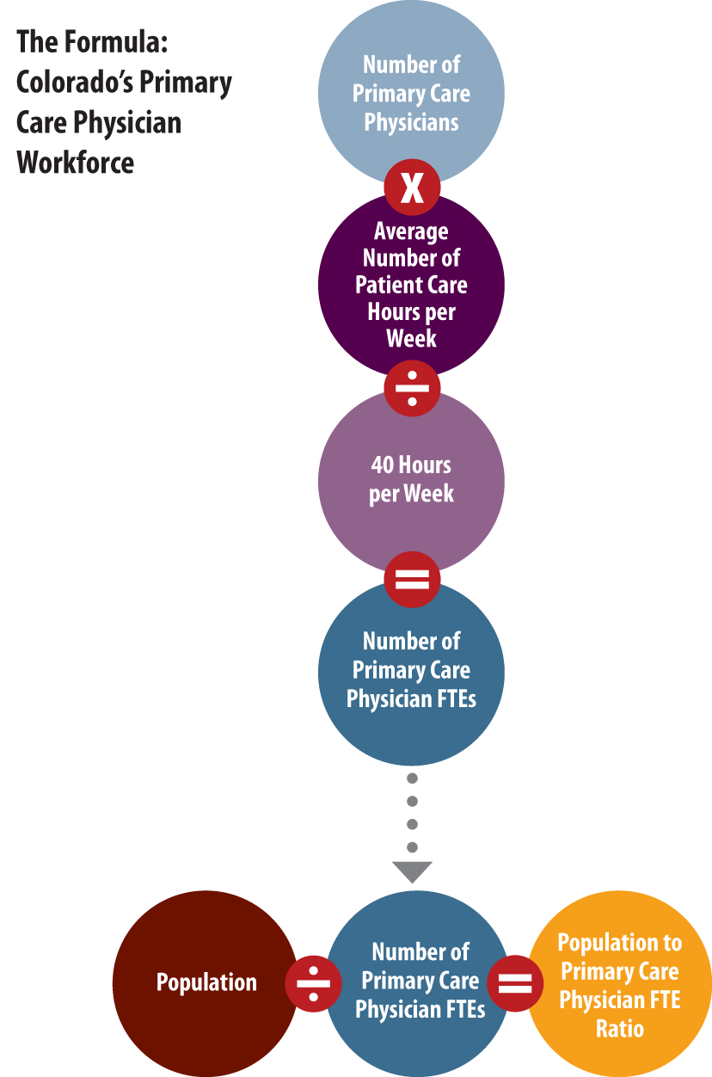
Put Formula on This Slide

Slide 9
Findings:
Primary Care

Slide 10
It Matters Where You Live
Colorado’s average panel size of 1,873:1 compares well to the 1,900:1 benchmark
Nine regions – six rural and three urban – don’t meet the benchmark.
What Colorado needs: Another 258 primary care physicians in the right places.

Slide 11

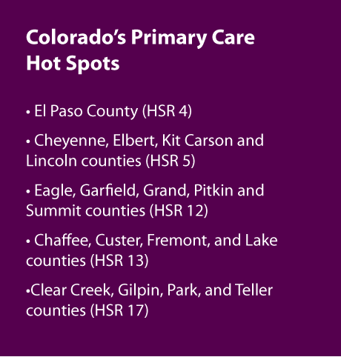

Slide 12
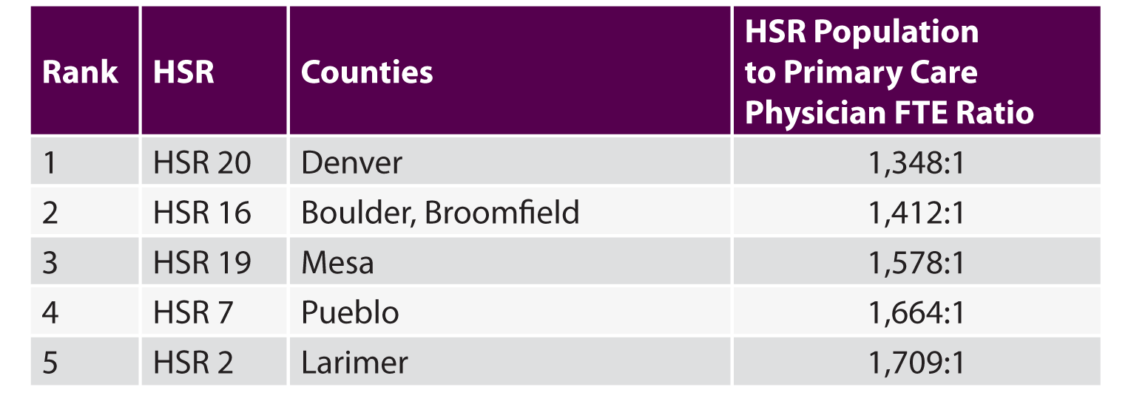
Greatest Primary Care Capacity
Regions with Relatively High Primary Care Capacity

Slide 13
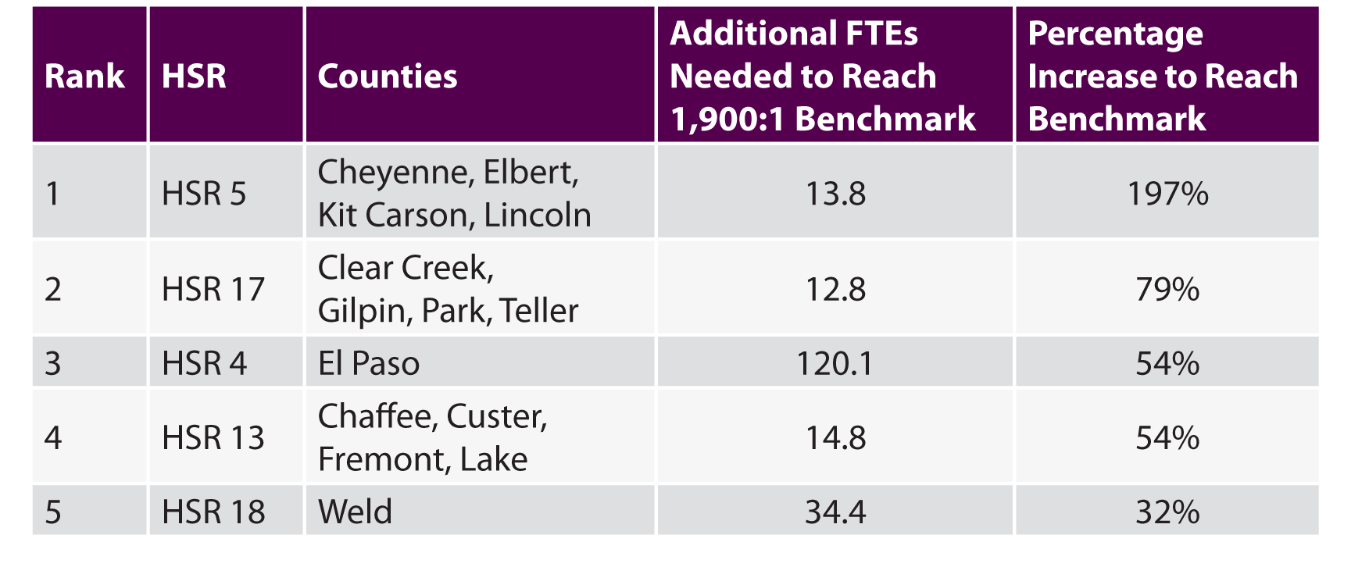
Least Primary Care Capacity
Regions with Relatively Low Primary Care Capacity and the Number of FTEs Needed to Reach the 1,900 Benchmark

Slide 14
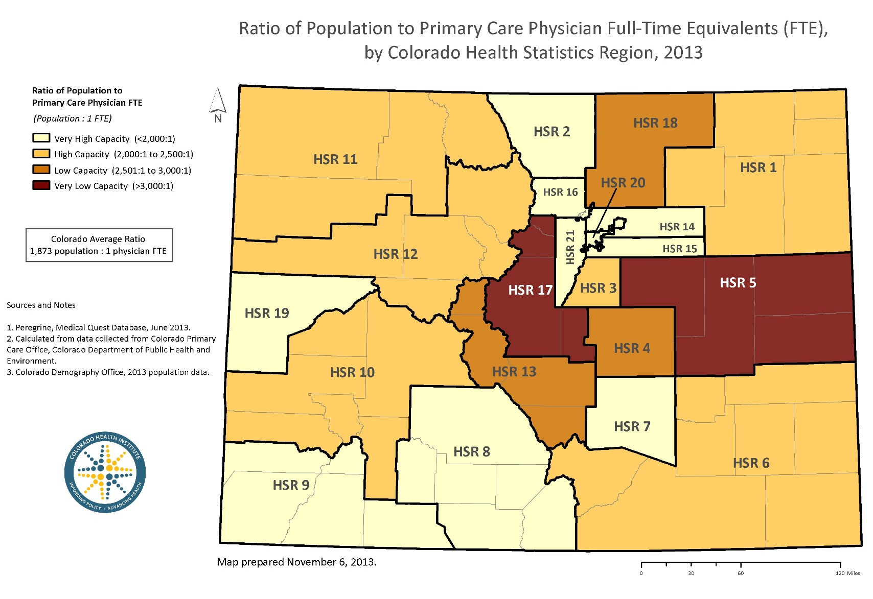
Regional View

Slide 15
Findings: Medicaid Primary Care

Slide 16
Disparities in Medicaid Capacity
Nine regions have relatively low Medicaid capacity.
Four urban, five rural.
We estimate an additional 440,000 Medicaid enrollees by 2016.
Capacity will need to increase.
Again, in the right places.

Slide 17
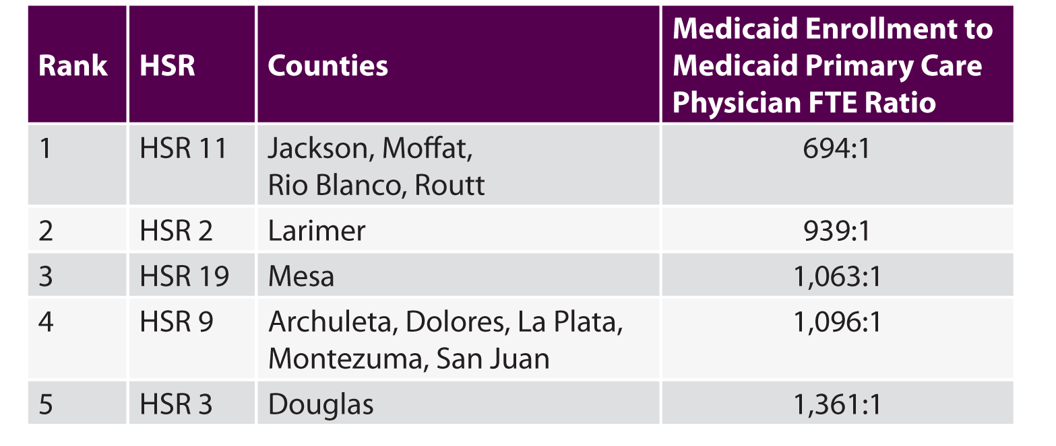
Greatest Medicaid Capacity
Regions with Relatively High Medicaid Primary Care Capacity

Slide 18
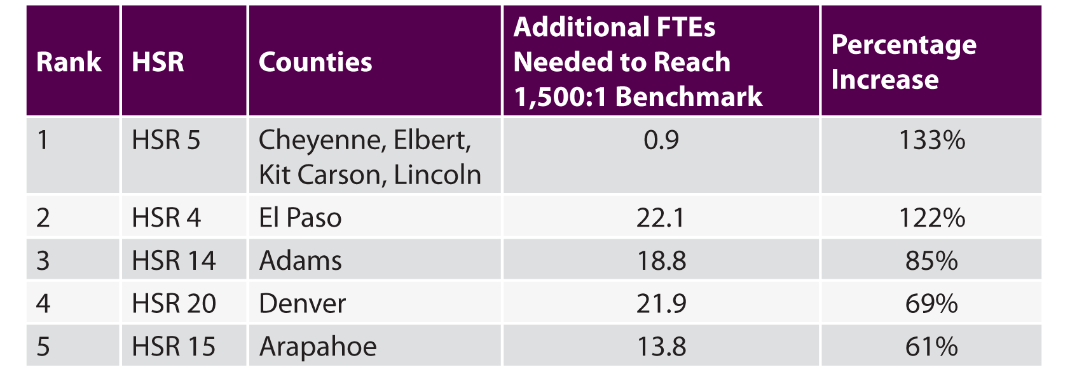
Least Medicaid Capacity
Regions with Relatively Low Medicaid Primary Care Capacity

Slide 19
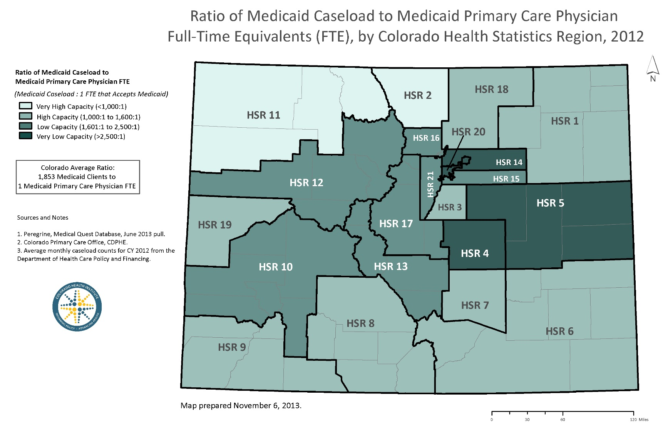
A Regional View

Slide 20
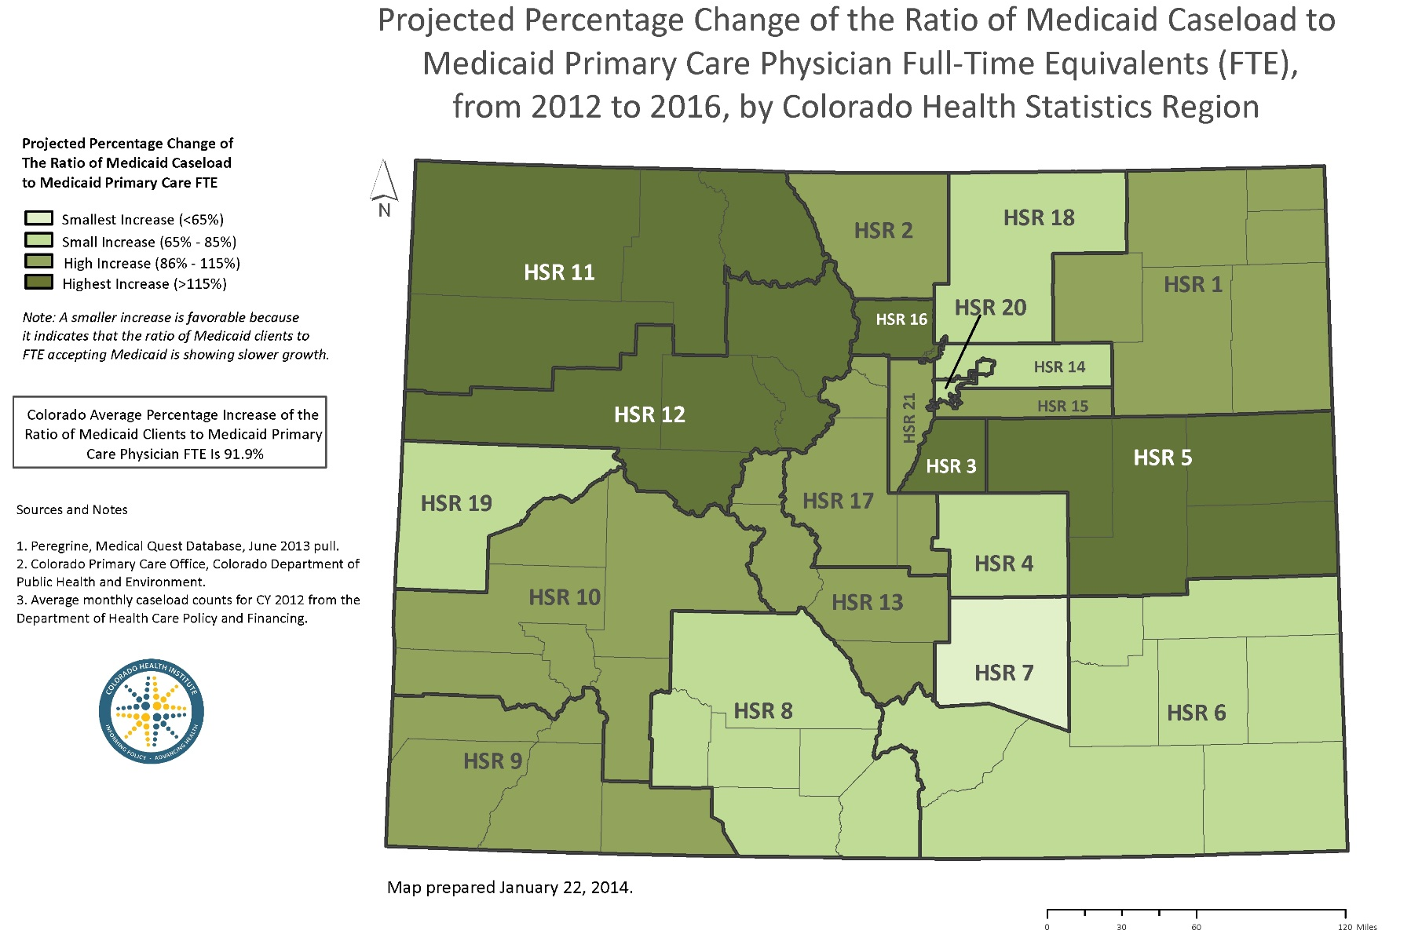
Post-Medicaid Expansion

Slide 21
Findings: Nurse Practitioners and Physician Assistants

Slide 22
Important Parts of the Equation
  On average, one NP or PA FTE for each two primary care physician FTEs.
  Important for integrated and delegated models of care.
  Colorado’s FQHCs report a ratio of about 1:1

Slide 23
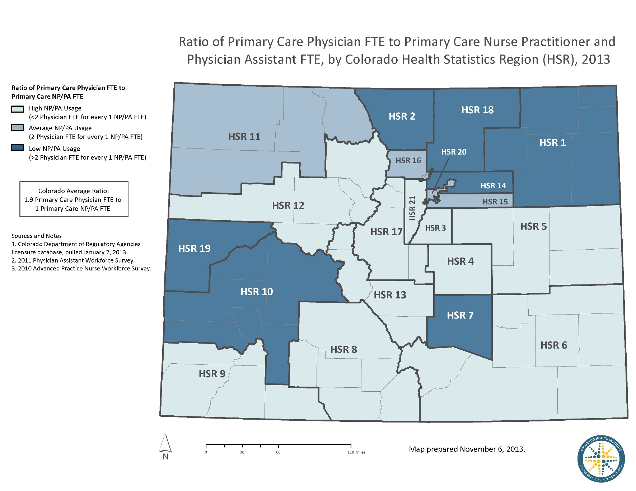
Regional View

Slide 24
The ‘So What?’

Slide 25
Why Regional Disparities?
Rural and frontier landscape of Colorado.
  Attracting professionals to remote places, requires a certain profile.
  Economics of rural practice.
  Jobs for spouses.
Market rewards specialists more than primary care physicians.

Slide 26
Possible Solutions
Training: “Grow your own”
Retention resources in rural areas
Hub and spoke
Tele-medicine
Incentives for primary care
Delegate care
Push technology envelope

Slide 27
Methodology

Slide 28

Defining Primary Care
Family/general medicine
Internal medicine
Pediatrics
Does not include OB/GYN.

Slide 29
The Data
Practicing physicians: Peregrine Medical Quest
Time in patient care: Colorado Department of Public Health and Environment (CDPHE)
Nurse practitioners and physician assistants: Colorado Health Institute
Population: U.S. Census
Medicaid caseload: Colorado Department of Health
Care Policy and Financing (HCPF)

Slide 30
Panel Size Benchmarks
Several large health systems gave us their patient panel targets
Experts writing in Health Affairs based analyses on panel sizes of around 1,900.
FQHCs and other safety net clinics tend to range between 1,250:1 and 1,500:1.

Slide 31
Three Takeaways
The study finds disparities in the availability of primary care across Colorado.
Five “hot spot” regions face significant challenges in primary care and Medicaid workforce capacity.
Potential solutions revolve around training, retention, new models of care and technology.

Slide 32
Questions?

Slide 33

Rebecca Alderfer 720.382.7074 AlderferR@coloradohealthinstitute.org
Amy Downs 720.382.7091 DownsA@coloradohealthinstitute.org

