Slide 1
Bending the Health Care Cost Curve
Market-Based Solutions
February 26, 2014
Legislative Lunch and Learn

Slide 2
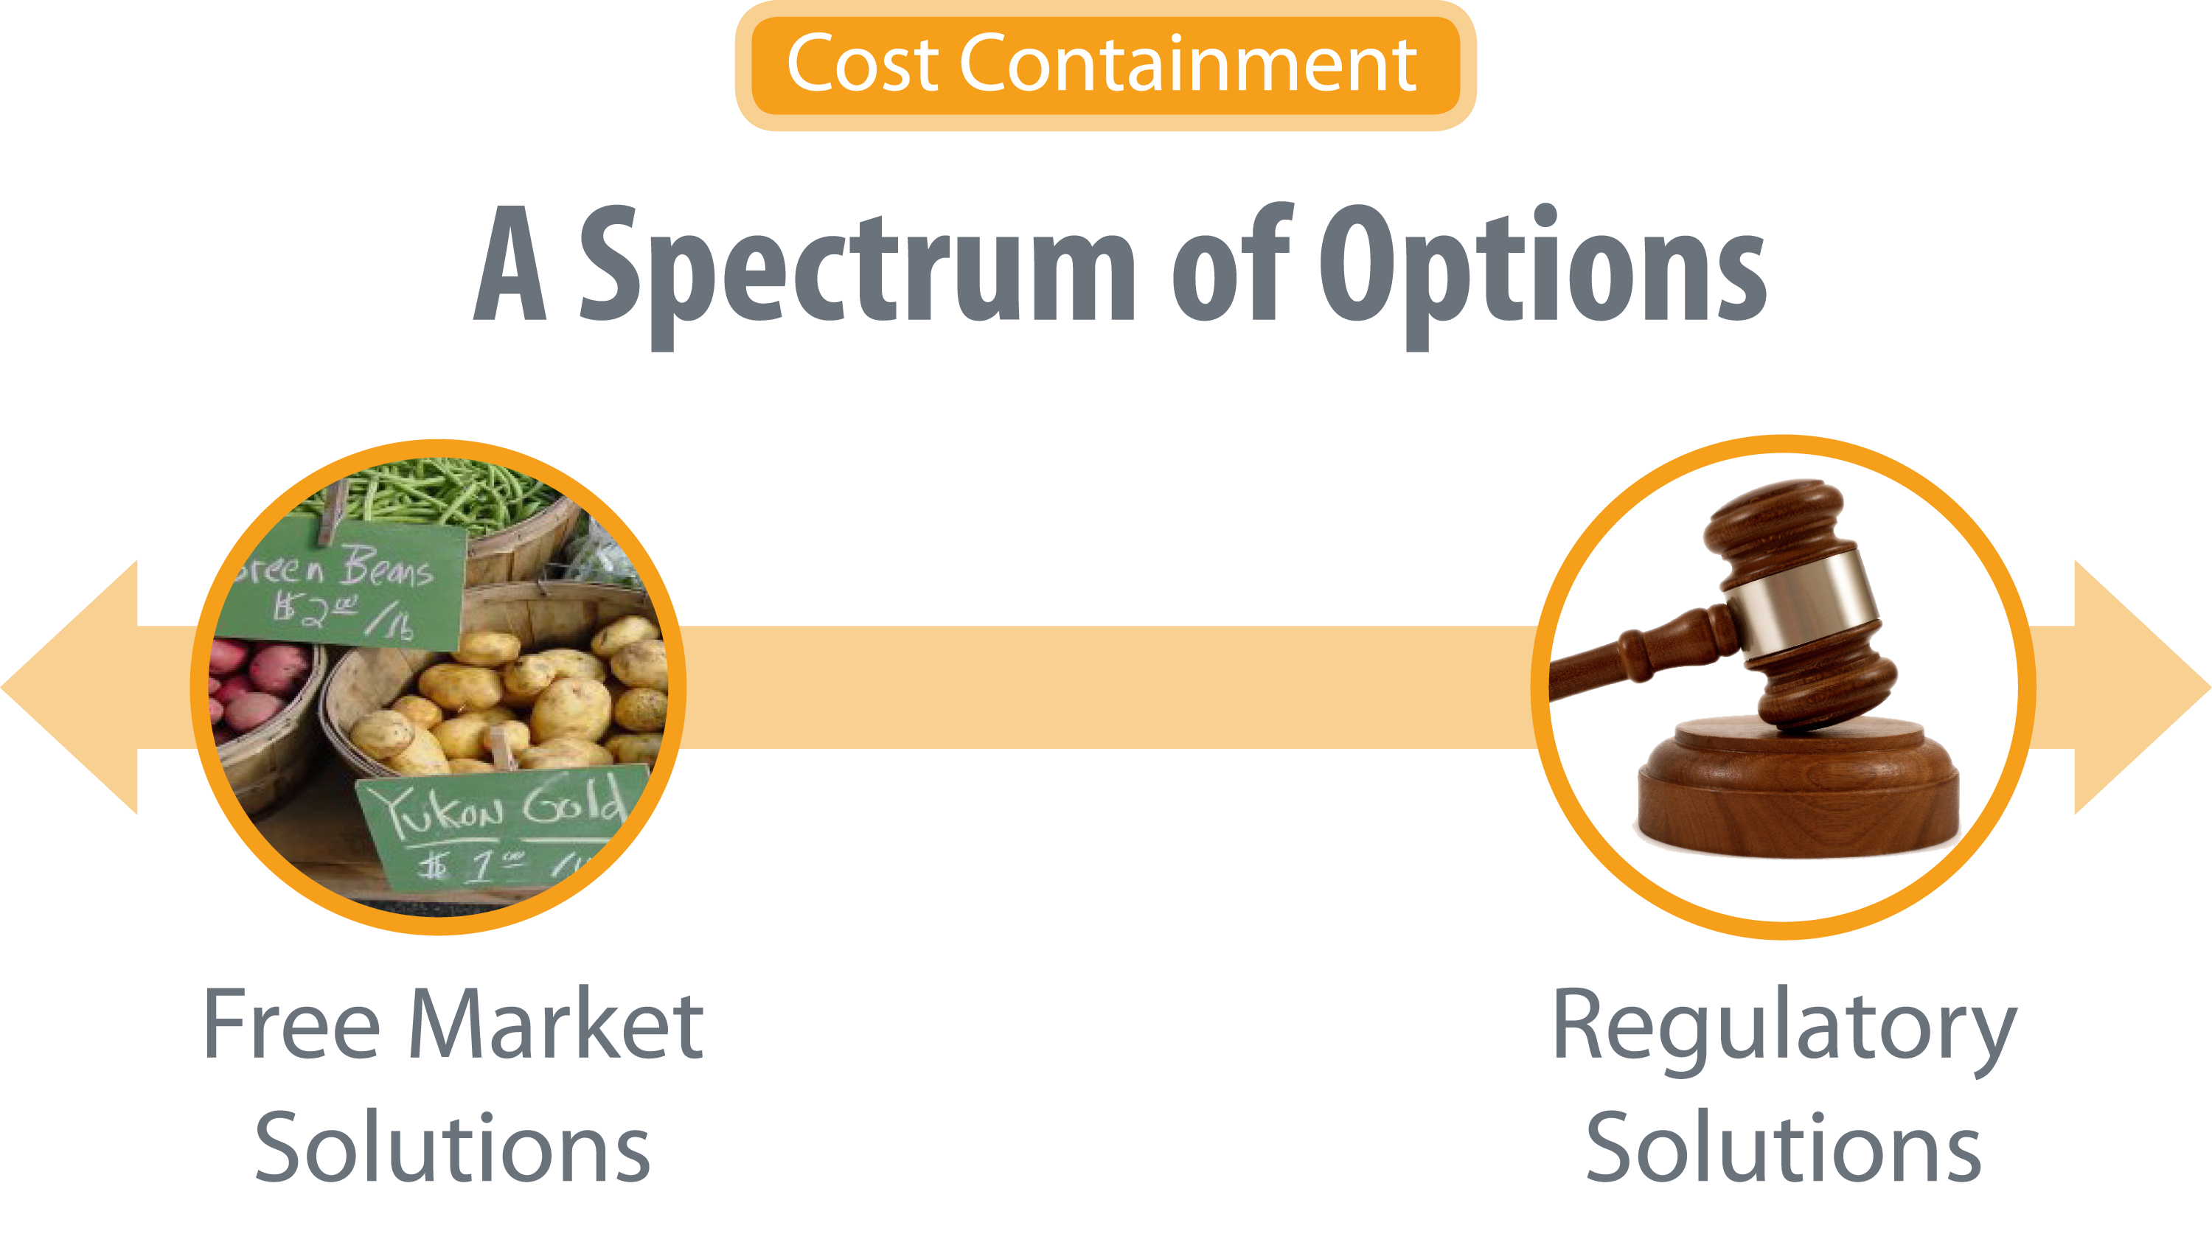
Cost Containment

Slide 3

Three Takeaways
Costs of health care services
continue to increase.
Myriad market-based opportunities to rein in costs.
Some have promise, some have obstacles to implementation, some have unintended consequences.

Slide 4

The Good News: Growth Curve is Bending
Between 2009
and 2011, annual increase in national health care spending
was the lowest
in 50 years:
3.9 percent

Slide 5
But It’s Not Good Enough

Slide 6
Conditions for Competitive Markets
  Consumers bear costs for what they consume
  Consumers and suppliers have complete and transparent information to make informed choices
  No barriers for suppliers to enter market

Slide 7
Health Care Cost Drivers

Slide 8
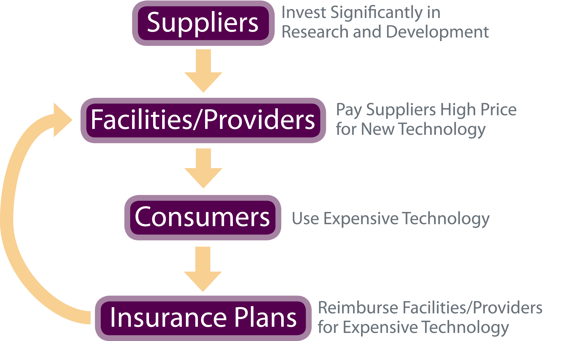
The Technology Conundrum

Slide 9

Health Care Cost Drivers
  Increases in Insurance Payments
Out-of-pocket payments
  55% in 1960
  13% in 2011
SOURCE: Health Care Costs: Key Information on Health Care Costs and their Impact, Kaiser Family Foundation, 2009

Slide 10


Health Care Cost Drivers
  Consolidation of insurance plans and providers: Limits competition
  Inefficiencies in medical care delivery and administration

Slide 11

Health Care Cost Drivers
  Financial
  and legal incentives
  to increase services

Slide 12
Market Solutions: Consumers Bear Cost for What They Consume

Slide 13

More Skin in the Game for Consumers
  Eliminate Tax Exclusion
  for Health Insurance Benefits
    Distorts market cost
    of health insurance
    Incentivizes employee compensation
    through premiums instead of wages
  Consumer-Directed Health Plans (CDHPs)
    High deductible plan
    Coupled with health savings account

Slide 14
Show Me the Money: High Deductible Plans

Slide 15
Findings on High Deductible Plans
Reduce the use of unnecessary
and necessary care
Could lead to $50 billion in annual savings
if half of employer-sponsored lives enrolled
More effective for reducing utilization in
healthy populations than unhealthy populations
Cost-sharing requires education so people
don’t forego important care
Notes:
.

Slide 16
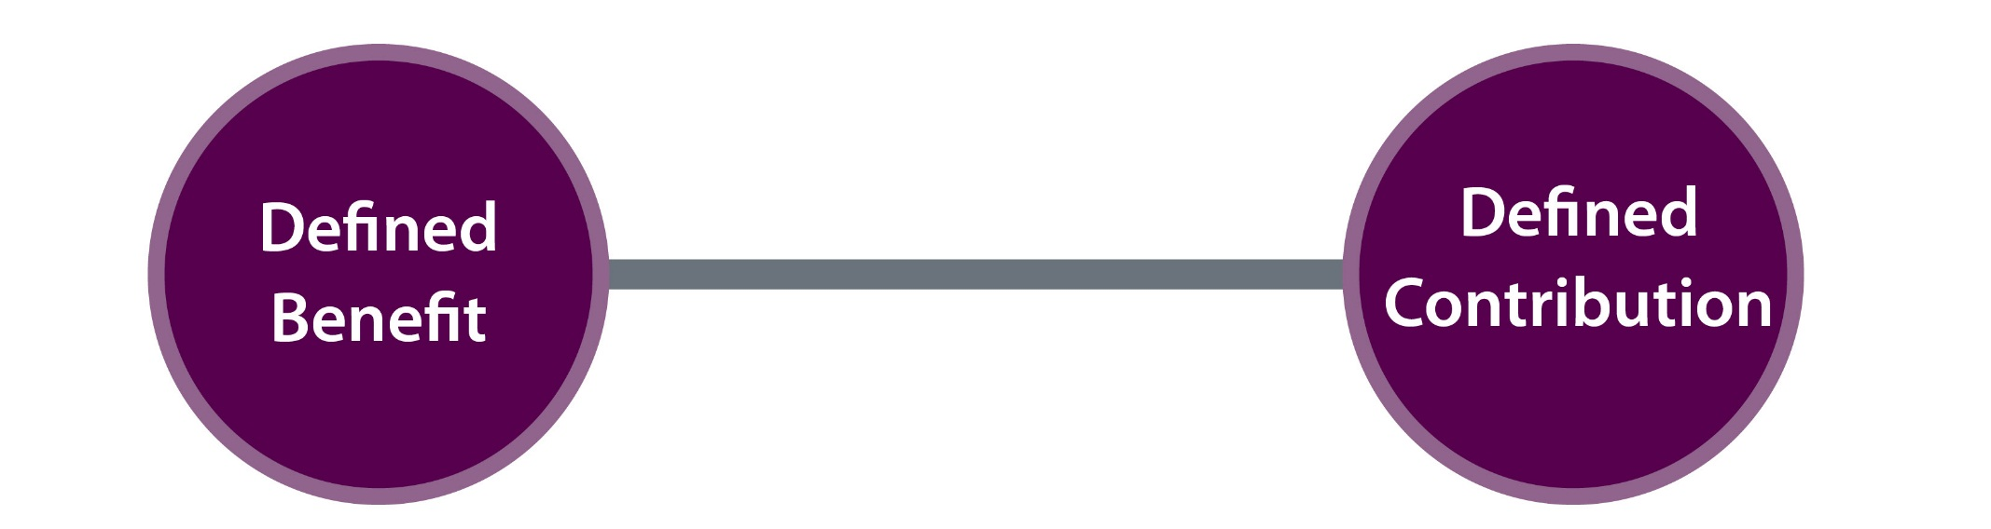
Benefit Design: Tipping the Scale
Defined Contribution
Defined Benefit

Slide 17
Reference Pricing: Asthma Drugs
Asthma
Drugs
Reference Price

Slide 18
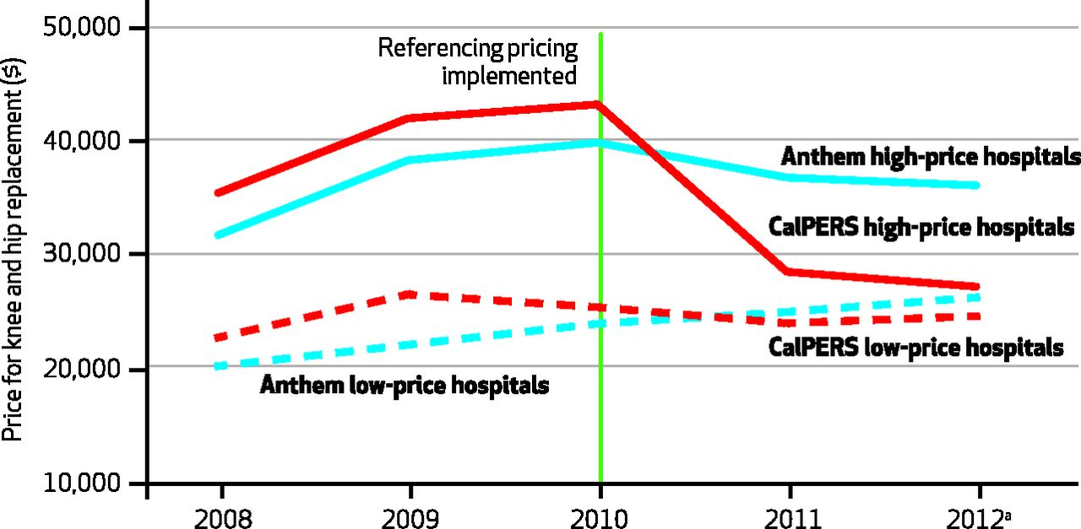

Reference Pricing: Not Just a Theory
Robinson J C , and Brown T T Health Aff 2013;32:1392-1397
©2013 by Project HOPE - The People-to-People Health Foundation, Inc.

Slide 19
Classifying Wellness Programs
Participatory (Walking Program)
Health Contingent:
Health outcome is measured
to receive reward/penalty
Activity-Only: Individual
must complete the activity (Diabetes class)
Health
Outcome: Tied to an outcome (Reduction in blood pressure)
Wellness Programs
Rosenbaum, S. (2013). Update: Non-Discriminatory Wellness Program Final Rules. Health Reform GPS. www.healthreformgps.org.

Slide 20
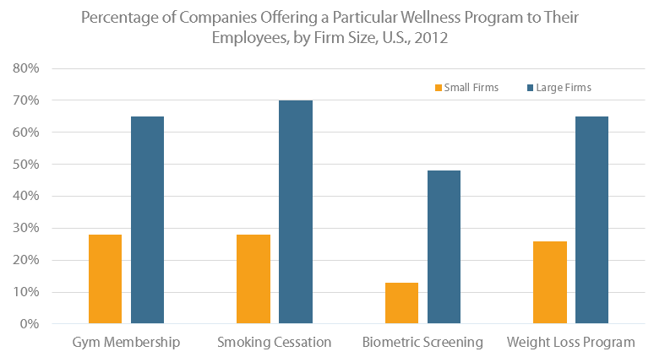
Wellness is Booming
SOURCE: Kaiser/HRET Survey of Employer-Sponsored Health Benefits, 2012

Slide 21
Market Solutions: Consumers Need Transparent Information

Slide 22



Transparent Information for Consumers to Make Informed Choices: Cost and Quality
  Health Insurance Marketplaces
  All Payer Claims Databases

Slide 23
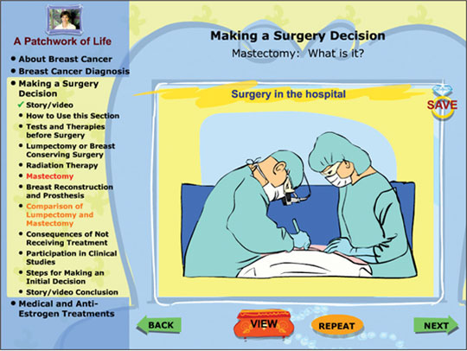
Engaging Consumers in Medical Decisions

Slide 24
Market Solutions: Increasing Competition
Notes:
Even when we pay the costs of what we consumer, even when we have the information we need to make informed choices, if there is a lack of competition in the market, we don’t end up having a lot of choices.

Slide 25


Increasing Competition Among Health Plans
  Sell insurance products across state lines to increase competition among insurers

Slide 26
Increasing Competition Among Providers
Anti-trust policies could be enforced more rigorously
Buying in bulk: Walmart and Lowes
  Crossing state lines to use providers
  (Centers of Excellence)
  Paying a bundled payment
Narrow networks
Greater transparency: Quality * Price = Value

Slide 27

Defensive Medicine and Tort Reform
Defensive Medicine:
When clinicians order tests, procedures or visits of doubtful value to reduce exposure to malpractice liability
Tort Reform:
Lowering caps on the type or amount of damages that may be awarded in personal injury lawsuits

Slide 28
Three Takeaways
Costs of health care services
continue to increase.
Myriad market-based opportunities to rein in costs.
Some have promise, some have obstacles to implementation, some have unintended consequences.

