Slide 1


Slide 2
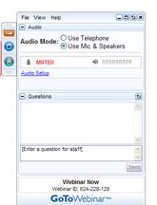




Webinar Basics
How do I ask questions
during the webinar?
Recorded webinar and PowerPoint slides will be available after the webinar.
Special thanks to our funders:

Slide 3


Your Presenters
Amy Downs
Senior Director for Policy and Analysis
Tasia Sinn
Research Analyst

Slide 4
Addressing the Boomer Challenge: Long Term Services and Supports
August 1, 2012

Slide 5
Today’s Discussion
The urgency of long term services and supports—what’s the hurry?
  Changing demographics
A summary of LTSS
Financing LTSS
On the Horizon: Where do we go from here?

Slide 6
Polling question
What is the most urgent priority for long term services and supports in Colorado?
  Transitioning individuals out of nursing facilities back into the community when they can.
  Focusing on cost-containment of LTSS.
  Encouraging individuals to purchase private long term care insurance to avoid entry into Medicaid.
  I’m not sure, that’s why I’m listening to this webinar.

Slide 7
The Challenge and
Urgency of LTSS:
Changing Demographics

Slide 8
What are Long Term Services and Supports?
“A broad range of supportive services needed by people who have limitations
in their ability to perform daily activities because of a physical, cognitive, or mental disability or condition.”
SOURCE: O’Shaughnessy, C. (2010). The Basics: National Spending for Long-Term Services and Supports (LTSS). National Health Policy Forum.

Slide 9
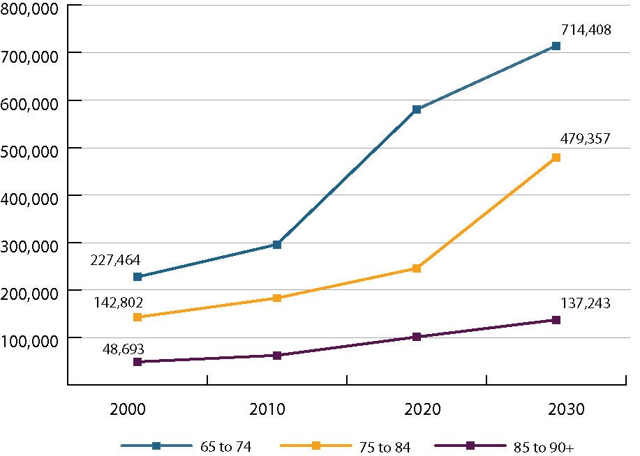
65+ Age Distribution in Colorado
SOURCE: Colorado State Demography Office, population estimates, 2000-2030

Slide 10
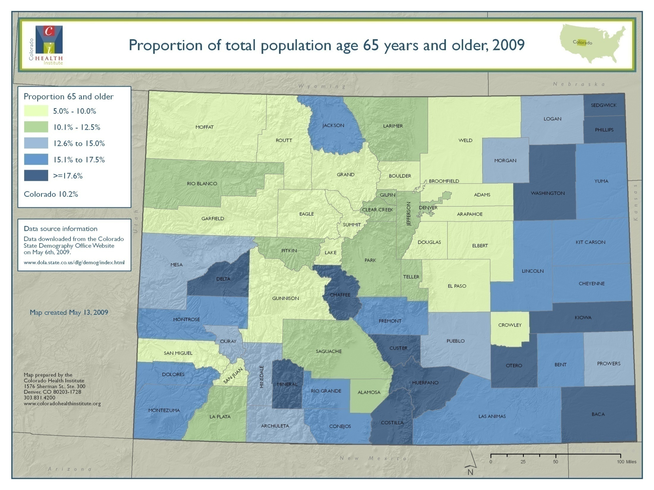

Slide 11
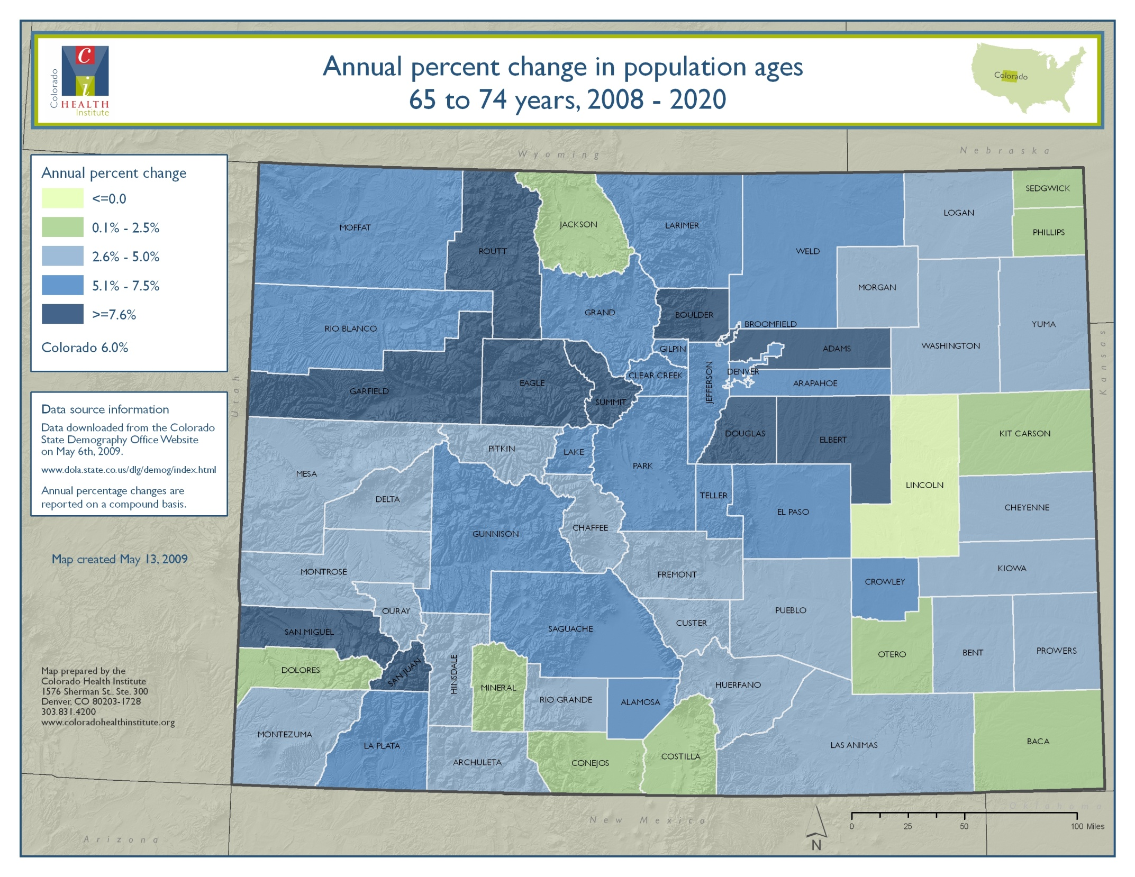

Slide 12
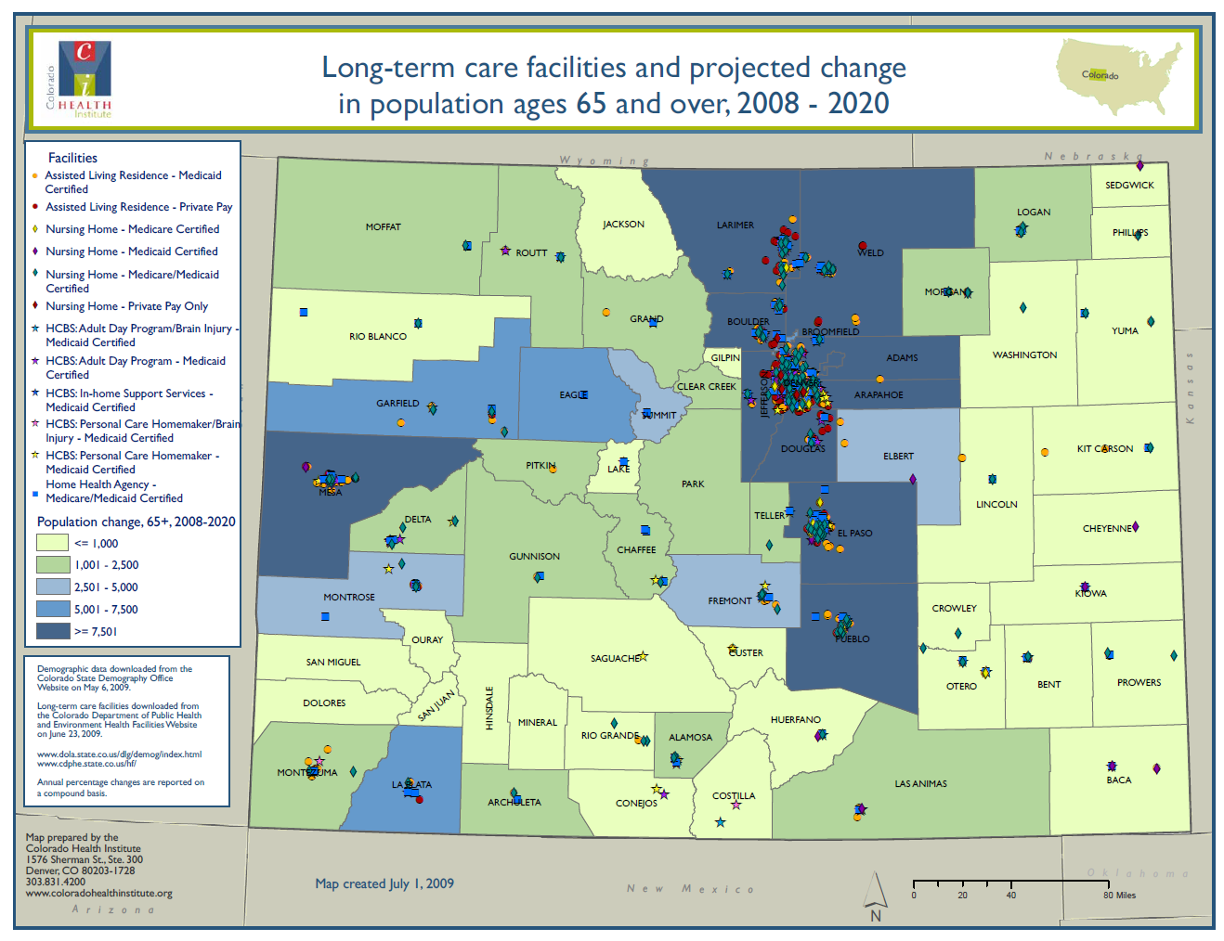

Slide 13
Where do Elders Receive
Long-Term Services and Supports?
At home
Personal and skilled services; adult day care
Residential setting
Group homes;
assisted living facilities
Institutional setting
Nursing facilities

Slide 14
Program for All Inclusive Care for the Elderly (PACE)
Provides long term services and supports
and acute care to individuals dually enrolled
in Medicare and Medicaid
Led by interdisciplinary team that coordinates care
PACE providers receive a fixed monthly rate from Medicare/Medicaid or Medicare/private pay
1,900 PACE Medicaid enrollees in Colorado

Slide 15
LTSS Workforce

Slide 16
Workforce issues
LTSS services are relatively labor intensive
Intensity drives cost
Different communities have different needs

Slide 17
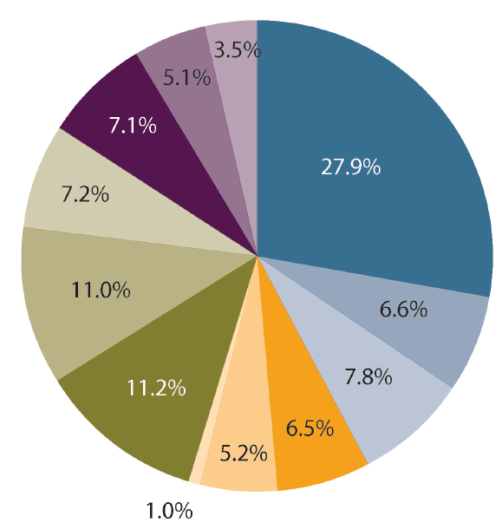
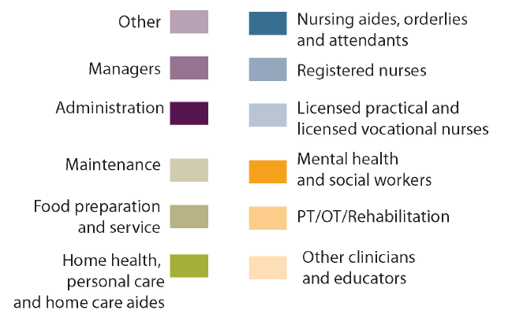
Staffing patterns for nursing homes and residential care facilities
SOURCE:LMI Gateway, Colorado Department of Labor and Employment, 2009

Slide 18
Financing Long Term Services and Supports

Slide 19
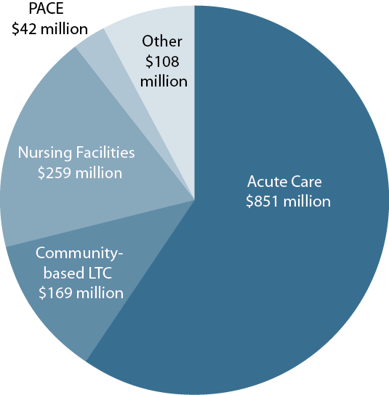
Medicaid Medical Services Premiums,
FY 2011-12
SOURCE: Colorado Department of Health Care Policy and Financing, FY 2012-2013 Budget Request
Notes: Projected General Fund expenditures before bottom line financing adjustments.

Slide 20
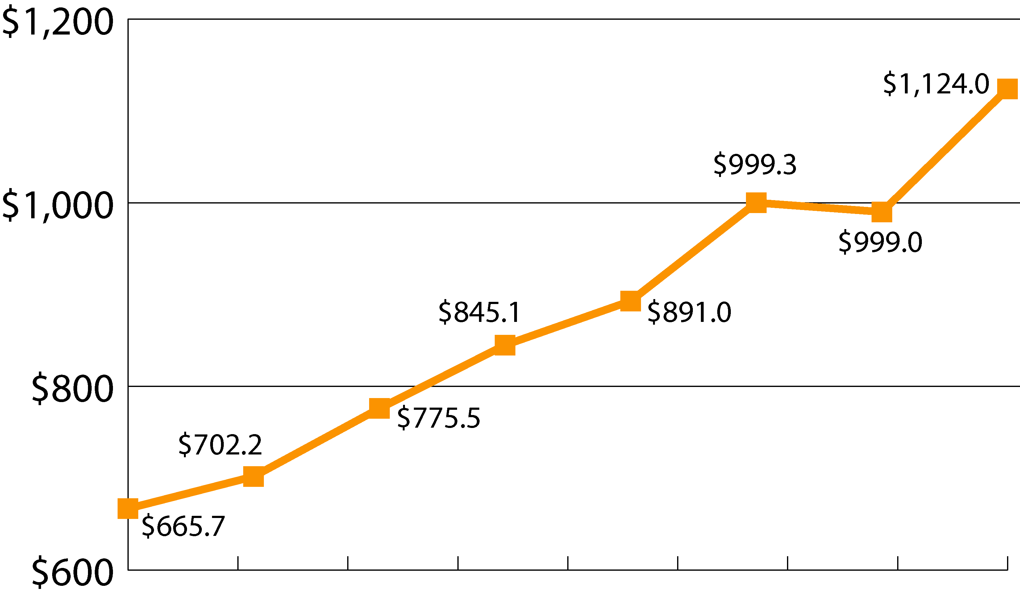
Medicaid LTSS Expenditures, FY 03-04 to FY 10-11
In Millions
2003-04 2004-05 2005-06 2006-07 2007-08 2008-09 2009-10 2010-11
SOURCE: Colorado Department of Health Care Policy and Financing

Slide 21
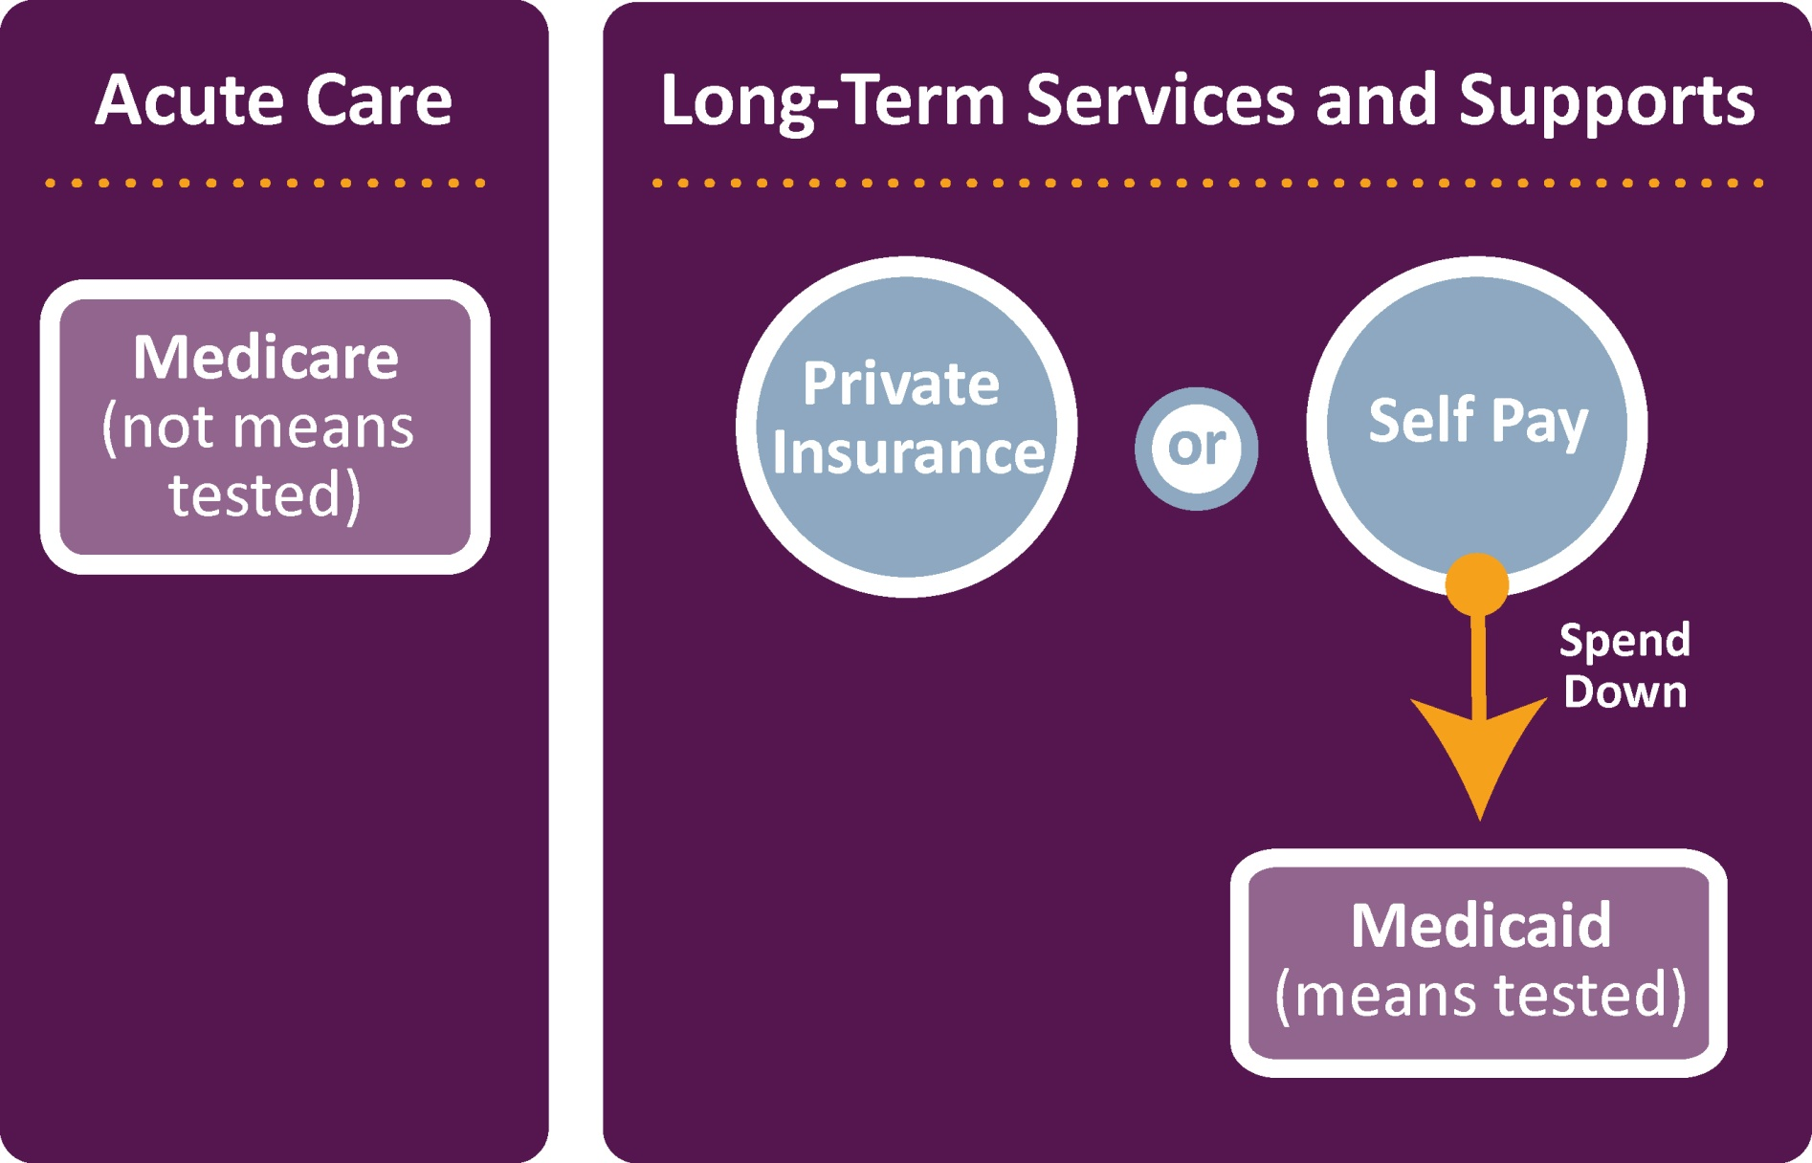
Interaction Between Acute and LTSS Insurance for Elders

Slide 22
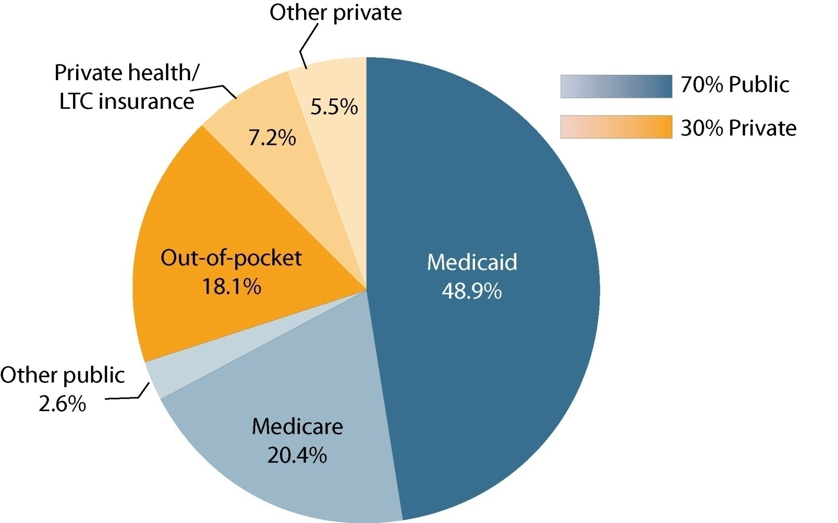
Who Pays for Long term Services and Supports?
SOURCE: Komisar, H, and L Thompson. (2006). National Spending for Long-term Care.

Slide 23
Polling question
Who has long-term care insurance?
  Yes, I have it!
  No, but I am considering buying.
  No, and I do not see any value in it for me.

Slide 24
The Lack of Long Term Care Insurance
The CLASS Act
  Voluntary long term care insurance program
  Premiums not based on health status
Feb. 2012 CLASS Act was repealed
by the U.S. House of Representatives
  Adverse selection
  Financially insolvent – distributions would exceed collections

Slide 25
Where do we go
from here?

Slide 26
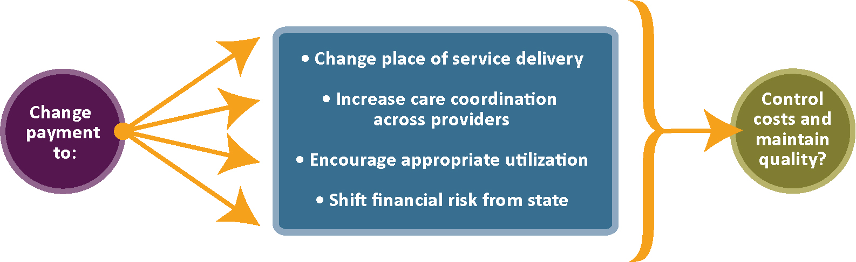
Mechanisms Being Considered to Reform Medicaid System

Slide 27

Moving people out of nursing facilities:
Colorado Choice Transitions
Colorado’s Money Follows the Person program
Transitions people from nursing facilities to the community when desired and feasible

Slide 28
Changing Reimbursement to Prolong Assisted Living
SB 12-128 (Roberts/Summers):
  Allows HCPF to provide clients at risk of nursing facility placement enhanced assisted living services
  Moves individuals in nursing facilities to assisted living

Slide 29
Dual Eligibles Planning Grant: Coordinating Care
Coordination of care for individuals
dually enrolled in Medicaid and Medicare (“dual eligibles”)
Inclusion of dual eligibles in Colorado Medicaid’s accountable care collaborative (ACC)
Proposal to CMS available on HCPF website
or can e-mail CHI for link

Slide 30
Person-Centered Payments in Long-Term Care
Redesign care planning tool and assessment form
for community based long term care services
In future could create person-centered “budget”
for each enrollee
Care plans would lead to less subjective decision making by care managers.
Request included in HCPF’s FY 2012-13 budget proposal, but denied

Slide 31
Waiver Consolidation
The state (HCPF/DHS) currently has multiple HCBS waivers
Discussion last legislative session to move all waivers to HCPF
First step in process to consolidate waivers
  Problem: Waiver participants can’t get services outside their designated waiver
  Concerns: Individuals do not want to lose services

Slide 32
Managed Care Models
Medicaid Managed LTSS
  Institution to Community/ Home Focus
  Little evidence to support
What’s needed
        Careful design
        Expertise
        Financial resources

Slide 33

“Boomers are just the beginning."
- Rich Umbdenstock, President, American Hospital Association
Amy Downs
720.382.7091 downsa@coloradohealthinstitute.org

