Slide 1



The 2011 Colorado Health Report Card

Slide 2


Slide 3
The 2011 Colorado Health Report Card Release
March 22, 2012
8:00am – 9:30am
King Center, Auraria Campus
RSVP: Kim Ribich, (303) 953-3669
KRibich@ColoradoHealth.org

Slide 4
Addressing the
Boomer Challenge
The Long-Term Services and Supports
March 15, 2012
2012 Health Policy Roundtables

Slide 5
Today’s Discussion
The urgency of long term services and supports—what’s the hurry?
  Changing demographics
A summary of LTSS
Financing LTSS
On the Horizon: Where do we go from here?

Slide 6
The Challenge and Urgency of LTSS: Changing Demographics

Slide 7
What are Long Term Services and Supports?
“A broad range of supportive services needed by people who have limitations
in their ability to perform daily activities because of a physical, cognitive, or mental disability or condition.”
SOURCE: O’Shaughnessy, C. (2010). The Basics: National Spending for Long-Term Services and Supports (LTSS). National Health Policy Forum.

Slide 8
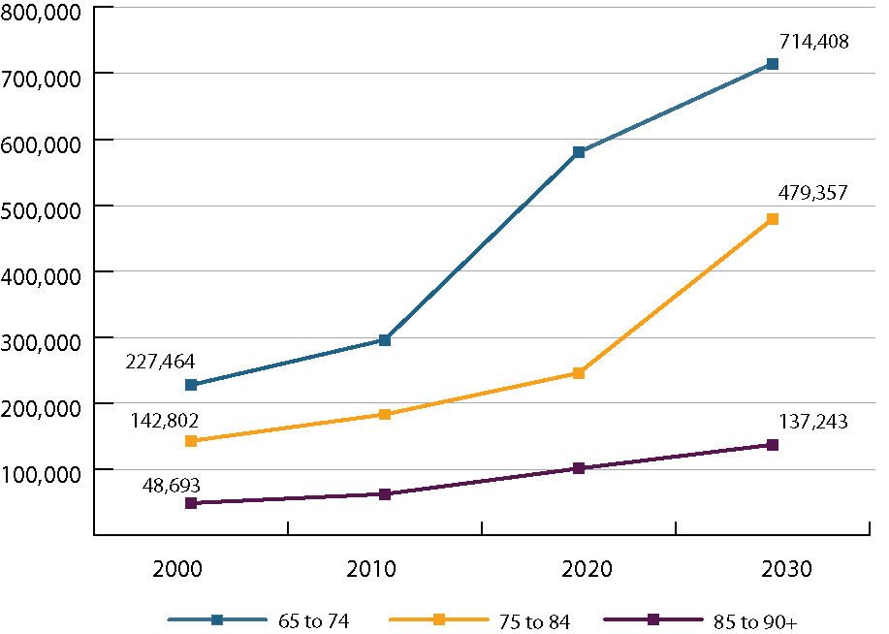
65+ Age Distribution in Colorado
SOURCE: Colorado State Demography Office, population estimates, 2000-2030

Slide 9
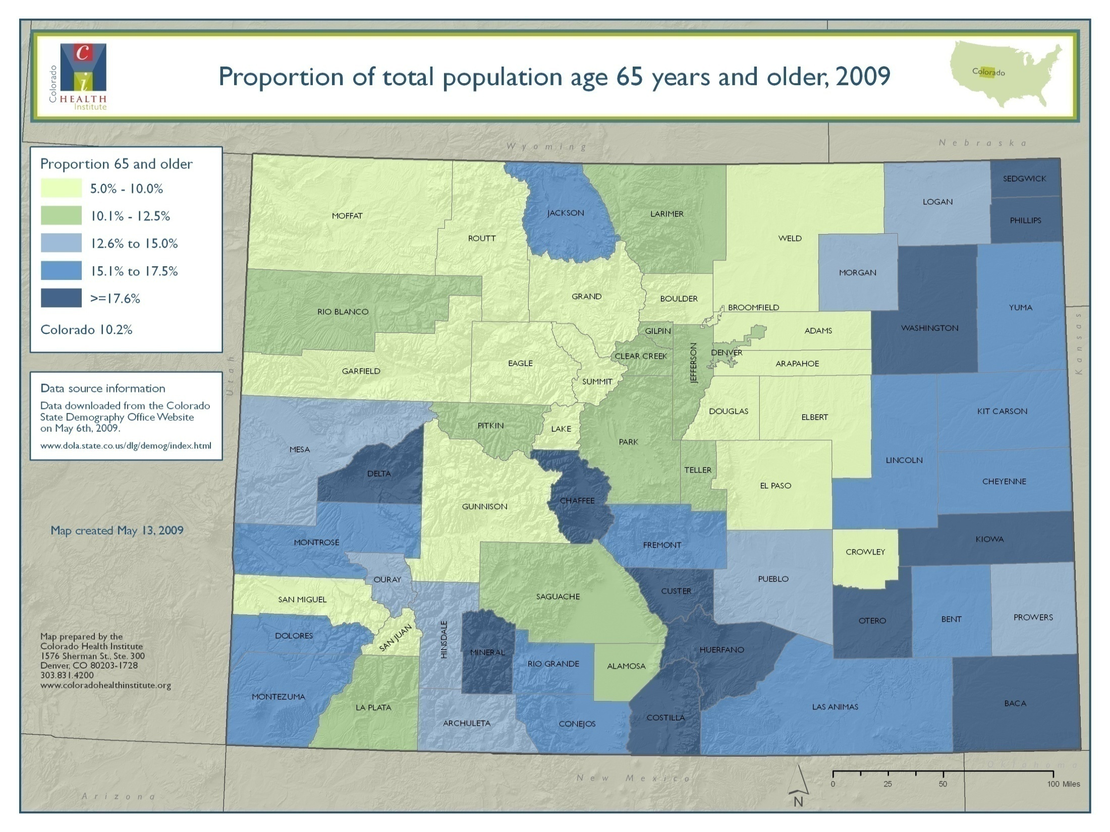

Slide 10
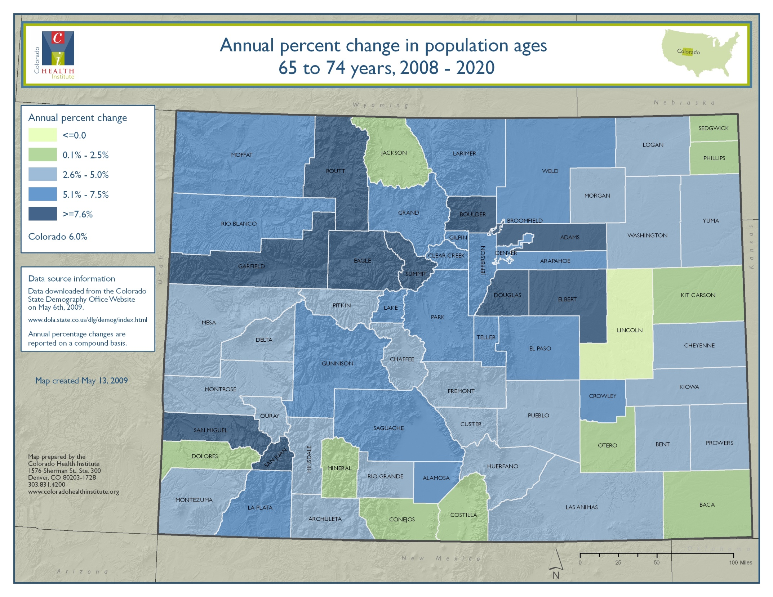

Slide 11
Where do Elders Receive
Long-Term Services and Supports?
At home
Personal and skilled services; adult day care
Residential setting
Group homes; assisted living facilities; adult
foster care
Institutional setting
Nursing facilities

Slide 12
Program for All Inclusive Care for the Elderly (PACE)
Provides long term services and supports
and acute care to individuals dually enrolled
in Medicare and Medicaid
Led by interdisciplinary team that coordinates care
PACE providers receive a fixed monthly rate from Medicare/Medicaid or Medicare/private pay
1,900 PACE Medicaid enrollees in Colorado

Slide 13
Financing Long Term Services and Supports

Slide 14
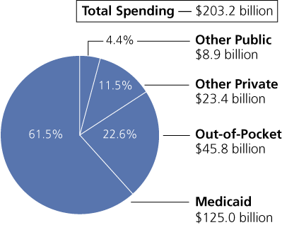
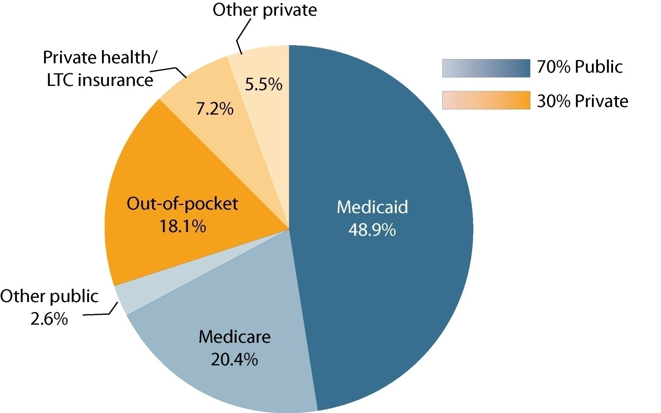
Who Pays for Long term Services and Supports?
SOURCE: Komisar, H, and L Thompson. (2006). National Spending for Long-term Care.

Slide 15
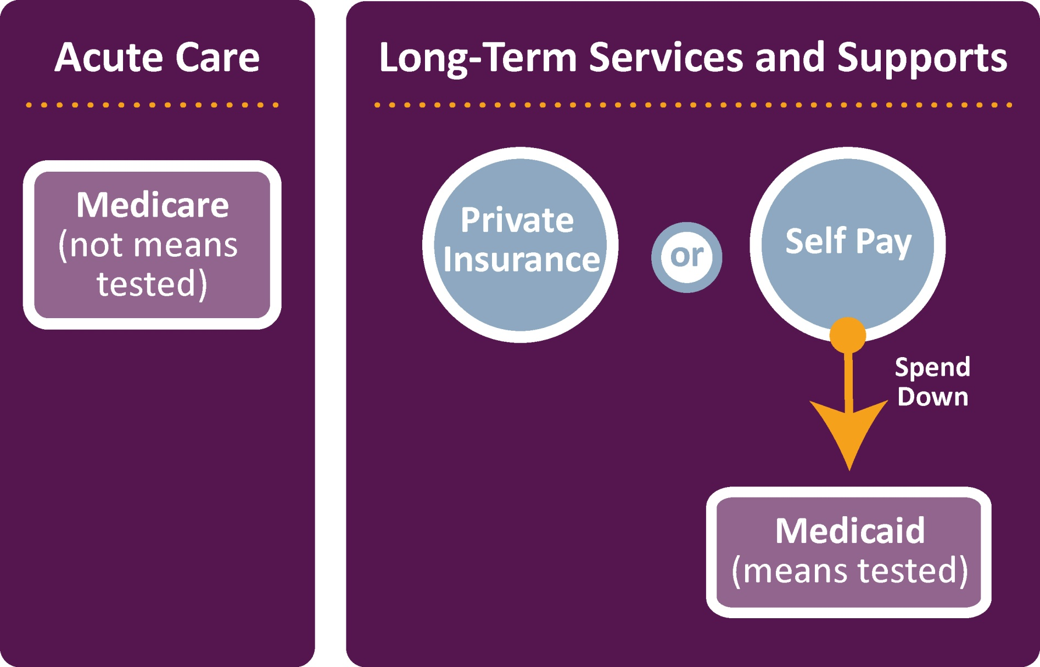
Interaction Between Acute and LTSS Insurance for Elders

Slide 16
The Lack of Long Term Care Insurance
The CLASS Act
  Voluntary long term care insurance program
  Premiums not based on health status
Feb. 2012 CLASS Act was repealed by US House of Reps.
  Adverse selection
  Financially insolvent – distributions would exceed collections

Slide 17
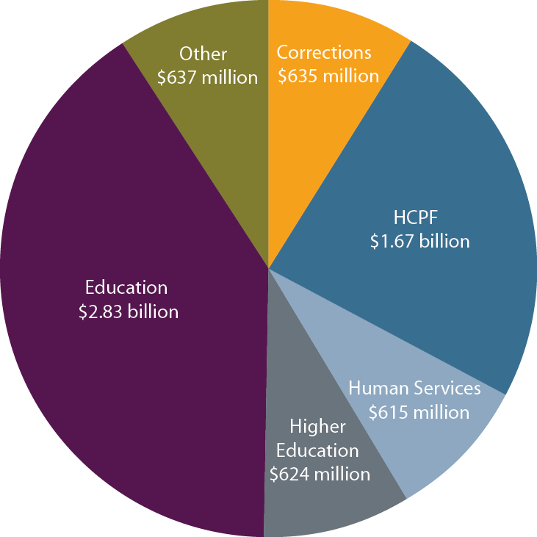
Colorado General Fund
Operating Appropriations
SOURCE: Joint Budget Committee, FY 2011-12 Appropriations Report.

Slide 18
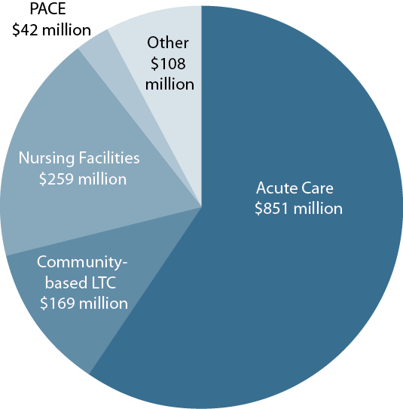
Medicaid Medical Services Premiums,
FY 2011-12
SOURCE: Colorado Department of Health Care Policy and Financing, FY 2012-2013 Budget Request
Notes: Projected General Fund expenditures before bottom line financing adjustments.

Slide 19
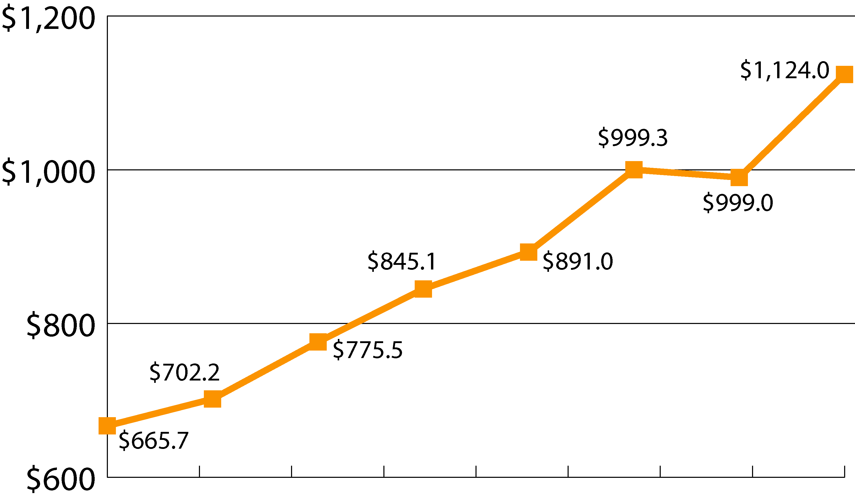
Medicaid LTSS Expenditures, FY 03-04 to FY 10-11
In Millions
2003-04 2004-05 2005-06 2006-07 2007-08 2008-09 2009-10 2010-11
SOURCE: Colorado Department of Health Care Policy and Financing

Slide 20
Where do we go
from here?

Slide 21
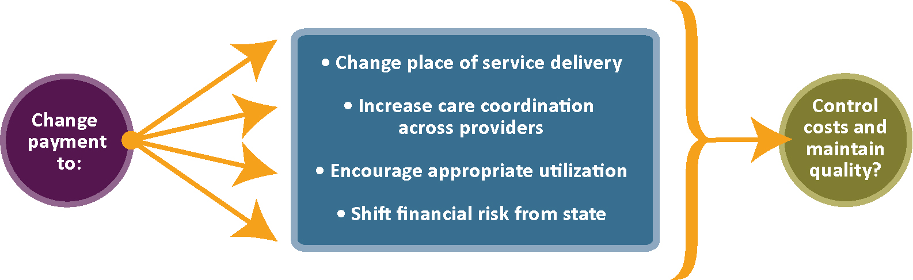
Mechanisms Being Considered to Reform Medicaid System

Slide 22

Moving people out of nursing facilities:
Colorado Choice Transitions
Colorado’s Money Follows the Person program
Transitions people from nursing facilities to the community when desired and feasible

Slide 23
Changing Reimbursement to Prolong Assisted Living
HB 10-1053 (Riesberg/Boyd)
  Analysis of tiered rate setting for assisted living
  Potential for increasing assisted living rates to postpone nursing facility placement
SB 12-128 (Roberts/Summers):
  Allows HCPF to provide clients at risk of nursing facility placement enhanced assisted living services
  Moves individuals in nursing facilities to assisted living

Slide 24
Dual Eligibles Planning Grant: Coordinating Care
Coordination of care for individuals
dually enrolled in Medicaid and Medicare (“dual eligibles”)
Possible inclusion of dual eligibles in Colorado Medicaid’s accountable care collaborative (ACC)

Slide 25
Coordination of Long Term and Acute Care
SB 12-127 (Newell/Summers):
  Allows LTC providers to contract with RCCOs in ACC
  In response to dual eligibles planning grant
SB 12-023 (Boyd)
  Require RCCOs to inform enrollees about PACE, if they are eligible

Slide 26
Person-Centered Payments in Long-Term Care
Redesign care planning tool and assessment form for community based long term care services
In future could create person-centered “budget” for each enrollee
Care plans would lead to less subjective decision making by care managers.
Request included in HCPF’s FY 2012-13 budget proposal

Slide 27
Waiver Consolidation
The state (HCPF/DHS) currently has multiple HCBS waivers
Upcoming legislation to move all waivers to HCPF
First step in process to consolidate waivers
  Problem: Waiver participants can’t get services outside their designated waiver
  Concerns: Individuals do not want to lose services

Slide 28
Managed Care Models
Medicaid Managed LTSS
  Institution to Community/ Home Focus
  Little evidence to support
What’s needed
        Careful design
        Expertise
        Financial resources

Slide 29

“Boomers are just the beginning."
- Rich Umbdenstock, President, American Hospital Association
Amy Downs
720.382.7091 downsa@coloradohealthinstitute.org

