Slide 1











Third Biennial Hot Issues in Health Care Legislative Conference
November 13, 2004
Colorado Springs, CO
Jim Geringer/ESRI
Governor 1995-2003
jgeringer@esri.com

Slide 2
Health policy-making covers an expansive terrain of influence – from the health of individuals, families and communities to the regulation and funding of the programs, professionals, and institutions that comprise the health care delivery system in Colorado.

Slide 3
Investments in health and health care come from a broad array of public and private sources, the interdependence and mutuality of these sources is critical to maintaining the health of individuals and the overall health care system.

Slide 4
State legislators play a pivotal role in shaping health and health care in Colorado as arbiters of federal dollars and programs and promoters of innovation at the state and local levels (including both public agencies and the private business sector)

Slide 5
Health policy decision-making can be improved upon with objective, unbaised and timely information to mediate that provided by powerful vested interests

Slide 6
Two Broad Issues
The need for developing public health data against standards from federal, state, local and personal perspectives
Building a partnerships to developing and use public health data

Slide 7

Technology Can Help Us Deal With Today’s Health Challenges… if we have access to the right data…at the right time
Collaboration
Western States Health PassPort
What is Health IT Framework?
What trends are affecting us?
How can we connect the policy makers with the providers?

Slide 8
So,
What do you mean by technology?
In the context of history, it’s any major change that benefits society
In today’s culture, it’s anything to do with the digital revolution
In Health Care, it’s a remarkable array of diagnostic, treatment and prevention tools

Slide 9
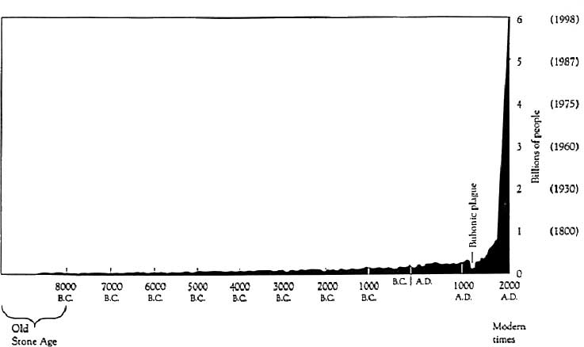
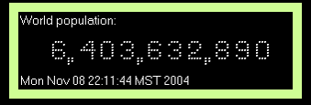
World Population Growth
The “Hockey Stick” Curve
http://www.census.gov/ipc/www/clock.html

Slide 10
World Population
Source: WallStreetView.com,
Rank | Country | Year | Population | % of World Total
1 | China | 2003 | 1,286,975,468 | 20.4%
2 | India | 2003 | 1,049,700,118 | 16.7%
3 | United States | 2003 | 290,342,554 | 4.6%
4 | Indonesia | 2003 | 234,893,453 | 3.7%
5 | Brazil | 2003 | 182,032,604 | 2.9%
6 | Pakistan | 2003 | 150,694,740 | 2.4%
7 | Russia | 2003 | 144,526,278 | 2.3%
8 | Bangladesh | 2003 | 138,448,210 | 2.2%
9 | Nigeria | 2003 | 133,881,703 | 2.1%
10 | Japan | 2003 | 127,214,499 | 2.0%
11 | Mexico | 2003 | 103,718,062 | 1.6%

Slide 11
Questions:
Is something significant happening in my place?
Is it a consequence of or benefit to my place?
Should society do something about it?
If so, how should the problem be solved?
What should my part be?

Slide 12
Value of Information Technology
Improves Quality and Safety
Drives Cost Savings
Helps Patients Navigate the Healthcare System

Slide 13
Improve Quality and Saves Lives
National adoption of ACPOE (ambulatory computerized physician order entry) could prevent
  2 million ADEs/year
  190,000 ADE admissions/year
  130,000 life-threatening ADEs/year
Center for Information Technology Leadership 2003

Slide 14
Cooperation and Data Sharing
Government at any level, the federal level in particular, has a history of isolating data, doling out information as patronage, creating highly segregated services
September 11, 2001 changed the focus of the nation, and created urgency for finding more efficient and effective ways to enable the public health community to cope with greater challenges, including the threat of bioterror.
Public and private partners must work together to develop locally-based solutions reflecting nationally-developed priorities

Slide 15
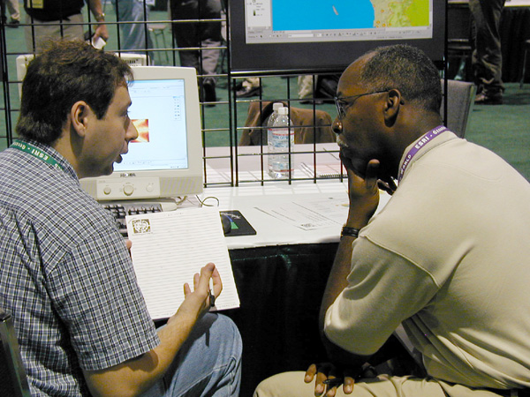
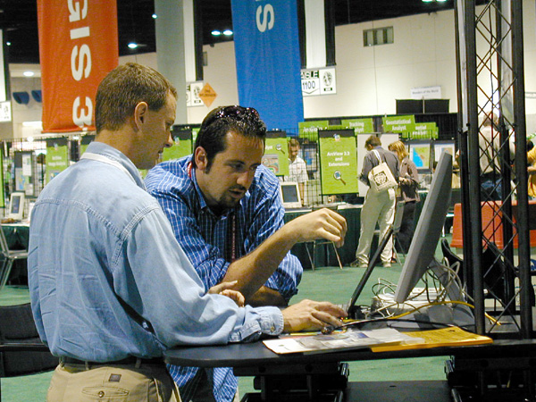
Data Sharing…Myth or Must-Have
Agencies must have a shared purpose before they feel the need to share data
Unless they have a common mission, they won’t change their culture

Slide 16
Recognize that Solutions Transcend Physical and Political Boundaries
The challenges of health care today span political and agency boundaries.
Solutions typically affect more than the geography of a single political or business jurisdiction, including international

Slide 17
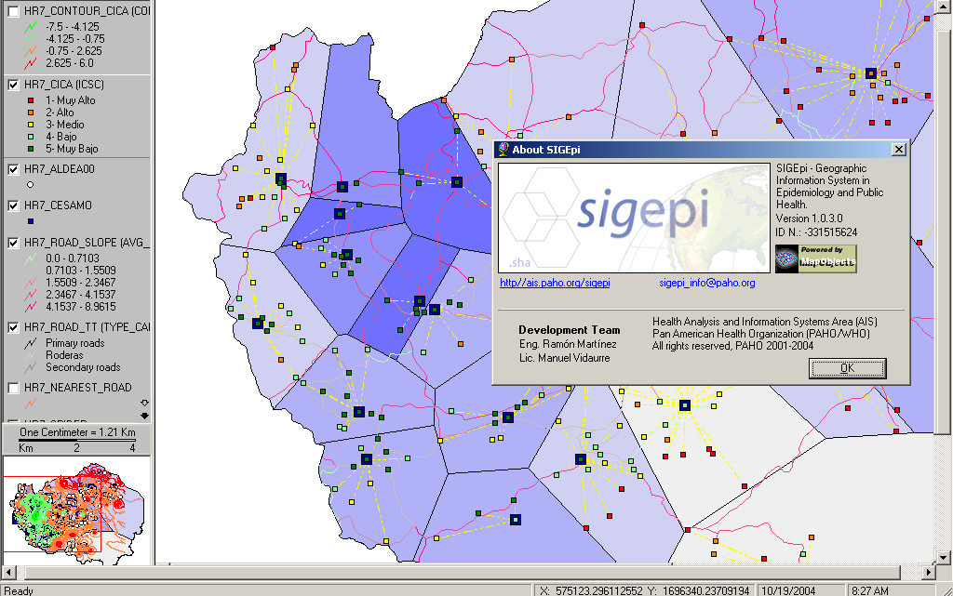
Geographic Information System in Epidemiology and Public Health
SigEpi was developed by Pan American Health Organization (PAHO)

Slide 18
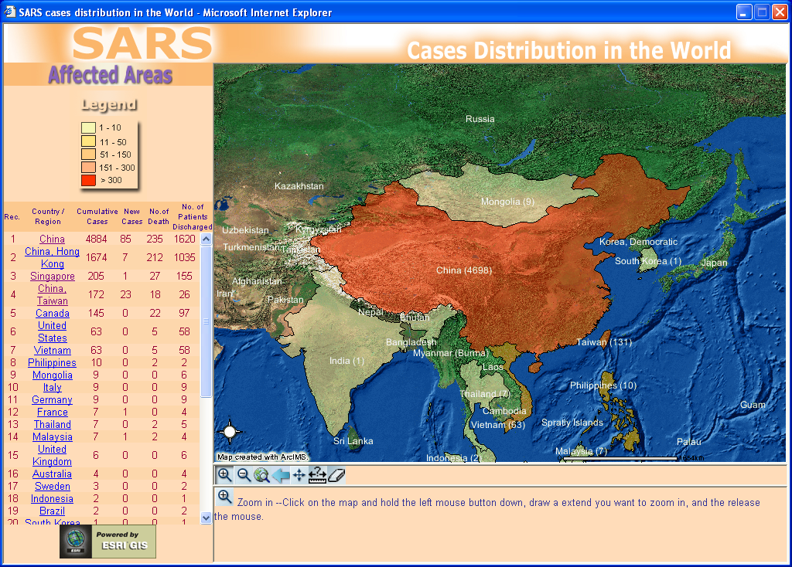
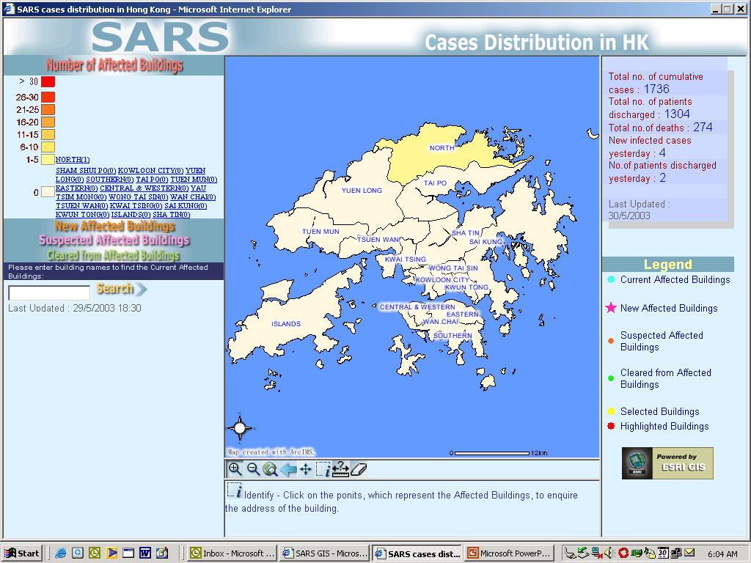
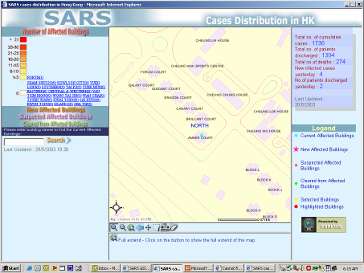
SARS Outbreak Analysis
Notes:
Community outbreaks of infectious diseases such as measles can be quickly analyzed using GIS tools.
Here we see a web site established in Hong Kong to track the locations of reports of SARS outbreaks.
In this slide we see Amoy Gardens, the epicenter for Hong Kong's SARS cases and where over 300 people infected with SARS lived.
GIS helped identify this clustering of cases and led to the early recognition that Amoy Gardens was a “reservoir” for SARS.
The globalization n of infectious disease makes the use of GIS critical across the entire healthcare system in every health ministry.

Slide 19
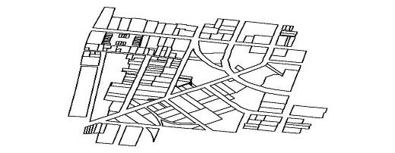
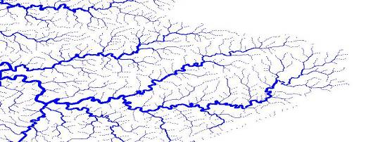
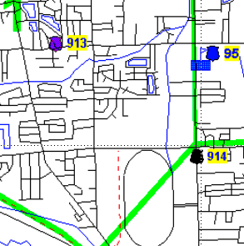
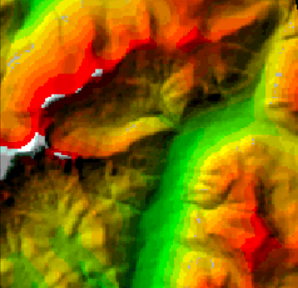
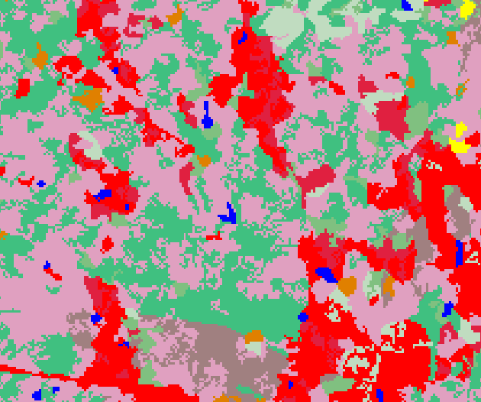
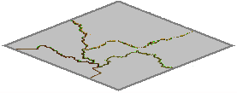
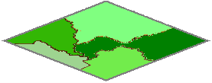

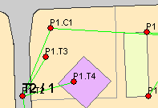

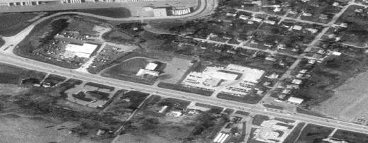
Much of our data comes in the form of physical reference
Framework (National Map)
Thematic
(Traditional)
Land Ownership
Transportation
Surface Waters
Elevation
Land cover
Boundaries
Soils
Vegetation
Census
Geodetic Control
Cadastral
Orthoimagery
Social Factors
Bio-diversity
Solving today’s more
Complex problems
requires integration
Engineering
Epidemiology
Environmental

Slide 20

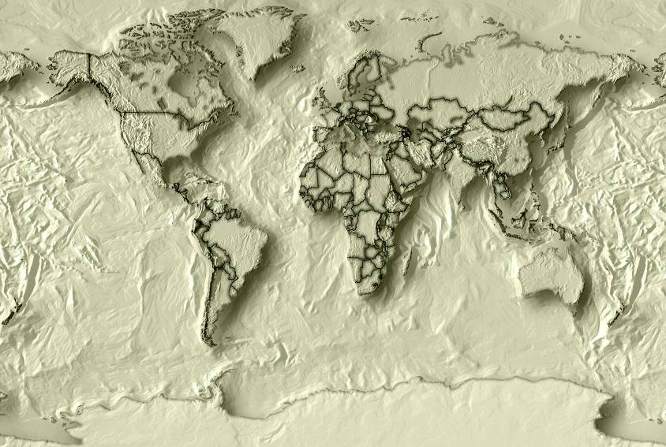
Geographic Referenced Data: More Than A Map
A Sense of Place
Every issue has a geography
Seeing the interrelationship of issues
Everything you work with is somewhere – and is connected to something

Slide 21

Moving Information to the Front Office
Governor’s
Information
System –
A Decision-maker’s Dream

Slide 22

What Was the Health Passport Pilot Project?
A Western Governors’ project demonstrating how people could use technology to:
  Enhance access to and quality of health care
  Improve coordination among providers
  Provide for greater personal responsibility and control of health care services
  Inform practitioners

Slide 23
HPP Smartcard
One card per family member
Multi-application hybrid architecture
(mag stripe for backward integration)
JAVA based microprocessor
Internet back-up from host using data
encryption via network
Notes:
HPPCARD-
Hybrid card - to function not only as interactive storage base (chip), but also compatible with mag- stripe Medicaid service authorization and first step in claims processing.
Cost approx $3.80 per card
Internet Back-up - Data stored in HOST during pilot to repopulate card if lost/stolen.
Open systems - Making it as open as possible; working with Navy and GSA to achieve fully open architecture points of possible partnership for phase #2.

Slide 24
Health Passport Services
Women, Infants
and Children
Health Passport Card
Maternal &
Child Health
Check-ups and
Immunizations
Food Benefits
Pre-School
Education
Notes:
3
Significant overlap in participation. In WY nearly 50% of clients who participate in Food Stamps or Medicaid or TANF participate in more than one of these programs.
Common data used by several providers.
North Dakota: Optimal Pregnancy Outcome Program shares info with WIC
Wyoming : WIC, EPSDT, HEAD START, Food Stamps

Slide 25
Think Big, Start Small, Scale Fast!
We thought big – concept originated in the mid to late 80’s
We started small – first with WIC only, then EBT
Wanted to scale fast, but it turned out that technology was the easy part; the hard part was sociology
It took almost a decade to change the culture, especially at HCFA
Three state pilot in 1999

Slide 26
Western Governors’ Association Partners
Bismarck, ND:
MedCenter One - Family Doctors
Bismarck Burleigh Nursing Service
Optimal Pregnancy Outcome Program
EPSDT Health tracks
Immunization Program
Head Start Program
WIC Program
Medical Assistance
Washoe County, NV
Immunization Program
Head Start Program
State WIC Program
ITCN WIC Program
Cheyenne, WY:
Cheyenne Children’s Clinic
City County Public Health Nursing
MCH
EPSDT
Immunization Program
Head Start Program
WIC Program
http://www.westgov.org/wga/initiatives/hpp/default.htm
Contact: Chris McKinnon WGA cmck@westgov.org

Slide 27
Lessons Learned from HPP
We had great interest in community-based solutions with regional coordination
We needed an infrastructure for clinical data sharing, incl data standards
Client and clinical data exchange efforts among providers were rare, but efforts between states and among federal agencies were practically non-existent
Many institutional and cultural barriers

Slide 28
Lessons Learned from HPP
Commitment at the highest level
Federal innovation capital provided
Collaborative framework -- representatives from twelve agencies in three different states defined standards for 850 different data elements (WIC, immunization, Head Start, clinics,etc)
Smartcard offline data sharing among different systems. Participants didn’t have to change their existing software.

Slide 29
Technology Was the Easy Part
We had to overcome the difficulty in bringing diverse stakeholders together toward a common goal
Sticky issues: the need to protect privacy and security; liability concerns; creating a governance model, agreements, policies and practices for building these kinds of exchanges
We ended up with a compelling and sustainable model for ongoing funding, resources and commitment

Slide 30
Other Lessons Learned
Everyone needs to be involved in defining the standards
Important to have firm deadlines (don't let the perfect be the enemy of the good)
Difficult to assess cost-benefit until years down the road after standards are in place

Slide 31
Leadership From Two Key Areas:
Health care providers - Community hospitals, physicians, health plans, clients and public health agencies
Visible and effective convener, an advocate at the top
These visionaries help organizations to move beyond competitive concerns to find ways in which they were able to control, yet share, data.

Slide 32
Conclusions
Success at the national, state and community levels depends upon accepted standards
Collaborative leadership at all levels to promote standards is vital
Federal leadership and funding to help establish standards is important

Slide 33
State Health Networks
Typically are stove-piped systems -- redundant data in different databases
States are moving toward either data warehousing or integrated systems serving same clients. (Examples include: Delaware Client Information System, Idaho Any Door program, Colo Combined Benefit Management System. WY is working on a new system too.
Eventual goal is web-based server-to-server client health data sharing statewide and regionally

Slide 34
A National Health Technology Infrastructure
Requires
Participation by givers and receivers
Standards-based Technology (Hardware, Software, Network)
Enterprise Architecture, incl GIS
Common Data Models, Data Sharing
A Spirit of Cooperation
Innovation Funding
Political Leadership/Organization
A Plan

Slide 35

Just Announced July 21, 2004 :
The Decade of Health Information Technology:
Delivering Consumer-centric and Information-rich Health Care
Framework for Strategic Action

Slide 36
Familiar Words…..
On President Bush’s Radar Screen
Appointment of sub-Cabinet Level Position – David J. Brailer, MD, PhD
Strategic Plan - Framework Report July 21, 2004
Cooperative Focus by All Federal Agencies
Increased Funding in Administration’s budget

Slide 37
HHS Awards $139 Million to Drive Adoption of Health Information Technology
October 2004
The Department of Health and Human Services (HHS) recently announced $139 million in grants and contracts to promote the use of health information technology (HIT). Awarded through HHS' Agency for Healthcare Research and Quality (AHRQ), this multi-year program builds on President Bush's initiative to use HIT to improve the nation's health care system.

Slide 38
HHS Secretary Tommy G. Thompson:
"Increased adoption of information technology will speed the transformation of health care services in this nation
We're heeding the President's call to improve patient safety and quality of care.
Technology can help to efficiently and effectively deliver the information caregivers need to take better care of their patients. These grants will help us ensure that the right patients are getting the right care at the right time."

Slide 39
Promoting access to HIT
Over 100 grants to communities, hospitals, providers, and health care systems to help in all phases of the development and use of health information technology.
The grants are spread across 38 states, with a special focus on small and rural hospitals and communities.
First year funding is $41 million and will total nearly $96 million over three years.

Slide 40
Developing statewide and regional networks
Five-year contracts to five states or their designees to help them develop statewide networks that are secure, ensure privacy of health information, and make an individuals' health information more available to health care providers.
The five states are Colorado, Indiana, Rhode Island, Tennessee and Utah.
Participants include major purchasers of health care, public and private payers, hospitals, ambulatory care facilities, home health care providers and long-term care providers.
First-year funding is $1 million for each state and will total $25 million over the course of the contracts.

Slide 41
Encouraging adoption of HIT by sharing knowledge
National Health Information Technology Resource Center -To aid grantees and other federal partners by providing technical assistance, provide a focus for collaboration, serve as a repository for best practices, and disseminate needed tools to help providers explore the adoption and use of health information technology to improve patient safety and quality of care.
The two-year contract, renewable for up to three years, was awarded to NORC, the National Organization for Research at the University of Chicago.
First year funding is $4 million, with an estimated value of $18.5 million over the course of the contract.

Slide 42
Framework for Strategic
Action – DHHS
Inform Clinical Practice
– Incentivize Electronic Health Records Adoption
– Reduce risk of EHR investment
– Promote EHR diffusion in rural and underserved areas
Interconnect Clinicians
– Foster regional collaborations
– Develop a national health information network
– Coordinate federal health information systems

Slide 43
National HIT Coordinator – Strategic
Framework Goals
Personalize Care
– Encourage use of Personal Health Records
– Enhance informed consumer choice
– Promote use of telehealth systems
Improve Population Health
– Unify public health surveillance architectures
– Streamline quality and health status monitoring
– Accelerate research and dissemination of evidence

Slide 44
Public – Private Partnerships
“While the Federal government plays an important role in HIT adoption, the effective use of and value creation from this technology, lies predominantly within the private sector.”
__Framework Report, July 2004

Slide 45
Use of GIS
The Following three strategies will achieve the goal of using HIT to improve health status:
Unify public health surveillance architectures
Streamline quality and health status monitoring
Accelerate discovery and dissemination
Each must work in a single integrated and cost-effective architecture through a health information network

Slide 46
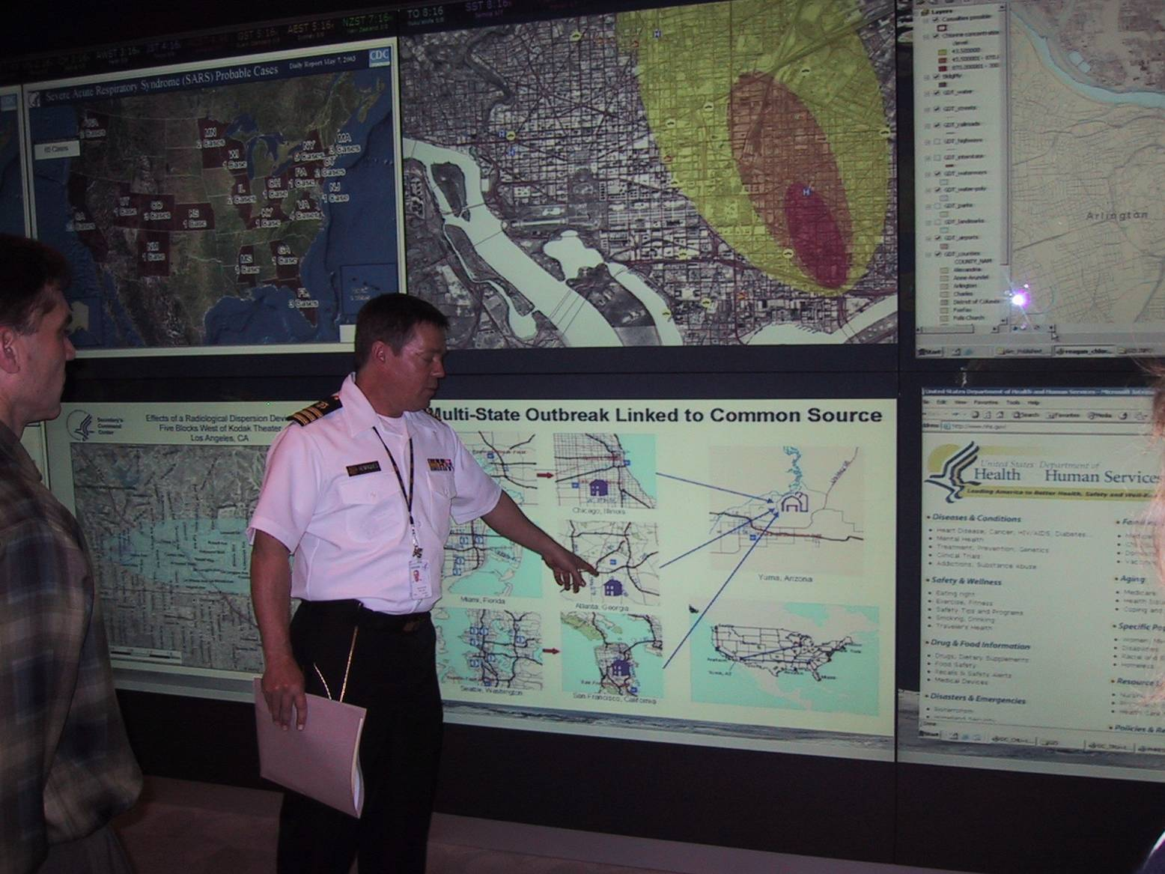
GIS in Public Health
Command Centers
Health Secretary’s Command Center
US Department of Health & Human Services
Notes:
Managing a public health situation is critical to the reputation of any national health ministry. Assessments must be made quickly and accurately using the best information available.
Her we see the way GIS is used by the United States health ministry (the Department of Health and Human Services) to follow and track unfolding events that have an impact on health and human resources in a local area.
The command center uses many different GIS applications to monitor, display, and analyze situations along with relevant resources, medical assets, and public health capabilities.

Slide 47
Recognition of Value by Congress
Medicare Modernization Act
Including the Electronic Prescription Program
NHII and National Health Information Technology Legislation
Patient Safety Improvement Act

Slide 48
IT Provisions in Medicare Modernization Act
Electronic Prescription Program
Establishes a real-time electronic prescribing program for all who serve Medicare beneficiaries with Part D benefits
Requires following electronic information: drug being prescribed, patient’s medication history, drug interactions, dosage checking, and therapeutic alternatives
Requires uniform standards for e-prescribing
Establishes a safe harbor from penalties under the Medicare anti-kickback statute

Slide 49
The Promise of Health Information Technology
Interoperable
Quality Care
Decision Support
Cost Effective Care:
Bench-to-Bedside
Medically Underserved
Consumer Involvement
Accuracy and Privacy
Public Health Monitoring

Slide 50
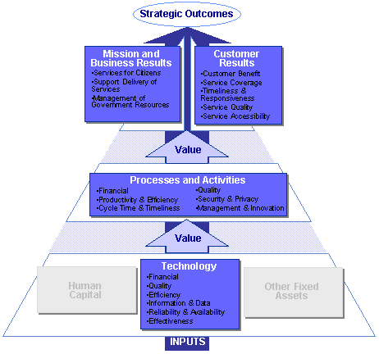
Federal Enterprise
Architecture
Purpose
Process

Slide 51
PERFORMANCE REFERENCE MODEL (PRM)
http://feapmo.gov/fea.asp
The PRM is a "reference model" or standardized framework to measure the performance of major IT investments and their contribution to program performance. The PRM has three main purposes:
Help produce enhanced performance information to improve strategic and daily decision-making;
Improve the alignment-and better articulate the contribution of-inputs to outputs and outcomes, thereby creating a clear "line of sight" to desired results; and
Identify performance improvement opportunities that span traditional organizational structures and boundaries.

Slide 52
HEADLINE 2003:
States Faces Worst Budget Deficit Since World War II
HEADLINE 2004:
State Budgets Rebounding, But Tough Road Looms Ahead
Notes:
As states completed FY 2004 and enter FY 2005, they are faced with a mix of good and
bad news. After more than three years of intense fiscal stress, FY 2004 marked a turning
point for state revenues and for budget shortfalls. After sharp declines, state revenues
started to improve and budget shortfalls started to shrink. States were also helped in FY
2004 by $20 billion in temporary federal fiscal relief including $10 billion directly for
Medicaid. During FY 2005, revenues are expected to continue to grow, but FY 2005 also
marks the end of the temporary federal fiscal relief. Many states are facing large budget
shortfalls totaling about $40 billion. While smaller than in previous years, these shortfalls
continue to place great stress on state budgets.

Slide 53
Elusive Income
In 1999, only five states were facing revenue shortages (MT, LA, TN, WY, ID)
Today even though revenues are up from a year ago, nearly every state is facing a mid to long term structural deficit

Slide 54
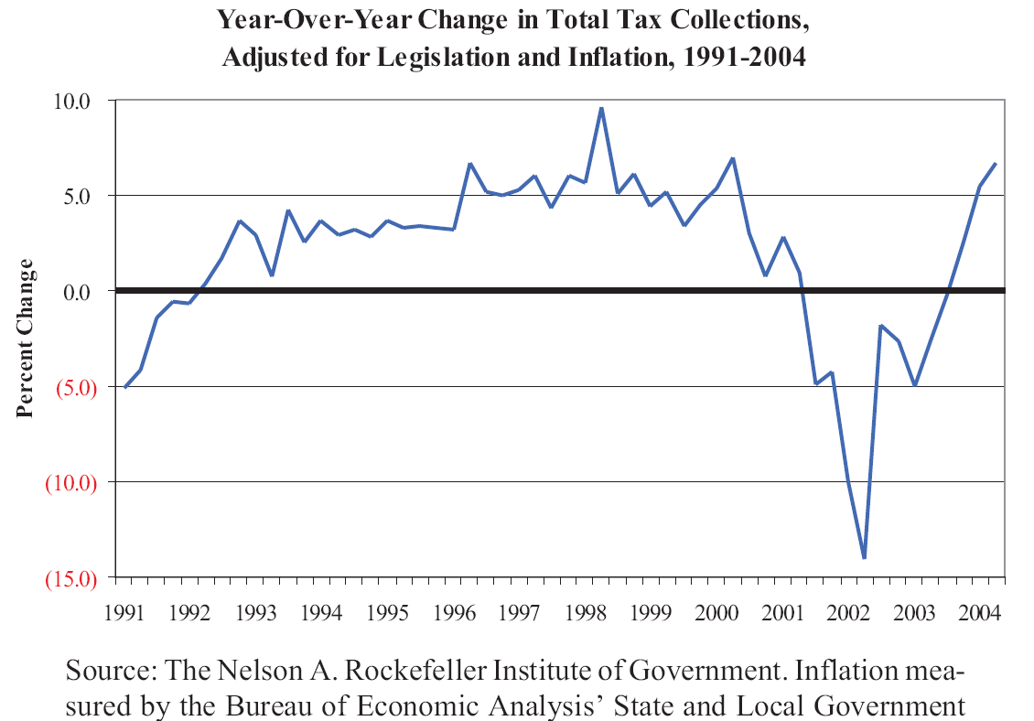
Nicholas Jenny August 2004
Notes:
State tax revenue grew by 11.4 percent in the April-June 2004 quarter compared to the year before, according to preliminary data collected by the Rockefeller Institute of Government. When adjusted for the effects of legislation and inflation, this increase was 6.7 percent. This is the third straight quarter of real, adjusted state tax revenue growth. Revenue performance has been improving for five quarters. The April-June quarter finishes the fiscal year for 46 of the states, so this accelerating growth has helped many states to meet or exceed their revenue targets.
The states that do not use a July 1 to June 30 fiscal year are: New York — April 1 to March 31, Texas —September 1 to August 31, Alabama and Michigan—October 1 to September 30.

Slide 55
Trends…Expenditures
Education – K-12 continues to increase, Higher Ed wants to recover from recent cuts
Health care costs will increase at double digit rates – Medicaid, employees, institution residents
Retirement accounts – unfunded future liabilities with the arrival of the boomers
Public Safety, Corrections, Homeland Security costs
Cost shifting caused by federal limitations

Slide 56
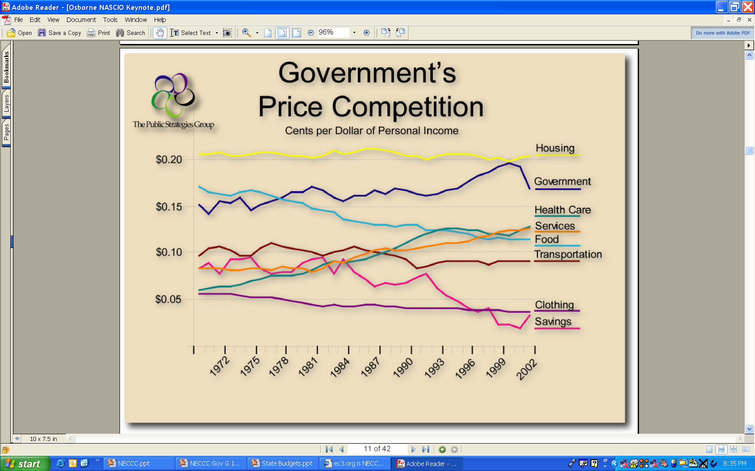
David Osborne,
NASCIO Annual Meeting
2004

Slide 57

My Experience with Government’s Big Four:
Education33%
Public Safety, Corrections
16%
Family Services 8%
Health Care
30%
Total 87% of General Fund

Slide 58
Today’s Hot Issues for
Governors
The Budget Crunch
Education
Economy and Jobs
Health Care
  Medicaid
  The aging population
Homeland Security
  The National Guard
Environment
Election Planning
Local Government Funding
Notes:
Of the many issues that might get a senior elected officials attention, these would typically rank in the top ten.
Every one could or does benefit from a GIS application

Slide 59
2004 Top Legislative Topics
Budgets
Political Polarization
Energy
Education Testing and Funding
Air Quality
Medicaid and Prescription Drugs
Workers’ Compensation
Criminal Justice
Consumer Protection
Obesity and Fitness
Source: NCSL Stare Legislatures Magazine
January 2004
Notes:
GIS can Actually aid in several areas in the 2004 Legislative Agendas
Examples
Budgets: GIS can assist in revenue auditing, budgeting, and developing a basic understanding of where a governmets wealth is derived.
Political Polarization. GIS can assist through the elections process and the Help America Vote Act.
Redistricting, Polling Place Locators, voter file maintenance, voter outreach,
Energy Main emphasis on infrastructure. This is a natural for ESRI in many areas such as infrastructure management, asset mangement, load balancing, long range planning.
Education and Testing and Funding. ESRI has clients at the state level using GIS to track individuals as the leave the public school system, long range planning and analysis, etc.
Air Quality: Sgsin numerous analytical and public outreach innitiatves can be supported.
Prescription Drugs: Exploring. ESRI is strong in the Health Markets
Criminal Justice: The emphasis of this legislation is the impact of Technology on law enforcement. ESRI and our partners have numerous solutions for this area.
Consumer Protection. Exploring
Obesity: Again Health is a strong market for ESRI. ESRI solutions can be used for analysis of at risk populations, research, targeting programs, public outreach, field reporting.

Slide 60
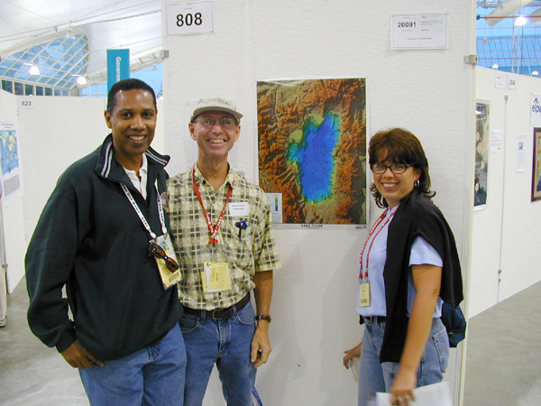


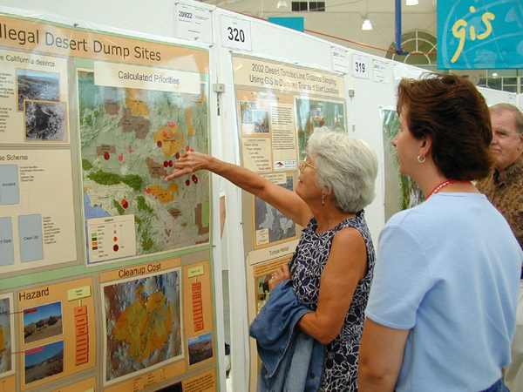

Put a Face on the Issue

Slide 61
Today’s Trends
Americans age 65+ will increase from 12% of population in 1997 to 20% of population in 2030
Rising healthcare costs - premiums increased 12.7% at the beginning of 2002
Physicians leaving practice due to burn-out or insurance concerns
Shortage of nurses in active practice
44.9 million or 16% U.S. population uninsured

Slide 62
Today’s Trends
Our Healthcare System is anything but interconnected
More than 90% of the 30B U.S. health transactions each year are conducted by phone, fax or mail
Revenues Invested in IT:
􀀹11.10% - Financial Services
􀀹8.10% - Insurance
􀀹6.5% - Consumer Services
􀀹2.2% - Healthcare
1/3 hospitals have CPOE systems completely or partially available - only 4.9% require their use.
Less than 5% of U.S. physicians prescribe electronically
Source: eHealth Initiative

Slide 63
Quality and Safety Challenges
44,000 to 98,000 deaths due to medical error costing $37.6 billion annually
770,000 injured each year due to Adverse Drug Events
(5% to 18% of ambulatory patients)
American adults on average receive only 54.9% of recommended healthcare
eHealth: Marchibroda August 2004

Slide 64
Fragmented Healthcare
Care is delivered by a variety of physicians, hospitals and other providers
Providers may provide care without knowing what has been done previously and by whom
Medicare beneficiaries see 1.3 – 13.8 unique providers annually, on average 6.4/year
Patient data unavailable in up to 81% of cases in one clinic…other data shows 1/3 of time
18% of medical errors due to inadequate availability of patient information
Marchibroda August 2004

Slide 65
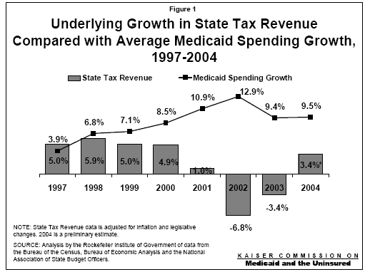
October 2004

Slide 66

Despite severe state fiscal stress, Medicaid enrollment grew by nearly one-third since the beginning of 2001 as the program maintained its role as a critical safety net for low-income populations.
Medicaid spending in FY 2003 and FY 2004 grew faster than other state programs, but slower than growth in private health insurance premiums.

Slide 67
Responding to pressure to control Medicaid costs, all 50 states and the District of Columbia implemented actions designed to control Medicaid spending growth in FY2004 and all states planned to implement cost containment measures in FY 2005.

Slide 68
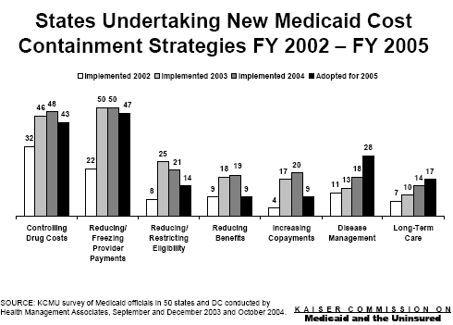

Slide 69
Federal fiscal relief helped states meet Medicaid shortfalls in FY 2004 and helped to maintain Medicaid eligibility levels; however, states are expecting sharp increases in the state share of Medicaid costs in FY 2005 as they replace the loss of the enhanced federal support.

Slide 70
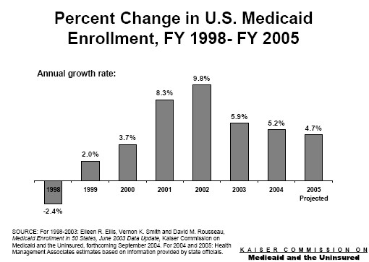

Slide 71
New Technologies Will Change the Way We Manage Information
The need for new and better ways of collecting, analyzing, presenting, and even selling information is driving trends in IT that will significantly change how individuals, companies and societies deal with information.

Slide 72
But We Need Information, not just DATA
We are a data driven society but what we don’t need is just more data.
Data isn’t something just be collected.
What we need is information that leads to a decision or action

Slide 73

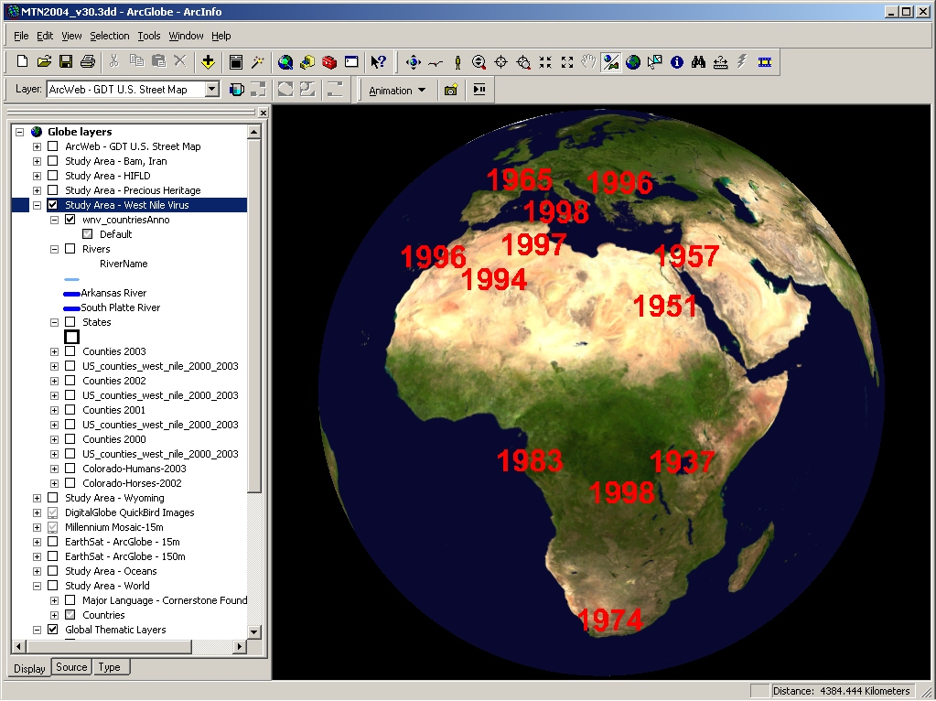
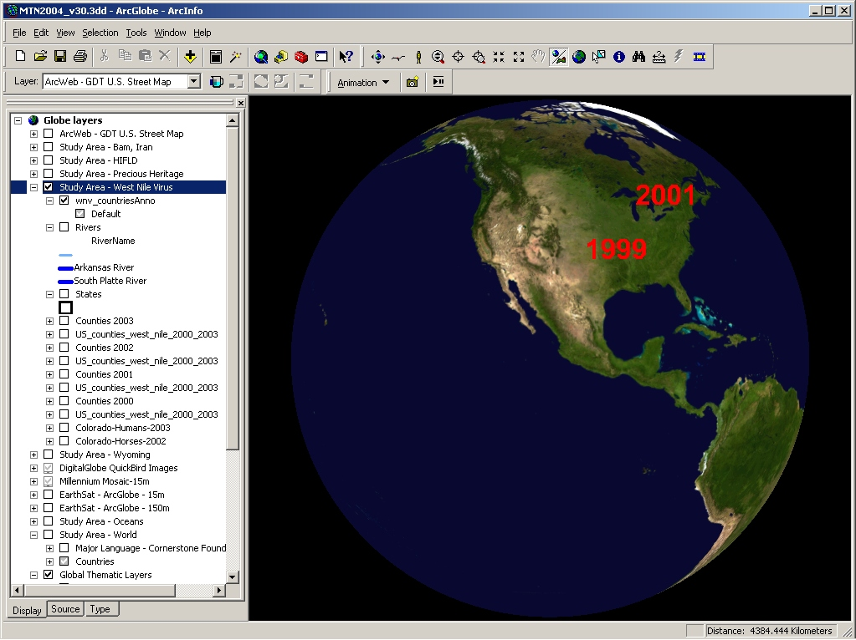
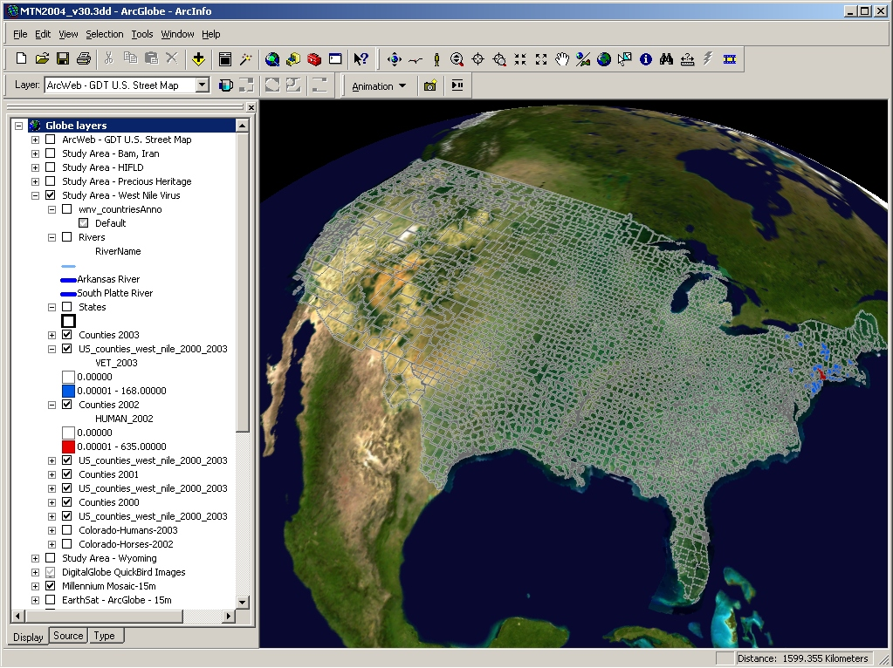
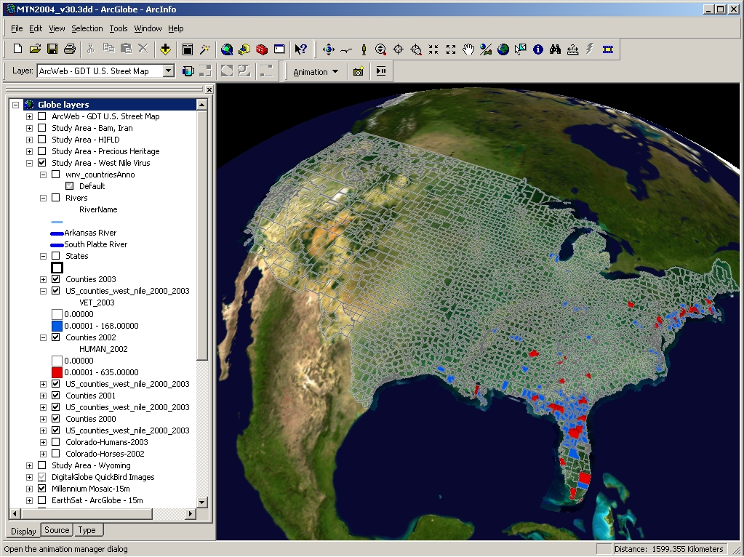
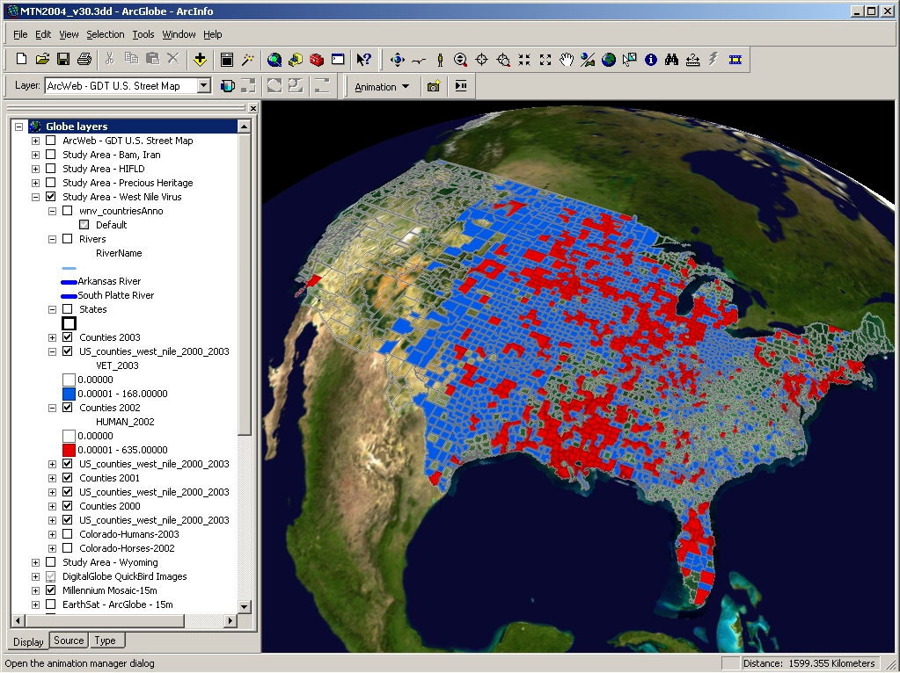
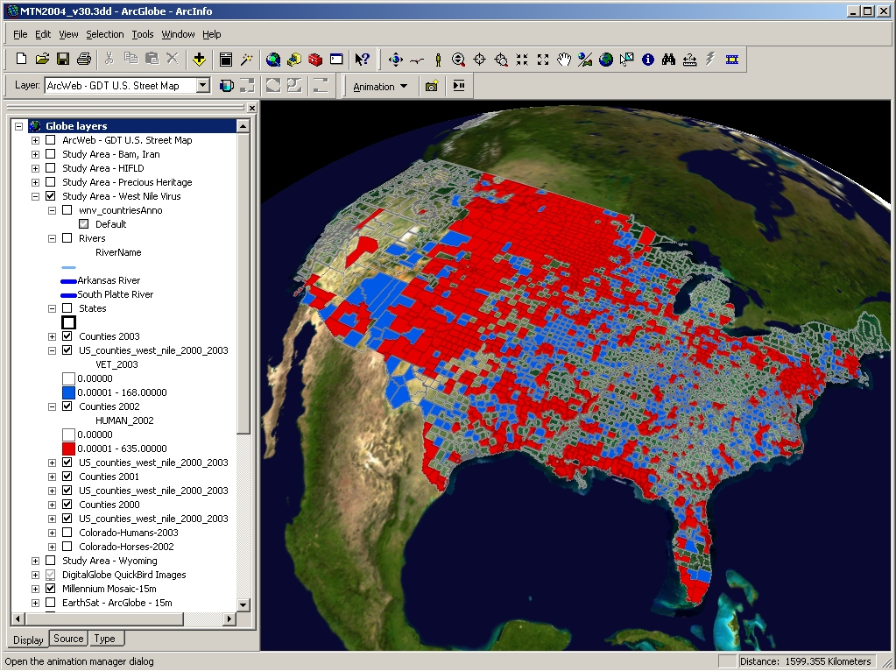
West Nile Virus

Slide 74
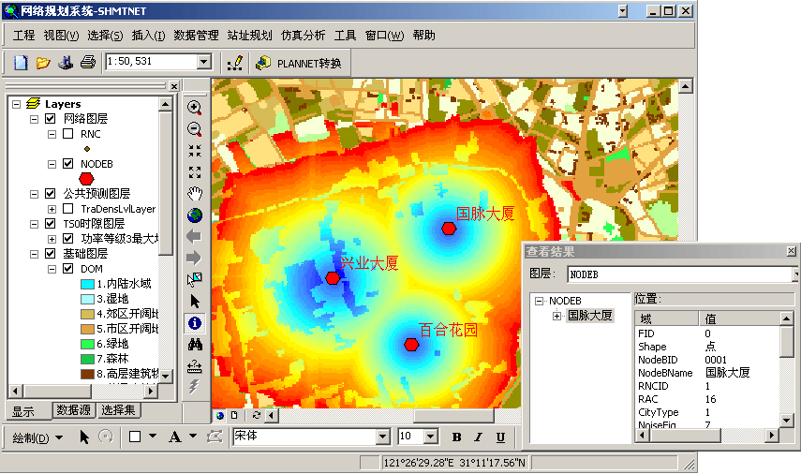
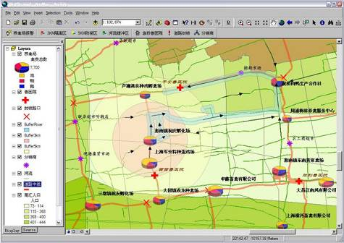
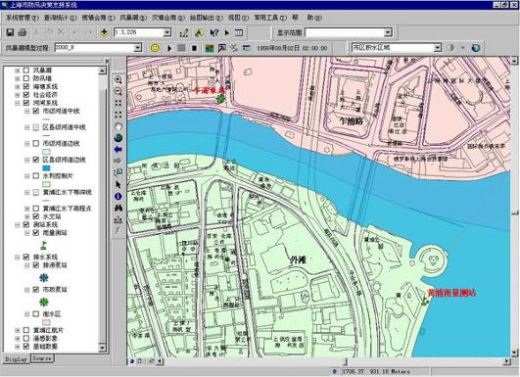
Shanghai mobile communication network animation system
Shanghai Animal Epidemic (Checking flu) Emergency Response system in action
Shanghai Flood Control System for Decision making
Notes:
LEFT
Shanghai mobile communication network animation system for optimization
RIGHT
Shanghai Animal Epidemic (Checking flu) Emergency Response system in action
BOTTOM
Shanghai Flood Control System for Decision making

Slide 75
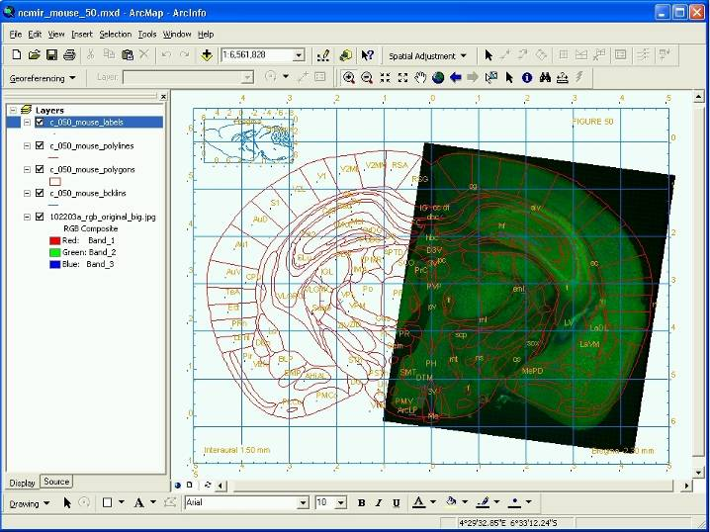
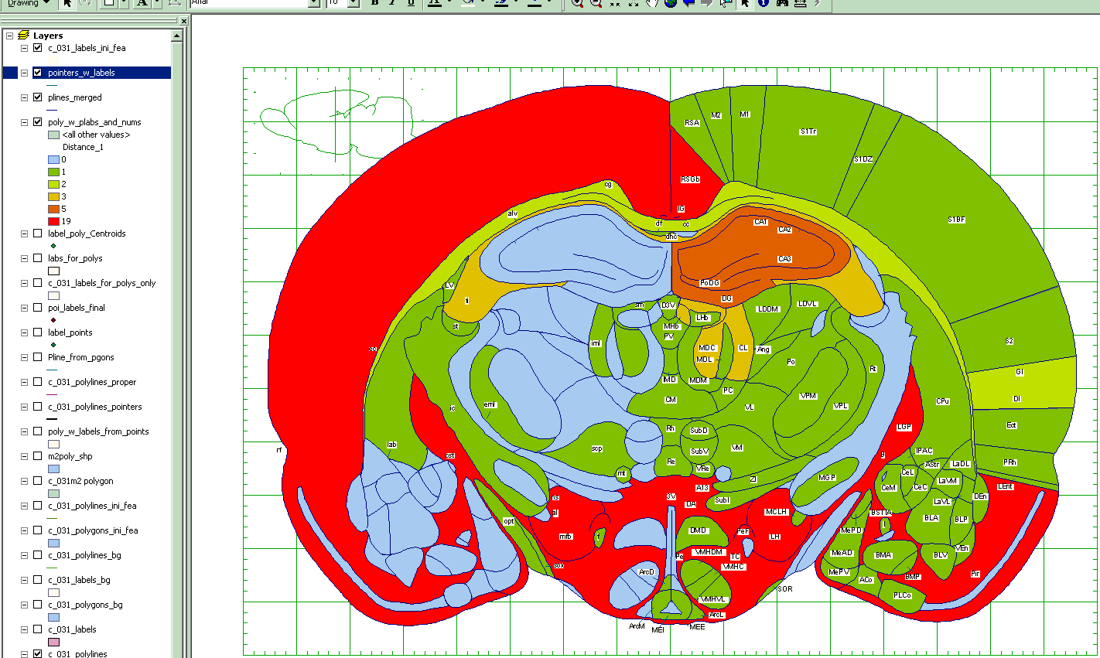
Biomedical Informatics Research Network - Brain Mapping
The Biomedical Informatics Research Network (BIRN) is a National Institutes of Health initiative
Notes:
BIRN uses ESRI’s ArcMAPto align and analyze biologicalimages and vectorsegmentations of the brain, which can be retrieved from multiple spatial data servers (including ArcIMS servers) maintained by partner universities

Slide 76
Japanese Schools Use Computer Chips to Keep Tabs on Children
The chips send signals to receivers at school gates. A computer in the system shows when a student enters or leaves.
More than 70 percent of parents supported the trials, indicating there is wide appreciation for this kind of effort," said Ichiro Ishihara, a teacher at a public elementary school in Iwamura town, Gifu prefecture (state), about 275 kilometers (170 miles) west of Tokyo.
"And the kids love it - they think it's cool," he added.
__MIT Technology Review September 28, 2004

Slide 77
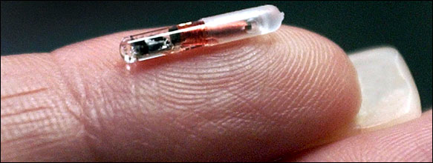
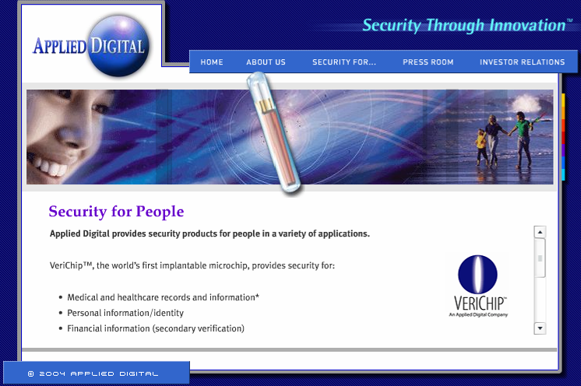
Identity Badge Worn Under Skin Approved for Use in Health Care (Oct 13, 2004)
Notes:
Applied Digital Solutions, based in Delray Beach, Fla., said that its devices, which it calls VeriChips, could save lives and limit injuries from errors in medical treatment.
DELRAY BEACH, FL and So. ST. PAUL, MN -- Applied Digital (NASDAQ: ADSX),
a provider of Security Through Innovation™ and Digital Angel Corporation
(AMEX:DOC) announced today that VeriChip™, the world’s first implantable radio
frequency identification (RFID) microchip for human use, has been cleared by the U.S.
Food and Drug Administration (FDA) for medical uses in the United States.

Slide 78
Private Sector Partnerships Might Prevent the Deaths of 90,000 Patients From Hospital Infections Every Year
Cereplex - (Gaithersbburg, MD) Looks for unusual infection patterns and identifies patients needing changes in therapy; has data analysis contracts with 11 U.S. hospitals
Theradoc - (Salt Lake City, UT) Software on hospital servers mines patient data for trends in infections and suggests courses of action for particular patients; sold to 12 U.S. hospitals
Vecna Technologies - (College Park, MD) Data-mining software for infection control; in tests at three Boston hospitals
Notes:
Every year, two million Americans contract infections in hospitals, and about 90,000 of them die as a result. Despite the severity of this quiet epidemic, physicians have no systematic way to quickly and effectively identify spreading hospital infections. Now a small but growing number of U.S. hospitals are adopting data-mining technologies widely used in other industries to alert doctors to problems they might otherwise miss.
One company helping hospitals connect the dots is MedMined of Birmingham, AL, which has sold its data analysis services to more than 80 hospitals since physician and computer scientist Stephen Brossette founded it in 2000. Hospitals transmit encrypted data from patient records and lab tests to MedMined, which then uses its data-mining algorithms to tease out unusual patterns and correlations. At first, only the most computerized and technologically savvy hospitals were interested, but “now we’re seeing more of a mainstream push,” says Brossette, the company’s president and chief technology officer. One incentive: increased public scrutiny of hospital-acquired infections. Illinois, Pennsylvania, and Missouri have passed laws requiring hospitals to publicly reveal their infection rates, and similar bills are pending in Florida and California.
MedMined and competitors such as Cereplex and Theradoc (see “Computerized Germ Catchers,” below) also track emergency-room and outpatient-clinic data to look for community outbreaks and bioterrorism events. Automating disease surveillance “is going to be hugely beneficial for patient care,” says Jerome Tokars of the Centers for Disease Control and Prevention in Atlanta. “Instead of collecting and counting data, personnel can start doing more prevention of hospital-acquired infections.”
One concern about the technology, says Robert Weinstein, chair of infectious disease at the John H. Stroger Jr. Hospital of Cook County in Chicago, is that it may send doctors chasing after too many false positives—seeming clusters of infections that turn out to be random statistical anomalies. Even so, most infection control specialists agree that they need help from computers in crunching the mountains of patient data that may conceal evidence of an impending outbreak.

Slide 79
All Data is Local
And Much of the Best is Locally Developed
States, Tribes
Local Gov
Business, Academia
Data Referenced Portal
Collaborative
Common Reference
Better Policy Decisions

Slide 80
Health and other major disasters, natural and human-caused

Slide 81
The Internet Will Allow Us to Share (Serve) Our Knowledge
Abstractions
Applications
Data Models
Metadata
Data
. . . And Leverage Our Individual Efforts

Slide 82
Next Steps
Show how the “stuff” affects people, their lives and their livelihood
Show more than the “what”
Show the where, who, why and how – capture the interrelationships

Slide 83
To Engage Your Policy Leaders
Put a face on it – relate it to PEOPLE
They are pre-disposed to think of technology as a discretionary tool not a necessity
Use the high priority issue of the day to catch their attention
Use terms that communicate
WATCH YOUR LANGUAGE!

Slide 84
Don’t Just Prepare for Yesterday’s Situations – Plan for Tomorrow’s
Policy makers should anticipate what ought to be, not just respond to what is
Better Planning, Strategies needed
“If you always do what you’ve always done, you’ll always get what you’ve always got.”
__Mayor Paul Oblock, Rock Springs, WY

Slide 85

Thanks!

