Slide 1
A BALANCED PORTFOLIO PERSPECTIVE FOR INVESTING IN POPULATION HEALTH
David Kindig MD, PhD
Colorado Hot Issues in Health Care
November 12-13, 2004

Slide 2
COLORADO HEALTH 2004 United Health Foundation Rankings
Overall State Rank 13
(9th in 2003)
Total Outcomes 6
(total mortality 10th, infant mortality 16th)
Total Risk Factors (Determinants) 14
(smoking 6th, obesity 1st, health
insurance 36th, high school graduation 30th,
adequacy of prenatal care 48th)

Slide 3
UNITED HEALTH 2004 STATE RANKINGS
Because Colorado’s overall risk factors are lower (14th) than overall outcomes (6th)
“ the state’s relative healthiness may remain steady or decline in future years if the risk factors are not addressed”

Slide 4
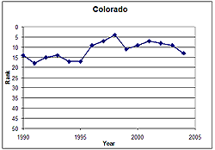
Trend of overall state rank in
United Health Foundation’s State Health Rankings

Slide 5
PRESENTATION SUMMARY
Improving health requires a balanced investment in all the determinants of health.
MEDICAL CARE IS ONLY ONE DETERMINANT OF HEALTH

Slide 6
Within medical care, we need to identify the most cost-effective investments and “pay for performance”
New public and private partnerships are needed to build a balanced portfolio

Slide 7
Social
Environment
Physical
Environment
Genetic
Endowment
Individual
Response
• Behavior
• Biology
Health
&
Function
Disease
Health
Care
Well-Being
Prosperity

Slide 8
EDUCATION AND HEALTH
Good education policy is good health policy
Years of schooling is one of the strongest predictors of improved health outcomes

Slide 9
Mortality Rate and Years of Schooling
 | Less than 12 years | 13+ years | DIFF
1994 | 595 | 255 | 340
1999 | 585 | 219 | 364

Slide 10
90 million American adults may lack the needed literacy skills to effectively use the U.S. health system
INSTITUTE OF MEDICINE 2004
HEALTH LITERACY
Total US Population (2002)

Slide 16
PAY FOR PERFORMANCE
Within medical care, we need to identify the most cost-effective investments and “pay for performance”

Slide 17
COLORADO HEALTH EXPENDITURES PER CAPITA (1998 CMS)
Massachusetts $4810
US Mean $3759
Colorado $3331
Utah $2731

Slide 18
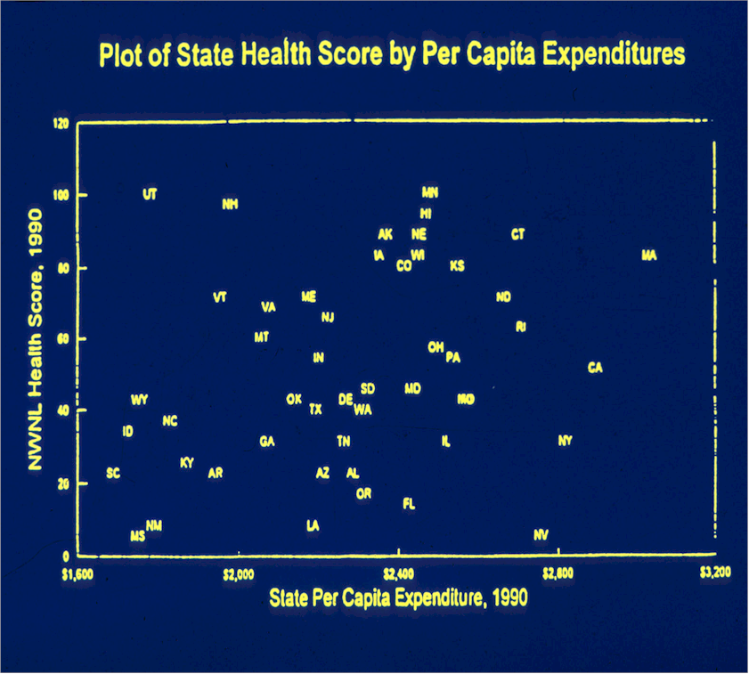

Slide 19
New York Times Says……

Slide 20
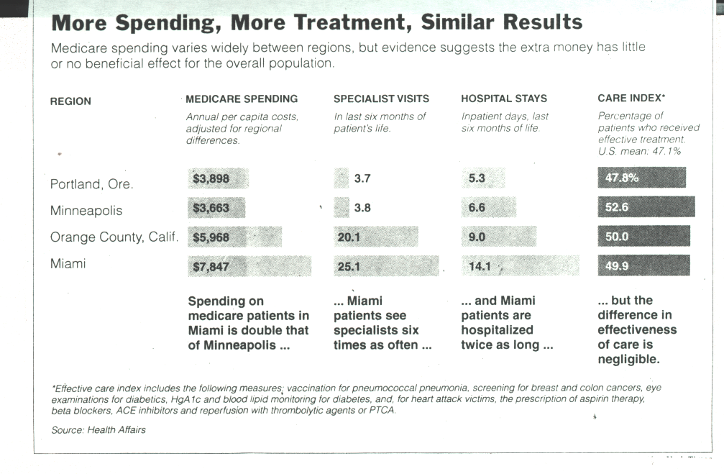

Slide 21
THE NEW YORK TIMES NATIONAL FRIDAY, JULY 11, 2003
Medicare to Pay Bonuses For Best of Hospital Care
By ROBERT PEAR with MARY WILLIAMS WALSH

Slide 22
New public and private partnerships are needed to build a balanced portfolio

Slide 23
Health Outcomes “Trust”
Medical
Care
Purchasers
(Public &
Private)
Other
Sector
Agents
Integrated
Delivery
System
Schools
Social Services
Environment
Public Health

Slide 24
CONCLUSION
A balanced scorecard is needed to guide a balanced health investment portfolio ...
so both market forces and government can be more effective and deliver value … the best health outcomes for the dollars invested in the multiple determinants of health

