Slide 1
Healthy Economy, Healthy Colorado
A Strategic Action Plan for Colorado’s Health and Wellness Industry
December 11, 2013
History Colorado Center

Slide 3
Remarks: Kenneth Lund Executive Director, Colorado Office of Economic Development and International Trade

Slide 4
Remarks: Larry Wolk, MD, MSPH Executive Director, Colorado Department of Public Health and Environment

Slide 5
Presentation: Michele Lueck President and CEO Colorado Health Institute

Slide 6
A Statewide Project
The Action Plan: Five Areas of Focus
What informed our thinking
How we will get there
Notes:
The report today –
CHI hired to provide content expertise and background research….

Slide 7
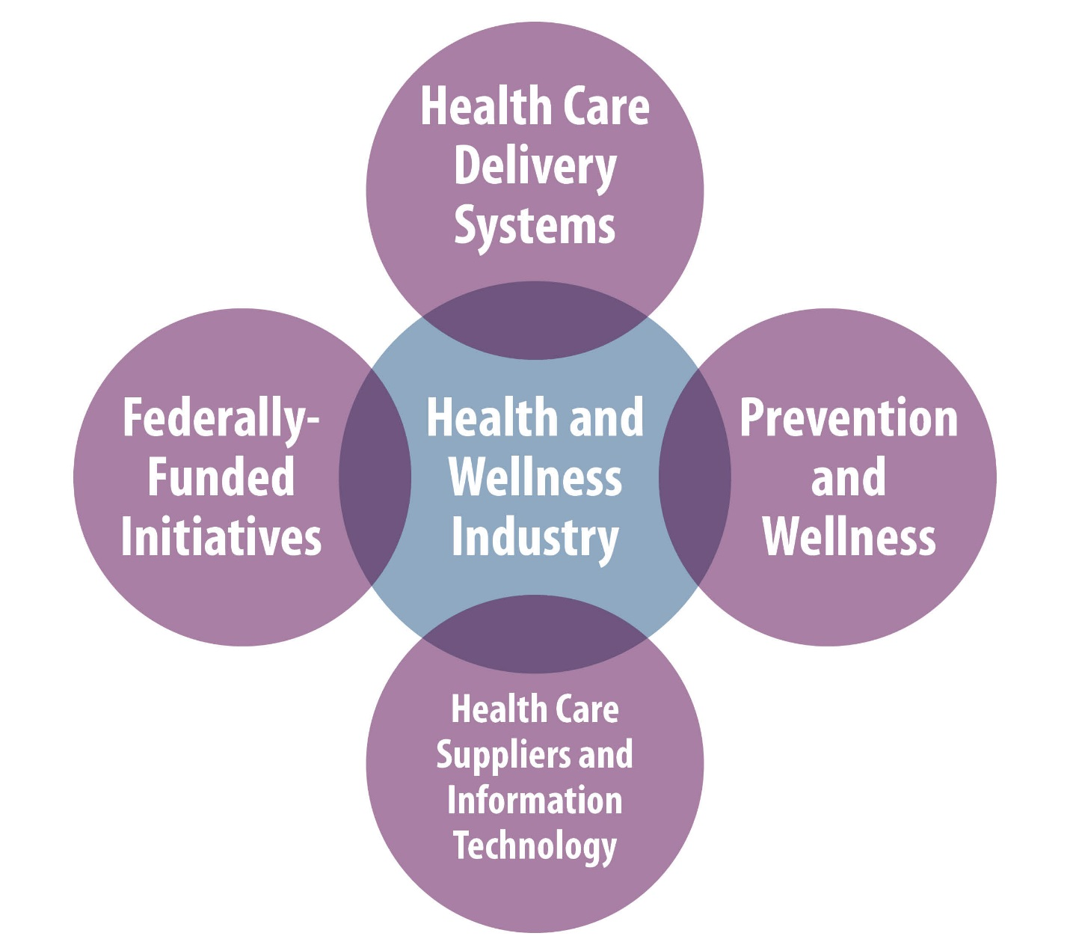
Defining Health and Wellness

Slide 8
Three Takeaways
Colorado’s health and wellness industry is a powerful economic driver for the state.
Colorado has a unique opportunity to leverage the strength of this sector, becoming the premier national destination for prevention and wellness, high quality health care services and outdoor recreation.
This strategic action plan reflects the thinking of industry leaders. It is a plan by the industry and for the industry.

Slide 9
The Vision: By the Industry, For the Industry
Colorado’s health and wellness industry will drive economic growth, improve health outcomes and promote a stronger, more productive workforce.

Slide 10
Setting the Stage
Action Plan: Created by industry leaders.
Research: Conducted by the Colorado Health Institute.
Solid Start: Many organizations, associations and initiatives already exist.
Goal: Leverage what’s out there.

Slide 11
Focus Number One
Position Health and Wellness as an export business by developing products and services that can be marketed and sold in markets across the nation and internationally.

Slide 12
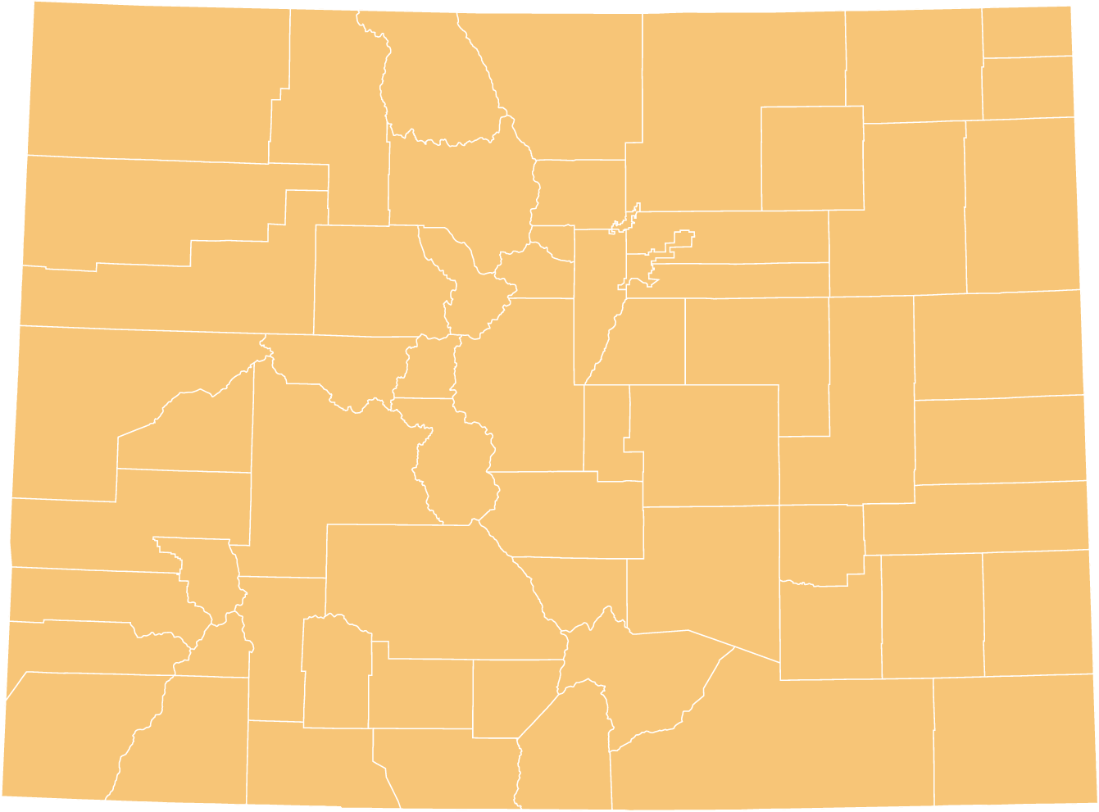
What Informed Our Thinking
What are the revenue streams that we can build
to bring new dollars into the state?

Slide 13
Action Plan: Recommendations
Invest in regional hubs and centers of excellence.
Health care delivery systems
Wellness tourism
Target high-growth companies.
Evaluate states with effective tax policies and incentives
Raise awareness of high-growth areas.
Digital health
Back office operations
Supply chain
Wellness programs for employers

Slide 14
Focus Number Two
Leverage business opportunities created by a significant increase in the number of people with health insurance and a growing demand for wellness services.

Slide 15
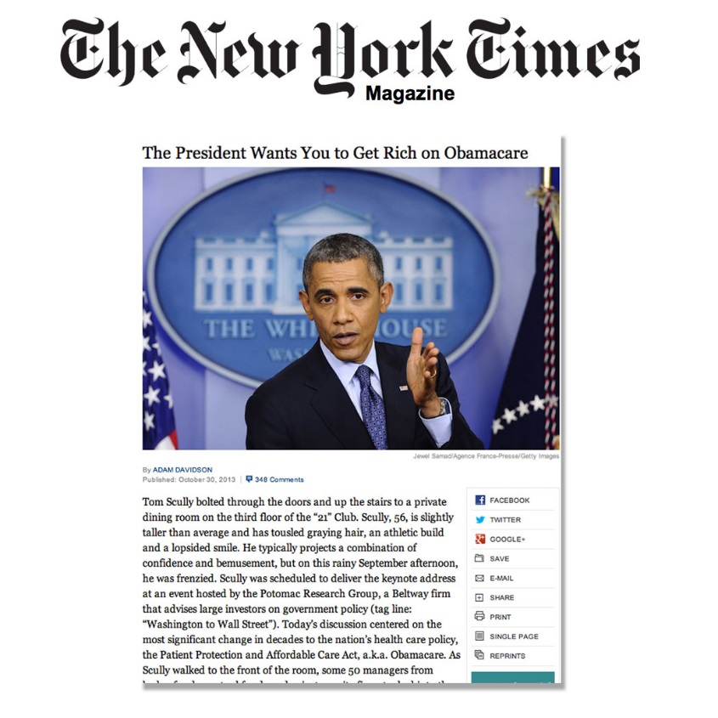
What Informed Our Thinking

Slide 16
Action Plan: Recommendations
Strengthen current health and wellness companies.
Reduce uncertainty about reform.
Actively look to reduce health care costs.
Identify new businesses.
Partner with Colorado Business Intelligence Center.
Recruit fastest-growing health and wellness companies.

Slide 17
Focus Number Three
Establish collaborative workforce strategies and educational programs that reflect the current and future needs of health and wellness employers.

Slide 18
Projected Job Growth Nationwide, 2010-2020
What Informed Our Thinking
Source: Bureau of Labor Statistics Occupational Handbook

Slide 19
Action Plan: Recommendations
Leverage ongoing educational efforts around science, technology, engineering and mathematics (STEM) and career ladders.
Invest in new technologies and the companies that can bring them to market.
Telehealth, remote monitoring

Slide 20
Focus Number Four
Invest in creating high-paying, high-demand jobs, such as those in health care information technology.

Slide 21
What Informed Our Thinking
Comparing Jobs and Wages, Health and Wellness Segments and All Industries, Colorado and the United States

Slide 22
Action Plan: Recommendations
Increase attractiveness of Colorado.
Reduce health care costs for business.
Market lifestyle and brand at national forums.
Host highly-visible conference in digital, IT or wellness app space.
Leverage high-skilled workforce and other leading clusters.
Financial services and IT.

Slide 23
Focus Number Five
Build infrastructure and support for established companies and start-ups, especially in the wellness sector.
Notes:
Also in supplier and digital health space. We recognize there are efforts underway but wellness is especially fragmented.

Slide 24
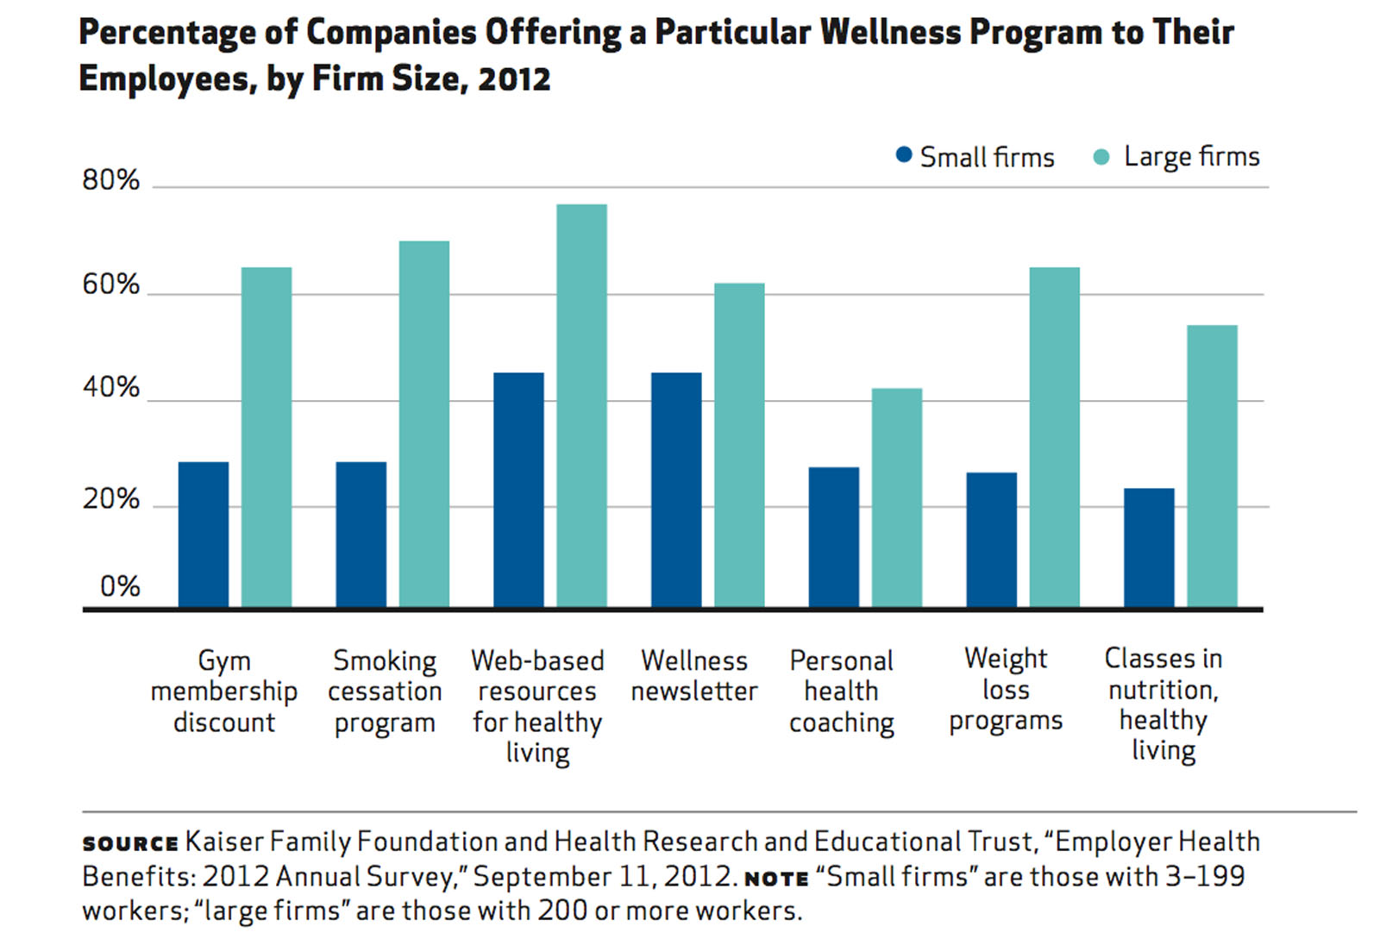
What Informed Our Thinking

Slide 25
Action Plan: Recommendations
Accelerate Colorado companies adopting wellness programs.
Identify evidence-based wellness practices.
Quantify economic impact or practices.
Disseminate information to employers.
Grow and recruit wellness innovation.
Target and recruit wellness companies to locate in Colorado.
Build on forums for innovators in wellness space.

Slide 26
Three Takeaways
Colorado’s health and wellness industry is a powerful economic driver for the state.
Colorado has a unique opportunity to leverage the strength of this sector, becoming the premier national destination for prevention and wellness, high quality health care services and outdoor recreation.
This strategic action plan reflects the thinking of industry leaders. It is a plan by the industry and for the industry.

Slide 27
Panel Discussion Moderator: Tom Clark CEO, Metro Denver Economic Development Corporation Panelists:
Jandel Allen-Davis, MD Vice President, Government and External Relations, Kaiser Permanente Colorado
Roger Holstein Chief Executive Officer, Healthgrades
Aaron Kennedy Chief Marketing Officer, State of Colorado
Lee Newman, MD, MA, FCCP, FACOEM Director of Environmental and Occupational Health, Colorado School of Public Health
Scott Rotermund President, WellTok

Slide 29
Michele Lueck
lueckm@coloradohealthinstitute.org
Karla Tartz
Karla.tartz@state.co.us

