Slide 1
The Health Professions Database and
Safety Net Indicators and Monitoring Project
September 7, 2008

Slide 2
CHI has surveyed 8 health professions
Physicians
Registered nurses
Pharmacists
Certified nurse aides
Dentists
Dental hygienists
Licensed practical nurses
Rural dentists

Slide 3
Future surveys include:
2008
Registered nurses
Nurse faculty members
2009
Rural physicians
Urban dentists

Slide 4
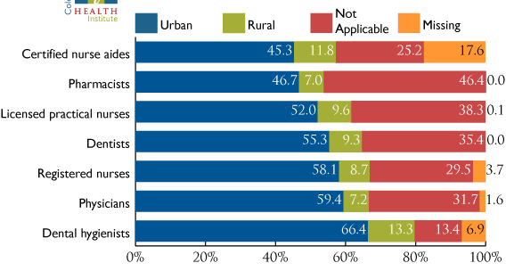
Colorado health professionals by practice location, 2005-07

Slide 5
Colorado RN shortage
Between 1991-92 and 1999-00, 26% fewer RN degrees awarded per 100,000 Coloradans
By 2020, RN shortage of 31% (32,300) projected in Colorado

Slide 6
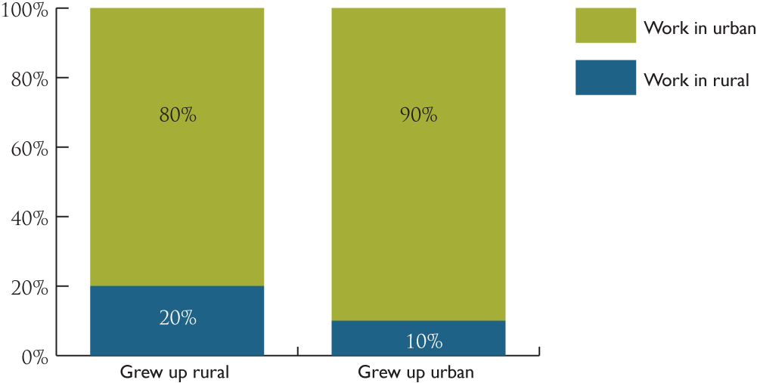
CHI survey: RN respondents growing up in rural areas twice as likely to practice in a rural community

Slide 7
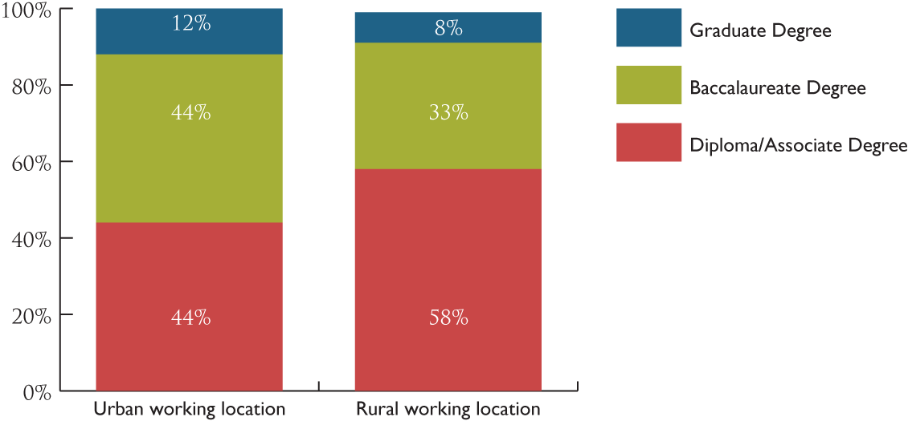
Highest nursing degree, urban and rural RN respondents

Slide 8
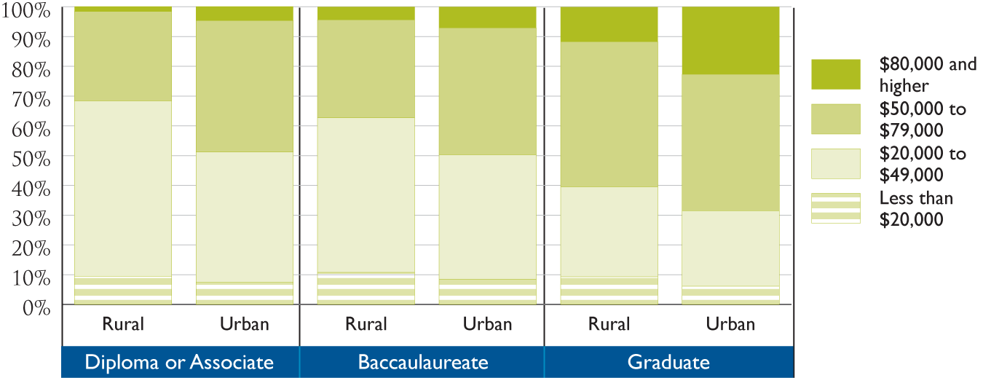
Salaries of rural and urban RN respondents based on highest educational degree

Slide 9
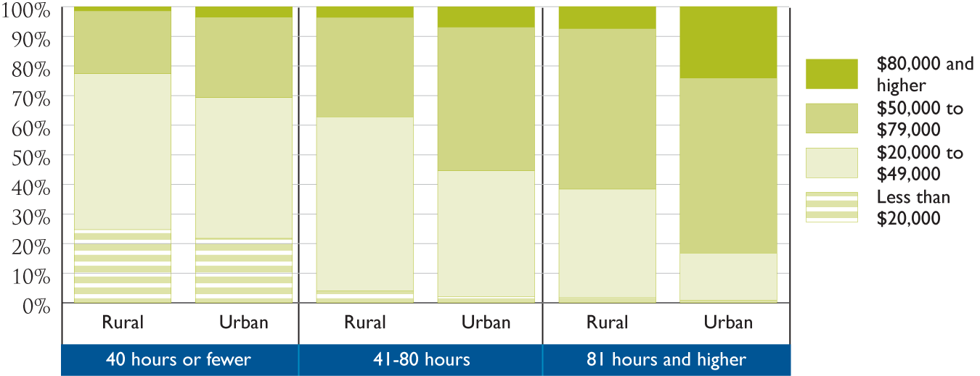
Salaries of rural and urban RN respondents based on hours worked every 2 weeks

Slide 10
Policy options - RNs
Increase number of faculty to expand RN training capacity
Focus on 2-year training programs
Grow your own programs in rural areas
Distance learning for students in remote areas
Expand loan repayment programs
Review scope of practice issues for expanded roles in primary care

Slide 11
Policy options continued
Flexible work/study programs
Expand career ladder from CNA to LPN to RN programs
Targeted outreach to middle and high school students to stimulate interest in nursing careers

Slide 12
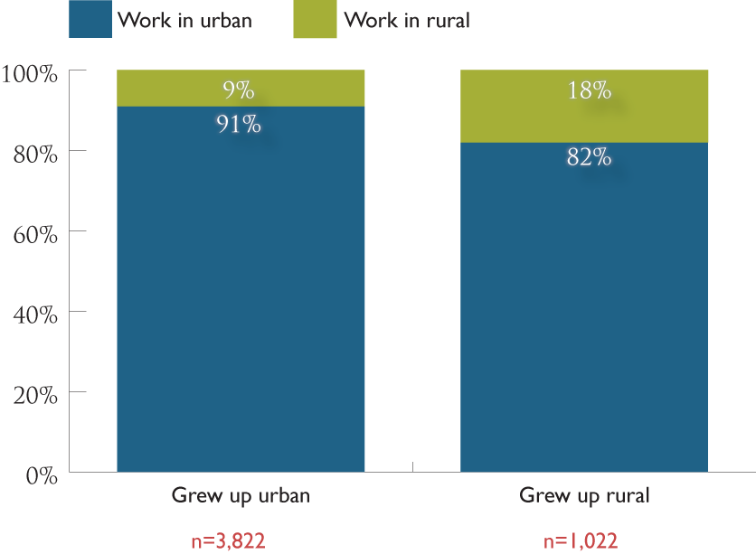
CHI Survey: Physician respondents growing up in rural areas twice as likely to practice in a rural community

Slide 13
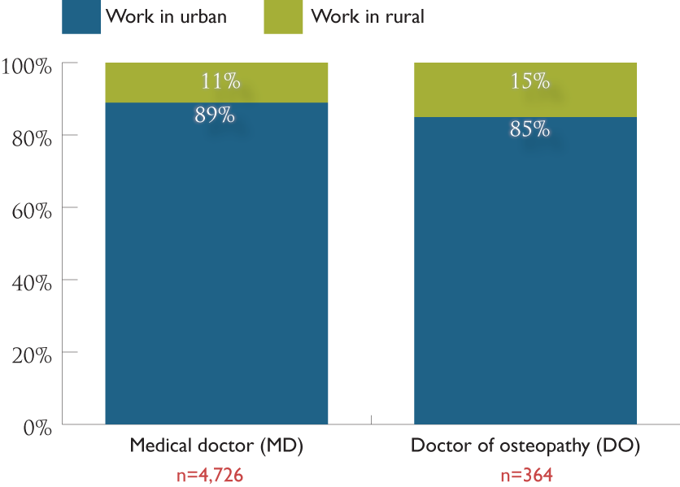
DOs more likely to practice in rural areas than MDs

Slide 14
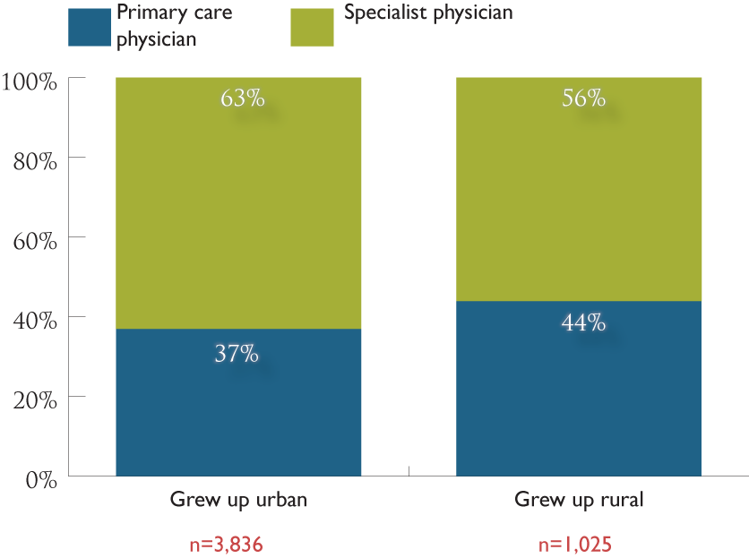
Physicians who grew up rural more likely to practice primary care

Slide 15
Policy options - Physicians
Expand loan re-payment opportunities for physicians committing to work in an underserved area (average debt of medical school graduates is $130,000)
“Grow Your Own” programs in rural areas
Greater emphasis on DO programs likely to lead to more primary care physicians
Expand telemedicine options
Encourage technology-driven training to increase productivity of existing medical staff
Examine scope of practice issues to increase primary care capacity

Slide 16
Policy options continued
Expand enrollment capacity in medical schools
Outreach to middle and high school students

Slide 17
The aging dental workforce is more acute in rural areas

Slide 18
Dentists’ income levels in urban versus rural settings
Income Level | Rural Practice Setting | Urban Practice Setting
Less than $50,000 | 6.7% | 5.1%
$50,000-$99,000 | 20.3% | 16.6%
$100,000-$149,000 | 24% | 23.6%
$150,000-$199,000 | 22.1% | 17.1%
$200,000-$249,000 | 10.8% | 13.2%
$250,000-$299,000 | 4.4% | 7.4%
$300,000-$349,000 | 3.8% | 5.9%
$350,000 or more | 7.6% | 10.8%

Slide 19
Other workforce projects
Health Workforce Website
http://www.coloradohealthinstitute.org/workforce/index.aspx
Rural Health Clinics: An Assessment of Data and Capacity
http://www.coloradohealthinstitute.org/documents/sn/rhc_report.pdf
Health Professions Workforce Inventory
http://www.coloradohealthinstitute.org/resourceHotissues/hotissuesViewItemFull.aspx?theItemID=45

Slide 20
Ongoing workforce projects
Collaborative scopes of care
http://www.coloradohealthinstitute.org/resourceHotissues/hotissuesViewItemFull.aspx?theItemID=43
Supply and demand study of physicians and nurses
Nurse Faculty Study: Surveys of nurse faculty, educational programs and clinical sites
Survey findings report on rural dentists

Slide 21
The Safety Net Monitoring System:
Development
Multi-year effort
Initial funding provided by The Colorado Health Foundation
Focus on basic physical, mental, and dental health care services
Diverse communications portfolio including Web site, symposia, publications

Slide 22
The Safety Net Monitoring System:
Value and Objectives
  Build data-driven reporting system of statewide value
  Identify, describe and monitor the ability of Colorado’s safety net providers to meet the primary health care needs of vulnerable populations
  Determine what variations exist among Colorado communities in the organization and financing of safety net services
  Inform policymakers about the changing dynamics of Colorado’s safety net system

Slide 23
Defining the safety net
Providers of primary physical, mental, and dental health care:
  Community and public hospital emergency departments
  Local health departments
  Non-federally qualified clinics and family practice residency programs
  Rural health clinics
  School-based health centers
  Community health centers
  Low-income dental clinics and public oral health programs
  Community mental health centers
  Migrant health centers

Slide 24
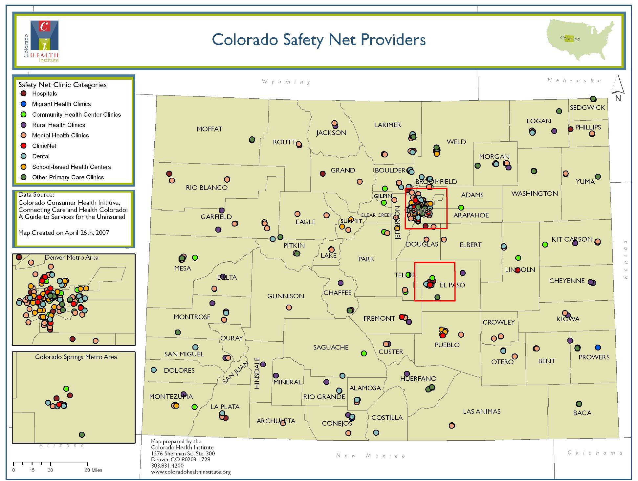

Slide 26
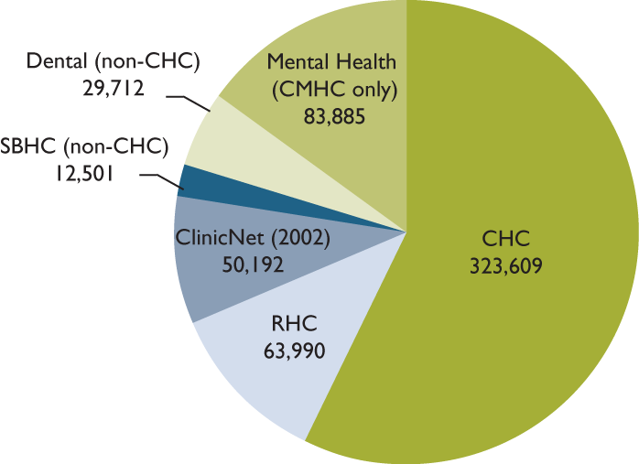
Over 500,000 Coloradans use safety net clinics
Safety net clinic users, 2005
Source: Colorado Health Institute, Safety Net Indicators and Monitoring System

Slide 27
Dimensions of vulnerability
Low income—less than 300% of the federal poverty level (FPL)
No or insufficient health insurance
Enrollment in publicly financed health care programs
Geographic isolation
No regular source of primary care
Cultural, language or other social barriers
Notes:
One thing that we have learned is that it is difficult to define what vulnerability is.
We have used a multidimensional definition.
Low income. - We use the threshold of those individuals with family incomes less than 300% of FPL.
In 2008, 300% of FPL is $31,200 for single person and $63,600 for a family of 4.
Established 300% based on literature that suggests that about 300% FPL is the point at which health insurance becomes unaffordable for many people.
Vulnerability is also a matter of degree
At one level we are all vulnerable, but clearly some of us are more vulnerable than others.
To illustrate this, I’ve included a few graphs on the next few slides.
Immigration?
We are not focusing in on immigration status as a dimension of vulnerability, although documentation status is likely to represent a barrier to receiving health care. Many immigrants, whether they are here legally or not, would likely fall under low income, uninsured, or having cultural or language barriers.

Slide 28
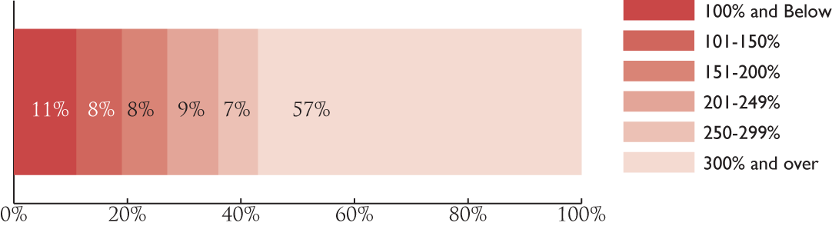
43% of Coloradans are below 300% of FPL, 2003-05
Source: U.S. Bureau of the Census, Current Population Survey

Slide 29
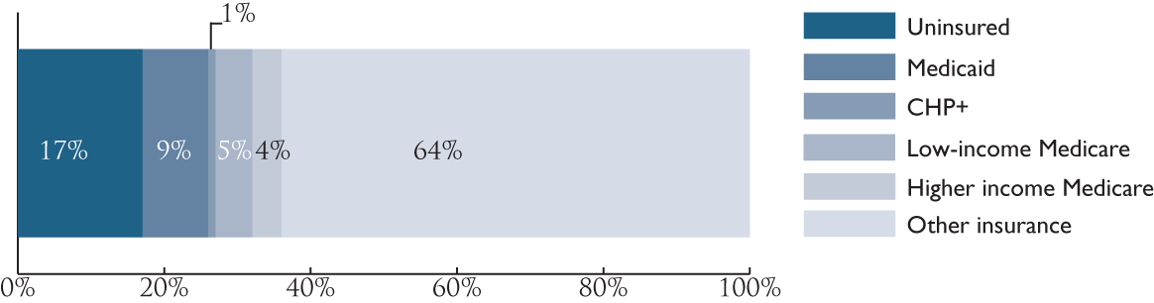
36% of Coloradans are uninsured or publicly insured, 2003-05
Sources: Colorado Dept. of Health Care Policy and Financing; U.S. Bureau of the Census, Current Population Survey
Notes:
Another dimension of vulnerability is health insurance status.
New Census numbers: Upwards of 800,000 people are uninsured in CO (about 16.7% of CO’s population). CHI is going to be issuing a brief soon about the number of uninsured in the state.
9% of the state is on Medicaid. Definitely better than being uninsured, but do to provider participation issues, Medicaid enrollment does not guarantee access.
Medicaid caseload is increasing
Current Medicaid caseload: ~400,000 (400k/4,766k = 8.4%)
CHP+ caseload: 59,769 (as of May 08) (59k/4,766k = 1.3%) – Rework with Amy’s JBC tables
Since 2000, it has gone up. Since 2004-05, it has gone down slightly and is now picking up. This may be due to the economy softening a bit and an administration that is investing a lot of resources into outreach and enrollment.

Slide 30
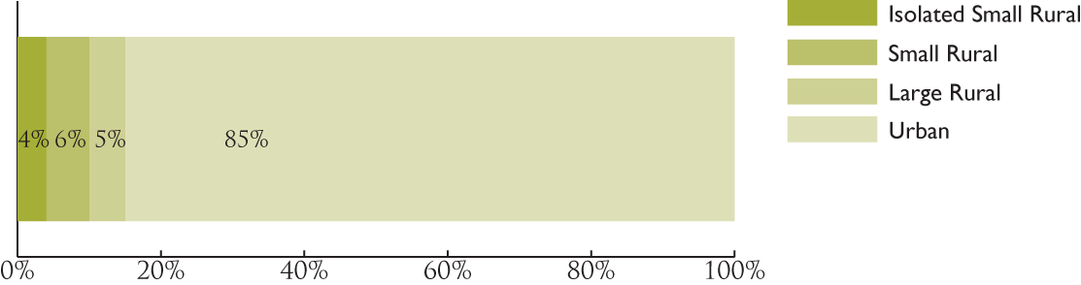
15% of Coloradans live in rural areas, 2005
Sources: RUCA: University of Washington, Rural Health Research Center; 2005 Population: Claritas

Slide 31
Vulnerable populations:
A multi-dimensional view
Low income
Insurance coverage
Geographic isolation
Sources: Colorado Dept. of Health Care Policy and Financing; U.S. Bureau of the Census, Current Population Survey; RUCA: University of Washington, Rural Health Research Center; 2005 Population: Claritas

Slide 32
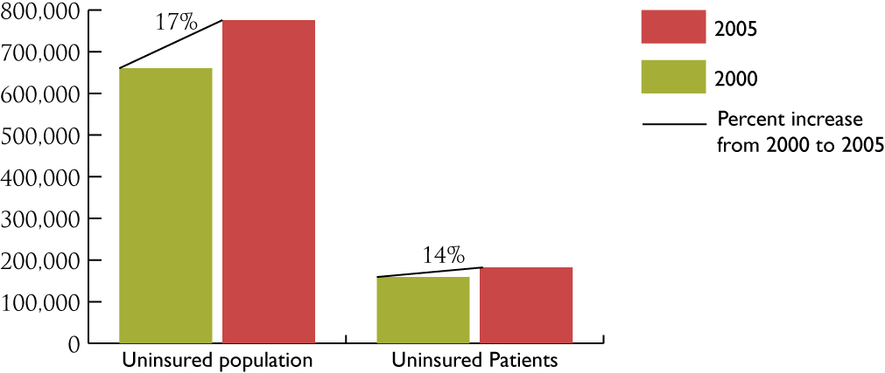
Does the safety net have the capacity to care for vulnerable populations?
Uninsured population and uninsured patients seen at Community Health Centers, 2000, 2005

Slide 33
Estimates of access, users, and visits to school-based health centers
For the 2006-07 school-year:
193,153 students had access to a SBHC (n = 38)*
20,964 students used SBHC services (n = 37)
66,708 visits were made to SBHCs (n = 38)
30,442 immunizations were provided (n = 31)**
Notes:
* To determine the number of students who had access to a SBHC, CHI analyzed responses to a survey item in which respondents were asked to identify eligibility requirements to receive services at their SBHC. 2006-07 school enrollment, feeder school enrollment, or school district enrollment was counted, depending on the eligibility requirements and the availability of SBHC services in each school district. School district enrollment was counted when a respondent indicated that all children (birth to age 21) were eligible to for SBHC services.
** Respondents were asked to count each injection as one immunization.
These totals may differ from totals reported in subsequent slides because not all SBHCs were able to report the same level of detail (e.g., unduplicated users by insurance source). Three respondents reported data for CY2007; all others provided 2006-07.
Source: CHI analysis of data from 2008 CASBHC and CHI Survey of School-Based Health Centers.

Slide 34
What was the health insurance status of students who visited SBHCs?
Insurance source | Number | Percent
Medicaid | 6,305 | 32%
CHP+ | 1,231 | 6%
CHAMPUS, TRICARE, or other govt | 142 | 1%
Private insurance | 2,113 | 11%
Uninsured/self-pay | 9,058 | 45%
Unknown | 1,096 | 5%
Total | 19,945 | 100%
Number of SBHCs reporting = 32
Source: CHI analysis of data from 2008 CASBHC and CHI Survey of School-Based Health Centers.

Slide 35
SBHC revenue sources
Total Revenue = $9,098,481
Number of SBHCs reporting = 37 (cash); 36 (in-kind)
Source: CHI analysis of data from 2008 CASBHC and CHI Survey of School-Based Health Centers.

Slide 36
What’s next?
Continued data collection from safety net providers
Analysis of survey data
Development of materials and publications
Continued enhancement of safety net Web site: http://www.coloradohealthinstitute.org/safetynet/index.aspx

Slide 37
Other rural safety net projects
Community case studies
Southwest Colorado Health and Demographic Profile
http://www.coloradohealthinstitute.org/documents/sn/swcolorado/swreport.htm
Northwest Colorado Health and Demographic Profile (underway)

Slide 38
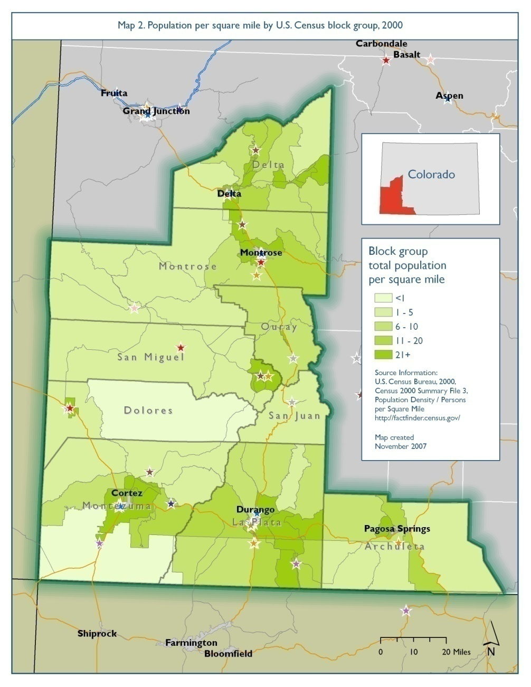
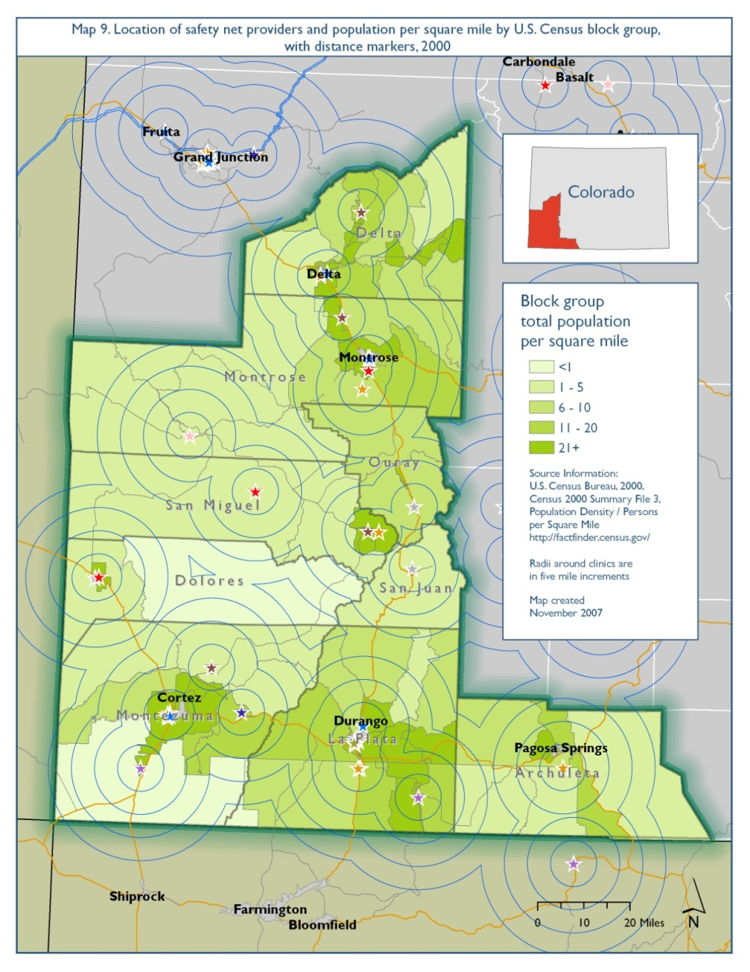
The safety net in Southwest CO

Slide 39
Questions?
Amy Downs
Director for Policy and Research
Colorado Health Institute
downsa@coloradohealthinstitute.org
303.831.4200 x221

