Slide 2
Introduction
Introductions
Emily Johnson Senior Policy and Statistical Analyst, Colorado Health Institute
Ross Brooks
CEO, Mountain Family Health Centers
Notes:
Emily’s slides will discuss Medicaid expansion and its future in terms of the state and its budget.
Ross’s presentation examined the impact at a local level from his perspective leading a group of rural community health centers.

Slide 3
The Bottom Line
Three Takeaways
Medicaid expansion was larger than expected, accounting for almost the entire decline in uninsurance.
The program’s future is still shaping up.
Changes will impact local communities and patients.
Notes:
There are really three things we hope will stick with you when you leave this room.
The first is that Medicaid expansion thus far has been much larger than anyone predicted when Colorado decided to expand. And in fact, the majority of people who have gained insurance since the Affordable Care Act (ACA)’s main provisions were implemented in 2014 got it through Medicaid. Medicaid accounted for almost the entire decline in Colorado’s uninsured rate.
The second is that we don’t yet know what the program will look like going forward. Trump’s election almost certainly means there will be changes, but we’ll still learning what those are, though we’ll look at a few scenarios later on.
Finally, know that whatever changes do happen, their effects won’t be contained to Capitol Hill in Denver. Impacts will be felt on a local level, and those can’t be ignored.

Slide 4
Notes:
Just to make sure everyone’s on the same page, we wanted to offer a quick reminder of what expansion entailed.
This is a picture of John Hickenlooper signing Medicaid expansion into law in May 2013.
States could choose whether to expand Medicaid under the ACA. Colorado did, like most states with Democratic governors, though the expansion was voted on and passed by the legislature. Hickenlooper cited economic stimulations, cost savings and benefits to enrollees as his reasoning.

Slide 5
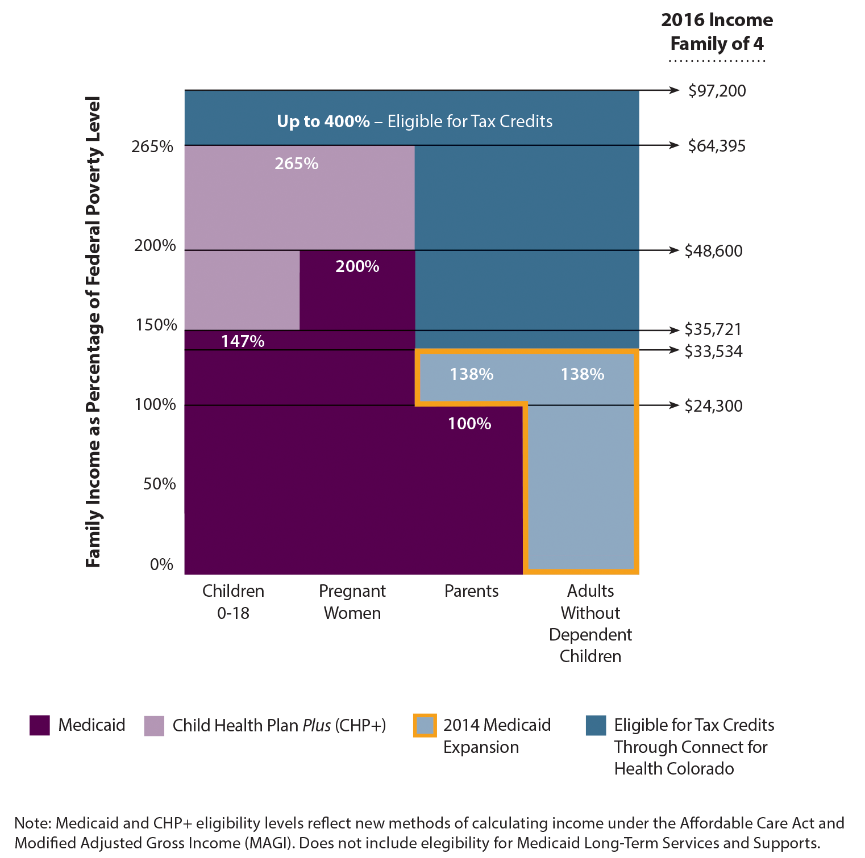
Medicaid and CHP+ Eligibility Changes
Notes:
Here’s a quick look at who eligibility was expanded to. Depending on who you are – e.g., if you’re a child, a pregnant woman, etc.– Medicaid covers you at different income levels.
Traditionally, the dark purple box was the group covered. It included kids up to 147 percent of the federal poverty level (FPL), adults up to 200 percent of the FPL and parents up to 100 percent of the FPL.
Medicaid expansion increased those levels so that parents and adults without dependent children are covered up to 138 percent FPL. If you look at the group in the yellow box, that’s the expansion population – it was really targeting adults.

Slide 6
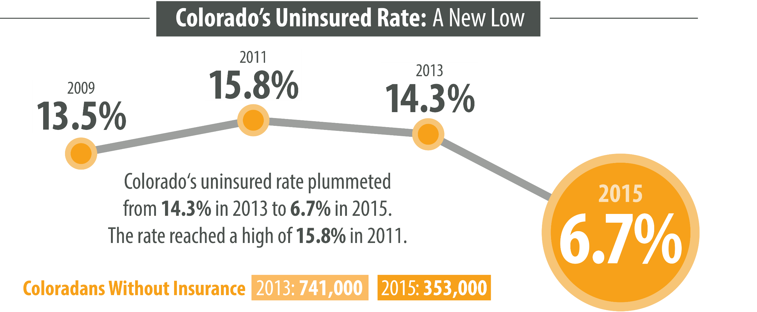
Notes:
But back to our first point, which is the sheer size of Medicaid expansion. As you may remember, in 2015 CHI found the uninsurance rate was at an all-time low.
This was big news! And it was almost entirely due to Medicaid expansion. The decline in the uninsured population was smaller than the increase in the Medicaid-enrolled population.

Slide 7
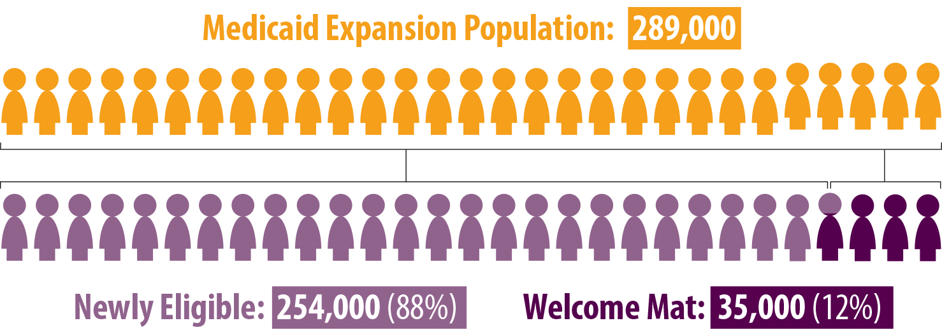
New People Who Got Coverage?
Medicaid Expansion Population as of June 30, 2015
Notes:
In the first year and a half, expansion was wildly successful, enrolling nearly 300,000 Coloradoans. That means Medicaid now covers 1.3 million people in the state.
A good chunk (12 percent) of these 300,000 were “welcome mat” enrollees, meaning they were eligible before expansion but had not enrolled. However, their enrollment is attributable to expansion – whether it’s because of the increased media coverage of the ACA or newly-eligible parents who enrolled their children at the same time as themselves.
Most (88 percent) were newly-eligible . . . in other words, people who fit into that yellow box on the previous slide.
Specifically, most were newly-eligible low-income adults without dependent children. They accounted for 77 percent of the expansion enrollees
But of course, nothing’s free. Now we turn to costs.

Slide 8
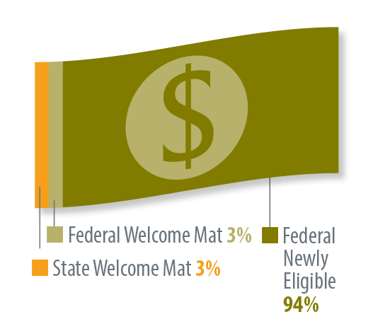
New Expenses What Did It Cost?
Federal Government Paid 97 Percent
of Expansion Cost in FY 2014-15
Notes:
While Colorado has, so far, paid nothing for the expansion to newly-eligible population, we include welcome mat when we talk about the total costs. Half of the cost of welcome mat enrollees is covered by the state, just like traditional Medicaid populations -- so Colorado did pay a little bit of the cost of expansion.
Overall, expansion costs added up to nearly $1.6 billion during the first two years — 29 percent more than the $1.2 billion forecasted by the fiscal note for the authorizing legislation.
So costs were much bigger than expected, but the federal government paid for the vast majority (97 percent) of them.

Slide 9
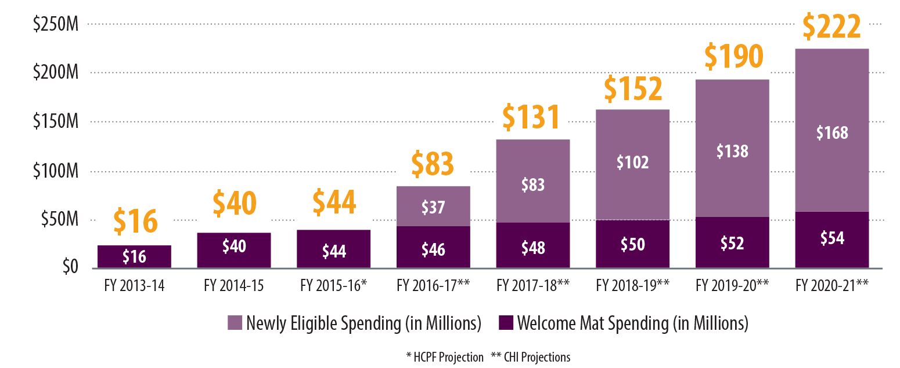
New Expenses: What Did It Cost?
Medicaid Expansion – Colorado’s State Financing by Year
?
?
?
?
Notes:
However, costs to the state are expected to go up next month as we take on some of the expansion spending.
By 2020, we’ll be taking on ten percent of the cost, and we’ll keep on covering ten percent from then on. That will cost us $222 million a year. This is a lot more than anyone predicted it would be, but it’s still a small percentage of our state budget.
Now, it’s worth stopping here to say that this graph was made before November 8 of this year. The projections you see are based on a world where Medicaid expansion continues on its current path, but that world may not exist under a Trump presidency.

Slide 10
Medicaid’s Future Still Shaping Up
Notes:
Which brings us to our second point, and that’s that we don’t know what the future holds for Medicaid, but it’s a pretty safe bet that things will change.
How they’ll change is still unknown, and there are a number of different options for program design. The federal government could continue to have the same qualifications for Medicaid but add a work requirement. Or maybe they’ll roll out Medicaid like it currently exists in Indiana, where expansion happened in a radically different way.
We’re now going to take a look at how some of the more likely options would work at a federal and state level.

Slide 11
Medicaid Going Forward New Options
Notes:
Before we get into it, it will be helpful to again review our current system and how that works.

Slide 12
Medicaid Going Forward New Options
Notes:
In Colorado, Medicaid covers different populations: here, we show that for kids, adults, seniors and people with disabilities.

Slide 13
Medicaid Going Forward New Options
Notes:
Colorado spends state money to cover each of these groups.

Slide 14
Medicaid Going Forward New Options
Notes:
We also get federal matching funds for each group – not always at the same rate, but a match nonetheless.
Most groups are matched one-to-one, but for the Medicaid expansion population it’s one-to-nine (or at least will be in 2020). In other words, we get nine federal dollars for every state dollar we spend on expansion adults.
This match applies for every dollar Colorado spends.

Slide 15
Medicaid Going Forward New Options
Notes:
For example, an extra Colorado dollar spent on kids…

Slide 16
Medicaid Going Forward New Options
Notes:
…means an extra federal dollar for kids.

Slide 17
Medicaid Going Forward New Options
Notes:
Likewise, an extra Colorado dollar spent on adults without dependent children…

Slide 18
Medicaid Going Forward New Options
Notes:
…means an extra nine federal dollars for adults without dependent children.
Proponents of this system say that it ensures spending is sufficient to cover all populations, even when there’s a sudden increased need for Medicaid – for example, if an economic recession results in higher enrollment, or an outbreak or natural disaster requires additional spending.
The concern among some fiscal conservatives is that it incentivizes the state to over-spend since they’re only risking fifty cents of every dollar they put into the program (and only saving fifty cents of every dollar they would cut).
Two often-cited changes are those in Paul Ryan’s outline for a Republican health care plan, which would have states move away from this current system and choose between a per capita allotment system or a block grant.

Slide 19
Medicaid Going Forward Per Capita Allotment
Notes:
Here’s how per capita allotment works. Let’s start with the same populations.

Slide 20
Medicaid Going Forward Per Capita Allotment
Notes:
Under per capita allotment, the federal government would pay a fixed amount of money per enrollee for these groups based on historical spending patterns.
In this example, let’s say kids usually cost $1,000 per year and seniors cost $3,000 per year. Colorado would get that amount of money per enrollee.
The amount of money keeps up with the number of enrollees you have.

Slide 21
Medicaid Going Forward Per Capita Allotment
Notes:
So if you enroll another person…

Slide 22
Medicaid Going Forward Per Capita Allotment
Notes:
…you get additional federal money to cover them.

Slide 23
Medicaid Going Forward Per Capita Allotment
Notes:
Colorado would then decide how much we want to spend on any given population.

Slide 24
Medicaid Going Forward Per Capita Allotment
Notes:
Maybe we spend as much as the federal government does.

Slide 25
Medicaid Going Forward Per Capita Allotment
Notes:
Maybe we spend more on some groups and less on others.

Slide 26
Medicaid Going Forward Per Capita Allotment
Notes:
Maybe we spend more on everyone.

Slide 27
Medicaid Going Forward Per Capita Allotment
Notes:
Maybe we spend less on everyone. The amount the federal government gives us per person doesn’t change.
The point is, the federal government isn’t reacting to what the state does anymore. More of the control goes to the state, and the theory is that this will make the state spend less moving forward since it will be saving (or spending) its own money.
This is similar to how Oregon currently runs its Medicaid program, which is often referred to as a block grant. But block grants are a little different.

Slide 28
Medicaid Going Forward Block Grant
Notes:
We’ve been hearing a lot about block grants recently. This was one of the specific changes mentioned by Donald Trump on the campaign train. Again, it’s the other option in Paul Ryan’s Republican health care plan. It’s also in Tom Price’s original ACA appeal bill – the Tom Price who will now be heading up Health and Human Services.

Slide 29
Medicaid Going Forward Block Grant
Notes:
Under a block grant, the state gets a set amount of federal money.

Slide 30
Medicaid Going Forward Block Grant
Notes:
Then, no matter what happens with enrollment…

Slide 31
Medicaid Going Forward Block Grant
Notes:
…if it shrinks…

Slide 32
Medicaid Going Forward Block Grant
Notes:
…or if it grows…

Slide 33
Medicaid Going Forward Block Grant
Notes:
The federal money stays the same.
With some exceptions to covering some services for the elderly and disabled populations, it’s up to states to decide how to administer these federal dollars.

Slide 34
Medicaid Going Forward Block Grant
Notes:
For example, states could choose to end coverage to adults without dependent children and put the money they save back into their state budget.

Slide 35
Medicaid Going Forward Block Grant
Notes:
Or maybe use some of the extra money to cover kids at a higher FPL.
Whatever they do and however many people they cover, that federal money stays the same.
Every year, this pot of federal money would only change to keep up with inflation and population growth – or at least that’s the sort of idea that a plan like this has. We have to wait and see what the final bill says to get specifics.
Block grants are very similar to per capita allotment in that they put more spending decisions on the state while giving the federal government more control over how much they spend. But there’s a key difference – under block grants, who you enroll and how many people you enroll in your state won’t affect how much federal money you get.
There are some concerns that this could incentivize states to limit enrollment and/or benefits. Other critics also say that if the amount a state gets is based on their historical spending patterns, this disadvantages poor states who have not historically been able to spend as much on Medicaid. It takes policy decisions that were meant as state policy decisions and gives them a permanent federal consequence.
But we don’t yet know exactly how the amount of a block grant would be determined. And the extent to which a Medicaid block would come with certain requirements or restrictions is unknown. Paul Ryan’s plan gives states a lot of leeway. In the ideal Ryan world, there would be almost total state freedom to administer Medicaid in any way the state saw fit.
But any changes to Medicaid will happen through the federal legislature, hopefully as a bipartisan effort. So they may include some requirements like having to cover all kids at a certain FPL.

Slide 36
Medicaid Going Forward
Notes:
Again, it’s important to stress the key difference that separates block grants from our current system and per capita allotment.
Under both per capita allotment and the current system…

Slide 37
Medicaid Going Forward
Notes:
…if you get more enrollees…

Slide 38
Medicaid Going Forward
Notes:
…you get more federal money to pay for them.
This is not the case with block grants. Under a block, the federal money you get doesn’t change no matter what.

Slide 39
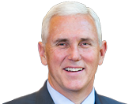
Medicaid Going Forward Market-Based Approach
Notes:
Those two options look at how federal funding will change, but there could also be changes in how states choose to (or are told to) administer Medicaid.
Colorado could be looking at a Medicaid plan similar to what Indiana has, which is very different from what you find in most states.
I’m specifically calling out Indiana’s program because:
It’s probably the most radical departure from traditional Medicaid,
Mike Pence, the Vice President-Elect, was governor of Indiana when the plan was developed and introduced, and
Seema Verma, Trump’s pick to head up the Centers for Medicare and Medicaid Services, helped craft the Indiana plan and may bring many of those ideas and philosophies to a federal Medicaid overhaul.
Indiana did expand Medicaid under the ACA, but not the way most states did. They had to apply for a special federal waiver in order to rework the program so dramatically.
Indiana replaced traditional Medicaid with a more market-based approach. Market-based approaches try to create an environment organized so that traditional supply and demand economics can take hold.
In Indiana, Medicaid enrollees are put into a high ($2,500) deductible health plan run by a managed care organization in the state. They are also given a $2,500 health savings account (HAS) – the idea is that they can use this HSA to pay for services until that deductible is met, and then the health plan kicks in.
Here’s where thing start to look really different. Enrollees must make monthly contributions to these HSAs, similar to how you would pay premiums if you have private insurance. Money in the HSA that isn’t spent in a given year can be rolled over to the next year, lowering these monthly payments.
The idea is that this gives enrollees an incentive to make decisions based on cost and value, which will lower prices and place an emphasis on personal responsibility. Many conservatives feel that having skin in the game is one of the tickets to reducing health care spending.
However, many liberals think it goes too far in making low-income beneficiaries pay and worry this might limit access to needed dare. They say that health care isn’t a traditional consumer good and doesn’t follow traditional supply-and-demand laws of economics. For example, many patients have a hard time distinguishing between medically necessary and medically unnecessary care, and are therefore not typical consumers.

Slide 40
Medicaid Going Forward Market-Based Approach
Notes:
Those are the political philosophies on either side of the issue, but you’re probably wondering about the evidence from Indiana’s program so far.
The bad news is that there’s not much data to use in an evaluation right now. Indiana’s Medicaid plan is still pretty new – it’s only a little more than halfway through a three-year demonstration period. And the state missed a deadline to provide preliminary data to the federal government for an evaluation this year.
So unfortunately, we’ll all just have to stay tuned for the results.
(At this point, the presentation goes to Ross to speak about the local impact).

Slide 41
The Bottom Line
Three Takeaways
Medicaid expansion was larger than expected, accounting for almost the entire decline in uninsurance.
The program’s future is still shaping up.
Changes will impact local communities and patients.
Notes:
We just hear a lot of information, but as a reminder, these are the three major takeaways from today.

Slide 42
Emily Johnson
johnsone@coloradohealthinstitute.org
720.382.7099
Ross Brooks
rbrooks@mountainfamilyhealth.org 970.928.1609
www.mountainfamily.org

