Slide 1
Essential
Health Benefits
Next Steps
in Colorado
February 2, 2012
2012 Health Policy Roundtables for Legislators

Slide 2
The Colorado Health Institute
CHI is a trusted and leading source of credible health information for Colorado leaders. Our data and analysis is used to:
  Inform policy
  Contribute to effective implementation
  Support state efforts to improve health
Access
Quality
Value
Prevention

Slide 3
Welcome!
2012 Health Policy Roundtables for Legislators
February 2nd: Essential Health Benefits
February 16th: Reining in Growth in Health Spending
March 1st: Cost Containment through Care Coordination
March 15th: The Boomer Challenge

Slide 4
Today’s Discussion
Essential Health Benefits: The Big Idea
What Health Reform Says About Essential Health Benefits
What This Means for Colorado

Slide 5

What’s At Stake?

Slide 6

A Profile of a Community

Slide 7

A New Clinic

Slide 8

Medical Clinic and Cafe

Slide 9
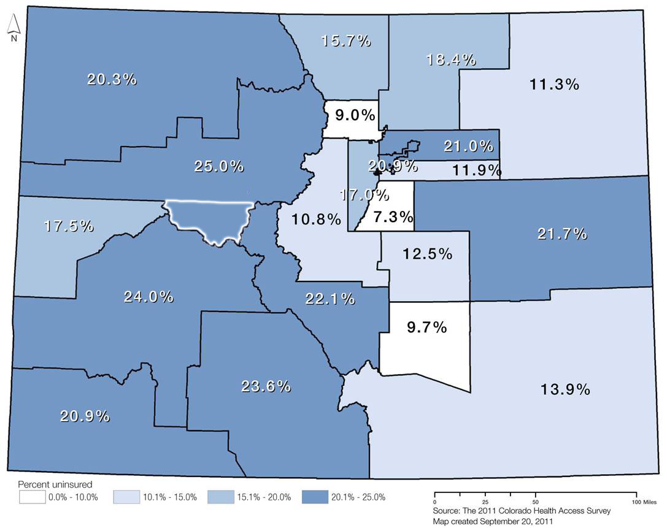
Pitkin County – One of Highest Rates of Uninsured
829,000
Coloradans
16% of population (2011)
Up from 678,000
Coloradans
  14% of population (2008-2009)
Pitkin County
Notes:
Rates of Uninsurance, Health Statistics Regions, Colorado, 2011

Slide 10
Essential Health Benefits: The Big Idea

Slide 11

Vending Machines and Health Insurance
What will the vending machine look like and how will it work?
What’s in the vending machine?
How big will the items be?

Slide 12

Vending Machines and Health Insurance
What will the vending machine look like and how will it work?
What foods will we sell in the vending machine?
How big will the items be?
Defining essential
health benefits

Slide 13
The Challenge of Defining Essential Health Benefits
“Defining the essential health benefits was always going to be one of the toughest issues policymakers would face in implementing the health reform law…
Nearly every segment of the health care industry has a stake in it.”
-- Larry Levitt, Gary Claxton, and Karen Politz
The Kaiser Family Foundation

Slide 14
Why Essential Health Benefits are Important
The framers of the essential health benefit concept were trying to address the issue of underinsurance.
In addition, they wanted to standardize benefits across plans and states.
Where people have coverage but still spend a large proportion of their income on services that are not covered.
675,000 Coloradans were underinsured in 2011.

Slide 15
What Health Reform Has To Say About Essential Health Benefits

Slide 16

What’s Really at Issue: Federal Reform
The Individual Mandate
“Severability”

Slide 17
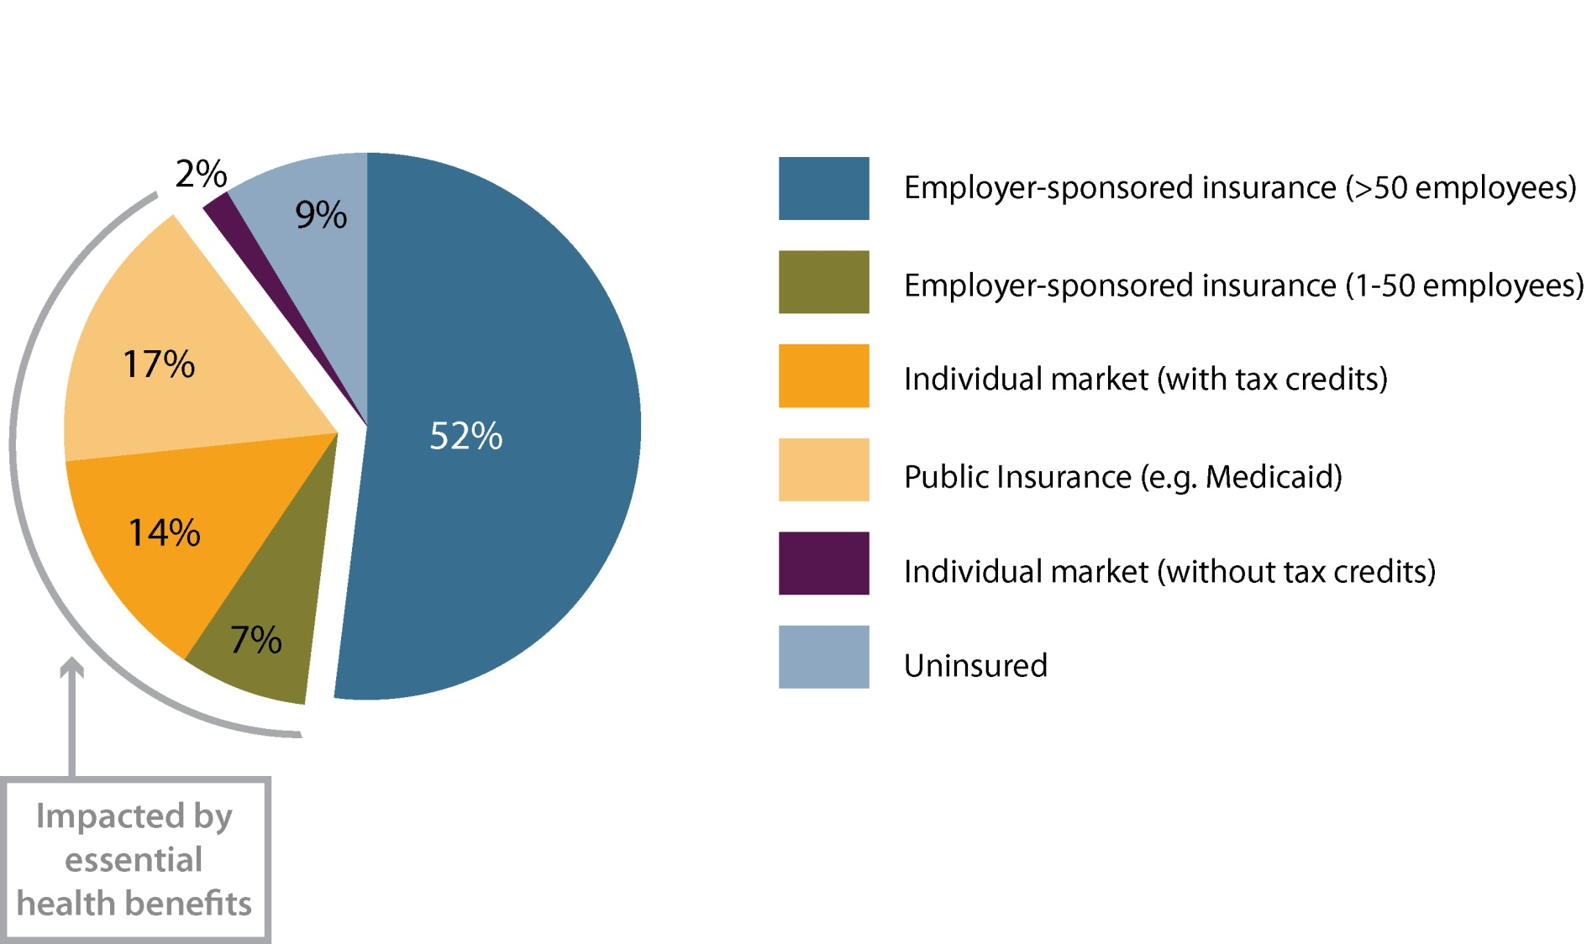
2016: Where Will the Currently Uninsured Go?
Impacted by essential health benefits
Total Coloradans newly insured by 2016: 510,000
Total Coloradans uninsured in 2016: 390,000
Source: Dr. Jonathan Gruber’s analysis for the Colorado Health Benefit Exchange

Slide 18
Who is Impacted by Essential Benefits in 2016?
Impacted |  | Not impacted
Small firm employer sponsored insurance | 340,000 | Large firm employer sponsored insurance | 2,370,000
Individual market (on and off Exchange) | 620,000 | Individual market (grand-fathered) | 70,000
TOTAL | 960,000 | TOTAL | 2,440,000
Essential health benefits will impact Medicaid for adults, but not for children.
Source: Dr. Jonathan Gruber’s analysis for the Colorado Health Benefit Exchange

Slide 19

What’s In the Law? Outlining EHB
The ACA provides main concepts, without structure or guidelines.
Laboratory services
Ambulatory patient services
Prevention, wellness,
chronic disease management
Emergency services
Pediatric services
Hospitalization
Mental health/substance abuse
Maternity care
Rehabilitative and
habilitative services
Prescription drugs

Slide 20
Which is the best value?
Plan 1
Plan 2
Plan 3
Covers 50% of Rx drugs
$30 co-pay for physician visit
$1,000 deductible
Covers 50% of Rx drugs
$30 co-pay for physician visit
$500 deductible
Covers 100% of Rx drugs
$0 co-pay for physician visit
$100 deductible
Monthly premium:
$500
Monthly premium:
$750
Monthly premium:
$1,000
Actuarial value =
70%
Actuarial value =
80%
Actuarial value =
90%

Slide 21

What’s In the Law? Four Benefit Categories
Platinum plans cover 90% of benefit costs.
Gold plans cover 80% of benefit costs.
All provide EHB and have out-of-pocket limits equal to HSA law
Silver plans cover 70% of benefit costs.
Bronze plans and cover 60% of benefit costs.

Slide 22

The Approach HHS Took to Define EHB
HHS commissions Institute of Medicine report – October 2011
  Should reflect plans in small
  employer market
  National premium target
  Encouraged flexibility across states
  Recommended public input
HHS holds stakeholder sessions to gather input

Slide 23
IOM Report: Policy Foundations
Economics
Ethics
Population Health
Evidence-based practice

Slide 24
What We Got: A Bulletin Leaving It Up To Colorado
States can choose from 4 benchmark plans:
  One of the three largest small group plans *
  One of the three largest state employee health plans
  One of the three largest federal employee health plan options
  The largest HMO plan offered in the commercial market
* Option recommended by HHS

Slide 25
What This Means for Colorado

Slide 26


The Big Balancing Act
Comprehensiveness of services
Cost

Slide 27
Phase 1:
Selecting A State Essential Health Benefit Plan
Essential Health Benefit Required Categories
State Benchmark Plan
Ambulatory Services
Ambulatory Services
Ambulatory Services
Emergency Services
Emergency Services
Hospitalization
Hospitalization
Maternity and Newborn Care
Maternity and Newborn Care
Mental Health and Substance Abuse
Mental Health and Substance Abuse
Prescription Drugs
Prescription Drugs
Rehabilitation and Habilitative Services
Rehabilitation and Habilitative Services
Laboratory Services
Laboratory Services
Pediatric Oral and Vision
Preventive and Wellness Services
Preventive and Wellness Services
Pediatric Services
Pediatric Services Including Oral and Vision

Slide 28
Many State Mandates Fit Within 10 Categories
Essential Health Benefit Categories
Ambulatory Services
Newborn Coverage
48 hour hospitalization after birth
96 hour hospitalization after C-section
Cleft palate
Medical food for inherited disorders
Autism Spectrum Disorders
Congenital Anomalies and Defects
Complications of pregnancy and childbirth
Maternity Care
Hospice and home health coverage
Alcoholism treatment
Prostate cancer screening
Diabetes care and equipment
Mental health parity
Emergency Services
Hospitalization
Which categories do these fit in?
Maternity and Newborn Care
Mental Health and Substance Abuse
Prescription Drugs
Rehabilitation and Habilitative Services
Laboratory Services
Preventive and Wellness Services
Pediatric services Including Oral and Vision
DOI: there are 34 state mandates on health insurance benefits as of 1/1/2012

Slide 29
Phase 2:
Decisions About Specific Services and Cost sharing
Ambulatory Services
Emergency Services
Limits to hospital days?
Hospitalization
Maternity and Newborn Care
Limits on number of therapy visits?
Mental Health and Substance Abuse
Behavioral health treatment?
Prescription Drugs
Rehabilitation and Habilitative Services
In-patient rehabilitative services?
Laboratory Services
Limits on types and number of oral health visits?
Preventive and Wellness Services
Women’s health services?
Pediatric services Including Oral and
Vision Care
HHS will be releasing additional guidance on cost sharing.

Slide 30
Where is there variation across markets?
Pediatric dental and vision care
Bariatric issues
Hearing aids
In Vitro fertilization
Autism: Applied behavior analysis therapy
Habilitative services
Behavioral health and substance abuse
Key issues in Colorado

Slide 31
Questions at Hand
Scope of benefits within each category?
Controlling costs by limiting visits?
Separate benchmarks for individual and small group?
State mandates re-evaluated in 2016?

Slide 32
The Road Ahead: 2012
COHBE & DOI submit comments to HHS
(January 31)
Jan
March
May
Sept
Feb
April
June
July
Aug
Oct
Nov
Dec
Final decision due to insurance plans
(Quarter 3)
Stakeholder meetings held by COHBE & DOI

Slide 33
The Road Ahead: 2013 and Beyond
2016
Colorado may be required to cover cost of difference between state & federal mandates
2016 & later
2013
2014
2015
2014 - 2015
Federal government covers difference between Colorado mandates and federal mandates

Slide 34
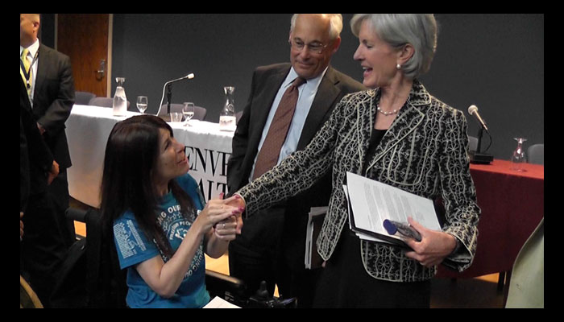
How We’re Going to Have This Discussion
DOI and COHBE will host forums to inform and receive public comments
DOI & COHBE not pushing legislation in 2012
Important issue for constituents
and stakeholders
across Colorado
HHS Secretary Kathleen Sebelius at a stakeholder meeting in Denver in November 2011.
Source: Health Policy Solutions

Slide 35
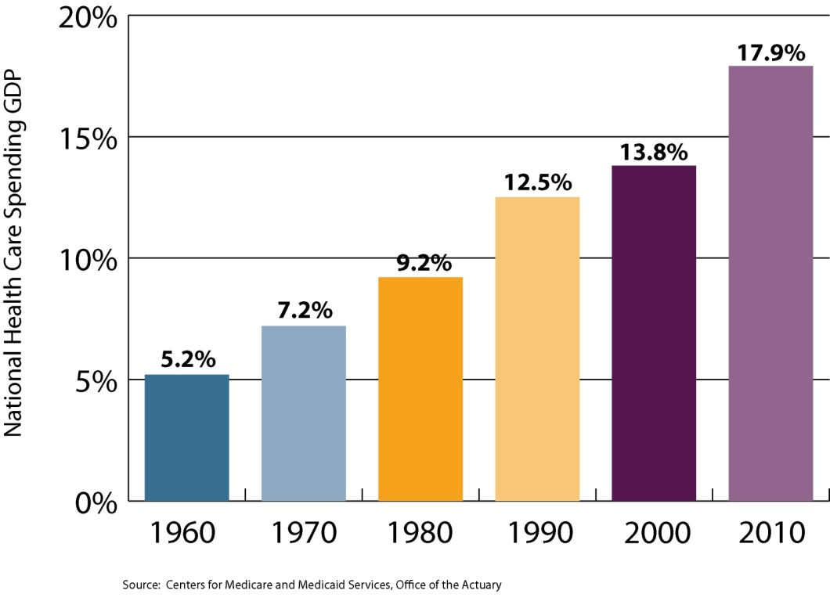
Next Event: February 16th
Reining in Growth in Health Spending
What are the drivers of health care cost growth in Colorado?
What can be done to address cost drivers?
What’s happening in Colorado?
National Health Care Spending as % of GDP

Slide 36
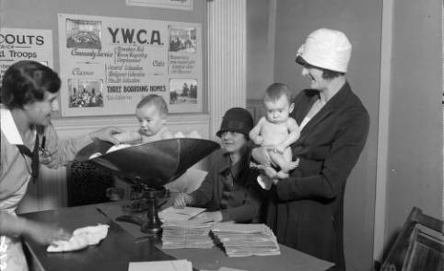
Source: The Henry M. Rhoads Photograph Collection, Denver Public Library Digital Collections
Michele Lueck 720.382.7073 lueckm@coloradohealthinstitute.org

