Slide 1
Climate-Smart Denver Harnessing Art & Culture for Data Driven Climate Solutions
Denver Regional Health Equity and Climate Summit
November 1, 2018
Notes:
I was asked to speak to you all today about how data can be used to tell a story. But we all know that data isn’t the greatest story teller. A story is only as good as the person telling the story after all, and data is not a great story teller. It can be one dimensional, flat, and maybe a bit boring. Apologies to those of you who love data! I love data too, but I have to be honest with you…I love people and their stories more. So how can we elevate data like this while also elevating the individual voices that can help us unlock what it means? That’s what I hope we can talk about today.

Slide 2
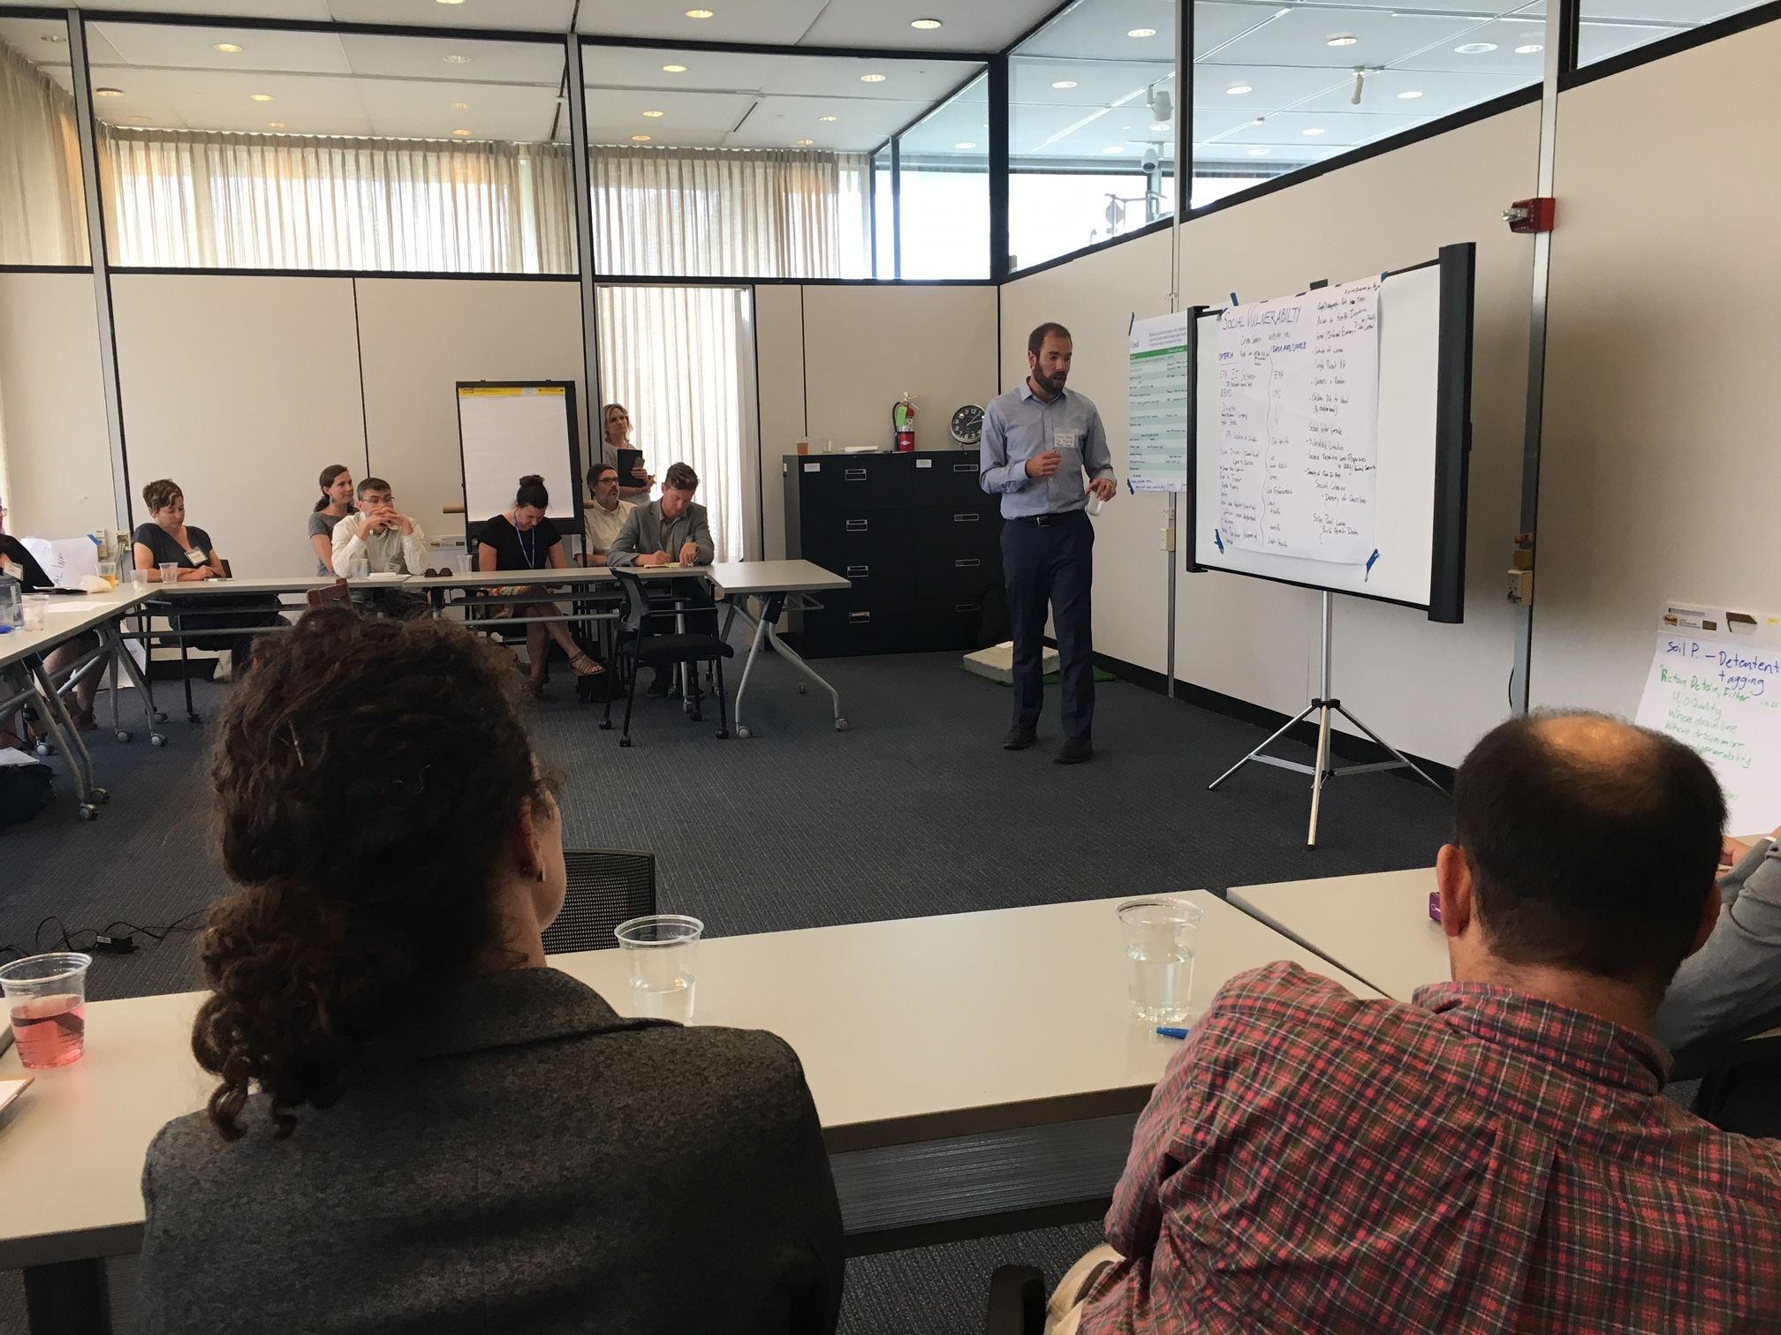
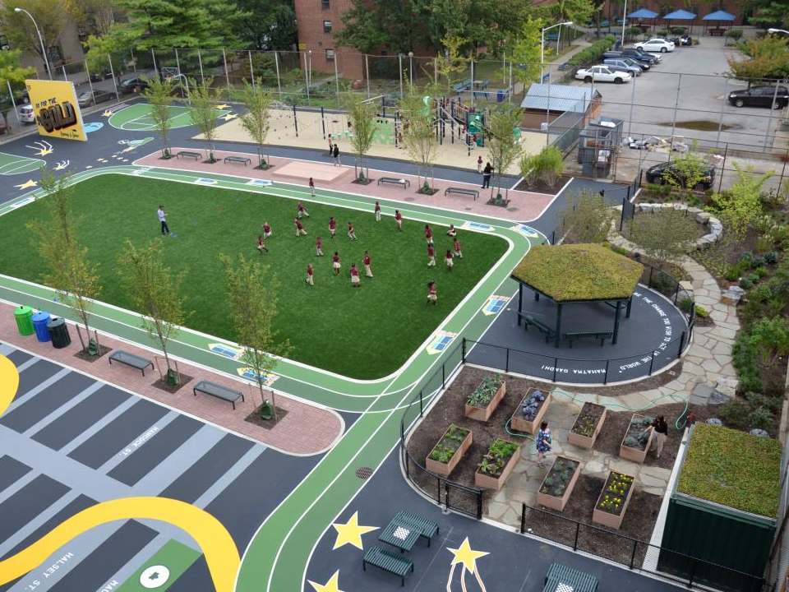
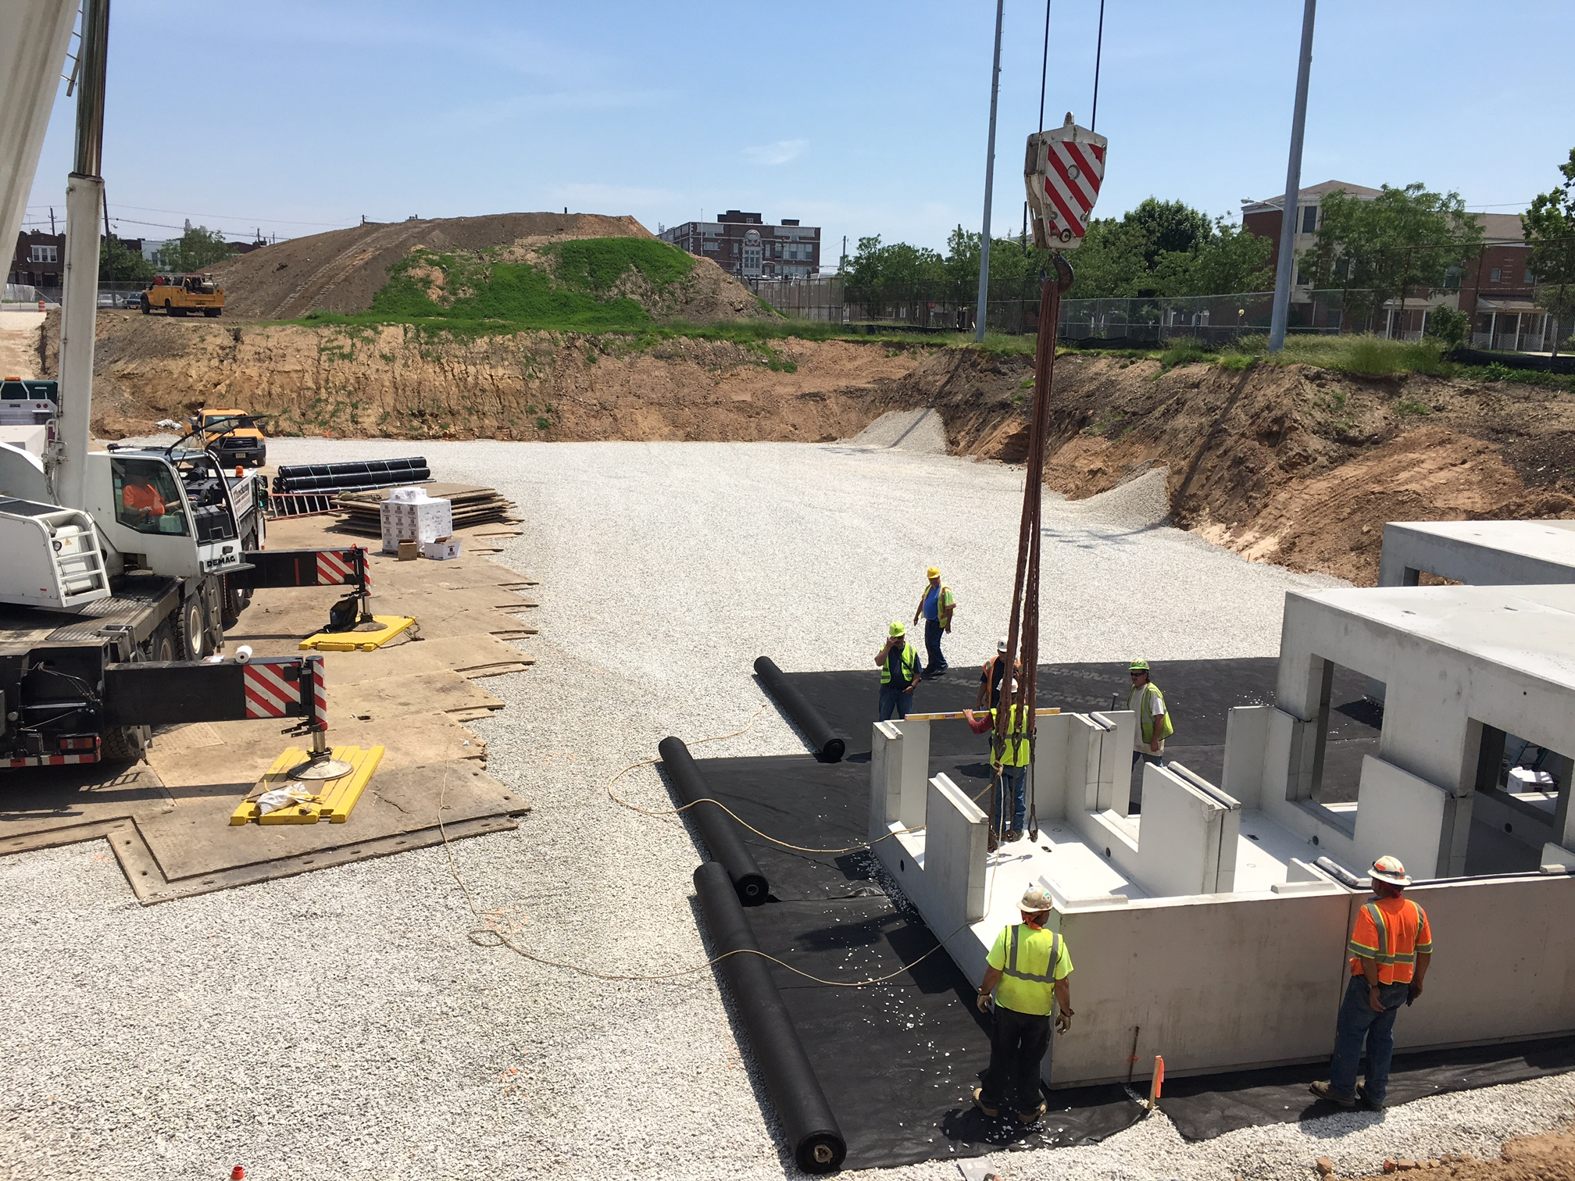
Climate Smart Denver Framework
Coalition Building
Policy and Decision Making
Implementation
Notes:
The Trust for Public Land has been worked with the City and County of Denver and a dozen other partners to create a GIS decision support tool that will provide us with guidance on how and where to take strategic action on climate change through green infrastructure. Through our process with partners, many of whom are in the room, the tool was built around five goals: health equity, cooling the city (tree canopy), absorb and protect (GI for water quality), connect through (alternative transporttation), and climate equity (focusing on the people with the greatest need).

Slide 3
How do we tell this story?
Notes:
So, when I was asked to tell you about how this data tells us a story I asked if I could talk to you instead about how we have struggled to make this data live and breath. How we are still trying to take this type of dense complex and powerful data and make it into something that the communities where we work can relate to and understand. I do not mean to say that regular non-data people (and I include myself in this bucket) cannot understand data like this and understand what it is telling us. To the contrary, the people who live in the neighborhoods most impacted by the realities of climate change live it every day and feel it in powerful and very personal ways. I think the problem I have faced, and what I hope to get some thoughts from you today on, is how we can translate this type of data into visible and evocative solutions that address climate challenges in the communities that are impacted the most. So one thing a map like this might tell us, is where to look for the best stories.

Slide 4
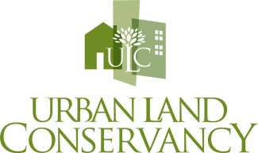
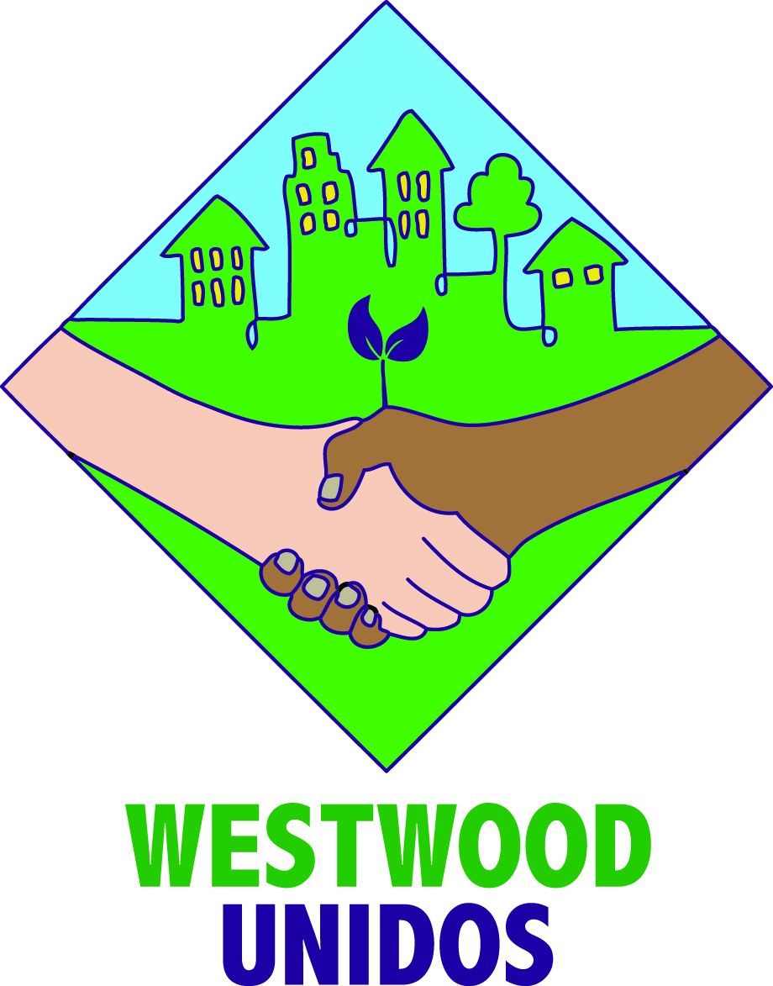
Cool Connected Westwood
Notes:
Cool Connected Westwood (CCW) is a coalition of partners dedicated to working collaboratively with Westwood residents to realize community-prioritized changes to the places where people live, work, and play in Westwood. Partners have been meeting since 2015 to identify shared goals and better align organizational priorities to more strategically deliver on the community’s vision for a healthier, safer, and more connected Westwood.

Slide 5
Westwood Via Verde
Notes:
Westwood is located in Southwest Denver. This neighborhood faces many economic and environmental challenges, including one of the city’s highest poverty rates, high population of kids under 19, historically limited access to parks and tree canopy cover, and it resides in two priority basins for water quality, meaning the water quality in Westwood is not good. This is one of the neighborhoods on the front lines of climate change.
The Westwood Via Verde is a neighborhood greenway that will connect vital community resources such as parks, clinics, schools, and other services through a connected system of bike lanes, sidewalks, and park pathways in the Westwood neighborhood of Denver. The three mile loop will incorporate green infrastructure best practices to enhance water quality, decrease the urban heat island, encourage walking and biking, beautify the neighborhood, celebrate Westwood’s unique culture, and improve the health and safety of Westwood residents by making it easier and more enjoyable to spend time outside.

Slide 6
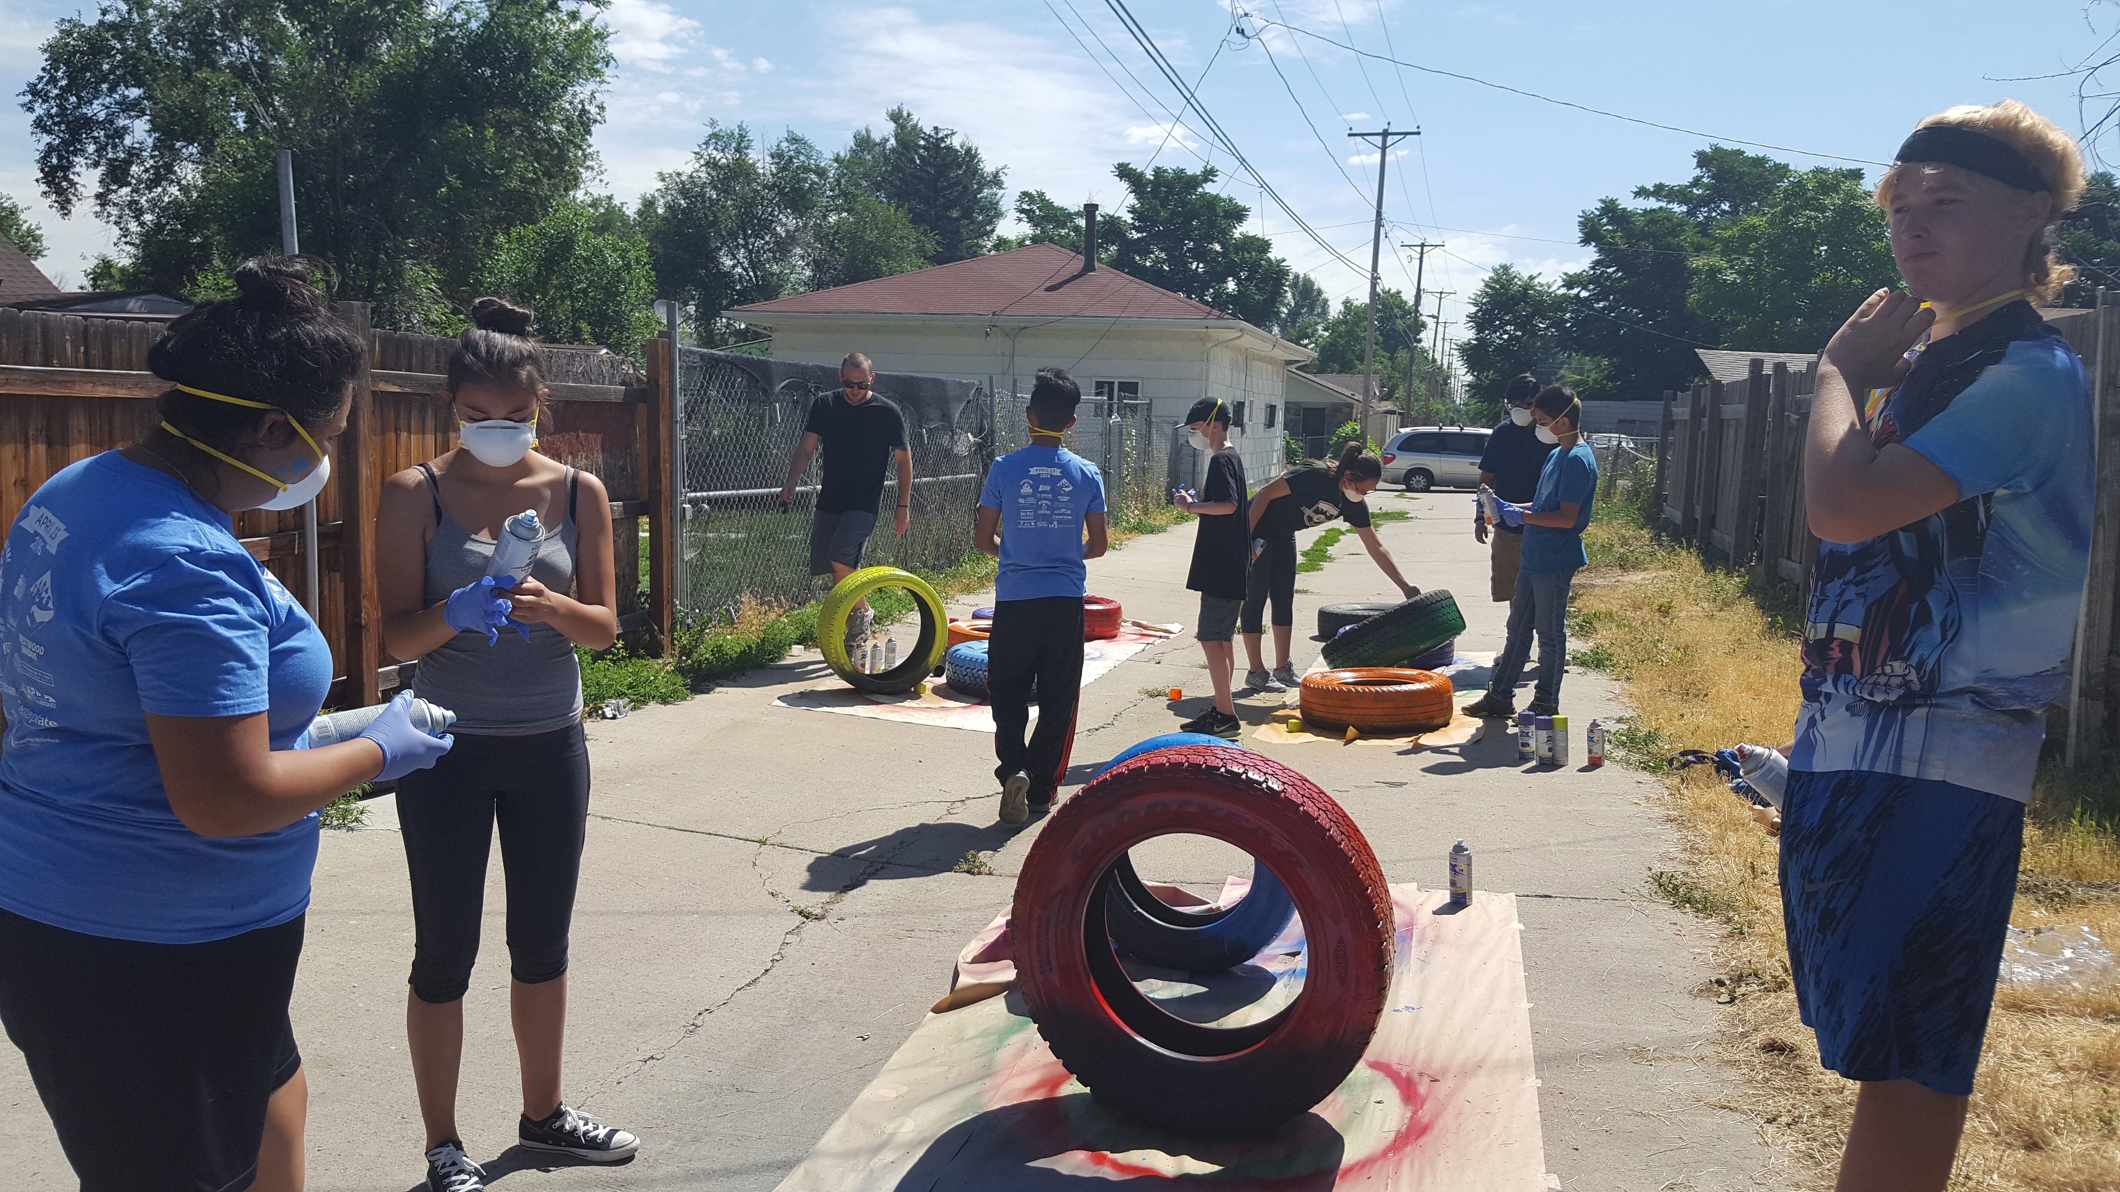
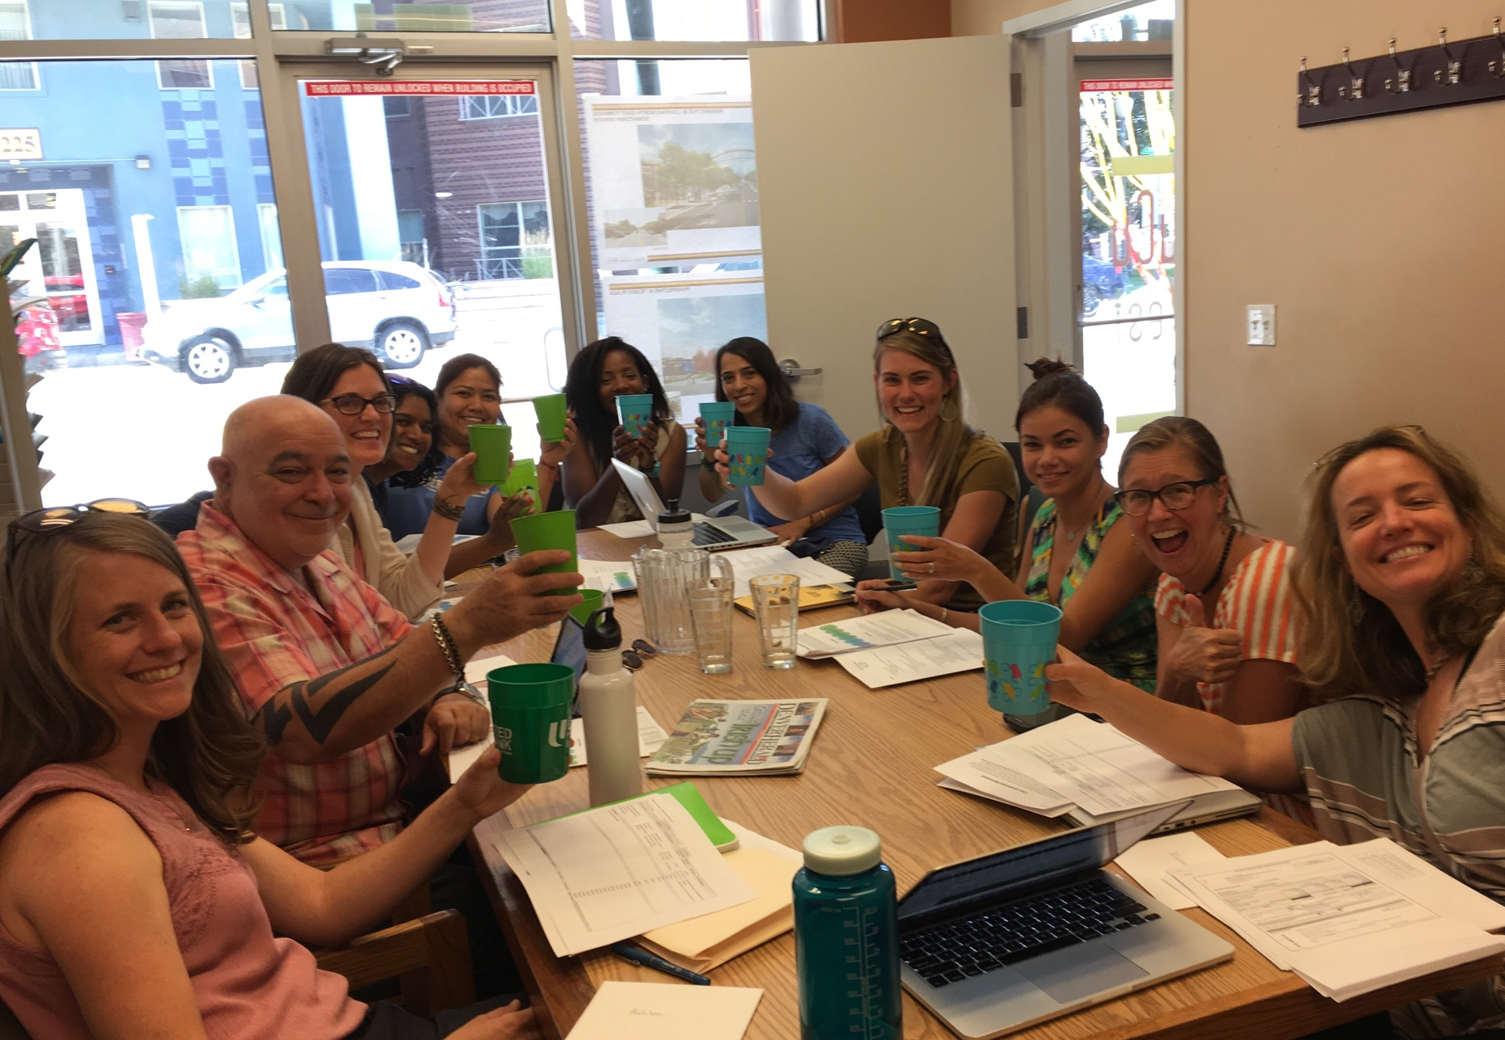
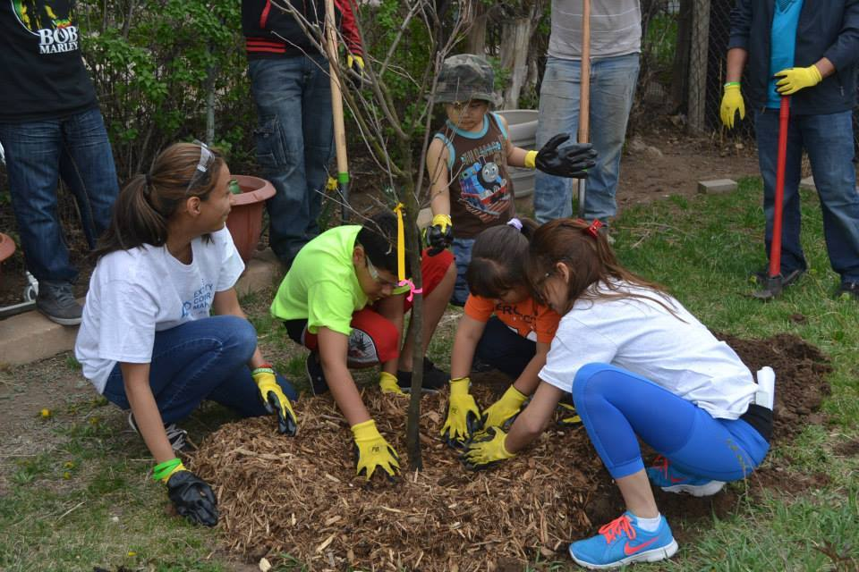
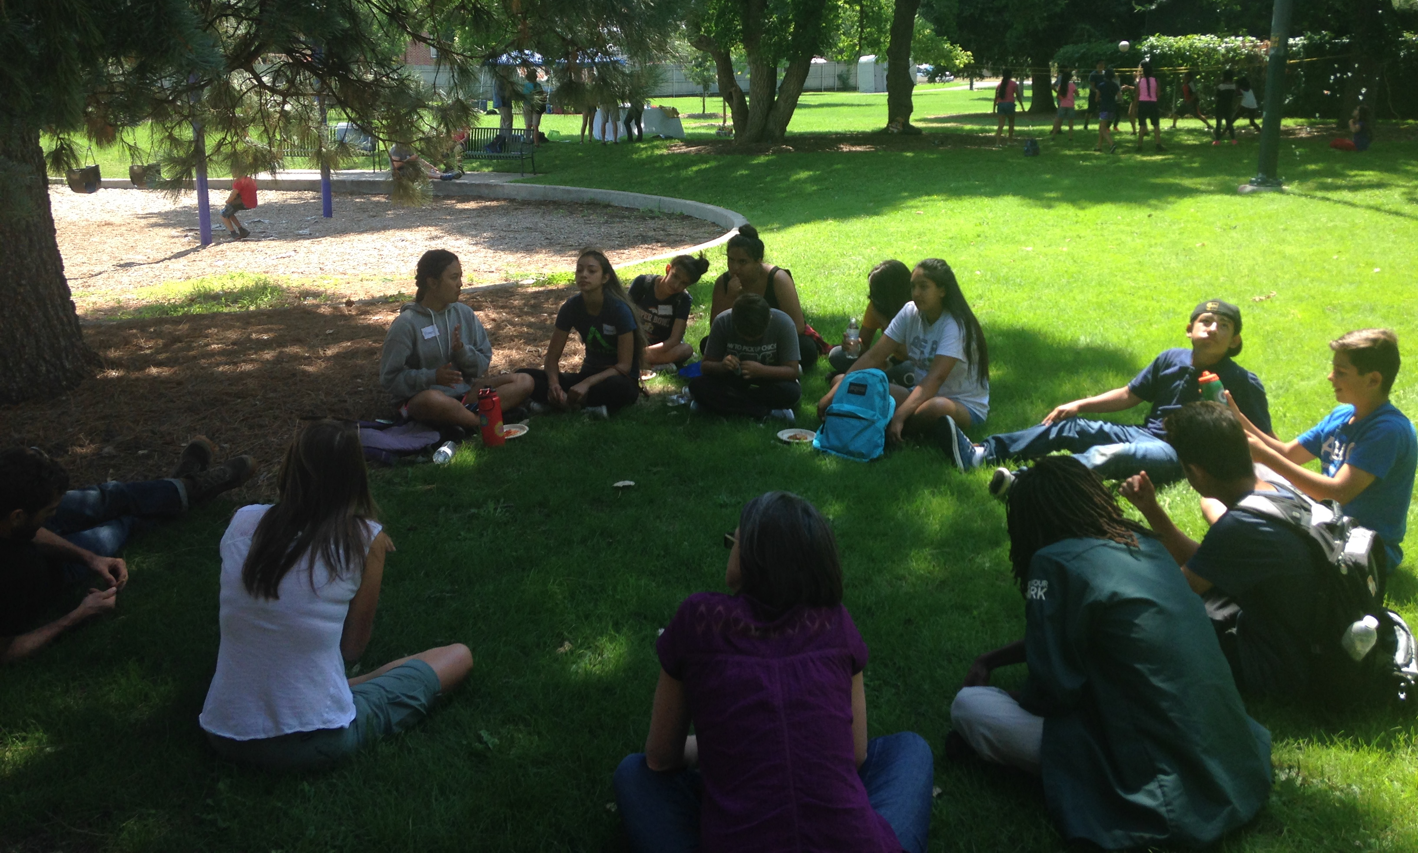
Notes:
If we want to tell a story we need to know the audience we are trying to connect to.

Slide 7
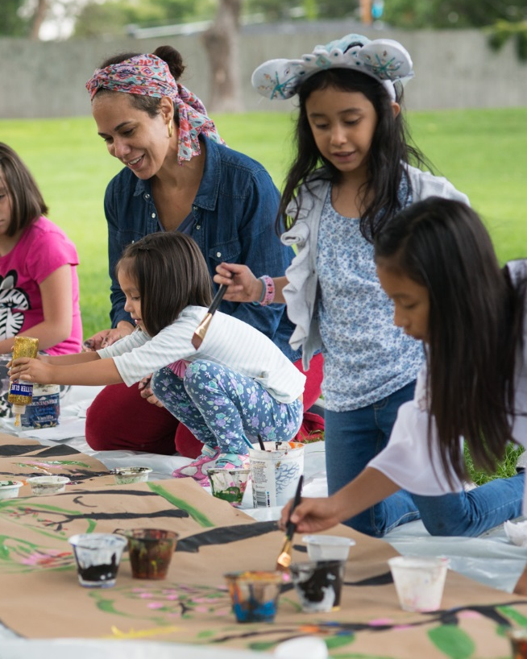
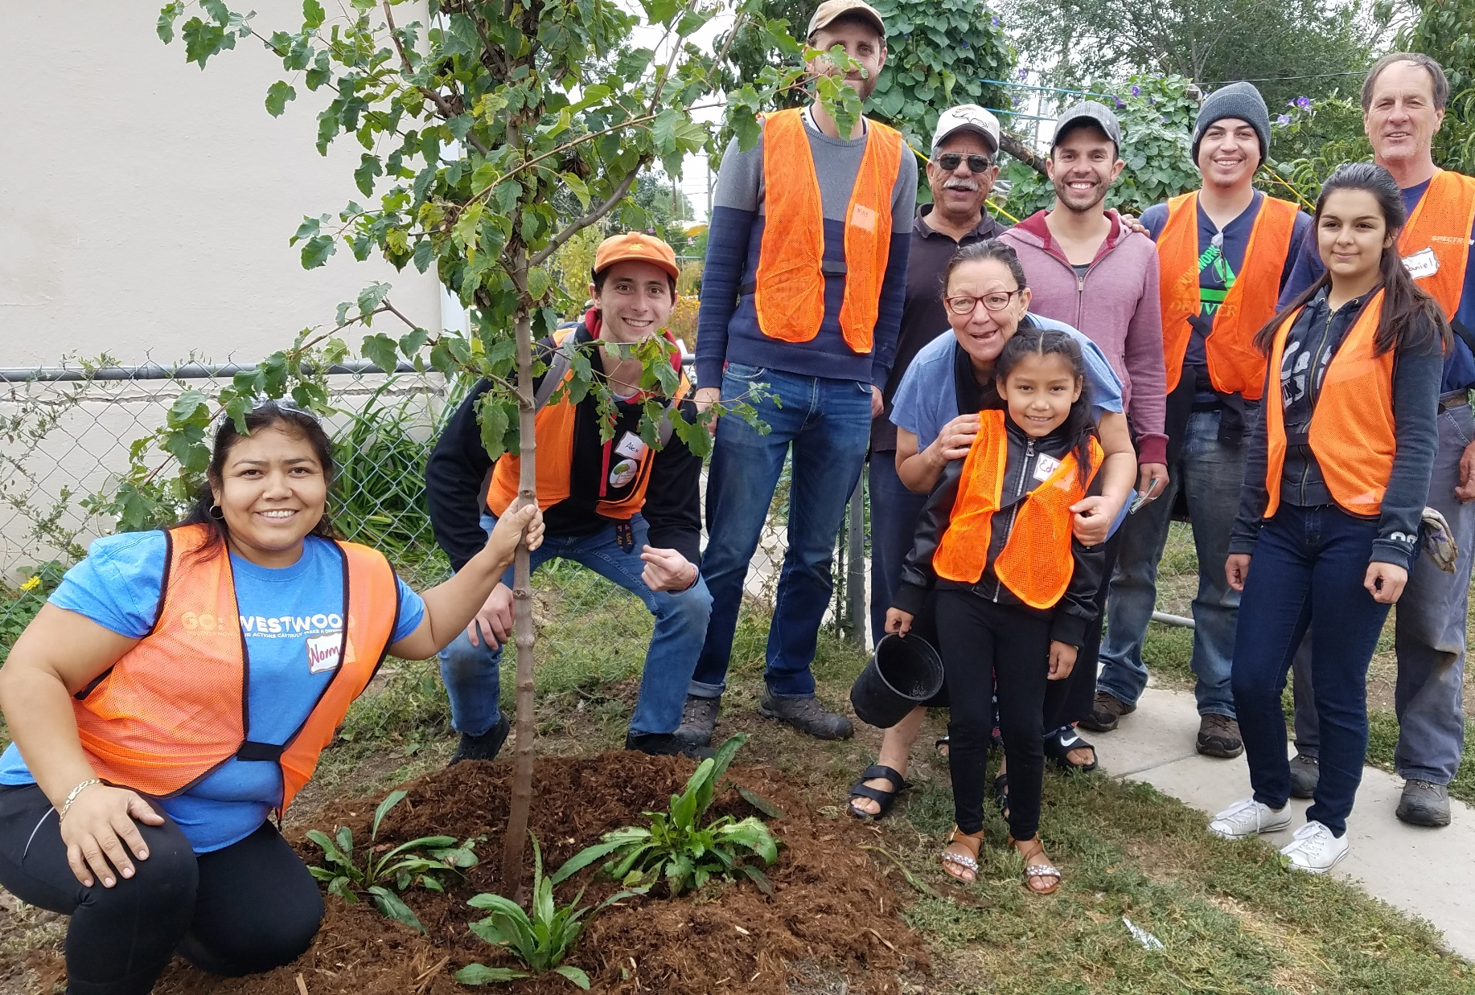
Block Parties with artists to promote Via Verde and tree planting in Westwood
Notes:
We worked with our community partners at Westwood Unidos to host three block parties across the neighborhood. A local artist was engaged to work with the kids and inspire them to create art about the importance of trees in Westwood. These parties helped us spread the word throughout the community about climate justice issues in Westwood. We leveraged community impact fund dollars which funded these events to help us amplify the JPB tree planting project which resulted in the planting of 245 trees in Westwood. We also partnered with Walk to Connect to lead community walks of the Via Verde and get input on where the community felt safety issues were a problem and to identify locations for shade trees and community art.

Slide 8
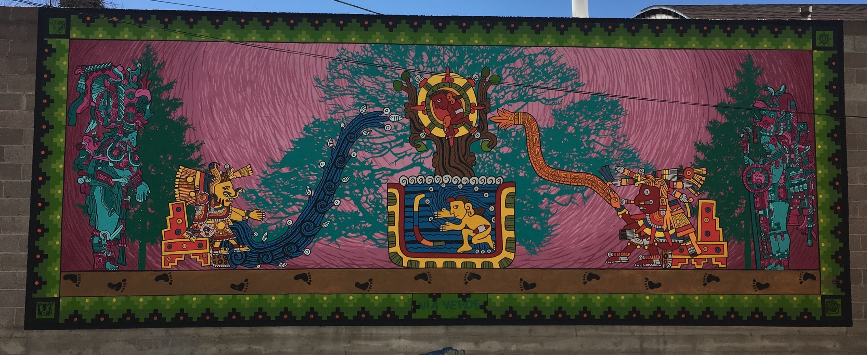
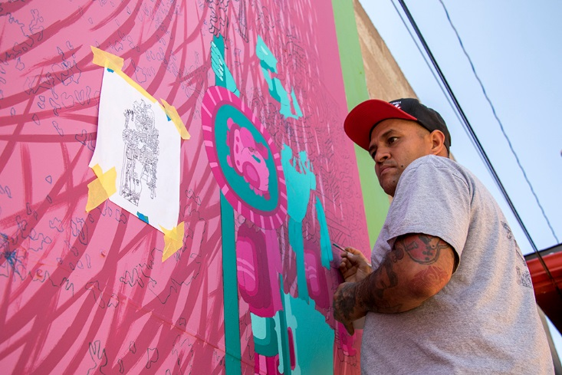
Via Verde Mural Project
Notes:
Artist Santiago Jaramillo created a mural along the Via Verde route to draw attention to climate justice issues and the Via Verde project. Santiago is a third generation Westwood resident and self-taught artist. His art is inspired by his culture, neighborhood, life experience and expression of self. He has been painting for over thirty years and teaches both painting and traditional Mexican/Aztec dance to the next generation of artists in Westwood and Denver. The mural, entitled The Via Verde: The Sacred Path to Change and Protection. This Aztec and Mayan-inspired mural is symbolic of community, culture, Earth, and life. Xiutecutli, the Aztec symbol of fire on the right, meets Chalchihuitlicue, the Aztec goddess of birth and freshwater on the left. Where their symbols come together, we find the tree of life, the ancient sea, the sun, and a child—altogether representing struggle and the cycle of creation. Along both sides of the mural, Mayan warriors drop seeds into the ground, showing the importance of caring for the Earth and the vision for a resilient food system in the community. Footprints represent the Via Verde, an envisioned neighborhood greenway through Westwood, as well as the community retracing its footsteps back to its ancestral roots.

Slide 9
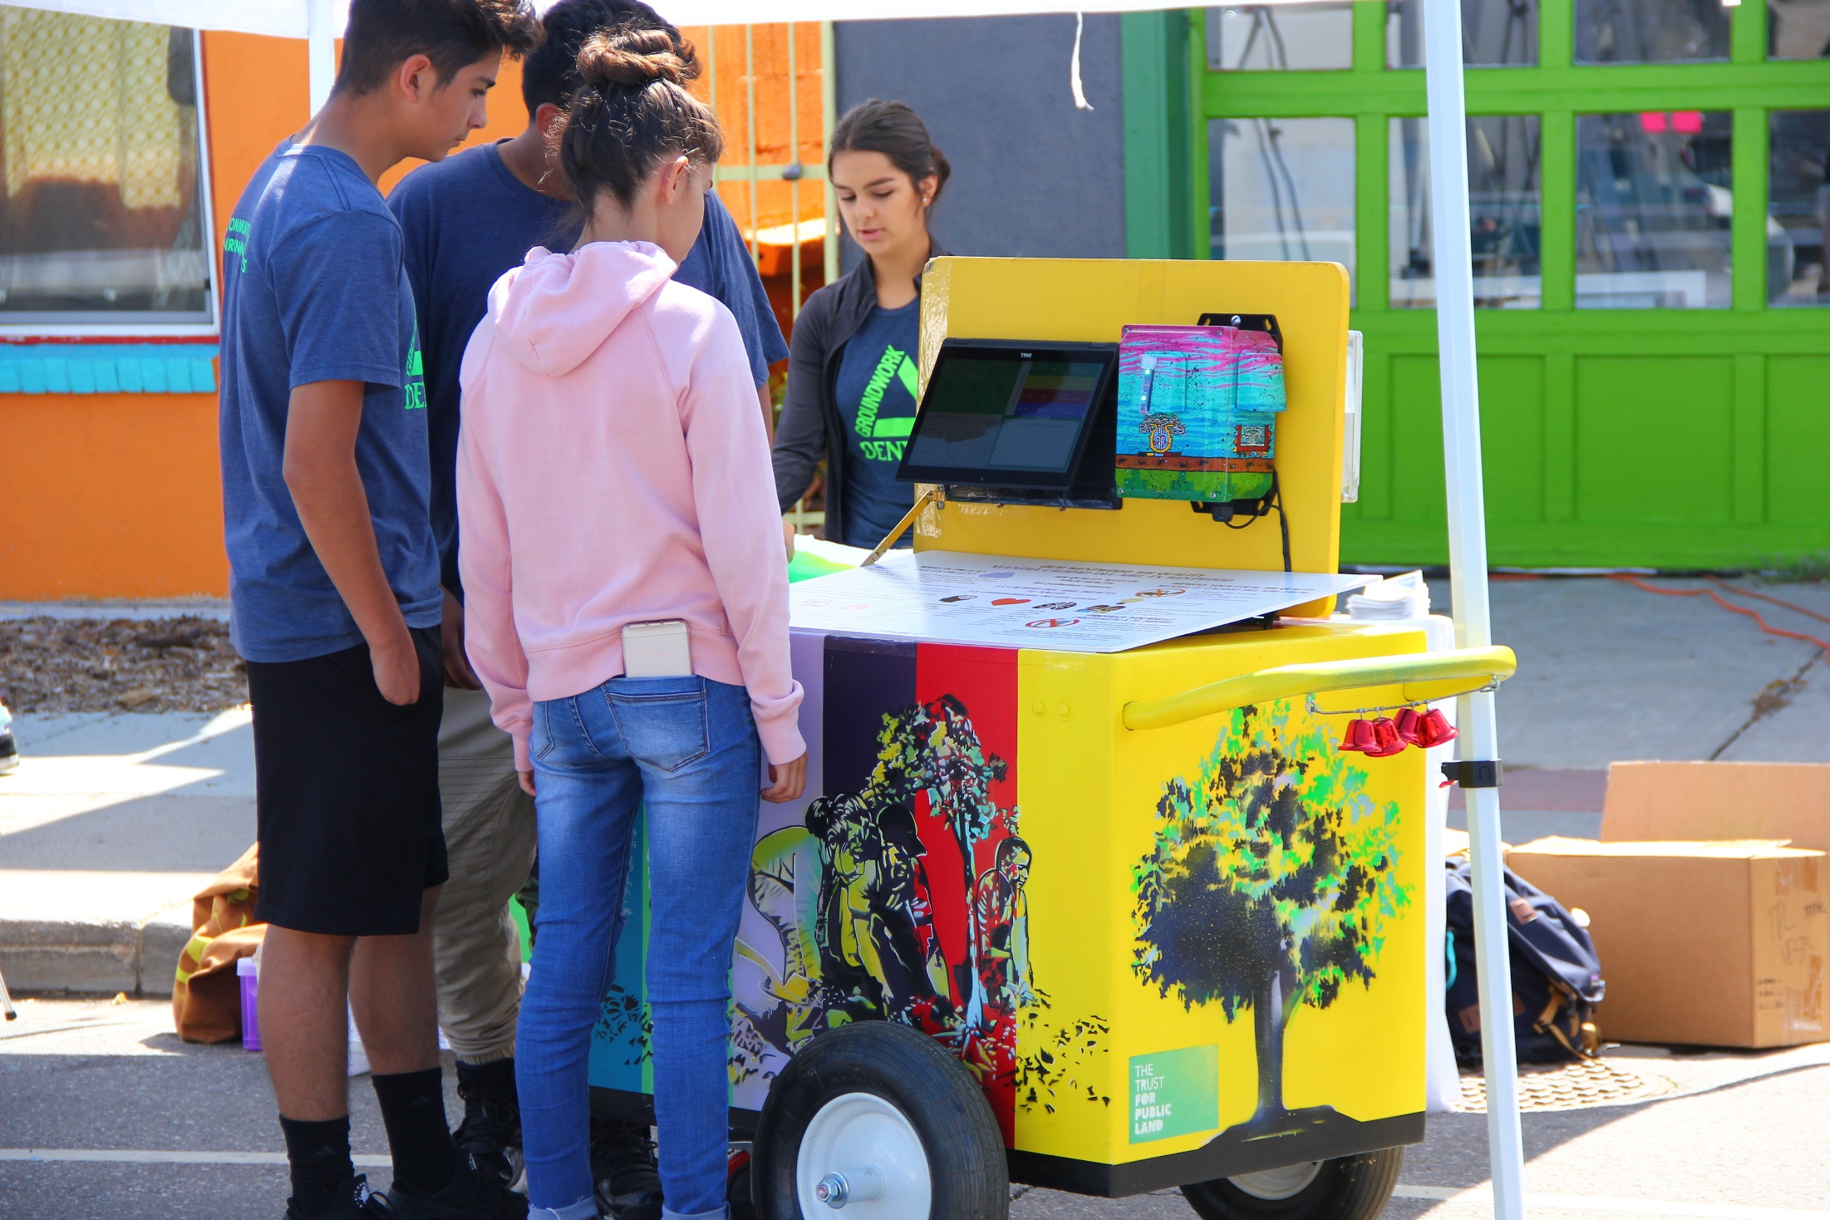
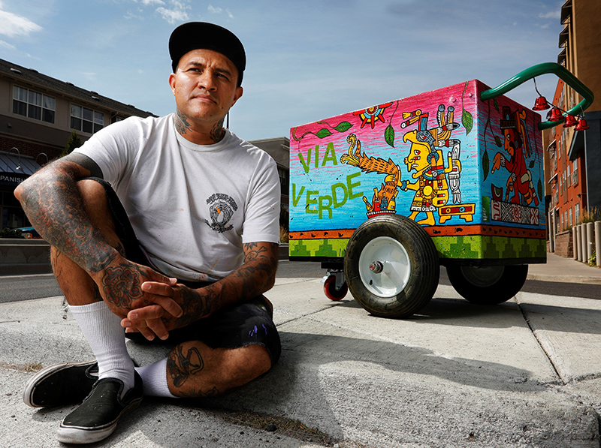
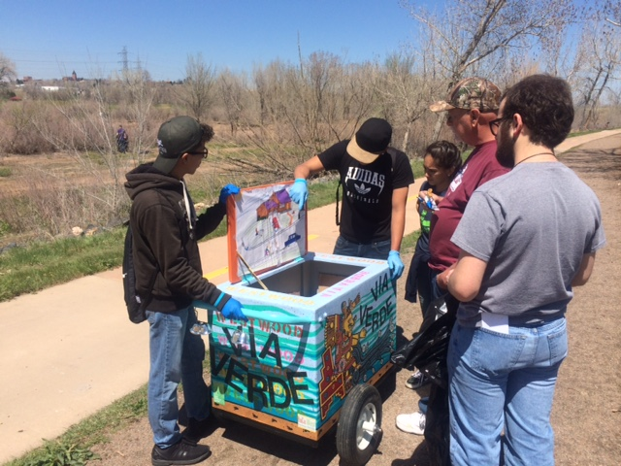
Climate Action Paleta Carts
Notes:
We worked with three local artist to create five climate action paleta carts. The carts each have a unique theme such as water quality, trees/air quality, culture, community, and food. Our partners at Groundwork Denver and Westwood Unidos used the carts to assist with outreach and engagement in the community around these issues. This year we partnered with the City’s Department of Public Health and Environment to install an air quality monitor in one of the carts. The cart is a prototype that the City hopes to deploy across Denver if they are successful with a Bloomberg Mayors challenge grant they have submitted.

Slide 10
http://www.youtube.com/watch?v=6A3oMMpaUrM
Colorado Trust Video:
Notes:
This video was produced by Colorado Trust about the City’s of Denver’s Denver Heat Vulnerability Map, published earlier this year by the city’s Department of Environmental Health (DEH). The video does a great job of showcasing the on the ground story telling of artists like Santiago Jarmillo, I would like to share the last few minutes with you if I can!

Slide 11
Some Questions for the data experts in the room….
How can we use art projects like the ones I have described in Westwood help drive policy?
How can your organization partner with local artists to engage the community around climate justice issues?
Where do these types of community driven projects overlap with other needed outreach in the area of access to health care or programs than connect people to needed resources to help address climate related illness or realted health risks?
Ask yourself, who do you need to listen to and who should be at the table for this discussion?
Notes:
Unfortunately, I do not know the answer to the question of how we can use data to tell a story. That is why I shared these examples of using data to help us identify the populations we need to be listening to so that they can tell their own stories and help us put this work into a local context.

