Slide 1
Delivering Health Care – and Savings?
Cost Containment Through Accountable Care
March 1, 2012
2012 Health Policy Roundtables

Slide 2
Welcome!
2012 Health Policy Roundtables for Legislators
February 2: Essential Health Benefits
February 16: Reining in Growth in Health Spending
March 1: Cost Containment through Accountable Care
March 15: The Boomer Challenge

Slide 3
Today's Discussion
The driving cost of fragmented health care
Two new models of health care in Colorado:
Medicare Pioneer ACO
Medicaid ACC

Slide 4
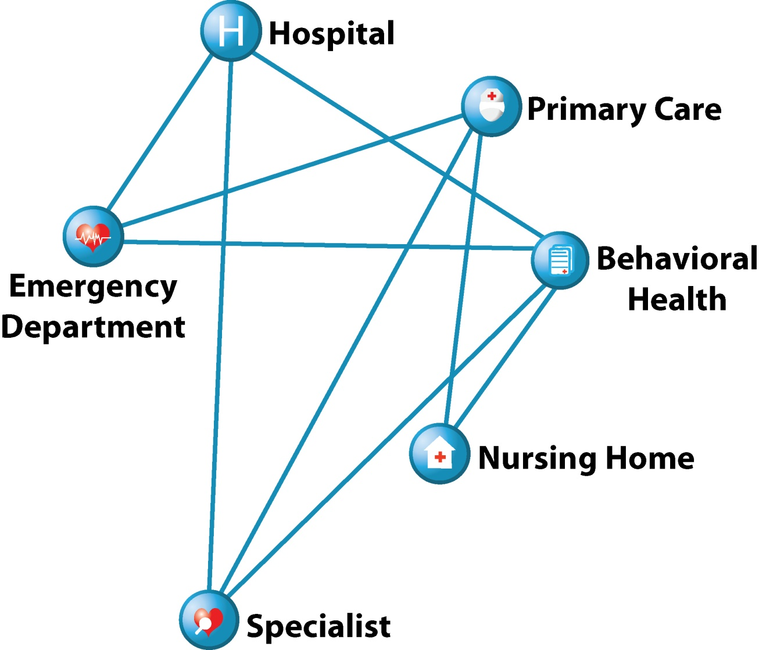
The Current Delivery System is Fragmented
Primary care providers may be unaware their patient has been to the hospital.
Patients may be subjected to unnecessary, repetitive tests.
A Dartmouth Institute study suggests 30 percent of care is unnecessary.¹
¹ The Dartmouth Institute, “Reflections on Geographic Variations in U.S. Health Care”, 2010.

Slide 5
What is Accountable Care?

Slide 6
Principles of Accountable Care
Provider leadership
Emphasis on primary care
Active and proactive care coordination
Electronic Health Records for care coordination and disease management
Community-based collaboration
Payment reform
{
Patient Centered Medical Home

Slide 7
How Accountable Care Works

Slide 8
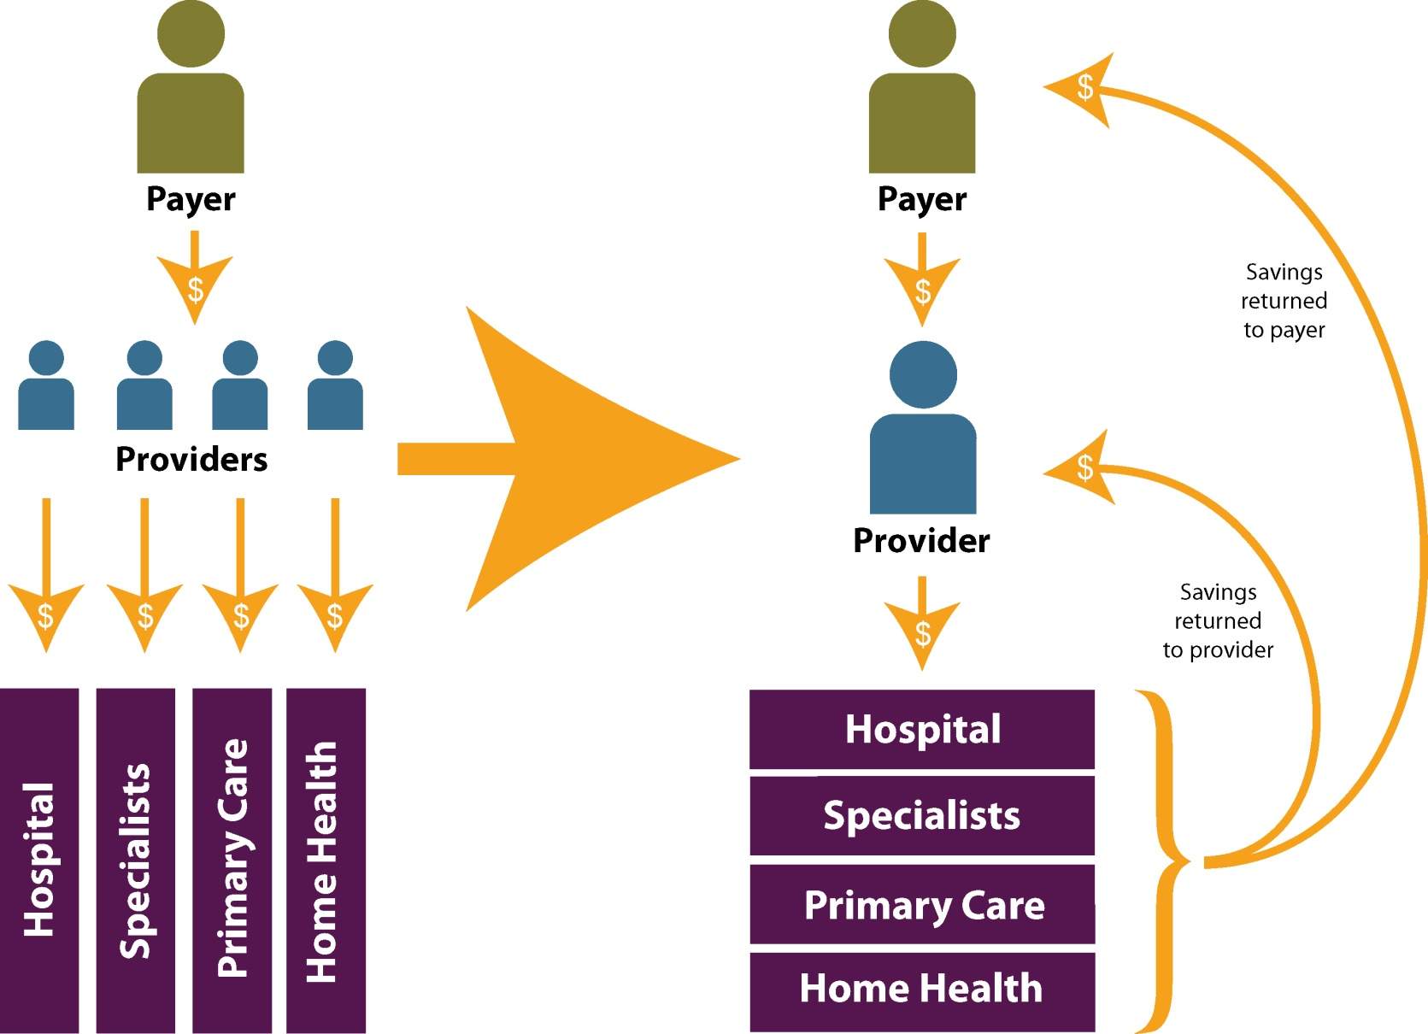
Payment Reform Under Accountable Care

Slide 9
Accountable Care in Colorado Medicare Pioneer ACO Medicaid ACC

Slide 10
Why a State Legislator Should Care About Medicare
Medicare covers almost 10% of Colorado’s population
Opportunities to improve care and reduce costs
Can we learn, apply and scale the results to other payers?

Slide 11
Medicare Pioneer Accountable Care Organization (ACO)
Physician Health Partners (Denver)
Provides care coordination and business process improvement services for physician practices
Established in 1996, a collaborative of 260 providers, serves 450,000 patients in metro area
One of 32 Medicare Pioneer ACOs in the U.S.
Will serve up to 28,000 Medicare patients

Slide 12
Medicare ACO Implementation
Year 1
Year 2
Year 3
2012
ACO shares 60% of savings or loss above benchmark
2013
ACO shares 70% of savings or loss above benchmark
2014
Eligible to move to a population-based payment
Must report (not meet) 33 quality measures
Payment tied to meeting 25 of 33 quality measures
Must engage ACO with non-Medicare payers

Slide 13
The Accountable Care Collaborative

Slide 14
Colorado’s Accountable Care Collaborative (ACC)
A Colorado-grown Medicaid cost containment strategy
One of a handful of states at the forefront
Began development in 2009, implemented in spring of 2011
ACC aligns with principles of accountable care
Seven regional ACOs

Slide 15
The ACC’s Seven RCCOs

Slide 16
Three Pillars of ACC

Slide 17
How Enrollees May Benefit
A pregnant woman with mental health needs visited the emergency room 28 times over 6 months.

Slide 18
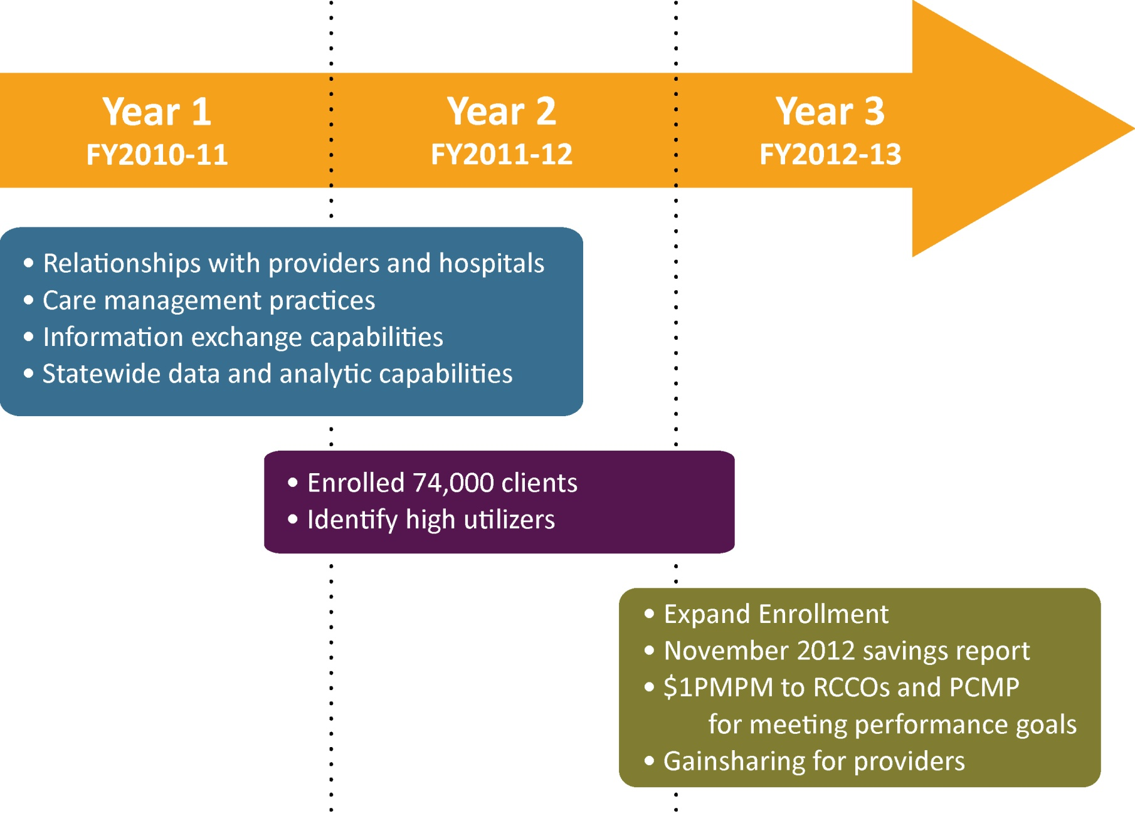
Medicaid ACC Implementation

Slide 19
Variation and Common Threads Across Regions
Led by “culture change”
RCCOs function as independent ACOs
The importance of relationships
Leveraging existing knowledge and expertise
Genesis of the RCCO
Community-driven approaches to care coordination

Slide 20
SDAC: The Potential of Data
Provides layers of insight into cost drivers across organizational levels:
RCCO performance within region on emergency department use, hospital re-admissions and imaging
Practice/clinic comparisons using risk-adjusted data
Clinician data facilitates clinical practice improvement
Patient data identifies high-risk patients

Slide 21
Moving Forward

Slide 22
Continued Payment Reform

Slide 23
Accountable Care: Challenges and Opportunities
“Culture change”
Initial investment
Attribution process
Based on preserving choice of provider
Not breaking any existing relationship with a PCP
Real-time health information

Slide 24
Salud Family Health Centers, Commerce City
Jeff Bontrager 720.382.7075 bontragerj@coloradohealthinstitute.org

