Slide 1
Delivering Health Care – and Savings?
Cost Containment Through Accountable Care
March 1, 2012
2012 Health Policy Roundtables

Slide 2
Welcome!
2012 Health Policy Roundtables for Legislators
February 2: Essential Health Benefits
February 16: Reining in Growth in Health Spending
March 1: Cost Containment through Accountable Care
March 15: The Boomer Challenge

Slide 3
Today's Discussion
The driving cost of fragmented health care
Two new models of health care in Colorado:
Medicare Pioneer ACO
Medicaid ACC
Notes:
Medicare is the federal program that provides coverage for adults over 65+ and PWD
Medicaid is the state/federal partnership that covers low-income individuals; currently it covers children and their parents, as well as PWD and low-income seniors
Also be talking a lot about providers – meaning the doctors, nurses, nurse practitioners, specialists – and their respective organizations
Cut to the punchline
There are these two initiatives – share similar names, similar concepts and it could be confusing
Medicare Pioneer ACO – federal pilot program that has a CO connection
Medicaid ACC – State-defined program

Slide 4
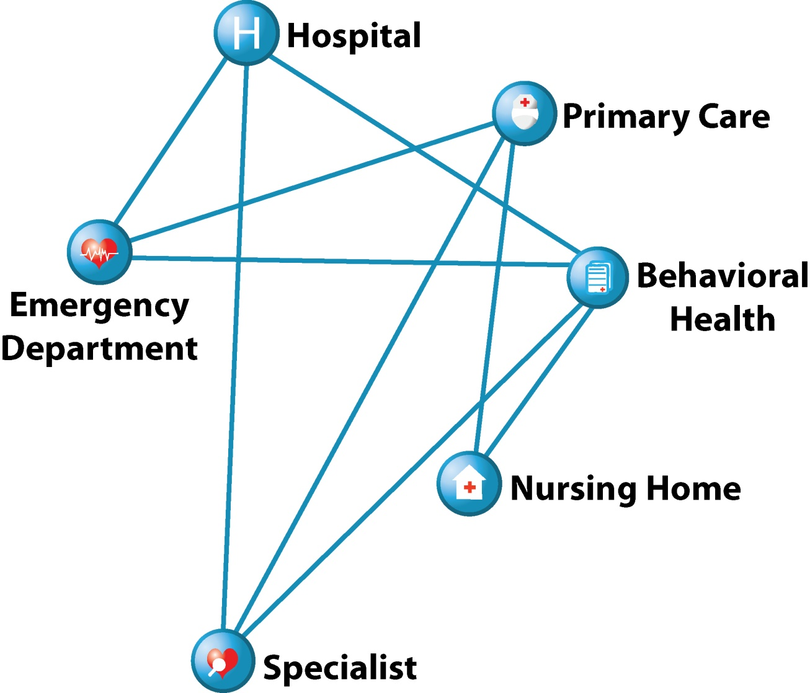
The Current Delivery System is Fragmented
Primary care providers may be unaware their patient has been to the hospital.
Patients may be subjected to unnecessary, repetitive tests.
A Dartmouth Institute study suggests 30 percent of care is unnecessary.¹
¹ The Dartmouth Institute, “Reflections on Geographic Variations in U.S. Health Care”, 2010.
Notes:
The bottom line is that we are spending almost 18% of our nation’s gross domestic product on health care, and it continues to go up
For purposes of this discussion, we’ll take a step back to discuss how health care is paid for
Most insurance programs, including Medicare and private plans, pay for health care on a fee-for-service basis. This means that individual doctors, hospitals, and other providers are paid for each service they furnish to a patient.
Critics complain that this approach rewards providers financially for delivering as many services as possible while driving up costs for patients and payers. In addition, it often leads to uncoordinated, fragmented care.
What we mean by fragmented care is that there is a lot of disconnected, uncoordinated care that happens in the way health care is delivered and paid for
It’s like the patient is like a pinball being bounced around between providers – we’ve tried to show that on this graphic.
As an example, nearly one in five Medicare patients discharged from the hospital is readmitted within 30 days – a readmission many patients could have avoided if their care outside of the hospital had been aggressive and better coordinated. Health Care.Gov

Slide 5
What is Accountable Care?
Notes:
Triple Aim: improving health of patients, improving the patient experience of care, while decreasing per capita costs. It’s kind of the “holy grail” of health care
Accountable care is an attempt to tackle all 3 of those things, by focusing on coordinating care among other concepts

Slide 6
Principles of Accountable Care
Provider leadership
Emphasis on primary care
Active and proactive care coordination
Electronic Health Records for care coordination and disease management
Community-based collaboration
Payment reform
{
Patient Centered Medical Home
Notes:
There are many flavors to ACO; is a local, provider-led entity comprised of a wide range of collaborating providers
Monitor care across care settings and are accountable to health care payers for the overall cost and quality of care for a defined population. All have some common principles.
Provider leadership
To undergo a major initiative like this takes strong leadership from doctors, other clinicians and their respective health care organizations
And this means a commitment both inside and outside of the examination room
Primary care
Primary care, of course, is the foundation of medical care, and there is strong emphasis on improving outcomes through prevention and managing chronic diseases (such as diabetes) at the primary care level
Of course, where the care coordination comes into play is with services such as specialists and hospitalizations; but think about primary care as the core of where the coordination happens
Care coordination
I want to take this out of the abstract and talk a bit about what we mean by this. I’ll come back to this on the next slide
Electronic health records/data and analytics:
In my mind, this is probably the biggest reason why the time is ripe for this sort of model – it relies on strong feedback of data and analytics to monitor patient health outcomes and costs, and the rapidly advancing technology has now enabled this to happen
Let’s first talk about what an accountable care organization is
Community
The vision is that local providers best know the needs of their patient populations
But it also is rooted in a shared vision, fostering community, across multiple providers
Payment reform:
This is where the “accountable” part comes in: clinicians are held accountable for the overall cost and quality of a defined patient population
This, of course, is a major vision of this entire effort – will come back to this
Care coordination sounds a lot like the health maintenance organizations (HMOs)/managed care models of the 1990s. It’s a good question, but there are some very important differences
Provider leadership is a key difference from the HMO world of the 90s where physicians often felt that key decisions were out of their hands and were controlled by a distant HMO – i.e., the infamous gatekeeper
patient choice – patients can see whomever they want, but also a feeling that the patient is an active participant in the team.
Different from 1990s where there was a lot of backlash against those models because the patients felt that they couldn’t choose their provider.
Patient-centered medical home:
Another key concept is building or maintaing that relationship between a patient and his or her primary care provider. This is embodied through the concept of a patient-centered medical home, some people call this the health home, but whatever you call it, the concept is that the patient is the focus of the care and has a usual place where he or she can go to receive primary care

Slide 7
How Accountable Care Works
Notes:
Graphic nicely illustrates care coordination – this is not meant to illustrate the ACO or ACC specifically, but the concept
the goal of care coordination is to enhance the quality and value of care.
I want to draw your attention that care coordination is based on the foundation of data and analytics
Not only the interchange of patient data between these entities, but on the availability of data that allows providers to monitor outcomes and costs
Second, I want to point out that the patient-centered medical home is the point from which care coordination begins
Finally, care coordination ideally happens among the different types of providers; we’ve included a few here: hospitals, specialists, behavioral health, etc.
In other words the patient getting the right care at the right place at the right time. In that sense, it improves access to care.
So, how is care actually coordinated? What would it look like if we walked into one of the clinics today?
Let’s start with an example – let’s assume there is an elderly patient who is hospitalized. The PC would know that the patient was hospitalized, and when she was discharged, a care coordinator works on a care plan with the physician and patient, checks in with the patient to make sure that she follows her medication regimen, assists with contacting other physicians she may need to obtain medical equipment or medication, etc. You can think of this person as adding a personal touch that results in more coordinated care.
This can happen in a number of ways:
Often, it is someone like a nurse or a social worker who is in communication with both the patient and the physician
They add the personal touch and make contacts with the patient
They coordinate care on a number of different levels, depending on the needs of the patient
Development of individualized care plans
Sometimes it means monitoring and just checking in with the patient periodically
Other times it is assist patients with contacting other physicians or obtaining medical equipment or medication
Assisting with care transitions and other needs

Slide 8
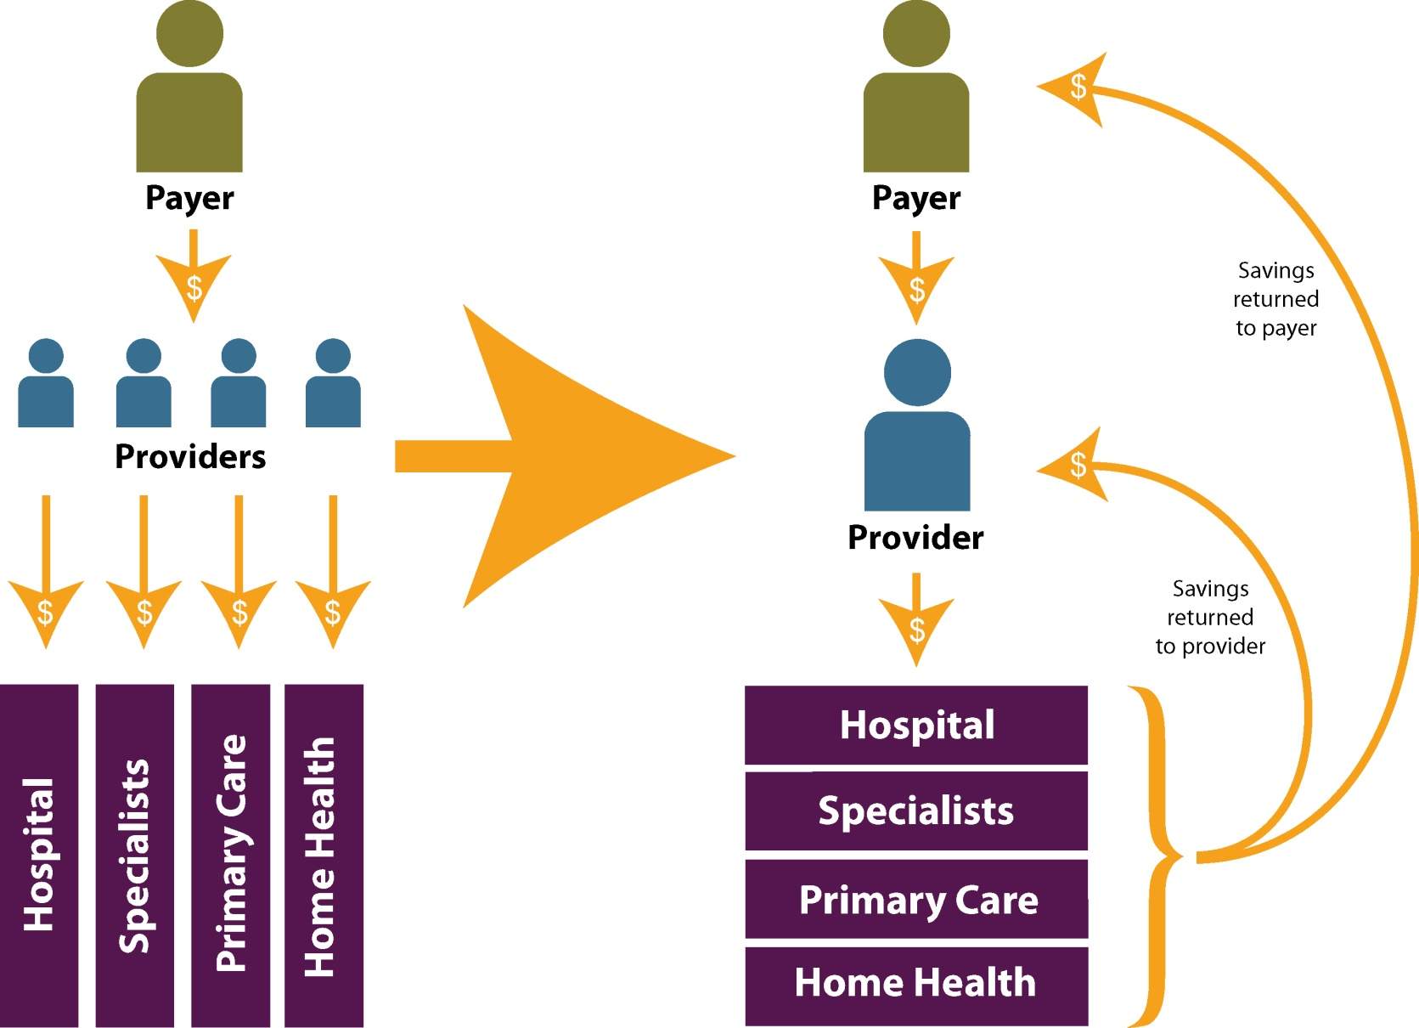
Payment Reform Under Accountable Care
Notes:
The second principle to review: Payment reform
Just to review, on the left we have our current FFS system –
A payer (MC, MK or insurance) pays for each procedure to each provider separately
Rewards utilization, promotes care fragmentation
Illustrated by the silos that drive costs
This big arrow embodies a transition from FFS to the accountable care approach on the right:
Vision of the ACO is that the payer contracts directly with the ACO and provider organizations without a health plan intermediary such as an HMO
Holds providers accountable for the cost and quality of care, in that the savings (and in some models, the financial risk) from effectively coordinating care and improving outcomes is shared back with the provider and the payer.
So there is that financial incentive present – they have more “skin in the game” if you will
Accountable care concepts apply across the entire health care system: Medicaid, Medicare and the private sector
This model is being tried out by big private insurers across the country – BC/BS in Illinois and Mass; Aetna, WellPoint
Details of financial arrangements
At least eight private health insurance plans have entered into ACO agreements with providers using a “shared risk” payment model. These arrangements make providers eligible for bonuses if they keep costs below a certain threshold but assess financial penalties against them if they exceed spending targets. Examples include Blue Cross Blue Shield plans in Illinois, Massachusetts, New Jersey, and North Carolina as well as Aetna and Anthem/ WellPoint.

Slide 9
Accountable Care in Colorado Medicare Pioneer ACO Medicaid ACC

Slide 10
Why a State Legislator Should Care About Medicare
Medicare covers almost 10% of Colorado’s population
Opportunities to improve care and reduce costs
Can we learn, apply and scale the results to other payers?
Notes:
Medicare covers 10% of the population in Colorado, it is a good place to start for reforming the way we deliver health
Because it covers the aged, expensive population with lots of opportunities to improve care and reduce costs
Medicare is FFS model – because it’s so big, a lot of things in our HC system are based off of it.

Slide 11
Medicare Pioneer Accountable Care Organization (ACO)
Physician Health Partners (Denver)
Provides care coordination and business process improvement services for physician practices
Established in 1996, a collaborative of 260 providers, serves 450,000 patients in metro area
One of 32 Medicare Pioneer ACOs in the U.S.
Will serve up to 28,000 Medicare patients
Notes:
The Center for Medicare and Medicaid Services (CMS) has an Innovation Center, and in May 2011 this Innovation Center announced that it would test a new Pioneer ACO model, targeted to organizations that already have a track record of managing financial risk and developing systems for being accountable for quality-related performance.
These are called “Pioneer” because it is on the cutting edge for Medicare reform; leading the way for others because they have already embarked on organized care practices
CMS selected 32 Pioneer ACOs with a variety of organizational structures so that they could evaluate what organizations and approaches work best in reducing costs and improving quality.
In Colorado, our very own PHP was selected – this is a private care coordination company that for the past 15 years have been developing a care coordination model.
Eventually, this will serve up to 28k Medicare beneficiaries in CO; will serve 860,000 nationwide
Extra notes:
The ACOs were selected in December 2011 and will begin actual implementation in APRIL 2012.

Slide 12
Medicare ACO Implementation
Year 1
Year 2
Year 3
2012
ACO shares 60% of savings or loss above benchmark
2013
ACO shares 70% of savings or loss above benchmark
2014
Eligible to move to a population-based payment
Must report (not meet) 33 quality measures
Payment tied to meeting 25 of 33 quality measures
Must engage ACO with non-Medicare payers
Notes:
How is this working?
PHP is working with three physician practices in the Denver area
PHP will provide care management, data analysis and quality improvement services to the participating practices to help them manage and improve the health of their Medicare population
One of the ways they do this is by co-locating a nurse or a social worker in a practice, who ensures for example, when a patient goes to a hospital, they receive care at discharge, hopefully to avoid a preventable re-admission.
I’ve put the timeline here to indicate a couple of key themes that happen over time with this ACO
First, the increase in the shared savings or risk – increases over time
Second, payment is increasing tied to quality improvements – they’ll be held accountable to a series of quality measures – put a list in your binders
Examples include: Everything from Hemoglobin A1c screening for diabetes to lower blood pressure to shared decisionmaking.
Third, is moving away from FFS for service and into different payment arrangements
ACO shares 60% of savings or loss above benchmark
Years 4 an 5: Full risk arrangements

Slide 13
The Accountable Care Collaborative

Slide 14
Colorado’s Accountable Care Collaborative (ACC)
A Colorado-grown Medicaid cost containment strategy
One of a handful of states at the forefront
Began development in 2009, implemented in spring of 2011
ACC aligns with principles of accountable care
Seven regional ACOs
Notes:
CO is at the forefront – only a handful of other states trying anything similar
inspiration for CO’s program came from NC, where there were very promising results
This is not something that came out of national health reform – development of the ACC actually began in 2009
ACC was created acknowledging that we had increasing caseload in Medicaid and a need to manage cost
85 percent of Medicaid enrollees are in a fee-for-service system. (Source: “Understanding the ACC program,” HCPF)
ACC aligns with those accountable care principles
Program vision: patient-centered approach; improve health outcomes, care quality while reducing the cost of care.
It’s a voluntary program for existing Medicaid enrollees
As a starting place, they will be monitoring whether ER use decreases, hospital re-admissions decrease, or unnecessary or duplicative imaging services like MRIs
encompasses seven coordinating organizations that have non-overlapping geographic territories
Extra notes: The ACC Pilot concept began development in 2009. RCCO proposals were released in August 2010, and organizations were selected in early 2011. The Pilot began in the spring of 2011

Slide 15
The ACC’s Seven RCCOs
Notes:
Here are the seven regions that I mentioned that I mentioned.
They are called Regional Care Collaborative Organizations, or RCCOs (they technically aren’t ACOs because they don’t share in risk among some other nuances, but for all intents and purposes, they serve in the same way as an ACO)
These are private companies that went through a competitive bid process
Recognize some of them (Rocky, CO Access) – others are new entities that were formed by communities
These regions were developed based on geography and the distribution of the population
responsible for achieving health and cost outcomes

Slide 16
Three Pillars of ACC
Notes:
There are 3 building blocks to the ACC
Like everything in health care, they have acronyms, but it’s actually pretty straightforward
The RCCO and clinician in the medical home work together to provide high quality and coordinated care to the patient, and they rely on the data and analytics to monitor how well they’re doing
You’ll notice that the medical home, or “patient-centered medical provider” (PCMP), is the basic unit of the ACC.
I think this diagram could be enhanced by adding the patient to the middle of it
Built on that foundation of data: that’s where the SDAC comes in – will talk about in a bit

Slide 17
How Enrollees May Benefit
A pregnant woman with mental health needs visited the emergency room 28 times over 6 months.
Notes:
You probably know that there are a relatively small proportion of patients that account for a big chunk of health care spending
These patients have often been deemed “Hot spotters”
It’s these folks that could potentially benefit the most from coordinate care
But beyond the statistics, it’s important to remember that we’re talking about real people here
We asked HCPF to share examples of the ACC in action, while protecting confidentiality, and this is a story they shared with us (I’ll paraphrase)
This is not a photo of this patient, BTW
Pregnant woman who visited the ER 28 times over 6 months with uncontrolled pain (almost 5 times a month)
Come to find out, she had a blood clotting disorder and was not adhering to her medication
During a OB/GYN visit, a care coordinator engaged with this woman and low and behold, she was diagnosed to be suffering from depression which had prevented her from following her meds
The CC developed a care plan, got her connected with behavioral health, prenatal care, connected her with a resource to find betting housing
Because of this intervention of the care coordinator, the woman is compliant with her meds and her emergency dept use has decreased dramatically
Triple aim: Improved patient experience, improved health, decreased costs
Paraphrase:
A pregnant woman was diagnosed with a blood clotting disorder and was not adhering to her medication regimen. Instead, she would present at the emergency department (ED) when she experienced pain—totaling about 28 visits in 6 months. After identifying her unhealthy ED use pattern, a care coordinator engaged with the patient and met with her during an OB/GYN visit. The woman was determined to have depression, which hindered her ability to follow her prescriptions, and a care plan in coordination with behavioral health and OB/GYN was formalized. The care coordinator connected her to Prenatal Plus, a counselor and helped her find better housing. Because of these multiple interventions led by the coordinated team, the woman is now compliant with her care plan and medical treatment. Her ED use decreased dramatically.

Slide 18
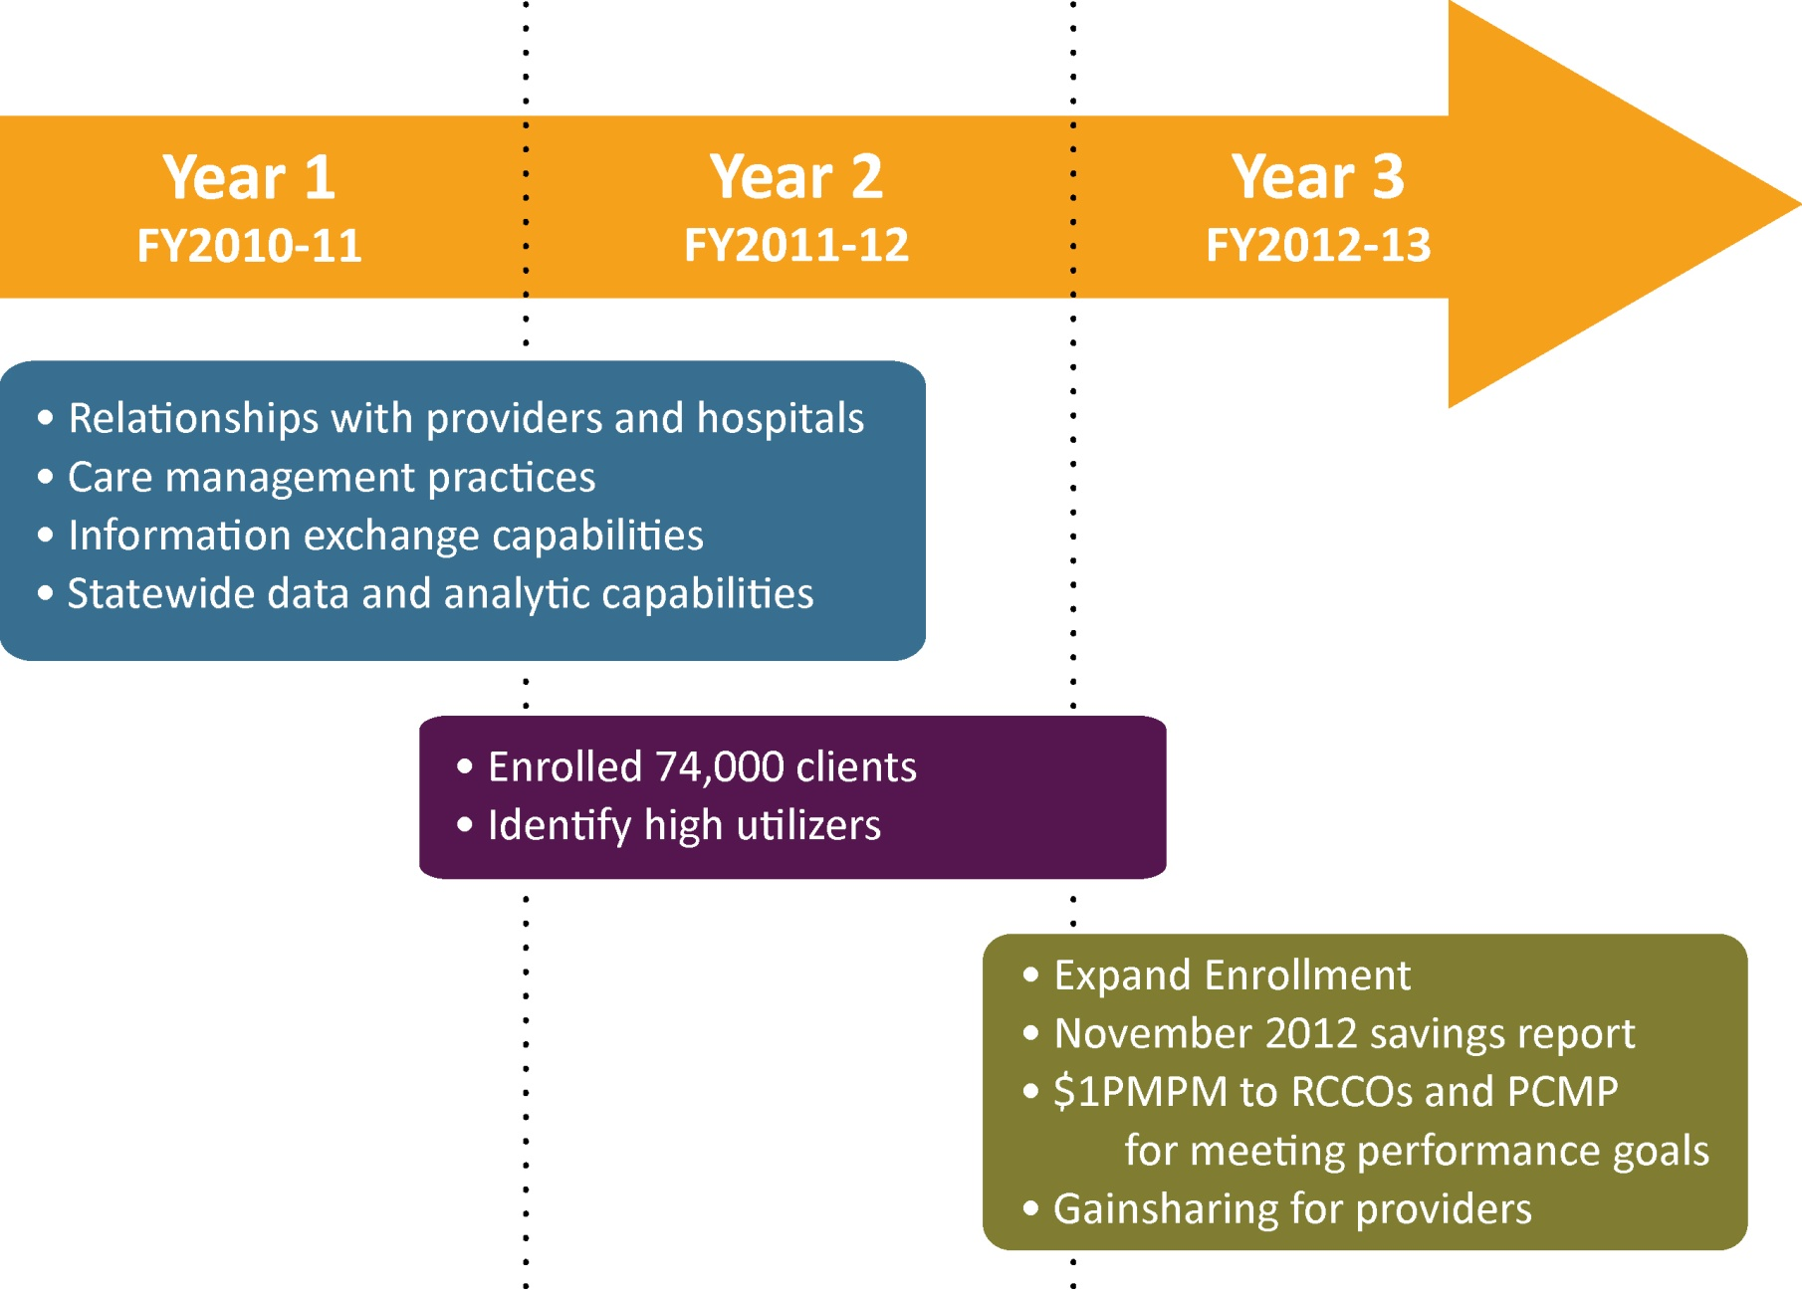
Medicaid ACC Implementation
Notes:
I won’t go through all of the text here, to summarize though essentially the providers have been organizing, developing their care coordination strategies, forming those relationships, and enrolling patients (latest number was 74,000 in November of 2011)
The ACC represents an incremental approach towards payment reform
There is not a change to Medicaid benefits, they have strategies in place to minimize disruption for the enrollees, and it is still based on the FFS payment system
What is different that the providers and the RCCOs get a little financial boost (called a PMPM supplement) to help pay for these medical home, care coordination services, essentially, it’s a step towards them having more “shared savings”
Kind of think of it as an investment
Currently, a provider can’t bill Medicaid for providing care coordination services
As the program unfolds over the years, a portion of this PMPM will be with-held and RCCOs and PCMP can only get it back if they meet performance goals.
I like to think of these performance goals as a system of check and balances, so that providers aren’t just motivated to slash services to patients, which may affect the quality of the care, or the outcome.
There are plans to expand enrollment to the newly eligible adults without dependent children, and possibly to individuals who are dually eligible for Medicaid and Medicare

Slide 19
Variation and Common Threads Across Regions
Led by “culture change”
RCCOs function as independent ACOs
The importance of relationships
Leveraging existing knowledge and expertise
Genesis of the RCCO
Community-driven approaches to care coordination
Notes:
As I mentioned before, the RCCOs (the local ACOs) all developed differently, and one of the principles of accountable care is that it is community-driven
I’ve put a few dot points up here about how the RCCOs and their approaches differ, but have some common themes
Culture change: First of all, this requires an acknowledgment that it isn’t business as usual, there are fundamental systemic changes, such as providers working in teams, actually talking with each other, having shared goals and a commitment to sharing data. This is a very different model.
Built on relationships: Not only between providers but between provider and patient. Care has become more fragmented – except for perhaps some rural communities, gone are the days when there was a personal relationship built with a physician and he or she helped to coordinated the care. This is an effort to gain some of that back.
RCCOs as ACOs: talked about that
What is encouraging is that this is being built off of existing knowledge and expertise – I mentioned Grand Junction, many of our safety net clinics around the state have been applying these principles for a long time
The ways the RCCOs developed are interesting – some are grassroots efforts of community collaboration, others are based in established organizations with a track record
Finally, there is variation in the strategies in which care coordination is delivered, though they aim to be community-driven in that they are focused on the needs of a specific population

Slide 20
SDAC: The Potential of Data
Provides layers of insight into cost drivers across organizational levels:
RCCO performance within region on emergency department use, hospital re-admissions and imaging
Practice/clinic comparisons using risk-adjusted data
Clinician data facilitates clinical practice improvement
Patient data identifies high-risk patients
Notes:
the SDAC (State Data & Analytics Contractor) and the potential for data
Again, the SDAC serves as a data repository and fosters accountability by monitoring patient services and outcomes, identifying opportunities for care improvement.
The beauty of this is that the data can be used and applied on multiple levels – I’ve put some examples. But let’s use the example of ED use
Can use data to compare between RCCOs, which has higher ED use, what can we learn from that
At the clinic or practice level, we can use risk adjusted data (which is a fancy way of saying “apples to apples”) to examine which practices had higher ED costs
We can examine patterns of patients from a particular physician visiting the ED and whether there is any sort of clinical improvements that can be made
At the patient level, identify those high-risk patients like the pregnant woman
It also assists in evaluation and the ability to report the results out to legislators

Slide 21
Moving Forward

Slide 22
Continued Payment Reform
Notes:
We’ve put this continuum of payment reform up here
The ultimate goal of these approaches is more skin in the game between payer and provider
Start with FFS
The ACC is a blended approach: FFS with care coordination and incentive payments
The ACO is a bit beyond that [around gainsharing] and has a defined movement over time will towards a global payment
Global Payment - risk-adjusted payment over fixed period of time to a responsible provider for patient’s care
Gainsharing
When savings exceed a threshold, a fraction of those savings will be shared between providers and the RCCO.

Slide 23
Accountable Care: Challenges and Opportunities
“Culture change”
Initial investment
Attribution process
Based on preserving choice of provider
Not breaking any existing relationship with a PCP
Real-time health information
Notes:
requires a culture change which can lead to challenges
an initial investment in getting folks into medical homes, investing in care coordinators, providing that care coordination not only to patients in the ACC or ACO, but to other patients as well
Developing capacity for EHRs is time and resource consuming
Attribution is the process of getting people into medical homes, there are certainly growing pains associated with this
First Medicaid is a very vulnerable population
Often moves around a lot
But there are concerted attempts to maintain choice and relationship with PCP
much of the data are based on claims to Medicaid, there is a lag of a few months or few weeks, so many of the RCCOs have taken this as an opportunity to complement the SDAC data with their own information to get it more in real-time

Slide 24
Salud Family Health Centers, Commerce City
Jeff Bontrager 720.382.7075 bontragerj@coloradohealthinstitute.org

