Slide 1
Using Data and Technology to Improve Colorado’s Health:
A perspective
from CHI
October 7, 2011
Culture of Data
Notes:
Cover possibility

Slide 2

Today’s topics
A brief (re)introduction to CHI
Our large-scale investments in data
and technology
What now? A comment on culture

Slide 3
A brief introduction
CHI is a trusted and leading source of credible health information for Colorado leaders.
Our insight is used to:
  Inform policy
  Contribute to effective implementation
  Support state efforts to improve health
Access
Quality
Value
Prevention

Slide 4
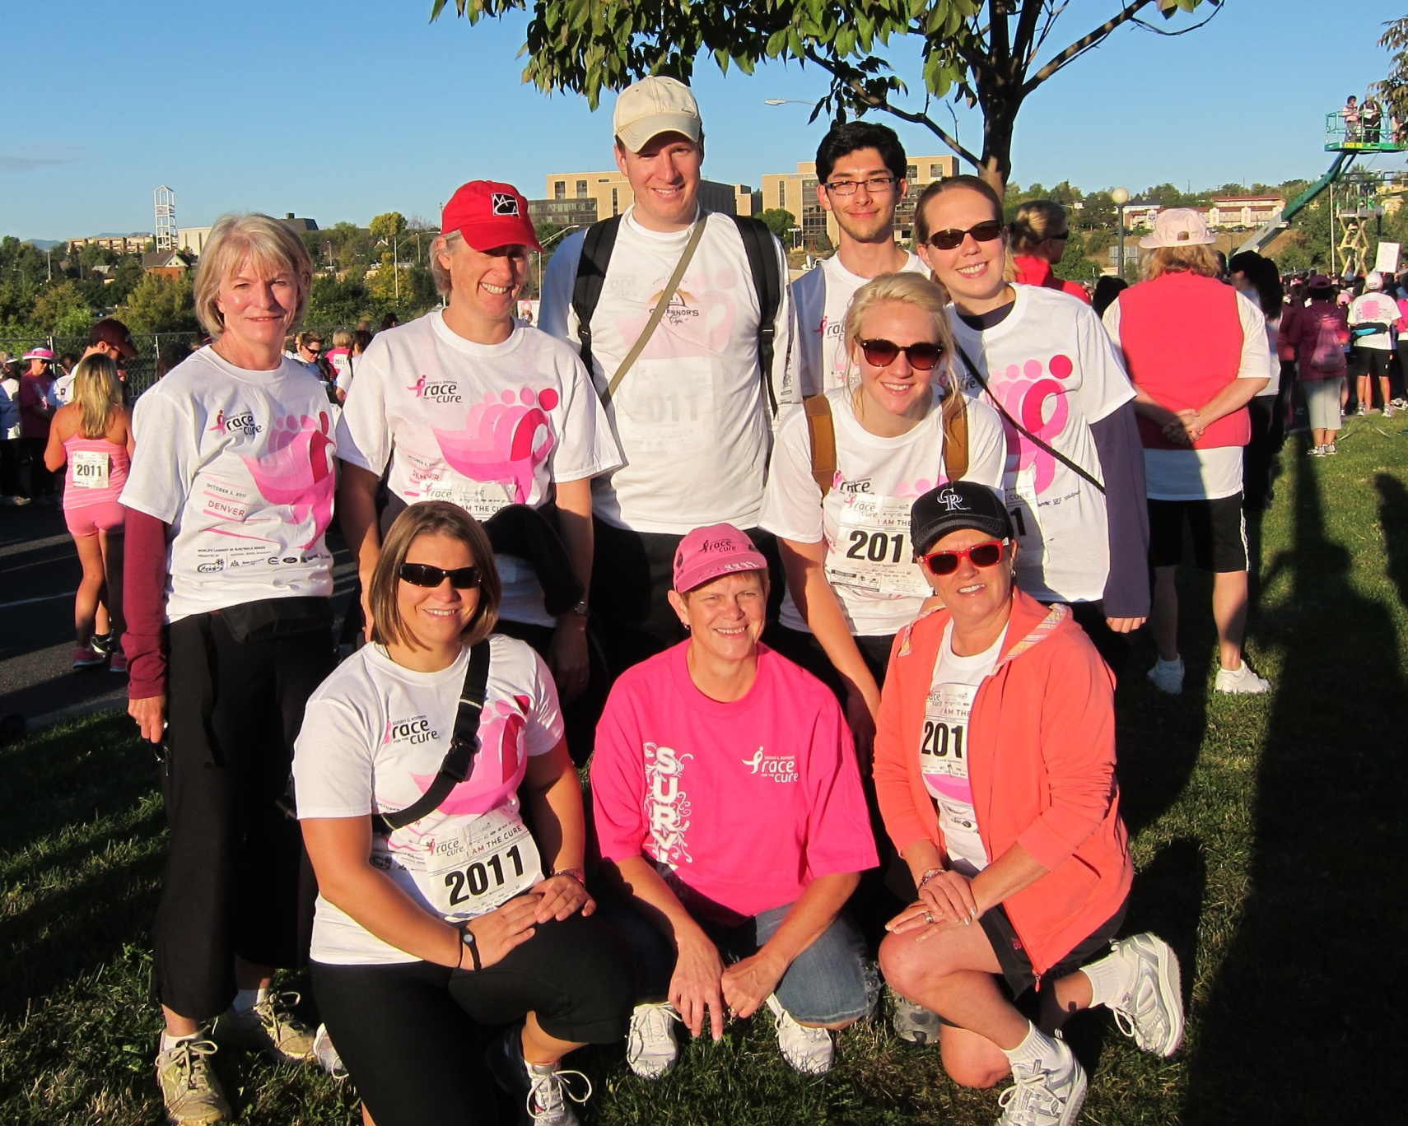
In other words…

Slide 5
Action 22 residents, age 0-64, by insurance status
Historically, a data house . . .

Slide 6
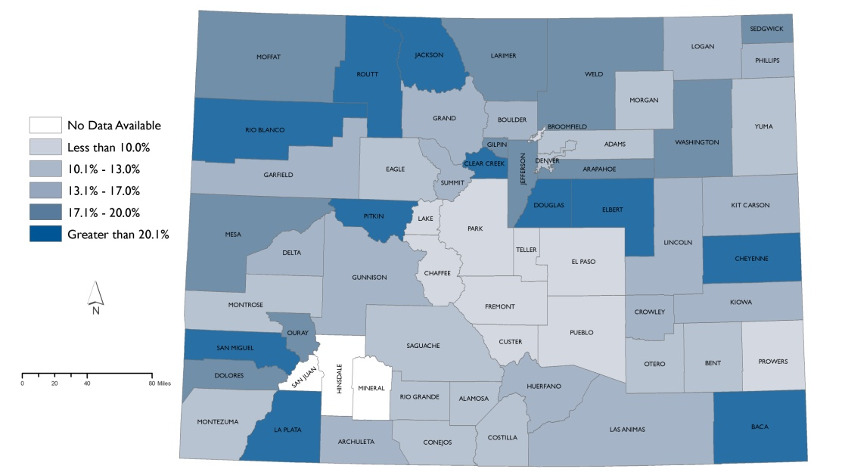
Our focus today, telling the story…
Percent of children who are eligible but not enrolled in Medicaid by county, 2009
SOURCE: CHI analysis of 2009 American Community Survey

Slide 7
Our Large Scale Investments
Notes:
Possible section cover page

Slide 8

Incenting new behaviors
Individuals
Purchasing Insurance
Alignment of payment and
Incentives
Integration
of Care

Slide 9
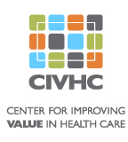



(Potentially) transformative investments
Physical Infrastructure:
  The ACA allocates $11 billion to FQHCs
Major initiatives in Colorado
All Payer Claims Database
Electronic Medical Records & HIT
Health Insurance Exchange
Notes:
KFF has a helpful issue brief on community health centers and the opportunities/challenges of health reform: http://www.kff.org/uninsured/upload/8098.pdf
The Affordable Care Act makes a multi-faceted investment in health centers. Reflecting health centers’ now central role in the U.S. health system, the law permanently authorizes the health centers program. In addition, the legislation makes a major near-term investment to increase health enter funding dramatically, laying the groundwork for major health center growth between 2010 and 2015. At the same time, the law anticipates and underscores that the real engine driving long term health center growth is the expansion of insurance coverage for low-income populations. With the aid of enhanced funding, health centers have an opportunity to solidify their position as a critical access point for people newly gaining health coverage. Ultimately, the success of the health centers expansion will be tied to two factors: the ability of their patients to gain access to
Health insurance and the ability of health centers to attract and retain newly insured patients.
Keep in mind that most of the clinics in the room felt left out of the state and federal health reform. Not sure what points if any you want to use from the paragraph above, though some of the CSNCs/RHCs will likely be affected by expanded FQHCs; some may even be applying to become a FQHC.
For CORHIO and CO-REC (CO Regional Extension Center), more information available here: http://www.corhio.org/co-rec.aspx. I would make the point that adoption of electronic medical records continues to move forward (COREC says over 1,500 providers have signed up as of February.) Michele, you can mention that there was a breakout session about what it takes to achieve “meaningful use” on Wed at the Forum.
The Colorado Telehealth Network (CTN) is statewide information and communications platform and highway that will enable patients, providers and payers to improve the quality of care, reduce costs and increase access for health care services. By connecting patients and providers on a high speed and secure statewide network, CTN can provide access to educational, business process and clinical care products.
CTN is a virtual private medical network that is HIPPA compliant, encrypted and socket secure. The network will play an instrumental role in promoting the adoption and availability of Telehealth services, which use audio, video and medical technologies to connect patients with physicians who are separated by hundreds of miles.
Full production deployment began in August 2010 to connect 200 community medical facilities and another 170 health care provider facilities over this $34 million initial network. The initiative is managed by the Colorado Hospital Association (CHA) and is a collaborative venture between CHA and Colorado Behavioral Healthcare Council (CBHC). The deployment of this initial phase will be complete August 2011.
Funding for CTN has been provided by the Colorado Hospital Association, Colorado Behavioral Healthcare Council, Federal Communications Commission, and the Colorado Health Foundation
More info: http://www.cotelehealth.com/telehealth/index.php

Slide 10

Integration: Medical homes
Reduce costs
Improved care quality
Reduced medical errors
Higher patient satisfaction
Fewer health disparities
Notes:
Medical home definition: A model of care that combines access, teamwork and technology to deliver quality care and improve health.
Basic components of patient-centered medical home outlined by NCQA (National Committee for Quality Assurance)
Access and advice during and after office hours provided by health care team
Uses data to identify and manage patient populations
Use evidence-based guidelines for preventive, acute and chronic care management
Provide self-care support and community resources
Track and coordinate tests, referrals and transitions
Use data to measure and improve performance

Slide 11

The promise deferred
  Medical homes require transformation
  Workforce as members
  of “care teams”
  Technology is not
  “plug and play”
  Health care neighborhoods
  Payment reform
Notes:
The full citation is: Nutting, P., et al. (2011). “Transforming physician practices to patient-centered medical homes: Lessons from the national demonstration project.” Health Affairs, v. 30, n. 3, p 439-445.
Key points/lessons from the National Demonstration Project:
Transformation is more than a series of incremental changes. A successful medical home requires a complete paradigm shift from all parties involved. Practices must be nimble, capable of continuous learning, reflection, etc. Two years isn’t long enough to implement the entire model.
New cognitive models are necessary. True “care teams” of clinicians working together represent very different ways of thinking than previous models (where a physician works in a model that emphasizes autonomy and commands a staff to support the physician’s work). Teams should form around patient’s needs and patients need to establish trusting relationships with other non-physician providers.
Change is tough, and an unrelenting pressure for constant change can cause tension, conflict, burnout, turnover, and resistance to further change. Successful practices had an internal capability for organizational learning and development; strong leadership; etc.
Information technology is not “plug and play”. Successful adopters of the medical home model were also early adopters of HIT and used it meaningfully.
Health care neighborhoods are critical to support a health care/medical home. Medical homes need to have a robust and collaborative relationships with hospitals, nursing homes, specialists, other health care professionals, and community agencies. This “neighborhood” must appear seamless to the patient.
Redesign and payment reform. We need to provide options for a staged approach that supports the transformation of small primary care practices into medical homes. If we don’t pay for it, it won’t happen.

Slide 12
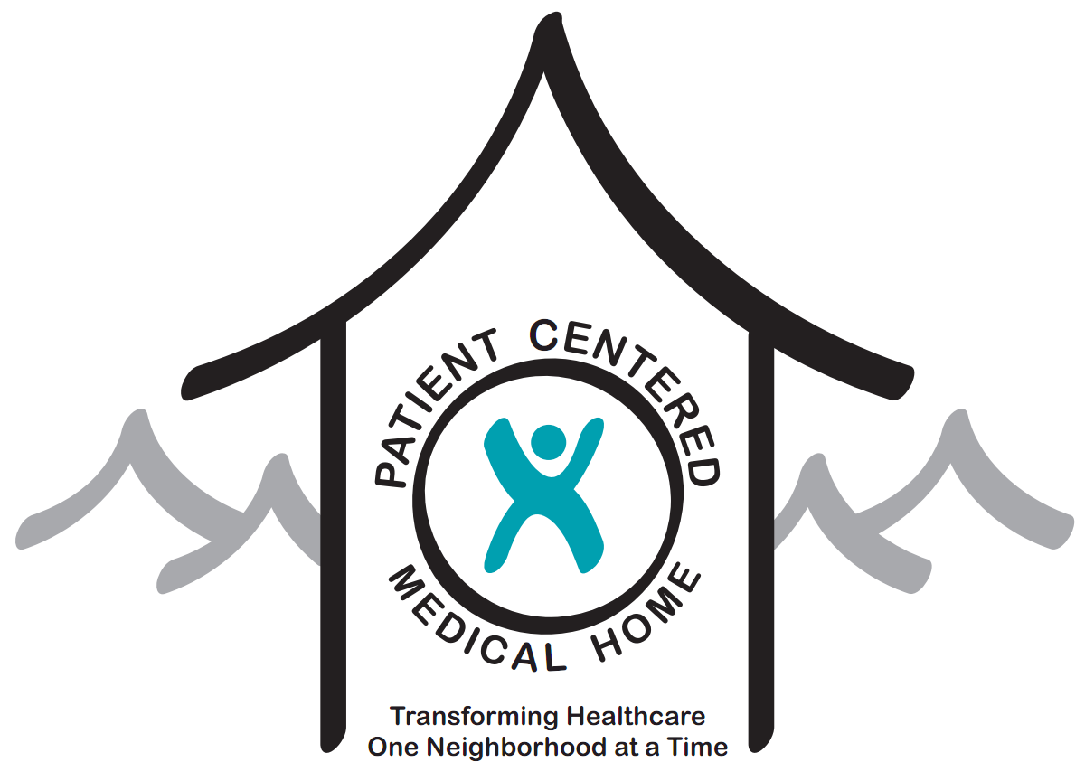

What CHI is watching
  The Colorado
  Multi-Payer, Multi-State Patient-centered
  Medical Home Pilot
  ACCs and Medicaid
    Political appetite to invest?
Notes:
The full citation is: Nutting, P., et al. (2011). “Transforming physician practices to patient-centered medical homes: Lessons from the national demonstration project.” Health Affairs, v. 30, n. 3, p 439-445.
Key points/lessons from the National Demonstration Project:
Transformation is more than a series of incremental changes. A successful medical home requires a complete paradigm shift from all parties involved. Practices must be nimble, capable of continuous learning, reflection, etc. Two years isn’t long enough to implement the entire model.
New cognitive models are necessary. True “care teams” of clinicians working together represent very different ways of thinking than previous models (where a physician works in a model that emphasizes autonomy and commands a staff to support the physician’s work). Teams should form around patient’s needs and patients need to establish trusting relationships with other non-physician providers.
Change is tough, and an unrelenting pressure for constant change can cause tension, conflict, burnout, turnover, and resistance to further change. Successful practices had an internal capability for organizational learning and development; strong leadership; etc.
Information technology is not “plug and play”. Successful adopters of the medical home model were also early adopters of HIT and used it meaningfully.
Health care neighborhoods are critical to support a health care/medical home. Medical homes need to have a robust and collaborative relationships with hospitals, nursing homes, specialists, other health care professionals, and community agencies. This “neighborhood” must appear seamless to the patient.
Redesign and payment reform. We need to provide options for a staged approach that supports the transformation of small primary care practices into medical homes. If we don’t pay for it, it won’t happen.

Slide 13
Incenting new behaviors
Individuals
Purchasing Insurance
Alignment of payment and
Incentives
Integration
of Care
CIVHC
All Payer Claims Database
Prometheus Payment Reform
Health Insurance Exchange
Individual Mandate
Medical Homes
ACOs
ACCs and RCCOs

Slide 14
What Now?
A Comment on Culture
Notes:
Possible section cover page

Slide 15
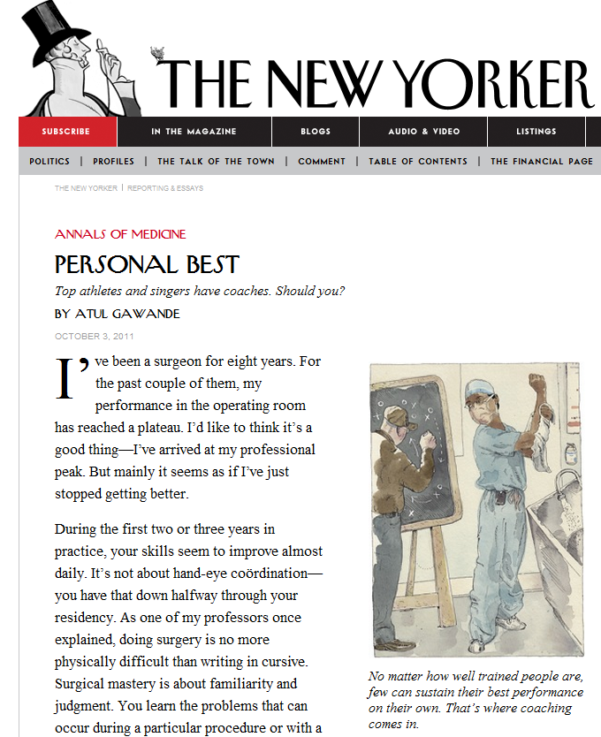
Risks & rewards of a data-empowered culture
http://nyr.kr/mWZCJE

Slide 16

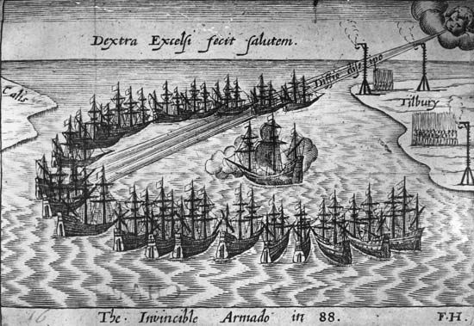
Michele Lueck • 720.382.7073 • lueckm@coloradohealthinstitute.org

Slide 17
Using Data and Technology to Improve Colorado’s Health:
A perspective
from CHI
October 7, 2011
Culture of Data
Notes:
Cover possibility

Slide 18
Today’s topics
A brief (re)introduction to CHI
Our large-scale investments in data
and technology
What now? A comment on culture

Slide 19
A brief introduction
CHI is a trusted and leading source of credible health information for Colorado leaders. Our insight is used to:
  Inform policy
  Contribute to effective implementation
  Support state efforts to improve health
Access
Quality
Value
Prevention

Slide 20
In other words…

Slide 21
Action 22 residents, age 0-64, by insurance status
Historically, a data house . . .

Slide 22
Our focus today, telling the story…
Percent of children who are eligible but not enrolled in Medicaid by county, 2009
SOURCE: CHI analysis of 2009 American Community Survey

Slide 23
Our Large Scale Investments
Notes:
Possible section cover page

Slide 24
Incenting new behaviors
Individuals
Purchasing Insurance
Alignment of payment and
Incentives
Integration
of Care

Slide 25
(Potentially) transformative investments
Physical Infrastructure:
  The ACA allocates $11 billion to FQHCs
Major initiatives in Colorado
All Payer Claims Database
Electronic Medical Records & HIT
Health Insurance Exchange
Notes:
KFF has a helpful issue brief on community health centers and the opportunities/challenges of health reform: http://www.kff.org/uninsured/upload/8098.pdf
The Affordable Care Act makes a multi-faceted investment in health centers. Reflecting health centers’ now central role in the U.S. health system, the law permanently authorizes the health centers program. In addition, the legislation makes a major near-term investment to increase health enter funding dramatically, laying the groundwork for major health center growth between 2010 and 2015. At the same time, the law anticipates and underscores that the real engine driving long term health center growth is the expansion of insurance coverage for low-income populations. With the aid of enhanced funding, health centers have an opportunity to solidify their position as a critical access point for people newly gaining health coverage. Ultimately, the success of the health centers expansion will be tied to two factors: the ability of their patients to gain access to
Health insurance and the ability of health centers to attract and retain newly insured patients.
Keep in mind that most of the clinics in the room felt left out of the state and federal health reform. Not sure what points if any you want to use from the paragraph above, though some of the CSNCs/RHCs will likely be affected by expanded FQHCs; some may even be applying to become a FQHC.
For CORHIO and CO-REC (CO Regional Extension Center), more information available here: http://www.corhio.org/co-rec.aspx. I would make the point that adoption of electronic medical records continues to move forward (COREC says over 1,500 providers have signed up as of February.) Michele, you can mention that there was a breakout session about what it takes to achieve “meaningful use” on Wed at the Forum.
The Colorado Telehealth Network (CTN) is statewide information and communications platform and highway that will enable patients, providers and payers to improve the quality of care, reduce costs and increase access for health care services. By connecting patients and providers on a high speed and secure statewide network, CTN can provide access to educational, business process and clinical care products.
CTN is a virtual private medical network that is HIPPA compliant, encrypted and socket secure. The network will play an instrumental role in promoting the adoption and availability of Telehealth services, which use audio, video and medical technologies to connect patients with physicians who are separated by hundreds of miles.
Full production deployment began in August 2010 to connect 200 community medical facilities and another 170 health care provider facilities over this $34 million initial network. The initiative is managed by the Colorado Hospital Association (CHA) and is a collaborative venture between CHA and Colorado Behavioral Healthcare Council (CBHC). The deployment of this initial phase will be complete August 2011.
Funding for CTN has been provided by the Colorado Hospital Association, Colorado Behavioral Healthcare Council, Federal Communications Commission, and the Colorado Health Foundation
More info: http://www.cotelehealth.com/telehealth/index.php

Slide 26
Integration: Medical homes
Reduce costs
Improved care quality
Reduced medical errors
Higher patient satisfaction
Fewer health disparities
Notes:
Medical home definition: A model of care that combines access, teamwork and technology to deliver quality care and improve health.
Basic components of patient-centered medical home outlined by NCQA (National Committee for Quality Assurance)
Access and advice during and after office hours provided by health care team
Uses data to identify and manage patient populations
Use evidence-based guidelines for preventive, acute and chronic care management
Provide self-care support and community resources
Track and coordinate tests, referrals and transitions
Use data to measure and improve performance

Slide 27
The promise deferred
  Medical homes require transformation
  Workforce as members
  of “care teams”
  Technology is not
  “plug and play”
  Health care neighborhoods
  Payment reform
Notes:
The full citation is: Nutting, P., et al. (2011). “Transforming physician practices to patient-centered medical homes: Lessons from the national demonstration project.” Health Affairs, v. 30, n. 3, p 439-445.
Key points/lessons from the National Demonstration Project:
Transformation is more than a series of incremental changes. A successful medical home requires a complete paradigm shift from all parties involved. Practices must be nimble, capable of continuous learning, reflection, etc. Two years isn’t long enough to implement the entire model.
New cognitive models are necessary. True “care teams” of clinicians working together represent very different ways of thinking than previous models (where a physician works in a model that emphasizes autonomy and commands a staff to support the physician’s work). Teams should form around patient’s needs and patients need to establish trusting relationships with other non-physician providers.
Change is tough, and an unrelenting pressure for constant change can cause tension, conflict, burnout, turnover, and resistance to further change. Successful practices had an internal capability for organizational learning and development; strong leadership; etc.
Information technology is not “plug and play”. Successful adopters of the medical home model were also early adopters of HIT and used it meaningfully.
Health care neighborhoods are critical to support a health care/medical home. Medical homes need to have a robust and collaborative relationships with hospitals, nursing homes, specialists, other health care professionals, and community agencies. This “neighborhood” must appear seamless to the patient.
Redesign and payment reform. We need to provide options for a staged approach that supports the transformation of small primary care practices into medical homes. If we don’t pay for it, it won’t happen.

Slide 28
What CHI is watching
  The Colorado
  Multi-Payer, Multi-State Patient-centered
  Medical Home Pilot
  ACCs and Medicaid
    Political appetite to invest?
Notes:
The full citation is: Nutting, P., et al. (2011). “Transforming physician practices to patient-centered medical homes: Lessons from the national demonstration project.” Health Affairs, v. 30, n. 3, p 439-445.
Key points/lessons from the National Demonstration Project:
Transformation is more than a series of incremental changes. A successful medical home requires a complete paradigm shift from all parties involved. Practices must be nimble, capable of continuous learning, reflection, etc. Two years isn’t long enough to implement the entire model.
New cognitive models are necessary. True “care teams” of clinicians working together represent very different ways of thinking than previous models (where a physician works in a model that emphasizes autonomy and commands a staff to support the physician’s work). Teams should form around patient’s needs and patients need to establish trusting relationships with other non-physician providers.
Change is tough, and an unrelenting pressure for constant change can cause tension, conflict, burnout, turnover, and resistance to further change. Successful practices had an internal capability for organizational learning and development; strong leadership; etc.
Information technology is not “plug and play”. Successful adopters of the medical home model were also early adopters of HIT and used it meaningfully.
Health care neighborhoods are critical to support a health care/medical home. Medical homes need to have a robust and collaborative relationships with hospitals, nursing homes, specialists, other health care professionals, and community agencies. This “neighborhood” must appear seamless to the patient.
Redesign and payment reform. We need to provide options for a staged approach that supports the transformation of small primary care practices into medical homes. If we don’t pay for it, it won’t happen.

Slide 29
Incenting new behaviors
Individuals
Purchasing Insurance
Alignment of payment and
Incentives
Integration
of Care
CIVHC
All Payer Claims Database
Prometheus Payment Reform
Health Insurance Exchange
Individual Mandate
Medical Homes
ACOs
ACCs and RCCOs

Slide 30
What Now?
A Comment on Culture
Notes:
Possible section cover page

Slide 31
Risks & rewards of a data-empowered culture
http://nyr.kr/mWZCJE

Slide 32
Michele Lueck • 720.382.7073 • lueckm@coloradohealthinstitute.org

