Slide 1
Rural APNs & PAs in Colorado: Results from CHI’s 2010 – 2011 Workforce Surveys
Jacqueline L. Colby, PhD, MPH
Colorado Rural Health Conference
August 11th, 2011

Slide 2
APNs: All Kinds
Nurse Practitioners (NPs)
Certified Registered Nurse Anesthetists (CRNAs)
Clinical Nurse Specialists (CNSs)
Certified Nurse Midwives (CNMs)

Slide 3
Plus PAs
Primary Care
PAs (57%)
Specialty Care PAs (43%)

Slide 4
How many are in rural areas?

Slide 5
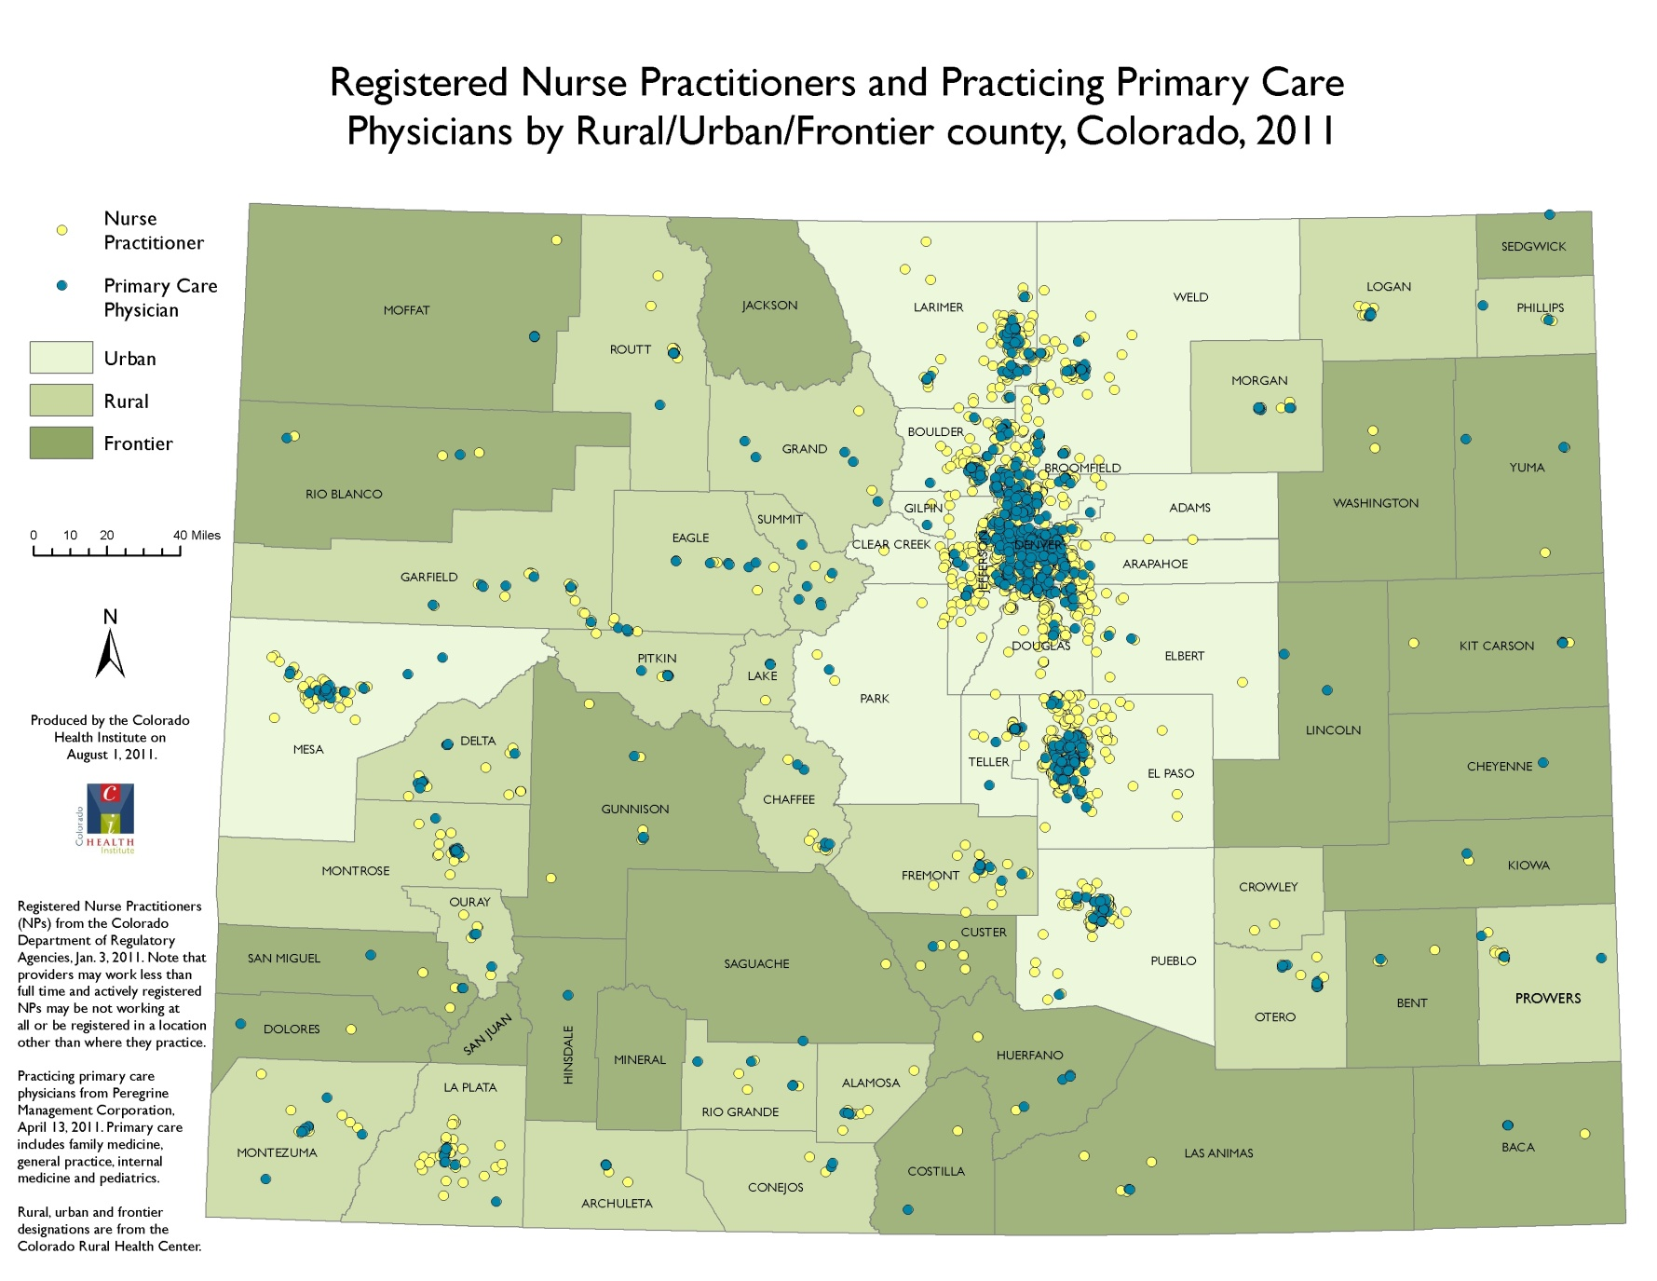
Distribution of NPs & Physicians
Counties with at least one registered NP and no practicing primary care physician

Slide 6
Distribution of PAs
Counties with at least one practicing PA and no practicing primary care physician

Slide 7
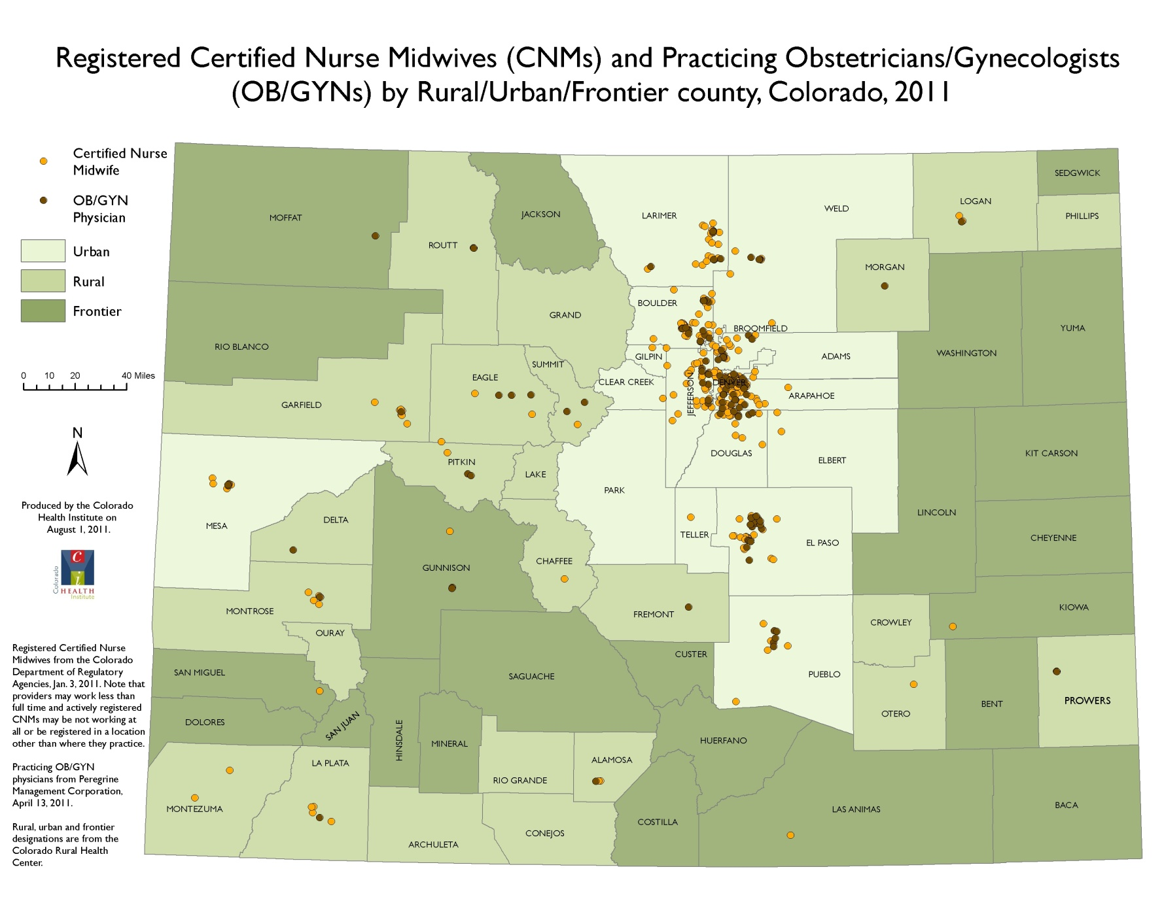
Distribution of CNMs & OB-GYNs
Counties with at least one registered CNM and no practicing Ob-Gyn

Slide 8
Rural APNs: Heavy lifters
N/A
N/A
N/A
N/A

Slide 9
Rural PAs: Carrying their share

Slide 10
Grow your own? Loan forgiveness?
52%
Rural NPs who reported growing up in a rural area
57%
Rural NPs who support increased access to loan forgiveness programs
Rural PAs and 65% of rural PAs in primary care who reported growing up in a rural area
PAs who support increased access to loan forgiveness programs
74%
58%

Slide 11
NP & PA Retention factors

Slide 12
NP & PA Retention factors
lack of respect
family responsibilities
insufficient wages

Slide 13
NP Work settings

Slide 14
Practice privileges available to NPs

Slide 15
NP hurdles to providing quality care
84%
Patient ability to afford access to needed care
63%
Availability of qualified specialists
76%
Receiving timely reports

Slide 16
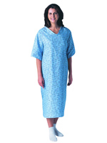
All insurance was not created equal

Slide 17
Summary of APN survey findings
Important providers of primary & anesthesia care
Upcoming retirement wave
Prescriptive authority not universal
Patients unable to afford needed care
Insurance doesn’t guarantee access either
Availability of specialists limits quality of care

Slide 18
Summary of PA survey findings
Rural PAs are important providers of primary care.
Retirements expected to be lower than NPs, as the former tend to be younger.
PAs’ scope of practice is based on a physician’s delegation of duties and often includes prescriptive authority.
Rural practices with PAs were slightly more likely than rural practices with NPs to accept Medicaid and CHP+ patients.
PAs in rural practices were more likely to accept Medicaid, Medicare and CHP+ patients than their urban counterparts.

Slide 19
Thank You
For comments and answers to questions contact:
Jacqueline L. Colby, PhD, MPH
Program Manager, Center for the Study of the Health Professions Workforce
720.382.7095
colbyj@ColoradoHealthInstitute.org
Athena Dodd, MSPH
Research Analyst, Center for the Study of the Health Professions Workforce
720.382.7093
dodda@ColoradoHealthInstitute.org

