Slide 1
Health Reform is Here
Colorado’s Changing Health Insurance Landscape
June 12, 2013
iTriage University
Denver, Colorado

Slide 2
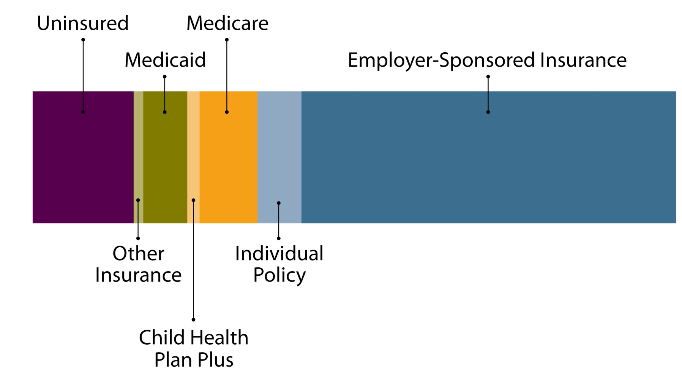
Today’s Discussion
How Coloradans get health insurance.
What’s changing?
Medicare
Public Insurance (Medicaid+)
Large Group
Small Group
Individuals
Uninsured

Slide 3
Three Takeaways
Three primary sources of new coverage: Employers, exchanges (marketplaces), Medicaid.
Small employers will have complex choices.
Hundreds of thousands of Coloradans will still be without health insurance.

Slide 4
Coverage Today

Slide 5
What Is Health Insurance?
Health insurance protects individuals from large expenditures or losses from illness, injury or disability by collectively pooling risk.
Risk: Possibility of loss or injury

Slide 6
Why Does Health Insurance Matter?
Condition | Uninsured Adults Compared to Insured Adults
Cancer | More likely to be diagnosed at an advanced stage
Heart attack | At greater risk of death
Diabetes | Significantly worse glycemic control
Trauma | Higher mortality rate in severe car accidents
Source: Institute of Medicine. “America’s Uninsured Crisis”

Slide 7
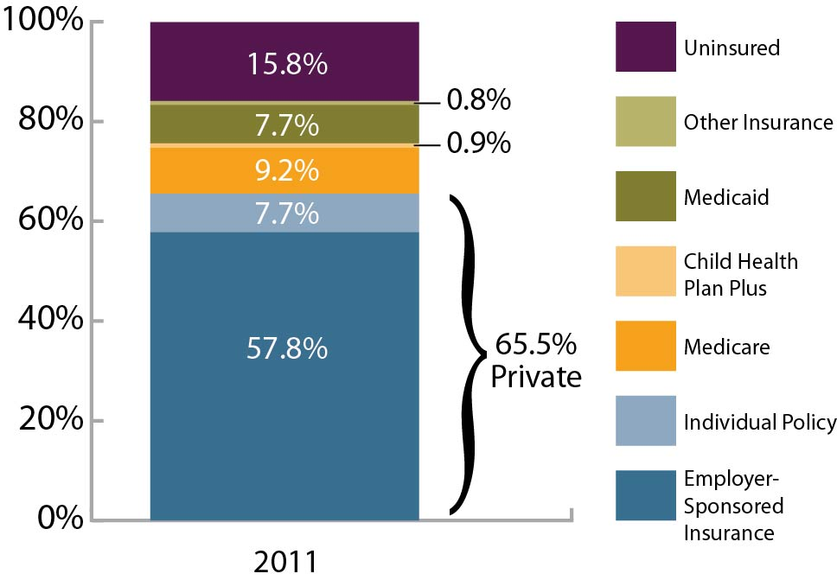
Private Market Covers Two-Thirds of Coloradans
Source: 2011 Colorado Health Access Survey

Slide 8
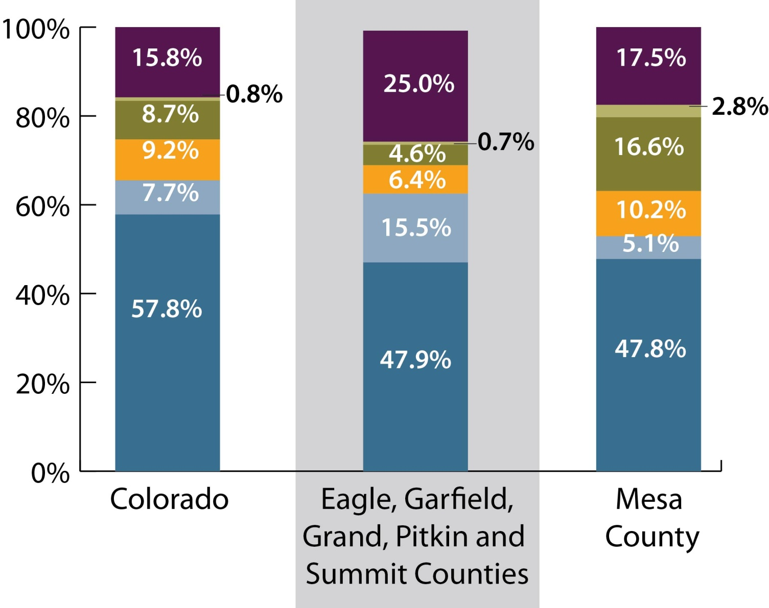
Coverage Varies Across Colorado
Uninsured
Other Insurance
Medicaid/Child Health Plan Plus
Medicare
Individual Policy
Employer-Sponsored
Insurance

Slide 9
What’s Changing in 2013 and 2014?

Slide 10
Major Changes Under Obamacare
Guaranteed Issue/Renewal
Individual Mandate
Lots of other stuff:
Extension of dependent coverage until age 26
No lifetime or annual limits on coverage
Essential health benefits
Health insurance marketplaces
Expansion of the Medicaid program (optional for states)

Slide 11
At a Glance:
Who is covered by Medicare?
People 65 and older as well as younger people with disabilities.

Slide 12
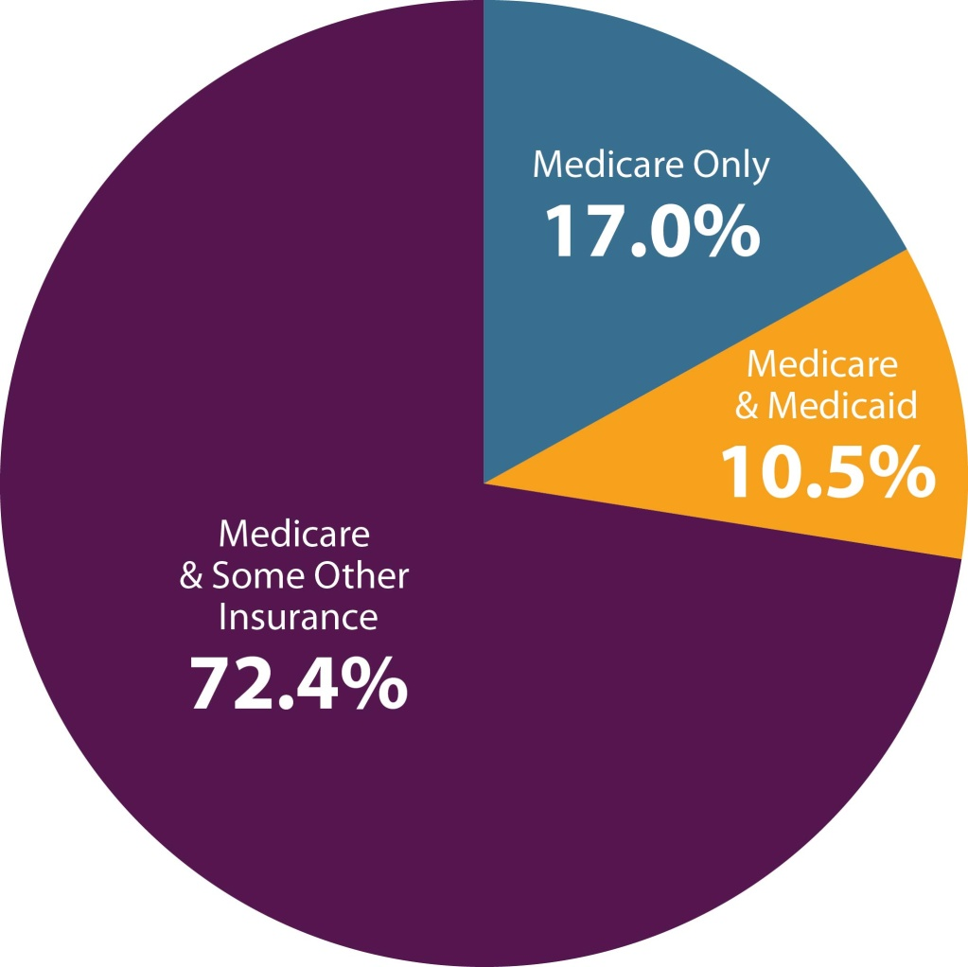
Nearly All Colorado Seniors Have Medicare
Many also have “supplemental insurance”
Source: 2011 Colorado Health Access Survey

Slide 13
Health Reform: Mostly Good News for Seniors
Phases in coverage of the “donut hole” (Medicare Part D drug benefit coverage gap).
Improves coverage of preventive services.
Changes and reductions in payment.
But uncertainty about providers

Slide 14
At a Glance:
Who is covered by Employer-Sponsored Insurance?
Two of every three Coloradans.

Slide 15
Colorado Employers and Health Reform

Slide 16
Changes to Large Group Plans
50+ employees, not self-insured
Must offer comprehensive insurance coverage or pay a tax penalty, starting in 2014
May continue to offer “grandfathered plans” that are exempt from some new rules

Slide 17
Small Group Market in Colorado
1-50 employees
Mandated benefits
Guaranteed issue and renewal
Premium rating:
smoking status,
industry,
age,
family size
geographic location

Slide 18
What’s in Store?
Eligible for tax credits if insurance is offered
1-25 employees
Small Business Health Options Program (SHOP) Marketplace in 2014
For businesses < 100 employees
Defined Contribution
Defined Benefit

Slide 19
At a Glance:
Who is covered by Individual Policies?
About 8 percent of Coloradans.

Slide 20
What’s in Store
Individuals can keep current insurance, employer sponsored or not.
Can purchase individual insurance through the health insurance Marketplace starting in 2014.
May be eligible for subsidies depending on income level.

Slide 21
Evolving Exchanges
New insurance marketplace
Enrollment set to launch October 1
Benefits begin January 1
Subsidies for individuals 138-400 percent FPL

Slide 22
At a Glance:
Who is covered by Medicaid?
Low-income children, parents, pregnant women, individuals with disabilities and the elderly.

Slide 23
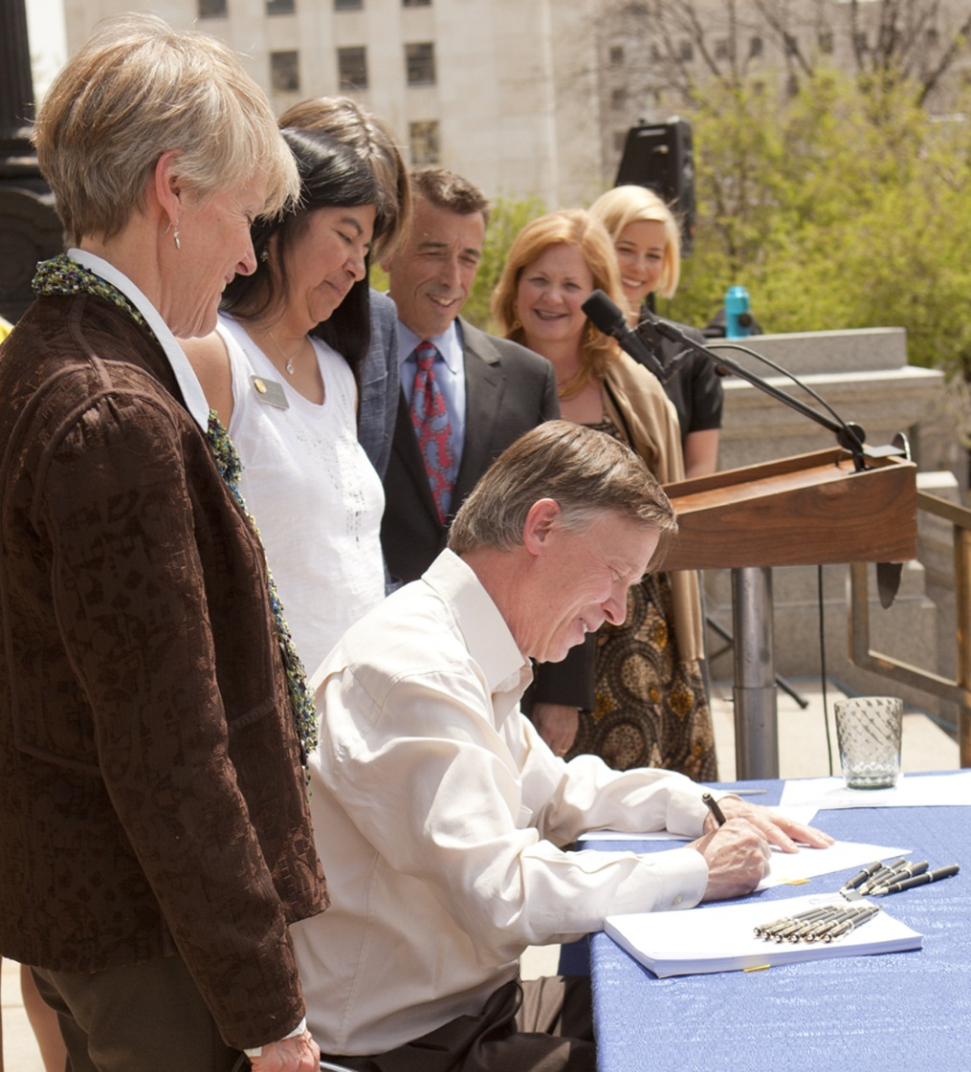
Colorado’s Medicaid Expansion
150,000 Newly Insured
Mostly Working-Age Parents and Adults Without Dependent Children
Another 60,000 Anticipated to Switch Insurance

Slide 24
At a Glance:
Who is Uninsured in Colorado?
About 16 percent of the population, up from about 14 percent in 2009.

Slide 25
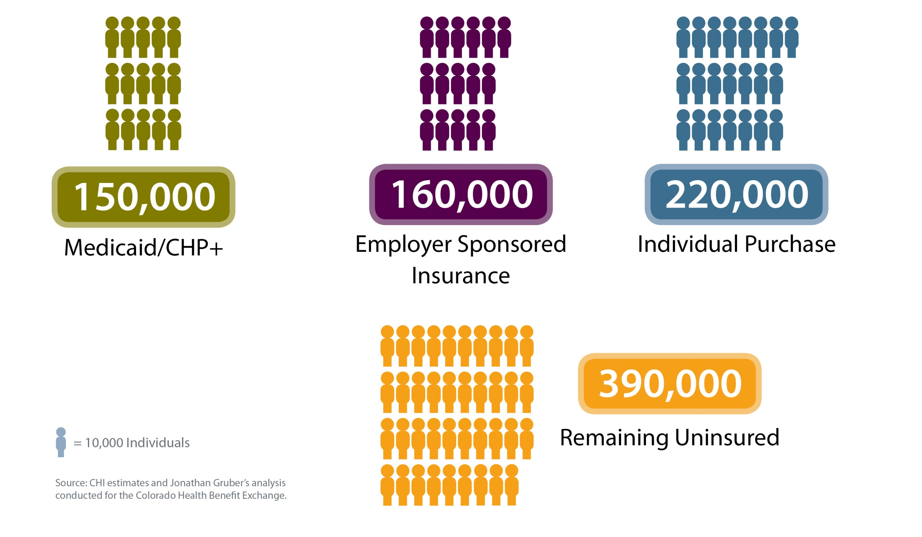
What Will Happen By 2016?
Uninsured Without HR Implementation
Uninsured After HR Implementation
390,000
Individual Purchase
220,000
= 10,000 Individuals
920,000
Employer Sponsored Insurance
160,000
Medicaid/ CHP+
150,000
Source: CHI estimates and Jonathan Gruber’s analysis conducted for the Colorado Health Benefit Exchange.

Slide 26
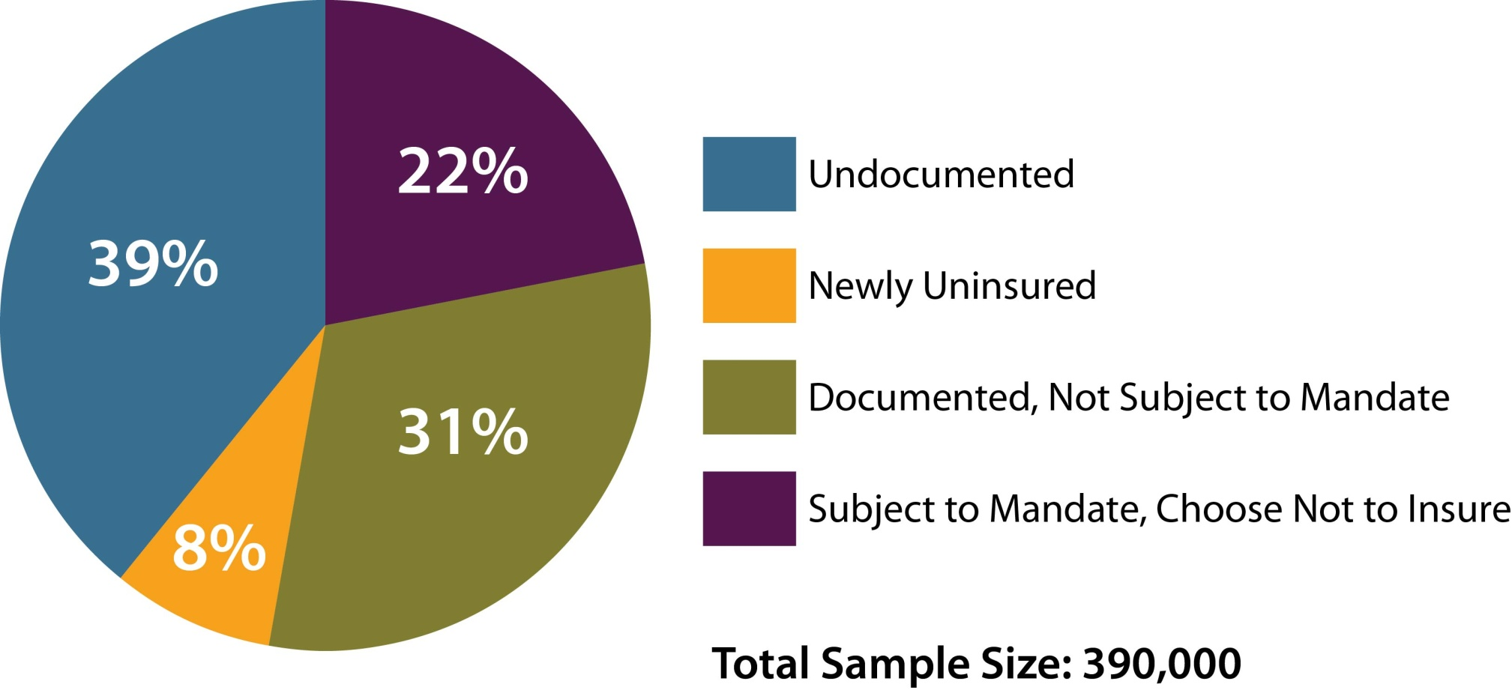
Estimate: 390,000 Will Still be Uninsured
Source: Colorado Health Benefit Exchange Research, Prepared by Jonathan Gruber, January 2012

Slide 27
Final Thoughts

Slide 28
Some Questions About Expectations
Will health insurance be affordable?
What can we learn from history?
Medicare Part D
Children’s Health Insurance Plan
How many Coloradans will actually be affected?
Will there be enough capacity?

Slide 29
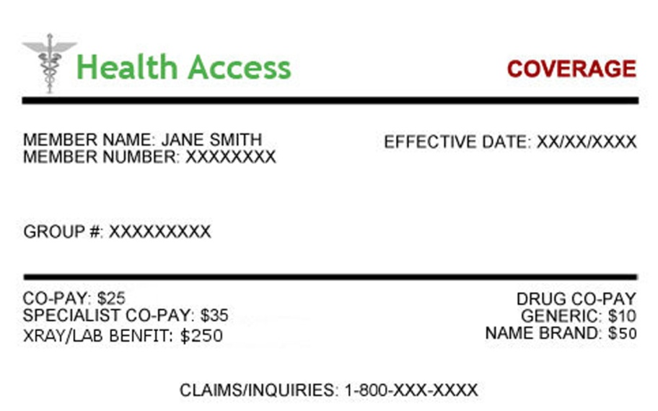
Remember
An insurance card doesn’t guarantee access to care.
Lacking an insurance card doesn’t necessarily mean lacking access to care.

Slide 30
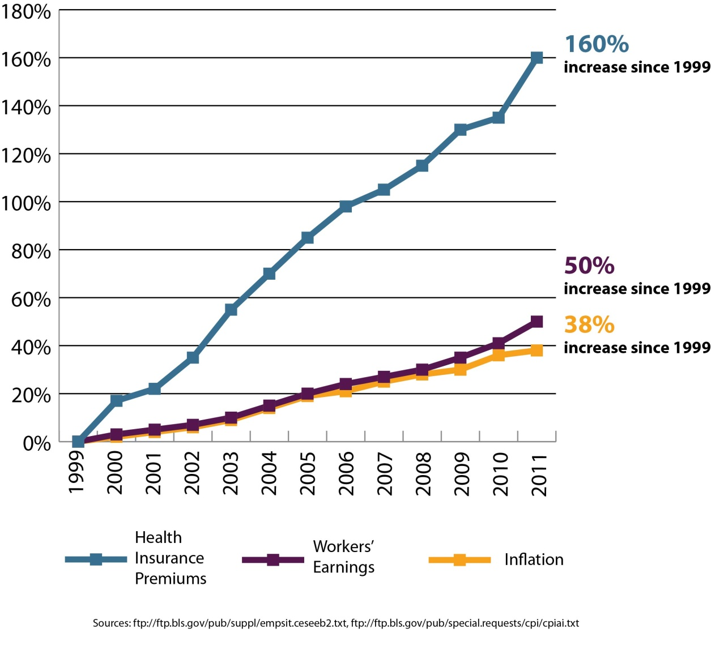
Health Care Costs: A Curve in Need of Bending

Slide 31
Three Takeaways
Three primary sources of new coverage: Employers, exchanges (marketplaces), Medicaid.
Small employers will have complex choices.
Hundreds of thousands of Coloradans will still be without health insurance.

Slide 32
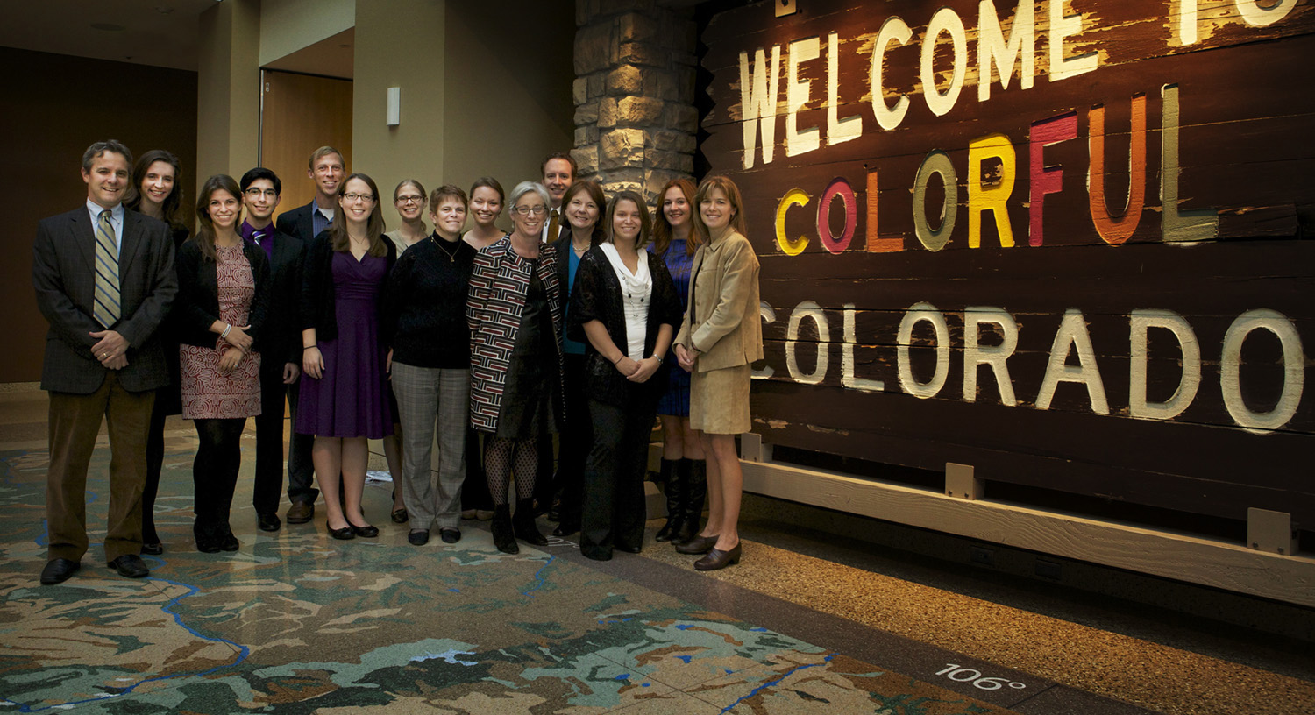
Jeff Bontrager bontragerj@coloradohealthinstitute.org 720.382.7075

