Slide 1
Coverage in Colorado’s Counties
Forecasting Health Insurance Dynamics in 2016
June 5, 2013
Colorado Human Services Directors Association and Colorado Counties
Keystone, Colorado

Slide 2
Three Takeaways
Health coverage will increase substantially in counties with high uninsured rates, but hundreds of thousands of Coloradans will still be uninsured.
Coloradans with low incomes will be most vulnerable to potentially complicated churn issues.
Coverage does not guarantee access to care, but Colorado has rich data resources to monitor coverage and access.

Slide 3
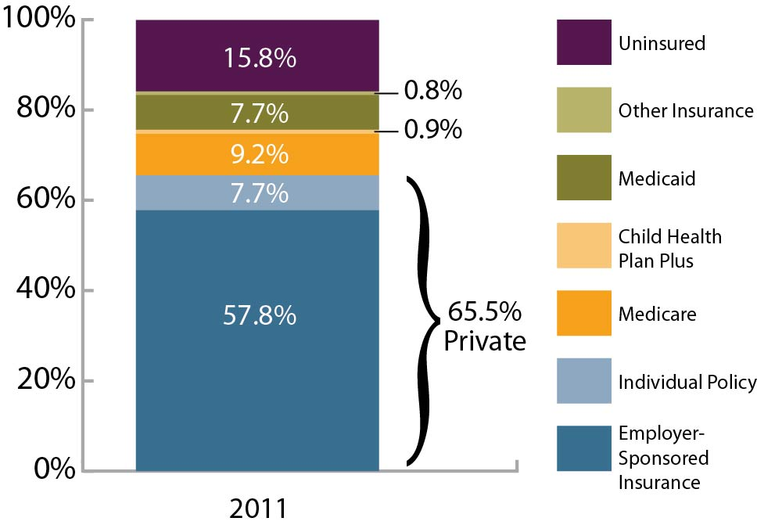
How are Coloradans Covered?
Source: 2011 Colorado Health Access Survey

Slide 4
The Potter Family: A (Fictional) Case Study
Mom and dad work for minimum wage ($30,000/ year)
127 percent of Federal Poverty Level
Mom, dad, mom’s sister uninsured
Kids on Medicaid

Slide 5
Predicting the Future

Slide 6
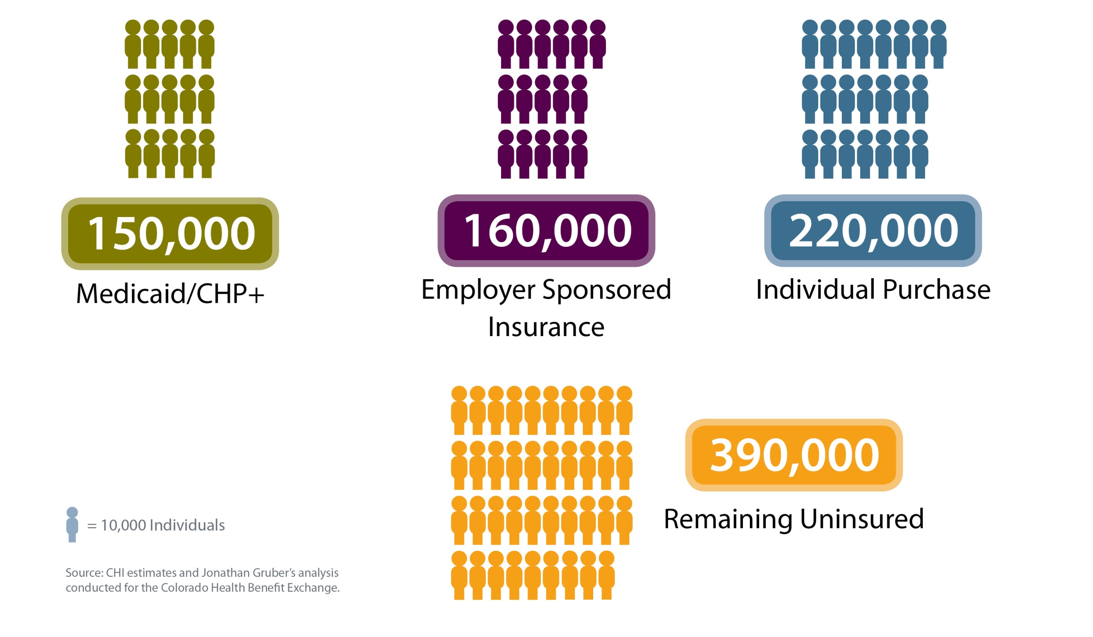
What Will Happen By 2016?
Uninsured Without HR Implementation
Uninsured After HR Implementation
390,000
Individual Purchase
220,000
= 10,000 Individuals
920,000
Employer Sponsored Insurance
160,000
Medicaid/ CHP+
150,000
Source: CHI estimates and Jonathan Gruber’s analysis conducted for the Colorado Health Benefit Exchange.

Slide 7
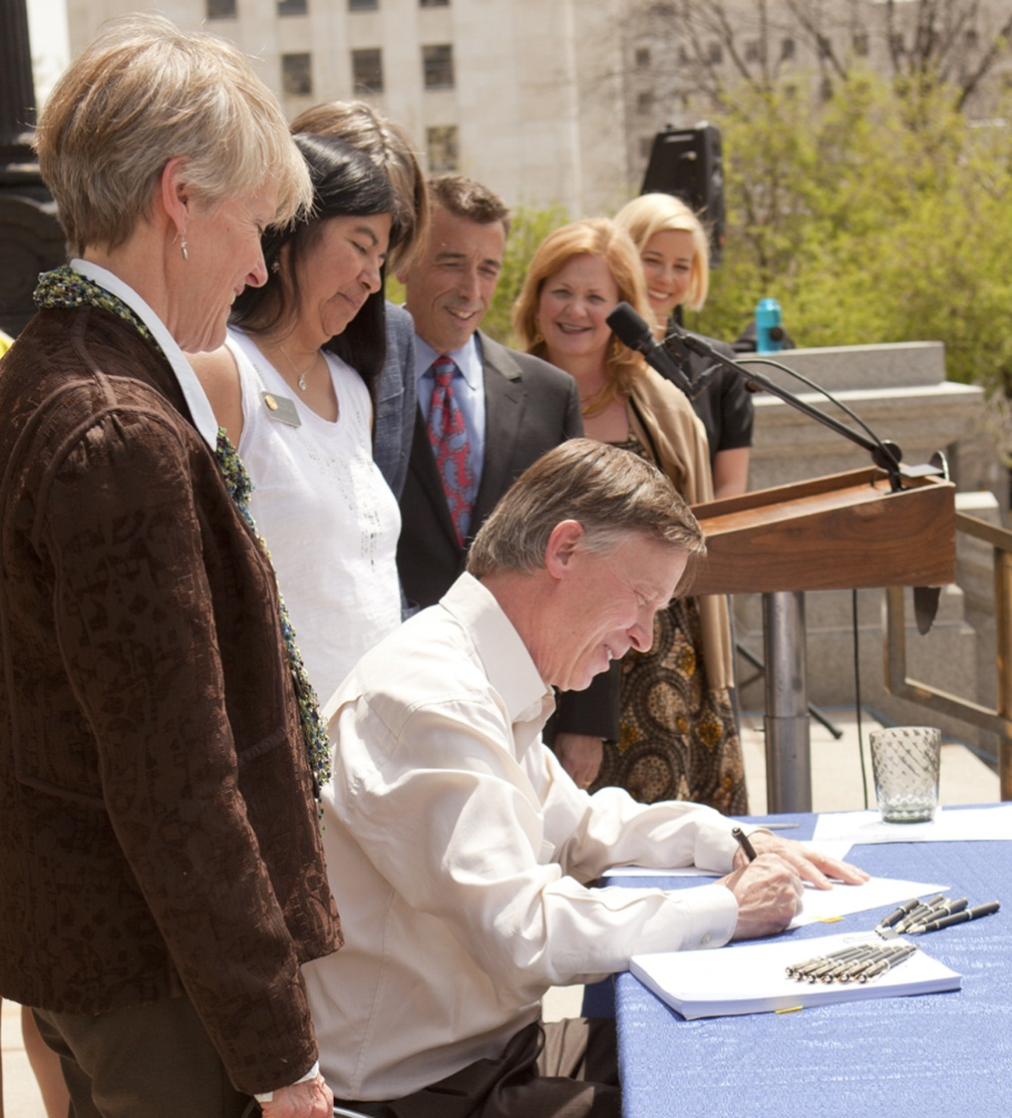
Colorado’s Medicaid Expansion
150,000 Newly Insured
Mostly Working-Age Parents and Adults Without Dependent Children
Another 60,000 Anticipated to Switch Insurance

Slide 8
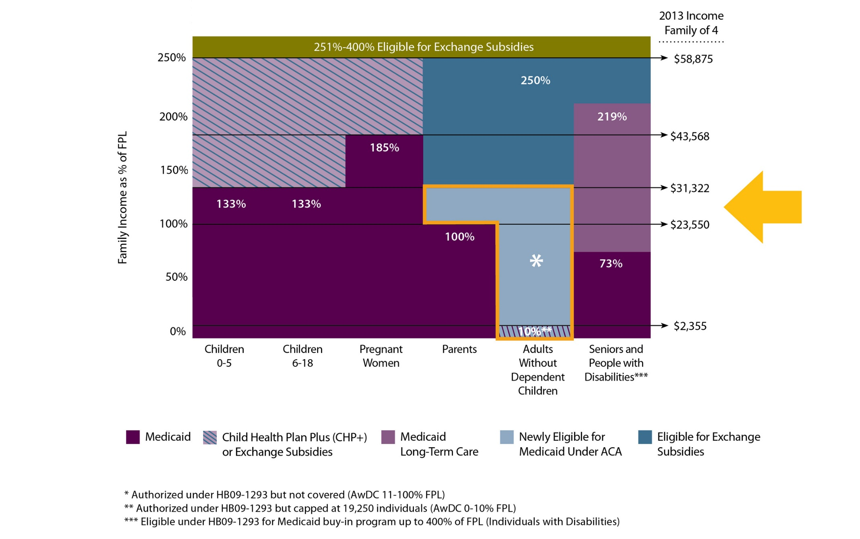
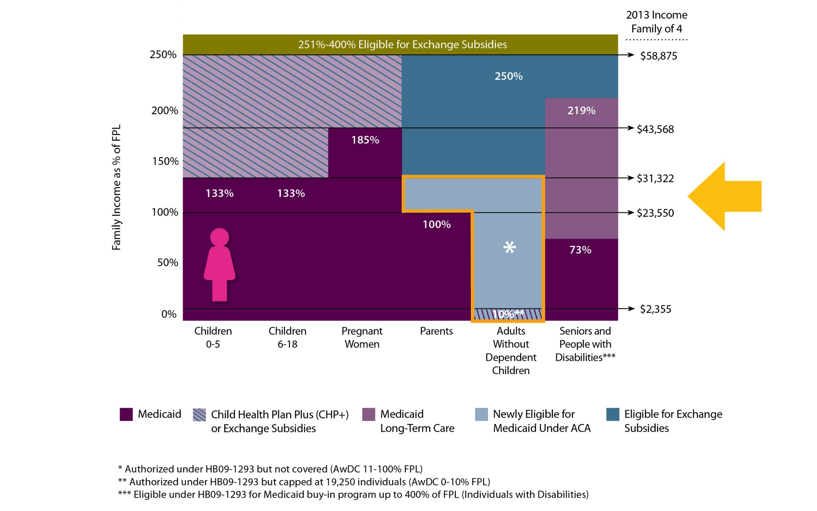
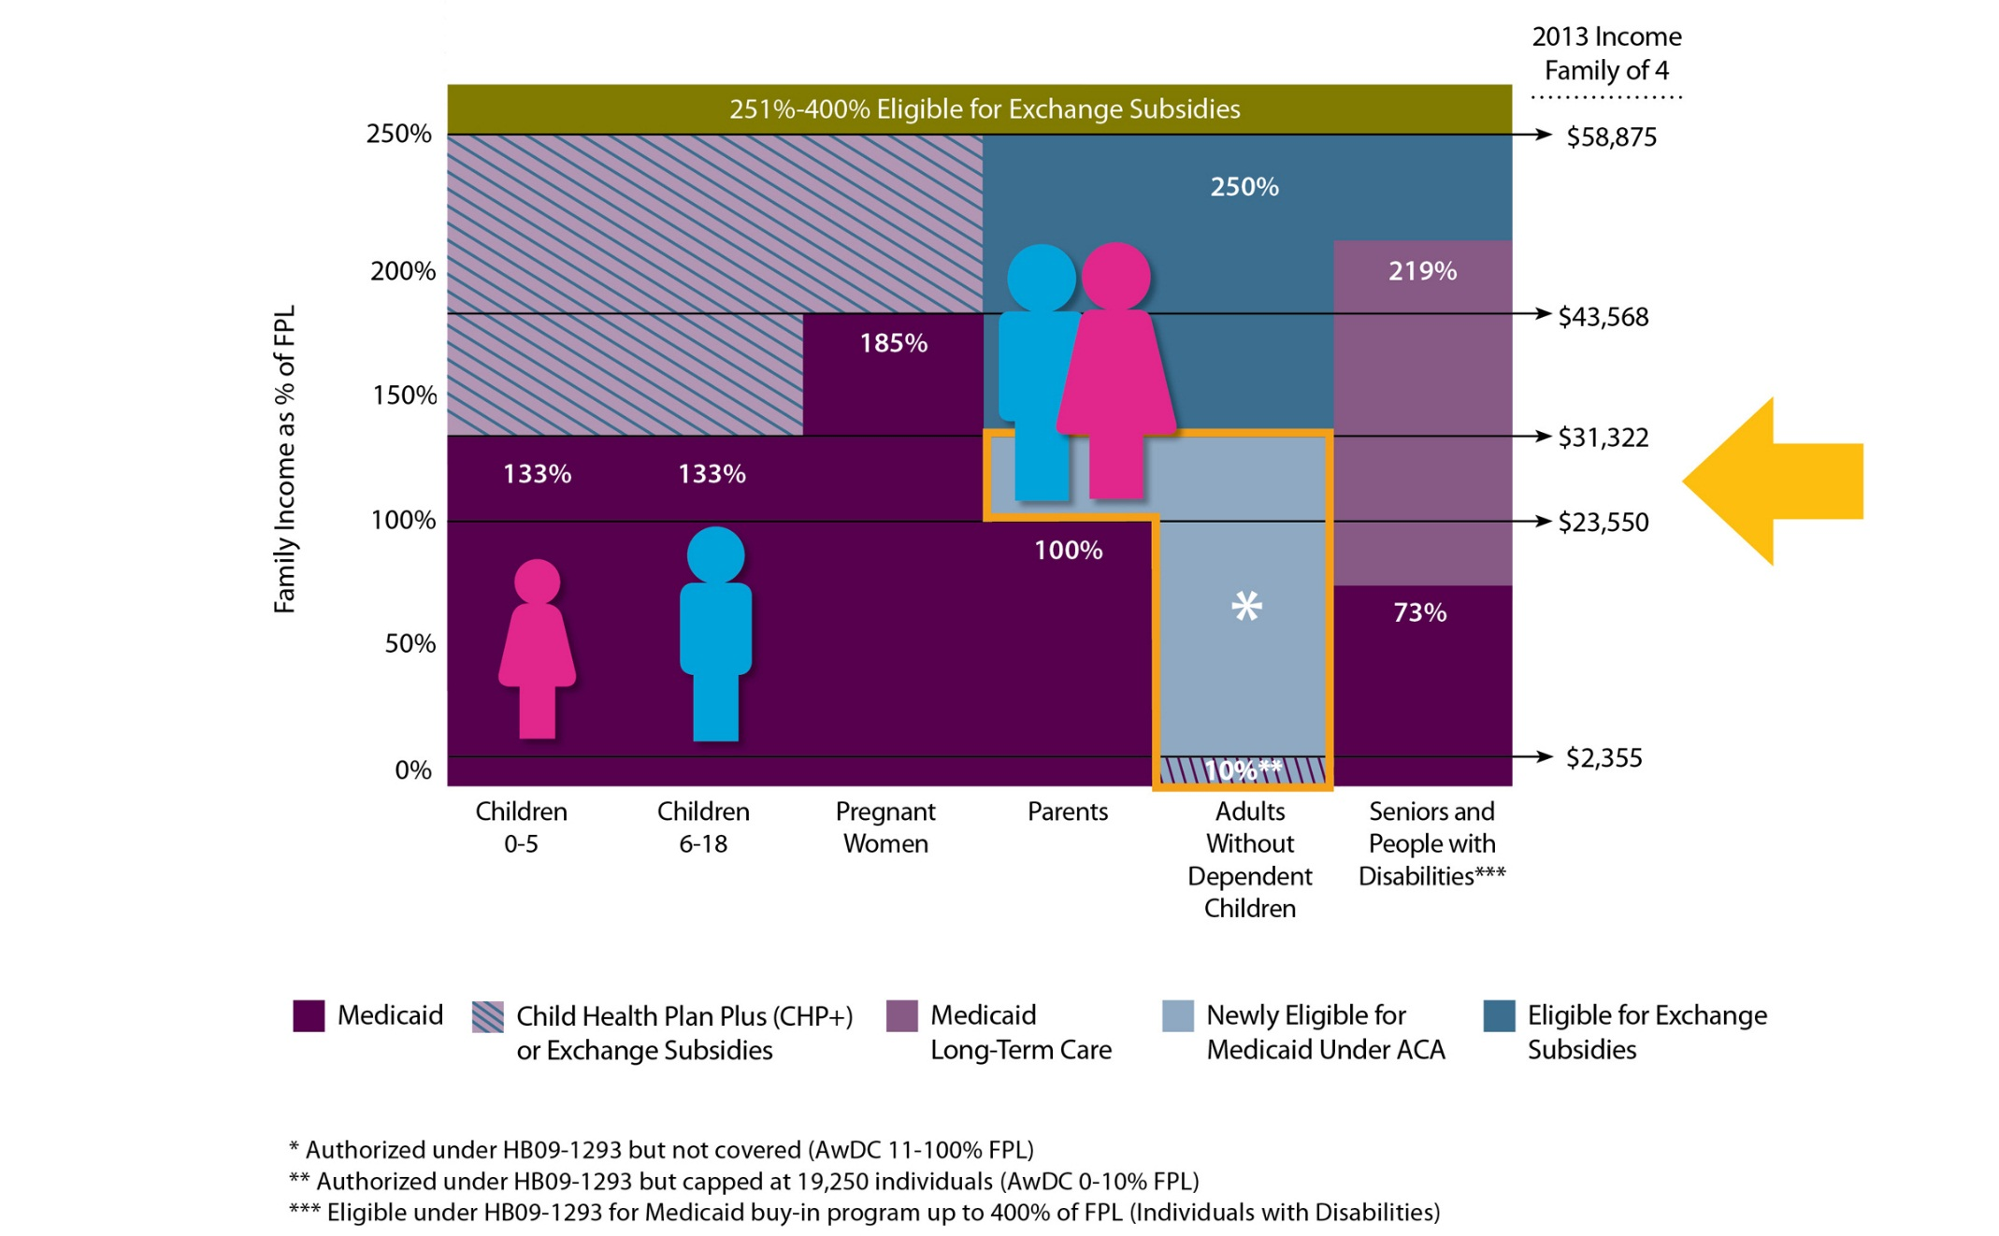
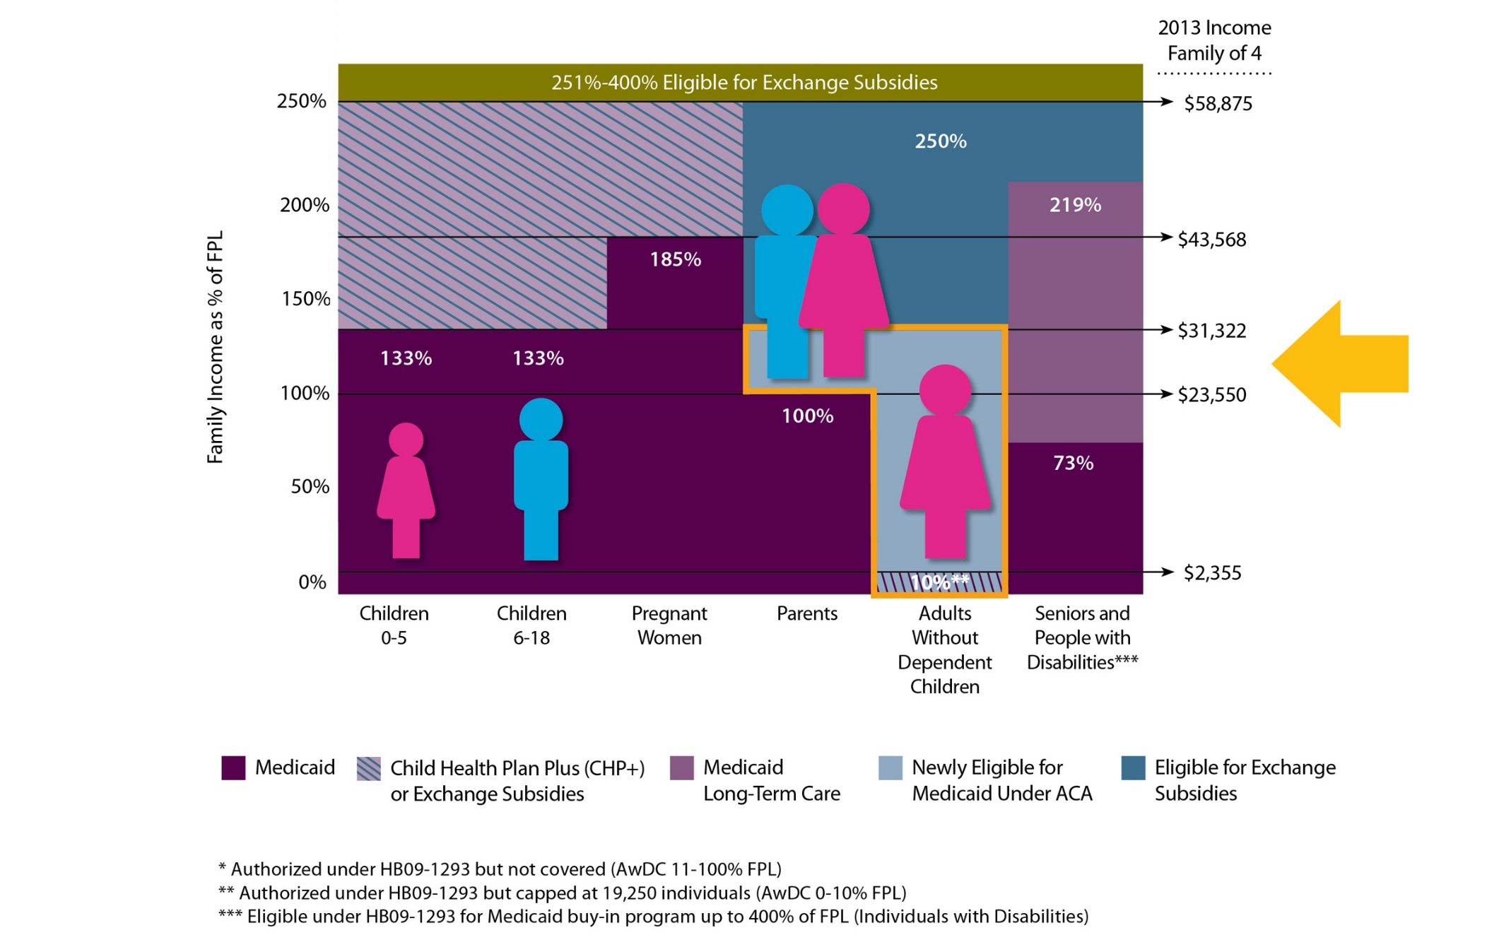
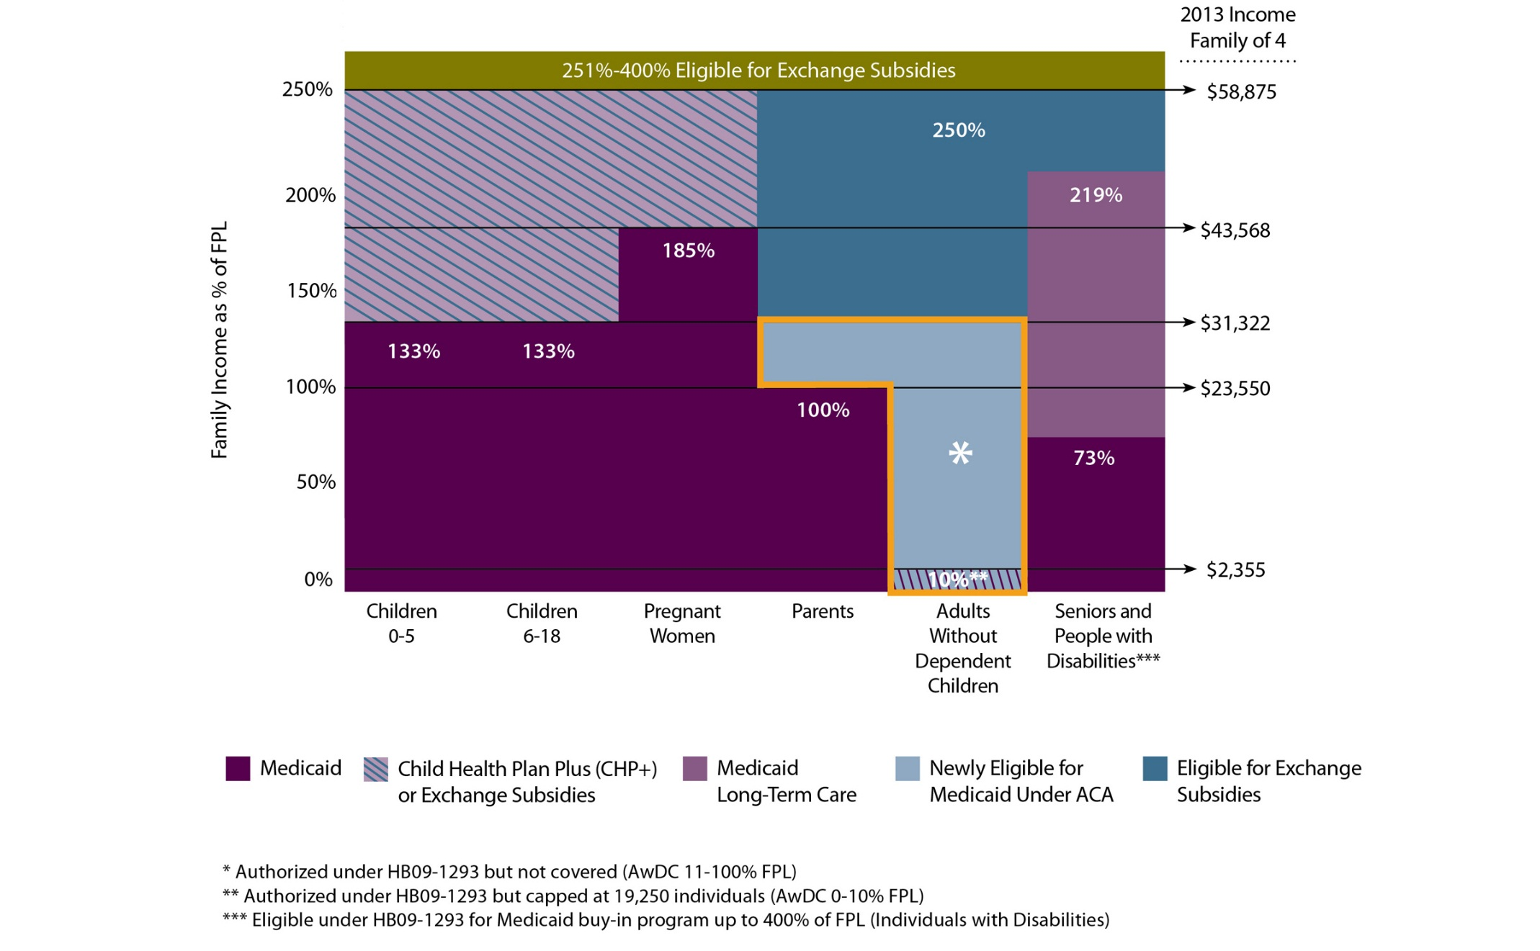
One Family, One Source of Coverage

Slide 9
Map 1: Percentage of the Population Covered by Medicaid, 2011
NOTE: Low income Medicaid enrollees includes adults and children who are enrolled in Medicaid based on their income. It does not include individuals with disabilities or foster care children, etc.

Slide 10
Map 2: Percentage of the Population Covered by Medicaid, 2016
NOTE: Low income Medicaid enrollees includes adults and children who are enrolled in Medicaid based on their income. It does not include individuals with disabilities or foster care children, etc.

Slide 11
Evolving Exchanges
Online marketplace
Enrollment set to launch October 1
Benefits begin January 1
Subsidies for individuals 138-400 percent FPL

Slide 12
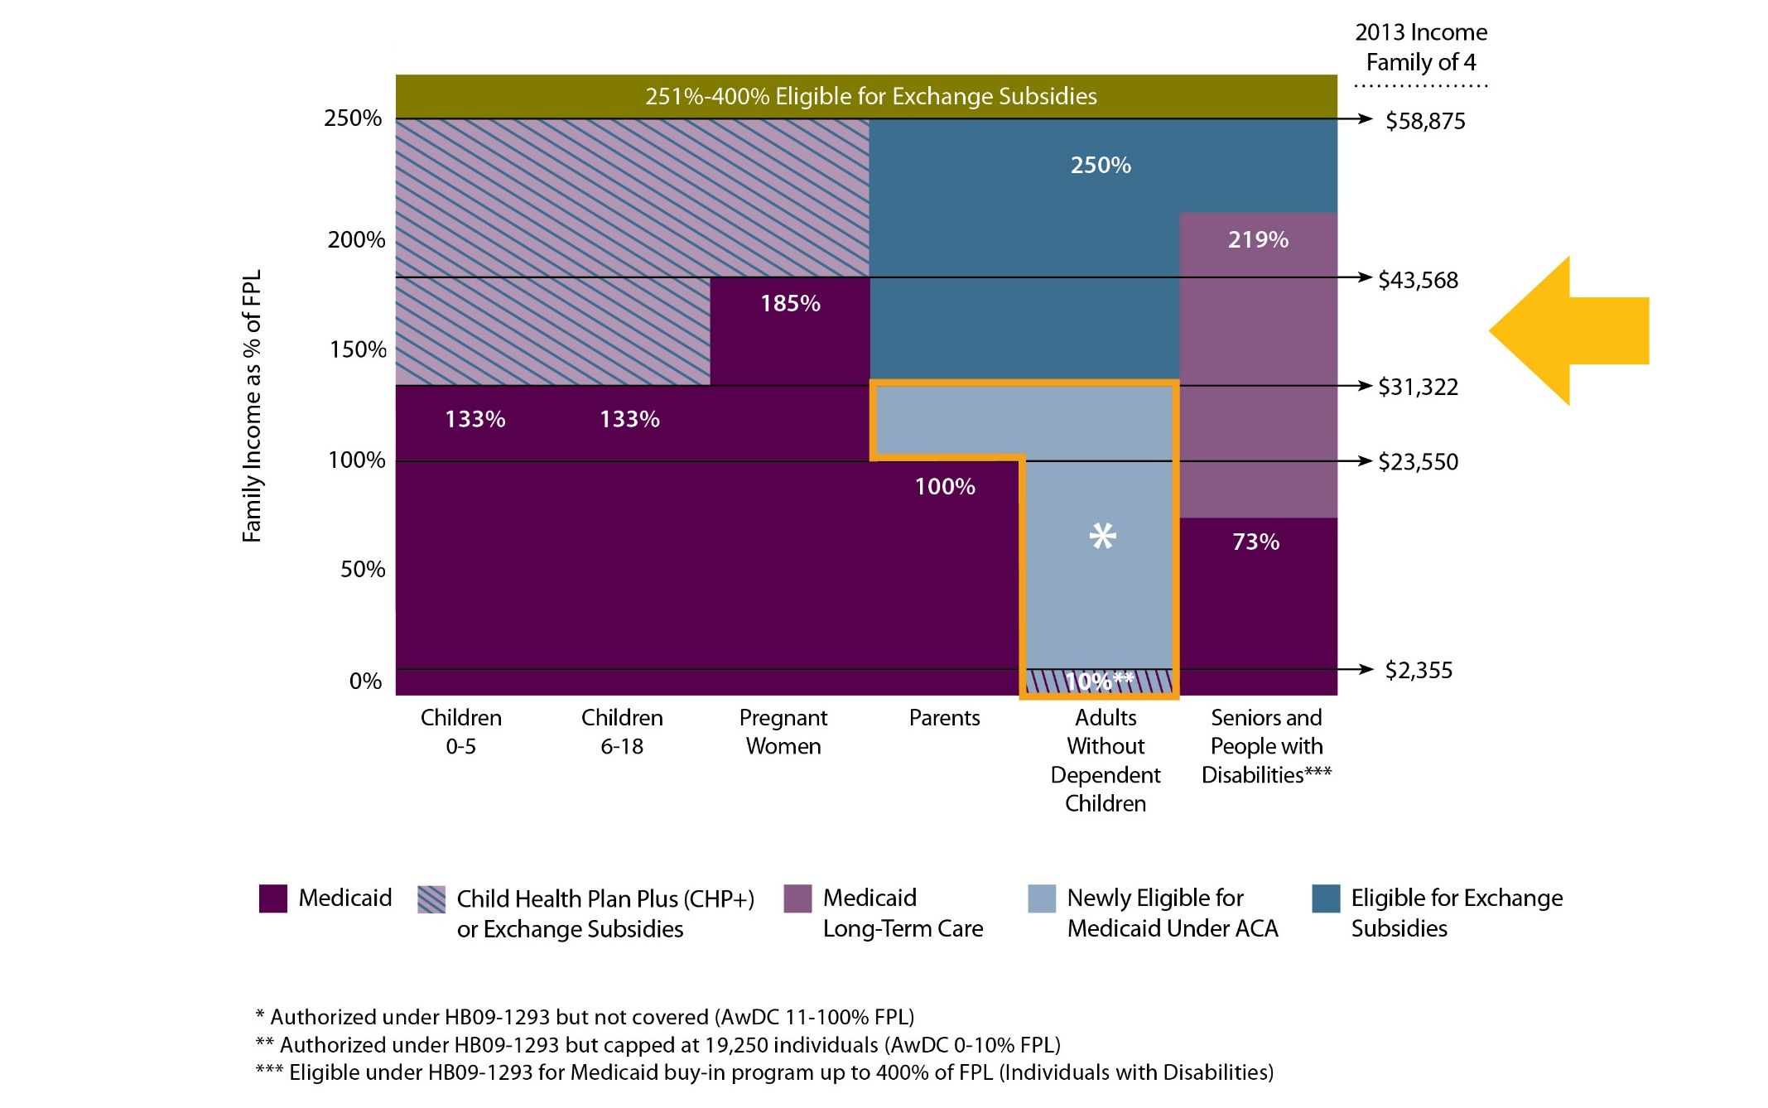
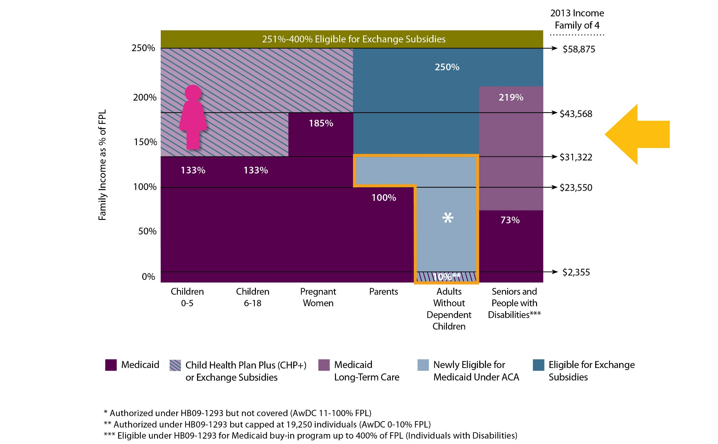
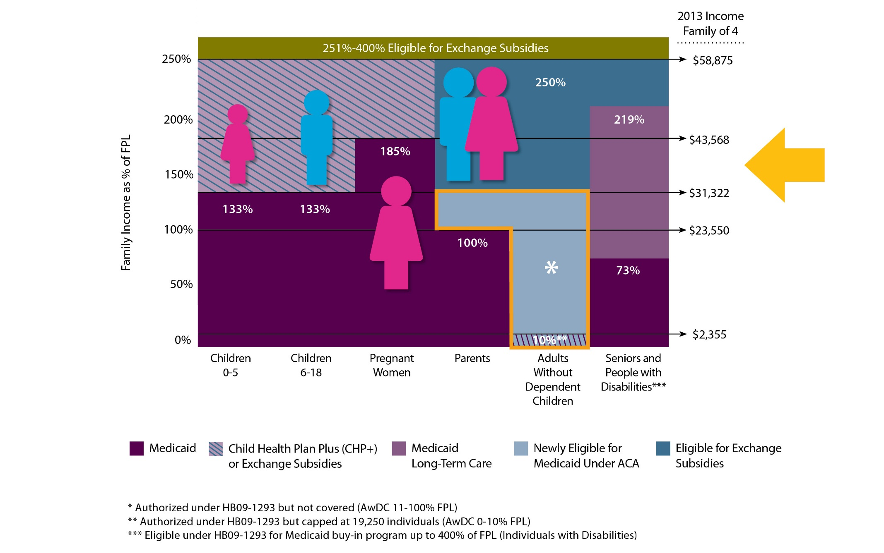
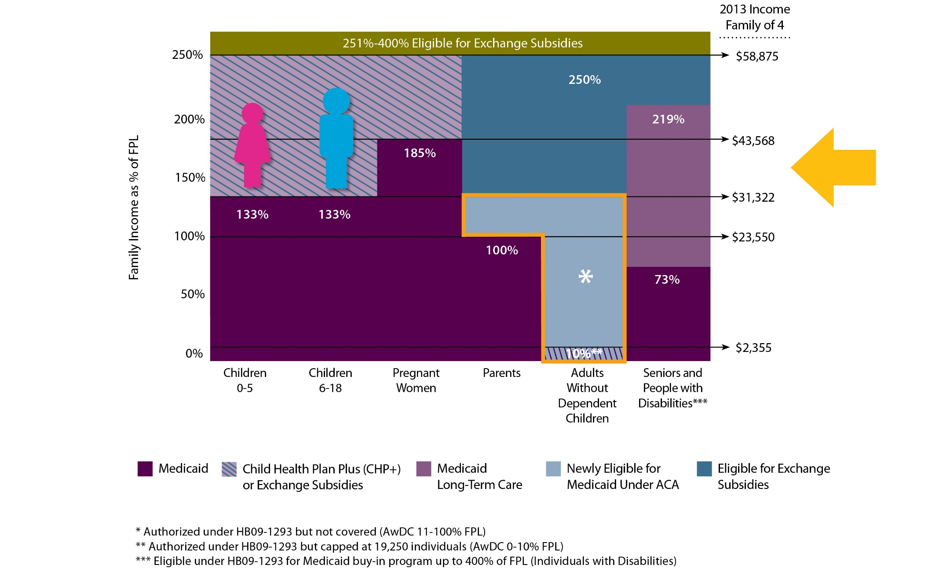
What Happens if the Potters’ Income Increases $3,000?

Slide 13
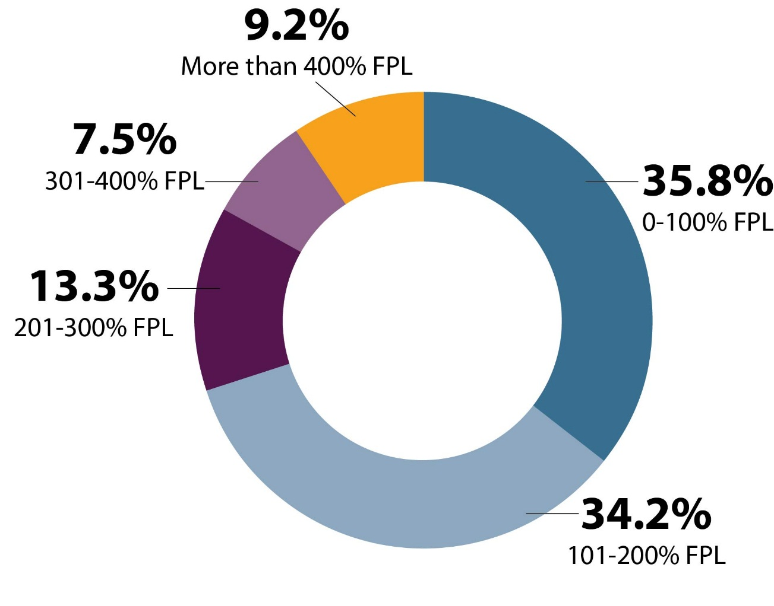
Coloradans with a Period of Uninsurance Tend to Have Low Incomes
Individuals Reporting a Period without Insurance Over 12 Months, by Percent of the Federal Poverty Level (FPL), Colorado, 2011
Excludes individuals who were uninsured for all 12 months.
Source: 2011 Colorado Health Access Survey

Slide 14
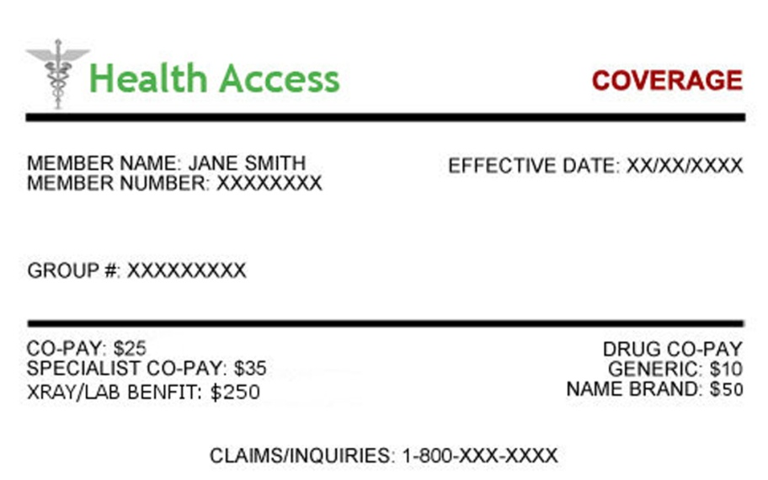
Remember
An insurance card doesn’t guarantee access to care.
Lacking an insurance card doesn’t necessarily mean lacking access to care.

Slide 15
Three Data Resources You Should Know About

Slide 16
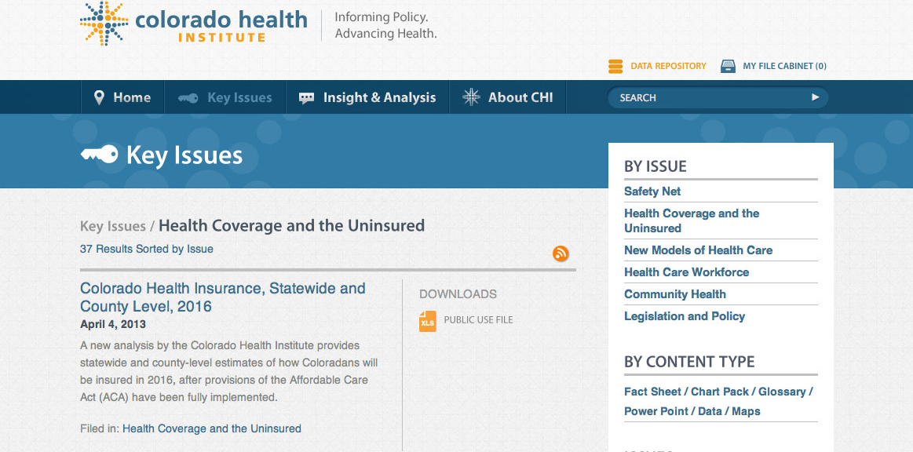
Colorado Health Institute: State and County 2016 Estimates
Available for download at: http://bit.ly/17ZDnkX

Slide 17
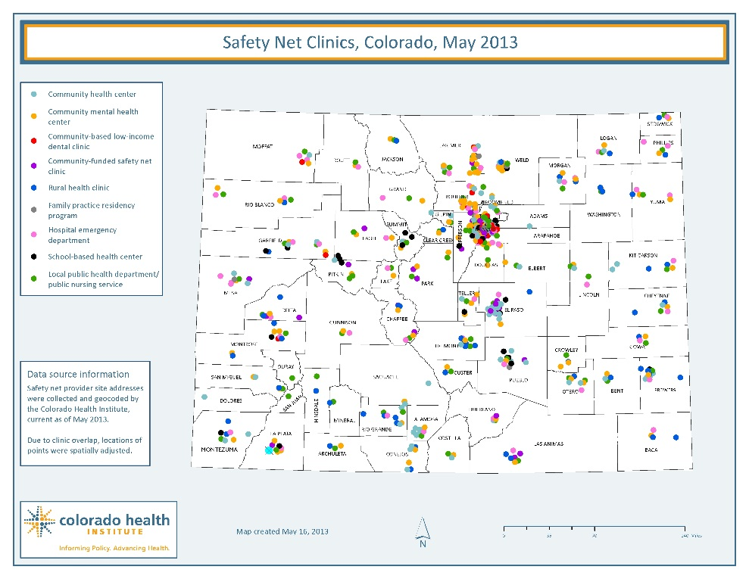
Colorado Health Institute: Safety Net Clinic Database
Most up-to-date map and downloadable database available online: http://bit.ly/151pVvl

Slide 18
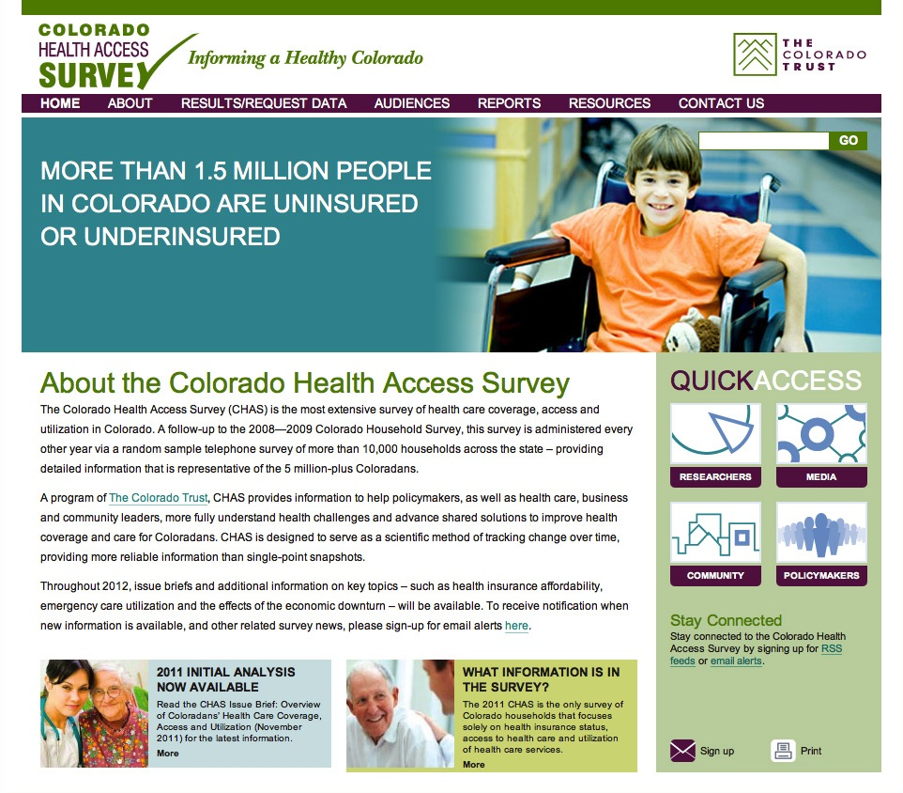
Colorado Health Access Survey (CHAS)
www.COHealthAccessSurvey.org
Data available in several ways
Research file
Public Use file
Custom reports
Briefings
Colorado Health Institute

Slide 19
Three Takeaways
Health coverage will increase substantially in counties with high uninsured rates, but there will still be hundreds of thousands of uninsured Coloradans.
Coloradans with low incomes will most vulnerable to potentially complicated churn issues.
Coverage does not guarantee access to care, but Colorado has rich data resources to monitor coverage and access.

Slide 20
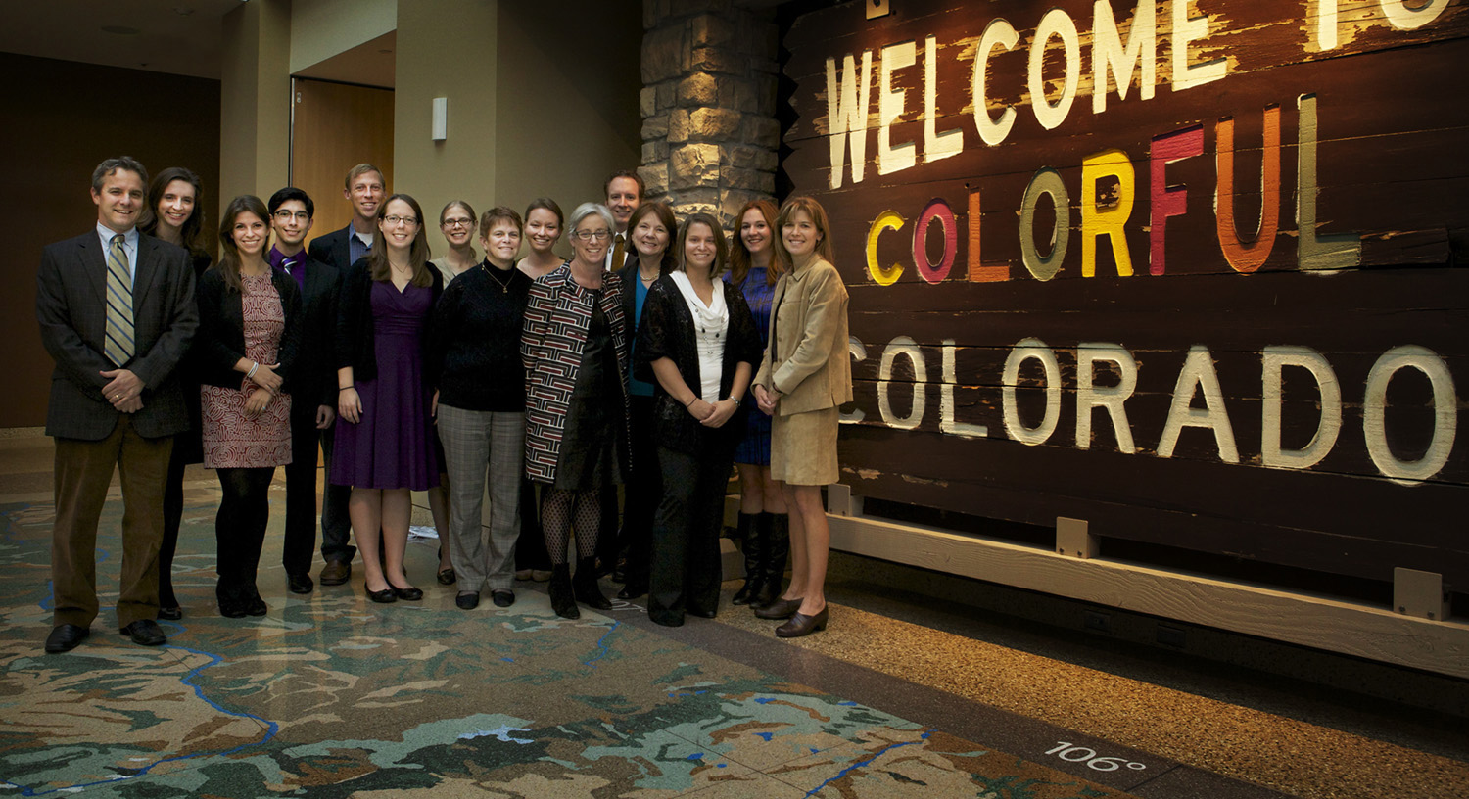
Jeff Bontrager bontragerj@coloradohealthinstitute.org 720.382.7075

