Slide 1
Colorado Children’s Health Insurance Status
2012 Update
April 6, 2012
All Kids Covered

Slide 2
Today’s Discussion: Three Key Takeaways
How many Colorado children are uninsured and eligible for public insurance programs?
How has this number changed since the start of the recession?
What can surveys tell us about EBNE and uninsured Colorado children?

Slide 3

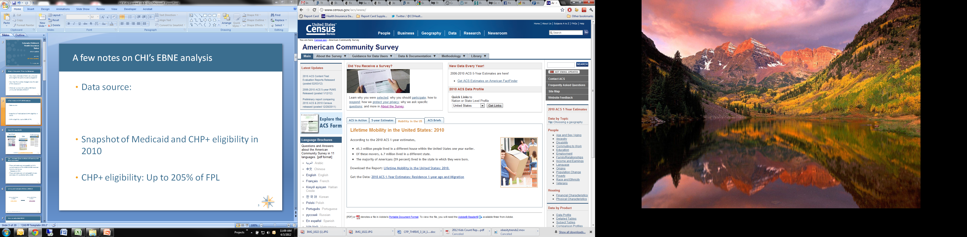
A few notes on CHI’s EBNE analysis
Data sources:
Snapshot of Medicaid and CHP+ eligibility in 2010
CHP+ eligibility: Up to 205% of FPL
+
Budget Division

Slide 4
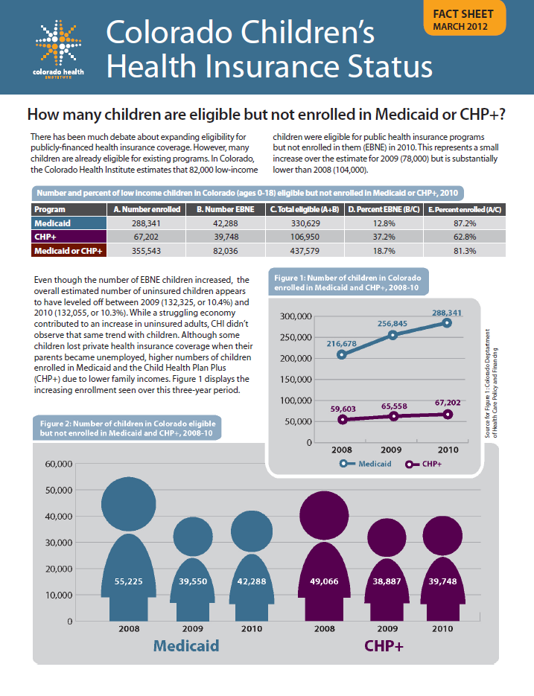
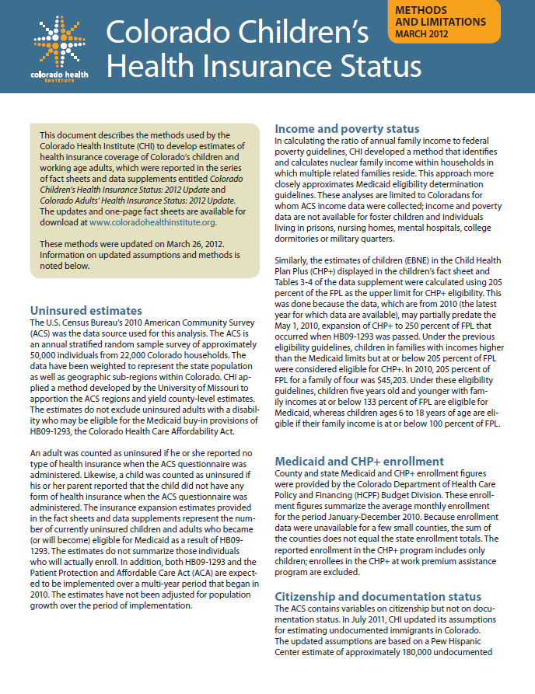
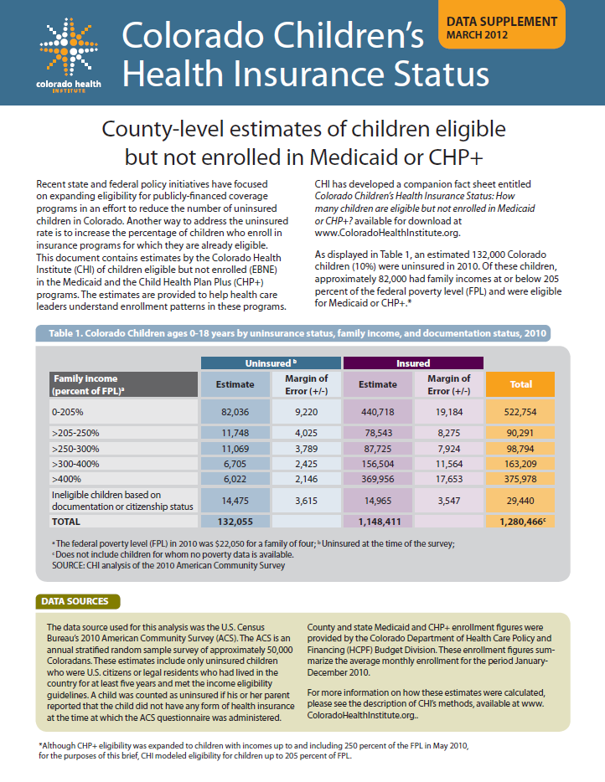
New CHI Issue Briefs
Fact Sheet
Methodology
Data
Supplement
Available at www.ColoradoHealthInstitute.org/EBNE

Slide 5
Can I compare these numbers with previous CHI EBNE estimates?
These estimates are comparable to CHI’s revised analysis of the 2008 & 2009 American Community Survey
  Released July 2011
These estimates are not comparable to any estimates CHI published before 2008

Slide 6
Uninsured Colorado children, 2009-10
Uninsured children
in 2009:
Uninsured children
in 2010:
132,325
132,055
SOURCE: CHI analysis of the 2009-10 American Community Survey

Slide 7
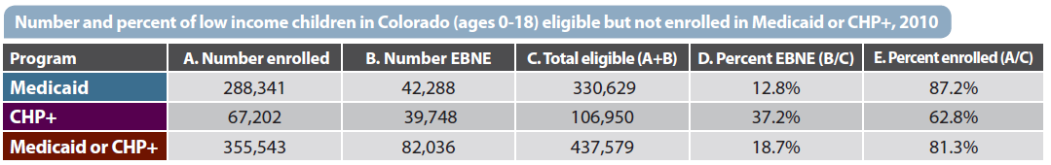
How we calculated EBNE
SOURCE: CHI analysis of the 2010 American Community Survey; Medicaid and CHP+ enrollment data from the Colorado Department of Health Care Policy and Financing

Slide 8
Uninsured Colorado children by EBNE status, 2010
SOURCE: CHI analysis of the 2010 American Community Survey

Slide 9
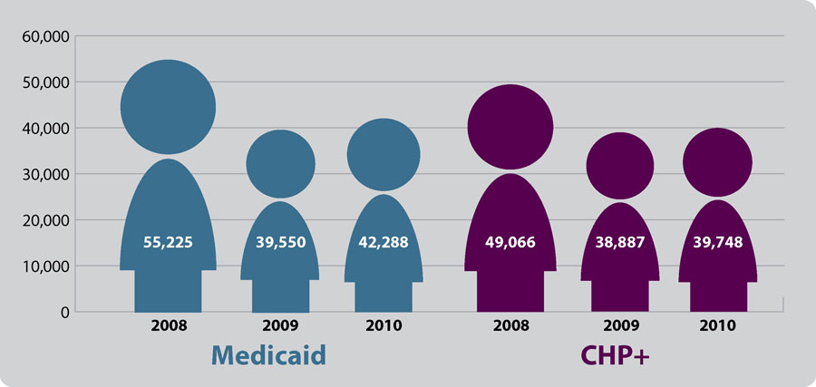

EBNE children in Colorado, 2008-10
SOURCE: CHI analysis of the 2008-10 American Community Survey

Slide 10
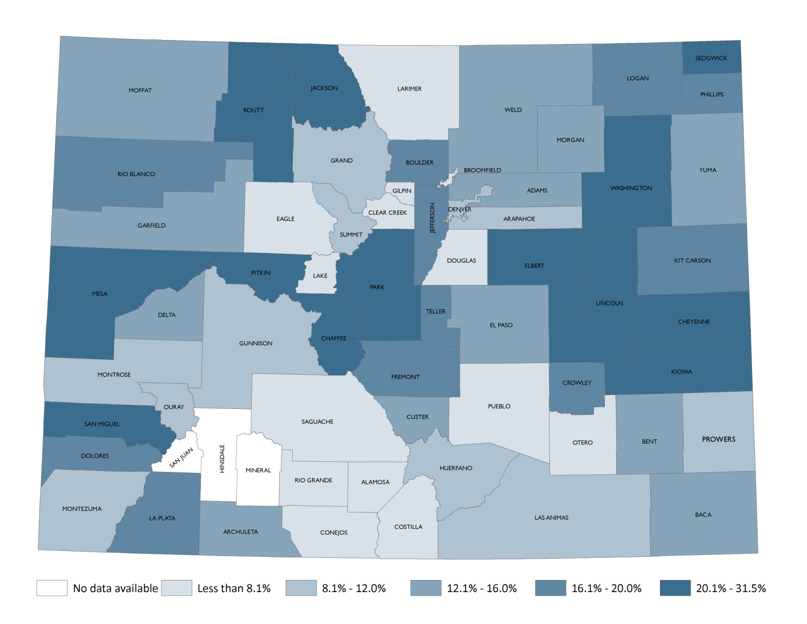
Percent EBNE in Medicaid, 2010
SOURCE: CHI analysis of the 2010 American Community Survey; Medicaid and CHP+ enrollment data from the Colorado Department of Health Care Policy and Financing

Slide 11
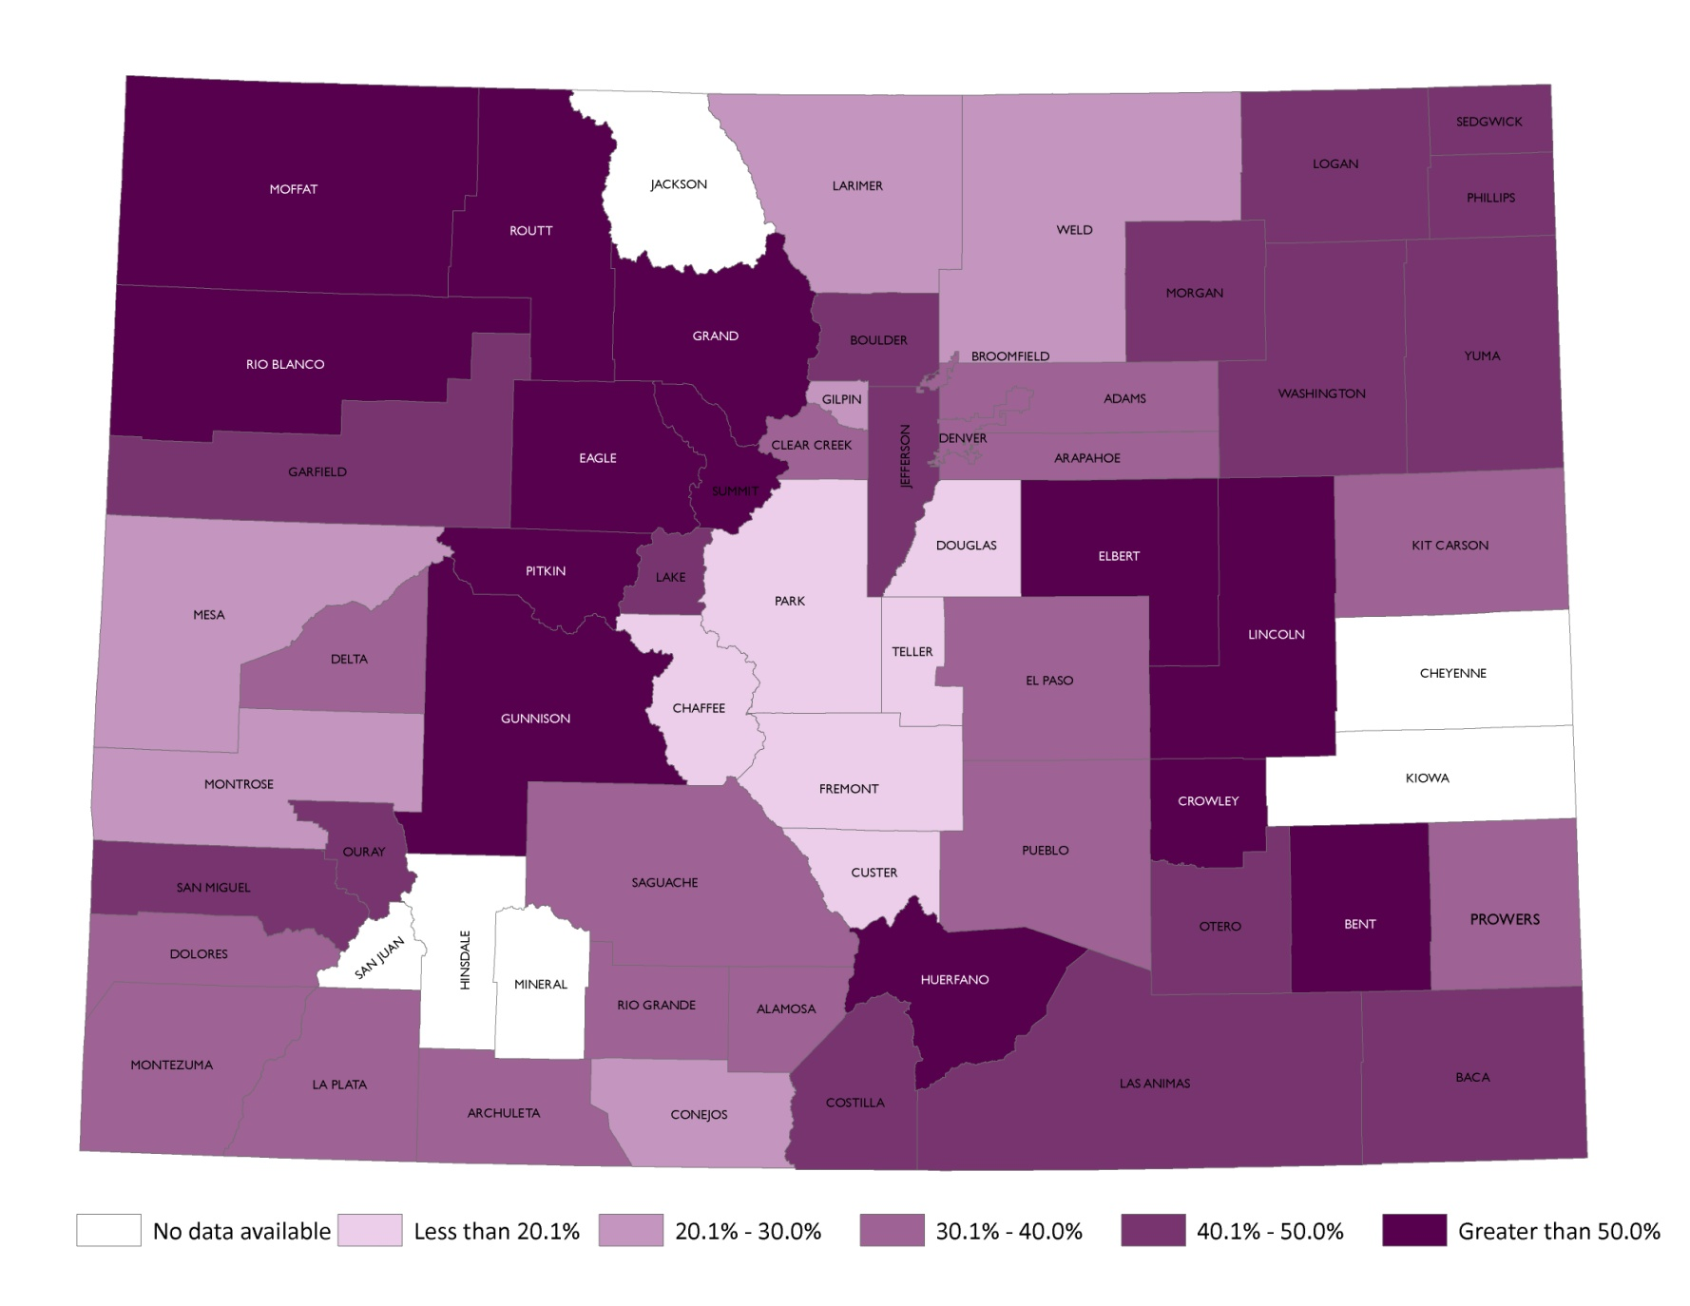
Percent EBNE in CHP+, 2010
SOURCE: CHI analysis of the 2010 American Community Survey; Medicaid and CHP+ enrollment data from the Colorado Department of Health Care Policy and Financing

Slide 12
HB 09-1293 CHP+ expansion
On May 1, 2010, the Colorado Healthcare Affordability Act (HB09-1293) raised eligibility for CHP+ from 205% of the Federal Poverty Level (FPL) to 250% of FPL
CHI estimates that 11,748 additional uninsured children became eligible for CHP+ under this expansion based on 2010 ACS data
SOURCE: CHI analysis of the 2010 American Community Survey
Notes:
12

Slide 13
EBNE children by race/ethnicity, Colorado, 2010
SOURCE: CHI analysis of the 2010 American Community Survey

Slide 14
EBNE children by English language proficiency, Colorado, 2010
SOURCE: CHI analysis of the 2010 American Community Survey

Slide 15
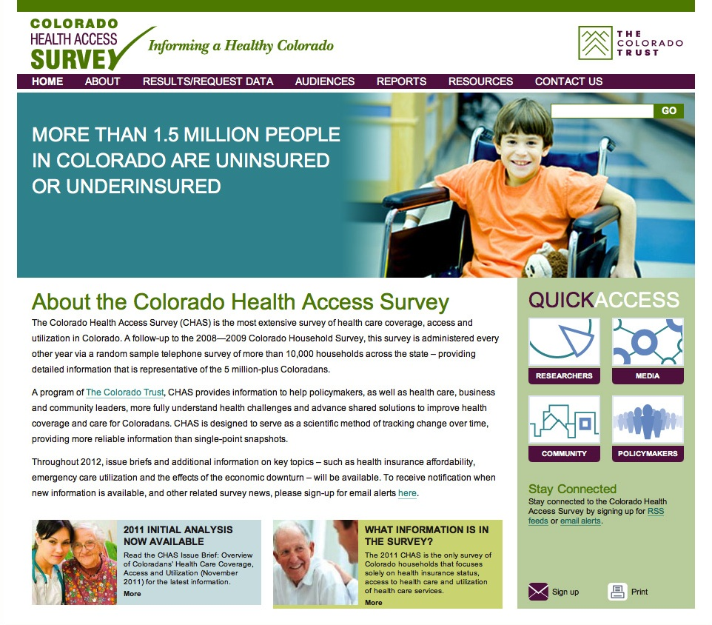
The 2011 Colorado Health Access Survey (CHAS)
10,352 households
May-August 2011
Telephone survey
Key focus areas:
  Access to care
  Health insurance
  Utilization

Slide 16
Colorado children’s usual source of care, 2011
 | Low-income uninsured kids | Uninsured kids | All kids
Has a usual source of care | 81% | 84% | 96%
Where do you usually seek care?
SOURCE: CHI analysis of the 2011 CHAS

Slide 17
Why are Colorado children uninsured?
Reason | Low-income uninsured Colorado kids | Uninsured Colorado kids
Cost is too high | 76% | 77%
Insured family member lost job or changed employers | 47% | 50%
Lost eligibility for Medicaid/CHP+ | 42% | 37%
Working family member not offered/eligible for insurance | 38% | 43%
Do not know how to get health insurance | 23% | 18%
SOURCE: CHI analysis of the 2011 CHAS

Slide 18


Slide 19
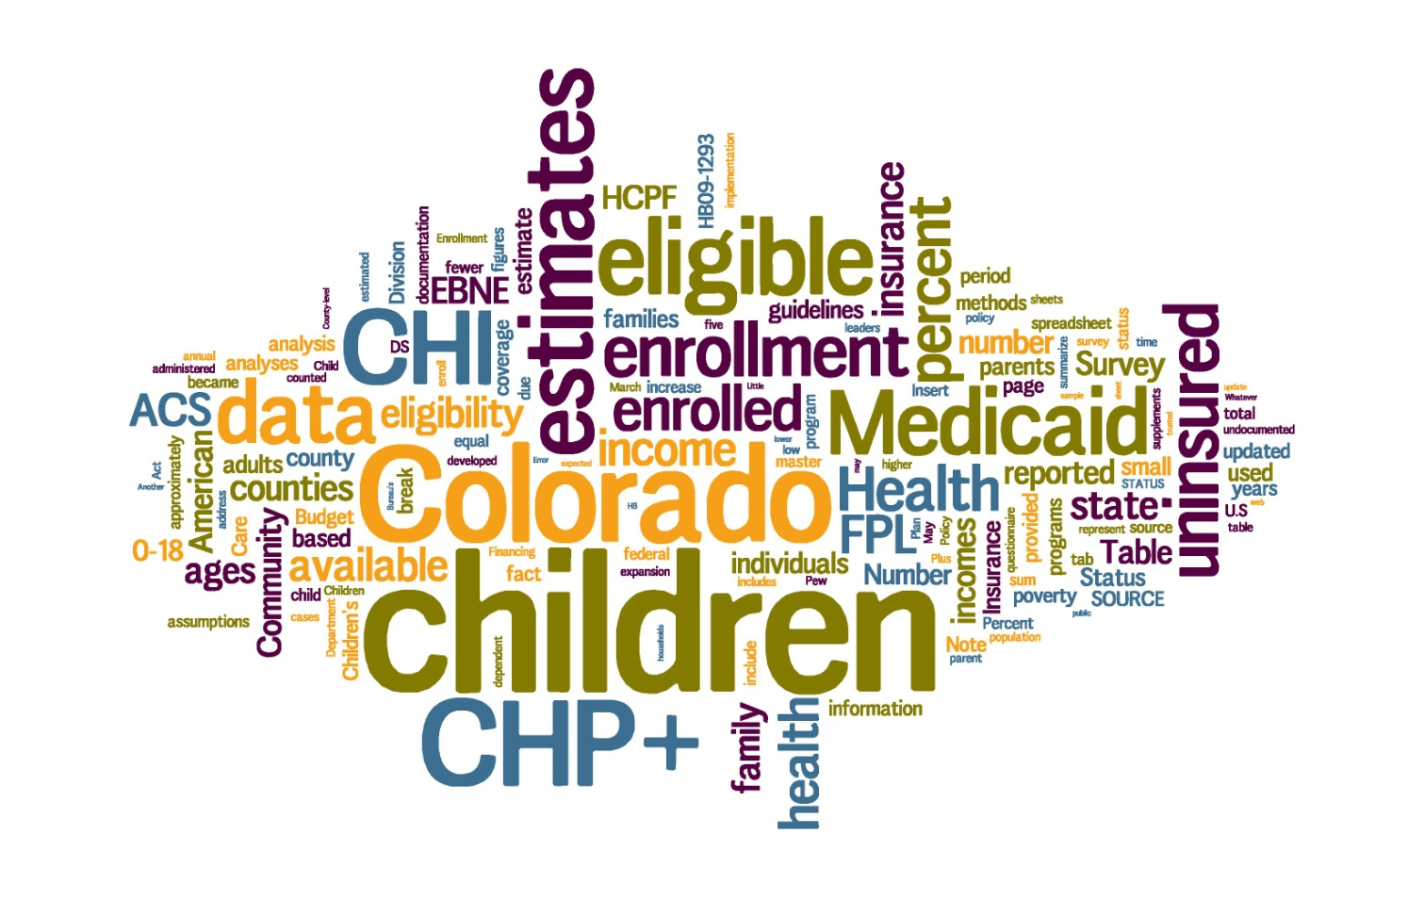
Emily King 720.382.7085 kinge@coloradohealthinstitute.org

Slide 20
Comparison of uninsured numbers & rates
Uninsured estimates for children 0-18 years from four sources, Colorado, 2008-2011
 | 2008 | 2009 | 2010 | 2011
ACS | 13.4% | 10.5% | 10.4%
CHS (Ages 0-14) | 8.2% | 8.7% | 5.1%
CPS | 12.5% |  | 8.7%
COHS/CHAS |  | 7.9% |  | 8.2%
 | 2008 | 2009 | 2010 | 2011
ACS | 171,442 | 134,508 | 133,256
CPS | 158,034 |  | 115,007
COHS/CHAS |  | 105,082 |  | 112,200
Source: CHI analysis of the American Community Survey (ACS), 2008-09 Colorado Household Survey (COHS) and 2011 CHAS; CDPHE analysis of Child Health Survey (CHS); and U.S. Census Bureau data from Current Population Survey (CPS). CPS reflects two-year averages covering CY2007-08 and CY2009-10.

