Slide 1
<!--PICODATESETmmddyyyy=02022008--><!--PICOTITLE=“Health care coverage and access in Colorado: Who gets what from where?”-->
Health care coverage and access in Colorado: Who gets what from where?

Slide 2
Health care coverage versus access to services: Do they coexist?
Not all Coloradans with coverage have access to health care
Not all Coloradans without coverage lack access to health care

Slide 3
Where do Coloradans get their health care coverage?
Source: The Lewin Group, Colorado Division of Insurance
Notes: Individuals eligible for both Medicare and Medicaid are included in the Medicaid category. CoverColorado includes fewer than one percent of Coloradans.

Slide 4
Colorado’s private market
Large employers, largely self-funded
Small firms (1-50 employees)
Individual market
Non-group coverage
CoverColorado (high-risk pool)

Slide 5
Trends in Colorado’s employer-based insurance market: Premium increases over time
Source: Medical Expenditure Panel Survey, 2006

Slide 6
Percentage of U.S. businesses by ownership type that offer health insurance coverage
Source: Agency for Healthcare Research and Quality, 2006

Slide 7
Most Colorado employers that provide health insurance offer a managed care plan
Source: Agency for Healthcare Research and Quality, 2006

Slide 8
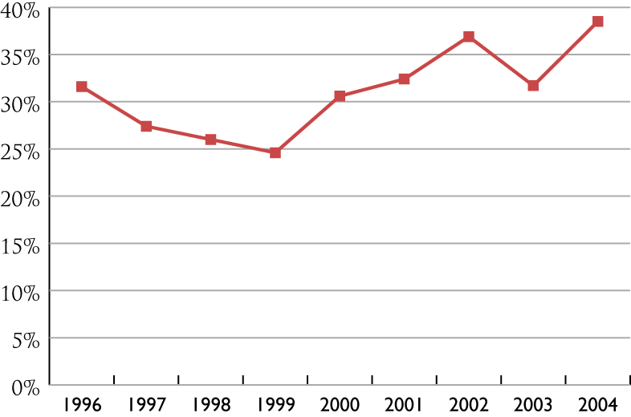
Almost 40% of private establishments in Colorado that provide health insurance self-insure at least one plan
Source: Agency for Healthcare Research and Quality, 2006

Slide 9
Private health insurance: Large employers and self-funded plans
Employee Retirement Income Security Act (ERISA), federal legislation passed in 1974
Governs large group market
Governs self-funded health plans

Slide 10
Erosion of Colorado’s small group health insurance market
Sources: Medical Expenditure Panel Survey and Colorado Division of Insurance

Slide 11
Small group health insurance market: 1994 reforms (HB 1210)
Guaranteed issue
Modified community rating
Rating based on health status, gender, claims experience, duration of coverage phased out over three years
Allowable rating factors included: age, family size, geographic region
Created Business Group of One (BG1)

Slide 12
Small firms in Colorado and employees with coverage
Sources: Colorado Division of Insurance and Colorado Department of Labor and Employment

Slide 13
Most recent rating reform: HB 07-1355
Eliminates use of claims experience and health status in rate setting
Health plans can still rate based on smoking status, industrial classification, age, family size and geographic location

Slide 14
Private health insurance: Individual (non-group) market
Roughly 3% of Colorado’s population is in the individual health insurance market
No guaranteed issue: Carriers allowed to deny applicant based on health status
Few mandates apply
File and Use State – Health plans must file premiums with the state and must be found actuarially sound

Slide 15
Individual market: CoverColorado
Colorado’s high-risk pool: CoverColorado
State subsidized health insurance plan for people “uninsurable” because of a pre-existing medical condition
A few other qualifying circumstances (see CHI brief on high-risk pool)
Around 23 states have a high-risk pool
CoverColorado has 6,500 participants

Slide 16
Enrollment in CoverColorado (1991-2005)

Slide 17
Public health care coverage
Federal-state partnerships
Medicaid
Child Health Plan Plus (CHP+)
Colorado Indigent Care Program
Federally financed and administered
Medicare
Veterans Administration health services
Indian Health Service
Military Health System

Slide 18
Medicare
Federally funded health insurance program for individuals 65 and older and people with disabilities
Covers inpatient and outpatient services, and partially covers costs of prescription drugs
Does not cover long-term care except first 90 days in SNF after hospitalization

Slide 19
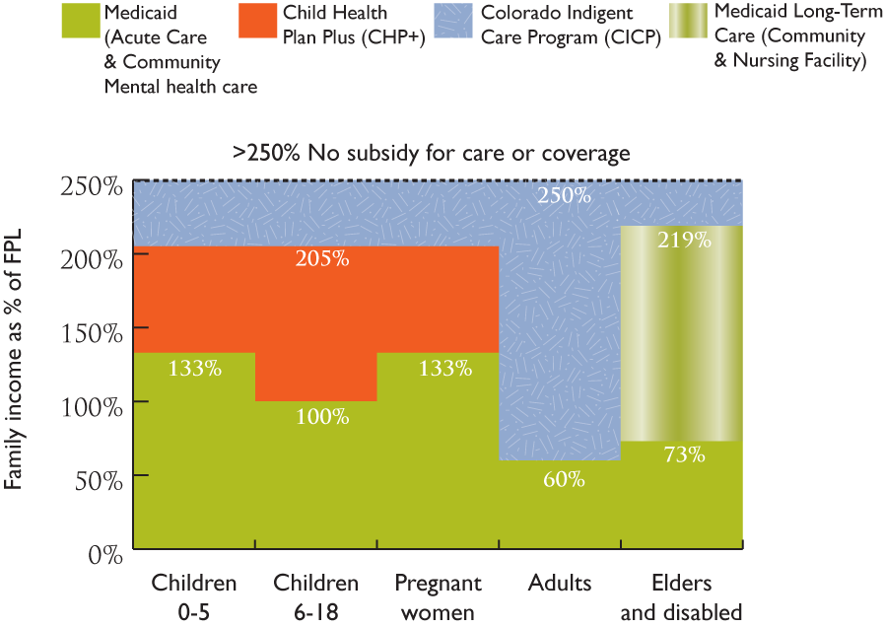
Eligibility for publicly financed health care services in Colorado
Family of 3
2007
$42,925
$35,199
$22,836
$17,170
$10, 302

Slide 20
How Colorado eligibility compares to other states
Colorado eligibility often viewed as “lean”
Covers all mandatory eligibility groups required by federal government and few optional groups (i.e. no medically needy program)
In 2003, 10% of Colorado’s population was enrolled in Medicaid compared to 19% of U.S. (tied for 50th place in country with VA and NH)
20% of low income Coloradans are enrolled in Medicaid compared to a national average of 31%
See appendix where income eligibility for children is compared across country

Slide 21
Medicaid and CHP+ caseloads have been increasing over time
Sources: JBC staff briefing documents and HCPF Nov. 1, 2006 Budget Request

Slide 22
Per-capita costs for Medicaid medical services
Sources: JBC Staff Briefing Documents and HCPF Budget Requests

Slide 23
What new resources are available for publicly financed health care in Colorado?
In the past 3 years, Colorado voters have supported increased/existing taxes be spent for health care coverage and programs to increase access.
Amendment 35 (Nov. 2004) – Expanded eligibility for Medicaid and CHP+ programs; provided grants to clinics to expand access to primary care
Referendum C (Nov. 2005) – Provided funds for health care, K-12 education, higher education and transportation programs ; increased CICP eligibility

Slide 24
Coverage without access
High co-pays and deductibles in relation to income can lead to deferment of care
Providers unwilling to accept patients with certain types of coverage
e.g., Medicaid, Medicare
Lack of providers in rural areas

Slide 25
Counties without a primary care physician
 | Bent | Crowley | Park | San Juan | Total
Population | 6,318 | 4,042 | 16,599 | 560 | 27,519
Source: Colorado Department of Public Health and Environment and Colorado Demography Office.
Notes: Primary care physicians include family, general, internal medicine, pediatric and OB/GYN physicians. Inmate population of Crowley County Correctional Facility has been removed from Crowley County population estimate.

Slide 26
Additional counties without a physician accepting new Medicaid clients
Cheyenne Clear Creek Conejos Hinsdale | Jackson Saguache Washington
Source: Colorado Department of Public Health and Environment

Slide 27
The uninsured in Colorado

Slide 28
Who’s most likely to be uninsured?
Coloradans with incomes under 100% of FPL (42%)
Young adults ages 18-34 (27%)
Rural residents (18%)
Individuals of Hispanic origin (36%)
People who work for small businesses (29% of businesses with <=10 employees)
People with less than a high school diploma (51%)
Source: CHI analyses of the Current Population Survey, CY 2003-05

Slide 29
Access to employer-sponsored insurance among uninsured employees, 2005
Declined Own or Family Member’s Health Benefits | 30%
Not Eligible, And No ESI Available Through Family Member’s Employer | 14%
No ESI Sponsorship from Own or Family Member’s Employer | 56%
Total | 100%
Source: Urban Institute analysis of the February 2005 Contingent Work Supplement of the Current Population Survey and the March 2005 Annual Social and Economic (ASEC) Supplement of the CPS.

Slide 30
Uninsured workers who declined employer-sponsored insurance by age
Uninsured Coloradans of working age (18-64) who declined employer-sponsored insurance, by age group, 2001
Notes: Results should be interpreted with caution due to small sample sizes and wide margins of error. Uninsured at point of survey.
Source: CHI analysis of 2001 Colorado Household Survey data.
The data used in these analyses were supplied by the Office of the Governor, State of Colorado, which specifically disclaims responsibility for the analyses, interpretations, or conclusions contained herein.

Slide 31
Uninsured workers who declined employer-sponsored insurance by income
Uninsured Coloradans of working age (18-64) who declined employer-sponsored insurance, by percent of the federal poverty level (FPL), 2001
Notes: Results should be interpreted with caution due to small sample sizes and wide margins of error. Uninsured at point of survey. 2000 Federal Poverty Level.
Source: CHI analysis of 2001 Colorado Household Survey data.
The data used in these analyses were supplied by the Office of the Governor, State of Colorado, which specifically disclaims responsibility for the analyses, interpretations, or conclusions contained herein.

Slide 33
Colorado uninsured rates by race and ethnicity, 2003-05
Note: Estimates for non-Hispanic Hawaiian/Pacific Islanders not available.
Source: CHI analysis of data from the U.S. Census Bureau Current Population Survey.

Slide 34
Colorado’s uninsured by race/ethnicity, 2003-05
Source: CHI analysis of data from the U.S. Census Bureau Current Population Survey. As reported in Profile of the Uninsured in Colorado, An Update for 2005, Colorado Health Institute, November 2006

Slide 35
Estimates of underinsurance
National estimates:
About 6% of non-elderly people with private employment-related insurance incurred out-of-pocket payments for health services exceeding 10% of family income in 2003
(JAMA 296(22), 13 Dec 06)
In 2003, 8% of people with private insurance and no medical debt reported skipping a test or treatment due to cost
(Kaiser Family Foundation 2003 Health Insurance Survey)

Slide 36
Access without coverage
The health care safety net: Free or discounted care for low-income uninsured patients, Medicaid and CHP+ enrollees, Medicare and underinsured
Hospitals
Community health centers
Rural health clinics
Private not-for-profit clinics

Slide 37
Types of safety net providers
Community and public hospital emergency departments (70)
Community Health Centers (a.k.a. Federally Qualified Health Centers) (118 clinic delivery sites )
School-based health centers (38)
Migrant health clinics (41)
Federally designated Rural Health Clinics (44)
Other community-based clinics such as faith-based clinics and family practice residency clinics (25)
Community and other non-profit mental health centers (177)
Community-based low-income dental clinics and public dental health programs (78)
Local health departments and public nursing services (53)

Slide 38
Over 500,000 Coloradans use safety net clinics
Safety net clinic users, 2005
Source: Colorado Health Institute, Safety Net Indicators and Monitoring System

Slide 39
What we have learned about safety net capacity: Meeting the need
Persons below 300% FPL and safety net clinic users, 2005

Slide 40
Where safety net resources in Colorado?

Slide 41
Does the safety net have the capacity to care for vulnerable populations?
Uninsured population and uninsured patients seen at Community Health Centers, 2000, 2005

Slide 42
Questions?
Pam Hanes, PhD, President and CEO
hanesp@coloradohealthinstitute.org
303.831.4200
www.coloradohealthinstitute.org

