Slide 1
Aid in Dying
Colorado’s Difficult Policy Question
Emily Johnson
June 9, 2016
Notes:
This presentation on aid in dying was prepared by the Colorado Health Institute for the Denver Medical Society in June 2016.

Slide 2
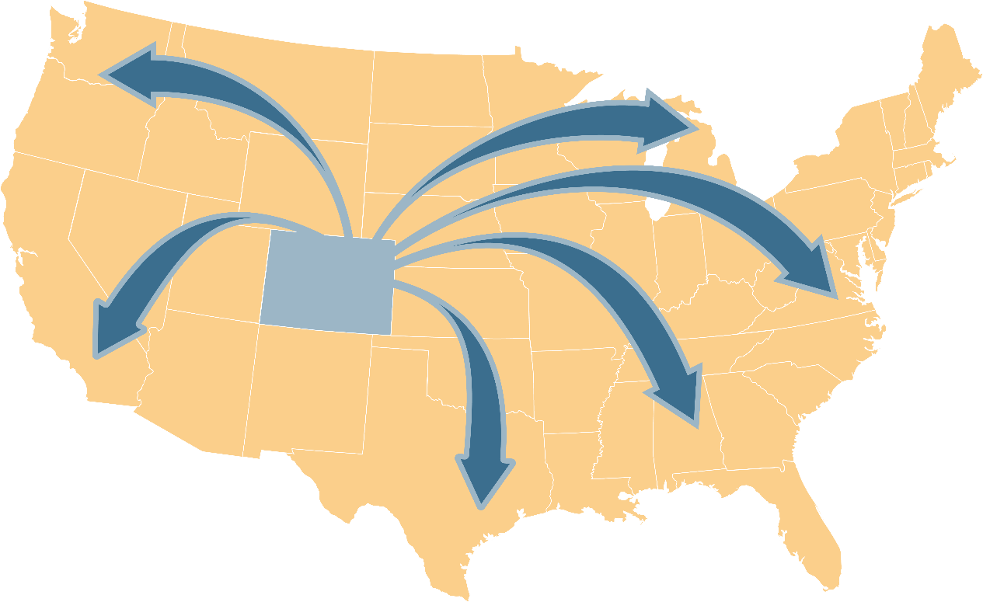
About Colorado Health Institute
Notes:
The Colorado Health Institute is a trusted source of independent and objective health information, data and analysis for the state’s health care leaders. CHI is funded by the Caring for Colorado Foundation, Rose Community Foundation, The Colorado Trust and the Colorado Health Foundation.

Slide 3
Today’s Discussion
International and historic context
The debate: supporters and opponents
Status in Colorado
Notes:
This presentation will review the international and historic context; aspects of the debate; and the status of aid in dying in Colorado.

Slide 4
Finding the Words Terms Used in This Presentation
Aid In Dying: Patient self-administers prescribed lethal medication.
Passive Euthanasia: Withdrawing medical treatment with the intention that it will result in a patient’s death.
Voluntary Active Euthanasia: Physician actively administers life-ending medication, usually intravenously.
Notes:
There is no consensus on the best term for this discussion. Supporters use phrases like “death with dignity” while opponents favor “physician-assisted suicide.”
“Aid in dying,” the term used in this brief, tends to be the most neutral description because it avoids words such as “suicide” and “dignity,” which are associated with advocacy efforts.

Slide 5
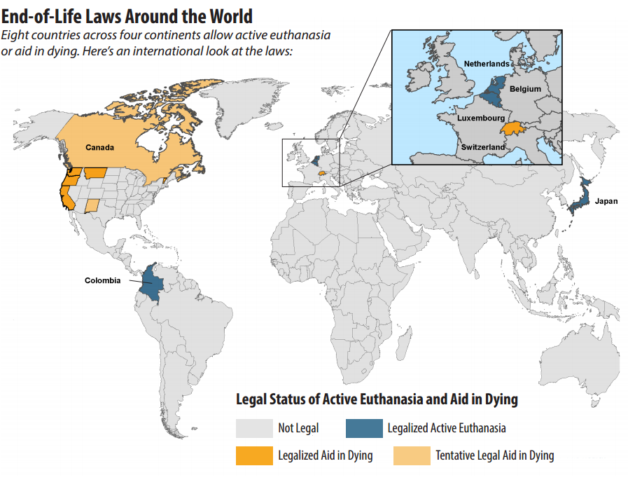
Notes:
Aid in dying is not always practiced in the same way. In U.S. states that allow aid in dying, a request for life-ending medication must come from a terminally ill adult patient with six months or less to live.
Other countries allow aid in dying under more liberal circumstances. In some European nations, requests can even be based on physical disability or psychiatric distress. Belgium extended its law in 2013 to cover terminally ill children as well as adults. Some aid-in-dying opponents view this as a “slippery slope” and worry it could follow legalization in the U.S. Today, however, terminal illness remains the only basis for a lethal prescription in states where the practice is permitted.

Slide 6
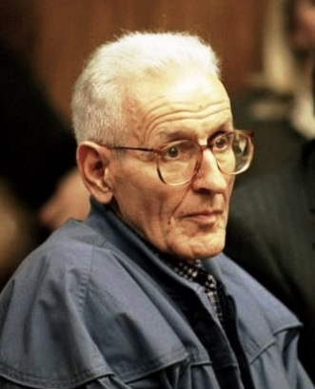
Historic Context United States in the 20th Century
1948-1990
1938
1980
1990s
1997
Notes:
Historically, much of the discussion in the U.S. has focused on euthanasia. Despite a few bursts of support during the Great Depression and patients’ rights movements of the 1970s, America has generally opposed this practice.
In the late 20th century, the work of Dr. Jack Kevorkian in Michigan reignited the assisted death debate. Dr. Kevorkian was a prominent euthanasia and aid-in-dying advocate who was convicted of second-degree murder after administering a voluntary lethal injection in 1998.
It is important to distinguish euthanasia, which was administered by Dr. Kevorkian and debated throughout most of America’s history, from the aid-in-dying methods being considered today by state legislators. In voluntary euthanasia, a physician actively administers life-ending medication, usually intravenously. Aid in dying, however, requires patients to self-administer the medication. A doctor or family member cannot do it for them.
This is no small distinction. For many proponents of aid in dying, self-administration is key to ensuring patient consent.
Dr. Kevorkian’s actions in the late 1990s, while polarizing, brought the issue to dinner tables across the nation. More Americans began to favor legalizing the practice of aid in dying.
The state of Washington’s assisted suicide ban was challenged in the Supreme Court in 1997. The court upheld the ban, but later that year Oregon became the first state to legalize aid in dying. In the years since, Oregon’s Death with Dignity Act has served as model legislation for advocates in other states.

Slide 7
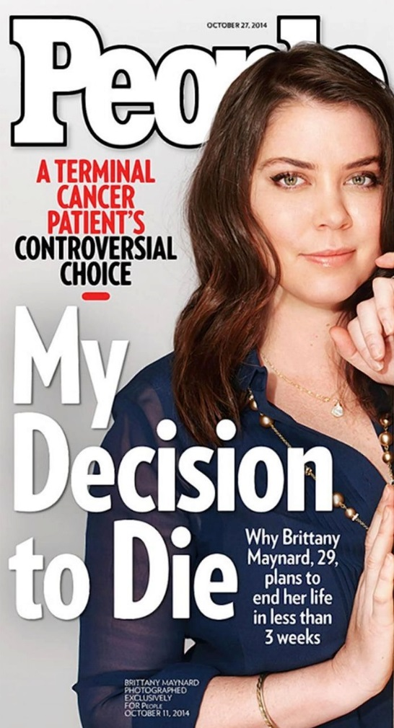
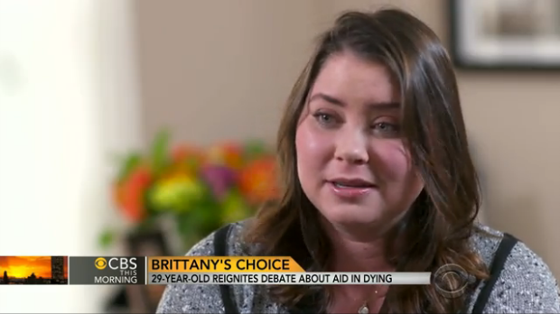
Historic Context Brittany Maynard: Renewed Advocacy
Notes:
Recently, there has been a new wave of interest in aid in dying in the U.S. The aging Baby Boomer generation and advocacy of groups such as Compassion & Choices and the Death with Dignity National Center have contributed to this. But the debate reached a fever pitch when one woman’s story became a nationwide discussion.
Brittany Maynard moved from California to Oregon in 2014 to take advantage of Oregon’s Death with Dignity Act after being diagnosed with terminal brain cancer. In the months to follow, the 29-year-old Maynard became a prominent advocate for the cause.

Slide 8
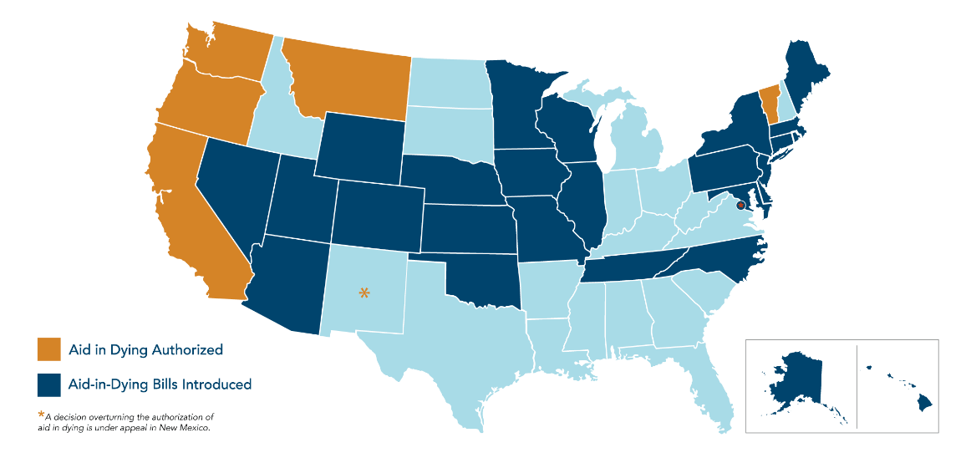
Current Context United States
Image from Compassion & Choices
Notes:
Since Brittany Maynard’s death on November 1, 2014, 26 states and the District of Columbia have introduced aid in dying legislation.
These new legislative pushes have refocused the spotlight on state experiences with aid in dying. States that permit the practice tend to lean Democratic. One exception is Montana, a politically mixed state, where legalization came by a court order rather than by legislation or ballot initiative.
Nationally, the Democratic Party has remained silent on the matter while the Republican Party opposes aid in dying as part of its official platform.

Slide 9
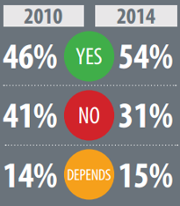
Current Context Physician Opinions
Medscape polls in 2010 and 2014 show physician support for aid in dying has grown. When asked, “should physician-assisted suicide be allowed?,” doctors said:
Notes:
Many physicians believe that the practice runs contrary to their vows to uphold ethical standards of medicine. The American Medical Association and most of its state affiliates, including Colorado, oppose legalizing aid in dying.
But supporters cite moral reasoning for their beliefs as well. They say there are cases of extreme suffering when pain cannot be alleviated. They believe that in these instances, helping patients who wish to die is an act of compassion.
And while physician organizations are generally opposed to the practice, the doctors they represent don’t always feel the same. Many physicians do not see aid in dying as incompatible with medical ethics, and that number seems to be growing. More than half (54 percent) of American physicians now support legalized aid in dying, according to a recent Medscape survey, up from 46 percent in 2010.

Slide 10
Oregon Death with Dignity Act A National First
Self-administration of lethal medication
Requesting patient must be:
- An adult
- A resident of Oregon
- Able to make & communicate health care decisions
- Diagnosed with a terminal illness that will lead to death within 6 months
Notes:
Oregon’s Death with Dignity Act has been used as the model for aid-in-dying legislation for nearly 20 years. Here are some main provisions of the law.

Slide 11
Oregon Death with Dignity Act Required Steps
Patient:
- Make two verbal requests to physician, separated
by 15+ days
- Provide written request to physician, signed by two witnesses
Prescribing physician:
- Assess patient diagnosis and prognosis
- Assess patient capability
- Inform patient of feasible alternatives
- Request that patient notify next-of-kin
Consulting physician:
- Confirm diagnosis and prognosis
- Confirm patient capability
Notes:
Oregon’s Death with Dignity Act has been used as the model for aid-in-dying legislation for nearly 20 years. Here are some main provisions of the law.

Slide 12
Oregon Death with Dignity Act Physician Protections
Physician protected from liability
Participation on either side is voluntary
Notes:
Oregon’s Death with Dignity Act has been used as the model for aid-in-dying legislation for nearly 20 years. Here are some main provisions of the law that specifically address physicians.

Slide 13
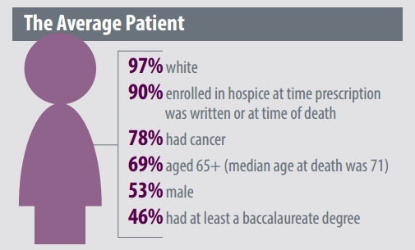
The Oregon Experience
Notes:
Oregon has allowed the practice of aid in dying since 1997. The option is most often used by those with terminal cancer diagnoses. Patients also tend to be well-educated and older – the median age at death is 71.
Oregon has the most robust data currently available, but drawing conclusions from its experience can be tricky. The sample is small and comes from a relatively homogenous state population. No one is sure what might happen in larger or more diverse states.

Slide 14
The Oregon Experience
Since 1997
In 2015
1,545
Prescriptions written
223 Prescriptions written by 106 doctors
223 Prescriptions written by 106 doctors
991
Patients died from ingesting prescribed pills
132
Patients died from ingesting prescribed pills
Notes:
In Oregon, 991 patients have died from ingesting medication since the law passed 19 years ago, a small percentage of the population. But that number is increasing, with 68 more patients receiving prescriptions in 2015 than the year before.

Slide 15
California End of Life Option Act A New Model
Differences from Oregon:
- Final attestation
- Interpretation services
- Sunset clause
- Tighter terminology
California Medical Society’s neutral position
Notes:
California’s End of Life Option Act, which was signed into law by Governor Jerry Brown on October 5, 2015, marks a turning point for aid-in-dying legislation. It greatly increases the number of people with the option, and many feel the law will replace Oregon’s Death with Dignity Act as a model that many states will follow.

Slide 16
Aspects of the Debate The Moral Question
“Assisted suicide is a reversal of the proper role of a doctor as a healer, comforter and consoler to an improper role of the physician causing a patient’s death.”
-Dr. Kenneth Stevens, Oregon
“As a physician, I resent the term ‘physician-assisted suicide.’ I have never felt I was assisting a suicidal patient, but rather aiding a patient with his or her end-of-life choice.”
-Dr. Peter Goodwin, Oregon
Notes:
Some of the most vocal opponents are religious groups, most notably the Catholic Church. Passages from scripture and statements from leadership are cited as arguments against both euthanasia and aid in dying, with the National Catholic Bioethics Center calling it a “fundamentally unreasonable act.”
But not all moral objections are based in theology. Many physicians believe that the practice runs contrary to their vows to uphold ethical standards of medicine. The American Medical Association and most of its state affiliates, including Colorado, oppose legalizing aid in dying.
But supporters cite moral reasoning for their beliefs as well. They say there are cases of extreme suffering when pain cannot be alleviated. They believe that in these instances, helping patients who wish to die is an act of compassion.

Slide 17
Aspects of the Debate Vulnerable Populations
Elderly and disabled patients
“[Vulnerable populations present] a legitimate concern that we should try to guard against. …But there’s no evidence that people with disabilities are more likely than others to access physician aid-in-dying.”
-Dr. Guy Micco, California
Notes:
Nearly all national disability rights organizations oppose aid-in-dying legislation. They view it as a form of discrimination that creates a double standard based on health or disability status.
From their perspective, aid in dying would give seniors and people with disabilities the tools to die, while the self-inflicted deaths of young, healthy and nondisabled people would still be treated as a tragedy to be prevented. They fear that disabled patients are more likely to be approved for aid in dying because their lives are seen as less valuable.
“We think that equal rights should also mean equal rights to suicide prevention,” said Diane Coleman, president and chief executive officer of Not Dead Yet (NDY), a leading disability rights group.
There are also concerns that consequences of becoming disabled may be driving the decisions of some patients. In Oregon, physicians for 91 percent of aid in dying patients said they believed fear of losing autonomy may have contributed to their patients’ decisions, and 40 percent may have been concerned about becoming a burden on family, friends or caregivers.
Disability activists worry that stigma is acting as an undue influence. “This is code for ‘I’d rather die than be embarrassed by my disability,’ ” said Carrie Ann Lucas of NDY.
Supporters say aid in dying is not a disability issue, but an autonomy issue. They emphasize that the practice is only for cases of terminal illness, not for those with a disability.
A 2007 study found that vulnerable populations such as physically disabled patients were no more likely to use aid in dying than the general population.
For supporters, the issue is a matter of patients’ rights. Compassion & Choices, the leading aid in dying organization, says its work aims to increase patient control and reduce unwanted interventions at the end of life.
The Denver Medical Society testified in support of HB15- 1135, the proposed aid-in-dying bill considered by the Colorado legislature in 2015, stating that it felt the bill protected vulnerable groups from abuse.

Slide 18
Aspects of the Debate Timelines for Terminal Illness
Professional agreement improves likelihood of accuracy
“Admittedly, we are inaccurate in prognosticating the time of death under those circumstances. We can easily be 100 percent off, but I do not think that is a problem. If we say a patient has six months to live and we are off by 100 percent and it is really three months or even 12 months, I do not think the patient is harmed in any way…”
- Dr. Peter Rasmussen, Oregon
Notes:
In the United States, all aid-in-dying laws require the diagnosis of a terminal illness that is expected to cause death within six months.
But doctors aren’t infallible. So how can they be sure someone only has six months to live? Aid-in-dying opponents point out that they can’t. And there is no shortage of patients whose disease progressed in much less than six months, while it has taken longer than expected for others.
In 2014, about 10 percent of Oregon’s aid-in-dying patients used medication they were initially prescribed in 2012 or 2013, indicating that some outlived a six-month prognosis. Brittany Maynard herself lived beyond the six-month prognosis she received in April 2014.
Supporters point out that the attending physician’s prognosis must be certified by a consulting physician. While this doesn’t guarantee an accurate timeline, supporters feel that agreement between professionals improves the likelihood of one. They also feel that the probable time of death is not all that significant, since patients themselves decide whether and when to take the medication.

Slide 19
Aspects of the Debate Coercion and Consent
Elder abuse
Medication monitoring
Safeguards in the legislation
“My concern is that the option of assisted suicide is simply much cheaper, and because of how broken our system is, these competing concerns may put some of our most vulnerable populations between a rock and a hard place.”
-Dr. Jessica Zitter, California
Notes:
A patient’s ability to make an informed decision lies at the core of aid-in-dying discussions. Regardless of their position on this issue, all sides acknowledge how important it is to prevent any form of coercion, overt or indirect.
Opponents worry that too few safeguards exist at numerous points in the process. Insurance companies may cover aid-in-dying counseling and medication yet deny requests for coverage of more expensive treatment options. This could pressure patients to make a decision based on finances, not suffering, they argue.
There is also the risk of more direct coercion. Colorado records more than 11,000 cases of adult abuse annually,11 and abused seniors may be more susceptible to outside influence in making this decision.
In addition, medication is not well monitored after it is dispensed. Many patients who receive a prescription choose not to use it. But if they keep the medication, it might be accessible to others. This makes it hard to guarantee consent. Opponents argue that family members or parties who stand to benefit from a patient’s death could put the medication in a patient’s food or otherwise trick them into taking it.
Supporters cite the protections written into aid-in-dying legislation. The patient must request the medication a minimum of three times. One of these requests must be made in the presence of two witnesses, one of whom is not related to the patient and doesn’t stand to gain financially from the patient’s death.
A private conversation must take place between the physician and the patient during which all available options are reviewed. And if there is any concern about the patient’s decision-making process, the doctor must request a mental health evaluation.
California’s law requires dying patients to sign an affidavit no more than 48 hours prior to self-administering the drug. The purpose is twofold. First, it confirms a patient consents at the time the medication is administered as well as when it was dispensed. Second, it helps track aid-in-dying medication. When a patient dies, whether from aid-in-dying methods or from the underlying illness, either the health care provider must file the completed affidavit or the person in custody of the unused medication must return it to a designated disposal facility.
Finally, supporters note that altering, concealing or destroying any document during the process is a felony. Likewise, it is a felony to coerce someone into making a request for the medication. There has yet to be a report of aid-in-dying coercion from any state where it is legal.
While both viewpoints are based on concern for the well-being of patients, the two sides differ in what they believe this means. There may be room for compromise in some areas. For example, increased documentation of consent may allay the fears of some opponents. In other areas, opinions seem to be irreconcilable, including the view by disability advocates that aid in dying is always a discriminatory practice.

Slide 20
The Debate in Colorado House Bills 15-1135 and 16-1054
Terminally ill, capable, adult patients with a six-month prognosis could request to take their own life using medication prescribed by a physician.
Prescribing physicians would not be accountable for the death if all conditions of the bill were met and documented.
Cause of death on death certificate to be listed as the underlying terminal illness.
Notes:
New legislation, entitled the Colorado End-of-life Options Act, was introduced this year. The proposed law would have legalized aid in dying for Colorado residents meeting certain conditions similar to those in Oregon and California. While HB 16-1054 made it out of committee, the sponsors pulled the bill in order to avoid a near-certain
A similar bill modeled after Oregon’s Death with Dignity Act was introduced in the 2015 session. After 11 hours of debate in the House Committee on Public Health Care & Human Services, HB15-1135 was postponed indefinitely.
A long list of physicians, disability rights activists, patients and others offered impassioned testimony during last year’s committee hearing. And while the key provisions in the 2016 bill remained largely unchanged, some new language aimed to address concerns raised in response to HB15-1135.
Opponents worried that inadequate end-of-life care, including insufficient pain management, could influence a patient’s decision to end his or her life if aid in dying is legalized. To allay these fears, the 2016 bill explicitly required health care providers to “meet or exceed the standard of care for end-of-life medical care.”
The new legislation also included more detail intended to reduce the risk of coercion. There was a more explicit requirement that attending physicians offer patients an opportunity to rescind their request at any time and for any reason. Additional phrases were also added to the patient’s written request form. This new language required the patient reiterate that he or she is not being coerced and is aware of the right to rescind.
The 2016 proposal shared some characteristics with California’s recent End of Life Option Act – most notably, the similar name. Both bills also defined terminology more explicitly or in more detail than Oregon’s original law.
For example, Colorado’s proposal included a requirement that participating physicians be licensed to practice in the state. And important terms such as “self-administration” and “health care facility” were defined in more detail.
But just because the bill was changed in 2016 doesn’t mean that every concern was addressed. During the 2015 committee debate, there was pushback on a provision requiring medical examiners to list the cause of death as the underlying illness rather than aid in dying. Opponents felt this was asking examiners to lie on the death certificate, but the provision remained in the 2016 proposal.

Slide 21
The Debate in Colorado Ballot Initiatives
End-of-Life Options
- Similar to house bills
Medical Aid in Dying
- Make aid in dying a constitutionally-protected right
- Legalize voluntary euthanasia
- Allow aid in dying in advance planning directives
- Similar immunity for medical providers
Notes:
Meanwhile, a petition has been filed to turn the 2016 End-of-Life Options Act into a ballot initiative. A separate petition proposes to amend the state constitution to make medical aid in dying a constitutionally protected right in Colorado.
The End-of-Life Options proposal is similar to the 2016 bill. But the medical aid in dying ballot initiative is substantially different than the bill introduced in the legislature.
It would legalize voluntary euthanasia, allowing physicians to help administer life-ending medication. Instead of requiring two physicians to approve a request for lethal medication, the amendment would require “permission of no person, governmental body or religious organization.” And it would allow aid in dying and euthanasia to be part of an advance planning directive, meaning that patients could designate ahead of time that under certain circumstances they should be administered the medication.
Lance Wright, the primary petitioner, said he feels that this is an issue of personal freedom. Wright, a Denver resident, has Parkinson’s disease, an illness that may not be covered under the proposed legislation. He has said he wishes to have this option available to him as his illness progresses.
Most supporters of more traditional aid-in-dying legislation staunchly oppose Wright’s proposal. Representative Lois Court, a sponsor of the Colorado End-of-life Options Act, says that it goes too far. Compassion & Choices has come out in opposition, reiterating its belief that self-administration is key to preventing abuse of the law. Instead, the group will continue to advocate for the Colorado End-of-life Options Act.
A poll commissioned in 2014 by Compassion & Choices, the pro-aid in dying group, found that 62 percent of Coloradans support the principle of aid in dying.

Slide 22
Review
Historical and international context
The debate
- The role of medical providers
- Vulnerable populations
- Diagnostic accuracy
- Coercion and consent
Status in Colorado
Notes:
This is a quick review of what we spoke about today.

Slide 23
Conclusion
Notes:
One might arrive at the conclusion as being that there IS no conclusion.
With Colorado’s debate on aid in dying entering its second year, both supporters and opponents are likely to increase their efforts.
Supporters believe this is an issue of patients’ rights and personal autonomy. They feel that current aid-in-dying laws and the new Colorado legislation include an appropriate number of safeguards.
Opponents base their objections primarily on moral reasoning, both religious and secular, and in concerns for the rights of people with disabilities.
No matter their view, Coloradans can expect to see a ballot initiative in the headlines this fall.

Slide 24
Discussion and Questions

