Slide 1
Uninsured On The Rise
What The 2011 Colorado Health Access Survey Tells Us About Vulnerable Coloradans
March 7, 2012
CHI/AHEC Conversation Series

Slide 2
Introducing the Colorado Health Access Survey
The 2011 “CHAS”
Succeeds 2008-9 Colorado Household Survey
Funded by The Colorado Trust
Will be available every other year until at least 2017

Slide 3
Introducing the Colorado Health Access Survey
10,352 households
Telephone survey
Administered in English and Spanish
Weighted to represent entire population
Statistically valid:
Geographic
Race/ethnicity
May-August 2011

Slide 4
Why the CHAS?
Where we are today
How we have changed in the past two years
The work ahead
Resources:
www.CoHealthAccessSurvey.org

Slide 5
Our Findings
The ranks of Colorado’s uninsured are growing, even among those employed.
The ranks of the underinsured are growing as well.
Various populations are disproportionally impacted.
Fewer Coloradans have a “usual source of care.”

Slide 6
1. The Number of Uninsured is Growing
2008-09 | 2011
678,000 Uninsured | 829,000 uninsured
14% of population | 16% of population

Slide 7
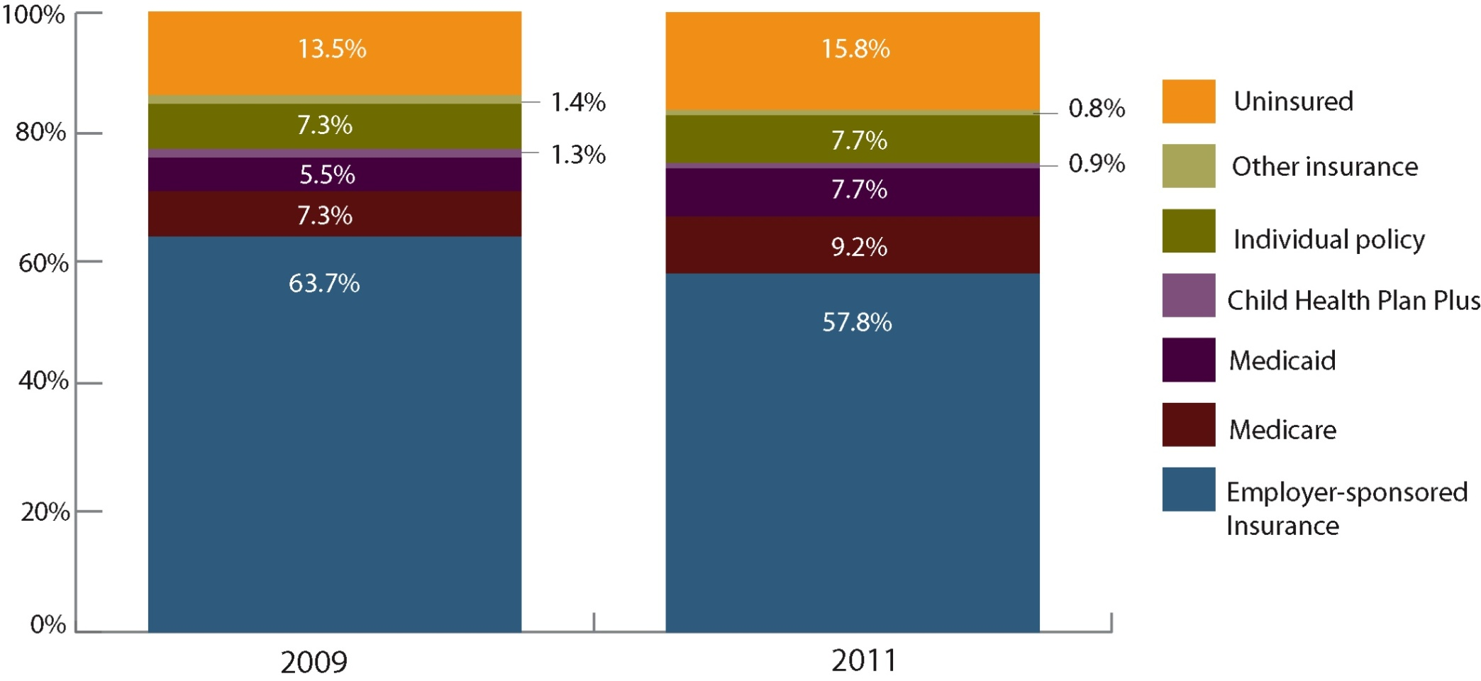
Fewer Coloradans Receive Employer-sponsored Insurance
Health Insurance, Colorado, 2009 and 2011

Slide 8
Cost of Insurance: Leading Reason For Lack of Insurance
Top 3 Reasons the Uninsured Reported For Lacking Health Insurance, Colorado, 2009 and 2011

Slide 9
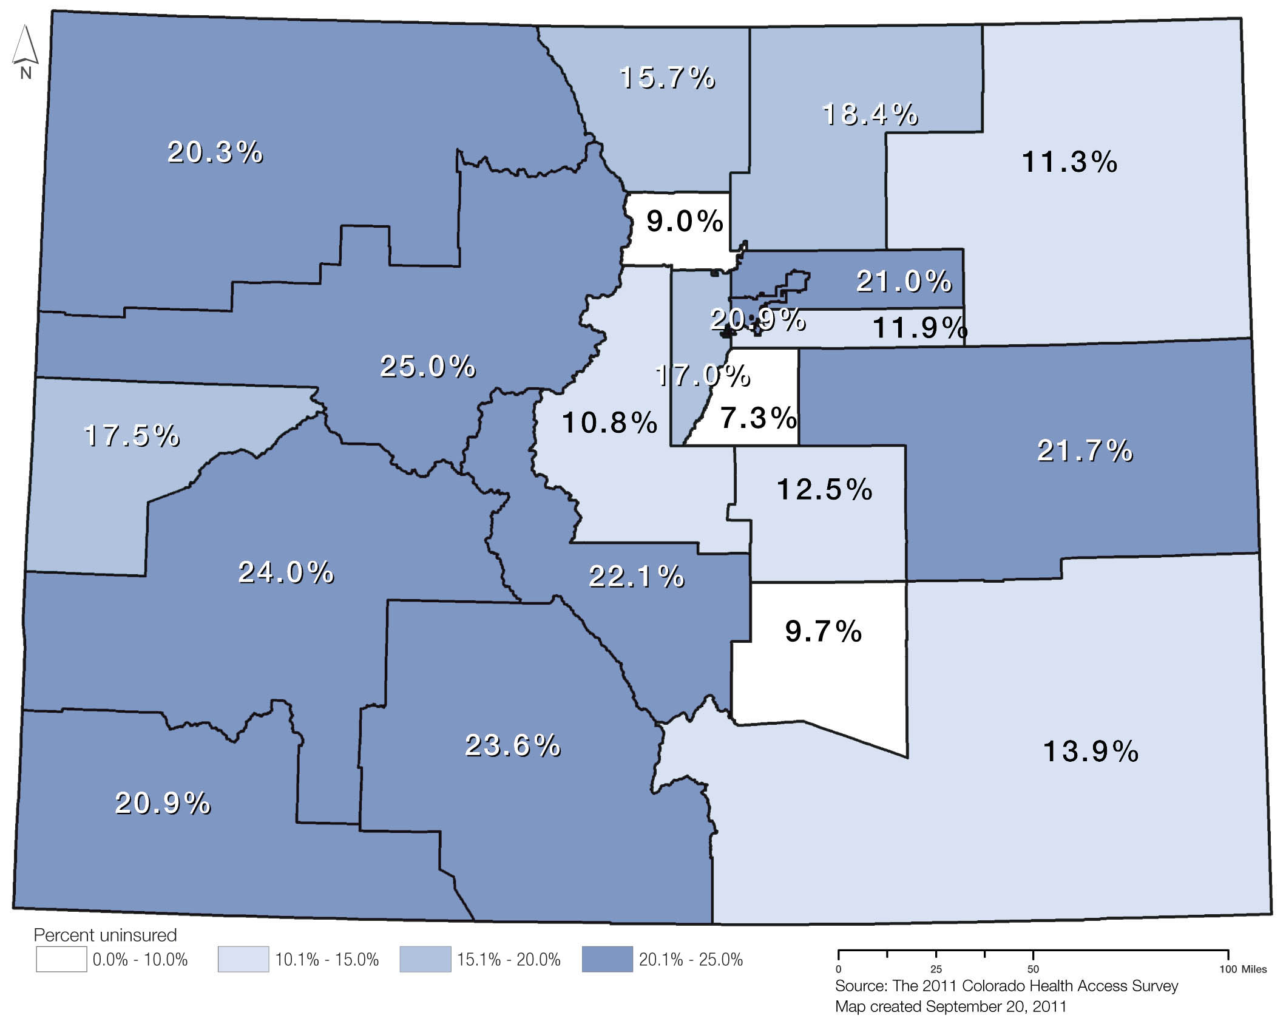
Uninsured Coloradans
Rates of Uninsurance, Health Statistics Regions, Colorado, 2011

Slide 10
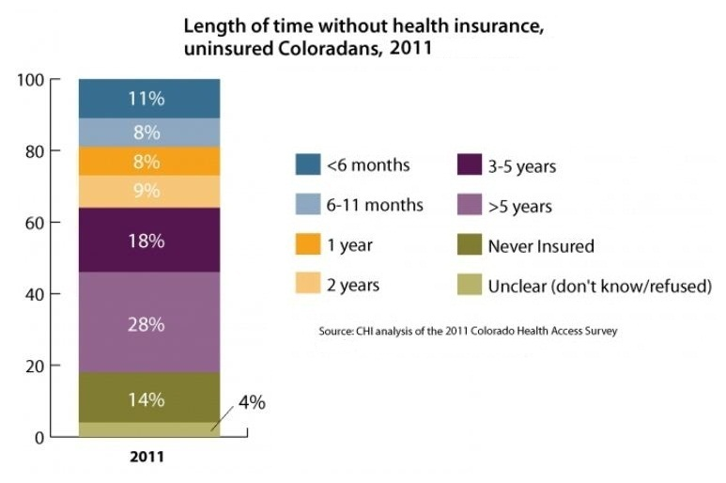
The Chronically Uninsured

Slide 11
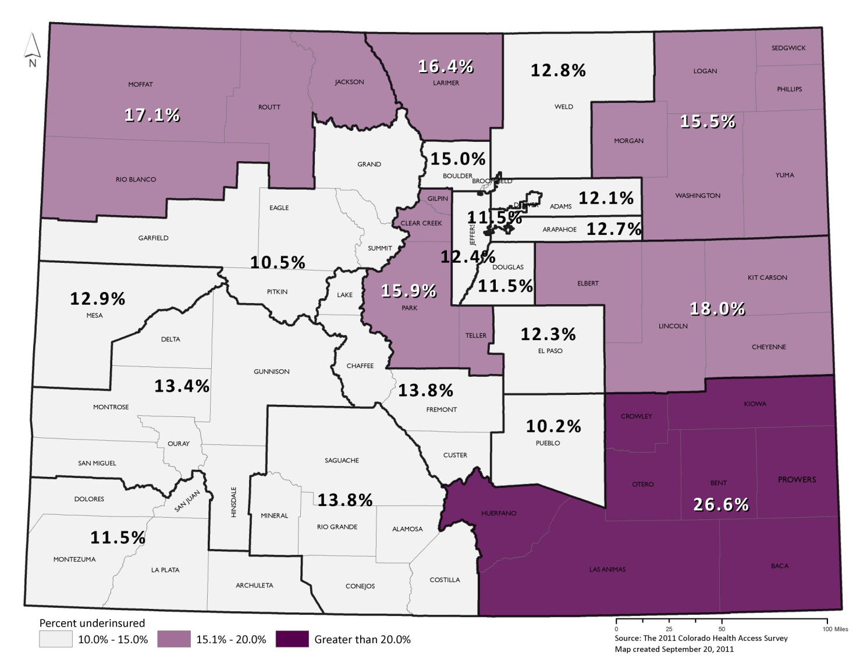
2. The “Under” -Insured Are Growing as Well
Rates of Underinsurance, Health Statistics Region, 2011
11

Slide 12
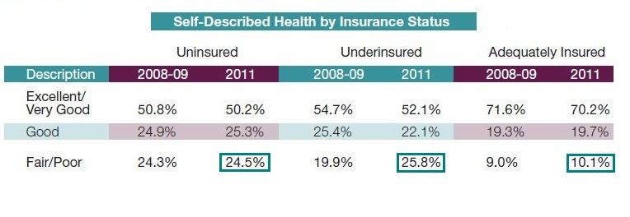
Nearly One-Third of Coloradans Are Un- Or Under-insured
Coloradans by Insurance Status, Colorado, 2011

Slide 13
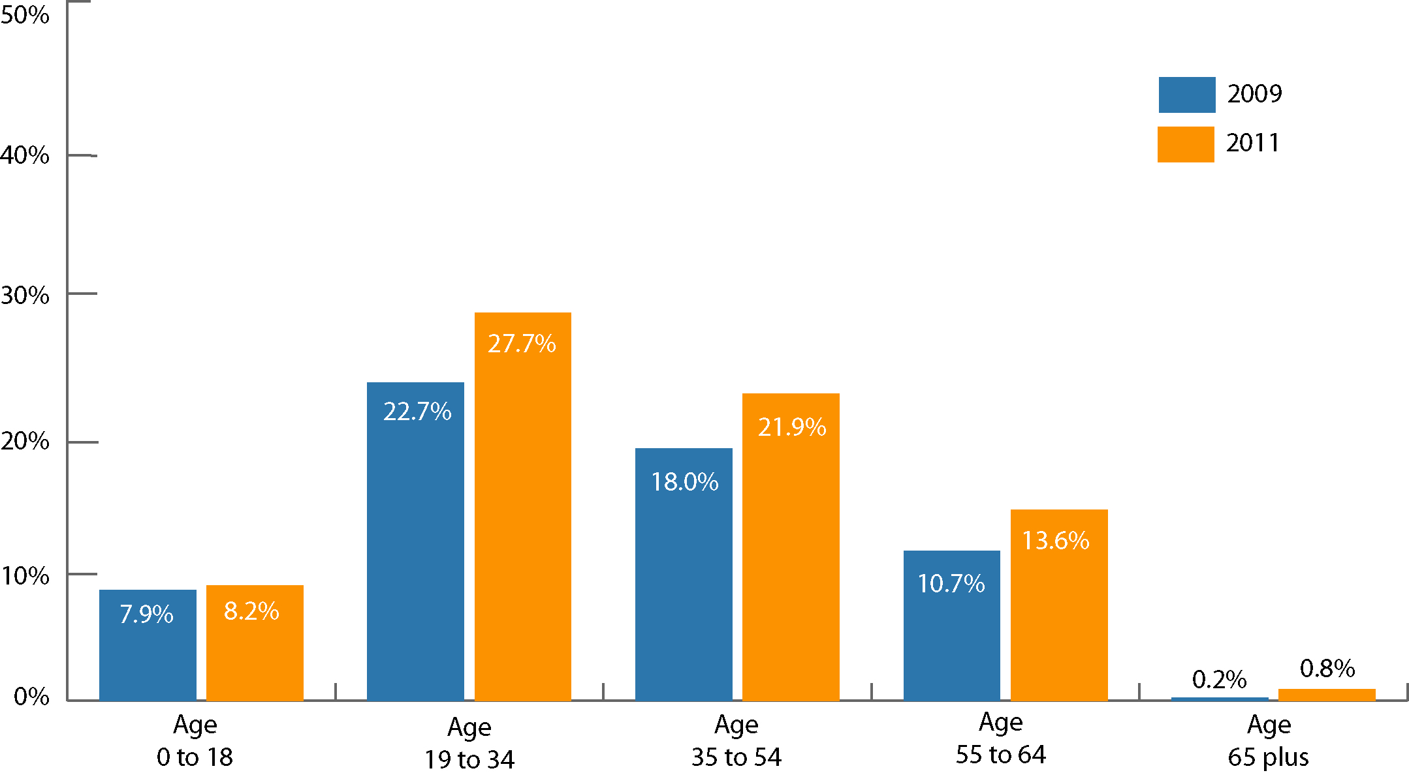
3. Various Populations Are Disproportionately Impacted
Uninsured Rates by Age, Colorado, 2009 and 2011
13

Slide 14
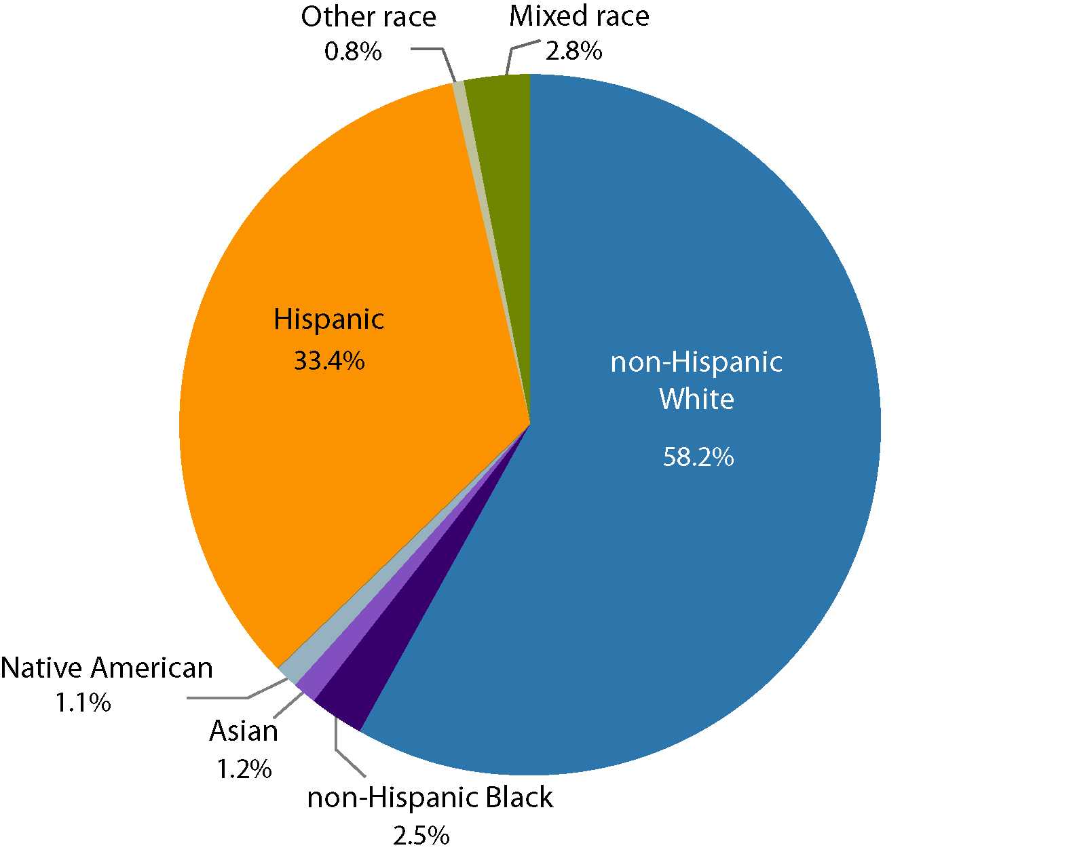
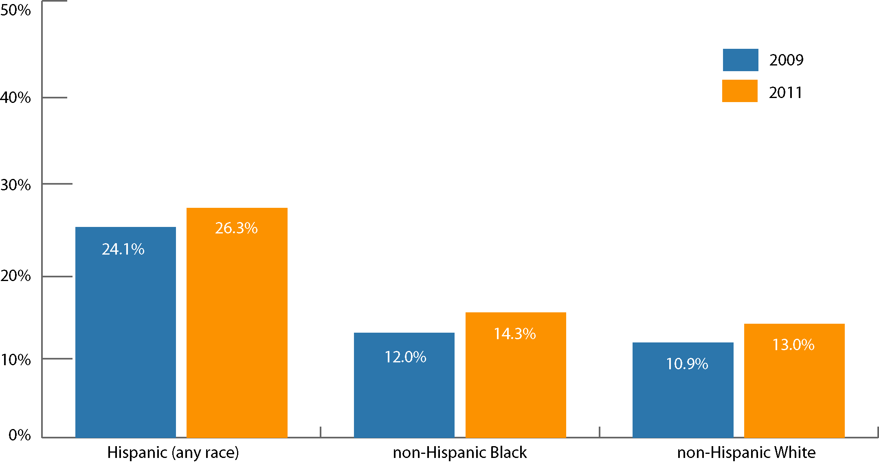
Most Uninsured Coloradans Are White. Hispanics Are Disproportionately Affected.
Distribution of Uninsured by Race/Ethnicity, Colorado, 2011
Percent Uninsured for 3 Racial/Ethnic Groups, Colorado, 2009 and 2011
14

Slide 15
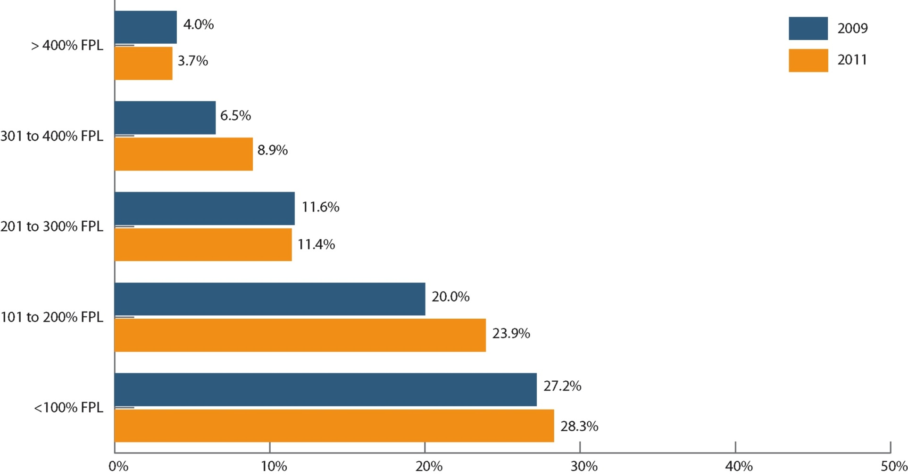
Poverty Correlates With Lack of Coverage
Uninsured Rates by Income as a Percentage of Federal Poverty Level, Colorado, 2009 and 2011
15

Slide 16
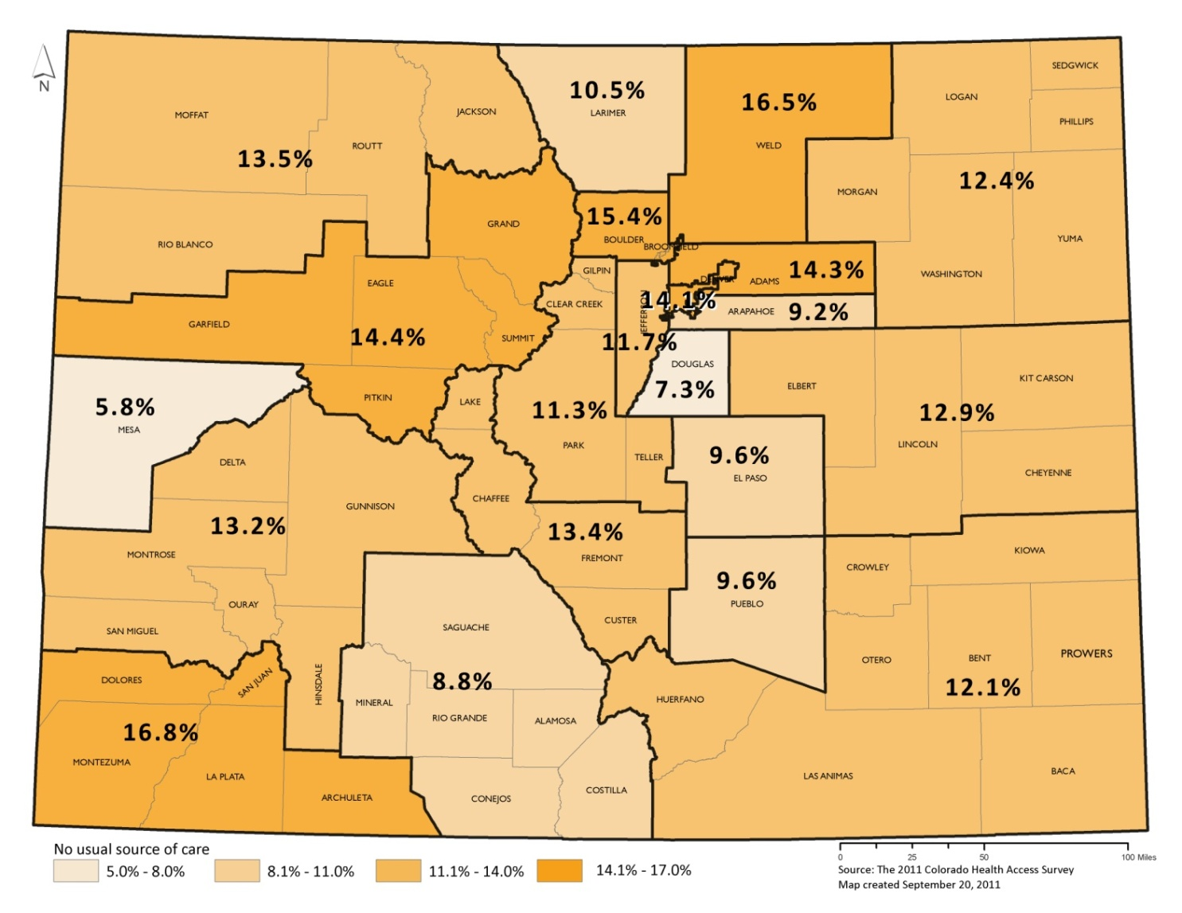
4. Fewer Coloradans Have a “Usual Source of Care”
Percent Who Reported Having No Usual Source of Care, Colorado, 2011

Slide 17
Lack of Dental Insurance

Slide 18
No “Usual Source of Care” is Associated With Higher Use of ER and Lower Use of Primary Care.
Utilization of Health Services, Colorado, 2009 and 2011

Slide 19
Why CHAS Matters
Informing Policy:
Eligibility and access
Affordability
Health disparities
Measuring impact of current policies
Current investments in medical homes, prevention and primary care
Describing the work ahead

Slide 20
The Importance of Access
Health insurance coverage
Better access (primary and specialty care)
Improved health outcomes

Slide 21
CHAS Moving Forward
Data available in several ways
www.CoHealthAccessSurvey.org
Research file
Public Use file
Custom reports
Briefings
Topics of Interest/ Deeper Dives
Affordability
Utilization
Barriers to coverage and access

Slide 22
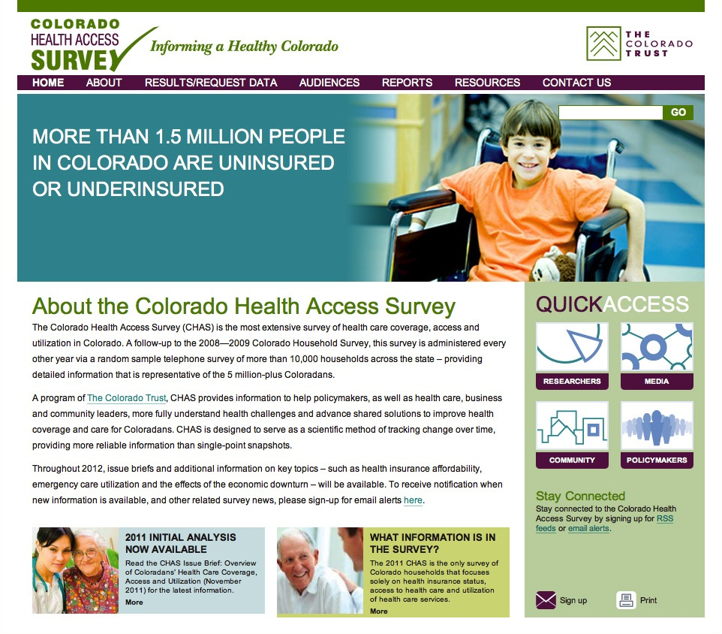

Slide 23
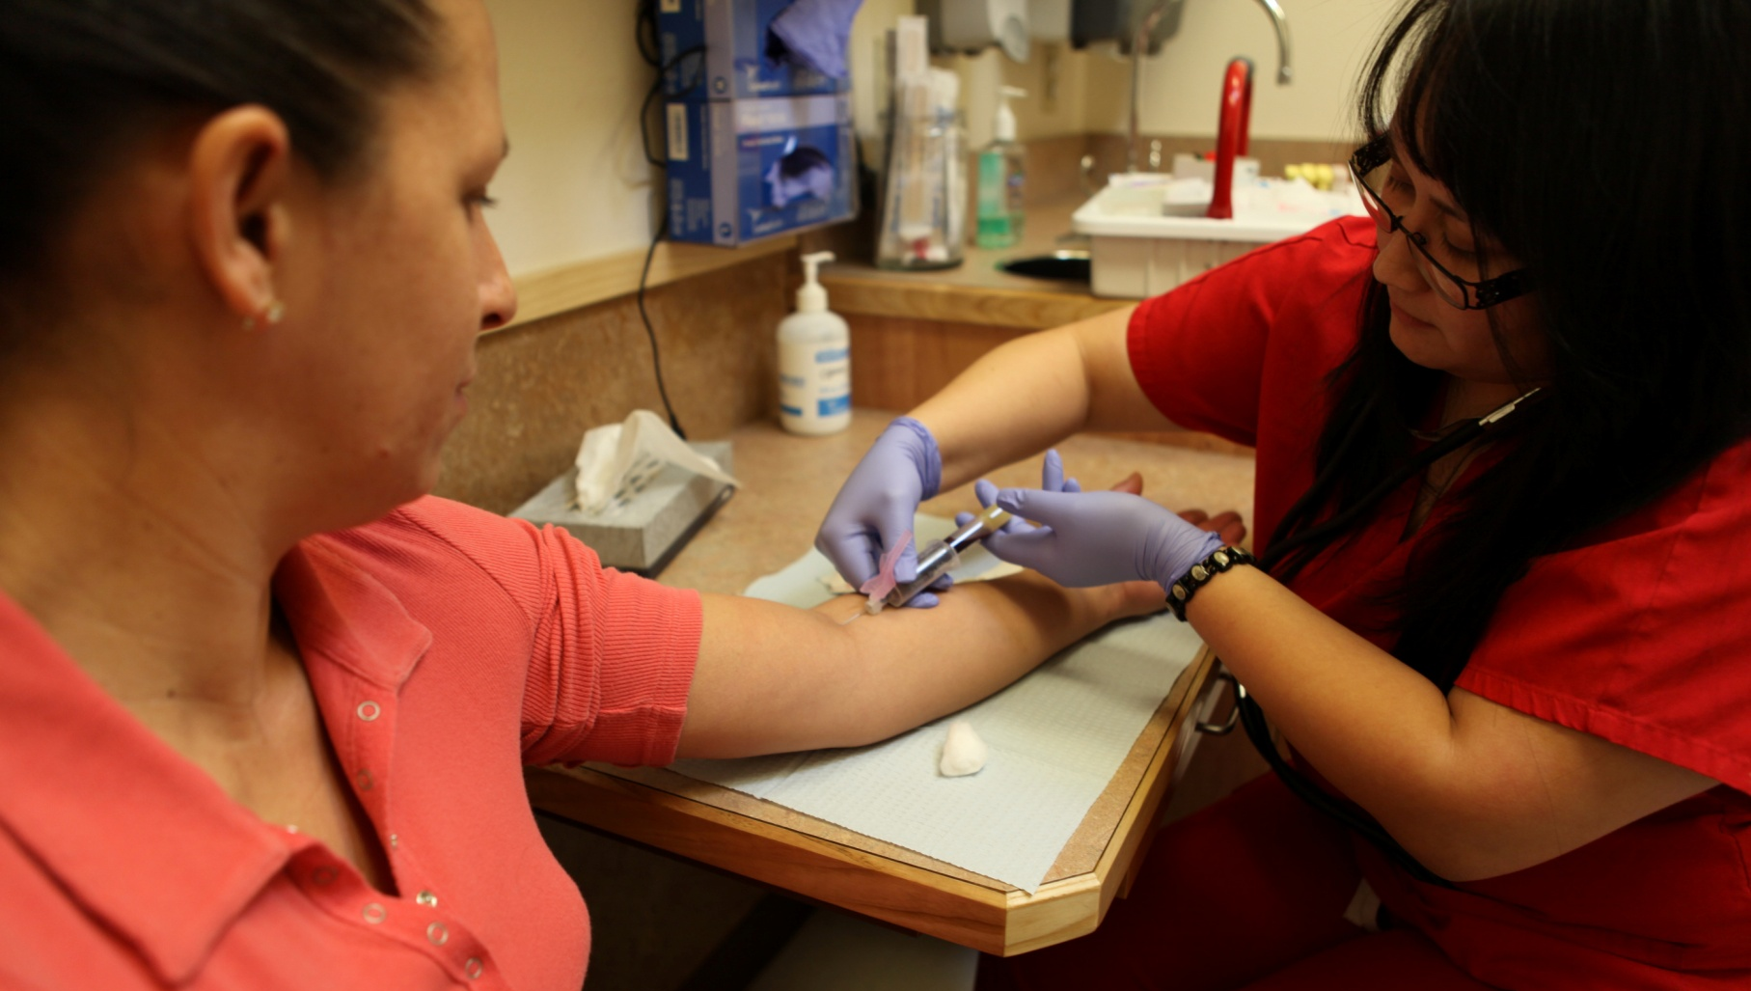
Salud Family Health Centers, Commerce City
Jeff Bontrager 720.382.7075 BontragerJ@ColoradoHealthInstitute.org
Westley Mori 720.382.7088 MoriW@ColoradoHealthInstitute.org

