Slide 1
Meeting Students Where They Are
February 20, 2025
Lindsey Whittington
Gerardo
Silva-Padrón
Colorado Health Institute
Supporting Student Health
with School-Based Health Care

Slide 3
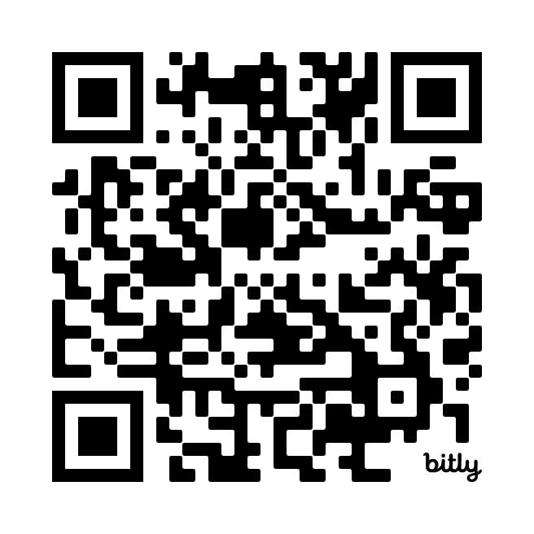
Register Today:
CHAS Data for Changing Times
colo.health/
CHAS-data
March 27, 2025

Slide 4



Today’s Presenters
Gerardo Silva-Padrón
Research and Policy Analyst
Colorado Health Institute
Lindsey Whittington
Data and Analysis Manager
Colorado Health Institute

Slide 5
School-Based Health Care 101
Notes:
Now, let’s start off by introducing everyone to what school-based health care is and why it is an integral part of health care delivery for kids.

Slide 6
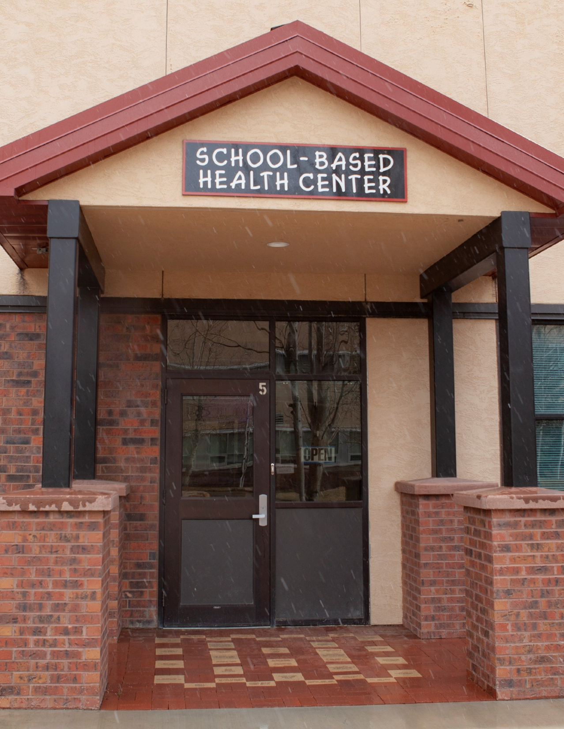
Reach of School-Based Health Care
71 clinics in Colorado
as of February.
Services are
also available via telemedicine and
mobile clinics.
School-based health care provides many benefits.
Notes:
SBHC in Colorado consists of school-based health centers that are health care facilities that are located within a school or on school grounds. As of February, there are 71 clinics operating across the state. These clinics served around 35,000 kids in 2023. The clinics are staffed with teams that can include medical and behavioral health providers, specialists, dental professionals, care coordinators, and so much more. Some locations have services that are provided as “school-linked”, which means it’s a smaller scale program that provides care outside the usual brick and mortal school-based clinic. This can include services provided through telehealth, mobile units, or single providers that partner to provide services to students and their families.
SBHCs are an important part of the health care system, as they often serve students and families who don’t have another medical home or can’t access services anywhere else. This includes families that often time face systemic barriers: those who are lower income, who are uninsured, or students whose families speak languages other than English. They are an important component of Colorado’s health care safety net.

Slide 7
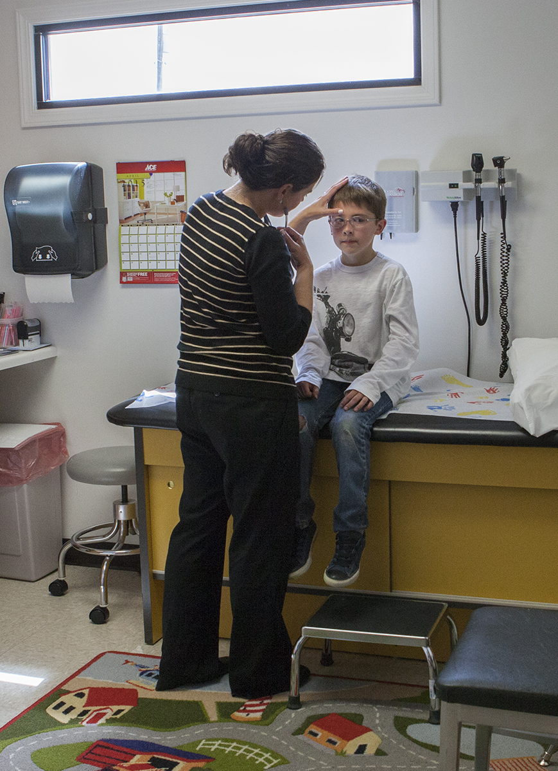
Key Services
  Well-child exams
  Sick visits
  Health screenings
  Immunizations
  Mental health and other counseling
  Substance use screening
  Oral health screening
  Reproductive health services
Notes:
Read off the key services that they provide

Slide 8







Benefits of School-Based Health Centers
Higher school attendance.
Increased graduation rates
Fewer visits to emergency rooms and urgent care centers.
Lower hospitalization rates for children with asthma.
Better access to mental health services.
Higher vaccination rates.
Less Medicaid spending on hospitals,
emergency rooms, and medicine.
Notes:
Read these

Slide 9
Exploring Data From the Interactive Tool
Notes:
Now, we are going to explore an interactive data tool that CHI developed in partnership with the Youth Healthcare Alliance, formerly known as Colorado Association for School-Based Health Care, and CDPHE. CHI has worked for many years on needs assessment focused on understanding the impact and needs of SBHC – however, in the last two updates, the needs assessment has transitioned to an interactive online tool that showcases a school need index. The tool allows users to understand where there might be higher need schools for services provision in different parts of the state based on the results of the index.

Slide 10
Key Findings From the Index
School-based health centers serve children and families who might not have access anywhere else.
Metro Denver schools with the highest needs are clustered east of I-25.
Rural schools, including in the San Luis Valley, show higher need and have limited access to existing school-based health centers.
Notes:
First, a few key findings from our analysis.

Slide 11
Methodology
17 Key Metrics Related to:
  Health Outcomes and Risk
  Health Insurance Coverage
  Access and Utilization of Care
  Student Need
Schools Grouped By:
Highest Need
Higher
Need
Average
Need
Lower
Need
Lowest
Need
Notes:
Before we explore the tool, I wanted to provide an overview of the methods of the needs assessment index that is presented in the tool. In the 2024 update, the index was developed based on 17 key health-related metrics, grouped into 4 focus areas. Metrics that measure things like health outcomes and risk, health insurance coverage, access and utilization of health care, and overall student need. Some examples of indicators include: the uninsured rate for youth, percentage of families that do not have a usual source of care, and school drop out rate. The metrics are available at different levels of geography, from school to health statistics region. Data are larger geographies are applied to schools within that geography area.
After calculating the index, the index is grouped into five categories based on natural breaks in the data. (read off these groups). You will see these colors on the mapping application that we will now explore.

Slide 12
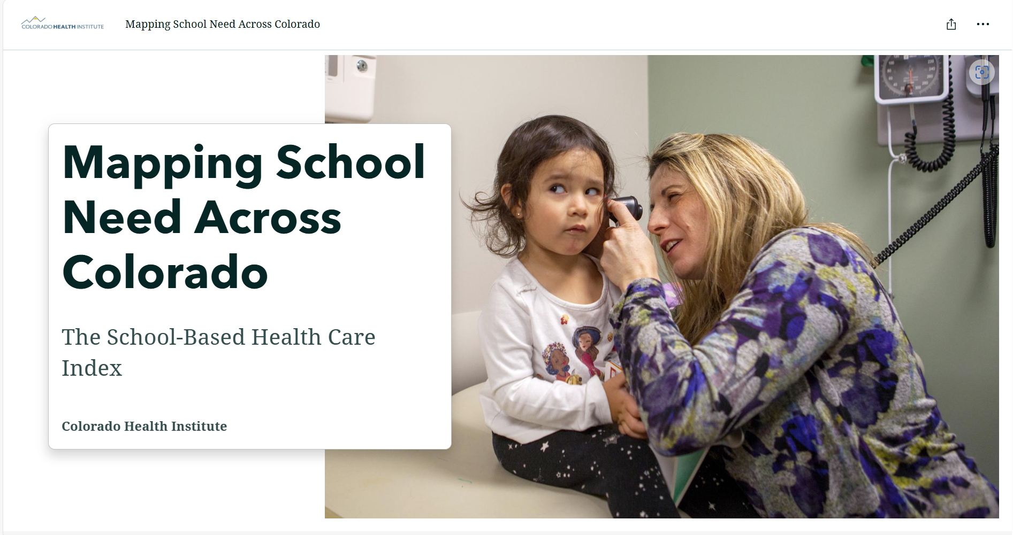
Exploring the Interactive Tool
Notes:
Link: Meeting Students Where They Are: Supporting Student Health With School-Based Care | Colorado Health Institute

Slide 13
Policies in Colorado and Other States
Notes:
In Colorado, we have made significant strides in expanding and supporting SBHCs, thanks to state policies that prioritize access to healthcare for students. However, when we step back and look at the national landscape, we see a variety of approaches—some states leading the way with robust funding and policy support, while others face challenges in implementing and sustaining these essential programs.
Today, we’ll explore the current policies governing SBHCs, the successes and challenges within Colorado, and how other states compare. Most importantly, we’ll discuss how leveraging schools can be essential to students health and well-being.

Slide 14
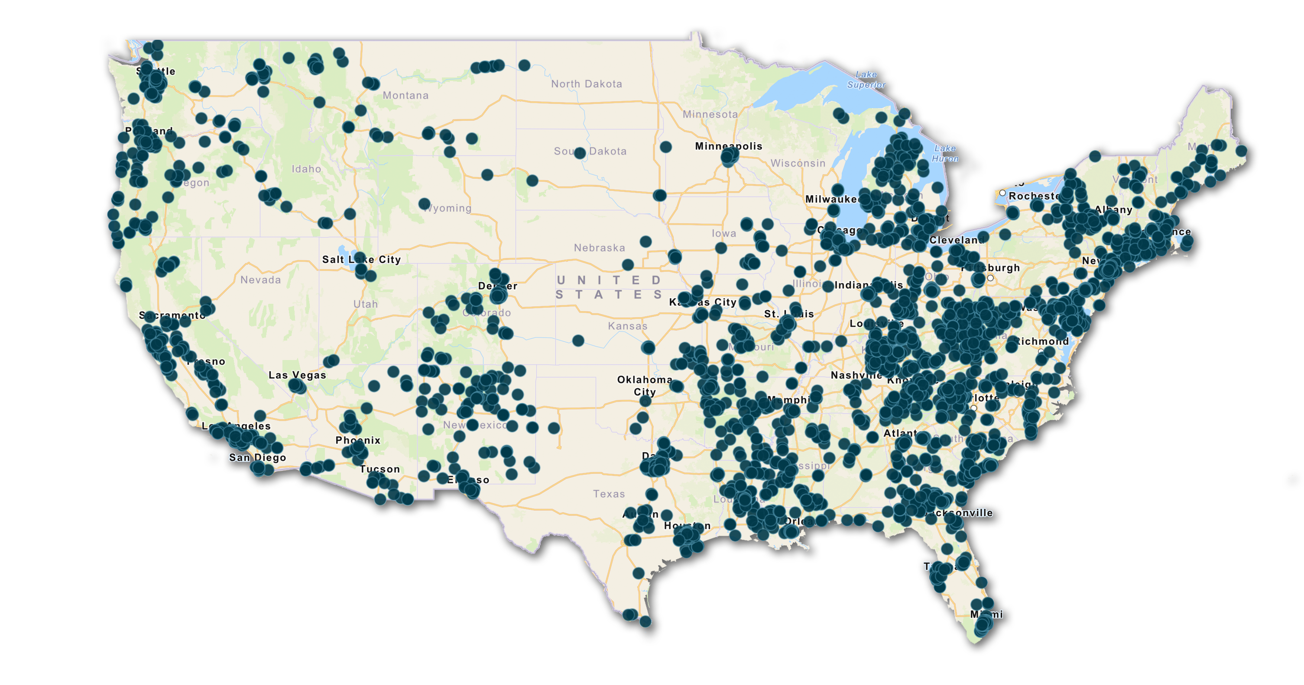
National Landscape of SBHCs
Source: School-Based Health Alliance
Notes:
The incredible team at the School-Based Health Alliance recently launched a new campaign called "Keep Healthy Together." This collective effort highlights the importance of SBHCs nationwide and supports healthier kids and stronger communities. As part of this campaign, they compiled valuable data, including a map of all the school-based health centers across the United States.
One key thing to note here is how SBHCs are widespread across many states, & this may be because several states having statutory measures in place that allocate dedicated funding to these centers. For many centers across the nation, funding can come through many ways such as federal and state grants, health care institutions, private grants, & in some states, they have even tapped into their Medicaid reimbursements to expand and sustain SBHCs.
This national map also showcases the remarkable growth of SBHCs in Colorado. Since the state’s first SBHC opened in 1978, the number of children with access to these essential health services has reached an all-time high. As of 2024, Colorado there is little over 70+ school-based health centers (SBHCs) operating across the state. Denver alone, Denver Health manages 19 SBHCs located within Denver Public Schools, which serves about 15,000 students annually.

Slide 15
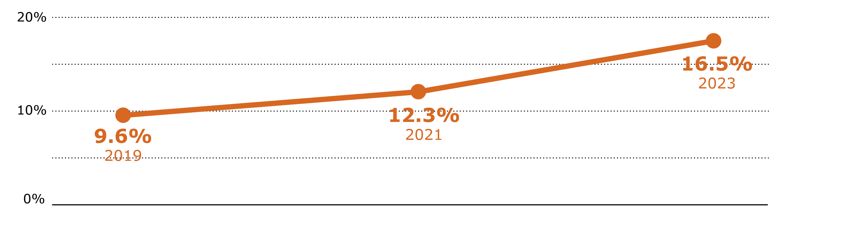
Children’s Mental Health
School-Age Children Were More Likely
to Experience Poor Mental Health Post COVID.
Topic: Experienced eight or more poor mental health days in the past month. Population: Coloradans ages 5 to 18. Years: 2019-2023.
Source: Colorado Health Access Survey
Notes:
Our most recent 2023 CHAS survey examined the mental health of school-age children (ages 5 to 18) by looking at the number of days they experienced poor mental health in the past month.
•In 2019, 9.6% of school-age children reported experiencing eight or more days of poor mental health in a month. •By 2023, that number had jumped to 16.5%—a significant increase.
It’s apparent that the COVID-19 pandemic had an impact on children’s mental health and overall well-being. Thus, forcing many school base health centers to think more critically about how to deliver mental health support such as looking into telehealth and video services.
On top of the great work school base health centers are doing in Colorado, the general assembly earlier this year voted to permanently continue the I Matter program. For those that may not be familiar with the program: This initiative, originally launched during the pandemic, provides up to six free telehealth or in-person counseling sessions to students from elementary through high school
These are both examples of how schools are becoming critical access points for quality mental health care—and how SBHCs and Colorado policies have played a major role in supporting students beyond traditional medical needs. Now let's transition to some notable policies that have impacted school base health centers.

Slide 16
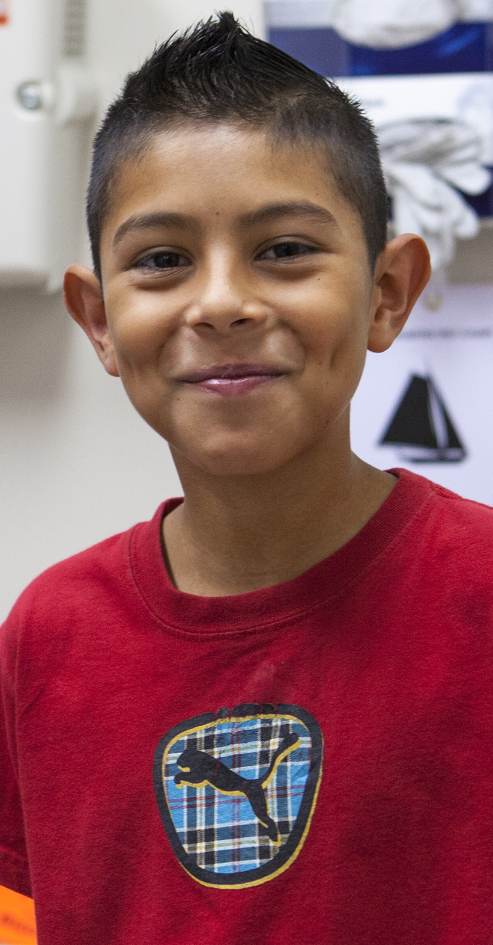
SBHCs and Mental Health
Senate Bill 22-147:
  $1.5 million for SBHCs
  SBHCs recognized as part of
  a network of mental health care
  Senate Bill 24-034:
  Expands to oversee new models of care, called school-linked services
    Including telehealth services and mobile health units
Notes:
SB 22-147: Enacted in 2022, allocated $1.5 million in federal stimulus funds for the School-Based Health Center Grant Program, which expand access to behavioral health services for children & families.
SB 24-034: Passed this last year, this bill expanded the definition of school-based health centers to include "school-linked" health-care services. This allows for grants to support services such as primary care, behavioral health, and oral care to be delivered through telehealth, mobile units, or referrals to clinics near school grounds. A little bit of a quick run down on school linked services:
Think of school-linked services like a "helping hand" from the school to connect students with doctors, dentists, therapists, and other healthcare providers outside of school.
Instead of having a doctor’s office inside the school (like what you see in a School-Based Health Center), the school helps students get care somewhere nearby—like at a clinic, hospital, or through telehealth (video calls with doctors). School administers and other staff members tend to be the ones fostering these partnerships between students and their needed service.
But to wrap us back to the bill... the bill did pass but did not receive its overall goal for funding support. However, it did expand the state definition of school base health centers by broadening the scope of accessible health services by incorporating school-linked models.

Slide 17
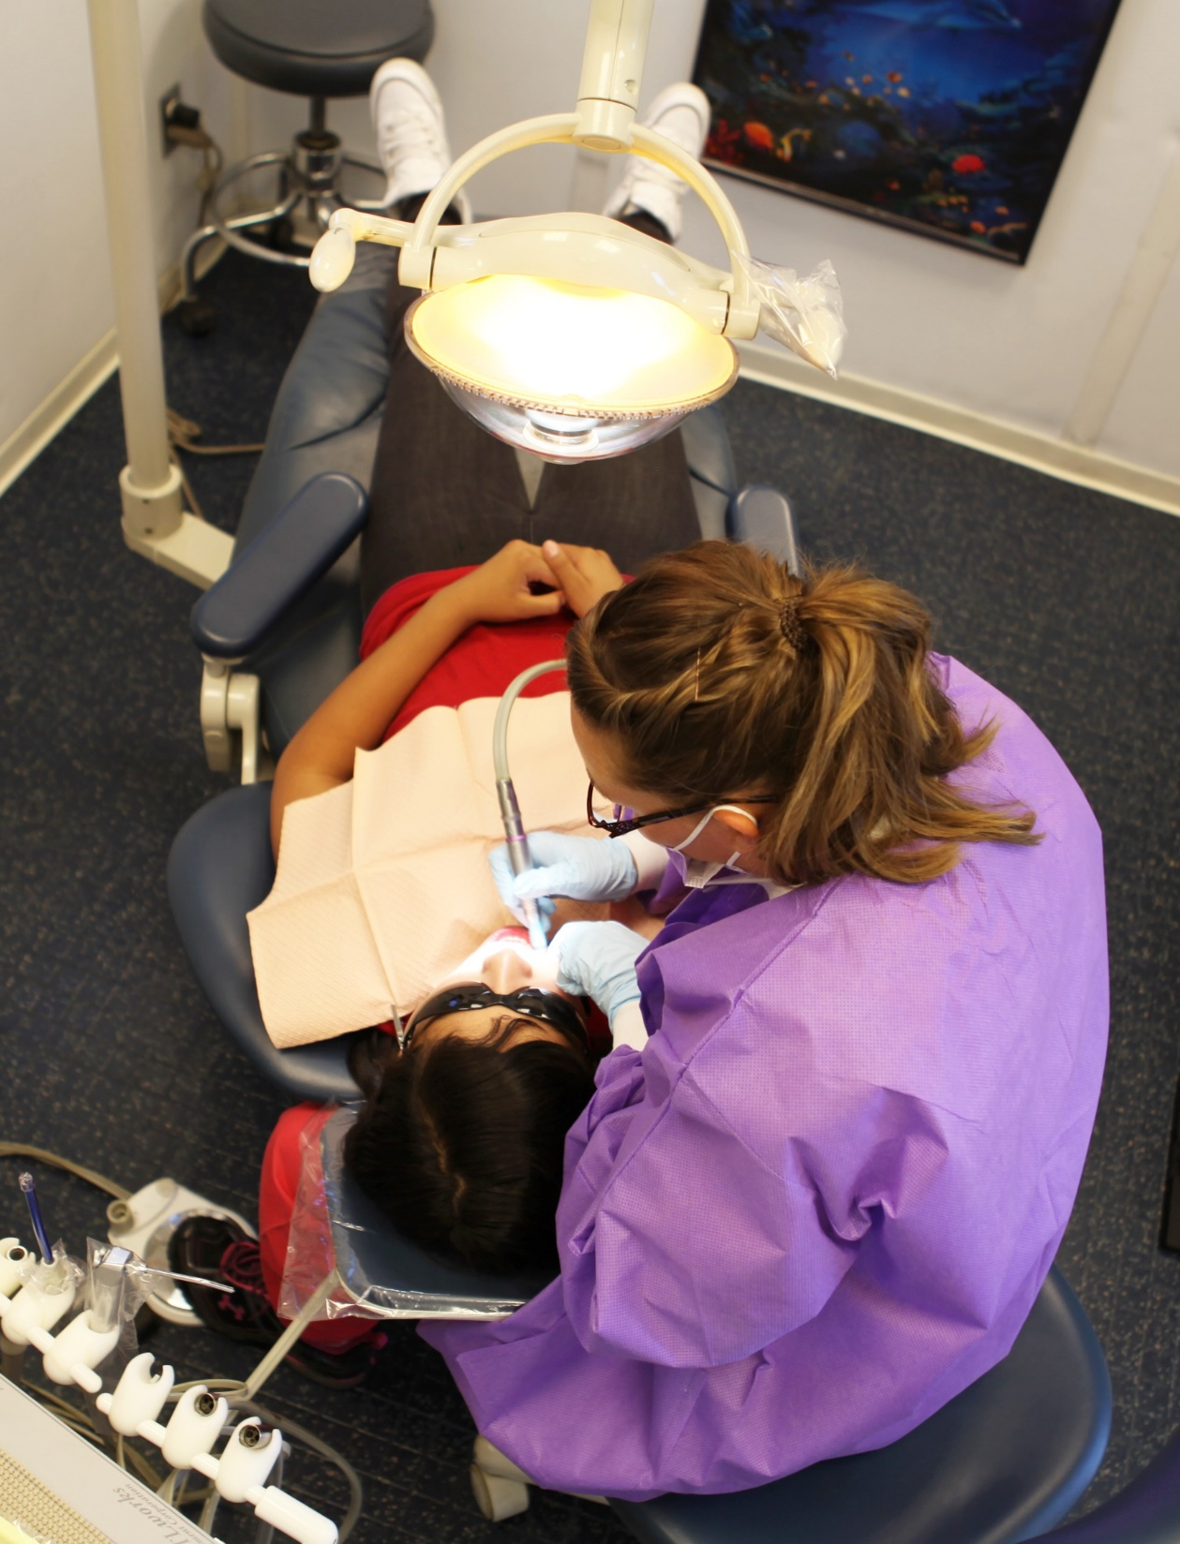
SBHCs and Oral Health
In Colorado, 6.5% of
school-age children
reported having fair or poor
oral health in 2023.
Senate Bill 24-142:
Select schools will be the pilot for oral health screenings
Notes:
Poor oral health can significantly impact a child’s school studies and their willingness to engage in a classroom. Poor dental health can lead to pain, infections, and difficulty eating, affecting a child’s nutrition and overall well-being. A national study found that children collectively miss about 34 million hours of school each year due to dental pain. For instance, ongoing dental pain such as cavities, infections or gum diseases, can affect a student's ability to concentrate throughout the school day, leading to a reduced ability to perform academically, which may result in more absences from school.
In Colorado, 6.5% of school-age children reported having fair or poor oral health in 2023 based on our CHAS survey results.
School-Based Health Centers (SBHCs) work hard to bridge the dental care gap by providing students with preventive and urgent services at no cost. These centers offer screenings, routine cleanings, cavity prevention, and X-rays, ensuring timely oral healthcare. By prioritizing school base dental care it promotes healthier students, academic success, and is a safety net for families that may not have insurance, access to transportation, or afford quality dental care.
In addition to these amazing services being offered to families and kids, Colorado last year also passed a bill SB 142, that will be piloting an oral health screening program in some schools. This type of program can help address disparities in dental care access, especially for families facing financial or logistical barriers. Thus, by integrating dental care into schools, Colorado is taking a crucial step toward ensuring all children all receive preventive and needed dental care.

Slide 18

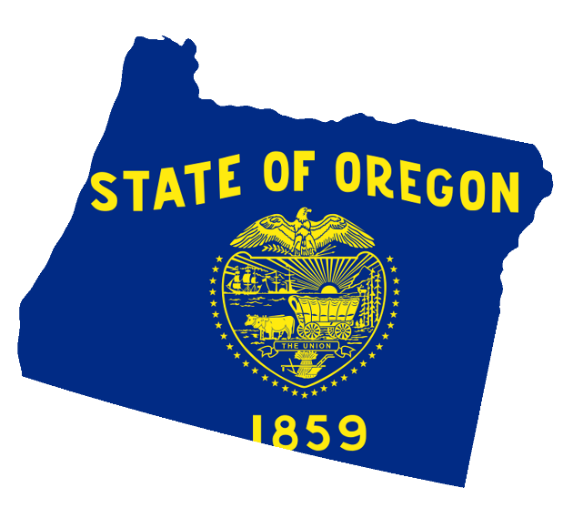
SBHCs in Other States
Louisiana
Dental training for nurse practitioners
South Dakota
Traveling
oral health teams
for rural schools
Oregon
Comprehensive preventive care
Notes:
While Colorado excels in school-based health centers, other states have developed unique programs tailored to their communities' specific needs. No two centers are the same, as each provides distinct services designed to support their local populations. Louisiana: Louisiana’s school-based health centers collaborated with dental providers. When it became clear the dental workforce shortage would be an obstacle, additional training was given to advanced nurse practitioners to perform focused oral health assessments, apply cleanings, and even referred students to dentists.
Next, South Dakota: In rural South Dakota, school-based health centers address the dental care provider shortage by engaging with medical and dental hygiene students, along with their professors. These teams travel to rural schools, delivering oral health education, screenings, and services. This hands-on experience not only addresses the provider shortage by giving students an opportunity to learn, but also aims to reach the children in underserved rural communities.
Oregon: Oregon’s school-based health centers offer a wide range of preventative services, including well visits, behavioral health, youth sexual health, and opportunities for youth to engage. To elaborate a little more, one of Oregon’s most innovative approaches is student involvement. The state empowers youth through their Mental Health Youth Advisory Council grants, which have a goal to help reduce stigma and promote mental health awareness for the younger population. These student-led advisory councils collaborate with school leaders and policymakers, organizing listening sessions to identify and address barriers that other students may be experiencing.
What makes this initiative truly impactful is that student input directly shape policy. Their feedback influences certification standards for new school-based health centers, ensuring that young voices drive the future of school-based healthcare.
These examples showcase how states are fostering innovative strategies to improve the everyday lives of children.

Slide 19
Chatting With Colorado Experts
Aubrey Hill
Youth Healthcare Alliance
Michelle Schultz
Colorado Department of Public Health and Environment
Monica Ycaza
Mapleton School District
Wendy Murillo
Center Consolidated School District

Slide 20
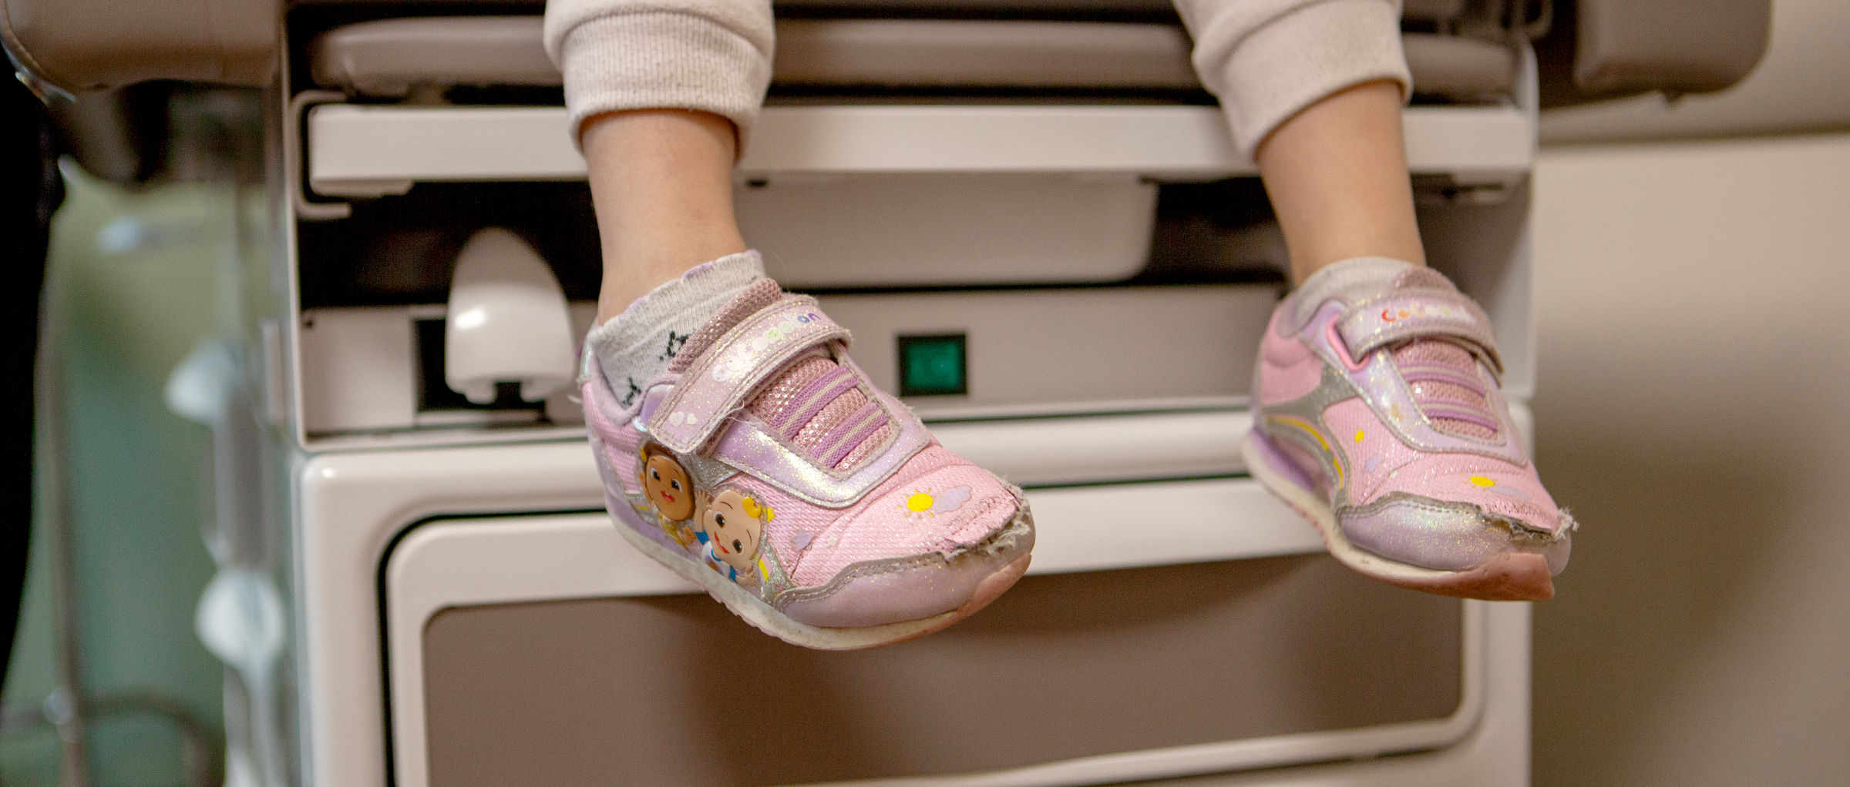
Lindsey Whittington
whittingtonl@coloradohealthinstitute.org
720.951.9251

