Slide 1


DECEMBER 5, 2024
Legislative Preview
Joe Hanel
Director of Communications
Colorado Health Institute

Slide 2


Thinking About 2025
Tools We Can Use
  Federalism
  Leadership
  Money
Work We Can Do
  Protect the Vulnerable
  Carry On With Our Priorities
Notes:
What we’re going to try to do today is construct a framework for how to think about public policy in Colorado in the next year. Or four years.
Just like any policy framework, we want to understand the tools we have at our disposal. Today's we'll look at three: the nation's federal structure, our state's leadership, and our financial resources — in this case the state budget.
Then we'll look at the tasks we can accomplish. We'll be looking at two. First, protecting our most vulnerable neighbors, and two, carrying on with our long-term work in health costs, housing, and more.

Slide 3
Federalism
Notes:
Our first tool is the nature of the United States itself.

Slide 4
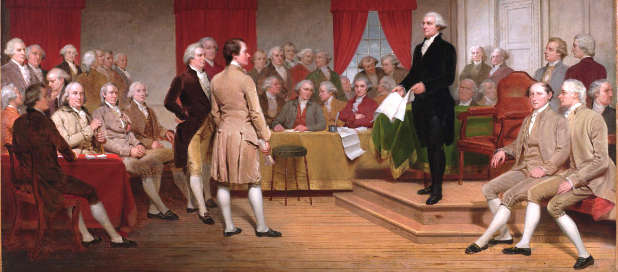
Federalism
Notes:
We’re a federal republic. That was decided back in 1789, as shown in this painting of the constitutional convention. That means power is split among our local, state, and national governments. It means there are things in our control.
The national government is still supreme, but there’s a lot that states can decide for themselves if the national government is unable or unwilling to step in.

Slide 5
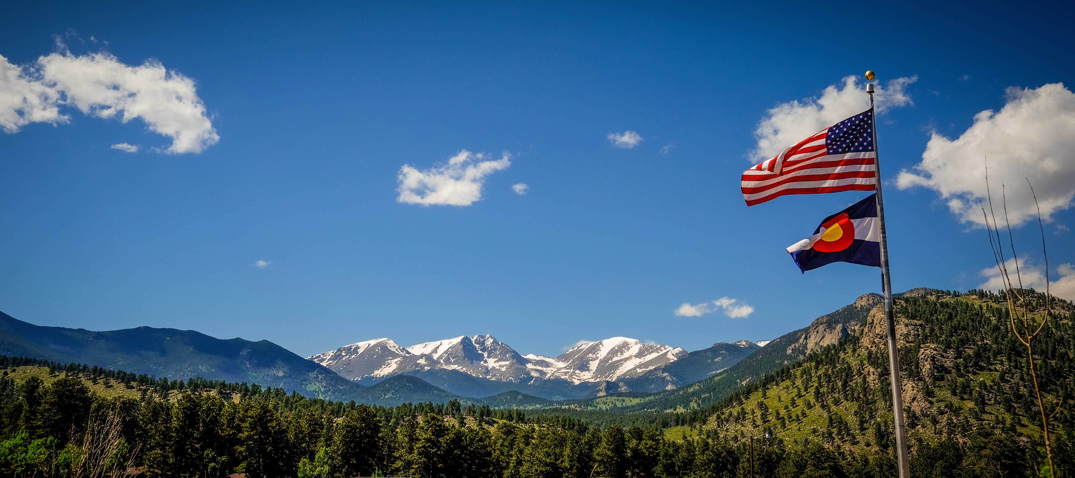
Federalism in Action
Essential health benefits
Affordable Care Act coverage
Firearms background checks
Same-sex marriage
Abortion rights
Notes:
Colorado already has done a lot of this work. Here’s a very brief sampling of national policies that Colorado has put into state law.
The Affordable Care Act established a set of essential health benefits that insurance plans have to cover, but Colorado already had a set of essential benefits in law, and it remains there. In CO, for example, hospitalization, labs, prescription drugs, those are all essential health benefits under state law, not just the affordable care act.
Speaking of the ACA, Colorado quickly took advantage of everything that law offered to states, such as expanding Medicaid and setting up an insurance exchange Connect for Health Colorado.
Back when there was a 5-day waiting period in federal law to buy a gun, Colorado circumvented that by setting up and paying for an instant background check at the Colorado Bureau of Investigation. Since then, the state has passed a three-day waiting period.
And just last month, Colorado voters put the right to same-sex marriage and the right to abortion in the state constitution.
So the idea is not new that Colorado can strike out on its own in health, the environment, and individual rights.

Slide 6
Leadership
Notes:
Next, let’s look at state leadership and start out with a quick look at the election and where it leaves Colorado. Republicans made some modest gains in the election. Their biggest victory was picking up the 8th congressional district seat.

Slide 7
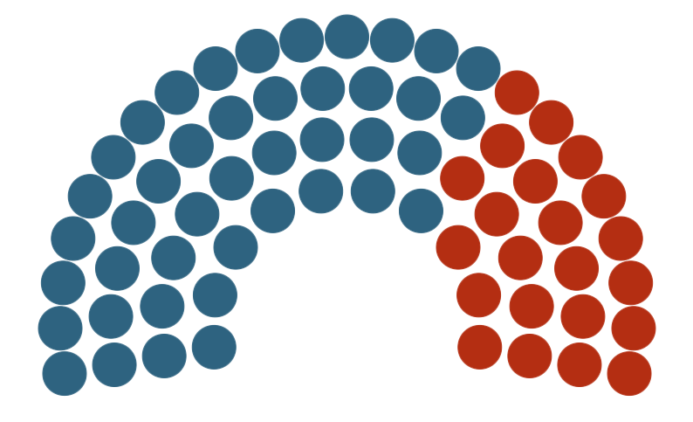
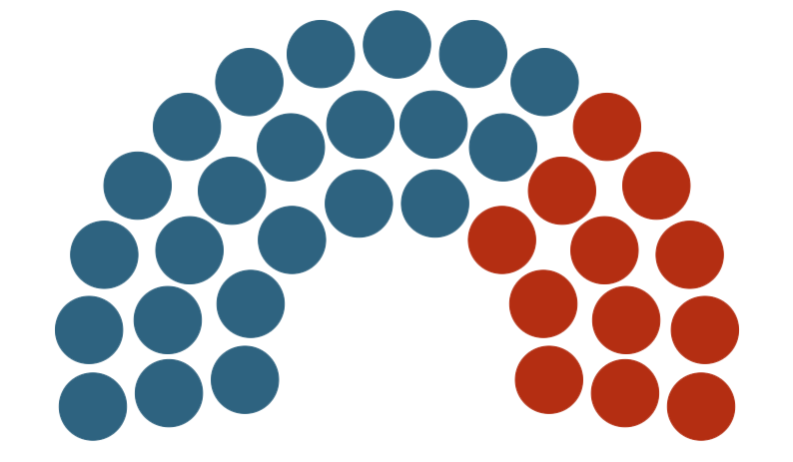
2025 Session: January 8 to May 7
The House
The Senate
43D
22R
23D
12R
Notes:
In the state House, Republicans picked up three seats, but Democrats still have a commanding 43-22 majority. But it’s no longer a supermajority, so Republicans should be able to gain more seats on some committees.
In the Senate, the parties each gained and lost a seat, which leaves us at the exact margin from last year, 23 Democrats and 12 Republicans.
The session starts on January 8 and runs for at most 120 days.

Slide 8
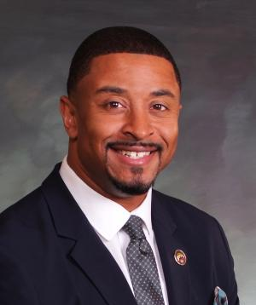

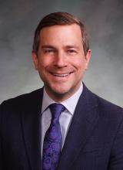

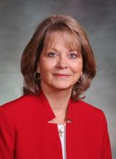
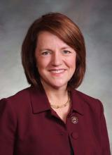
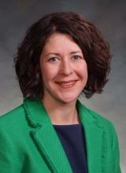


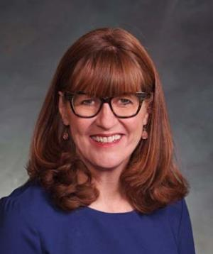
Senate President
James Coleman
Governor
Jared Polis
Joint Budget Committee
Four Democrats
Two Republicans
Speaker
of the House
Julie McCluskie
Notes:
100 legislators, but three power centers. First is Gov Jared Polis.
Next is Joint Budget Committee. 6 members, 3 each from House and Senate, four Dems and two Republicans. The JBC is at odds with Polis over some of his proposed cuts to education and health care providers.
Finally, chamber leadership, personified by new Senate President James Coleman and Speaker of the House Julie McCluskie.
These three power centers will interact over the next five months about the legislature’s biggest task — the state budget. The final budget will reflect a compromise between all of them.

Slide 9
Leaders Everywhere
Notes:
And we can’t talk about leadership without acknowledging that Colorado has an active and well-resourced community in health advocacy and health policy. Many members of this community are in the room right now or watching online.

Slide 10
Understanding
the Budget
Notes:
The last tool in our mental framework is money. That means the state budget. And I’m sorry to say but this tool is a bit unreliable.

Slide 11

Budget Timeline
Briefings and hearings
24-25
adjustments
Figure-setting
and balancing
Long Bill
Notes:
Before we get to the numbers, we thought a quick overview of the budget process might help you follow the action.
The governor put in his budget on November 1. Right now, the JBC is getting briefings on each department, after which they call the department leaders in for a hearing to justify their requests. After the legislature convenes in January, they will vote on changes to the current 2024-25 budget, called supplementals. This year, those might be cuts.
In February, the JBC starts to set line items for each department, and by the end of March they will have produced a balanced budget. That budget gets put into the Long Bill, and both the Senate and the House each have a week to amend it. The Long Bill is the last chance anyone has to get an item into the 25-26 budget.

Slide 12

The State Budget
It’s tight!
There’s no money for new programs
It’s constrained
by the state constitution
Notes:
Now let’s get into the numbers. The one thing to know about the budget is that it’s tight. There is essentially no room for new programs. In fact, some legislators say the rank and file is being told that they will not be able to pass any bills that spend money in 2025.
And one reason it’s tight is because of legal constraints on revenue that are unique to Colorado.

Slide 13






Two Types of Budget Woes
1
2
EXPENSES
REVENUE
EXPENSES
REVENUE
TABOR
Notes:
You might have heard people say that Colorado is back to having tight budgets after several years of extra money from pandemic relief funds. And that’s true, but this time we’re in a slightly different sort of budget trouble than normal. When I was a reporter at the Capitol, we were dealing with several years of dire budgets from the financial crash of 2008. That’s part 1 of this drawing. There was just not enough tax revenue coming into the piggy bank. This time around, we’re in the second part of the drawing. Our revenue is healthy. The economy’s pretty good, actually. But our expenses have grown even more than revenue. And there’s this little matter of the Taxpayer’s Bill of Rights, or TABOR. It’s a revenue limit — the strictest in the country. If revenue goes over the TABOR limit, the legislature has to send it back to taxpayers. For the 24-25 budget, the state is probably about $750 million over the limit. It won’t help to raise taxes or fees, because that extra revenue would just push the budget farther over the TABOR limit. That’s why we’re looking at spending cuts.

Slide 14
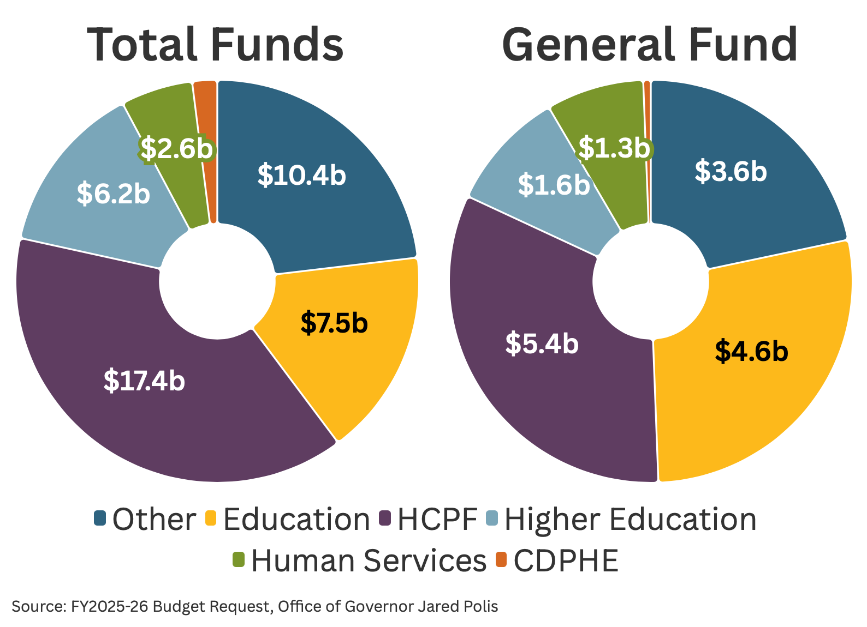
2025-26 Budget: An Overview
General Fund
$17.8 billion
Total Funds
$46.1 billion
n HCPF
n K-12 Education
n Higher Education
n Human Services
n CDPHE
n Other
Notes:
After all that, the budget is probably going to look a lot like you see here. Not to say there won’t be important changes, but the big expenses are what they are — health care and education. Health Care Policy and Financing is by far the biggest department by total dollars, followed by K-12 education and Higher Education. It’s the same story in the general fund, which is the part legislators have the most control over. HCPF and K-12 Education are the two biggest departments. Higher education and Human Services have $1.6 billion and $1.3 billion, respectively.

Slide 15


Balancing Options
Freezing/cutting provider rates
Privatizing Pinnacol
Notes:
The governor has proposed many items to bring the budget into balance. We will talk about two. First is freezing or cutting the rates the state pays to health care providers in Medicaid, aiming to pay 95% of what Medicare pays. Providers who currently get above 95% of Medicare would be cut back to 95%. The JBC has been working for years to incrementally raise provider rates, and this proposed cut is not sitting well with JBC members from both parties.
The second is privatizing Pinnacol Assurance. Pinnacol is a quasi-public workers comp insurance company. The state set it up more than 100 years ago. Polis wants to fully privatize it and use the proceeds from the sale to backfill the state budget for the next few years. There are two drawbacks to this plan. First, you can only sell a 100-year-old company once, and this option wouldn’t be available to deal with an even bigger budget problem in the future. And two, if legislators reject the sale, then they will have to find another $100 million in cuts this year.

Slide 16
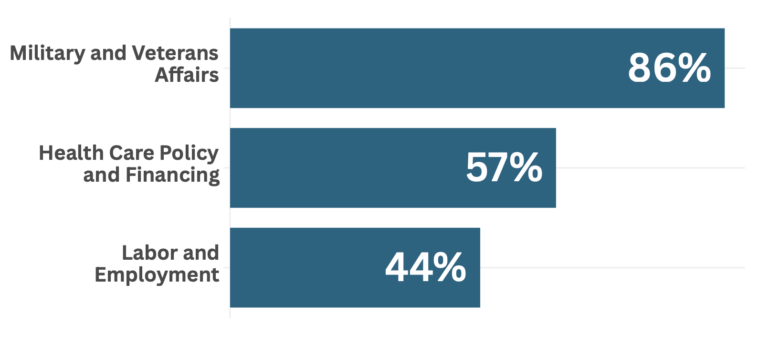
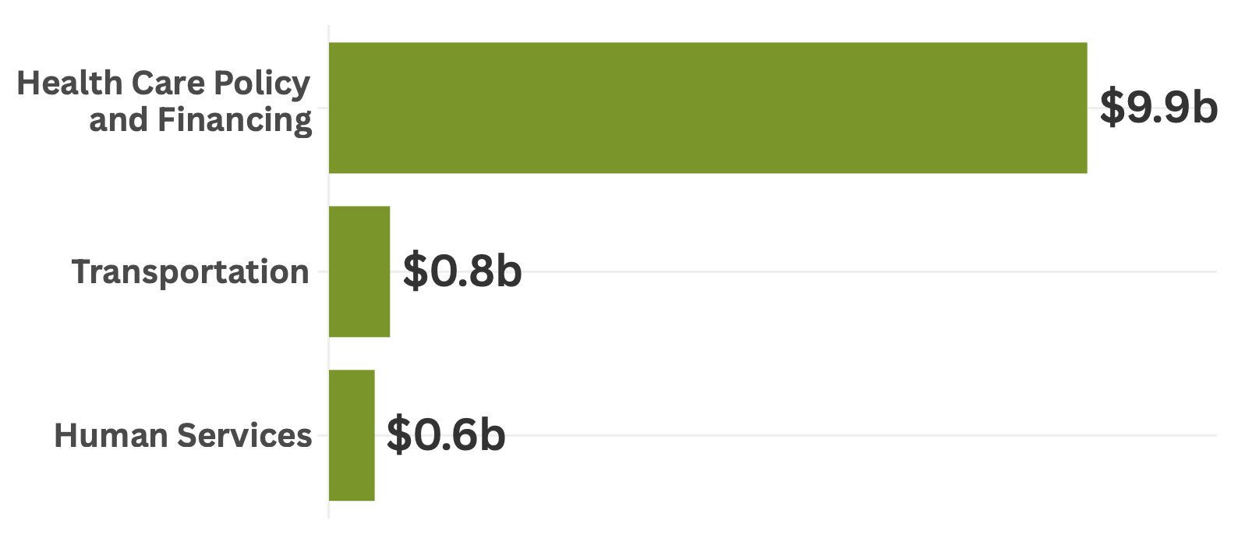
Federal Funding for State Agencies
Notes:
To wrap up our look at the budget, I want to talk about federal funds. We usually don’t pay too much attention to federal funds because there’s not much to say about them. They come from the federal government for specific purposes, and the legislature doesn’t have much say at all over them. The federal government pays for about 30% of the state budget. That’s more than $13 billion. We don’t expect many changes this year, but after Trump and congressional Republicans have had time to put together their first budget, we could see some big changes in the coming years.
So we thought we should look at where the state is most vulnerable to federal changes. The chart shows the percentage of federal funds in the seven departments most dependent on money from Washington. First is military and veterans’ affairs. That’s basically the National Guard. Then we see HCPF with Medicaid, Labor with unemployment insurance,
But in terms of raw dollars, there’s really one big item, and that’s Medicaid. Nearly $10 billion in federal funds will come to HCPF in the next budget, mostly for Medicaid. Now you see why Emily spent so much time this morning on looking at potential cuts to Medicaid, either by changing the federal match rate or by block granting the program. Even a 10% cut would be a billion dollars.

Slide 17
Thinking About 2025
Tools We Can Use
  Federalism
  Leadership
  Money
Work We Can Do
  Protect the Vulnerable
  Carry On With Our Priorities
Notes:
That was a look at the tools we have to work with. We reminded ourselves that this is a federal republic and there’s a lot that a state can do in such a system. We looked at our leadership in and out of the capitol. And then we looked at probably the weakest tool in our toolbox, the state budget. State finances is probably where Colorado is most exposed to risk from radical changes coming from Washington — especially in Medicaid.

Slide 18
Protecting
the Vulnerable
Notes:
Now let’s look at the state’s tasks. Our research for this presentation brought up two broad themes about the policy work going on in Colorado right now. Protecting the vulnerable, and carrying on with all the other work.

Slide 19

Trans Rights and Health Care
Access to gender-affirming care
  Insurance coverage
  Provider availability
Notes:
Transgender people found themselves as targets of a culture war in the past several years, with bans on medical care, sports participation, and public bathrooms.
They’re feeling this as hate. Calls to the Trevor Project, an LGBTQ suicide hotline, spiked by 700% in the days after the election. Colorado has a special role to play here, because it has become a sanctuary state for trans people seeking gender-affirming care. 26 states have laws or rules banning gender-affirming care for anyone under age 18.
The legislature established the legal right to gender-affirming care a few years ago, while other states were outlawing it. In 2025, One Colorado is backing a bill to add gender-affirming care as an insurance benefit in all state-regulated plans.
Polis opposes mandates on insurance, so this could be a tricky decision.
It’s also hard to find providers, because the number of people coming from out of state for this care has doubled in the past couple of years. But the most common treatment is hormone replacement therapy, and any primary care doctor can get trained to provide this. Look for some efforts in that area, even if they might not involve legislation.

Slide 20



Immigrants
10% of Coloradans are immigrants
Deportation threats
  Rights education
  Upholding the law
Insurance for the undocumented
  OmniSalud
  Cover All Coloradans
Notes:
[adAnother explicit target of Trump’s campaign was immigrants. He mostly talked about deporting undocumented immigrants, but his close advisers have also talked about targeting naturalized citizens or U.S.-born children of immigrants, even though that group is protected under the 14th Amendment. Trump even came to Aurora, which he claimed is a “war zone,” to say he would invoke a 1798 law called the Alien Enemies Act that gives presidents the authority to detain members of an enemy nation.
We talked to the Colorado Immigrant Rights Coalition about this, and they say they are focusing on educating community members about their rights and making sure the state and local governments in Colorado follow state law, which says law enforcement will only help federal immigration authorities if they have a warrant signed by a judge.
Colorado also has taken big steps toward getting health insurance to undocumented people, both through the OmniSalud program for private insurance and Cover All Coloradans in Medicaid, which launches Jan. 1. Data privacy is going to be extremely important for those programs to succeed.

Slide 21

The Safety Net
Utilization costs up
Medicaid unwind
Provider rate cuts
Youth behavioral health settlement
Accountable Care Collaborative
Notes:
And finally in our first category of protecting the vulnerable, our safety net needs attention. Probably the most important thread in the safety net is Medicaid.
These issues are mostly separate from the presidential election. First, the cost of health care for Medicaid has risen far beyond expectations from last year, and its putting pressure on the whole state budget.
Safety net clinics and hospitals are sounding the alarm about an influx of uninsured patients that is putting a them under great strain. Everybody likes to complain about low reimbursement from Medicaid, but the fact is that many providers depend on Medicaid, because without it their patients have no way to pay.
Speaking of provider pay, the governor’s budget calls for freezing provider reimbursement rates or even cutting some of them back to 95% what Medicare pays. This has Joint Budget Committee members pretty steamed — both Republicans and Democrats. The JBC has been trying to raise provider rates for the past several years, and they are saying they will not approve these cuts.
Thestate is now under federal court supervision to rebuild its youth behavioral health system for Medicaid members, after a lawsuit settlement last winter.
And finally, phase 3 of the Medicaid Accountable Care Collaborative launches on July 1. Our Medicaid program has a lot going on right now.

Slide 22
Carrying On
With Our Priorities

Slide 23

Drug Prices
Pharma vs. hospitals
340B program:
Drug discounts for hospitals
The issues:
  Hospital charity care
  Contract pharmacies
Notes:
Possibly the biggest fight of the session. Pharma companies say hospitals are abusing the 340B drug discount program. Hospitals say they are not, and they are seeking legislation to validate the way they are using the program. Several other states have passed legislation like this and perhaps 20 more will consider it in 2025.
The issues are whether hospitals are providing enough of a public benefit with the discounts they receive, and whether they can use contract pharmacies in addition to their in-house pharmacies.

Slide 24

Housing
Junk rental fees
Landlords’ use of AI
Mobile home water quality
Construction defects

Slide 25
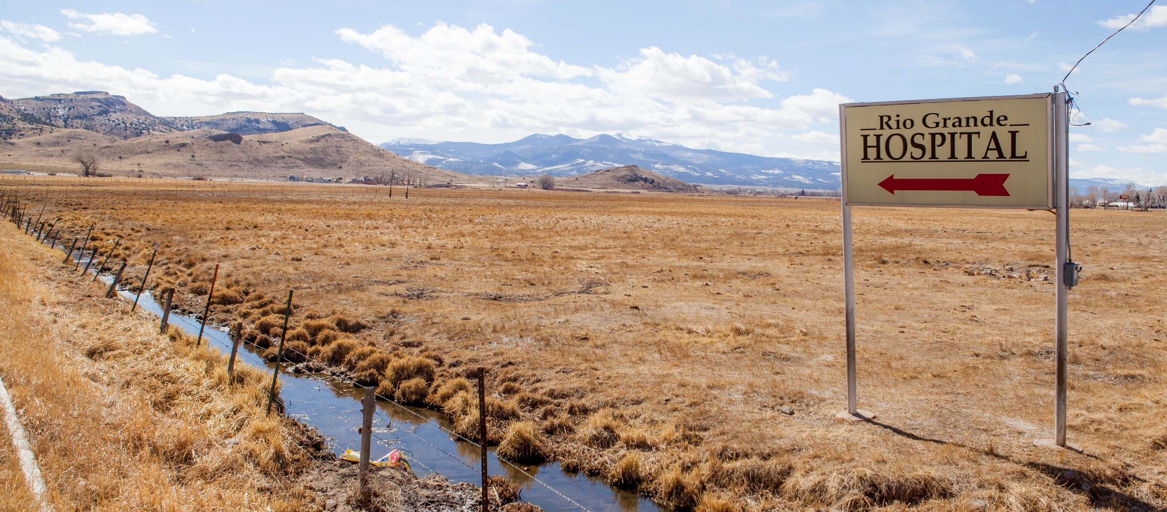
Health Care Providers
Medicaid audits
Hospital provider fee
Facility fees
Out-of-network billing
Notes:
Medicaid audits: Providers say that Colorado’s cost-recovery audits are too burdensome and are discouraging them from serving Medicaid patients.
The Colorado Hospital Association is floating a plan to get more federal money from the Hospital Provider Fee, aka the CHASE fee. Maybe up to $150 million. It might not require legislation.
Consumer advocates are targeting hospital facility fees.
And the out-of-network billing dispute is back. Doctors say insurers are unjustly excluding them from their networks.

Slide 26
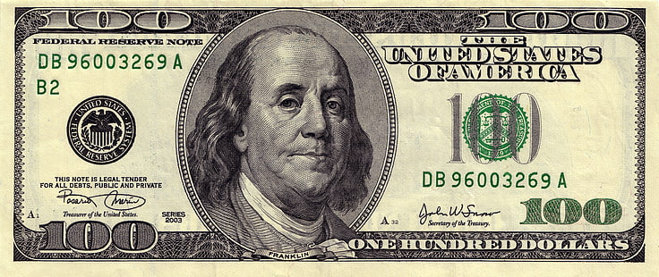
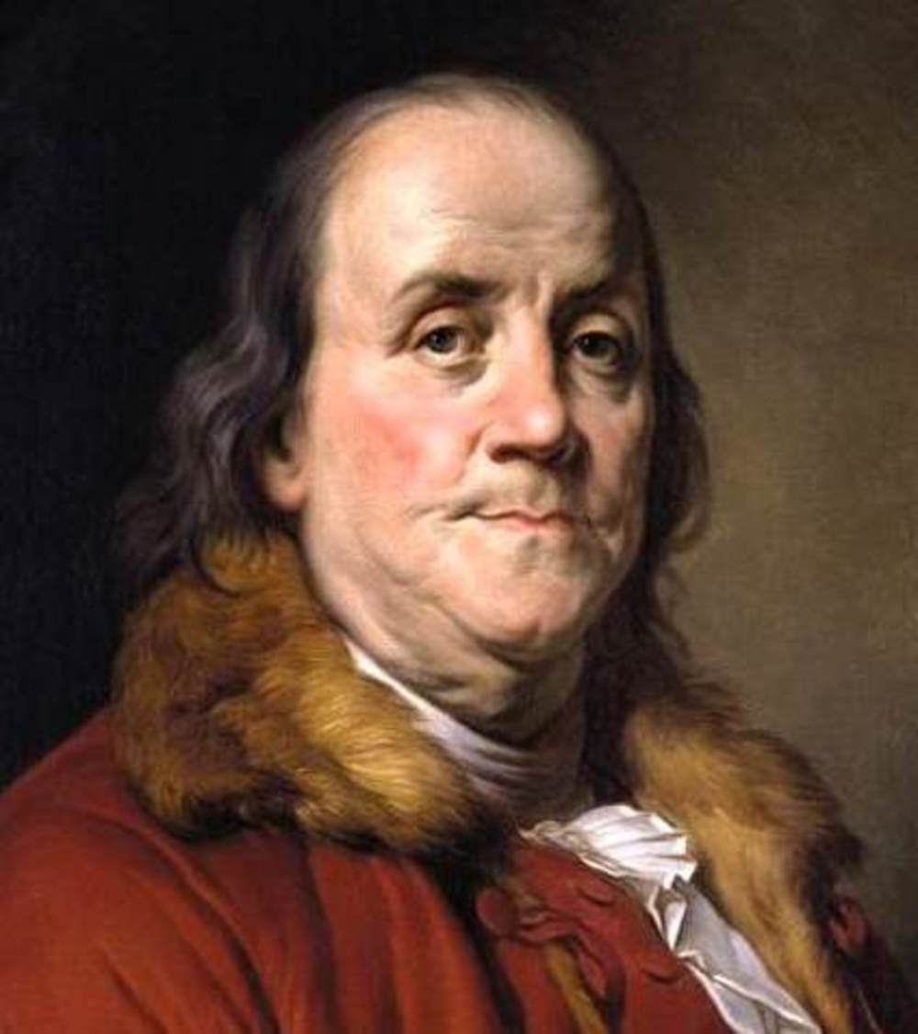

Slide 27
Discussion

Slide 28

Joe Hanel
Hanelj@coloradohealthinstitute.org

