Slide 1


DECEMBER 5, 2024
Colorado in Context
The Federal Health Policy Landscape and
What the Election Means for the Centennial State
Emily Johnson MS
Managing Director of Research, Evaluation, and Convening
Colorado Health Institute
Notes:
Good morning. So happy to welcome you all to HIHC. We’re closing out the first part of today leaning into that pillar of our strategic plan around answering critical questions at a federal level, which is a place there are a lot of questions right now. And I guess more specifically, we don't have a lot of answer to share about the incoming administration today, but we are teasing out what questions we could be asking and where our attention might land.
My name is Emily Johnson, and I’m the MD of REC. I’ve been with CHI since 2015, or through three presidencies, working on policy analysis. And in the field at a national level for longer.
Really, having done this for a while, you might think that a lot of us are accustomed to the idea of change or sort of used to an ebb and flow, having been through major changes in the health policy landscape. But I think that experience has actually made me hyperaware. We saw how radically different things were before and after the ACA and I think for me that gives me an appreciation of how real and tangible some of the changes are that we're facing today. The ACA was truly a seismic shift in health policy. Without commenting on the merits of it, it was a major policy change that had impacts for years and still does.

Slide 2
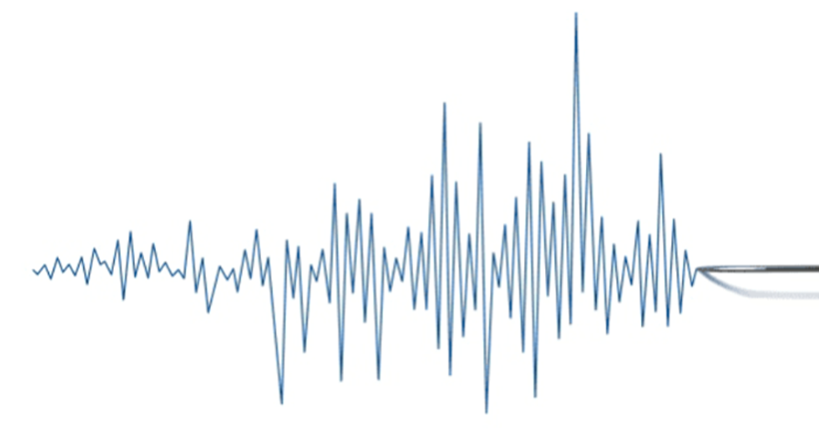

Three Takeaways
Trump nominees question expert consensus.
Federal budget restrictions
will drive policy.
Combined, these can
create seismic shifts.
Notes:
So I know we might all be fatigued from talking about RFK and Dr. Oz, but let's see if we can distill all the goings-on into three things to remember about how these changes will impact Colorado, our budget, and our health.
The first major theme is that when we think about Trump's health nominees, it's notable the degree to which these are people who question expert consensus on a lot of health policies. That's true of a lot of Americans. We are becoming more suspicious of our institutions. I think what's curious is that many of the nominees have traditional credentials, they have MDs after their names. But they are coming at this from a place that is not traditional.
Second, it sounds like a lot of the policy decisions we're going to see are probably drive by budget more than ideology. Overturning the ACA wasn't a GOP platform the way it has been in past elections but limiting spending was. There is even the Department of Governmental Efficiency concept being bandied about. Though it's important to remember that we still have a Congress that controls the budget so the circles around the administration aren't in total control here. We'll look at that in a bit.
And finally, when you combine these two conditions, we are likely on the cusp of some seismic shifts. There is so much to think about that we are at risk of analysis paralysis, so we are doing this to perhaps take a first cut of compartmentalizing. And we'll take a look at those possible shifts over the next half hour or so.

Slide 3
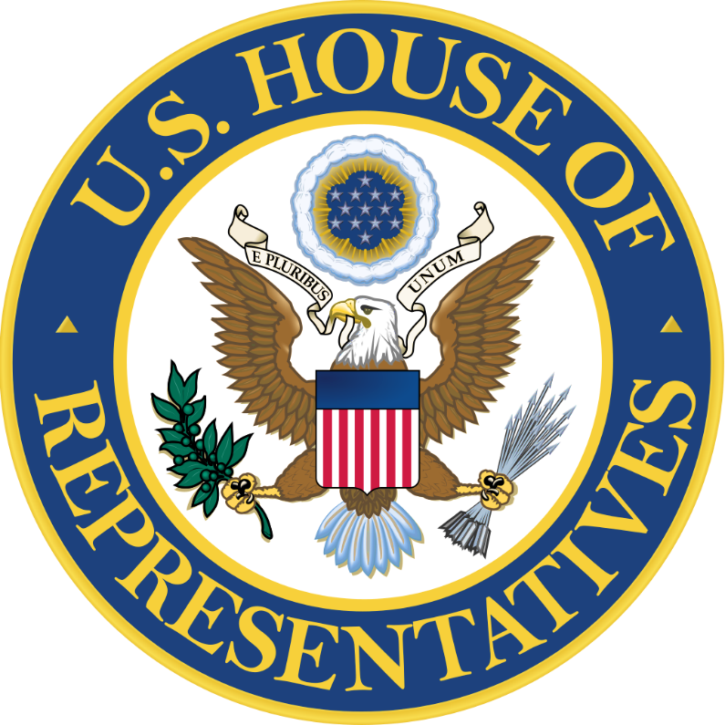
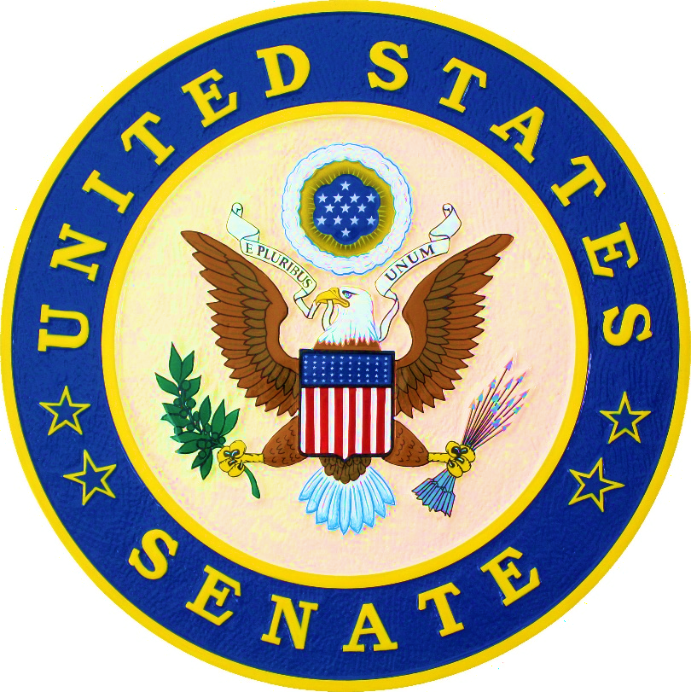

A GOP Trifecta
Notes:
So let's again remember the stage that has been set for at least the next two years. There is currently a Republican "trifecta" -- The GOP has control of the house, the senate, and the executive branch (or will in January). Trifectas can be powerful. There was a Democrat trifecta in place when the ACA was passed.

Slide 4
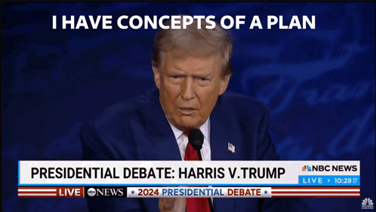


“I have concepts
of a plan.”
“I’m going to let him go wild on health.”
Notes:
Now, like we said, health policy was not a major priority for the Trump campaign this year. And it’s unlikely to be a priority for his administration. So even with a trifecta in the executive and legislative branches, overturning the Affordable Care Act faces an uphill battle.
I think there are two headlines that frame this conversation. Trump's comments about the ACA during the presidential debate, the infamous "concepts of a plan," indicate he's probably not proposing a replacement bill like we saw with the 2017. Does anyone remember what the bill to replace the ACA was called? (American Health Care Act). Yeah, it's kind of hard to remember because that debate seems to be lying pretty fallow.
And so while again, a lot of changes are subject to congressional approval, a lot of the power on health will probably reside the people that are heading the agencies that touch on health policy. Trump famously said he would ask RFK to "go wild on health."

Slide 5

Department of Health and Human Services
Notes:
And this is why we are focusing on agency and department appointments today, starting with the biggest of them - the Department of Health and Human Services.

Slide 6

Robert F. Kennedy, Jr. JD
Environmental lawyer
Former presidential candidate
Anti-vaccine activist
Medical conspiracy theories
Focus on alternative medicine and wellness
Notes:
At the potential head of HHS under the new Trump administration is, of course, RFK Jr. I’m going to refer to Trump nominees throughout, and I’ll take this moment to emphasize that no one has been confirmed yet, and their plans are not written in stone, but we’ll still be looking at them to indicate which direction we think things are headed.
So RFK Jr. What we know is that he has for most of his career served as an environmental lawyer.
He has advanced medical conspiracies including wi-fi radiation causing cancer and questioning the connection between HIV and AIDS.
Alternative medicine, like psychedelics, and a focus on wellness, like food

Slide 7
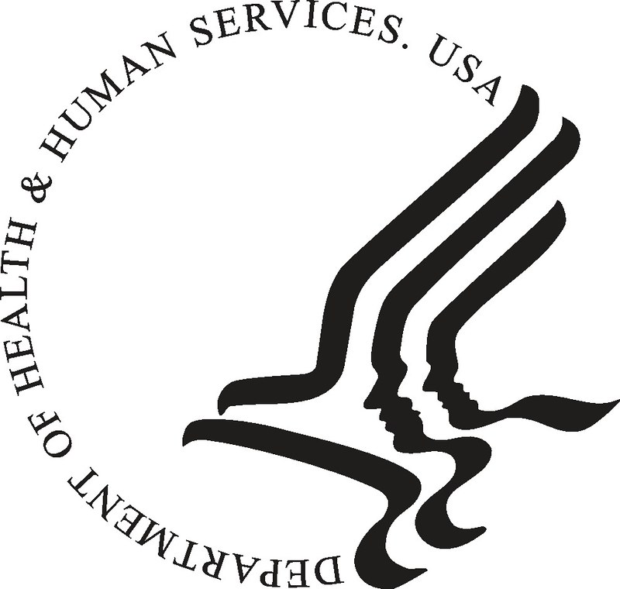
A Complex Organism
National Institutes of Health
Food and Drug Administration
Centers for Disease Control and Prevention
Centers for Medicare and Medicaid Services
U.S. Surgeon General
Indian Health Service
Agency for Toxic Substances and Disease Registry
Health Resource and Services Administration
Agency for Healthcare Research and Quality
Substance Abuse and Mental Health Services Administration
Administration for Strategic Preparedness and Response
Advanced Research Projects Agency for Health
Administration for Children and Families
Administration for Community Living
Notes:
HHS is a collection of agencies and offices. Here we’ve listed the public health and the human service agencies that fall under its umbrella. There are 13 subordinate agencies, and I’ve also included the office of the surgeon general here given the influence that person can wield.
All told, the HHS controls an annual budget of well over $2 trillion, which makes it by kind of a lot the largest federal agency..
25 cents of every dollar the federal government spends happens somewhere in here. And the agency employs 80k people across the globe. So there is a ton of complexity in this department, not just in terms of the subject matter dealt with, but also administratively.

Slide 8
Focus for Today
National Institutes of Health
Food and Drug Administration
Centers for Disease Control and Prevention
Centers for Medicare and Medicaid Services
U.S. Surgeon General
Indian Health Service
Agency for Toxic Substances and Disease Registry
Health Resource and Services Administration
Agency for Healthcare Research and Quality
Substance Abuse and Mental Health Services Administration
Administration for Strategic Preparedness and Response
Advanced Research Projects Agency for Health
Administration for Children and Families
Administration for Community Living
Notes:
And while each of the HHS agencies plays an important role, we want to focus today on potential impacts and changes across these four offices: NIH, CDC, FDA, and CMS. The picks to lead these offices are the movements I’m guessing most people in this room are following the most closely.

Slide 9

National Institutes of Health
Notes:
But turning our attention to these entities, we'll start with a deeper dive on the National Institutes of Health.

Slide 10

Key Statistics:
  $51 billion budget
  19,000 employees
  $529 million
  to Colorado
Primary agency for
medical research
Network of 27 institutes
and centers
Colorado grantees include CU, CSU, National Jewish Health
Notes:
The NIH is the primary agency for funding medical research in the country. Key stats.
First, remember that national institutes of health is plural. There are nearly 30 institutes of health that already have their own focuses on biomedical disciplines. So you can’t entirely change the focus overnight. But you can change funding.
Sources:
2024 budget
https://www.hhs.gov/about/budget/fy2024/index.html
2024 money to CO
https://report.nih.gov/award/index.cfm?ot=&fy=2024&state=CO&ic=&fm=&orgid=&distr=&rfa=&om=n&pid=&view=statedetail#tab1

Slide 11
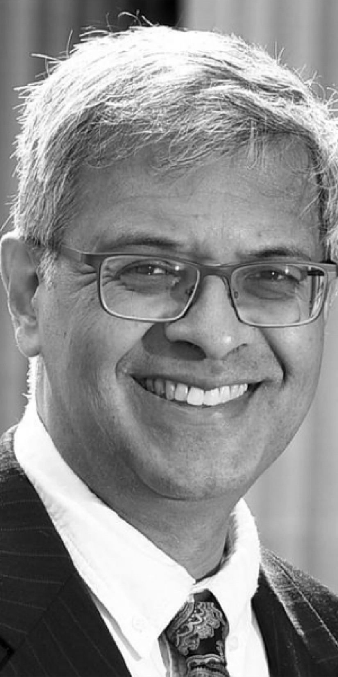
Jay Bhattacharya MD, PhD
Professor of medicine, economics, and health research policy
Controversial opinions
on COVID-19 protocol
Pro-vaccine
More innovative techniques
in research
Notes:
If there is a spectrum of orthodoxy for Trump’s cabinet nods right now, Dr. Bhattacharya iso probably one of the more conventional picks. He has a medical degree, although he never completed a residency, and a PhD in economics and is a professor of health research policy.
The major controversies he’s seen in the past were around COVID restrictions and advocating for lifting a lot of the lockdown and quarantine restrictions in favor of herd immunity. There was a semi-famous open letter that he signed opposing lockdowns — the Great Barrington Declaration.
So he’s not a politically neutral figure, but he has called vaccines successful and his inroads with Kennedy seem to be mostly around wanting to fund more innovative techniques in research. He hasn't been explicit about what those innovative techniques might be, but his interests indicate things like wearable technologies and cancer-spotting AI.

Slide 12


RFK proposes to “devote
half of research budgets from the NIH toward preventive, alternative, and holistic approaches to health.”
Notes:
And so within each of these departments, again, are going to look at one seismic shift to watch for.
Within the NIH, the most focused proposal we have heard is RFK stating in a Wall St Journal op-ed that he thinks half of the NIH budget should be spent on “preventive, alternative, and holistic medicines.”
Depending on what exactly Dr. Bhattacharya means by innovative techniques, this is probably not at odds.

Slide 13

Food and Drug Administration
Notes:
Next up is the FDA.
Quick show of hands, who here today fed a pet this morning?
What about giving a baby formula?
Who is wearing sunscreen?
Makeup or perfume?
Add your hand to the mix if you have used soap or eaten food today.

Slide 14
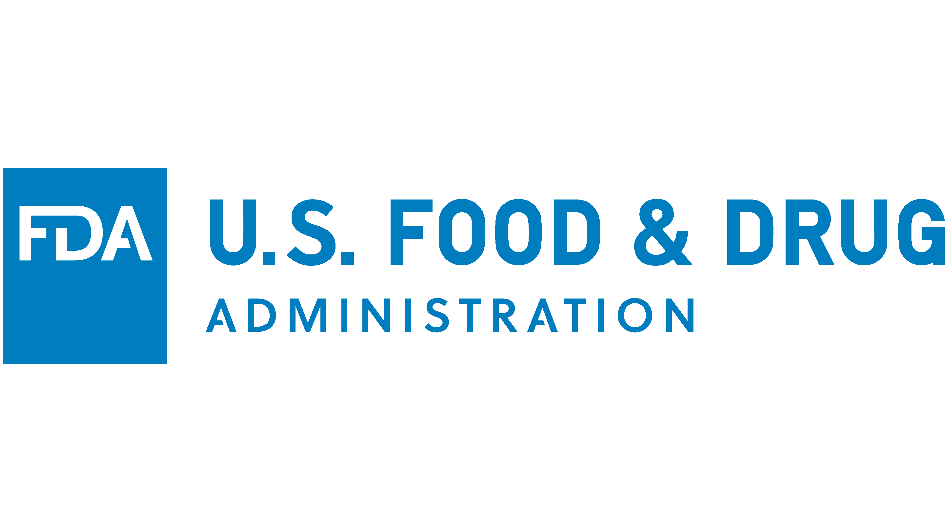
  Key Statistics:
  $7 billion budget
  19,000 employees
  Does not distribute money to states
Ensures safety, efficacy, and security of most food, drugs, cosmetics, and more
Notes:
Great, that means that your life has been touched by the United States Food and Drug Administration this morning.
The FDA is, of course, tasked with ensuring the safety, efficacy, and security of most food, drugs, cosmetics, and more.
It has a 7B budget and 18k employees. It distribute money to states usually, though there are some pilot programs that do this. Still, by a show of hands, FDA impacdts us all.
SOURCES
2025 budget: chrome-extension://efaidnbmnnnibpcajpcglclefindmkaj/https://www.fda.gov/media/176923/download#:~:text=The%20FY%202025%20Budget%20provides,the%20FY%202023%20funding%20level.

Slide 15

Marty Makary MD, MPH
Surgical oncologist
Worked with Trump 45
on surprise billing
Critic of COVID-19
public health response
Focus on food and
chronic disease
Notes:
Tapped by Trump to lead this agency is Marty Makary. Though bear in mind that there were 5 commissioners in the four years of Trump. This is not usual.
Dr. Makary is a surgical oncologist who worked closely with the first trump administration on surprise billing. He has authored a number of books on health care and has a lot of visibility for his writing and research on the high cost of health care and the need for more transparency in medicine.
He's a frequent guest on Fox News and was a vocal critic of the public health response to COVID. He speaks often on Fox and in other settings about the importance of food and emphasizes concerns over chronic, rather than infectious, disease.

Slide 16

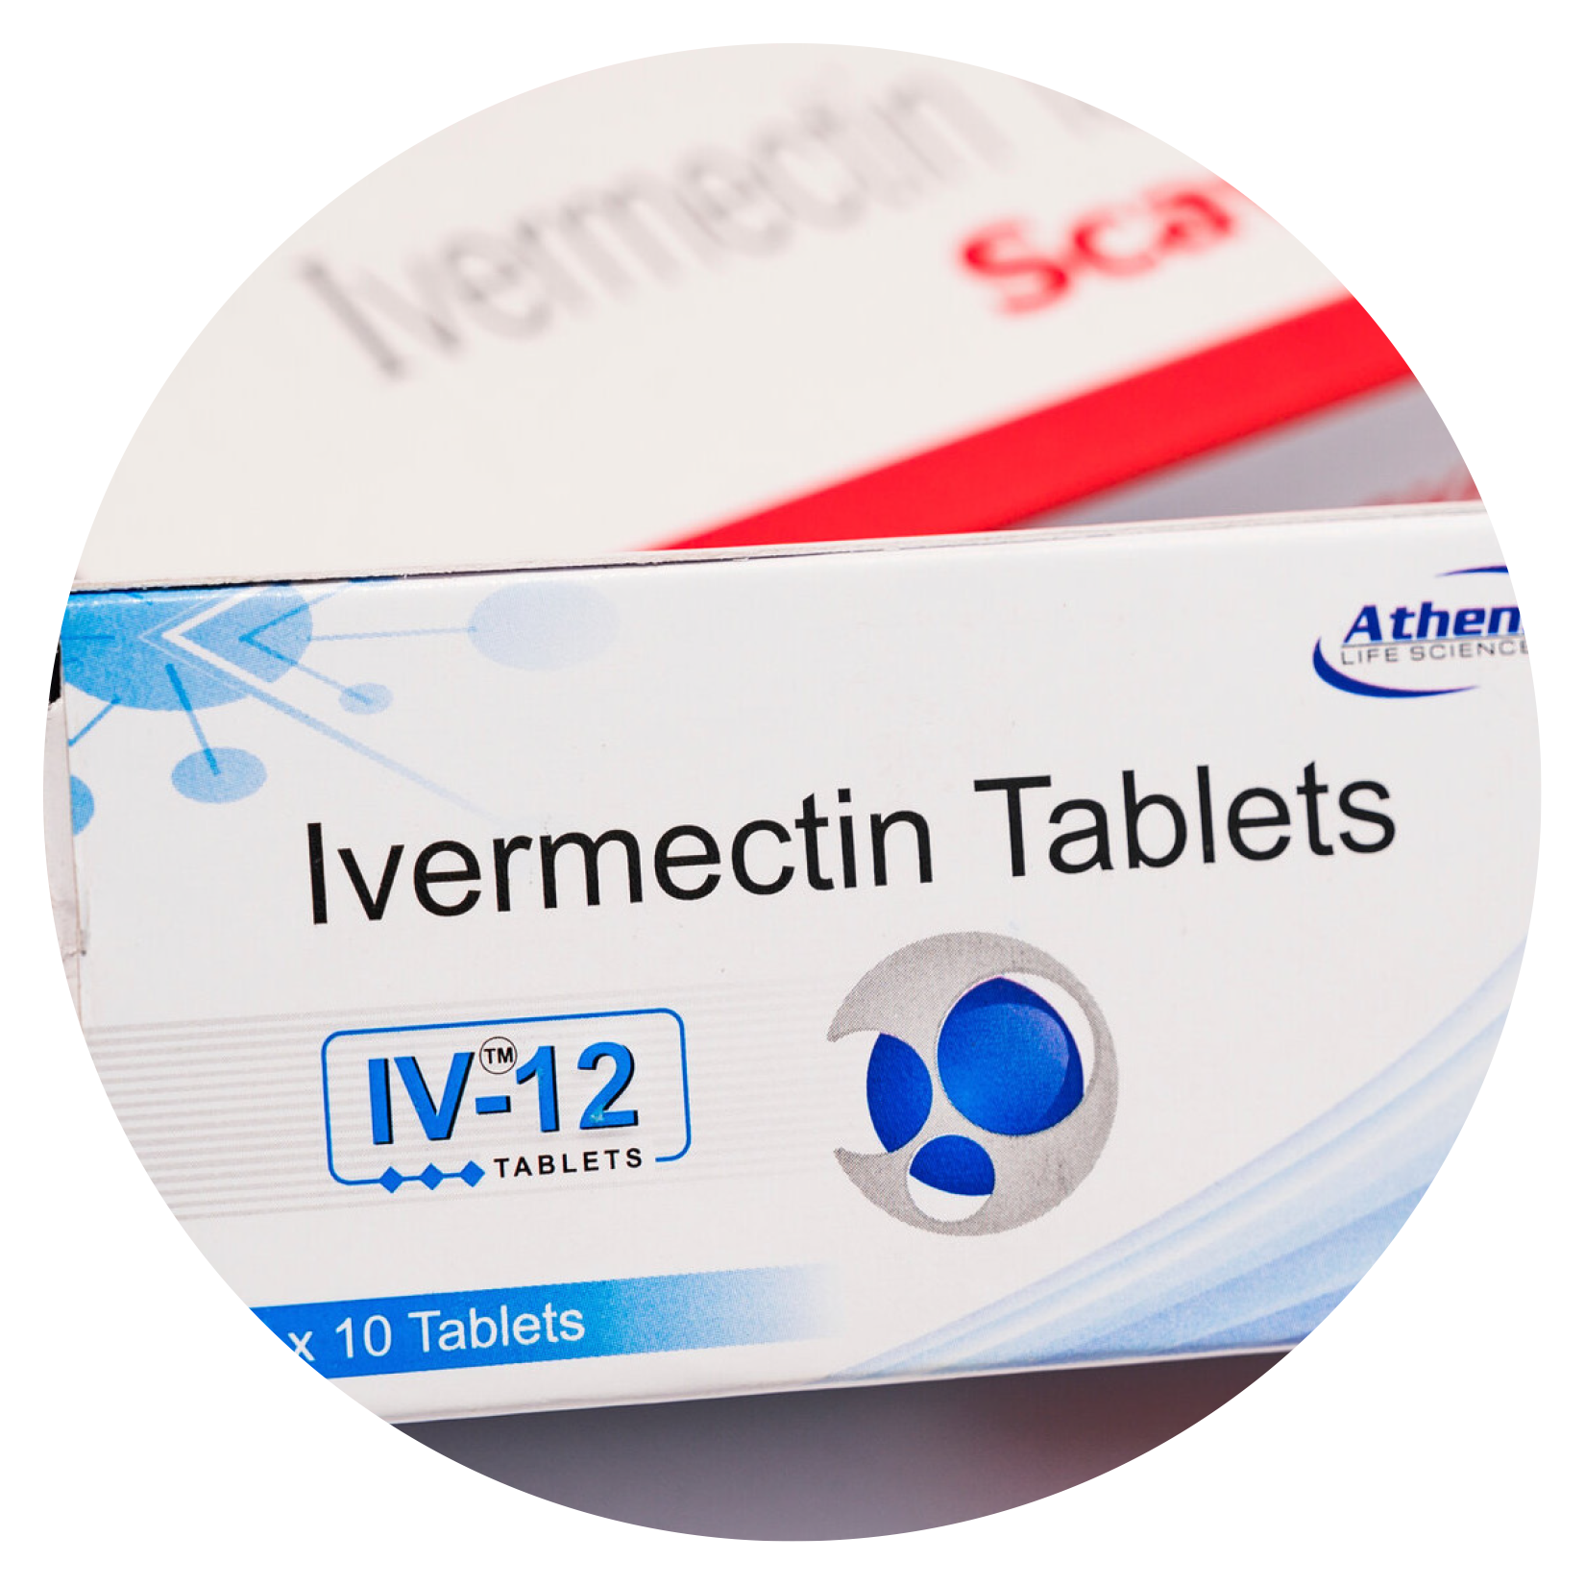
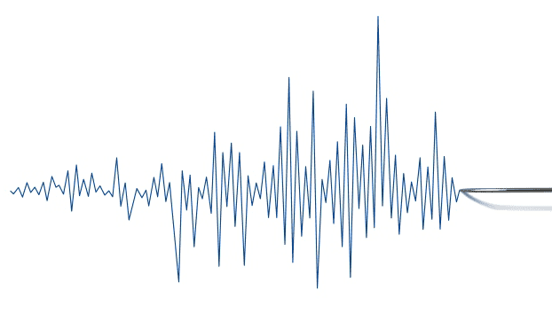
Psychedelics
Oversight Changes
Psychedelics
Pesticides
Ivermectin
Processed Food
Raw Milk
Vaccines
Notes:
In terms of our seismic shift in this potential new FDA, I think we are looking at a paradox of increased regulation and decreased regulation.
We are likely to see less regulation on things like psychedelics, ivermectin, and raw milk. RFK has actually described the FDA as waging a war on public health by suppressing raw milk.
At the same time, expect a closer look at pesticides, processed foods, and vaccines. Increased oversight genreally feels like a good thing, but how this will play out depends on what type of additional studies we are looking at or what types of evidence is in play here.

Slide 17

Centers for Disease Control and Prevention
Notes:
Next in the lineup – centers for disease control and prevention.

Slide 18
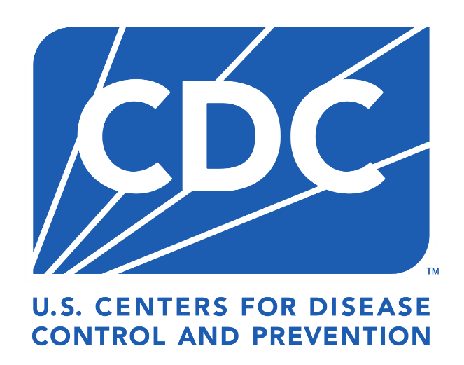
Key Statistics:
  $12 billion budget
  12,000 employees
  $234 million
  to Colorado
Mission is to protect Americans
from health threats, prevent disease, and promote wellness
Colorado programs include Emerging Infections Program, Colorado Healthy Schools Program, lead poisoning prevention
Notes:
The CDC's mission is to protect Americans from health threats, prevent disease, and promote wellness. Its budget is $12 billion and $234 million of this funnels to Colorado.
The types of programs you may know and love that are CDC funded include TKTK. A lot of programs here are run through LPHAs and CDPHE and I assume a lot of people in this room and online today specifically work on one of these programs.
SOURCES
CDC overall budget: chrome-extension://efaidnbmnnnibpcajpcglclefindmkaj/https://www.cdc.gov/budget/documents/fy2024/cdc-overview-factsheet.pdf
CDC figure for CO: chrome-extension://efaidnbmnnnibpcajpcglclefindmkaj/https://fundingprofiles.cdc.gov/Report_Docs/PDFDocs/Rpt2023/Colorado-2023-CDC-Grants-Profile-Report.pdf

Slide 19
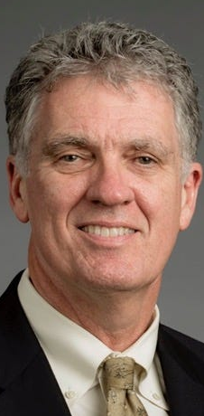
Dave Weldon MD
Former GOP congressman
Claims vaccines
may cause autism
Tried to remove vaccine oversight from CDC to
an independent agency
Notes:
Trump has selected Dave Weldon, a former Republican congressman.
Dave Weldon is a darling of the vaccine-autism controversy movement, though truly the furthest he has gone is in saying he thinks more studies are needed when it comes to the potential connections between vaccine ingredients and autism in kids. Own two children are vaccinated.
But he is still very much an RFK-style pick. He has tried in the past to remove vaccine oversight from the CDC and transfer it to an independent agency. Right now, the CDC director has autonomy to accept or reject vaccine recommendations provided by the Advisory Committee on Immunization Practices, so he might not feel the same urgency here if the CDC director is him.

Slide 20
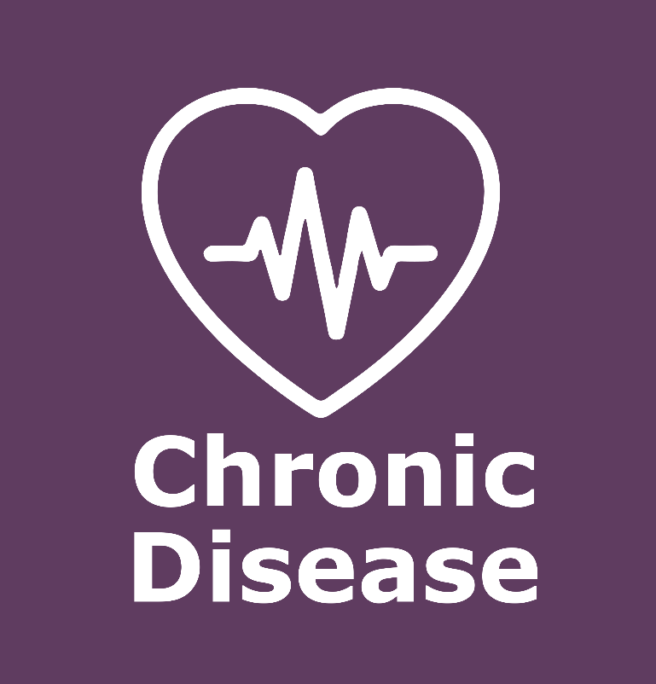
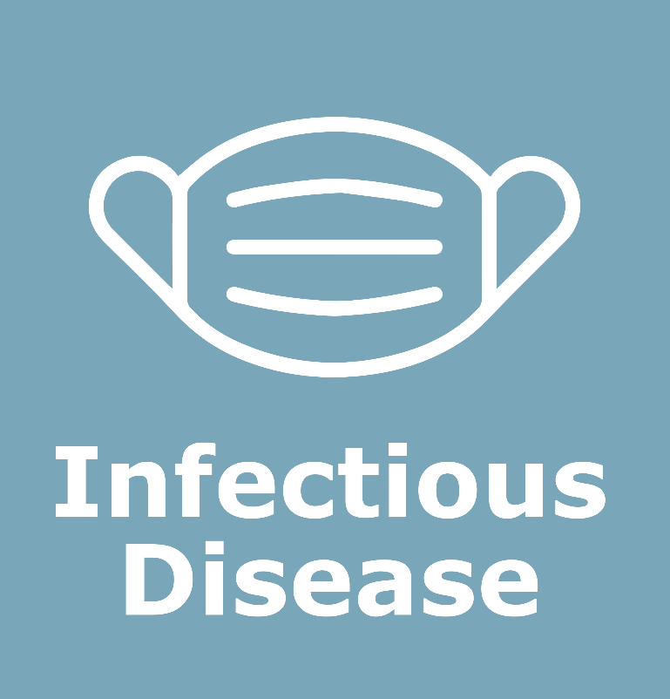
Notes:
And the big news for CDC is likely to be a shift away from infectious disease and towards chronic disease. There have been many, many signals that this is the direction this administration wants to go.
And for some of us in public health, it might be like, “finally, chronic disease.” So some people might prefer this shift?
But a lot of infectious disease work is still preventive – think about Vaccines for Children under this infectious disease category. And when it comes to thinking about chronic disease, there may be other places in the larger administration plans that could work against this – for example, America First Policy Institute CEO Brooke Rollins will probably be up for Secretary of Agriculture where, if her actions match the American First Policy Institute's plans, we'd be reducing funding on food stamps. Which is notable when you think about the connections between food and chronic disease.

Slide 21
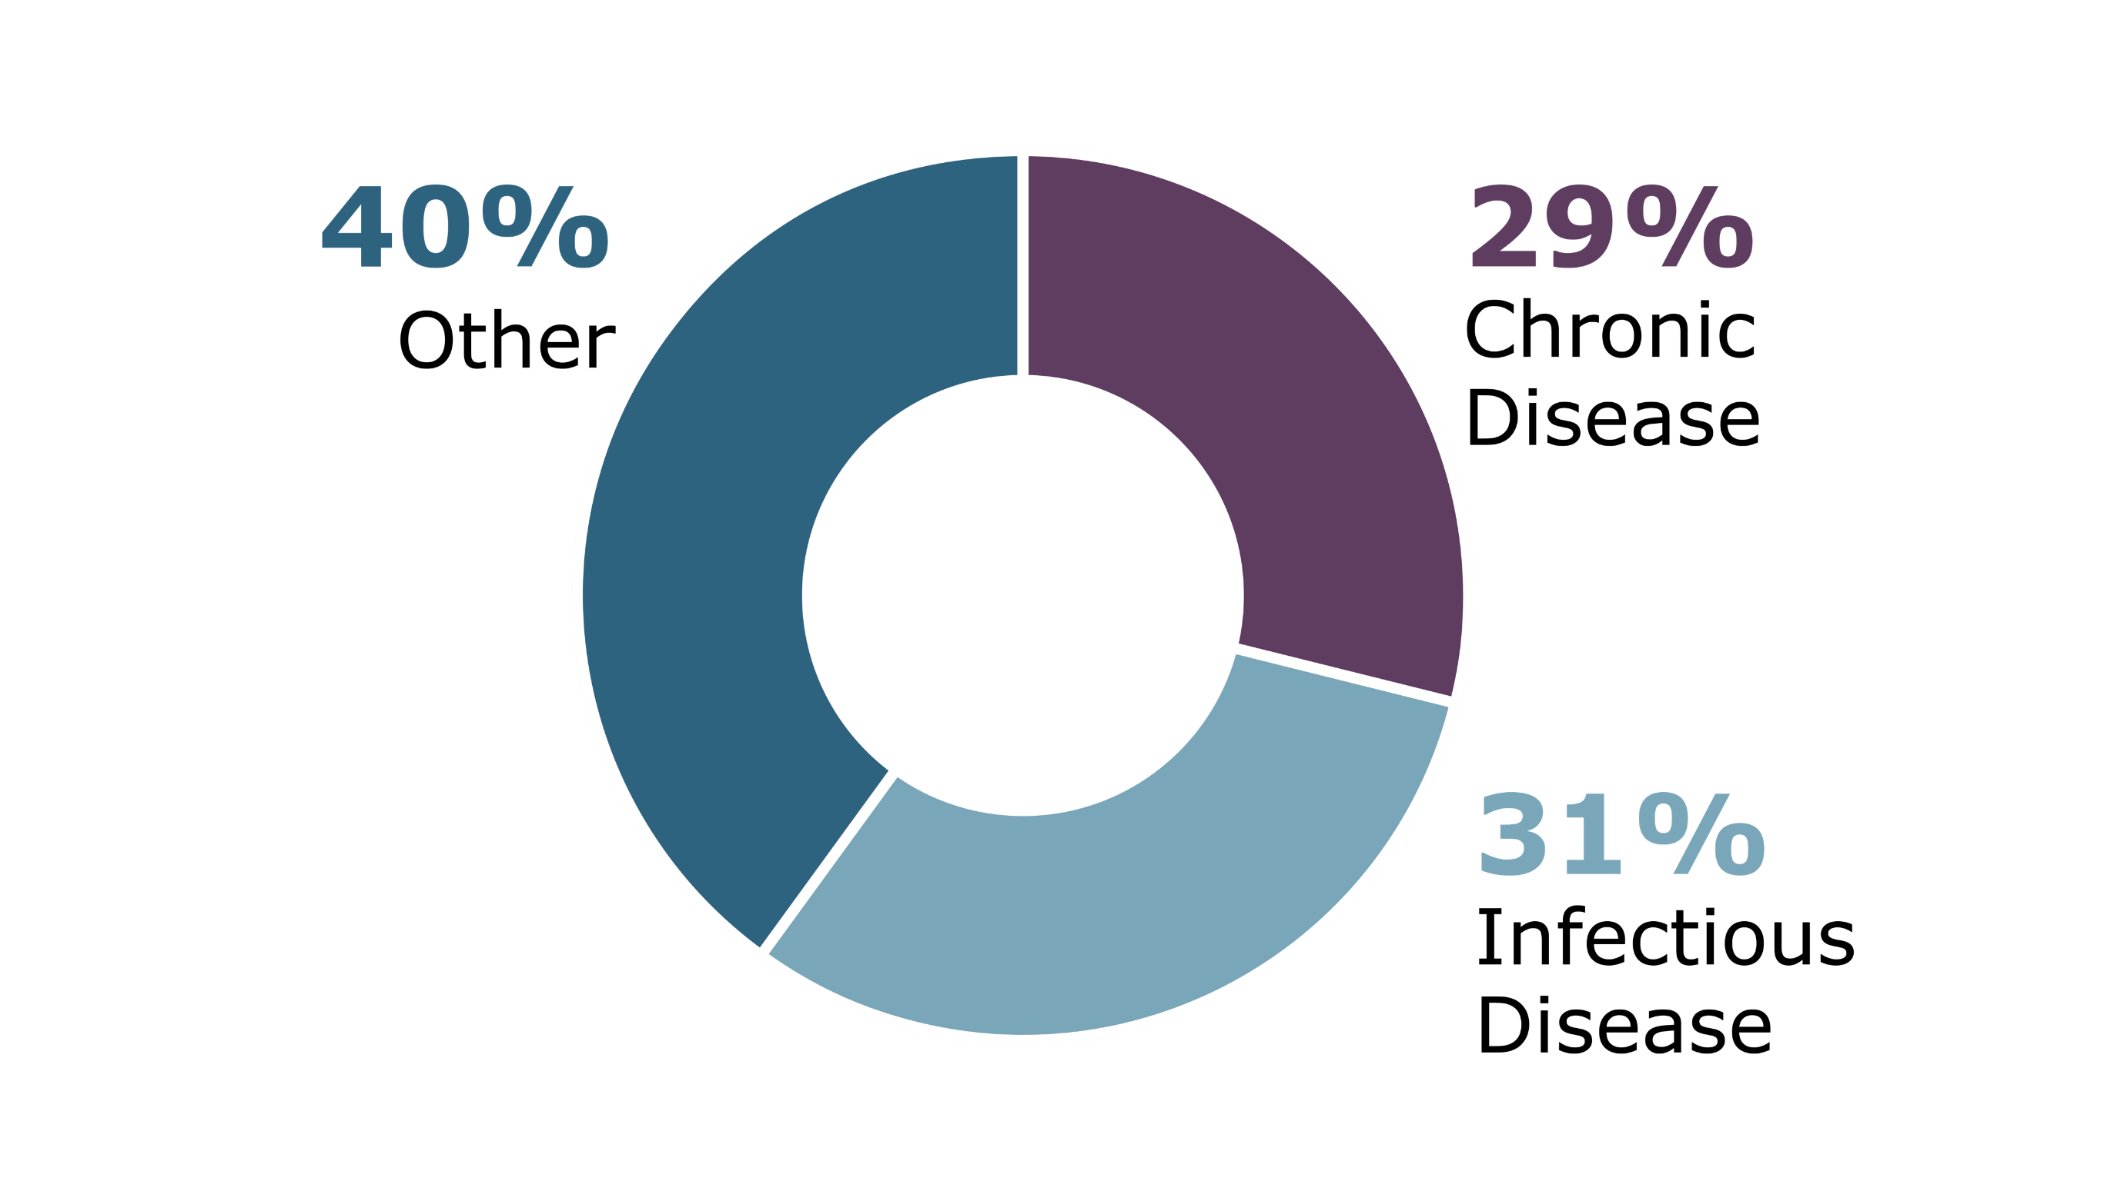
Notes:
Right now, roughly a third of funding goes to chronic disease, a third to infectious disease, and a little more than a third to the sort of “other” things like bioterrorism, additional support for public health. So in those buckets, you could decide how you want to interpret connections to chronic versus infectious disease. So it’s hard to say how much will go to each of these. And even harder to say, what’s the right amount?
And if we do pull away from infectious, who is holding the bag when we get the avian outbreak? Local, hospitals, etc?

Slide 22

Centers for Medicare and Medicaid Services
Notes:
Last but not least, let's take a look at CMS.

Slide 23

Key Statistics:
  $1.5 trillion budget
  6,700 employees
  $9.5 billion
  to Colorado
Oversees health care programs including
Medicare, Medicare Advantage, Medicaid,
and Child Health
Insurance Program
Notes:
CMS is the federal agency that oversees health care programs, chiefly Medicare and Medicaid.
It has the largest budget of any HHS agency, making it the largest agency in the largest department. It's so much money but most of that goes to providers or goes to clinics, what we call pass-through fundings. These are entitlement programs and part of our social fabric – if you qualify for Medicaid, the federal government says, you get it.
CMS has less than 7k federal employees since most of its work goes through third parties and state administration. And almost $10B of our state budget comes from here.

Slide 24
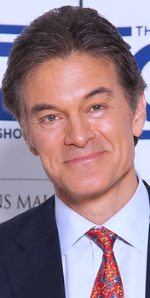
Mehmet Oz MBA, MD
Cardiothoracic surgeon
Television personality
Interest in alternative medicine and faith healing
Former Senate candidate
Medicare Advantage for All
Notes:
If we are talking spectrum of orthodoxy, this one is probably on the other side. CMS is the largest HHS agency and Dr. Oz is a television personality without any administrative experience of this scale.
His interest in alternative medicine and faith healing has been quite public. This has included selenium supplements for cancer prevention, homeopathic cures, diet pills, detoxes and cleanses, as well as promoting faith healing and faith healers on his show.

Slide 25

Notes:
Populations CMS serves — children, childless adults through the Medicaid expansion, people over age 65, people who are disabled.

Slide 26
Medicaid Funding Cuts
Lower the Federal Match
Block Grants
Notes:
-rolling back the expansion FMAP might be easier to do
BLOCK GRANTNG MEANS YOU ARE NO LONGER DOING ENTITLEMENT.
-maybe have it be “MK funding cuts” – lower the FMAP, do block grants. The big shift here is around the amount of $. If the intent is to shrink government, this is the largest agency in the largest department.
-what does TANF teach us? What are some programs already block granted? There is precedent for moving away from entitlement and this is what it has looked like.

Slide 27
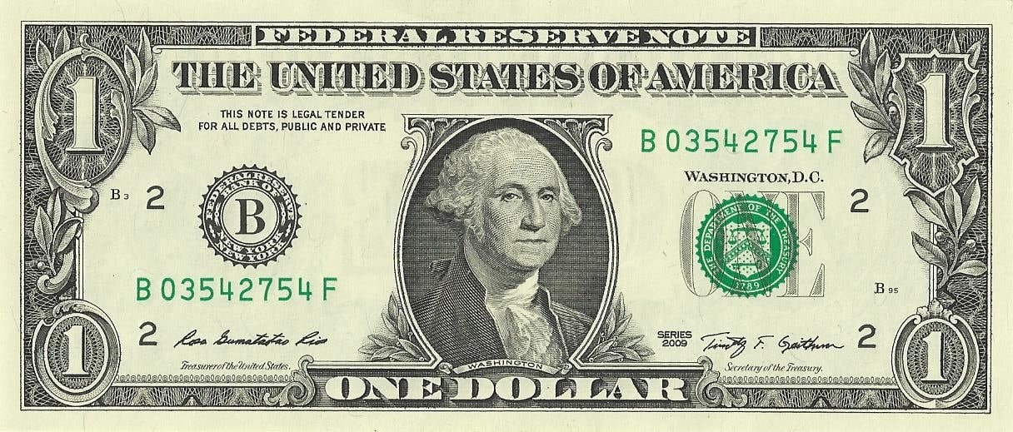
Medicaid Today: High Federal Match
65% Federal Funds
35% State Funds

Slide 28
Medicaid at a Lower Match
50% Federal Funds
50% State Funds

Slide 29
Medicaid Today: Entitlement
Notes:
Before we get into it, it will be helpful to again review our current system and how that works.

Slide 30

Medicaid Today: Entitlement
Notes:
Colorado spends money on each of these groups.

Slide 31

Medicaid Today
Notes:
We also get federal matching funds for each group – not always at the same rate, but a match nonetheless.
This match applies for every dollar Colorado spends.

Slide 32
Medicaid Today: Entitlement
Notes:
So an extra dollar spent

Slide 33
Medicaid Today: Entitlement
Notes:
…means an extra federal dollar. A match of this sort applies to every dollar Colorado spends.
Proponents of this system say that it ensures spending is sufficient to cover all populations, even when there’s a sudden increased need for Medicaid whether because of an economic recession or an increased need for spending like if there’s an outbreak or natural disaster.
But the concern among some fiscal conservatives is that it incentivizes the state to over-spend since they’re only risking fifty cents of every dollar they put into the program (and only saving 50 cents of every dollar they take out). So a common conservative proposal is moving to a block grant.

Slide 34
Medicaid Block Grants
Notes:
Under a block grant, you get a set amount of federal money

Slide 35
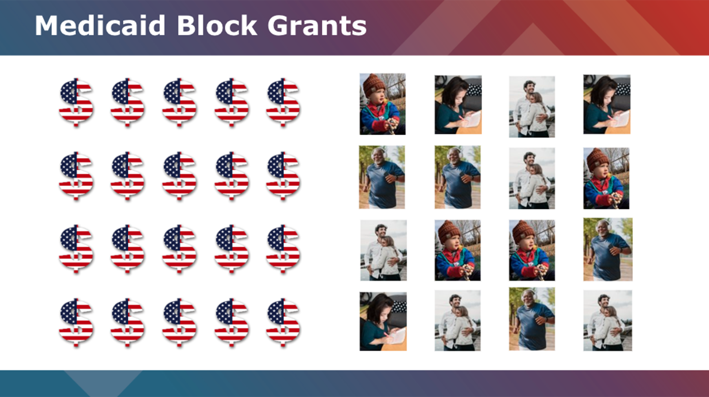
Notes:
Then no matter what happens with enrollment…

Slide 36
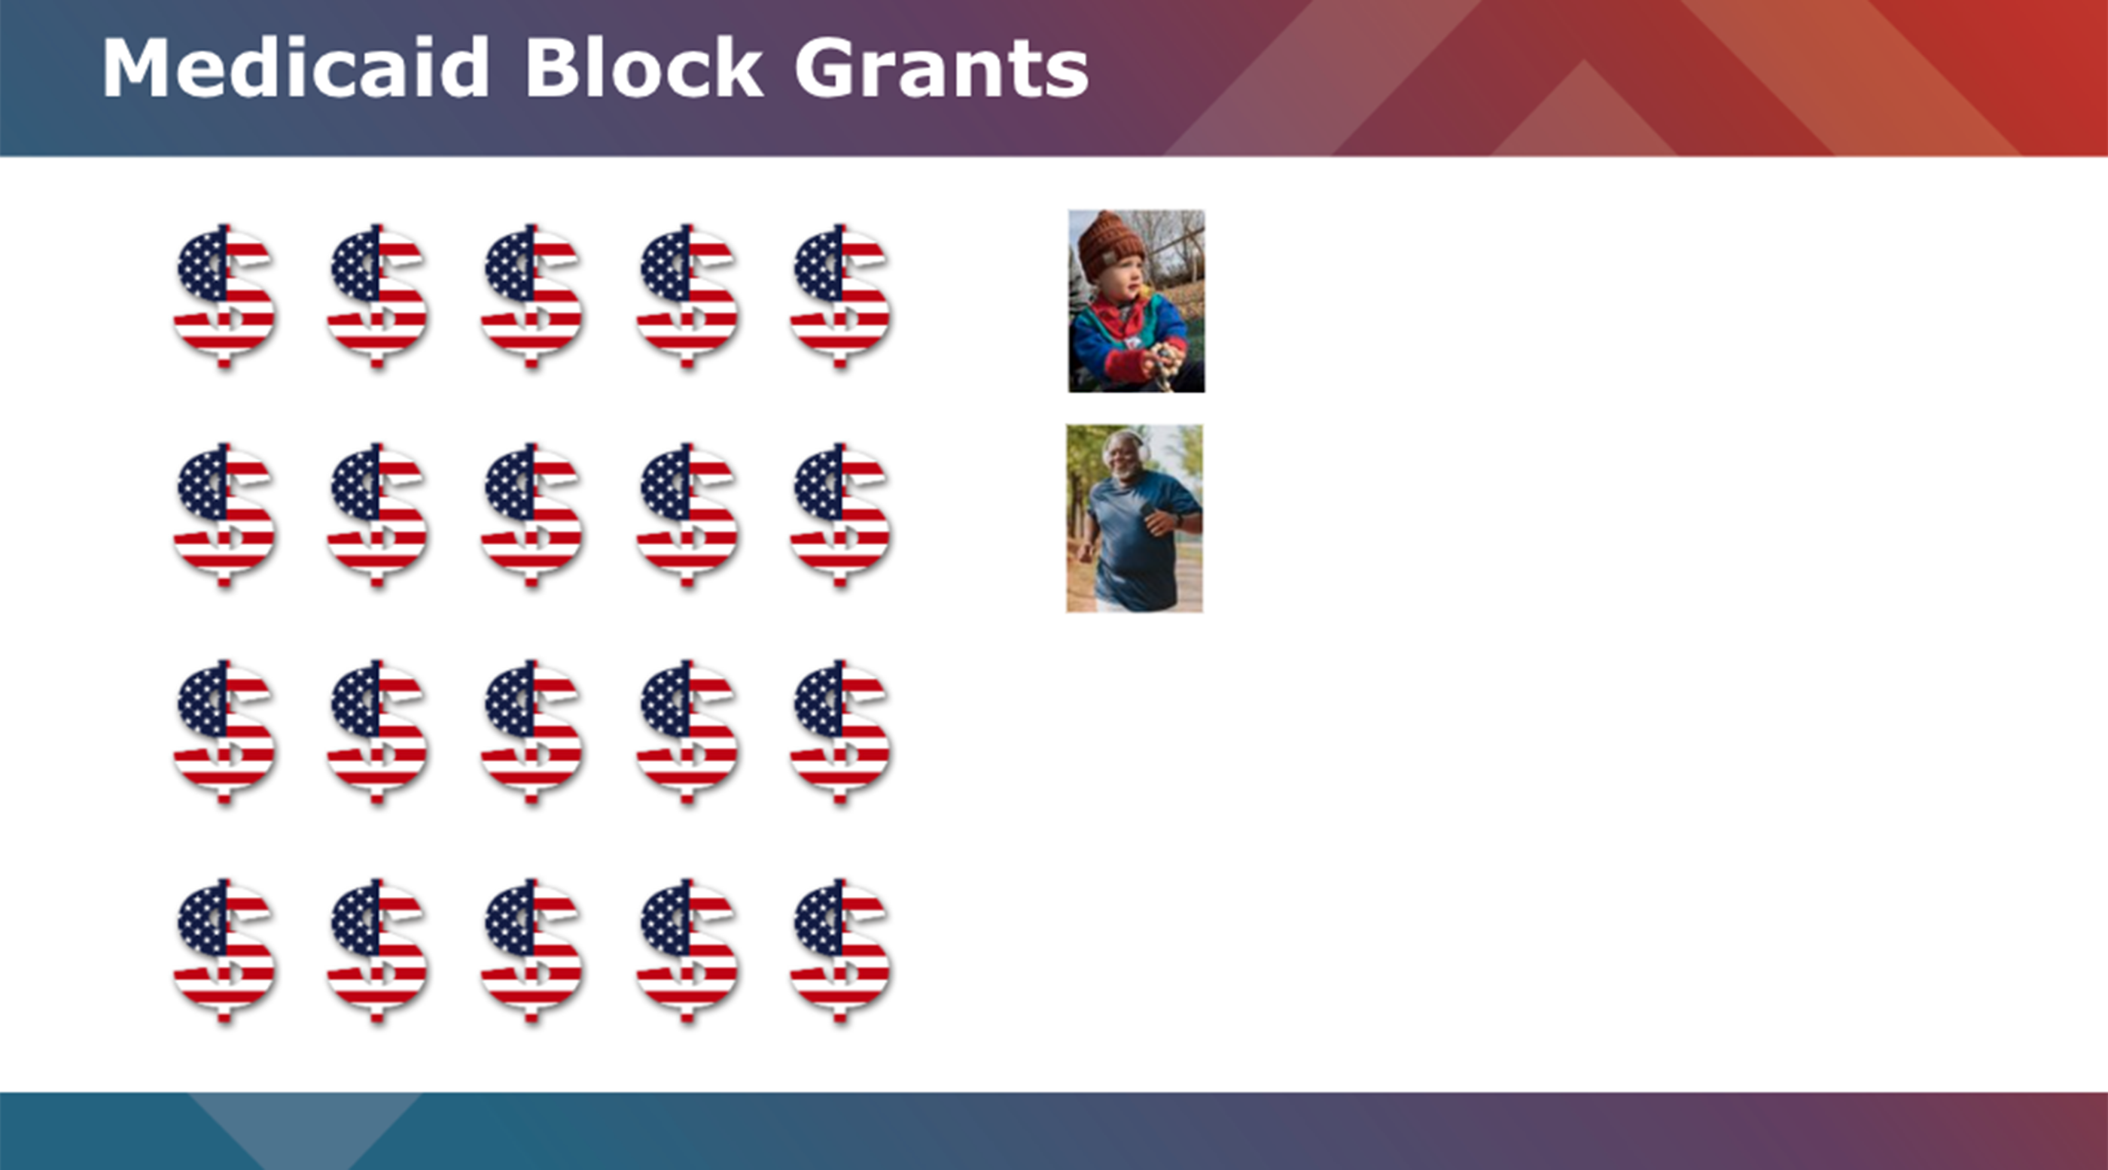
Notes:
…if it shrinks…

Slide 37
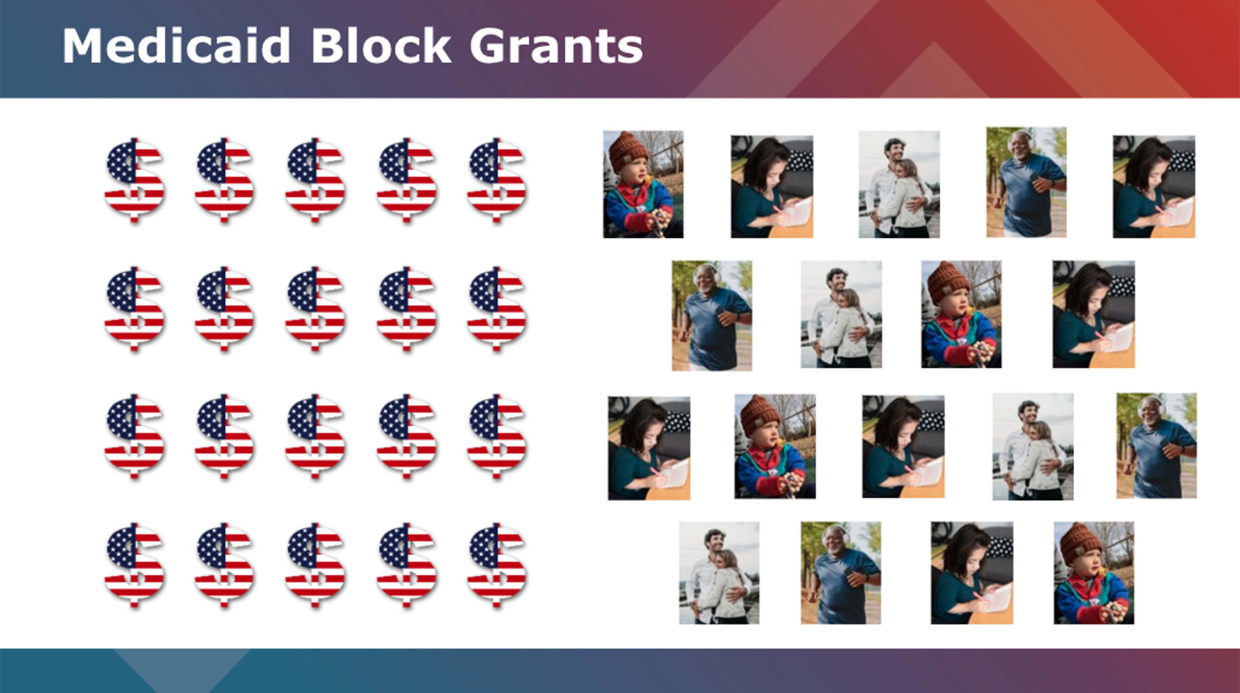
Notes:
…or if it grows….

Slide 38

Notes:
The federal money stays the same and it’s up to states how to administer it.
Every year, only changes would probably be to keep up with inflation / population growth, but we’d have to wait for a final bill for specifics.
There are some concerns that this could incentivize states to limit enrollment and/or benefits.
But we don’t yet know exactly how the amount of a block grant would be determined. And the extent to which a Medicaid block would come with certain requirements or restrictions is unknown. We can guess what Trump, RFK, or Dr. Oz would want to see happen but changes to Medicaid need to go through the federal legislature. Even with a trifecta, some more moderate conservatives may demand that block granting also include some requirement like having to cover all kids at a certain FPL.

Slide 40
Three Takeaways
Trump nominees question expert consensus.
Federal budget restrictions
will drive policy.
Combined, these can
create seismic shifts.
Notes:
So again, uncertainty abounds. But here are three thing we think you should keep your eyes on.
1 – what’s curious about these nominees is that many have the right credentials, they just come at this from a place that is not traditional.

Slide 41
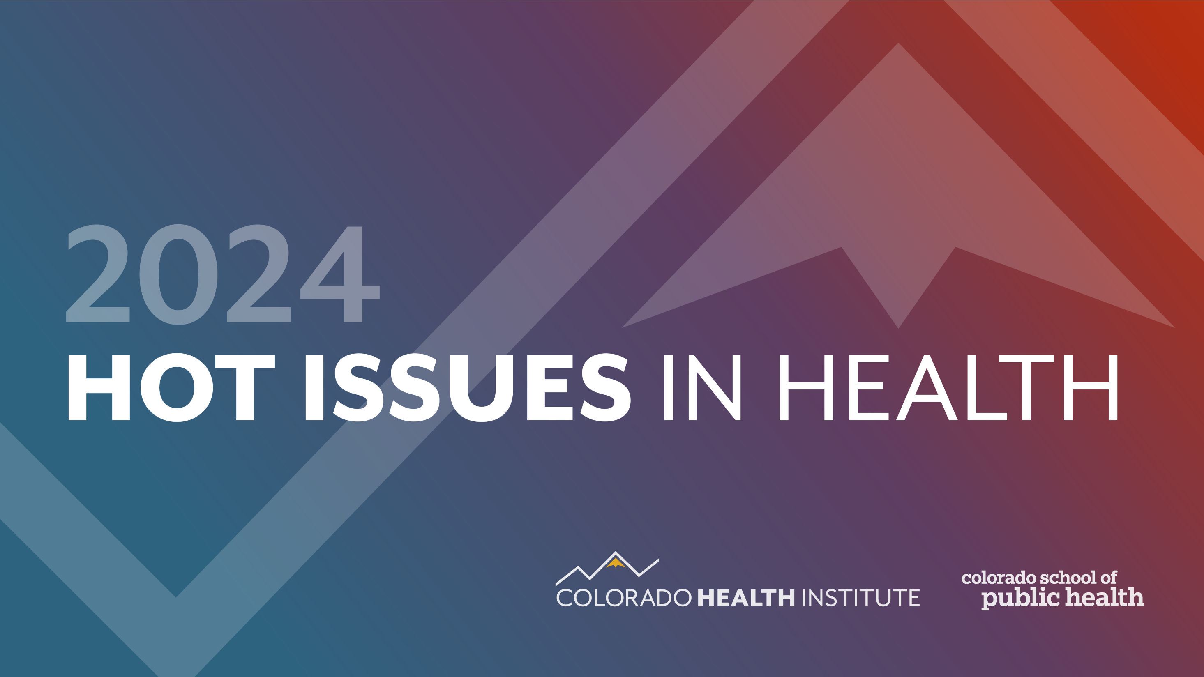
Emily Johnson MS
Johnsone@coloradohealthinstitute.org

