Slide 1
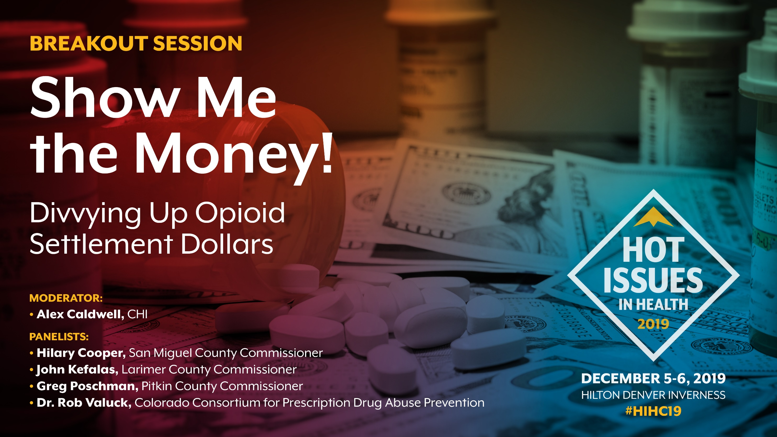
Notes:
Good afternoon. Thank you for joining Show me the Money! Divvying up Colorado’s Potential Opioid Settlements
EARN THE RIGHT: Alex.. Director.. Behavioral Health Portfolio.. This is my FOURTH HIH.
- We are over 20 years into the opioid crisis. (1996 OxyContin. Which lead to Heroin… fentanyl epidemic.)
- But this year, for the first time, states are starting to win major settlements from companies who have been involved in manufacturing and distributing opioids.
- Colorado expects to be one of those states. It’s not clear yet how much money or when its coming.
- So the question is – if the money dropped tomorrow, how should we spend it to create the biggest impact?
That’s our topic for today.
We are joined today by three fantastic panelists to share their thoughts on how to address the opioid crisis – we’ll be hearing from them shortly.
First, I’ll give a 10 minute overview on the opioid settlements and the results from some research we conducted this year on how to spend those dollars.

Slide 2
Key Takeaways
Opioid litigation dollars are coming – as are fights about how to spend them.
Experts prioritize treatment and recovery.
Community context is critical.
Notes:
1. Opioid litigation dollars are coming – as are fights about how to spend them.
2. When we asked a group of experts how to spend the dollars, they recommended focusing primarily on treatment and recovery - rather than things like prevention or harm reduction.
3. But no community in Colorado is the same in terms of its experience of the opioid epidemic or its efforts to address the problem. Context is critical to decide how to spend the dollars.

Slide 3
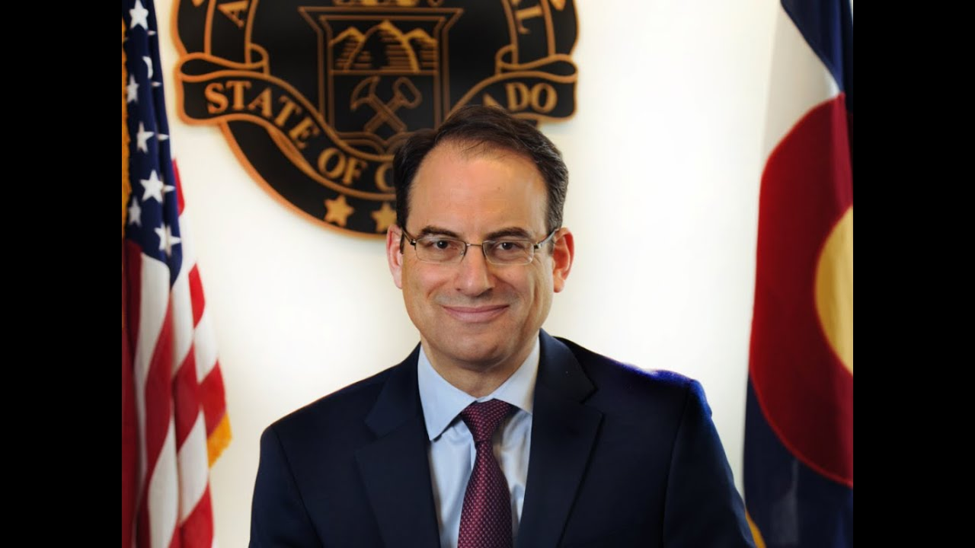
Notes:
First – what are these opioid settlements?
there are thousands of lawsuits ongoing.
Colorado does not yet have access to settlement dollars… but we do expect some of the settlements.
Depending on where the chips fall, different people may have different levels of control over the dollars, including…
WHOS THIS?
AG, Phil Weiser. Colorado’s office of the AG is very involved in securing settlement dollars. In fact they could not be here to comment today given those discussions are ongoing. Anyone here in the audience from the AG’s office?
AND our county commissioners. In a couple minutes we’re talking with them. Some of the lawsuits could result in direct distribution of funds to counties and municipalities in CO… so they are thinking about this even now. Are there others in the audience

Slide 4
Imagine you have $100 million to spend over five years to address the opioid crisis.
How would you allocate it?
Notes:
Tensions are high nationwide to ensure that the dollars go to the places, people, and services who need them most.
A lot of people are thinking about that tension.
For example, the Colorado Consortium for Prescription Drug Abuse Prevention (the Consortium) retained CHI with funding from the Colorado Health Foundation to conduct a survey a group of experts in Colorado. We wanted to know how they would allocate these dollars to create the biggest impact.
We asked them…
Here’s what they said:

Slide 5
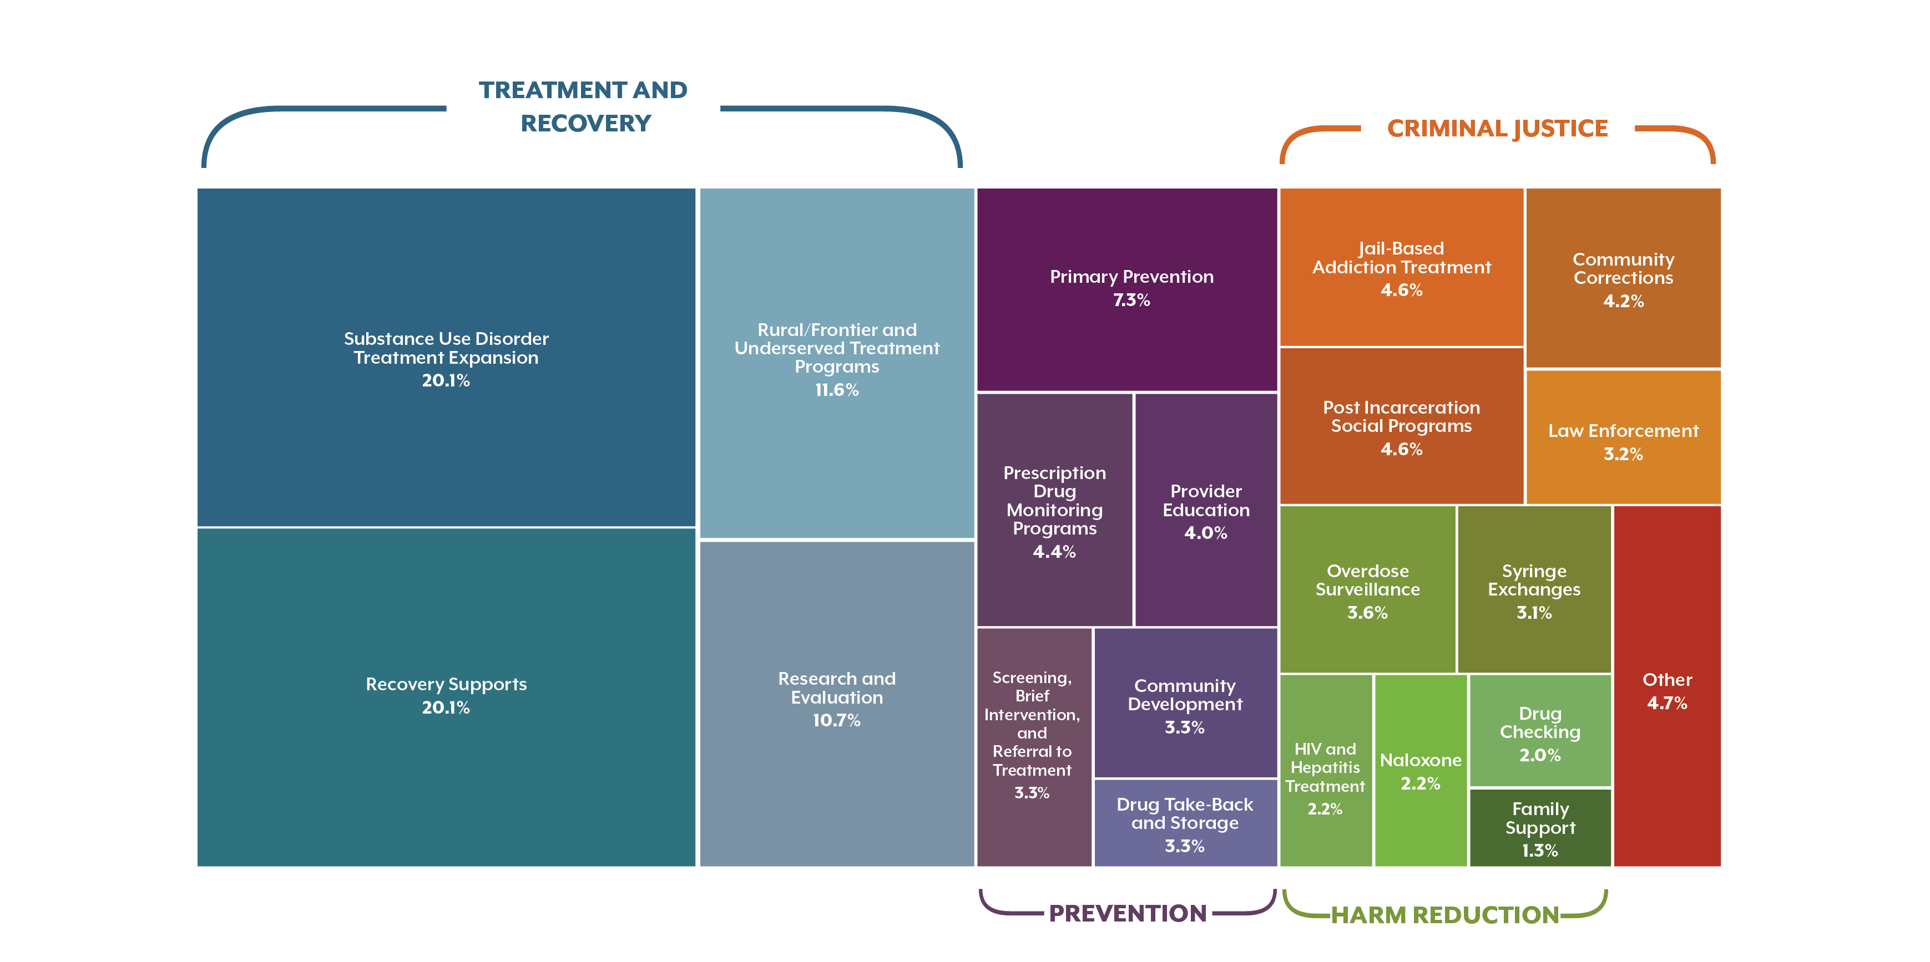
Colorado Experts Recommend Opioid Settlements
Go to Treatment and Recovery
41.3%
21.8%
21.7
14.2%
Other:
1.0%
Notes:
Each respondent allocated their $100M dollars across 20 different strategies in 4 domains. Then we took a weighted average. So this is the collective expertise of that group.
In aggregate, they recommended Treatment and recovery. That’s in blue. Includes things like treatment programs in rural, frontier, and underserved areas – as well as recovery supports.
In aggregate, the respondents ranked other strategies as lower priority. For example:
prevention (purple) – primary prevention happening in schools,
criminal justice (orange) like post-incarceration social programs, and
harm reduction (green) like syringe exchanges.
This graphic illustrates their aggregate allocation. Each box represents one of the domains, and the size of the box corresponds to the share of proposed spending. Bigger box, more money allocated to that domain.
More detail is available in the handout and reports available at the back of the room – you can grab on your way out.

Slide 6
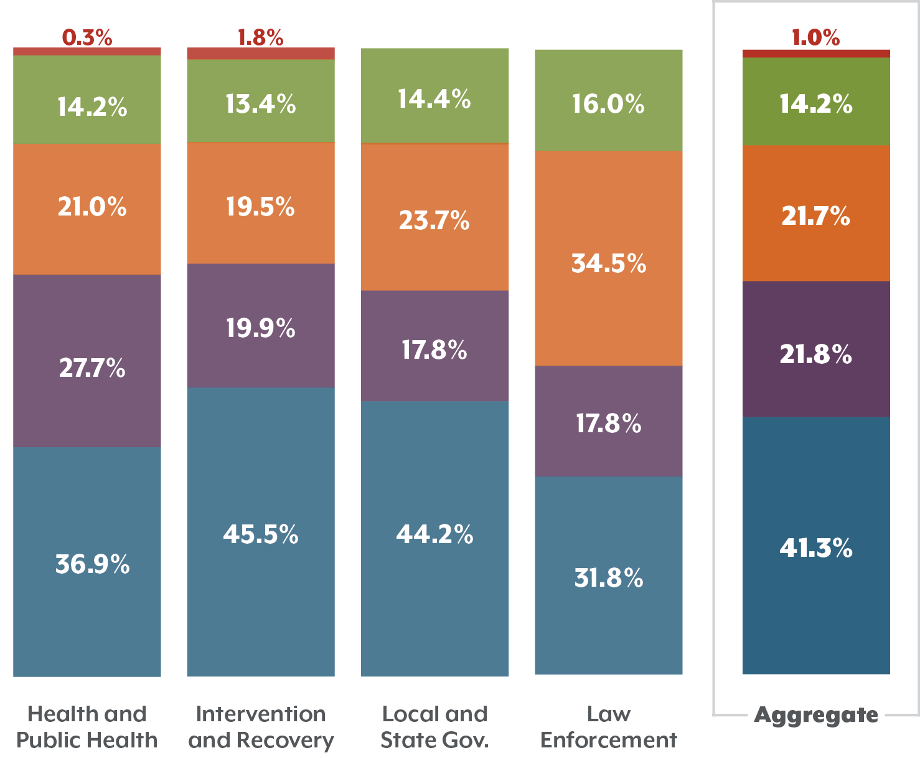
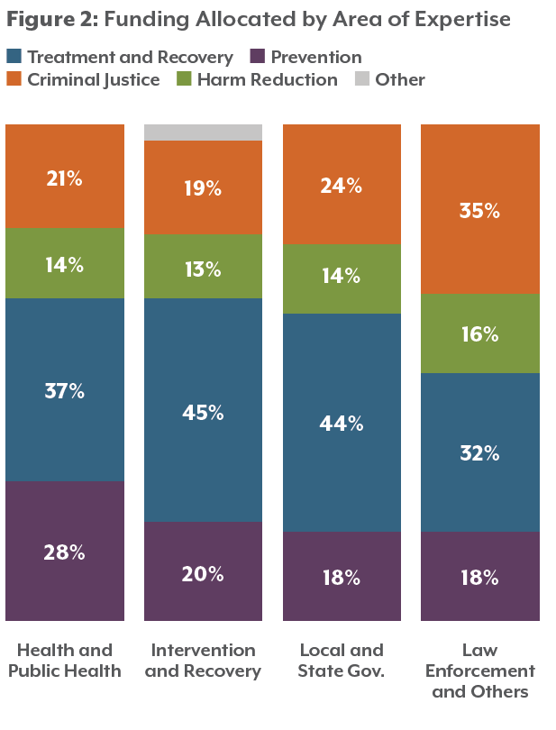
Funding Priorities Differ by Area of Expertise
Notes:
So that’s in aggregate. But – again, context is critical in these decisions. Not all communities or policymakers will take the same approach in allocating these resources.
For example, when we looked at who prioritized which strategies among the survey respondents, there were some stark differences – mainly reflecting the area in which the respondents worked.
People working in intervention and recovery said almost half of the dollars (45%) should go to intervention/treatment and recovery.
That’s compared to people representing law enforcement who thought about 32% should go to trx.
That’s a $13m investment either going to trx or not depending on who’s making the call.
Notice that consistently prevention only gets 20 percent of the bucket
So what’s this tell us? Depending on who’s in the room making these decisions, prioritizing the settlement dollars could land on very different priorities.

Slide 7




Policy Questions
All eggs in one basket?
Can we spend it?
What will our impact be?
Will it last?
Notes:
But regardless of who’s making the decisions, they come with a slew of policy questions. We’ll share just four–
All eggs in one basket
Some communities need broad financial support across their behavioral health system.
But others need significant support in one part — such as building a system of recovery supports or increasing the number of medication-assisted treatment providers in the region.
Think breadth versus depth of investments
Can we spend it
To what extent are communities ready to absorb dollars?
For example, we can build a treatment center… but do we have a workforce that’s ready to support that facility?
What will our impact be?
What are the outcomes policymakers want to achieve?
if the goal is reducing all substance misuse - not just opioids, then its investments in family supports, access to health care, primary prevention.
But if the goal is reducing opioid-related deaths, then it’s Naloxone, harm reduction.
Sustainability.
Unlike the tobacco settlements, the opioid settlement dollars are not in perpetuity. They are a one-time thing.
So sustaining their impact is a big deal.
Think – we’re in a rural community where the nearest residential treatment center is a four-hour drive away… over a couple mountain passes … we need treatment beds. It will take longer but we’re taking the long view.
OR - are our needs so acute that we need to train more staff to deliver medication assisted treatment – even though staff may leave the region?
Key here is – these decisions are not one size fits all.

Slide 8

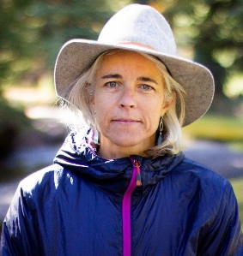
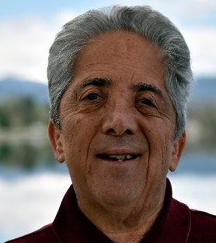
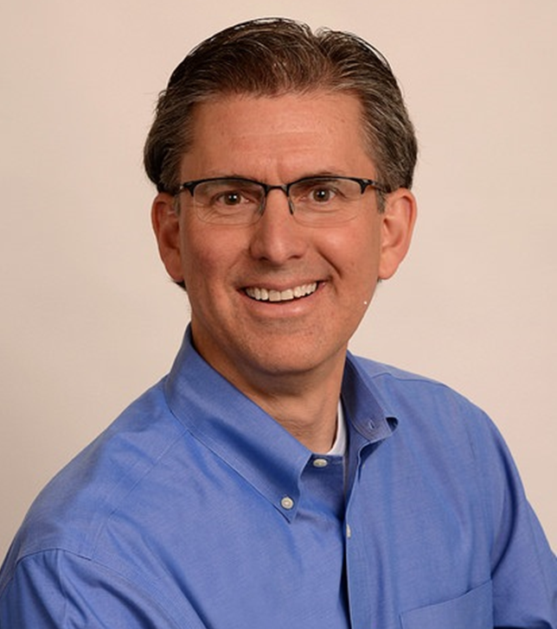
Panelists
Commissioner
Hilary Cooper,
San Miguel County
Commissioner
John Kefalas,
Larimer County
Dr. Rob Valuck,
Colorado Consortium for Prescription Drug Abuse Prevention
Notes:
I’d like to turn now to our panelists. We are joined by three superstars whom I’ll introduce in a second.
First – audience – we want to hear from you. Use the sticky notes to write down your questions and hold them up for Hieu to grab and we’ll try to answer as many as we can at the end.
I’d encourage you to think about – How do we collectively get smart before these dollars arrive –what are the considerations in your community or your work? and what do we do if the dollars don’t arrive?

Slide 9

Panelists
Commissioner
Hilary Cooper,
San Miguel County
Commissioner
Greg Poschman,
Pitkin County
Dr. Rob Valuck,
Colorado Consortium for Prescription Drug Abuse Prevention
Notes:
I’d like to turn now to our panelists. We are joined by three superstars whom I’ll introduce in a second.
First – audience – we want to hear from you. Use the sticky notes to write down your questions and hold them up for Hieu to grab and we’ll try to answer as many as we can at the end.
I’d encourage you to think about – How do we collectively get smart before these dollars arrive –what are the considerations in your community or your work? and what do we do if the dollars don’t arrive?

Slide 10
Make Your Voice Heard!
  Imagine you have $100 million
  to spend over five years
  to address the opioid crisis.
How would you allocate it?
Use the dots on your table to allocate
your dollars.
Notes:
Clearly Colorado has a lot of gain from these potential settlements – and a lot to lose if we don’t get it right. So CHI will be watching these settlements closely.
Thank you all for joining – and I want to especially thank our panelists!
Handout – and limited number of reports that will be published on our website shortly.
We’ll be hanging out to discuss.
On your way out… we want to hear from you. Imagine you have….
On your tables you will find circular stickers. Each are worth $25million. Take four.
Put your stickers on the poster hanging on the wall (Hieu to wave) – and we’ll put up the posters on twitter after our sessions to see where this group lands!

