Slide 1
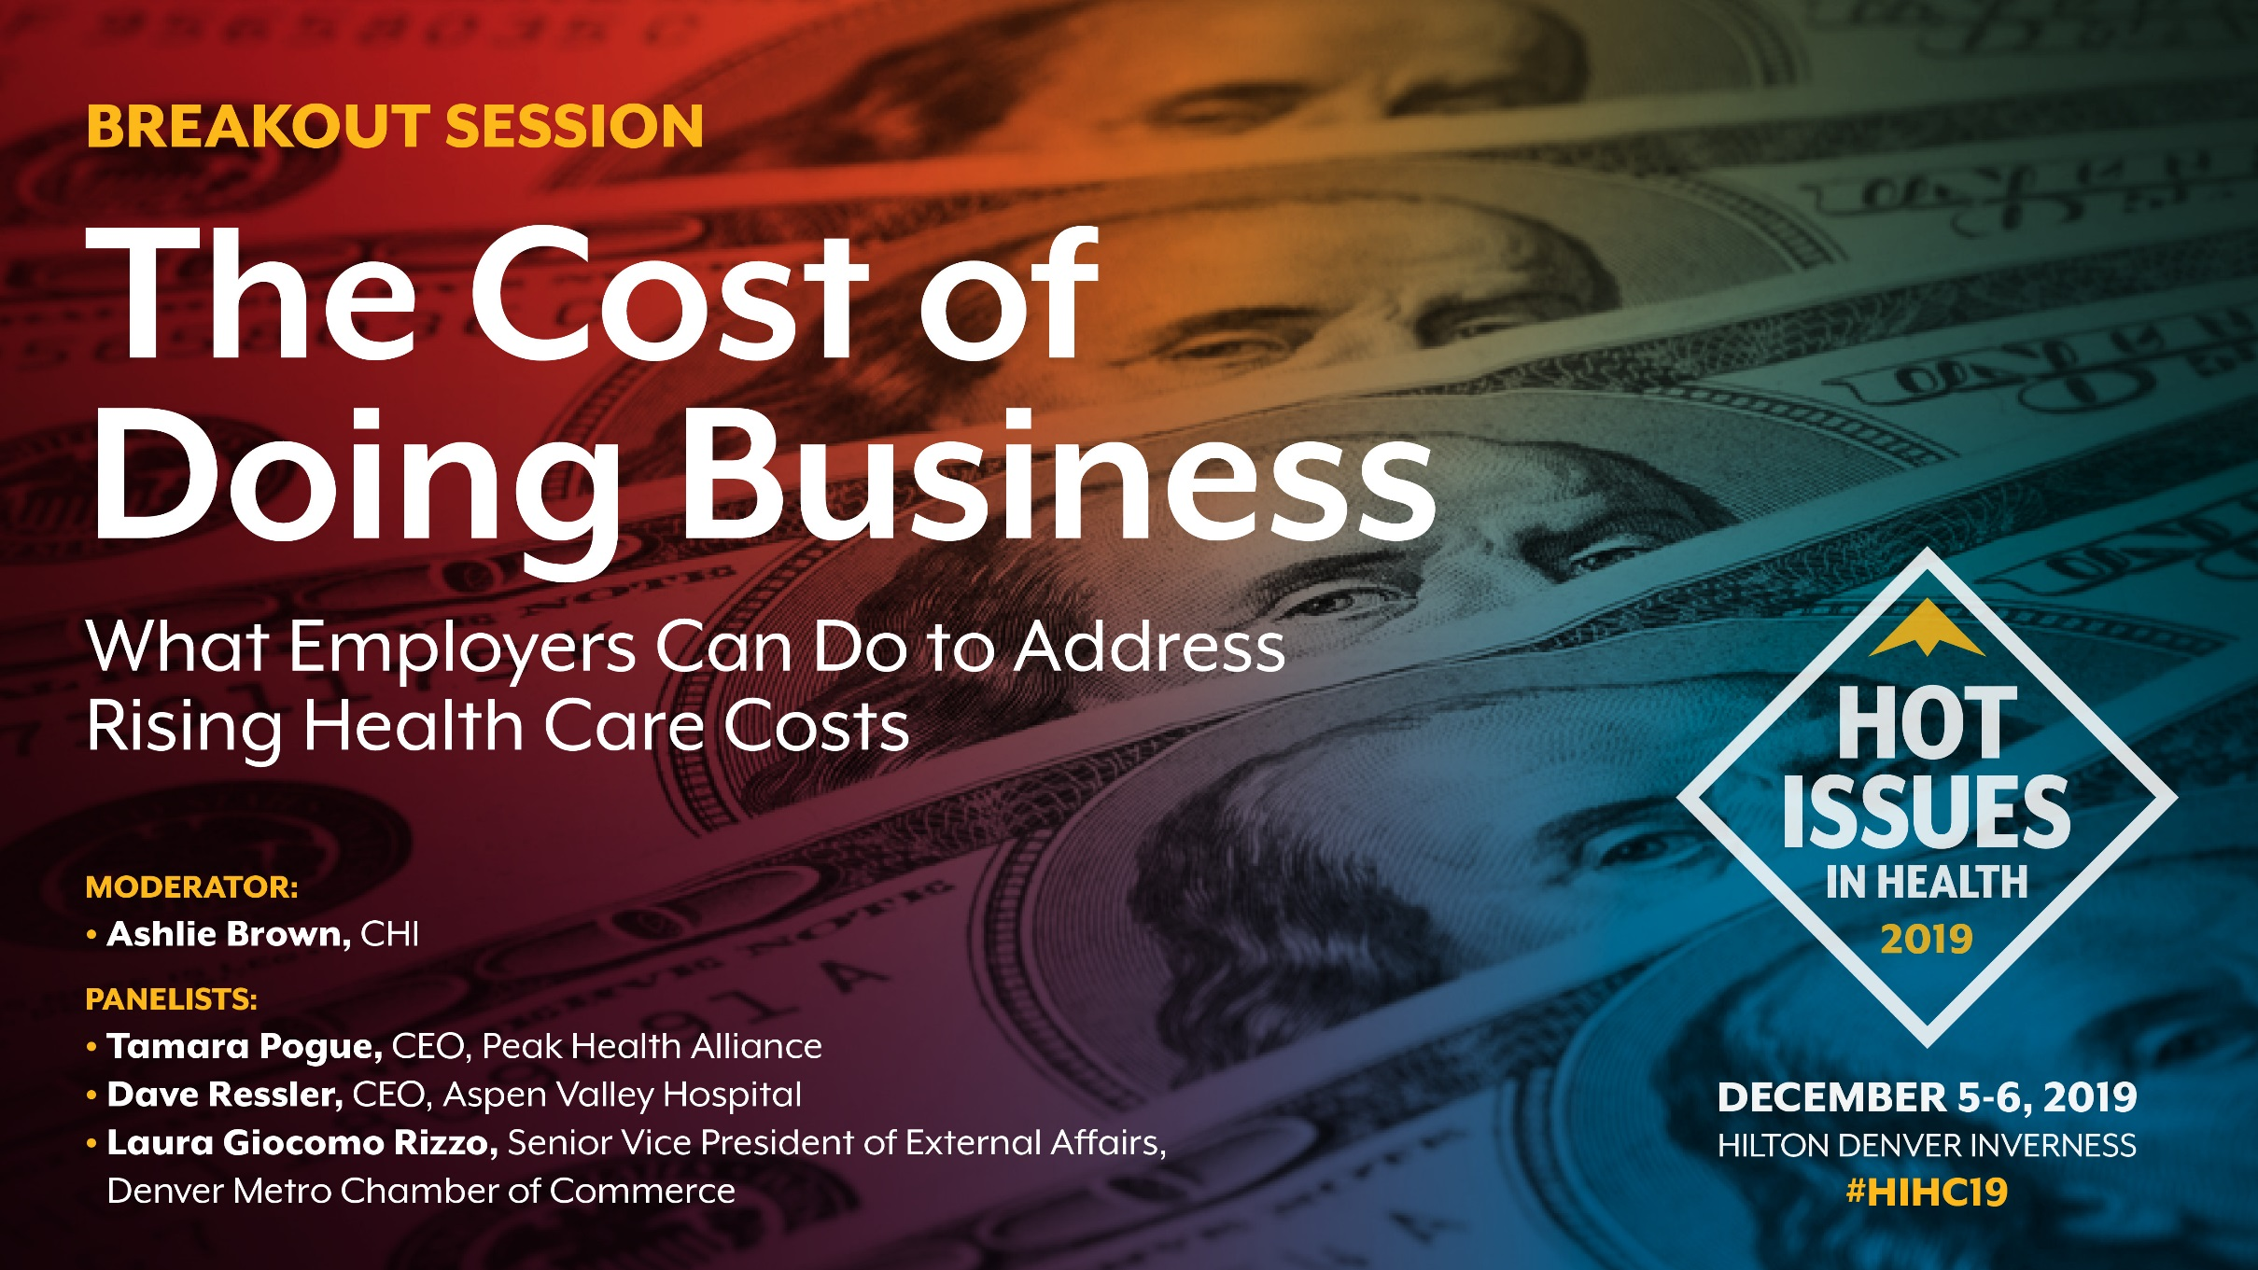
The Cost of Doing Business
What employers can do to address rising health care costs
Notes:
Hello, my name is Ashlie Brown and I’m a Director at CHI. I focus on health care delivery system and payment reform initiatives, including employer strategies to address rising health care costs.
We have a great panel with us today. We will hear from each panelist about how employers across Colorado are tackling this issue. Tamara Pogue will talk about the Peak Health Alliance, a new purchasing collaborative in Summit County. Dave Ressler will talk about Aspen Valley Hospital’s role as a major provider and employer in Pitkin County and a leader with the Valley Health Alliance. Laura Giocomo Rizzo will share her insights from working with employers through the Denver Metro Chamber of Commerce.
But before we dive into the panel discussion, we want to take a few minutes to level set. Why are employers important in the conversation and what are some of the challenges they face to getting more involved? After we level set, we will hear from our panelists and then reserve about 15 minutes at the end of the session for audience questions. As you think of questions throughout the session, please feel free to write them down on the note cards and my colleague Spencer Budd will pick them up.
Allie’s notes for JG session 11.06.19:
CHAS slide – only include the ESI percentages, not the full coverage mix (done)
[stopped taking notes for a while because Spencer was capturing them all]
For takeaway #3 – consider framing as, “Is this the market’s last stand?” (settled on many employers, many strategies)
Thinking about prepping panel: Bob Smith will be the challenges (no Bob Smith… tear)
Whether you give people a chance to ask questions before the panel depends on timing. Anticipate you won’t have time. Plan to say up front that you will have time for Q&A at the end. (no questions until the Q&A)
Plan for running it twice: same lead-in question for panelists and then different follow-up questions. (done)

Slide 2
Three Takeaways
Employers foot the bill for most Coloradans (and it’s a big one)
Relationship status: It’s Complicated
Many employers, many strategies
Notes:
As we dive into this conversation about what employers can do to address rising health care costs, I want you to keep three things in mind:
- First, employers pay a large share of health care costs. Most Coloradans still get insurance through their employer. Collectively, this adds up to a big bill… and a big opportunity for change.
- While many of us get insurance through our employer, this relationship is complicated. And it’s getting more complicated.
- Finally, while there is a big opportunity collectively, there are many different types of employers and that’s going to require a variety of strategies.

Slide 3



Colorado’s Employers Pick Up
More of the Cost of Health Insurance
Employer contribution
Employee contribution
$13,351
$4,963
Average Out of Pocket
$797
Deductible
$4,011
Average Premium Cost for Family Coverage in Colorado (2018): $18,314
Source: Medical Expenditure Panel Survey 2018
Notes:
Audience question: How many bought their first car with no help from their parents? How many got a free car? How many had to pay a little?
We start with a car because that’s how much health insurance costs for the average family in Colorado, and just like our parents, our employers are helping us out. A lot.
Source: MEPS
QC:
Premium cost with employer/employee split: https://www.kff.org/other/state-indicator/family-coverage/?currentTimeframe=0&sortModel=%7B%22colId%22:%22Location%22,%22sort%22:%22asc%22%7D
Deductible: https://meps.ahrq.gov/data_stats/summ_tables/insr/state/series_2/2018/tiif3.pdf
Was not able to confirm average out of pocket ($797). Is that also from MEPS?

Slide 4
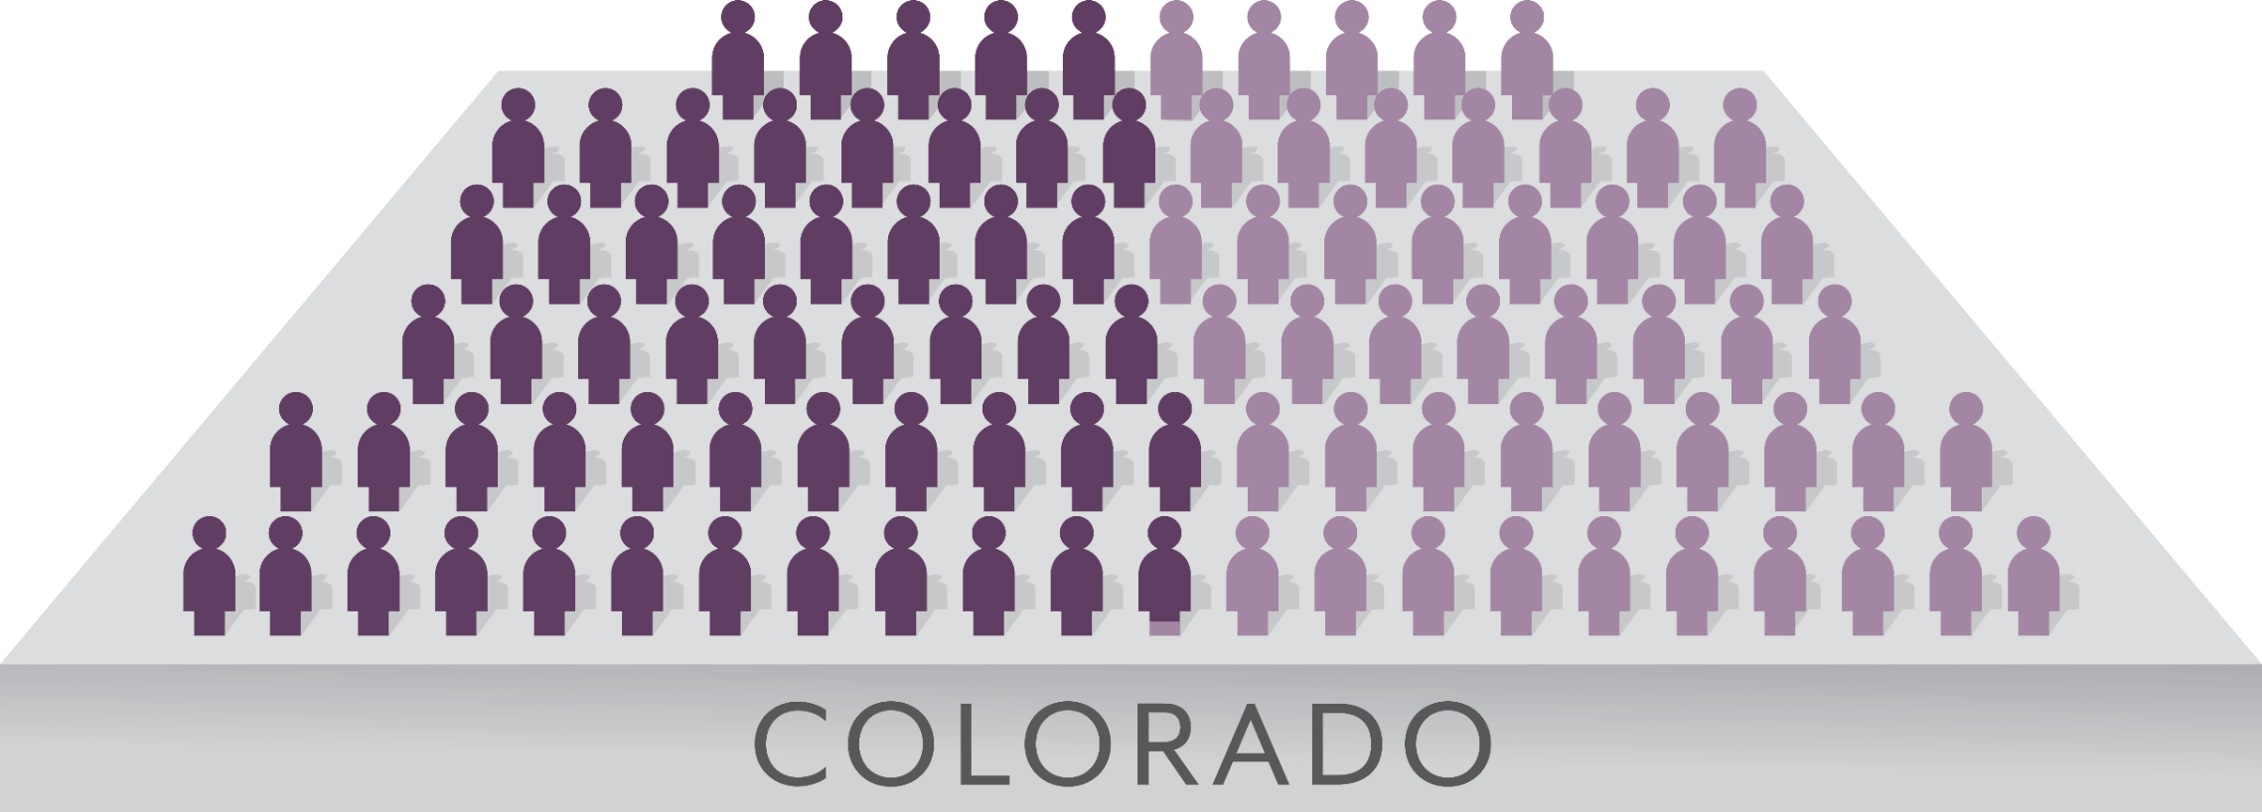
Most Coloradans Still Get Insurance Through Their Employer …
52.7%
of Coloradans had employer-sponsored insurance in 2019
Source: Colorado Health Access Survey 2019

Slide 5


… But It’s Not the Same Employer as Last Year
~580,000
Number of Coloradans who either lose, gain, or change their ESI coverage every year
4.2
Average number of years
an employee remains with their employer (nationally)
Source: Colorado Health Access Survey 2019, U.S. Bureau of Labor Statistics
Notes:
-------------------------------
Alternate data points:
Median employee tenure in January 2018 was 4.2 years
Median tenure among workers ages 55 to 64 was 10.1 years
Median tenure among workers ages 25 to 34 was 2.8 years
Note 1: This comes out every 2 years so January 2018 is the most current until January 2020
Note 2: median tenure for >25 hasn’t really changed since 2008 so I wouldn’t lean too hard on the idea that this is changing
https://www.bls.gov/news.release/tenure.nr0.htm
Overall, the distributions of insurance among those who churned looks like a lot like the overall insurance breakdown for Coloradans.
Only 16.4% of those currently with ESI churned in the past year compared with 19.1% of all Coloradans in the same age category.
About 600,000 Coloradans churned either to ESI, from ESI or between ESI in the past year. (587,375 is the actual number)
P:\Projects\Hot Issues in Health\2019 Conference\Presentations\Breakout Sessions\Affordability\SASOutput_ChurnAges0to64.xml

Slide 6
Times Are Changing
In 2019, More Than Half Are in Favor of a National Health Plan
Percent who favor a national health plan in which all Americans would get their insurance
from a single government plan:
Source: Kaiser Family Foundation Polling Data
Notes:
Q for the audience or for panelists: Do you really think this is the last chance to save the market?
Sources:
First four bars from slide 3 at this source: https://www.kff.org/slideshow/public-opinion-on-single-payer-national-health-plans-and-expanding-access-to-medicare-coverage/
Last bar calculated from KFF 2019 polling values from here: https://www.kff.org/interactive/tracking-public-opinion-on-national-health-plan/

Slide 7
Spectrum of Solutions: Our Focus
More Government
Less Government
Single Payer
Reinsurance
Employer- Sponsored Insurance
Consumer-Driven Health Care
Medicaid/Medicare
Catastrophic Plans
Marketplace
Public Option
High Risk Pools

Slide 8
Employers Are a Mosaic, Not a Monolith
Brian – We’re attempting to create something that looks like a “mosaic”.
Retailers
Health Care Companies
Large Corporations
Professional Services
CHI
Mid-sized Firms
Local entrepreneurs
County Governments
State Government
Hospitality
Small Businesses

Slide 9
Different Employers Take Different Approaches to Risk
More Control, More Risk
Self-Funded
Partially Self-Funded (Level Funded)
Fully-Insured
Less Control, Less Risk
Notes:
Self-Funded employers can customize their health plan rather than simply buying an off the shelf product from an insurer. Self-Funded employers are not subject to state-level regulation (regulated by ERISA), but are on the hook for all health expenses their employees incur.
Fully-Insured employers have less flexibility, but are only responsible for paying the predetermined amount in premium contributions since the insurer is responsible for paying the claims
A hybrid approach sometimes called Level Funding has emerged in the past few years. Level Funding allows employers to pay a regular monthly fee based on expected claim costs, with the potential to recoup funds if actual claims are lower than expected.
Stop loss insurance (AKA excess loss insurance) which kicks in once health expenses reach a certain threshold, can limit the financial exposure of self-funded employers, allowing smaller employers to self-fund or level-fund their health plans (source: DOI 2017 Health Insurance Cost Report).
https://www.kff.org/report-section/2018-employer-health-benefits-survey-section-10-plan-funding/
https://www.onedigital.com/blog/is-partially-self-funding-plan-in-your-future/

Slide 10

Many Employers,
Many Strategies
Today’s Panel:
Tamara Pogue
CEO, Peak Health Alliance
Marguerite Tuthill
Director, Value-based Operations, Community Care Alliance
Laura Giocomo Rizzo
Senior Vice President of External Affairs,
Denver Metro Chamber of Commerce

