Slide 1
PANEL DISCUSSION
Realizing Affordability: Colorado’s Public Option and Other Insurance Innovations
MODERATOR:
Helen Drexler, Delta Dental of Colorado
PANELISTS:
Michael Conway, Colorado Division of Insurance
Tom Donohoe, SCL Health
Amanda Massey, Colorado Association of Health Plans
Billy Wynne, Direct Health PBC

Slide 3
Notes:
JOE
Introduction + Session Preview
Thanks to Megan/SCL.
Please note that we will not have time for questions – find us later if you have something to ask or feedback to share.
We hope you will come away ready for the 2020 legislative session. We’re going to use a few movie memes to examine the up[coming session, so a second goal of our presentation is to show everyone that Allie and I have truly terrible taste in movies.
Case in point…
When we were looking for a movie to capture the feeling of the constant barrage of developments in politics today, we knew there was only one choice…

Slide 4
Setting the Scene
Notes:
JOE
Sharknado.
It’s exactly what you think it is: a tornado full of sharks.
Who has seen one of the six Sharknado movies?
I’m not afraid to admit that I have watched Sharknado 3: Oh Hell No. [CLICK]
You may laugh, but I think the Sharknado canon is the most incisive social commentary of the decade.
Think about it. At any moment, you might be going about your business and you think, I’ll just check the latest news, and [CLICK]
SHARKS!

Slide 5
The Context: ECONOMY
Notes:
JOE
Looking beyond Colorado’s borders, we’re in some dangerous waters when it comes to the economic, policy, and political context.
Headline: Recession seems increasingly likely.
More:
Economic: We’re still enjoying a record-long economic expansion, but economists seem to agree that the good times have to end some time, probably within the next year or two. Globally, the economy is already shaky. The long boom has led to relatively good times for Colorado’s state budget. Legislators have spent a lot of money in recent years, and Gov. Polis’ priorities are far from cheap. But can they sustain what they’ve already committed if the economy starts to sink?

Slide 6
The Context: POLICY
Notes:
JOE
Looking beyond Colorado’s borders, we’re in some dangerous waters when it comes to the economic, policy, and political context.
Headline: Lack of agreement about health policy direction.More:
Health Policy: The Affordable Care Act is the law of the land, but it’s under constant threat in the courts. Democrats are arguing about whether to build on the ACA or shake up the system with Medicare for All. Voters won’t be much help in deciding a direction: New NYT/Upshot survey finds approx. equal support (around 30%) for Medicare for All, Obamacare-plus, and conservative plan to reduce federal involvement and increase state autonomy. Where does this leave policymakers, especially in purple(ish) states?

Slide 7
The Context: POLITICS
Notes:
JOE
Looking beyond Colorado’s borders, we’re in some dangerous waters when it comes to the economic, policy, and political context.
Headline: Tensions are high, with parties moving further left and right.
More:
Political: 2020 is a presidential election year. Impeachment proceedings happening. Everything is politicized. Imagine being a state legislator and get a bill passed through an hours-long hearing, while everyone around you is watching the impeachment hearings, and you’re wondering if your bill will get passed in time for you to knock on a few doors for your campaign tonight. That’s what they’ll be facing for 120 days.

Slide 8
Notes:
JOE
With the 2019 election in the rearview mirror, lingering bad blood from recall campaigns, and a new budget proposal from the governor, legislators are preparing for a contentious 2020 session marked by more yelling than usual. (Rep. Singer reference)
Governor Jared Polis has settled in to his role as the new sheriff in town, and his posse of state department leaders has an ambitious agenda – led by two emboldened holdovers from the Hickenlooper administration.
The pressure of campaigning in a major election year and the many substantial policy proposals on the table – taken together with the limited time and energy available for the legislative session – will pit policy against politics.

Slide 9
Notes:
ALLIE
(Movie: Anchorman)
We’re expecting this year to be contentious, and at times, legislators may not even know what they’re yelling about.

Slide 10
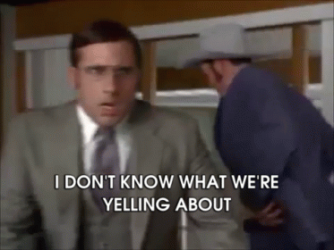
Notes:
ALLIE
Like Brick Tamland, Anchorman’s beloved weatherman, legislators might be feeling overwhelmed next year and caught up in the emotions of it all.
During my five years of tracking Colorado’s state legislature, I’ve noticed that things often seem to be tense at the Capitol – but 2020 is an election year with plenty of high-stakes items for debate and plenty of outside pressures. It could send even the most level-headed personalities over the edge.

Slide 11
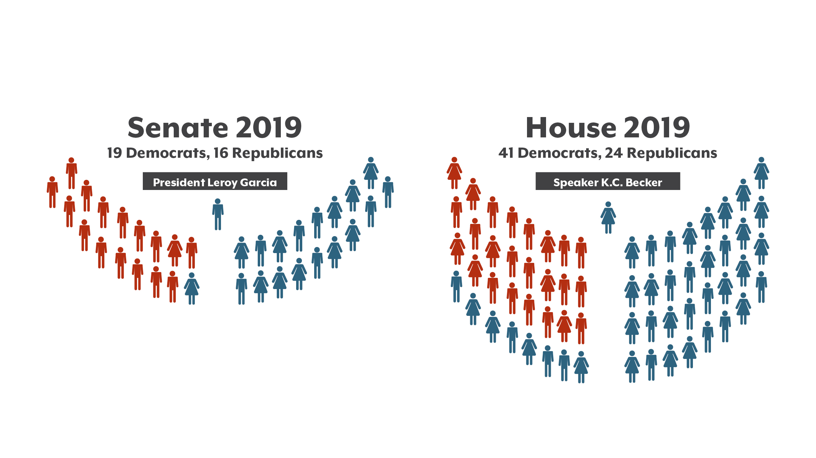
State Legislature
Notes:
ALLIE
Why all the yelling? We’re going into another year of unified Democratic control, but that doesn’t mean there’s unified agreement. The margin in the Senate is close, and may be even closer at times during the session. Republicans have charged Democrats with overreach, and we’ll now have the added political stress of a presidential election year that also sees most of these seats up for grabs. There’s also bad blood left over from attempted recall campaigns in the interim.
Audience engagement: for a t-shirt and raffle ticket, can anyone tell me how many recall petitions targeted this group in 2019? (Answer: 6)
There were 6 recall attempts aiming to remove Gov. Polis, 2 Representatives, and 3 Senators. 1 of the targeted legislators in the House resigned for unrelated reasons; the other 5 were unsuccessful.
The noise has died down, and Dems effectively defended themselves (even gaining support in some instances), so despite the bad taste they’re coming into the session from a position of strength.
So we can all agree that Colorado is a blue state full of a bunch of liberals that’s basically the new California, right? Maybe not.

Slide 12
2019 Election Results Show a Purple Streak
Proposition CC
Proposition DD
Get ready for 2020: Approving another “sin tax” to fund early childhood education?
Notes:
ALLIE
The sound defeat of Prop CC – which would have removed the “refund” aspect of TABOR – tells a different story…one of Colorado’s persistent libertarian streak, with some voters who shun new statewide taxes and perceived attacks on fiscal conservatism, even while maintaining support for the elected officials who back those efforts. “Yes” vote on Prop CC would have immediately impacted state budget planning. Note that a similar initiative failed in Jeffco (1A), where I live, by a similar margin. And voters were basically split on Prop DD, which asked to legalize and tax sports betting to help fund the state’s water plan, though it managed to squeak by. This question of using sin tax revenue to fund important but unrelated initiatives seems to divide Coloradans.
Looking ahead, you’ll want to keep your eyes on a tobacco and nicotine tax measure. You may remember that a proposed measure failed to gain traction in the legislature this year, but it’s likely to be on the ballot in 2020. Early conversations indicate that the revenue would be promised to early childhood education. The close fight over Prop DD results say this could be an uphill battle.

Slide 13
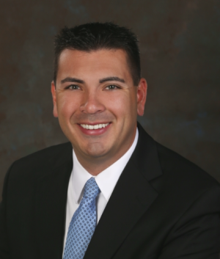
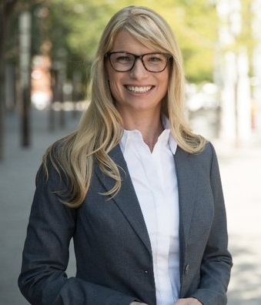
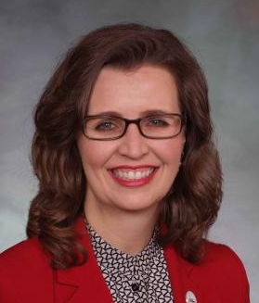
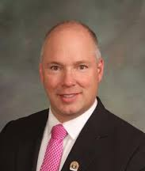
Senators Take Starring Roles
President Garcia (D-Pueblo) toes the line
Sen. Pettersen (D-Lakewood) charts new territory; impact on bill timing?
Close races: Sen. Zenzinger (D-Arvada), Sen. Priola (R-Henderson)
Notes:
ALLIE
Let’s turn back to the actors. While there are lots of detailed and important policy discussions that take place in the House, the most consequential action (and most likely roadblock) will be in the Senate.
President Garcia will need to continue to balance the will of his constituents – he’s a moderate Democrat from a moderate district in Pueblo – with the goals and preferences of his party as he leads a closely divided chamber.
Sen. Pettersen is expecting to be on maternity leave for some portion of the session (what this will look like is anyone’s guess). We’re mentioning this 1) because she’s discussed it openly and 2) because it’s uncharted territory – and something Colorado, and other states, will need to confront as more women run for office. It also has ramifications for policy debates, as any absence in the closely divided Senate can affect a bill’s chance of passage.
And we’ll have a better sense soon of which races will be most competitive, but two to watch in the Senate: Sen. Rachel Zenzinger out in Jeffco and Sen. Kevin Priola up in Adams County.
Tomorrow, Yamiche Alcindor of the PBS NewsHour will be here to discuss some of the actors to watch on the national stage, including our very own US Senate race, and how divisive things are beyond the borders of our state.

Slide 14
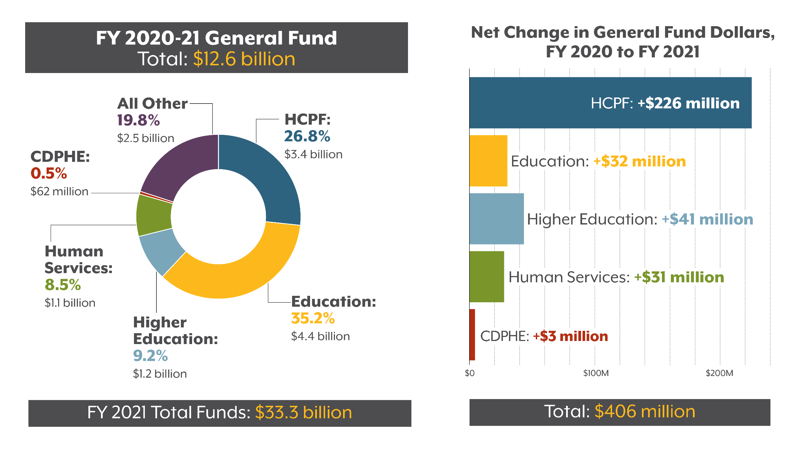
General Fund Grows Unevenly
Notes:
ALLIE
And you can’t talk about divisive things without talking about Colorado’s budget.
Audience engagement: Raise your hand if you think the state budget is growing from this fiscal year to next year. Raise your hand if you think it’s staying flat or decreasing. (Answer: growing, with both GF and TF up nearly 3%. Exceeds pop’n growth, inflation)
Quick overview – a look at the departments that make up the GF budget, which is the subset of the budget made up of state funds that is controlled by our legislature. [Walk through #s and context]
It’s also interesting to look at the $ change in these departments’ budget from the current fiscal year to the next one. [Walk through #s and note that HCPF budget increase accounts for about 55% of the entire GF increase]

Slide 15
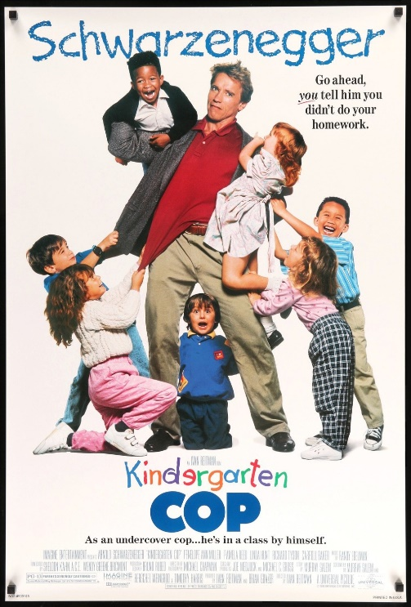
Coming Attractions in the Budget
$28M Expanded preschool for at-risk kids
$17.5M Medicaid coverage for SUD treatment
$5.5M Eight weeks paid family leave for state employees
$2.5M Child immunization outreach
$1.2M Pharma monitoring and prescribing technology
Notes:
ALLIE
There is so much to consider in the budget. Just a few General Fund highlights that may be of interest to the Hot Issues community from the request:
Expanded pre-K; Medicaid inpatient and residential treatment for substance use (state shows this as savings, but is new money; $88M TF); paid family leave program for state employees ($10M TF); child immunization outreach; enhanced pharma monitoring and technology to help with controlling costs ($4.6M TF).

Slide 16
Pressure Builds on State Finances
Full-day K participation higher than projected
Additional General Fund needs:
CHP+
State reserve
Prior sessions’ bills are getting expensive
No help from Proposition CC
Notes:
ALLIE
And you can’t ignore the broader context. In addition to the cooling economy, as Joe outlined earlier, full-day K enrollment has been higher than predicted – which is great for our kids, but means a higher cost than originally budgeted. Additional needs include things like extra funds for the Child Health Plan Plus, or CHP, program, and to bolster our state reserve to prepare Colorado for a future recession. (nearly $60 million combined)
A handful of recently passed bills, like the Medicaid substance use benefit I just mentioned, had low up-front costs with bigger price tags in subsequent years – and those larger budget impacts are starting to hit home this year, making financial decisions even tougher.
And there’s no relief from Prop CC, so the state needs to continue to budget for taxpayer refunds.
All of this will combine to once again make the budget one of the biggest plot lines of the legislative session.
I do want to say that Colorado has a strong track record of bipartisan progress that is the envy of many other states, and most our legislators maintain that their colleagues across the aisle are actual people trying to do the best they can most of the time.

Slide 17
Notes:
ALLIE
…But the session may feel, at times, like that epic Anchorman street fight, with everyone battling over the same turf and looking out for their own.
Joe’s going to talk about the governor’s office and his team’s role in all of this.

Slide 18
Notes:
JOE
(Movie: True Grit)
A year into the Polis administration, and it should be clear that there’s a new sheriff in town.
Gov. Jared Polis is a Democrat, like his predecessor, John Hickenlooper. But that’s about where the similarities end.
Hickenlooper often acted as the public face of Colorado, a sort of chief marketing officer, and he was happy to let the legislature do its thing for 120 days.
Polis is an experienced legislator, and he’s been keen to use the legislature to pass laws that advance his bold agenda. In health policy, that means cutting consumer costs.
That has been a big change for a lot of people, especially hospital executives. They’re going to need some [CLICK]…

Slide 19
Notes:
JOE
True Grit to thrive in the Polis administration.

Slide 20
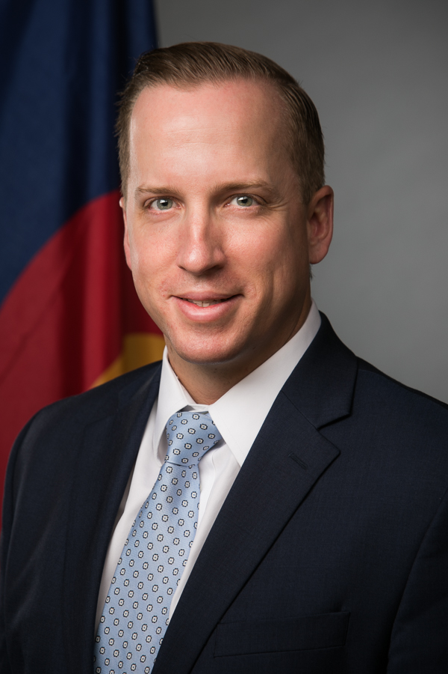
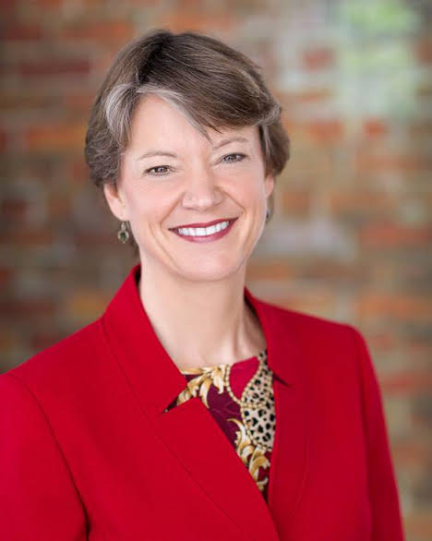
Old Deputies Wield New Power
DOI: A new mission of consumer advocacy
HCPF: New willingness to use market might
Notes:
JOE
Polis has some tough deputies. In the health space, it’s notable that his two main deputies are holdovers from the previous administration.
We just heard from Michael Conway, the insurance commissioner. There’s also Kim Bimstefer, director of Health Care Policy and Financing, which of course runs the Medicaid program.
Let’s take a second to note how much these two have transformed their respective agencies.
The Division of Insurance used to be focused on actuarial work. Making sure regulated insurance carriers were charging the right price for their policies.
Under Conway, it has become a force for driving down consumer prices. DOI is creating legislation and new programs that allow it to shape the insurance and health care market, not just oversee it.
HCPF insures about a fifth of the population of the state through Medicaid. Under Bimstefer, the agency has started to use that market power to try to drive down prices not just for Medicaid members, but for the whole state.
These two have probably dropped off the holiday card list of a lot of hospital CEOs this year, because they’ve both taken the governor’s focus on consumer costs and run with it.

Slide 21
Notes:
JOE
We actually almost called this session…

Slide 22
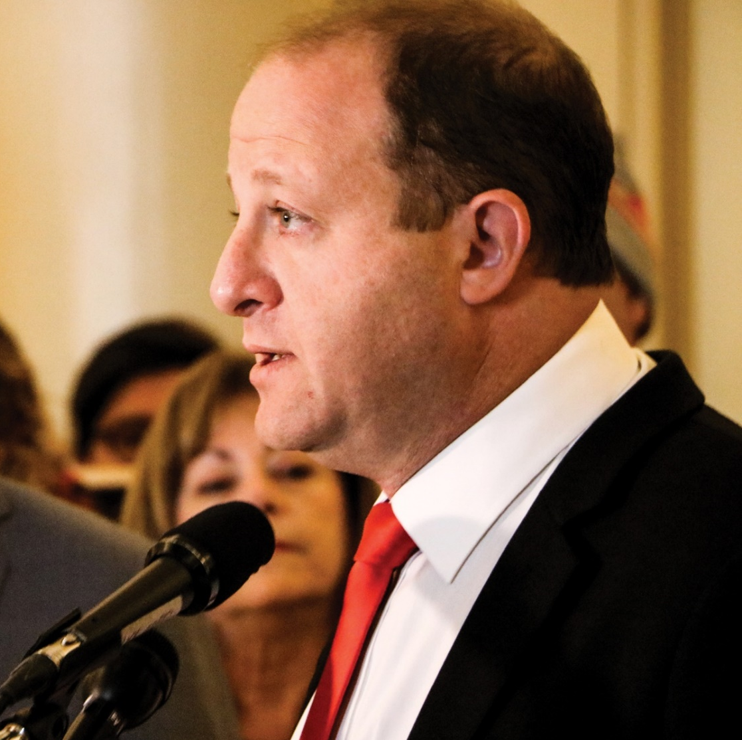
Polis Places Big Bets
Public Option
Reinsurance
Purchasing Alliances
Payment Reform
Notes:
JOE
Gov. Polis launched out of the gate last year with a big legislative agenda, and it made 2019 arguably the most important health policy session since Colorado expanded Medicaid.
So what will he do for Act II?
We think it’s going to be a lot of follow-up on Act I. That means building on:
Public Option
Reinsurance
Purchasing Alliances
Payment Reform
All these ideas were kicking around before Polis became governor. He provided the push – and the votes – to advance them.
But none of these ideas is a sure bet to survive in the long run.
Let’s look at some of the biggest initiatives the Polis administration is pushing, because they’re probably going to be the big story of 2020.

Slide 23
Public Option Gets a New Flavor
Notes:
JOE
First is the public option , which we just heard about.
This is not the public option a lot of us were expecting when the legislature passed a bill about it last spring.
We think this is a new-ish idea on the American health policy stage.
If you have Medicare for All on the left, which is basically single-payer health care, then the classic public option is a more centrist approach, which would use Medicare or Medicaid to allow anyone to buy in to public coverage instead of working with a private insurer.
Colorado’s public option is even closer to the center. Instead of squeezing out private insurers, it boosts their role.
But it’s still to the left of what we have today, because it relies to some degree on government coercion. It might require some insurance companies to participate, and it would save money by setting lower prices for hospitals.

Slide 24
Notes:
JOE
Next we have reinsurance.
I’ve been covering Colorado governors either as a reporter or a health analyst since Bill Owens, and this is the first time I’ve seen one call a news conference to announce insurance prices.
It’s easy to see why. In previous years, prices went up 20 or 30%. But thanks to the reinsuance program, in 2020 they will drop by 20%, or even more on the western slope.
So it seems to be working. HOWEVER – there are also unintended consequences: Some people will end up paying slightly MORE for coverage in 2020. The program isn’t cheap for the state. It needs general fund dollars that could be spent on other priorities, and it also levies a fee on hospitals to help fund it.
And it’s authorized only for two years, so expect all these issues to come up when legislators try to extend the reinsurance program next year. Polis probably will have to spend some political capital if he wants to do another press conference on insurance prices next fall.

Slide 25
Notes:
JOE
Another idea in the mix: Community purchasing alliances. Summit County set one up that will start covering people on New Year’s Day. Mike Conway and the DOI offered a lot of help to get Peak off the ground.
This idea saves consumers money by driving a harder bargain in negotiations with the local hospital.
The model is spreading, and Peak is expanding to Grand County and the Four Corners region, and other counties are looking at creating their own alliances.
Gov. Polis loves this idea, too, and he has talked about taking it statewide.
PEAK HEALTH ALLIANCE:
Early signs of success: premiums down additional 20 percent in Summit County. Keys to Peak’s success: comprehensive claims data, provider negotiations.
Potential audience engagement: Can you name Peak’s hospital partner or either of its insurance partners? (St. Anthony Summit-Centura, Bright, Rocky Mtn Health Plans)

Slide 26
Affordability and Transparency
Insurance affordability standards HB 19-1233
Surprise billing HB 19-1174
Hospital financial transparency HB 19-1001
Hospital Transformation Program
Hospital Community Benefits HB 19-1320
Notes:
JOE
And then we have several new initiatives that change the way health care bills are paid, who pays them, and how we keep track.
Note that each of these, like the batch of previous slides, has an impact on hospitals.
***
Notes: Reference Conway panel remarks from earlier in the day, if applicable. 1/15 is date for first hospital transparency report.

Slide 27
Who Pays? How Much? And For What?
Notes:
JOE
This leads to big questions about if and how these initiatives all fit together.
There is a different timeline, geographic reach, insurance market(s) for each. Is there a coherent/coordinated plan for the administration’s cost-saving initiatives, or is it a bunch of ideas working independently (throwing everything at the wall to see what sticks)? [Mention HTP as example of payment reform]
Crucially, how will the cumulative effect of all these affect hospitals, and how will hospitals respond? There are some rural hospitals that are just barely hanging on, and legislators will hear a lot about that from their local hospitals and the hospital industry. There are also hospital groups that are pulling close to a billion dollars a year in profit in Colorado. So calibrating each of these initiatives to work together and to target high hospitals profits without bankrupting someof them is going to be a tough job.

Slide 28
Notes:
JOE
So we expect it’ll be off to the races.

Slide 29
Notes:
ALLIE
(Movie: Fast and the Furious)
Legislators will be vying for voters’ approval next fall. But before that, policy and politics will be vying for attention in a race to the finish – in what always seems to be a really quick legislative session.

Slide 30
Notes:
ALLIE
You might even say it’s going to be… “fast and furious.” We’re going to see a powerful start, some high-risk maneuvers, and all eyes on the finish line.

Slide 31
Notes:
ALLIE
Our final movie metaphor is a franchise with even more installments than Sharknado, so you know it’s good.
Often in election years, policy agendas are shorter and less complex. Not so for 2020. Either the bills or the campaigning is going to have to take a backseat…which may present a conundrum for legislators who definitely can’t afford to coast on the policy front.

Slide 32
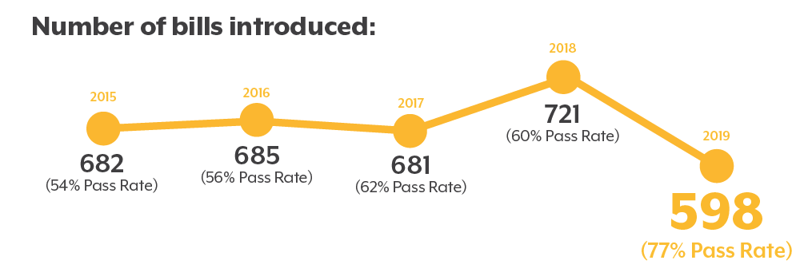
What to Expect
2019 session: “Slow start, fast finish”
Don’t expect another slow start
Fast finishes are here to stay
Notes:
ALLIE
At the end of the last session, we summarized the 120 days as a slow start but a fast finish. Don’t expect another slow start in 2020.
Audience engagement: To back up for a moment: does anyone remember how many bills were introduced last session? A t-shirt for anyone who remembers the exact number. (Answer: 598)
This was a lot fewer than the session before, but almost 80% of those bills passed – and almost 40% of all introduced bills were still undecided on the last Monday of the session. This poses a big challenge in a state that guarantees a hearing for all bills. We may see even fewer bills this year, but we’ll definitely see them earlier. Legislative leaders are putting a priority on having policy proposals ready to go sooner so they don’t experience a repeat. This will be more feasible since they’re not coming off an election too. Interim committees are also helping get bills ready: together, they proposed a whopping 48 bills for introduction next year, which are ready and waiting for introduction.
But no matter how organized legislators are with introducing bills earlier, it seems like fast finishes are here to stay.

Slide 33
Notes:
ALLIE
And you’re probably already feeling the intensity at your workplace, at home, or at holiday gatherings with your family – though we still have almost a year to go until the election. Know that the pressure is compounded for legislators, as most of them are also gearing up for their own campaigns – with most looking to stay in the legislature, and others eyeing bids for county commissioner spots or congressional seats.

Slide 34
Notes:
ALLIE
So they’re going to be faced with a couple options…forks in the road, if you will, between the pull of campaigning on one side and the many important topics awaiting them on the other side of the new year.

Slide 35
Spotlight: Hospitals Pushing Back
Total Cost of Care proposal
Sets cost reduction goals for all parts of health care system
Goal: $3.3 billion in savings over first 5 years
Spreads responsibility, avoids rate setting
Notes:
ALLIE
Another group that’s feeling the pressure: hospitals. And they’re coming out swinging with a “total cost of care” proposal that they see as an alternative to the public option. 6 other states have something similar, with Massachusetts’ program being the most established.
While details are still coming together, TCC would set goals for reducing costs across all parts of the health care system, shifting the burden to include carriers, pharma companies, and others in addition to hospitals. The goal is more than Early estimate: $3 billion in total system savings over the first 5 years.
Hospitals say this approach is more comprehensive – and also more fair – since it affects the entirety of the health care system, and it avoids rate setting, which is currently a component of the state’s public option.
There are so many important bills we could profile here, but we’ve focused on this one because it’s going to involve a showdown. Expect lots of time and energy to be invested in total cost of care and the public option by both proponents and opponents.

Slide 36
Bills Will Fight for Attention
Notes:
ALLIE
Issues around costs – and how they impact hospitals, insurance carriers, and affordability for consumers – will be at the center of the health policy bill world next year. But many other important things will be fighting for attention as well. Here’s just a quick look.
Tobacco and nicotine regulations will be a big deal, from a potential ballot measure to expected bills proposing to raise the purchase age to 21 and perhaps ban flavors.
Opioids and substance use will continue to be an important part of the health care debate, with 5 bills coming from the interim committee.
We’ll see renewed attempts to increase transparency around pharmaceuticals and rein in high drug costs through methods like an affordability board.
There are so many mental health policies to tackle, like increasing the # of peer support specialists and navigating questions re: the intersection with criminal justice.
The debate over immunizations is coming back, and advocates will try to figure out how to increase the vaccination rate in a way the governor can support.
The DOI cracked down on health care sharing ministries over the summer following consumer complaints, and we’ll see a bill hoping to do the same.
Housing affordability and tenants’ rights have become a big deal at the legislature, and they are increasingly viewed as inside the health sphere, not apart from it.
We’ll also see efforts to increase enrollment in safety net programs and add to assistance provided by programs like TANF and SNAP.
And this is by no means a complete list. Plenty of other big-ticket items will be back.
Audience engagement: So, I’d like you to take 1 minute, turn to your neighbor, and tell them which of these issues – or something that’s not represented here – is the biggest priority for you. [Take 2-3 examples from audience, 5 words or less]

Slide 37
Notes:
ALLIE
Clearly, there’s no shortage of policy change on the docket, and legislators will feel like they’re being pulled in different directions. Some of you are probably feeling that way as well by this point in the presentation. I hope you can all find time between today and January 8th to step back and relax a little.

Slide 38
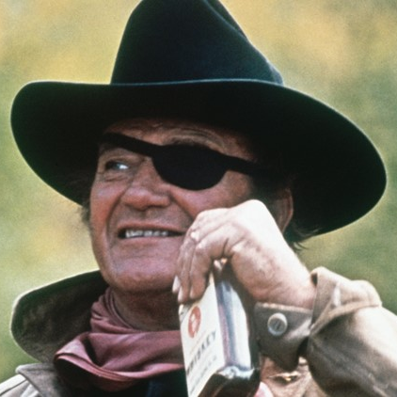
More Yelling at the Capitol in 2020
New Sheriff, Tough Deputies
Policy and Politics Race to the Finish
Notes:
ALLIE
That brings us to a reminder of our takeaways.
Legislators are preparing for a contentious 2020 session marked by more yelling than usual.
Governor Jared Polis has settled in to his role as the new sheriff in town, and his posse has set an ambitious agenda in motion.
The pressure of campaigning in a major election year coupled with the many substantial policy proposals on the table will pit policy against politics.

Slide 39
Notes:
ALLIE
We don’t want you heading to lunch feeling stressed and thinking about a tornado full of sharks. So here’s a nicer, more inspirational shark: Left Shark, of 2015 Super Bowl fame. (Also Right Shark, the boring one.) Who remembers this? Anyway-
The point here is that things might seem a little overwhelming, but this is kind of the Super Bowl for Colorado health policy, and this month we’re wrapping up the halftime show between sessions. Remember, this is why we do the work! You’ve heard all morning about the dizzying number of things going on in and outside of the legislature, and it might be hard to stay in sync – [animation] but Left Shark went viral for being out of step, in a way that people really identified with. Sometimes breaking the mold is how you get noticed.
All eyes are on Colorado, there’s definitely no choreography, and anything could happen. THANK YOU for being here. Now get out there and dance your fins off.

Slide 40
Notes:
ALLIE
We appreciate your attention today. As Joe mentioned, please find us later in the conference if you have questions or feedback to share.

Slide 41
Notes:
You’re now free to head to lunch in the Sunrise Room. Staff are available to help guide you. Just make sure to be at your chosen breakout session promptly at 1:00.

