Slide 1
Big Margins, Big Challenges
2023 State Legislative Preview
Allie Morgan and Joe Hanel
Colorado Health Institute
Notes:
Action-packed day
Final content session
Part recap, part forecast
Wrap up w/ a look at what’s coming

Slide 2
Notes:
Introductions – Allie, then Joe
Acknowledge that it takes a village!

Slide 3
Legislative Preview: Our Time Today
Election Review: Colorado Democrats are in a position to do big things.
Budget and Economic Outlook: Money is getting tighter.
Policy Preview: Major challenges exist, but so does the ability to tackle them.
Notes:
3-part session
Outcomes/implications of voters’ decisions
Added to Dem political power; soul-searching for Rs
Historic federal funding, economy doing well
Money getting tighter, can’t forget implementation needs
Major challenges without simple solutions
Ability as state, health policy community to tackle them
Obligation, resources, partners as winning recipe
Q&A at the end
A little levity

Slide 4
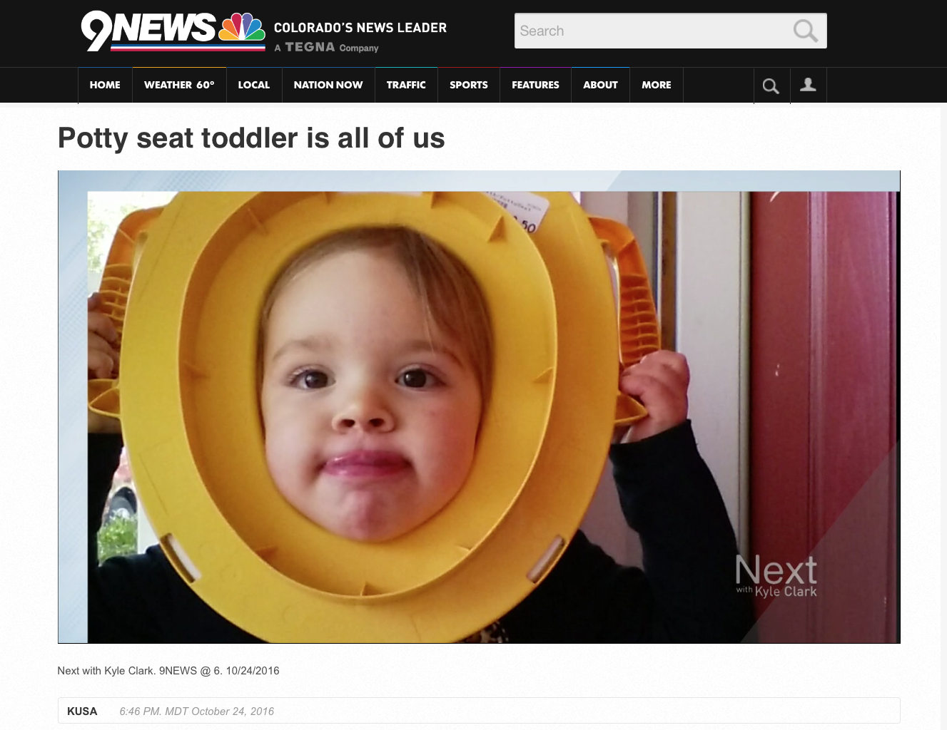
Notes:
Kids have helped capture how we’ve felt during recent election cycles
2016: Ivy Hanel
2018: Charlie Hanel

Slide 5
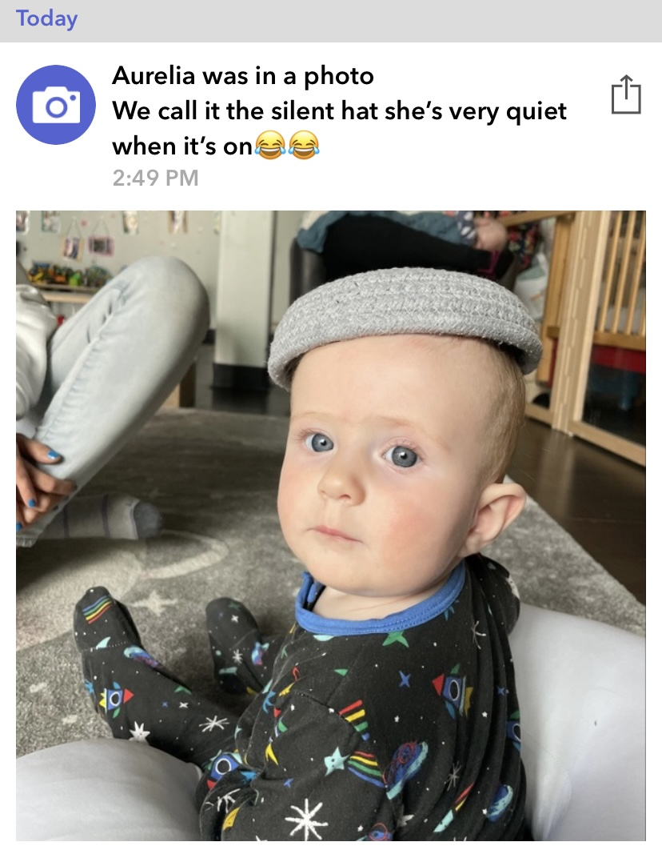
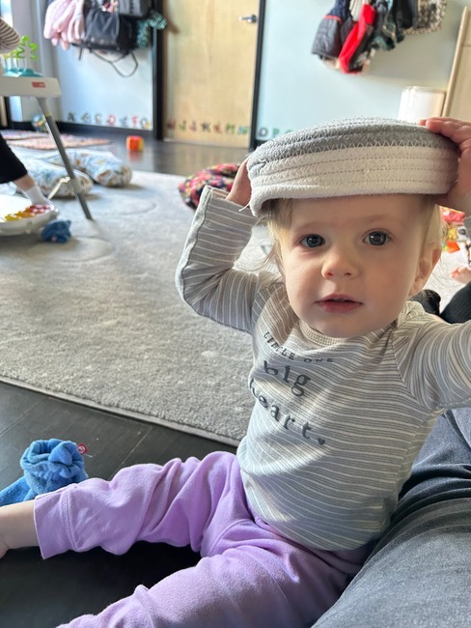
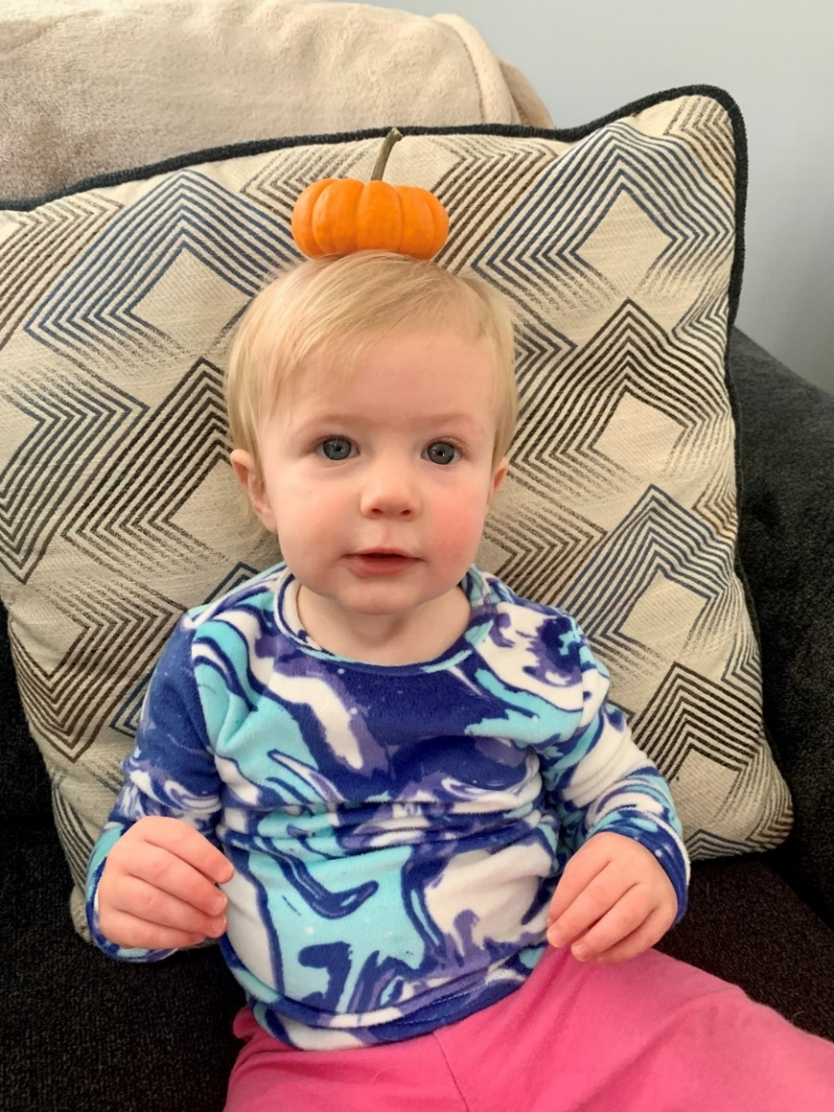
Notes:
Daycare illnesses; audience engagement
But- we’re grateful, we get cute photos
Small woven basket as silent hat
Has grown but still works
Unexpected, change it up

Slide 6
Notes:
There are other things in life for which I wish I had a Silent Hat. And this fall, one of them was campaign commercials.
Not as competitive as predicted but didn’t lessen number of ads
Moment of desperation, put pumpkin on the TV, then recorded ads

Slide 7
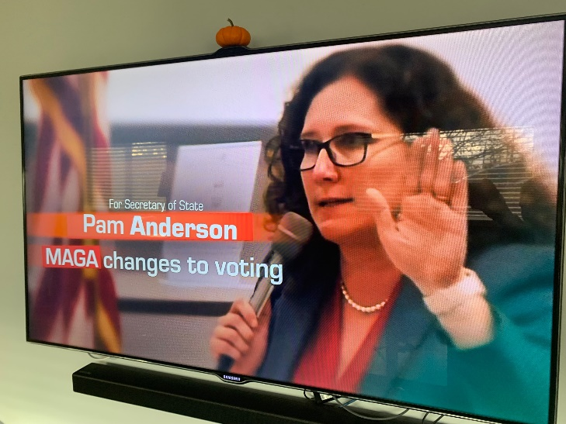
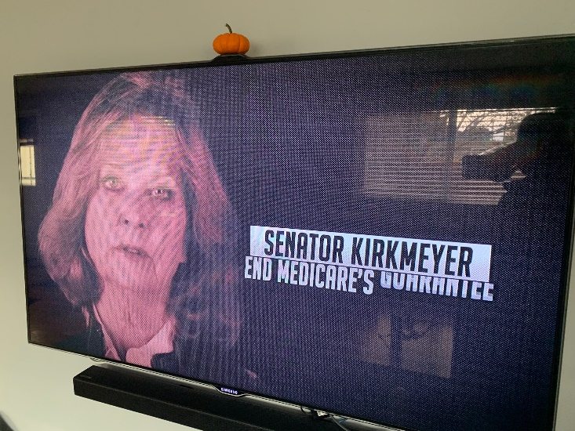
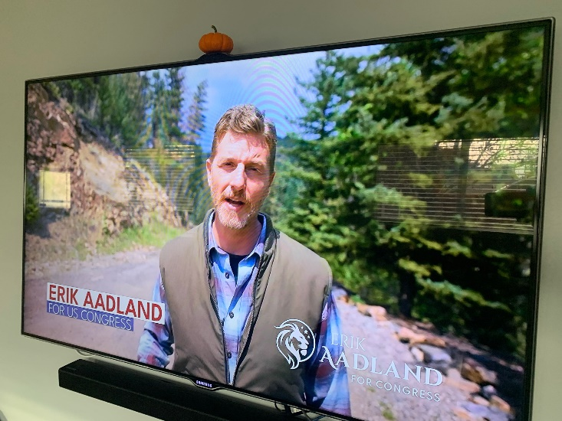
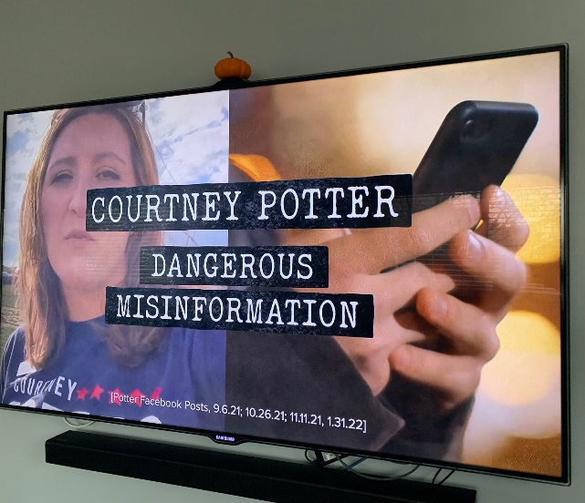
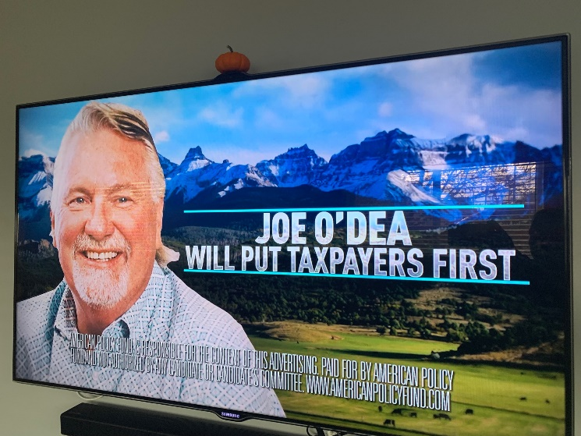
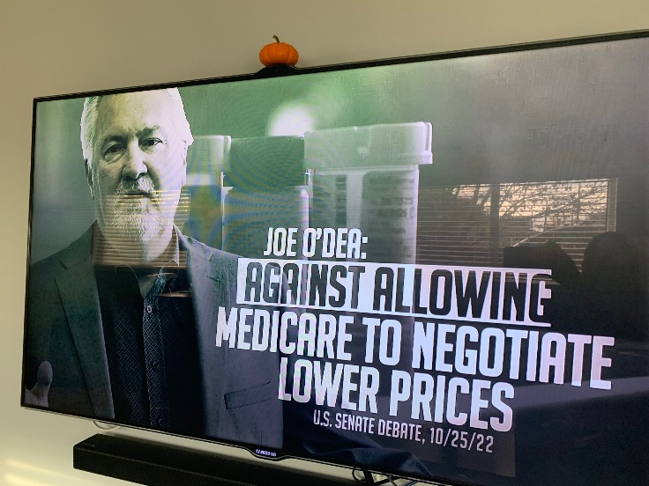
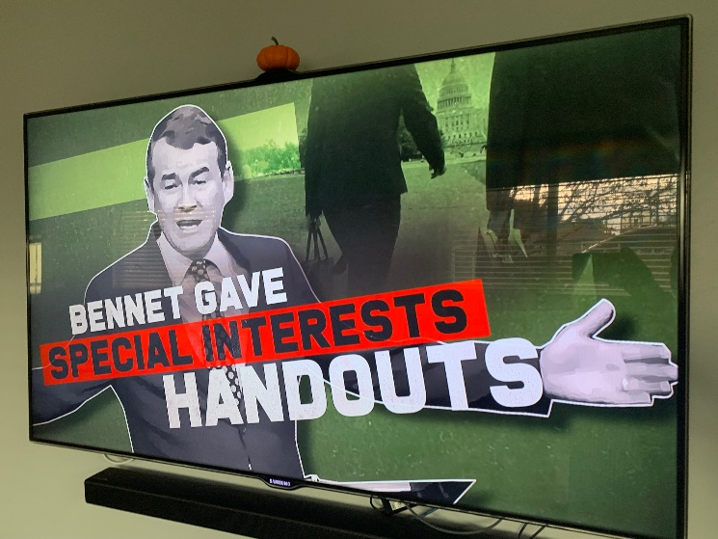
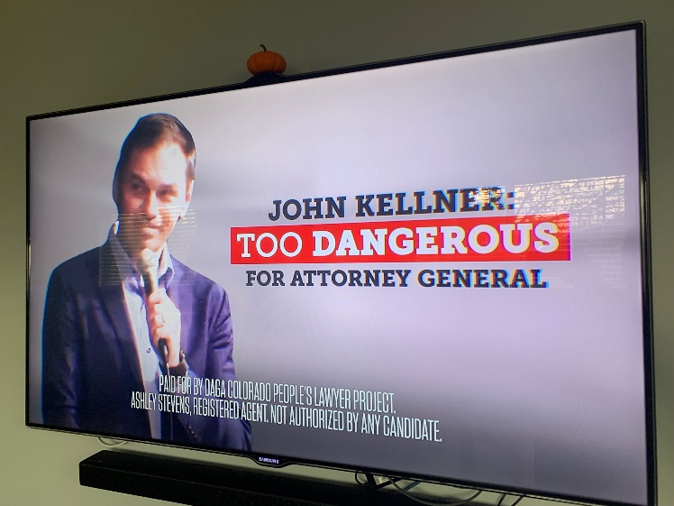
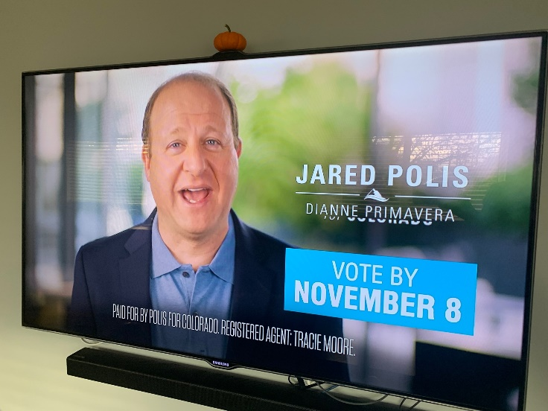
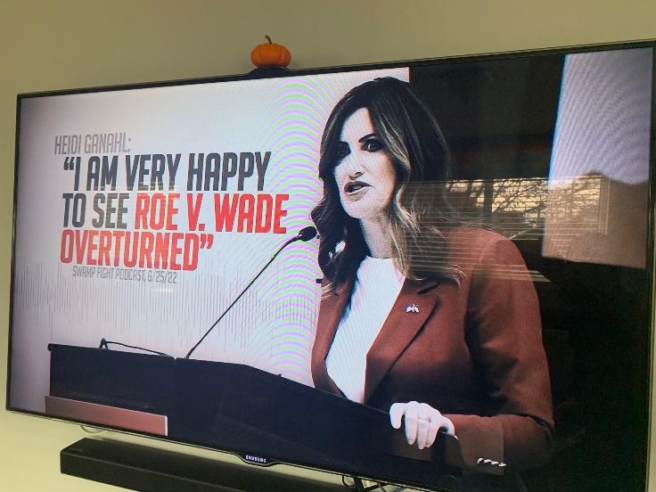
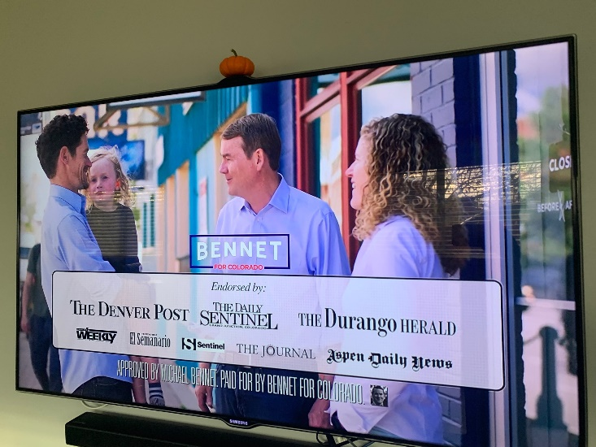
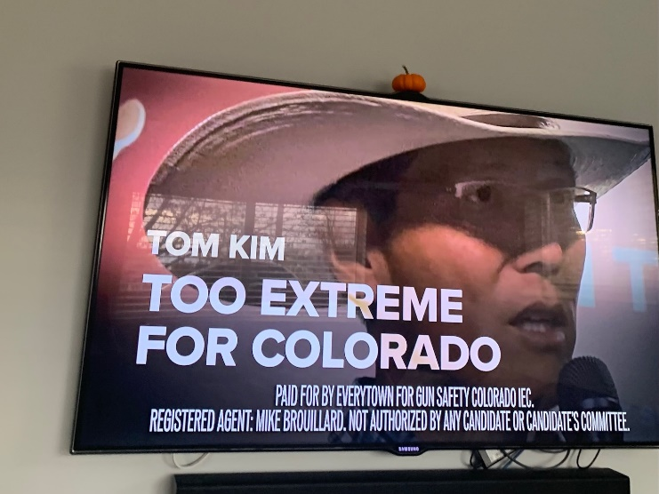
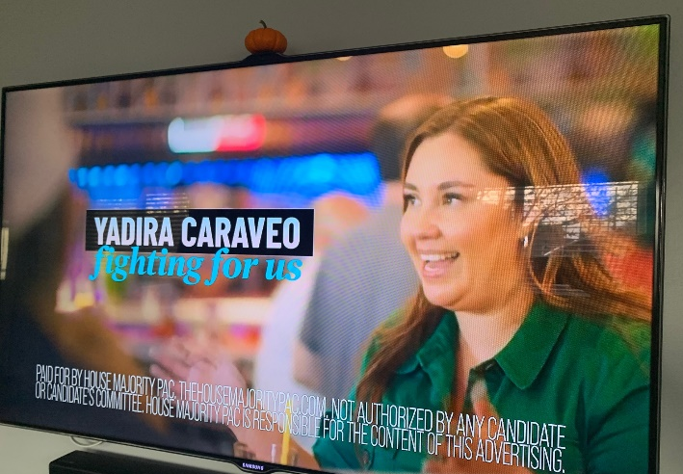
Notes:
Here’s how it worked … It didn’t.
Didn’t even capture ballot measure commercials
No matter leaning, relieved to get a break
Voter turnout lower than last midterms
ASK: For raffle ticket, how much?
2022: 2/3 active voters. 2018: 3/4 active voters
Can’t attribute to fatigue; probably decreased engagement
Even with excellent practices, strong turnout, we can improve
Don’t let yourself tune out!

Slide 8
The 2022 Election
Notes:
One month out

Slide 9
Election Takeaways
Colorado voters are increasingly progressive.
Colorado Republicans have no clear path to rebuild.
The policy debate will become internal to the Democratic Party — center vs left.
Notes:
Progressive electorate – outcomes we haven’t seen before
Conservative party in a world of hurt
Terms of debate shift to center-left vs left-left

Slide 10
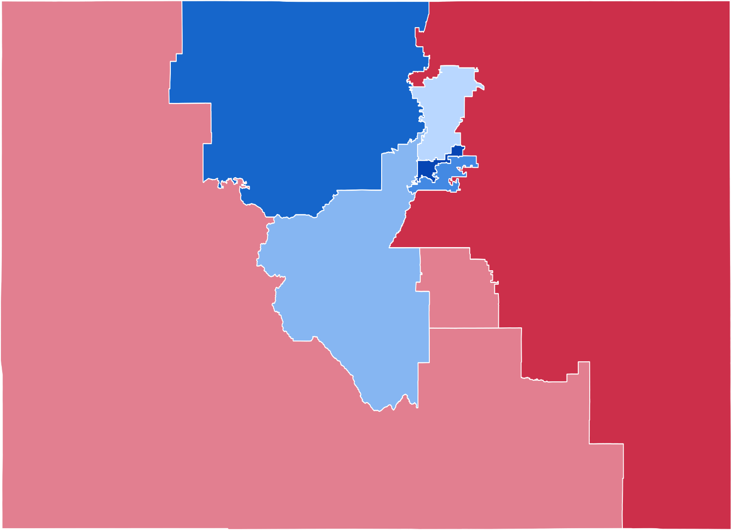
Election Results
8th Congressional District
https://en.wikipedia.org/wiki/2022_United_States_House_of_Representatives_elections_in_Colorado#/media/File:2022_Colorado_United_States_House_of_Representatives_election_by_Congressional_District.svg
Notes:
One month out from the election.
Start with federal.
Congress split. No real hope of major action next 2 years.
Big story is Rep-elect Caraveo. 1% over Kirkmeyer.
New district
Physician
1st Latina
She and Pettersen are only 6th and 7th women
Q: who was the first?

Slide 11
Election Results
59%-39%
56%-42%
Notes:
As for the other top offices, it was a Democratic cakewalk.
Won all statewide contests by 10% or more.
Polis, won by 19. Bennet: 14. easiest election of his career.
Treasurer, SOS, AG all re-elected

Slide 12
Election Results: Ballot Measures
Notes:
11 ballot issues. progressive
school meals. First time CO voters have approved a tax that wasn’t on tobacco or marijuana.
Psilocybin mushrooms. Second state to do so (Oregon).
$300m for affordable housing. NCSL: only affordable housing measure
tax cut: conservatives’ lone victory

Slide 13
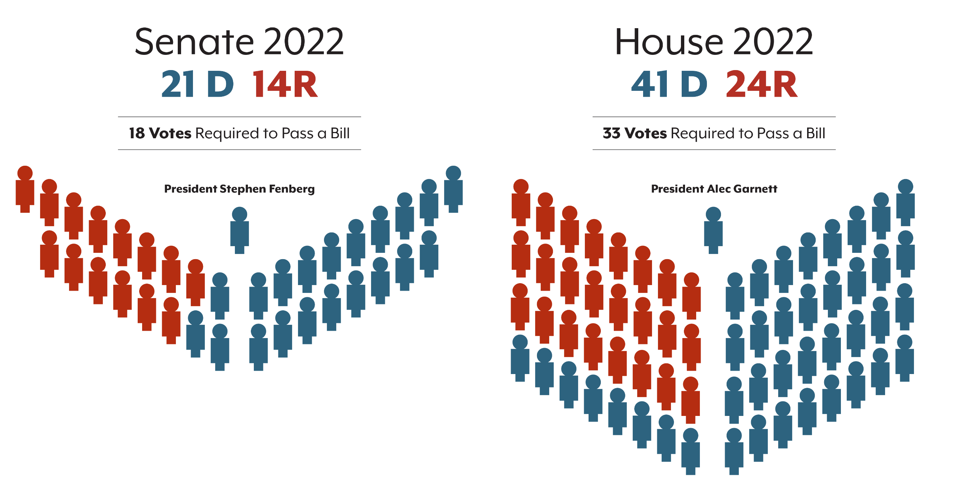
2022 General Assembly
Notes:
down the ballot to … what we’re talking about this afternoon.
Here’s where the state legislature stood last session.
Ds commanding lead in the House, 3-2 majority in the Senate.
Republicans thought their best chance to regain a foothold on power was to win back the state Senate.
They had to flip just four seats. So what happened?

Slide 14
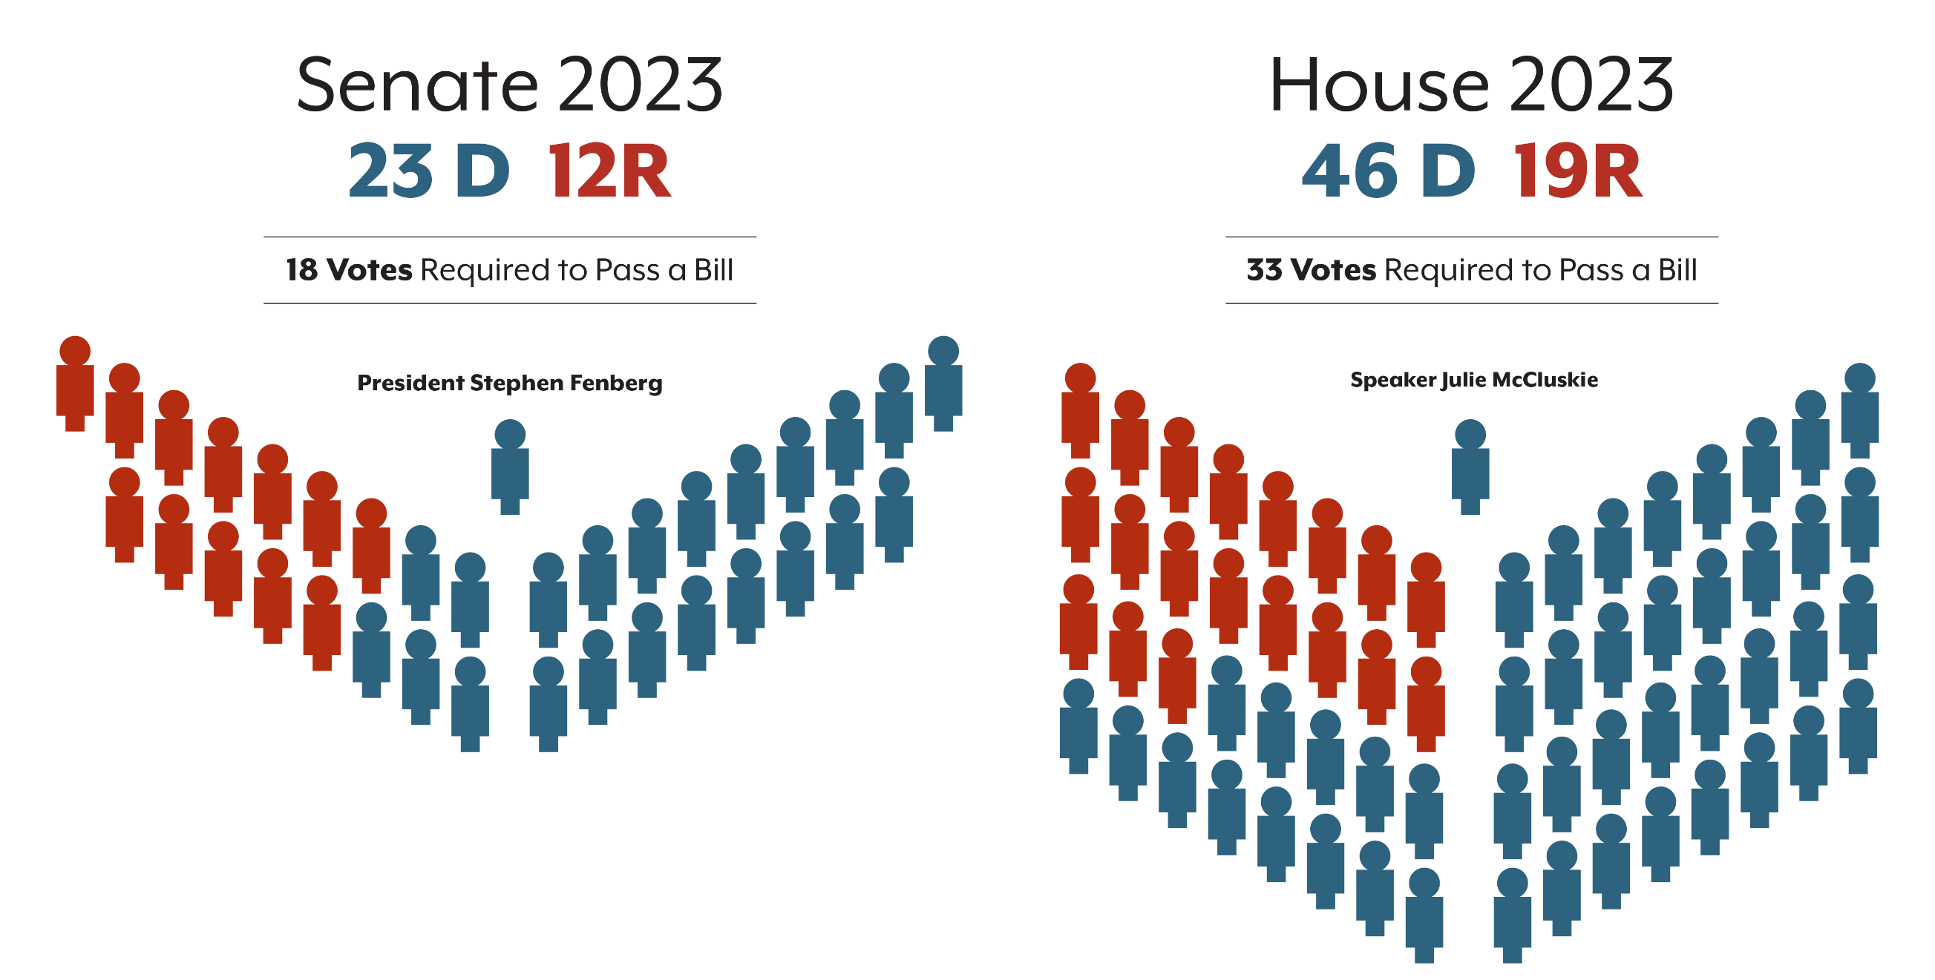
2023 General Assembly
Notes:
lost another 2 in the Senate. 5 in the House.
70% supermajority in the House. It’s the widest D margin in state history.
For the Colorado Republican Party, it was simply brutal.

Slide 15
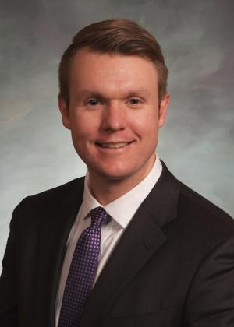
Republicans Have No Clear Path
“Honestly, I think Colorado Republicans need to take this and learn the lesson that the party is dead. This was an extinction-level event. This was the asteroid that ended the reign of the dinosaur, and in this case, the dinosaur was the Republican party.”
Quoted by Colorado Public Radio
Rep. Colin Larson (R)
Notes:
Rep. Colin Larson, … probably would have been House Minority Leader
extinction-level event,
Doesn’t mean Republicans cease to exist. Means not a viable statewide political force.
We have a pretty good idea what this means for policy the next few years…

Slide 16
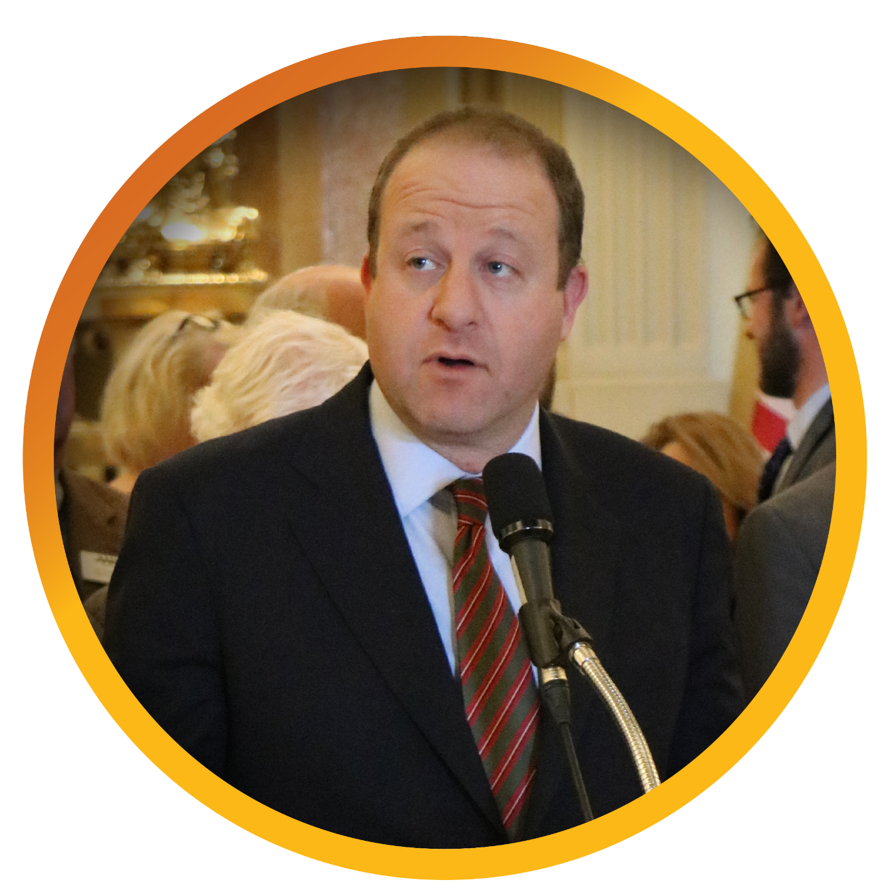
Election’s Impact on Policy
Notes:
center of gravity entirely inside the Democratic Party.
You’ll still see Republican legislators engaging
But direction is up to Dems
Polis mandate. Cut costs (Refer to Polis remarks from morning.)
Second impact: Progressive voices strengthened. Two sides are center-left and left-left. Single-payer, TABOR

Slide 17
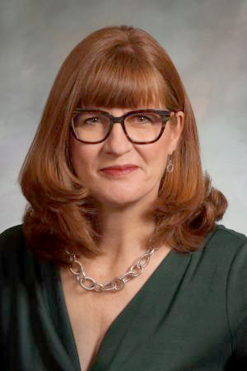
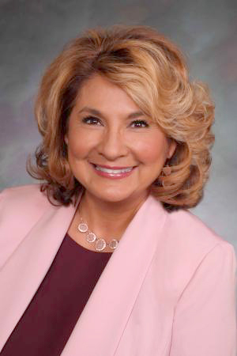
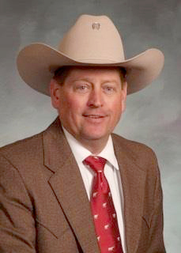
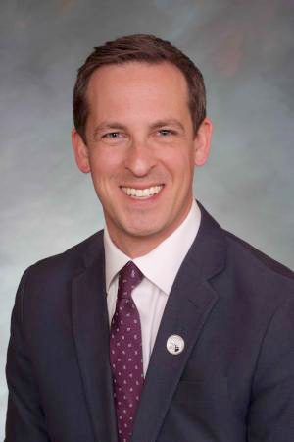
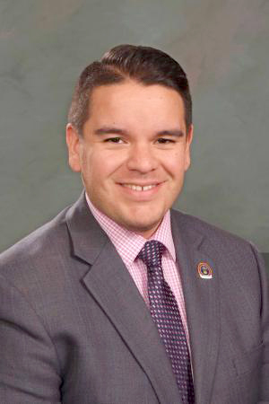
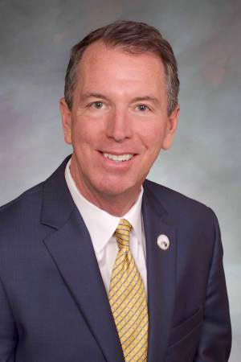
Leadership
Speaker of the House
Julie McCluskie
House Majority Leader
Monica Duran
House Minority Leader
Mike Lynch
Senate President
Steve Fenberg
Senate Majority Leader
Dominick Moreno
Senate Minority Leader
Paul Lundeen
Notes:
House leadership elections. McCluskie, ran as a moderate .. rural district … no landslide, … knows how to appeal to moderate and rural voters.
Mike Lynch, … Rep. Hugh McKean, who was himself a moderate and butted heads with the right of his caucus.

Slide 18
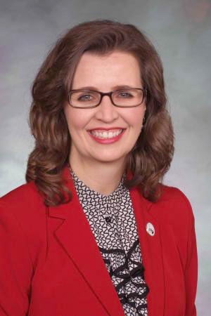
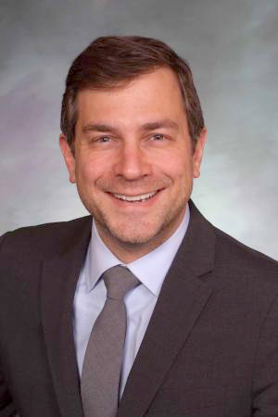
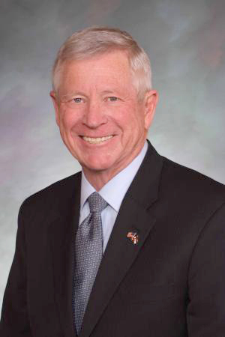
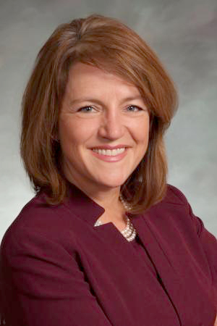
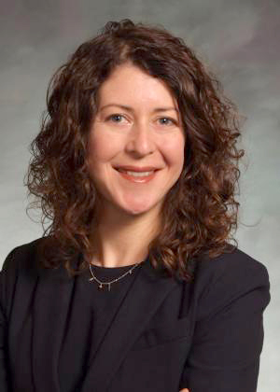
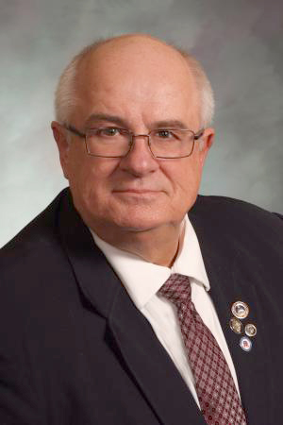
Joint Budget Committee
Sen. Rachel Zenzinger
Chair (D)
Sen. Jeff Bridges (D)
Sen. Bob Rankin (R)
Rep. Shannon Bird (D)
Rep. Emily Sirota (D)
Rep. Rod Bockenfeld (R)
Notes:
The Joint Budget Committee will see lots of changes. arguably the most demanding and important job … approve the state budget, line by line.
The only returning member is Zenzinger, the chair.
Rankin. Most experienced member … resign in January, Senate GOP selects new member. Big shoes to fill.

Slide 19
Budget Outlook, Implementation Needs
Notes:
Work of JBC/many of you depends on this
Multitude of new programs, offices
Need to be factored in

Slide 20
Budget Takeaways
There’s a lot of federal money!
But much of it is already committed
Look for less focus on new programs, more on solidifying previous ideas
Notes:
What are takeaways?
A lot of federal money has been made available to Colorado, others
“historic,” “transformational,” “once in a generation”
Even if much hasn’t been spent, great deal has been committed
Dollars can go for next 4 years
But pool of unclaimed money has shrunk substantially
By necessity, should be less focus on new programs, huge fiscal notes; more on how to build on and sustain

Slide 21
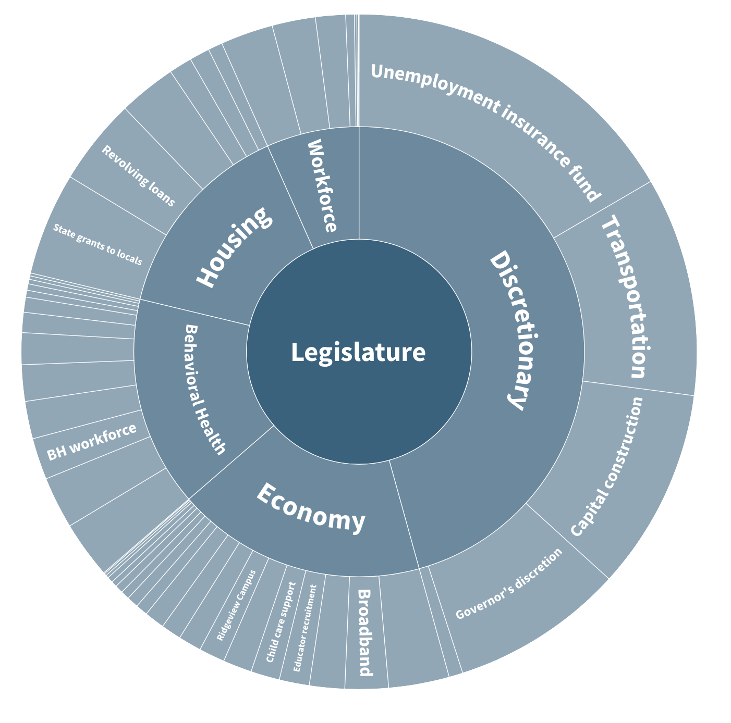
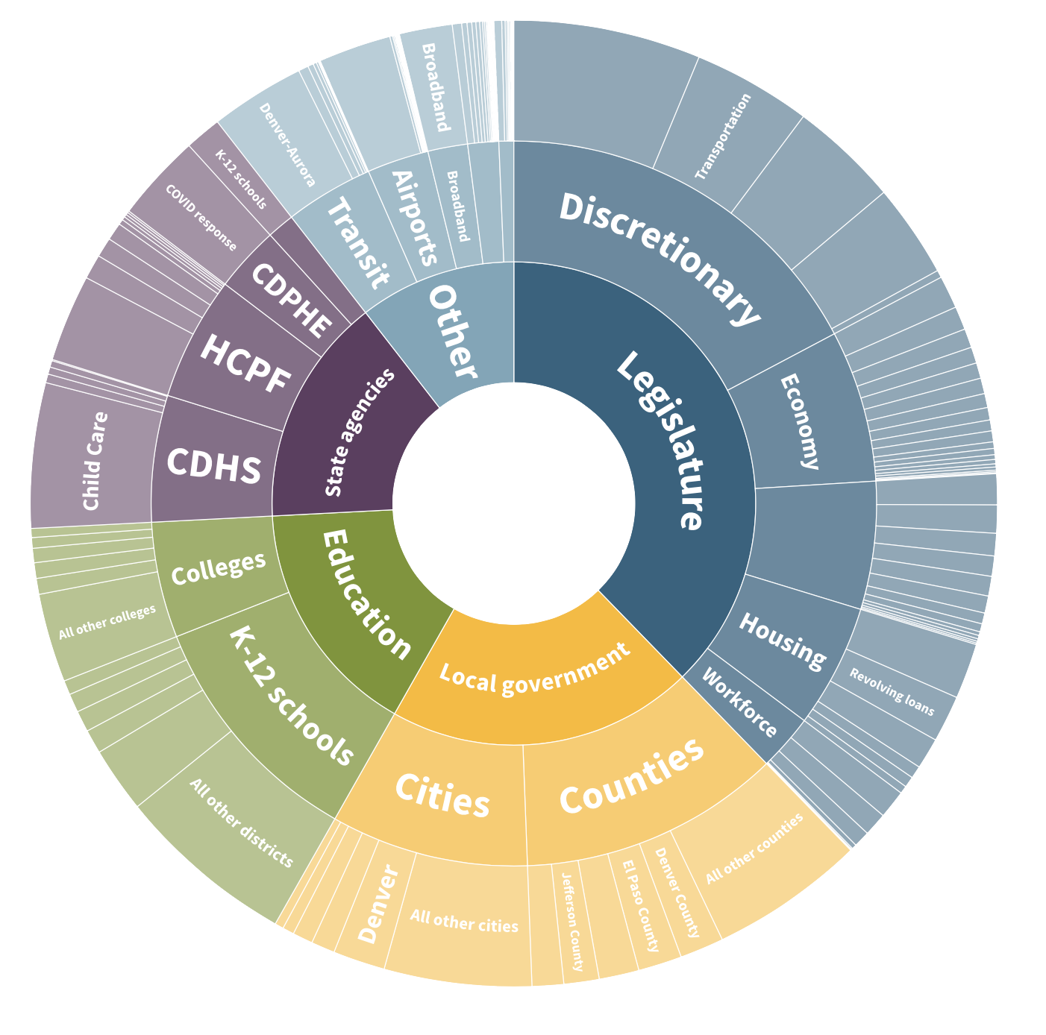
Implementing ARPA
More than $9 billion to Colorado public agencies
$3.8 billion appropriated by legislature
colo.health/ CO-ARPA22
Notes:
Don’t want to downplay
Most has come through ARPA, but some – including more funds to come – is from infrastructure bill and inflation reduction act
Largest federal investment in the states since the New Deal
CHI traced more than $9 billion in funding
[ASK: Who’s gone online to use this tool? Who had no idea it existed?]
Probably heard about most almost $4 billion under the legislature’s control
Workgroups focused on behavioral health, housing, and economic recovery
Might be a few tens of millions left to spend in 2023.
Short link
Most of the decisions are out of the legislature’s hands and with state agencies; grants, RFPs
Remember this money is time-limited
Big. Really important. Didn’t solve all of our problems.

Slide 22
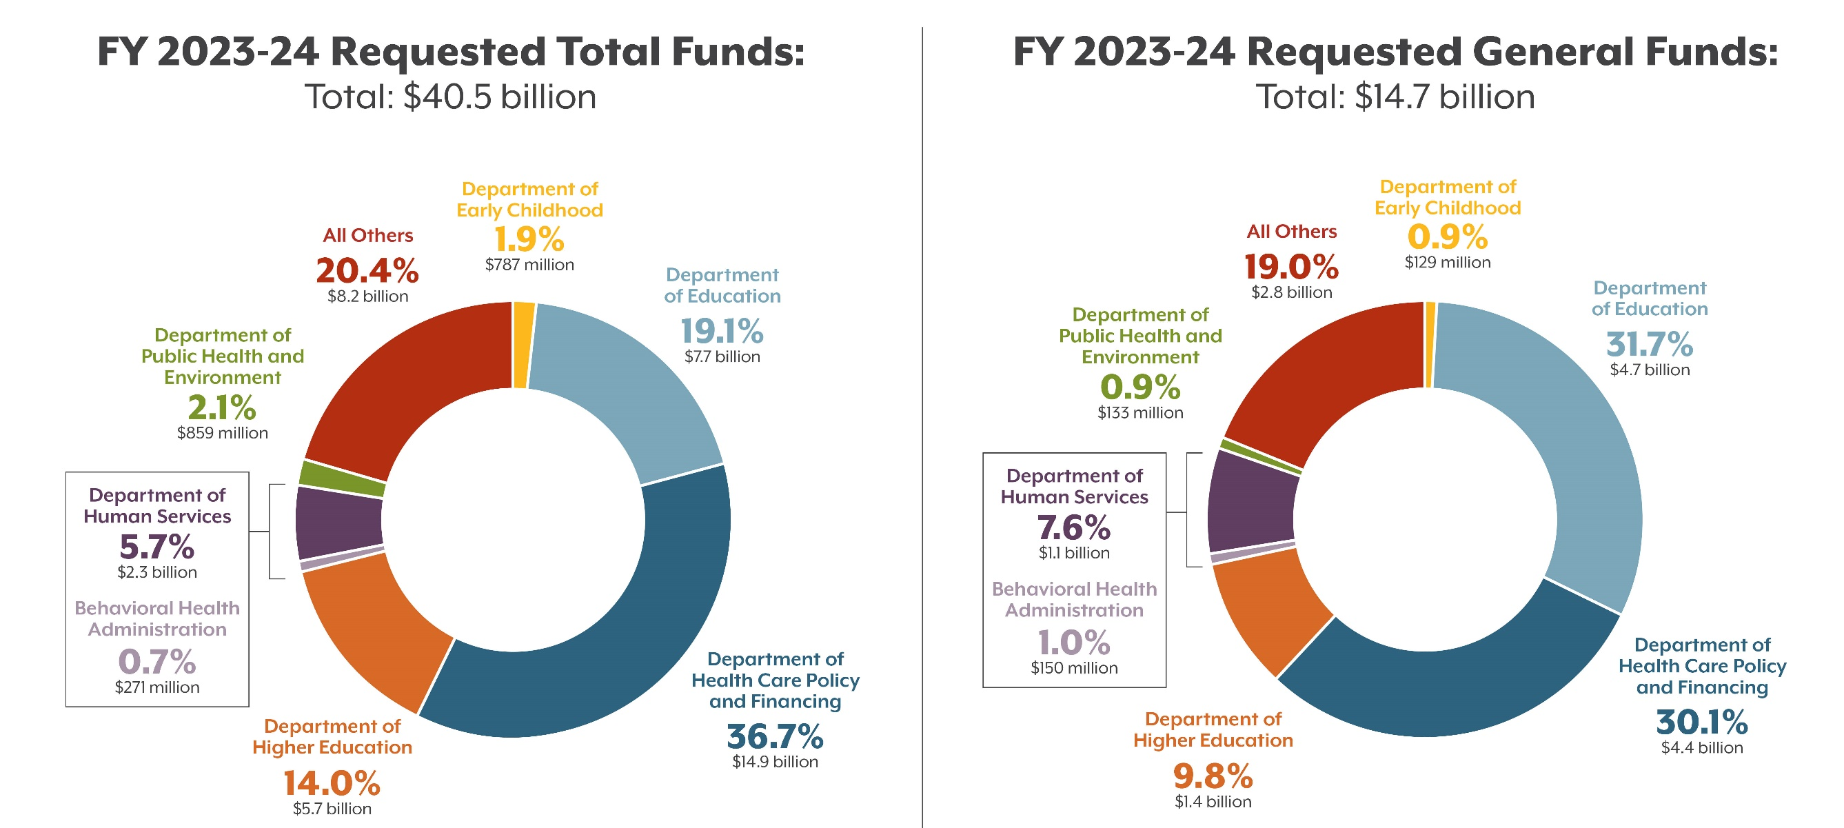
The State Budget
Source: Governor’s Budget Request Released Nov. 1, 2022
Notes:
Based on governor’s budget request. [ORIENT]
Largest single departments are HCPF and K-12 Education.
For HCPF, reflects coverage (and an enhanced federal match) for a larger population under PHE
BHA, DEC

Slide 23
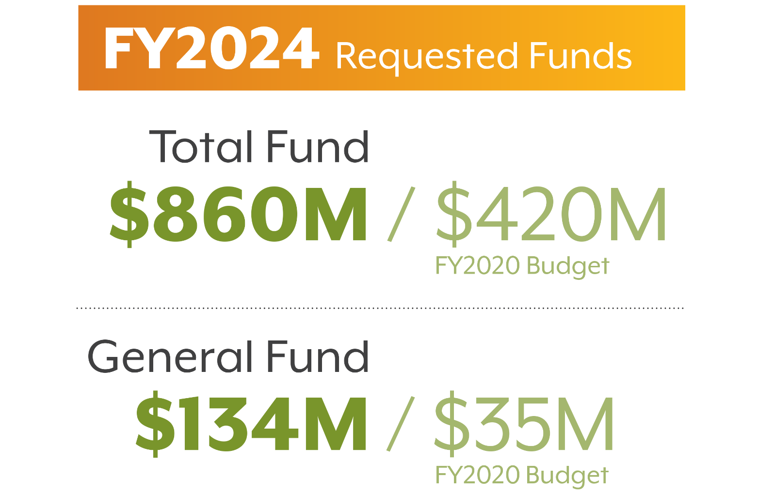
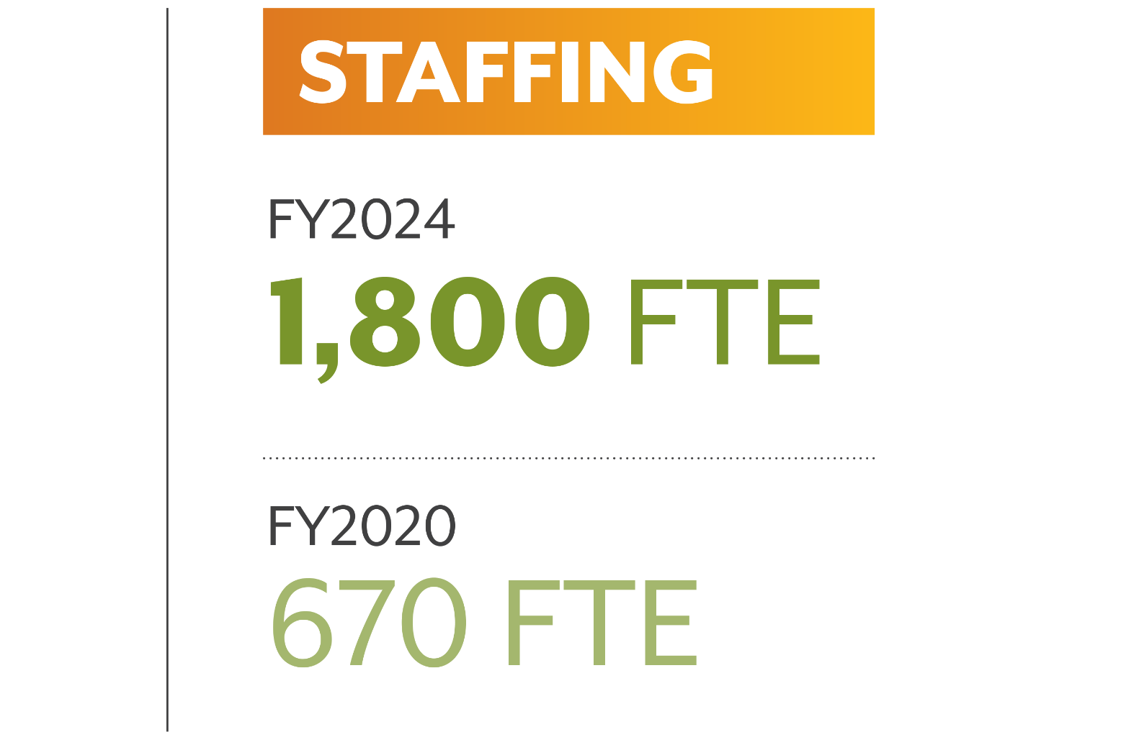
Notes:
CDPHE - requested budget for FY2024 is $860 million TF and $134 million GF
In FY2020, CDPHE’s budget was about $420 million TF – less than half – and $35 million GF – just about 1/4 of.
Staffing has nearly tripled from 670 FTE then to more than 1,800 now.

Slide 24
Revenue Forecast
“This forecast anticipates continued, yet slowing, expansion, but the path forward has narrowed. With a worsening economic outlook around the world, the possibility of a national downturn looms.”
Legislative Council Staff, September 2022 Economic & Revenue Forecast
Last report in September, next on December 20th
Revenue grew 23.7% from FY21 to FY22
Exceeded TABOR cap by $3.7 billion
Notes:
Zoom out-
Colorado presents revenue forecasts quarterly, next on 12/20
Learned state revenue grew by nearly 24% over the prior year
Thanks to income tax and other collections, ended up more than $3.7 billion over TABOR cap
Consumer spending is strong and so is job growth, but inflationary pressures are growing too
GF revenue to be slightly higher, but not keep pace with inflation
Will contend with “continued yet slowing economic expansion” and looming threat of national downturn

Slide 25
Why Money Is Tighter
Notes:
To pull a few things together, make sure we’re on the same page-
Cooling economy
TABOR and the revenue cap it imposes
Recently passed ballot measures will add to pressure
Voters chose to lower state income tax rate. 0.15% sounds small - more than $400 million cut
Also approved that commitment for affordable housing
In less prosperous years, changes will limit the pool
ARPA dollars have already been directed
Legislative Council staff told members of the JBC that they won’t actually have much left
Just $85 million to work with, who knows how much will be spoken for over next 3-4 months
https://coloradosun.com/2022/09/22/colorado-economic-forecast-september-2022/

Slide 26
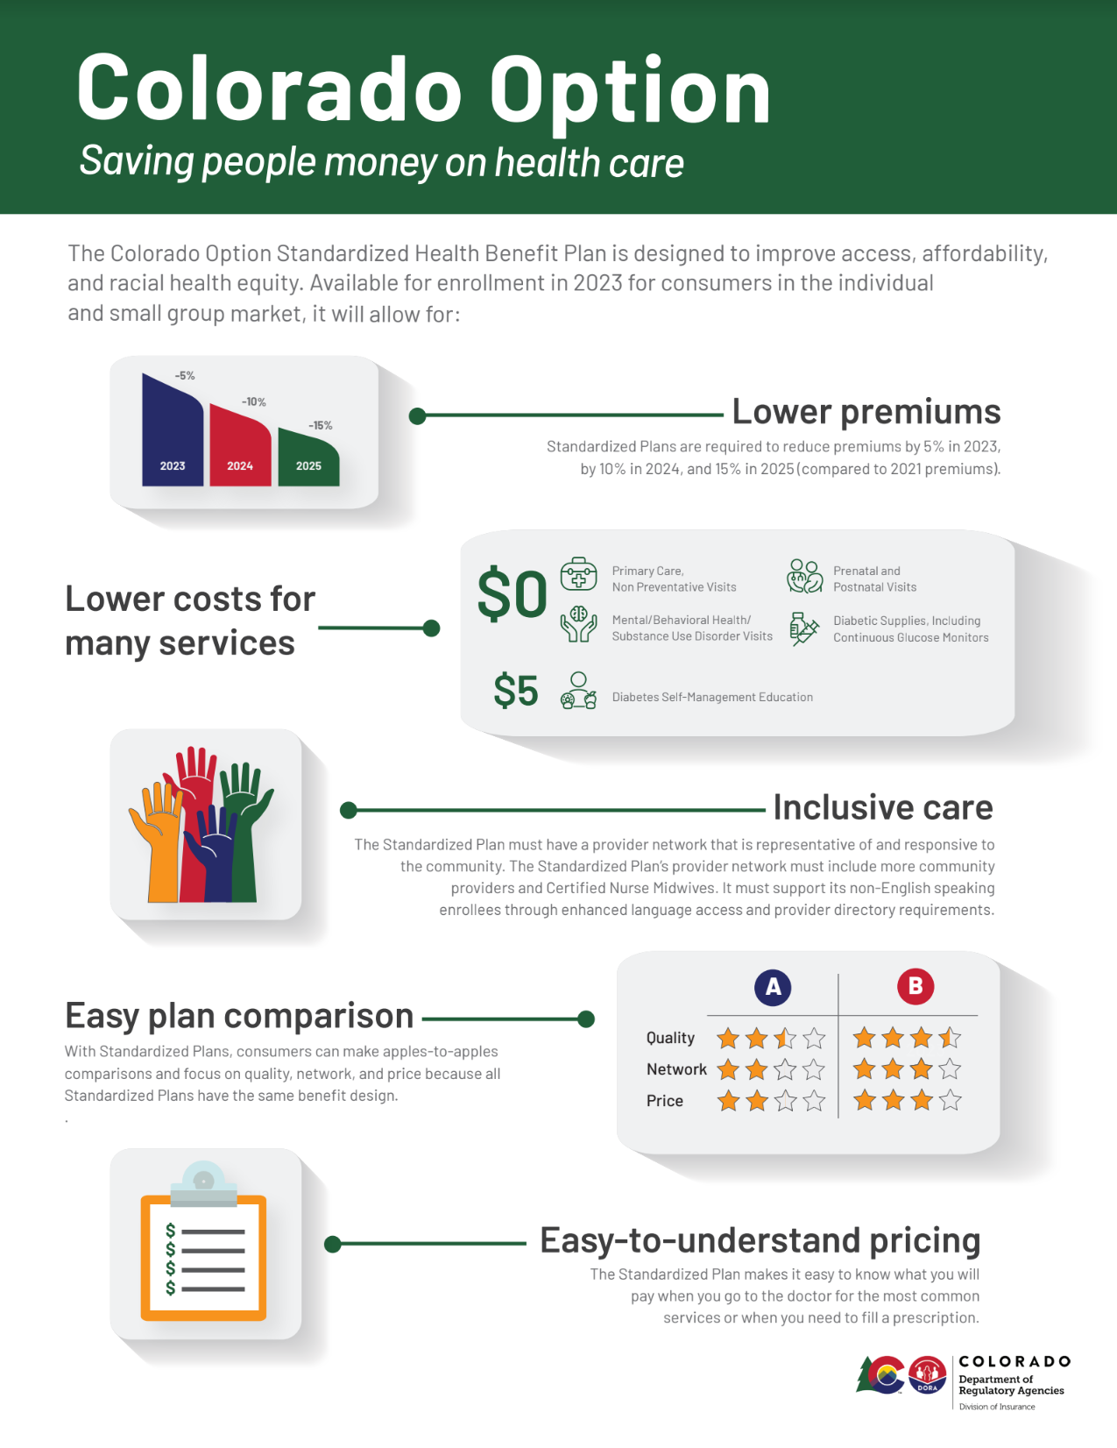
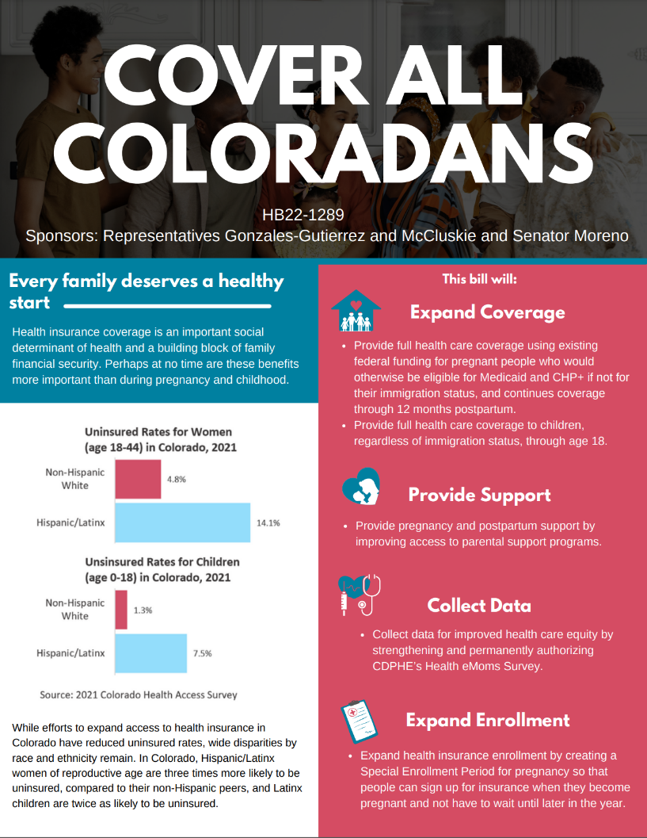
Recent Commitments
Notes:
Recent programs and implementation needs:
Colorado Option, created 2021 session, coverage begins on January 1
What will uptake be like? Will required cost reduction targets for insurers, which gradually increase, be met? Will consumers see meaningful improvements in access to coverage?
Another is Cover All Coloradans effort, put forth last session. 2025: HCPF will offer Medicaid coverage for low-income children and pregnant people
Estimates will benefit about 3,500 individuals. Will that estimate hold? How might this interact with other new efforts? Where are remaining gaps for these families?
Leaned in to advancing health equity through recent legislation and executive order. New DEI training requirements, department-specific equity strategic plans. HCPF’s plan is more than 80 pages long.
What will come from these strategic planning efforts, and how will we measure success in addressing health inequities in Colorado?

Slide 27
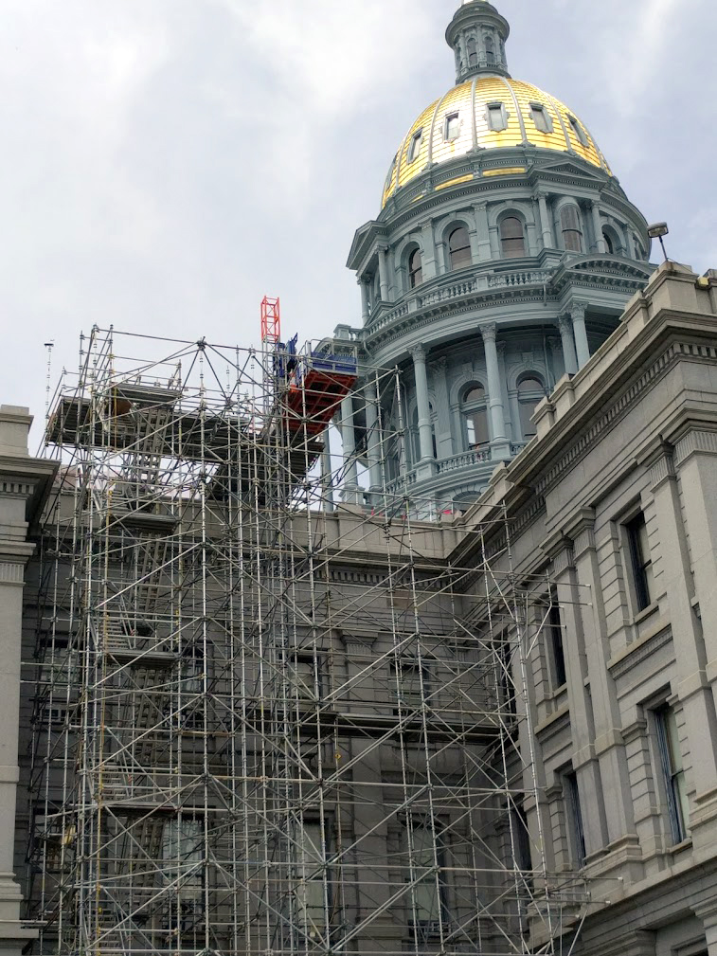
Remaking State Government
Streamlining services, avoiding duplication
Rapid system transformation
Supporting providers
Ensuring capacity for families
Notes:
Recently created or elevated
BHA is a cabinet-level office charged with being the single entity driving behavioral
Thrilled to have Commissioner Medlock; ASK: Anyone else w/ BHA?
Streamlining services and thereby avoiding duplication; begin work in the midst of rapid transformation
Some providers and policy groups are feeling whiplash
Open positions
OEC – DEC, meant to unify early childhood system and oversee Universal Preschool Program, set to launch next fall
[ASK: Anyone w/ DEC?]
So many challenges. Pandemic forced many providers to close, exacerbated shortage of affordable, high-quality child care slots
May lament constant illnesses, but access to child care is crucially important
Other notable: Office of Climate Preparedness within Gov’s Office. Karam and panelists spoke about Marshall Fire as catalyst for action … don’t have a choice but to respond.

Slide 28
Ending the Public Health Emergency
Ending the Public Health Emergency
Notes:
Could talk about a lot of other program and budgetary considerations
Upcoming end of the PHE; has been extended every 90 days but its future is uncertain, requires planning now
How Medicaid enrollment has changed as people have been added but no one has been disenrolled. Growth of about half a million people. MK covers 1 in 4.
Qs around how many people will shift off; estimates around 300,000 Coloradans, many of them children.
Large portion should qualify for financial assistance, but what impact on uninsured rate?
How will our existing systems and staff, at state and county levels, handle eligibility redeterminations?
Big lift. Many have moved or lost housing, adding to challenge – Update Your Address campaign
Need to make sure adequate resources to support Medicaid members, and staff/systems.
Could start happening before end of session.
[ASK: Who’s actively thinking about, working on our response to end of PHE? Thanks, we’re with you.]
Now will turn our focus to session in more detail.

Slide 29
2023 Policies to Watch
Notes:
Hearing a lot of ideas percolating. More questions at this point

Slide 30
Policy Questions for 2023
Forests or trees? Colorado’s problems are interconnected
Consolidate or double down? Progressives see a window of opportunity
Notes:
First, so many of the big issues facing Colorado right now are multidimensional.
Hard to create policy that keeps big picture in mind
Second, will this be a year to firm up policy changes from last few years, or go bigger

Slide 31
Notes:
behavioral health, policing, and housing. Two years ago, … removed felony penalties for possessing … illegal drugs. In 2022, after headlines … restored felony penalties for fentanyl. Compromise … no one happy, … revisit it this year.
But problem isn’t just fentanyl. SUD often wrapped up in crime, homelessness. Add unaffordable cost of housing,
→ calls to crack down
toughening the penalty? No. Loosening? No. $300 million for affordable housing? Good start,
housing alone won’t address BH issues.
The challenge is to see how it’s all tied together, and to find wise ways to blend resources and channel energy from people working in each domain

Slide 32
Policy Topics to Watch
Notes:
I’m not trying to say we need one massive bill ...
A lot of good policy happens at step at a time
Ideas we’ve heard that are in the works
eating disorders: associated with death by suicide.
improve early mental health intervention for youth, who have had their childhoods upended by this pandemic.
evictions becoming a problem again. Address by making legal process easier to engage in
Q to audience
Q: consolidate or 2x down

Slide 33
Notes:
another major challenge with overlapping elements — the health care system itself.
Health care is too expensive:
It’s disconnected and siloed.
And we can’t find enough workers … crack that nut
… drive down the cost, at least somewhat. …make referrals seamless ...
But you need … an actual human doing the job.
I’m talking not just about physicians and psychiatrists … but hands on-work:
nurses and CNAs, Home health workers, peer supporters, child care

Slide 34
Policy Topics to Watch
Notes:
We’re hearing a desire to do more to help the workforce in direct care and child care. Hospitals interested in workforce, too.
That includes increasing accountability for hospital community benefit spending — basically the work hospitals do to justify their nonprofit tax status.
Hospitals – take a pause.
Consolidate or 2x down

Slide 35
Session Takeaways
It’s up to Colorado No national solution is on the horizon for behavioral health and workforce challenges.
Money is tight, but … Federal support is still a factor.
Ideas are percolating Democrats enjoy more political capital today than ever. And they seem ready to spend it.
Notes:
Thank you for attending our preview session. Leave you with a few takeaways
It’s up to Colorado.
Money is getting tight in 2023, but lots of fed dollars still in system
Sara, Jeff, EJ talked about motivated partners. And we have them. … Dems have power to make big changes if they wish. How far they go is story of next few years in Colorado

Slide 36
Joe Hanel and Allie Morgan
HanelJ@coloradohealthinstitute.org
MorganA@coloradohealthinstitute.org
Notes:
After Q&A, hand off to Kristi for the bike drawing.

