Slide 1
Partners In Health
How Public Health and Health Care
Systems Are Working Together
to Solve Big Problems
Safety Net Advisory
Committee (SNAC) Lab
May 31, 2017

Slide 2
Objectives
Leverage our collective focus on vulnerable populations.
Provide a forum for opportunities and lessons learned.
Share the latest strategies for using data to measure effectiveness.
Synthesize input from the group and develop a shared body of knowledge.
2

Slide 3
What We Will Cover
Introduction
How Public Health and Health Care Can Solve Big Problems Dr. Bill Burman, Executive Director, Denver Public Health
Facilitated Discussion
3

Slide 4
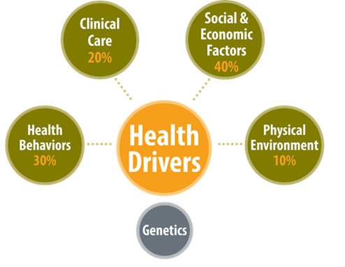
Most Health Happens Outside the Clinic
Source: Robert Wood Johnson Foundation’s County Health Rankings Model
4

Slide 5
The Health Care System
The Public Health System
Health Outcomes

Slide 6
Public Health and Health Care: How Big Systems Can Solve Big Problems
Dr. Bill Burman,
Executive Director, Denver Public Health
6

Slide 7
Triple AIM

Slide 8
Fantasy or Goal?
Nice-sounding fantasy or a realistic goal for health care transformation?

Slide 9
Where you sit defines what you see: my lens
My background
Clinical – HIV and TB care provider, hospital-based ID practice
Public Health – developing effective collaborations to address population health
Medical care administration – building bridges within an integrated care system and across an urban community
Denver Health
Hospital, emergency medical system, primary care and specialty clinics
School-based clinics, medical care in the county jail, public health

Slide 10
Key messages
Triple Aim is achievable, but tinkering with the current system won’t do it
Transformational changes required
Universal coverage
Change the payment model
Take a broader view of health
Appropriately fund and don’t medicalize social services
Give prevention more than lip service
Take addictions seriously

Slide 11
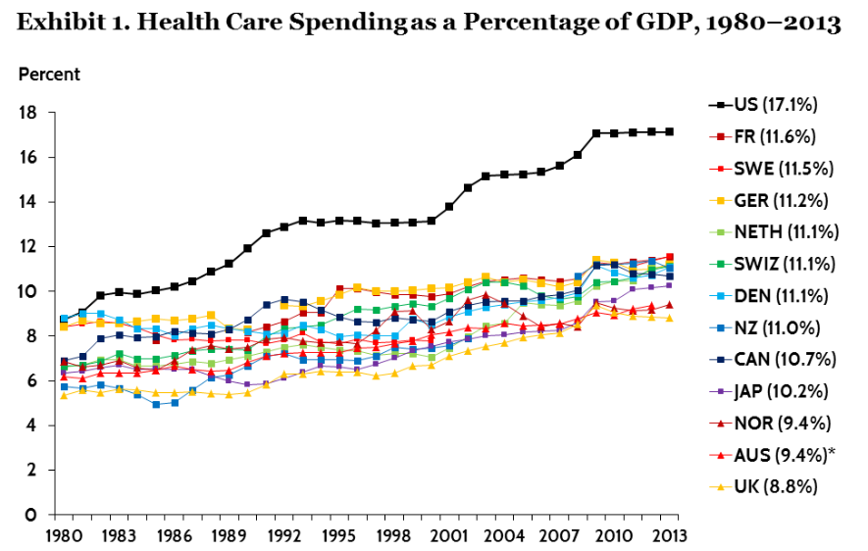
Health Care Spending as a Percentage of GDP, 1980-2013
http://www.commonwealthfund.org/publications/issue-briefs/2015/
oct/us-health-care-from-a-global-perspective

Slide 12
http://www.commonwealthfund.org/publications/fund-reports/2014/jun/mirror-mirror

Slide 13
Comparisons to Australia, Canada, and Germany (years of life lost)
http://www.healthdata.org/results/country-profiles

Slide 14
Comparisons to Australia, Canada, and Germany (years of life lost)

Slide 15
Comparisons to Australia, Canada, and Germany (years of life lost)

Slide 16
Evidence that the Triple Aim is achievable
Results from other market economies – better health, more satisfied patients, much lower costs
Australia – multiple payers, multiple providers
Canada – single payer, multiple providers
Germany – multiple payers, multiple providers
Within the US – inverse correlation between costs and quality in Medicare

Slide 17
Current interventions are unlikely to support the achievement of the Triple Aim
ACA expansion of health insurance – benefits seen in MA (financial security, better medical outcomes, improved survival), but no evidence of cost reductions
Alternative payment mechanisms (ACOs, bundled payments, etc.) – modest improvements in costs and outcomes, not clear that these are generalizable
Expansion of managed care – promising results within individual systems, but not clear if generalizable
High deductible health plans (with health savings accounts) – decrease utilization, but unlikely to result in better health and more satisfied patients

Slide 18
How could the U.S. achieve the Triple Aim?
Transformational changes required
Universal coverage
Change the payment model
Broader view of health
Appropriately fund and don’t medicalize social services
Give prevention more than lip service
Take addictions seriously

Slide 19
Universal health coverage – Why might it be associated with a decrease in costs?
Decrease in administrative costs of health care
Decrease in overall costs of care by minimizing expensive, delayed care for chronic conditions (deferred medical care is not avoided care)
Enable true cost-transparency – lack of universal access requires cost-shifting and hinders cost transparency

Slide 20
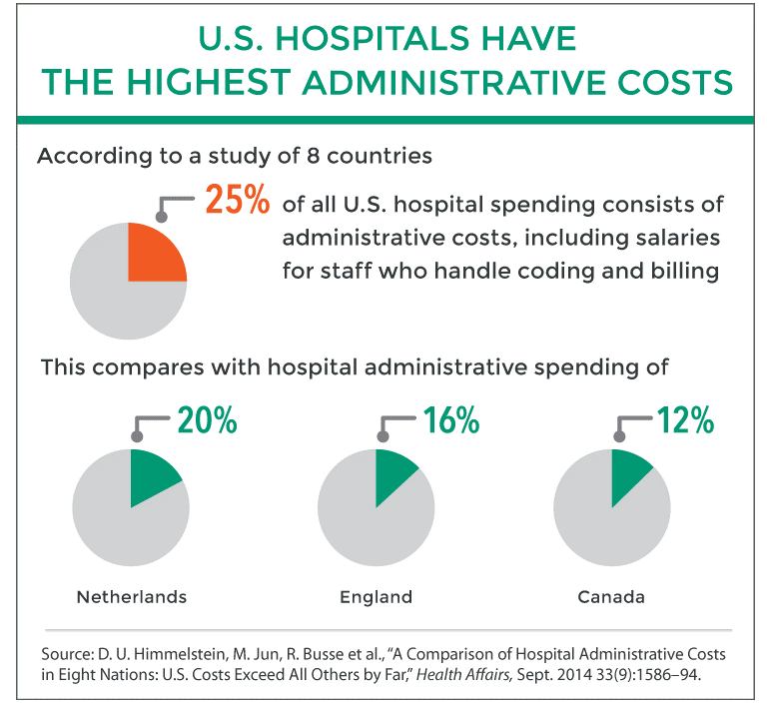

Slide 21
$288 billion – projected annual savings if U.S. medical administration costs were comparable to the average of the Netherlands, England, and Canada

Slide 23
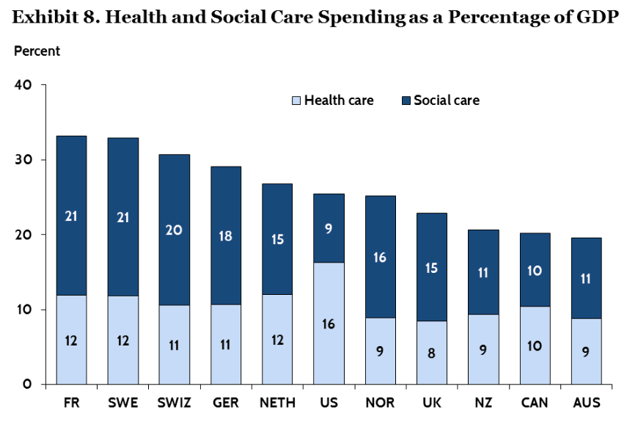
Relationship between spending on medical care and social services

Slide 24
How can medical care systems better manage social and economic barriers to health?
Routine screening for barriers (e.g., housing, food insecurity, legal issues affecting health)
Limited provision of key forms of support
Partnerships to manage social and economic barriers
Close working relationships
Standard referral processes
Tracking of referrals
Advocate for adequate funding for social service partners

Slide 25
What risk factors drive premature death and disability in the US?
http://www.healthdata.org/results/country-profiles

Slide 26
Childhood obesity
Serious problem
Associated with childhood type 2 diabetes and asthma
Predictive of chronic diseases among adults (e.g., heart disease, cancer, osteoarthritis): premature death, considerable morbidity, and expensive medical care
Unless we move the needle, forecast for our community is shorter lives and higher health care costs
Difficult to treat: very few individual-level interventions (besides surgery) that lead to sustainable improvements
Prevention is the key to controlling obesity and its consequences

Slide 27
Obesity: Increase in obesity among U.S. children, 1971-2008
Denver = 16.5%

Slide 28
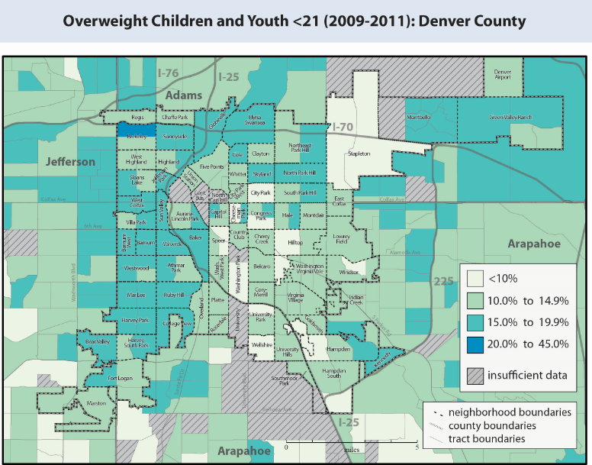
http://denverpublichealth.org/home/health-information-and-reports/data-and-informatics-tools/colorado-health-observation-regional-data-service-chords

Slide 29
Obesity in Denver children, aged 2-5 years, by race/ethnicity

Slide 30
Changes in the incidence of Type 2 diabetes in youth in the U.S., by race/ethnicity
Mayer-Davis EJ. N Engl J Med 2017; 376: 1419-29

Slide 31
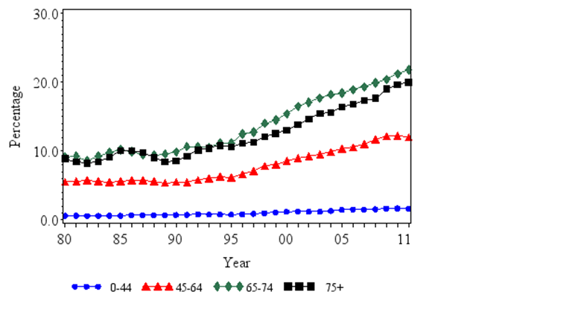
Percentage of U.S. adults with diabetes (1980 – 2011)
An increase of 10 million more diabetics in the U.S. over the past decade
http://www.cdc.gov/diabetes/statistics/prev/national/figbyage.htm

Slide 32
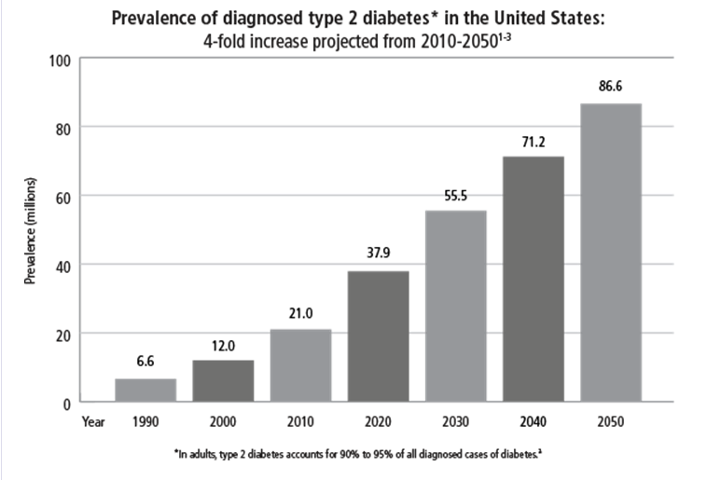
Projected prevalence (millions) of type 2 diabetes in the U.S. (1990-2050)
http://63.131.129.123/guidelines/projected-prevalence-type-2-diabetes

Slide 33
What role does medical care have in childhood obesity?
Recognition and providing data for monitoring - through electronic medical records
Dietary and exercise counseling, referral to community resources - standard work done with high quality for all persons in need
Advocacy for community-level interventions (e.g., sugary beverages tax) - policymakers listen to doctors (especially if advocating for something other than their pay check)
Possibility of sustainable funding for prevention - in a capitated payment environment, it may make sense for a medical care provider to fund some community-level interventions

Slide 34
General framework for involving medical care in prevention
Data for monitoring – from electronic medical records
Screening and referral – often to community-based organizations
Effective communication and social norming
Advocacy for community-level policy changes
Limited funding – from community benefit and capitated care funds

Slide 35
2011: state of tobacco control at Denver Health
High adult smoking rates: stable at ~ 26%
Provider awareness of tobacco-related illnesses and interest in enhancing cessation work
Multiple electronic health records (EHR) – clinics, hospital, ED, public health
Inconsistent recording of tobacco use, provider advice and referrals
Lack of standardized counseling, sporadic use of cessation resources

Slide 36
Ask, advise, refer – the scientific basis
Lancaster T, Stead LF. Individual behavioural counselling for smoking cessation. Cochrane Database of Systematic Reviews 2017, Issue 3. Art. No.: CD001292. DOI:

Slide 37
Ask, advise, refer – the scientific basis
Lancaster T, Stead LF. Individual behavioural counselling for smoking cessation. Cochrane Database of Systematic Reviews 2017, Issue 3. Art. No.: CD001292. DOI:

Slide 38
Internal Alignment
2012
2013
2014
2015
2017
Assess
Coaching & Feedback
Assess
Change
Change
Media
Reinforcement
Leadership
support
Met with physicians
2 cessation champions identified
Assessed current and future state
Received Amendment
35 grant
Clinic Survey re: smoking assessment and referral
56% of staff completed
5 / 8 clinics completed
Clinics requested trainings and materials
Standardized QuitLine Fax Referral Form for clinics
Before: ~ 5 min.
After: < 1 min.
Referrals increased by % in 1 yr.
Clinics receive specific reports
Clinic performance
Comparison to other clinics
Provider level performance
I am a Smoke-Free
Zone
waiting areas
patient rooms
stickers
cards
Posters
Tobacco Free Campus Cmte
signage
banners
DH Tobacco Free Campus Policy enforcement
BI portal data
DH Cessation Clinics - Level One Physicians
- Montbello
- Parkhill - Pena Southwest - Westside
Created LCR algorithm
New educational
materials
Clinic and provider trainings
EHR modified to capture Ask & Advise

Slide 39
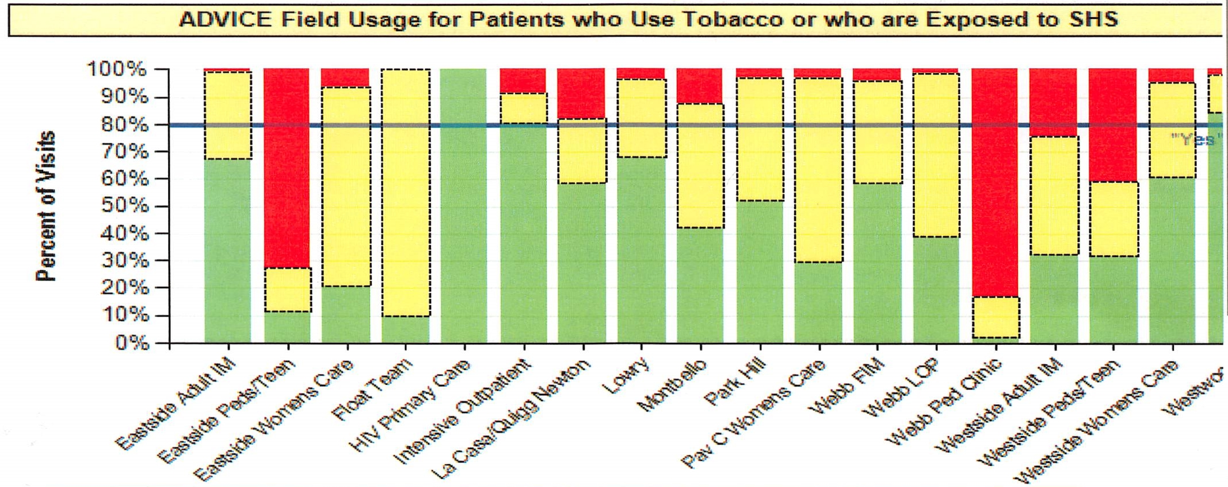
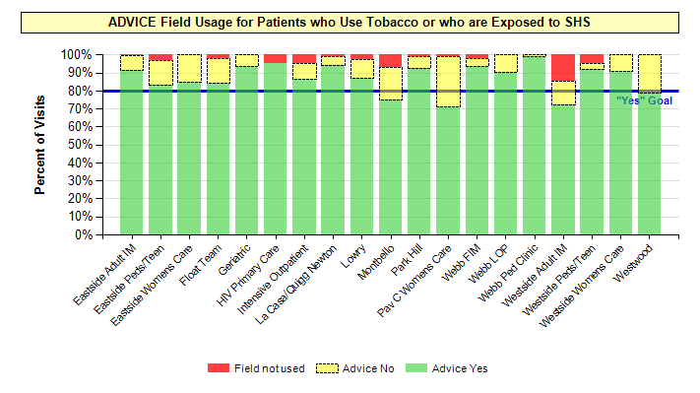
Quality improvement
November
2014
11% Were Using Field
Field Not Used
Advice No
Advice Yes
89% Are Using Field
May
2015

Slide 41
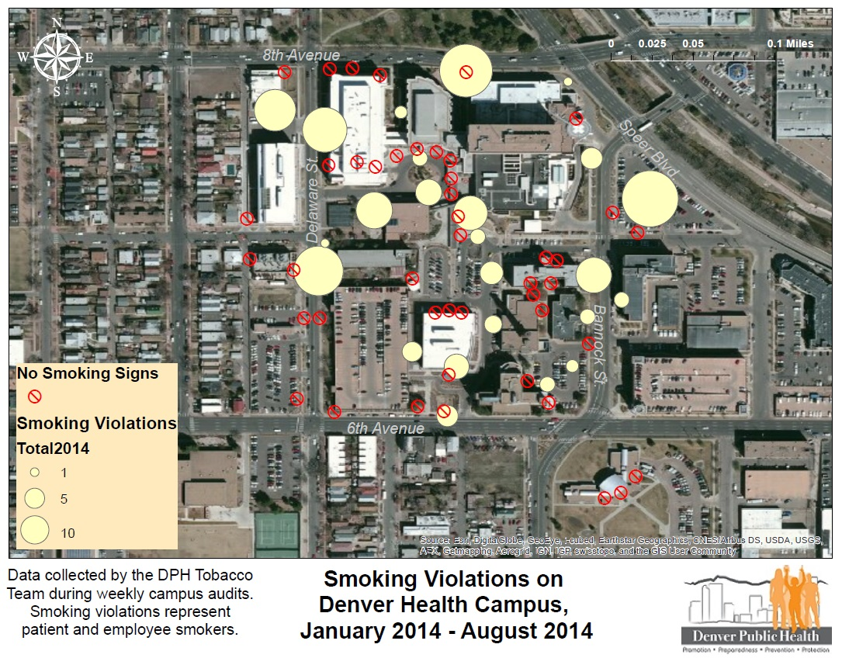
Improving our own environment
Weekly smoking audits provided data for smoke free campus enforcement

Slide 42
Progress towards a smoke-free campus
902 Encounters

Slide 43
Community-based interventions
Decrease tobacco initiation among youth
Decrease sales to youth < 18 years – tobacco retail license *
Youth-led communication campaign
Educate about effects of increasing the state tobacco tax *
Decrease secondhand smoke exposure
Change behavioral norms about exposing children to smoke
Expand smoke-free multi-unit housing *
Implement smoke-free policies at technical schools and job-sites
* Supported by Government and Community Relations

Slide 44
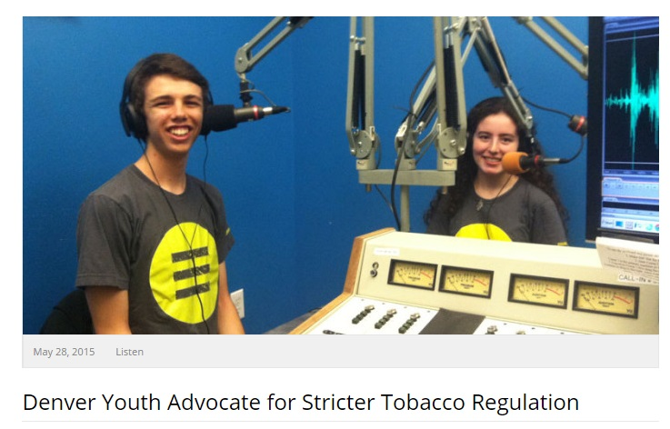
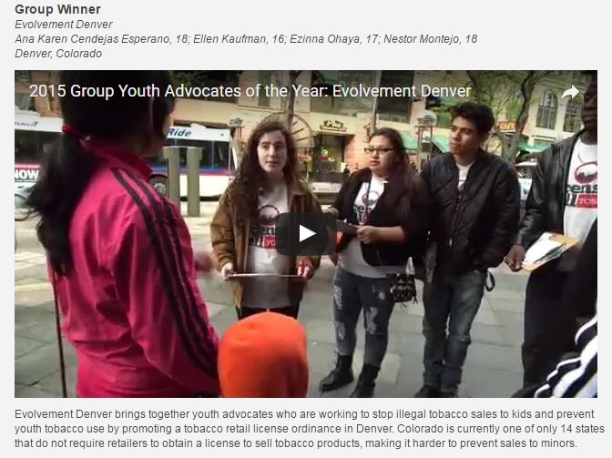
Youth-led effort to require a license to sell
tobacco

Slide 46
Changing behavioral norms about 2nd-hand smoke exposure in children
Mass Media Campaign Regional (metro-county)
Geographic Target:
18 counties in NE Colorado,
includes Denver
Demographic Target:
smokers,
parents of young children, especially low SES and
Spanish speaking adults aged 18-34
Media Campaign :
September, 2013-June, 2014
3 flights: 4 weeks each
Outlet | Impressions
Television | 45,995,629
Radio | 20,201,958
Digital ads | 30,354,306
Out-of-Home | 249,190,999
Long-form interviews | 110,600
Earned Media | 1,306,436
Website | 38,797
Evaluation
Random-digit dial post-pre survey of 375 residents in target area after the first flight
Campaign reached target audience and ads were memorable
However, results illustrated a need to motivate smokers to action

Slide 47
Increase in smoke-free multi-unit housing buildings in Denver (2013-16)
Clearing the Air Housing Summit
32,000 units
Educational Postcard Campaign
begins
Increase of 254%
Smoke-Free Housing Forums begin

Slide 48
Results - changes in adult smoking prevalence, DH clinics (2009-2017)
Clinics trained; coaching begins
EHR amended to capture advice & referrals
Clinic-specific reports initiated
(provider education)
Standardized Quitline Fax form for all clinics
(clinical process)
DH Tobacco Cessation Clinics open

Slide 49
Results - changes in adult smoking prevalence, ACS clinics (2009-2017)
Clinics trained; coaching begins
Estimates for effects on health and medical costs
Rate of MI decreases by 50% in first year after cessation (Fichtenberg CM. N Engl J Med 2000;343:1772-7
1% point decrease in smoking results in $35.40 decrease in per capita medical costs (Lightwood J. PLoSOne 2013; 8: e47145)
No financial incentive to Denver Health for tobacco cessation except via its managed care programs
Funded program to decrease tobacco-related health burden – CT scan/surgery to detect and treat early lung cancer
EHR amended to capture advice & referrals
Clinic-specific reports initiated
(provider education)
Standardized Quitline Fax form for all clinics
(clinical process)
DH Tobacco Cessation Clinics open

Slide 50
Lessons from tobacco control: keys to successful clinical interventions
Alignment
High-level attention – Patient Safety and Quality goal
Aligned community and clinical efforts
Focus
Simple intervention (Ask, Advise, Refer)
Reach
Involve the entire system: clinics (CHS, specialty, dental, behavioral, public health), ED, hospital
Quality improvement
Use LEAN tools to monitor and assure correct application of the intervention

Slide 51
Lessons from tobacco control: Keys to successful community interventions interventions
Community involvement
Help youth take the lead
Work with business groups, community groups
Advocacy
Health care systems are respected by policymakers – use that voice to improve health
Policy changes
Can markedly expand reach
Effective communication/marketing

Slide 52
Role of addictions in health
Direct complications of the addiction
Increased risk behavior leading to other acute and chronic medical problems
Leading underlying cause of severe injury
Decreased adherence to treatment for other chronic conditions
Treatment of HIV infection
Involvement in the judicial system – leads to increased barriers to health
Result – addictions are one of the leading causes of costs and adverse health outcomes in my community

Slide 53
Changes from 2005 to 2015 in the leading causes of death and disability in the U.S.
http://www.healthdata.org/united-states

Slide 54
Taking addictions seriously – role of medical care providers
Prevention of addiction – appropriate treatment of pain to decrease risk of opioid addiction
Screening to identify addictions – done with all patients
Treatment for mild to moderate substance misuse – ideally within the primary care setting
Referral for treatment when needed
Advocacy for adequate funding and for policy changes needed (e.g., increase in alcohol tax)

Slide 55
Triple Aim – it can be done in the U.S.
Achievable – but not by tinkering
Universal access to medical care
Changes in payment models – no fee-for-service for specialty/procedural care
Broader view of health
Community-level prevention
Manage social and economic barriers
Take addictions seriously

Slide 56
Discussion Questions
What other examples can you share on how public health and health care are working together to solve big problems?
What policy changes are necessary to strengthen that relationship?
How can researchers, philanthropists and advocates strengthen or facilitate that relationship?

Slide 57
2017 SNAC Labs
July 26
October 4
December 6

