Slide 1
The budget realities of medical and long-term care expenditures for people with functional impairments
Opportunities for LTC reform in the Patient Protection and Affordable Care Act (ACA)

Slide 2
Major provisions of the ACA …
Insurance market reforms
Insurance coverage and clinic expansions
Payment reform and quality improvement initiatives
Public health promotion and disease prevention initiatives
CLASS Act for long-term care financing and LTC systems’ reform
Health professions workforce initiatives
Notes:
After more than a year of much debate, The Patient Protection and Affordable Care Act was signed into law on March 23, 2010
There are many dimensions of this legislation, the short term effects of the legislation will be to institute insurance reforms that will expand eligibility for some groups, provide protections against loss and cancelation of eligibility and increase more transparency. The mid term affects will be to expand insurance coverage to low-income individuals and families through Medicaid and subsidies under the insurance exchanges, and to expand employer-based coverage through tax credits and insurance exchanges. The longer term goals are to improve the overall health of the public through improved preventive and public health initiatives and to ultimately reduce health care costs through improved population health and improvements in the way health care is provided and paid for.

Slide 3
What’s the problem? What is LTC and why is reform needed?

Slide 4
The Aging Imperative: Coloradans ages 65 and older by age cohort, 2000-2030
SOURCE: Colorado State Demography Office
Notes:
SWITCH GEARS…a simple refresher course in the state’s demographic imperative brought about by the aging of the baby boomers AND because so many folks retire to Colorado…as can be seen in the following map…the mountain communities on the western slope will experience the greatest population growth among 65-74 years
So why should Colorado be concerned about the adequacy of its LTC programs and services?
This slide summarizes the growth of the 65 and older population in absolute numbers. Between 2000 and 2030…..
Green line (85 – 90) = 180%
Red line (75 – 84) = 236%
Blue line = (65 – 74) 214%

Slide 5
What is LTC?
Nursing care, personal assistance and other supportive services provided to individuals with significant functional limitations*
[* Functional limitations are defined as the inability to perform activities of daily living (ADLs) and/or instrumental activities of daily living (IADLs) without assistance from others]

Slide 6
LTC is a continuum of care
Informal care (80% of care provided)
Family, friends and neighbors
Home and community-based services (HCBS)
Home health care, personal attendant care and adult day health programs, assisted living
Institutional care
Skilled nursing facilities (nursing homes)

Slide 7
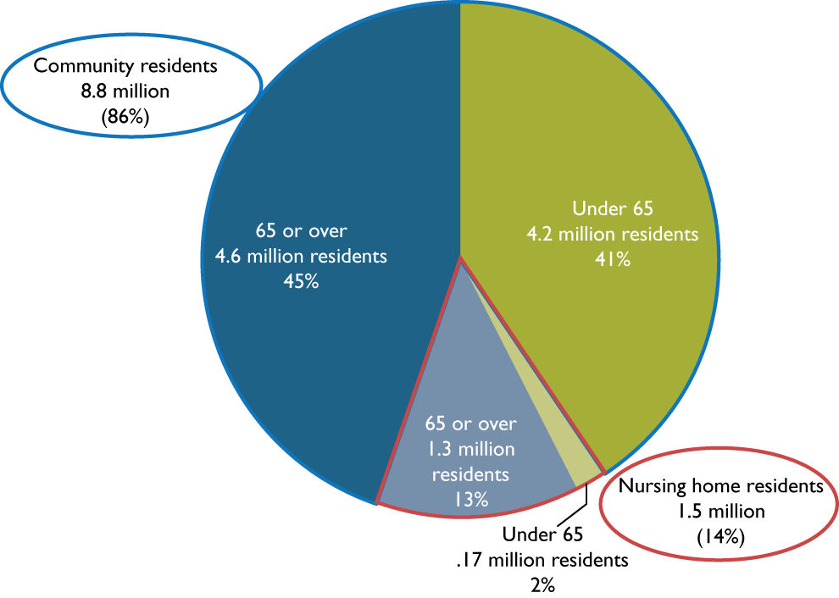
Who needs LTC and where do they reside?
Note: Community residents with long-term care needs are defined as people who need another person’s assistance with activities of daily living (ADL or instrumental activities of daily living (IADLs)
Source: Health Policy Institute, Georgetown University. Analysis of data from the 2005 National Health Interview Survey and the 2004 National Nursing Home Survey

Slide 8
POP Quiz: Does Medicare cover the costs of long-term care?

Slide 9
Medicare and post-hospital care
Medicare pays for 100 days of care in a skilled nursing facility immediately following a hospital stay of three days or more (Medicare fully covers the first 20 days of skilled nursing facility care and days 21-100 require a co-payment)
Medicare pays for physician prescribed home health care including skilled nursing care, physical therapy, speech therapy, occupational therapy and medical social services

Slide 10
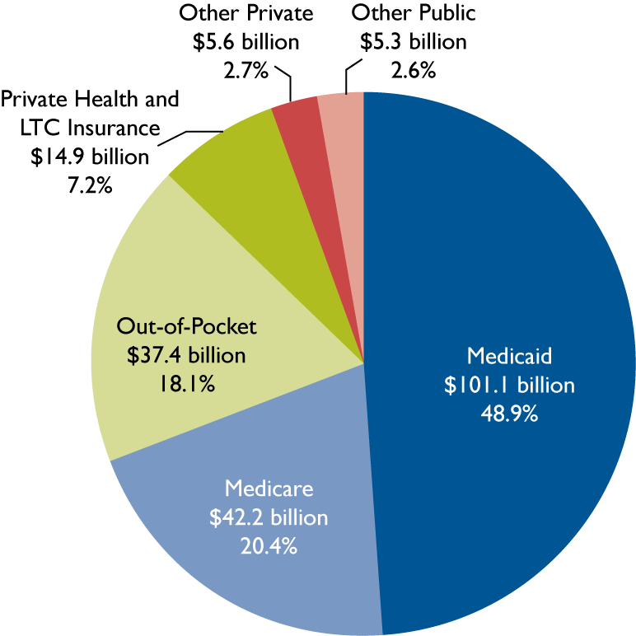
Total national spending for short-term nursing home stays and LTC, 2005
Keep an eye on this number
Source: Georgetown University, Long-Term Care Financing Project, 2007
Notes:
From Kindle

Slide 11
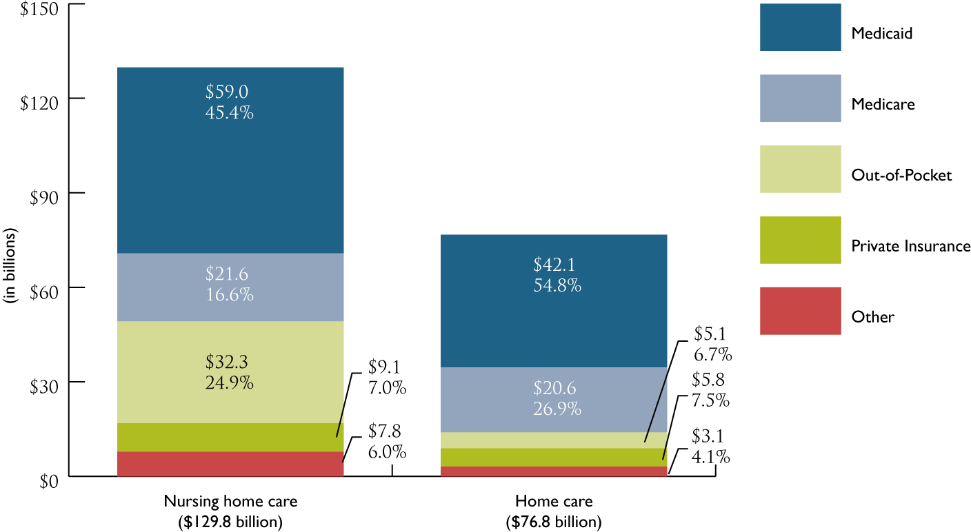
National spending for LTC by place, 2005
Source: Georgetown University, Long-Term Care Financing Project, 2007

Slide 12
Colorado Medicaid and LTC
Colorado Medicaid reimburses for skilled nursing facility care and home and community-based services (HCBS) for individuals who qualify based on financial (219% of FPL or $24,264 annual income in 2009) and functional (ADL/IADL) eligibility
Individuals 65 and older and permanently disabled individuals are eligible for Medicaid long-term care coverage
Notes:
HCBS are services where medical providers come into the home to render the necessary services to keep a disabled individual from being institutionalized in a nursing facility or hospital.

Slide 13
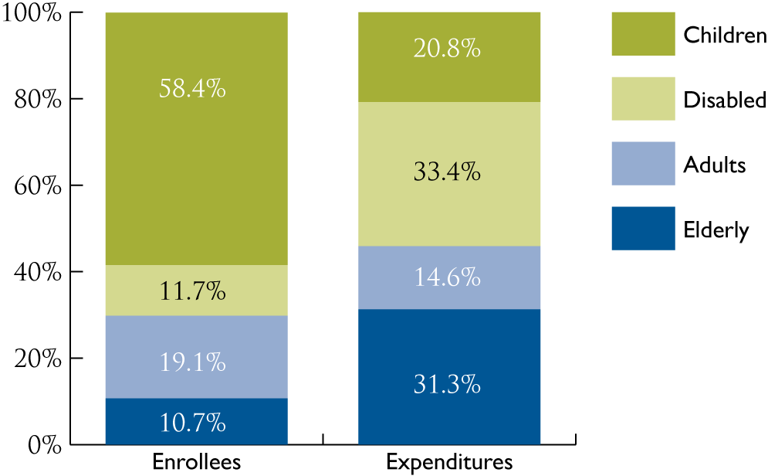
Colorado Medicaid enrollees by eligibility group and expenditures, FY 2009-2010
SOURCE: Colorado Department of Health Care Policy and Financing, FY 2010-11 Budget Request
Notes:
Health care financing reform cannot occur without an assessment of financing of long term care services.
This slide makes that point with respect to the MK program in CO. You’ve probably heard in the past, in MK individuals age 65 and older and people with disabilities comprise 1/3 of the caseload and 2/3 of the cost. Rule of thumb.
Well, that’s changed over the past couple of years. They now comprise 1/5 of the caseload and 2/3 of the cost. And of course, this doesn’t include Medicare. 22% of caseload 65% of costs.
On the other end of spectrum, kids = 58% of caseload and 21% of costs.
Older adults in MK = $20,000/year while children are $1,700/year.

Slide 14
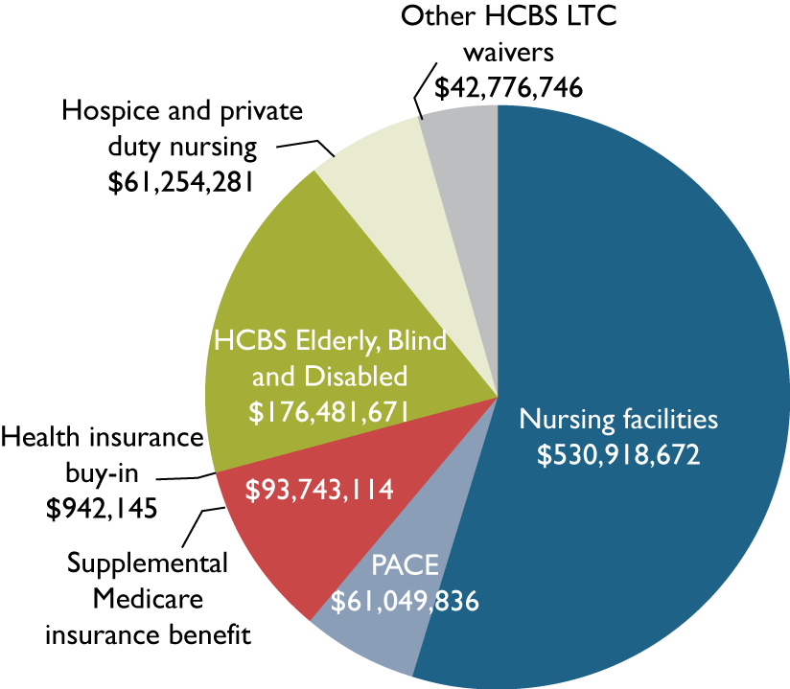
Colorado Medicaid LTC expenditures by type of expenditure, FY 2008-09
SOURCE: Colorado Department of Health Care Policy and Financing, FY 2010-11 Budget Request
Notes:
Medicaid spends nearly a billion dollar a year on LTC (incl. federal and GF). $967 billion. Here is a breakdown of how those dollars are allocated.
Nursing facilities comprise around 55% of all LTC costs..
In Colorado, 13,070 -14,000 full-time enrollee equivalents were on the HCBS-EBD waiver in FY2006-07, compared with 9,681 full-time enrollee equivalents in nursing facilities. Comparing those two populations nearly 60% are in HCBS/EBD)
Medicaid patients enrolled in a nursing facility have much higher costs than those on an HCBS-EBD waiver. In FY 2006-07, the cost per full-time equivalent enrollee in a nursing home was $49,408; the cost per full-time equivalent enrollee for an individual on an HCBS-EBD waiver was $9,221.
Just to give you a sense of the impact of the enhance FFP, if LTC is around one billion, under the enhanced federal match, the feds pick up 62% or $620 million, when match goes back to 50/50 the feds will pick up $500,000. This means that the state needs to come up with $120 million, JUST FOR LTC.

Slide 15
Estimating the need for LTC: A Colorado vulnerability index

Slide 16
Vulnerability index based on self-reported health status
Would you say your health in general is excellent, very good, good, fair or poor?
Are you limited in any way in your ability to work because of a physical, mental or emotional problem?
[Health status questions from the 2008-09 Colorado Household Survey]
Notes:
Two of the broad goals of health reform are to improve the public health and reduce the overall spending on medical care. To this end, the legislation included many provisions to encourage preventive health services. In 2011 Medicare will cover an annual comprehensive health risk assessment with out any copayments or deductibles. In addition, Medicare will pay for specified preventive care such as colonoscopies, breast cancer screenings, cholesterol screenings and annual flu shots. (S.4103)
There is a gap in Medicare coverage for prescription medications for seniors called the donut hole. In 2010, after a senior has paid $2,700 on medications a year, coverage stops until that same person has spent about $6,200 and then Medicare prescription coverage assists with costs again. The PPACA provides seniors who reach the Gap $250 in 2010. In 2011, pharmaceutical companies are required to provide a 50 percent discount on brand name drugs to seniors who reach the GAP . The coinsurance rate for generic and brand-name drugs will gradually be reduced from 100% in 2010 to 25% in 2020
Medicare Advantage plans are private insurance companies that provide health care services to seniors. The actual costs to Medicare vary significantly throughout the US. Payments to Medicare Advantage plans will be modified to more closely align with the payments for traditional Medicare fee for service rates in the same geographic area.
To encourage the provision of primary care services, primary care providers will receive a 10% Medicare bonus for primary care services through 2016. Primary care providers include family medicine, internal medicine, geriatric medicine, pediatric medicine; as well as nurse practitioners, clinical nurse specialists and physician assistants. This provision also applies to general surgeons practicing in Health Professional Shortage Areas.

Slide 17
Out-of-pocket health care expenditures as % of household income among 65+ by income and health status 2000-04
 | Age | 2000 | 2001 | 2002 | 2003 | 2004
Income Category
Poor/near poor (at or below 125% of federal poverty level) | 65 and over | 22.6 | 23.5 | 27.6 | 27.8 | 29.3
 | 65-74 yrs | 24.4 | 25.7 | 27.7 | 23.4 | 29.0
 | 75-84 yrs | 22.9 | 23.3 | 28.4 | 30.2 | 29.4
 | 85 and over | 17.6 | 18.7 | 25.7 | 32.4 | 30.0
Other | 65 and over | 6.3 | 7.3 | 7.2 | 8.0 | 8.1
 | 65-74 yrs | 5.6 | 6.2 | 6.4 | 6.9 | 7.4
 | 75-84 yrs | 3.9 | 8.4 | 8.2 | 9.1 | 8.2
 | 85 and over | 7.6 | 9.3 | 7.9 | 10.3 | 11.1
Health Status
Poor or fair health | 65 and over | 13.1 | 13.9 | 14.6 | 16.0 | 15.2
 | 65-74 yrs | 11.8 | 13.5 | 14.4 | 13.8 | 14.3
 | 75-84 yrs | 14.6 | 14.7 | 15.2 | 17.5 | 15.4
 | 85 and over | 13.8 | 13.2 | 13.5 | 19.5 | 17.9
Excellent, very good or good health | 65 and over | 6.7 | 7.6 | 8.4 | 8.9 | 9.4
 | 65-74 yrs | 6.2 | 6.2 | 7.1 | 6.9 | 8.9
 | 75-84 yrs | 7.5 | 9.1 | 9.6 | 10.7 | 9.3
 | 85 and over | 7.1 | 10.6 | 11.9 | 13.9 | 12.8

Slide 18
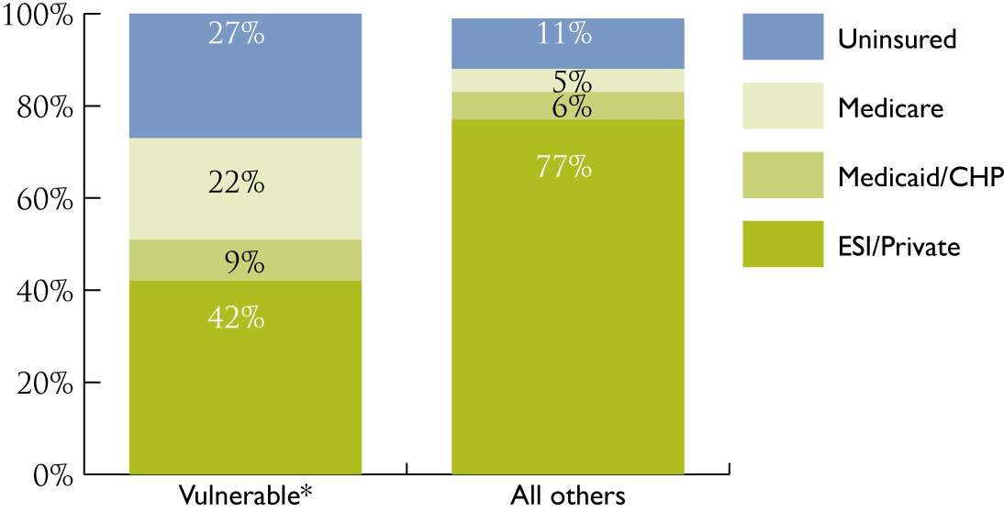
Vulnerable Coloradans by insurance status

Slide 19
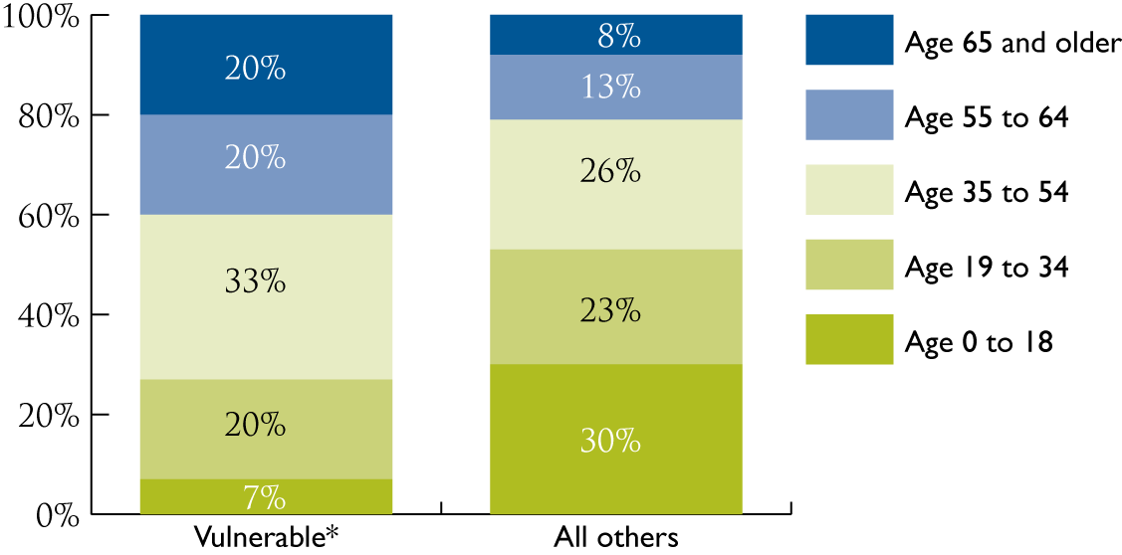
Vulnerable Coloradans by age

Slide 20
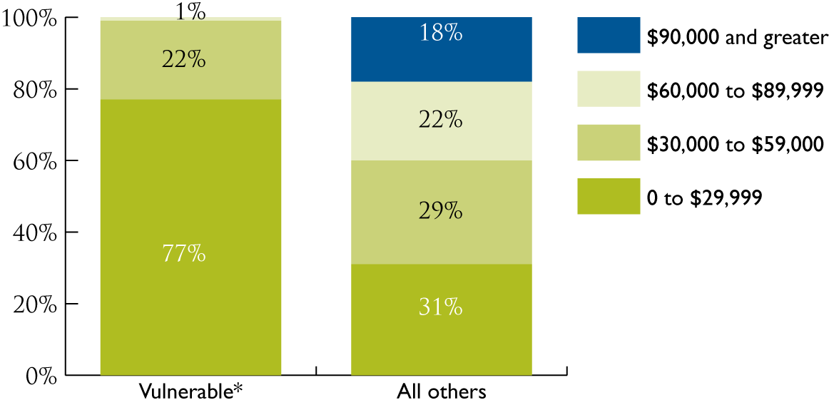
Vulnerable Coloradans by household income

Slide 21
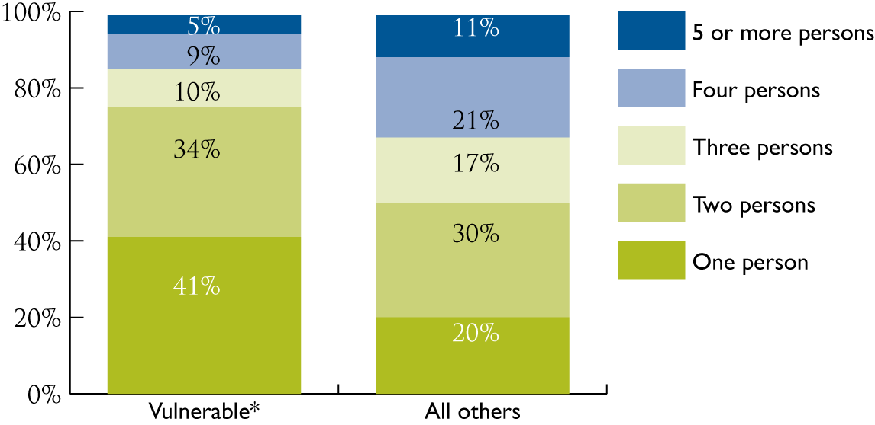
Vulnerable Coloradans by family size

Slide 22
Vulnerable Coloradans by age and insurance, income and health status
 | % ages 55-64 | % ages 65+
Insurance Status
Employer-sponsored | 69.5 | 44.1
Medicare | 5.2 | 88.3*
Medicaid | 1.8 | 9.5
Private purchase | 11.8 | NA
Uninsured | 10.7 | NA
% Federal Poverty Level
Equal or less than 100% | 13.9 | 11.6
101-200% | 14.6 | 29.4
201-300% | 16.8 | 23.8
Greater than 300% | 54.7 | 35.2
Health Status
Fair/poor | 21.7 | 25.0
Disability limiting work | 22.3 | 28.6
Out of pocket medical expenses greater than 10% of income | 20 | 14.4

Slide 23
The ACA and Long-Term Care Reforms

Slide 24
Provisions of Community Living Assistance Services and Supports (CLASS) Act
National, voluntary insurance program for purchasing community living LTSS assistance
Must pay 60 months of premiums and have worked at least 3 calendar years
Must have functional limitation (lasting for at least 90 days) documented by a licensed health care provider (2-3 ADL limitations) OR cognitive impairment
Benefit not less than $50/day (based on functional scale, 2-6 benefit levels)
Notes:
Most people are somewhat familiar with the insurance reforms and expansions in the Patient Protection and Affordable Care Act but there are many other provisions that are equally important to ensuring that all legal residents have access to care once covered,
Not the subject for today, but there are significant new dollars going into the network of safety net providers and the training of a primary care workforce.
There is also new money going into geriatric training which I have not included in today’s slides

Slide 25
State “balancing” incentive payments for long-term care
Incentives for states to offer home and community-based services (HCBS) as an alternative to nursing homes
States provided broad encouragement to shift LTC spending from institutions to the community
Competitive opportunity to receive enhanced reimbursement for all HCBS services from 10/2011-9/30/2015

Slide 26
Community First Choice Option
State option to provide community-based attendant services as a state plan benefit to individuals who meet NH level of care standard
Includes transition costs to move a resident from a NH to the community

Slide 28
Questions???

