Slide 1
Hot Issues in Health Care: 11/25/02 Colorado Household Survey (2001): Demographics of the Uninsured
health policy solutions, inc.
31377 Tamarisk Lane
Evergreen, CO 80439
Phone: 303/679-6805
E-mail: TLJ6805@AOL.COM
<<!-- PICOTITLE= "Colorado Household Survey (2001): Demographics of the Uninsured" --> <!-- PICODATESET mmddyyyy=11252002 -->
Tracy Johnson, Ph.D.
Funded by: Health Resources and Services Administration (HRSA)
Grantee: Governor’s Office, State of Colorado

Slide 2
Presentation Outline
Data Sources for the Uninsured
Demographics of the Uninsured Coloradoans
Rates of Uninsurance Statewide
Rates of Uninsurance among Sub-Population
Utilization Patterns of the Uninsured
Final Thoughts

Slide 3
Uninsured Estimates Compared

Slide 4
Characteristics of Uninsured Coloradoans Source: Colorado Household Survey (2001)
Adults (76%)
Male (52.4%)
Non-Hispanic white (59.1%)
Born in the U.S. (80.4%)
Employed or a full-time student
(69.7% of uninsured adults are employed or full-time students)
Working at a permanent job
(84.9% of uninsured adults have a permanent job)
In good to excellent health (83.4%)
(however, 92.3% of INSURED are good or excellent health)
Living in an urban area (76.1%)

Slide 5
Colorado Uninsurance Rates by Duration
Point-in-Time Uninsured: 11.7%
Continuously Uninsured for Past 12 Months: 7.8%
Two-Thirds (67%) of the currently
uninsured have been without coverage
for the past 12 months
Uninsured at ANY TIME in Past 12 Months: 15.9%
Source: Colorado Household Survey (2001)

Slide 6
Uninsured Coloradoans by 200% and 300 % FPL

Slide 7
Uninsured Adults and Children by Ethnicity

Slide 8
Distribution of Uninsured 2000: Adults and Children Compared
Source: Colorado Household Survey (2001)

Slide 9
Colorado Uninsurance Rates by Age
Source: Colorado Household Survey (2001)

Slide 10
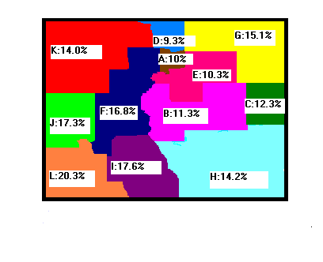
Uninsurance Rates in
Colorado Regions
KEY:
A:Boulder, Gilpin
B: El Paso, Elbert, Fremont, Lincoln, Park, Teller
C: Cheyenne, Kit Carson
D: Larimer
E: Adams, Arapahoe, Clear Creek, Denver, Douglas, Jefferson
F: Chaffee, Eagle, Grand, Gunnison, Lake, Pitkin, Summit)
G: Logan, Morgan, Phillips, Sedgwick, Washington, Weld, Yuma
H: Baca, Bent, Crowley, Custer, Huerfano, Kiowa, Las Animas, Otero, Prowers, Pueblo
I: Alamosa, Conejos, Costilla, Mineral, Rio Grande, Saguache
J: Delta, Mesa, Montrose
K: Garfield, Jackson, Moffat, Rio Blanco, Routt
L: Archuleta, Dolores, Hinsdale, LaPlata, Montezuma, Ouray, San Juan, San Miguel

Slide 15
*

Slide 17
Final Thoughts
Subpopulation rates of uninsurance important because:
Legislative policy implications
Program implementation/operations/marketing
Colorado Household Survey (2001) Report
http://www.hrsa.gov.osp.stateplanning/CO2001.htm
CHS 2001 will be housed at the Division of Insurance (2003)

